Slide 1

Mobile Application for Building Future Homes
BATCH NO: A12
R. NEEMA TABASSUM(154G1A0558)
D. GAYATHRI (154G1A0526)
S. BHAVANA (154G1A0513)
K. JAGADEESH(154G1A0534)
C. ANUSHA (154G1A0506)
Project Guide:
T.V.NAGA JAYUDU M.Tech.(Ph.D.)
Assistant Professor
Srinivasa Ramanujan Institute of Technology
Department of Computer Science & Engineering

Slide 2
Contents
Abstract
Problem Definition
Project Planning
Literature Survey
Requirements
References

Slide 3
Abstract
Construction process management coordinates and supervises the variety of projects and specifies project objectives and plan which includes budgeting, delineation of scope, selecting project associates. This mobile application provides unprecedented opportunities to innovate and enhance the construction process management by providing effective Interface for user to choose all the requirements and providing the suitable suggestions to proceed.

Slide 4
Problem Definition
The effective communication among project team and users in construction sites is a real dilemma for construction projects productivity.
The main objective of the project is to develop a mobile application system to create a single interface between the home officers and mobile users.

Slide 5
Project Planning
Days | Target | Status
(7-02-2019 to 10-02-2019) | Design of UML diagrams | Completed
(11-02-2019 to 15-02-2019) | Literature Survey, Screen designing | In progress
(16-02-2019 to 23-02-2019) | Implementation | Not yet completed
(24-02-2019 to 27-02-2019) | Testing | Not yet completed
(28-02-2019 to 8-03-2019) | Output and Documentation of project | Not yet completed

Slide 6
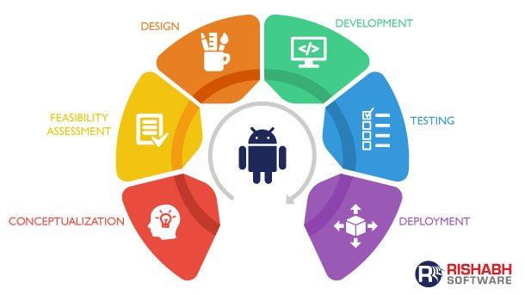
Project Planning Model
Agile Model

Slide 7
Contd….
Modules
Users:
Profile creation
Buying Land
Selecting Requirements
Cancelling Requirements
Selecting contractor
Sharing contact details
Feedback

Slide 8
Contd….
Admin
Verifying the Profiles
Collecting Requirements
Filtering Requirements
Sharing Contractor Details
Contractor
Profile Creation
Sharing Contact Details
Providing Construction Services

Slide 9
Literature Survey
a. Existing Systems
99acres
This mobile app makes it easy to search buy, sell or rent property in India. It provides details about local real estate information.
Houzify
This mobile app provides details about decoration ideas and interior designs.

Slide 10
Contd….
b. Limitations of Existing Systems
The existing system don’t give all the information regarding the land and total construction process at one place.
Doesn’t provide details about contractors.
Time taking process to consult many people at different stages involved in construction.

Slide 11
Proposed System
This project was about the implications of mobile application system in sustainable construction project management.
This mobile application provides users with valuable features like information about sites, send request for interpretations and retrieve information about construction projects.

Slide 12
Benefits of proposed system
This mobile application creates a single interface between the home officers and mobile users.
It suggests and provides suitable land details to the user for purchasing within their budget and desired location.
Effective user interface allows user to choose all requirements like flooring, room design models, pop(Plaster Of Paris), wood work easily using their mobile.
Based on user requirements it suggests the best contractor details.

Slide 13
Requirements
Software Requirements:
Operating Systems – Windows7/8/10(32-bit or 64-bit)
Platform – Android Studio 3.3
Programming in- Java, Extensible Markup Language(XML)
Hardware Requirements:
RAM Capacity – 8GB and above
Hard disk – 2GB or 4GB
Processor – i3 or above
Screen resolution-1280 x 800

Slide 14
References
https://ieeexplore.ieee.org/document/8393574
https://ieeexplore.ieee.org/document/8289256
https://ac.els-cdn.com/S1877705814019067/1-s2.0-S1877705814019067-main.pdf?_tid=fb25c7cc-a676-4468-9e84-730d5406c959&acdnat=1550049247_de1a6dc7135685d607eaa2041318408b

Slide 15
Thank you
Any Queries?

