Slide 1
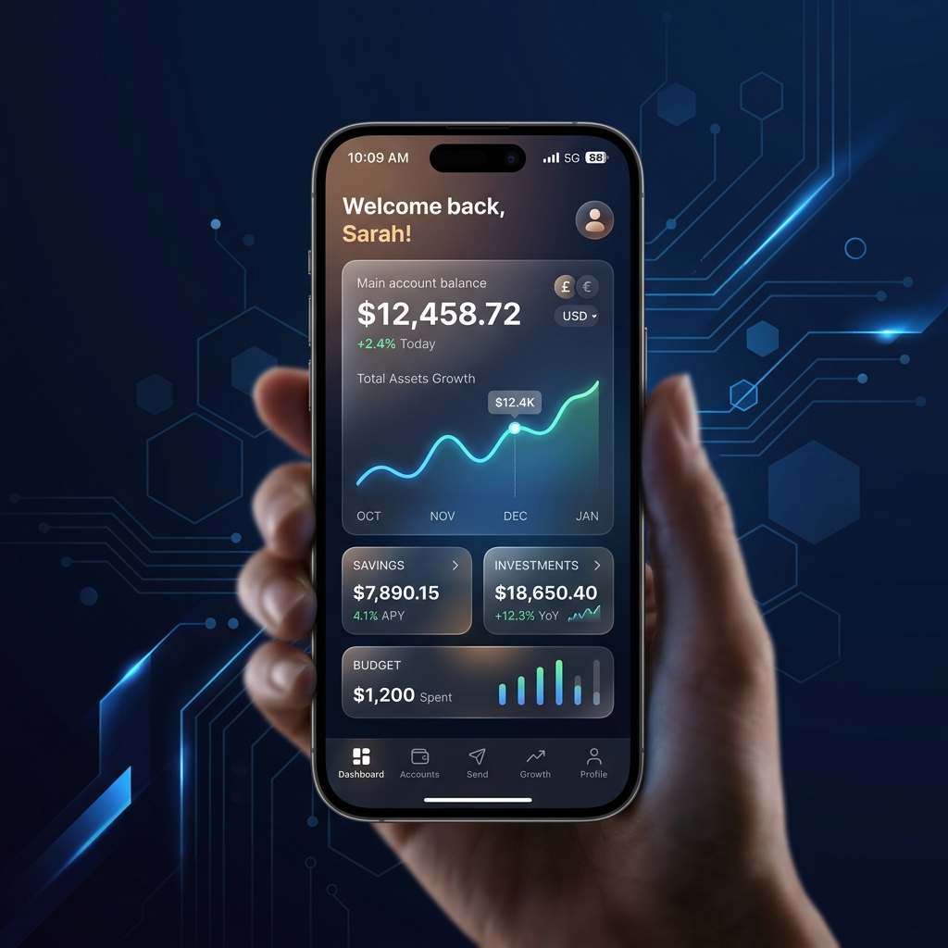
NIDHI BANK: FULL DETAIL
Comprehensive Architectural Analysis

Slide 2

1. System Architecture Diagram
Frontend: Next.js 14 (App Router) serving the client application.
Backend: FastAPI providing a high-performance RESTful API layer.
Database: Neon PostgreSQL (Serverless) for durable data storage.
Hosting: Multi-provider deployment (Vercel for Frontend, Render for Backend).
Communication: JSON-based REST APIs with CORS protection.

Slide 3
2. Frontend: Next.js Implementation
State Management: React 'useState' and 'useEffect' for local session handling.
Client-Side Rendering: 'use client' directive for interactive dashboard elements.
API Integration: Native 'fetch' API with async/await for non-blocking I/O.
Session Persistence: Utilizing 'localStorage' for storing JWT-less user sessions.
Real-time Updates: CustomEvent dispatchers for immediate UI feedback.

Slide 4
3. Backend: FastAPI Engineering
Framework: High-performance Python 3.x FastAPI (Asynchronous by design).
Data Validation: Pydantic models (UserSignup, UserLogin) for schema enforcement.
CORS Middleware: Explicit 'CORSMiddleware' configuration for global access.
Dependency Management: 'psycopg2' with RealDictCursor for mapping SQL to JSON.
Error Handling: Custom HTTPException wrappers for structured API responses.

Slide 5
4. Database: PostgreSQL Schema
Users Table: Primary identifier (SERIAL), Unique Email/Mobile, Hashed Passwords.
Transactions Table: Foreign Keys linking to Users (sender_id, receiver_id).
Data Types: 'DECIMAL(12,2)' for precision banking calculations.
Timestamps: 'TIMESTAMP WITH TIME ZONE' for global transaction auditing.
Normalization: 3NF design ensuring zero data redundancy.

Slide 6
5. Fund Transfer: Atomic Logic
Integrity: Wrapping balance updates in a single SQL TRANSACTION (BEGIN/COMMIT).
Validation: Strict server-side verification of sender balance vs. transfer amount.
Receiver Checks: Database-level existence verification before processing.
Error Recovery: 'ROLLBACK' mechanism on any failure to prevent money loss.
Logging: Automatic record insertion into the transactions table.

Slide 7

6. Security: Cryptographic Hardening
Hashing: Direct 'bcrypt' salt/hash implementation for credential storage.
Prevention: Mitigation of 'passlib' vulnerabilities (72-character limit).
CORS: Rigid Origin, Method, and Header white-listing for the Render API.
Authentication: Secure sign-in flow with server-side credential verification.
Input Sanitization: Mitigation of common SQL Injection and XSS vectors.

Slide 8
7. UI/UX: Design Philosophy
Theme: Midnight Blue Dark Mode using HSL CSS variables.
Glassmorphism: High-fidelity 'backdrop-filter: blur(10px)' on all panels.
Typography: 'Inter' sans-serif family for maximum readability.
Animations: Keyframe-based fadeIn/Down/Up for a smooth product feel.
Responsive: 100% Mobile-first UI using CSS Media Queries.

Slide 9
8. Administrative Management
User Hub: Advanced searchable list of all registered bank users.
Dashboard: Real-time balance fetching with locale-aware (₹) formatting.
Management tools: Dynamic transaction lists filtered by User ID.
Virtual Cards: Logic-based card generation with mock security credentials.
Audit Trail: Detailed logging of last 5 transactions on individual profiles.

Slide 10
9. SDLC & Deployment Pipeline
Version Control: Centralized GitHub repository architecture.
CI/CD: Automated Git-triggers for Vercel (Frontend) and Render (Backend).
Environment Sync: Centralized .env management across local/prod nodes.
Build Verification: Rigid Next.js build checks to prevent runtime errors.
API Redundancy: Multiple health-check endpoints for monitoring.

Slide 11
10. Future Innovation Roadmap
Authentication: Integration of Biometric and TOTP-based 2FA.
Analytics: AI-driven spending patterns and risk score calculations.
Internationalization: Support for multi-currency (USD, EUR) transfers.
Architecture: Transitioning from monolith to modular Microservices.
Scalability: Implementing Redis-based caching for high-traffic sessions.

Slide 12
11. Summary of Achievements
Fully functional end-to-end banking ecosystem built in < 1 week.
Successfully mastered both Python (FastAPI) and JavaScript (Next.js) paradigms.
High-end visual aesthetic on par with industry Fintech products.
Scalable foundation ready for real-world user onboarding.

Slide 13
12. THANK YOU / Q&A
Technical Documentation: 100% coverage in PROJECT_TRACKER.md.
Software Stack: Open source, modern, and high-performance.
Presentation Author: Designed with Antigravity AI for perfection.
Questions?
Thank you for your time!

