Slide 1
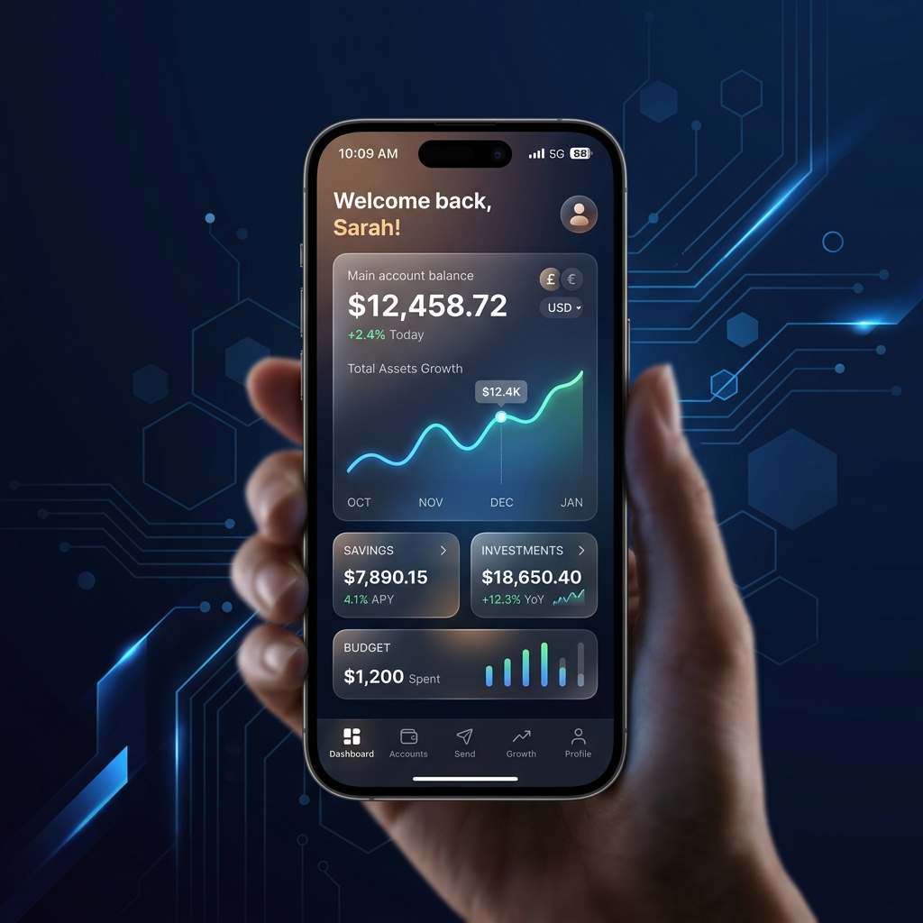
NIDHI BANK
Modern Financial Architecture

Slide 2
Executive Summary
Professional Digital Banking platform.
Focus: UX, Security, Reliability.
Built with Next.js/FastAPI.

Slide 3

Tech Stack
Frontend: Next.js 14
Backend: FastAPI
DB: PostgreSQL

Slide 4
Key Features
Real-time Balance
Atomic Transfers
Admin Dashboard

Slide 5

Security Protocols
Bcrypt Hashing
CORS Hardening
Robust Validation

Slide 6
UI/UX Philosophy
Glassmorphism Theme
Responsive Design
Micro-animations

Slide 7
Data Modeling
Relational Schema
ACID Transactions
Optimized Querying

Slide 8
Challenges
CORS handling
Auth Logic Fixes
Deployment Sync

Slide 9
Future Roadmap
2FA Integration
AI Fraud Analytics
Multi-currency

Slide 10
Conclusion
Secure and Scalable.
Mastery of Full-stack.
Production Ready.

