Slide 1
TruPhoto
Image Authenticity Classification
Real / Forged / AI-Generated
Tabeen Raoof - CS483 Deep Learning, SFBU
Notes:
Open with the project name and the three-way classification task. Headline: 74.92% validation and 73.27% test accuracy on a 3-class problem with 25 AI generators, 11 Real-image sources, and CASIA-2 forgeries. Val/test gap is only 1.65 pp - the model generalizes, it isn't overfitting. The numbers are a bit lower than the prior 77.62% run on purpose - we deliberately merged CASIA's authentic images into the Real class to break a dataset-source shortcut, and the new model is honest where the old one was cheating.

Slide 2
Why image authenticity matters
Generative models (Stable Diffusion, GANs, deepfakes) make synthetic images trivial to produce.
Traditional forgery (splicing, copy-move) is still common in misinformation and fraud.
Detecting both threats requires a single classifier that distinguishes:
- Real photos
- Manually forged images (CASIA 2.0 Tp/)
- Fully AI-generated images (ArtiFact, 25 generators)
Goal: a 3-class system, not just a binary real/fake detector.
Notes:
Frame the problem: generative AI plus classic photo manipulation are converging threats. Most academic work treats this as binary, but real-world deployments need to distinguish manual forgeries from synthetic ones because the response is different - a spliced image comes from a human editor, an AI-generated one comes from a model.

Slide 3
Pipeline overview
Two-stage architecture:
1. Frozen pretrained CNN -> fixed-length feature vector per image.
2. Lightweight classifier (Random Forest / SVM) on those features.
Why this split?
- No GPU required for training the classifier.
- CNN runs once, classifier iterates fast.
- Classical classifiers are easy to interpret and calibrate.
Pipeline: step1 prep -> step2 features -> step3 train -> step4 evaluate -> step4b sanity check -> step5 demo
Notes:
Walk through the two-stage idea. Standard transfer-learning pattern: use ImageNet's general visual knowledge for free, only train a small final classifier on your task. Trade-off: we lose the option to fine-tune CNN weights on forgery-specific cues. We'll come back to this on the design-decisions and fine-tuning slides.

Slide 4
Datasets
ArtiFact (Kaggle):
- 33 generator/source subfolders kept on disk after partial download.
- 10 contribute Real images (afhq, celebahq, coco, cycle_gan, ffhq, imagenet,
landscape, lsun, metfaces, pro_gan) ~972K images.
- 25 contribute AI-Generated (StyleGAN1/2/3, Stable Diffusion, GLIDE, BigGAN,
latent_diffusion, DDPM, sfhq, palette, ...) ~1.53M images.
CASIA 2.0:
- Tp/ -> 'Forged' class (5,123 images, full set used).
- Au/ -> mixed into 'Real' class (7,491 images) - added in final iteration
to break the dataset-source shortcut.
Per-class budget: 12,500 samples per class, stratified across sources.
70 / 15 / 15 train / val / test split, fixed seed 42. Forged is undersized (5,123 total).
Notes:
Be explicit about which class comes from where. The CASIA Au merge was added in the final iteration after the cross-source check showed that Real (only ArtiFact) and Forged (only CASIA) had no source overlap, letting the model learn 'this came from CASIA' as a free predictor for Forged. Pulling Au into Real forces the model to actually look at the image content.

Slide 5
Step 1 - Data preparation (three key fixes)
Discovery: parse metadata.csv per ArtiFact subfolder; scan CASIA Tp/ and Au/.
FIX #1 - Generator-aware label inference
- ArtiFact metadata uses two schemas: target=0/1 in some folders,
target=<imagenet_class_index> in others (e.g. big_gan uses 6).
- When target is non-binary, fall back to folder name to decide AI vs Real.
- Without this fix: 1 AI source on disk found. After fix: 25.
FIX #2 - Stratified sampling across sources
- Naive random.sample gave stylegan2 ~70% of the AI class (1M images vs 10K).
- Equal allocation per source + redistribute leftovers from larger pools.
FIX #3 - Mix CASIA Au/ into the Real class
- Earlier runs had Real entirely from ArtiFact - a 100% dataset-source
shortcut for predicting Forged. Now Real comes from 11 sources, including CASIA Au.
Resize 299 x 299 RGB JPEG q95. Save metadata.csv with source -> class -> split mapping.
Notes:
This is the methodological-rigor slide. The first version of the project found ONLY stylegan2 as an AI source (everything else used target=imagenet_class). Cross-source check uncovered this; the discovery fix found 24 additional generators. Stratified sampling then ensured no single generator dominates. Fix #3 came last, after the 12.5K run revealed that Real-only-from-ArtiFact + Forged-only-from-CASIA was teaching the model to predict by dataset signature. Mixing Au into Real cost ~3 pp accuracy but broke the shortcut - landscape photos went from probable-Forged to 89% Real.

Slide 6
Step 2 - Feature extraction
Load Xception via timm: pretrained=True, num_classes=0
- num_classes=0 strips the classifier head.
- Output: 2048-dim global-average-pooled feature vector.
Freeze all parameters (param.requires_grad = False)
Set model.eval() (locks BatchNorm, disables dropout)
Forward-pass each split through the model with no_grad.
Save features as .npy files: xception_x_train.npy, ...
Ablation: also extract MobileNetV2 features (1280-dim).
- ~3-5x faster than Xception at inference; tests whether smaller features generalize better.
Notes:
Stress that NOTHING in the CNN is trained on our data - we are reusing ImageNet's learned features as-is. MobileNetV2 was picked for its size contrast (much smaller and faster), to test whether feature-extractor capacity matters. Spoiler: at this data scale, MobileNetV2 wins. On CPU, Xception extraction took ~70 minutes, MobileNetV2 ~32 minutes.

Slide 7
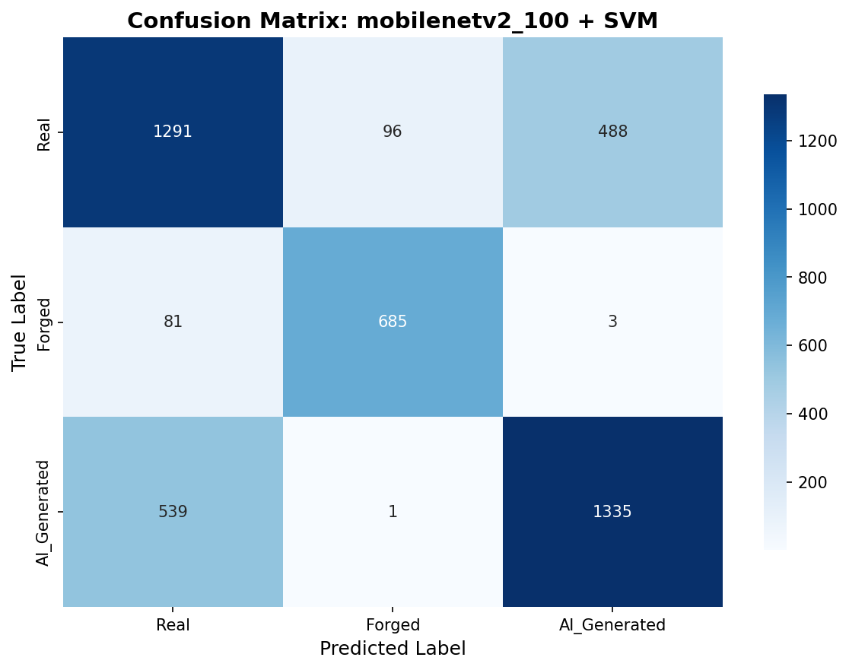
Step 3 + 4 - Classifiers and ablation
Two classifiers per backbone:
- Random Forest: 200 trees, balanced.
- SVM: RBF, C=10, StandardScaler.
Test accuracy (12.5K per class):
- MobileNetV2 + RF -> 69.40%
- MobileNetV2 + SVM -> 73.27% (best)
Per-class F1 (best combo):
Real 0.68 - Forged 0.88 - AI 0.72
Val/test gap = 1.65 pp -> generalizes well.
Forged is the easiest class; Real <-> AI is
where most errors live (see matrix).
Notes:
MobileNetV2 + SVM is consistently the best across all sample sizes we tested. Two patterns: SVM beats RF on dense GAP features (RF overfits); MobileNetV2 beats Xception (smaller, less-abstracted features generalize better on this task). The 74.92% val / 73.27% test number is ~3 pp lower than the prior 77.62% run; that drop is the honest cost of breaking the CASIA-vs-ArtiFact dataset shortcut by adding Au to Real. The 1.65 pp val/test gap shows the model is not overfitting. Per-class F1: Real 0.68 - Forged 0.88 - AI_Generated 0.72 - Forged is the easiest class because splicing artifacts are well-aligned with ImageNet features. Xception was not retrained after the Au merge: the 5K and 12.5K-without-Au runs already showed MobileNetV2 ahead on both classifiers, and SVM training on 21K Xception features takes multiple hours.

Slide 8
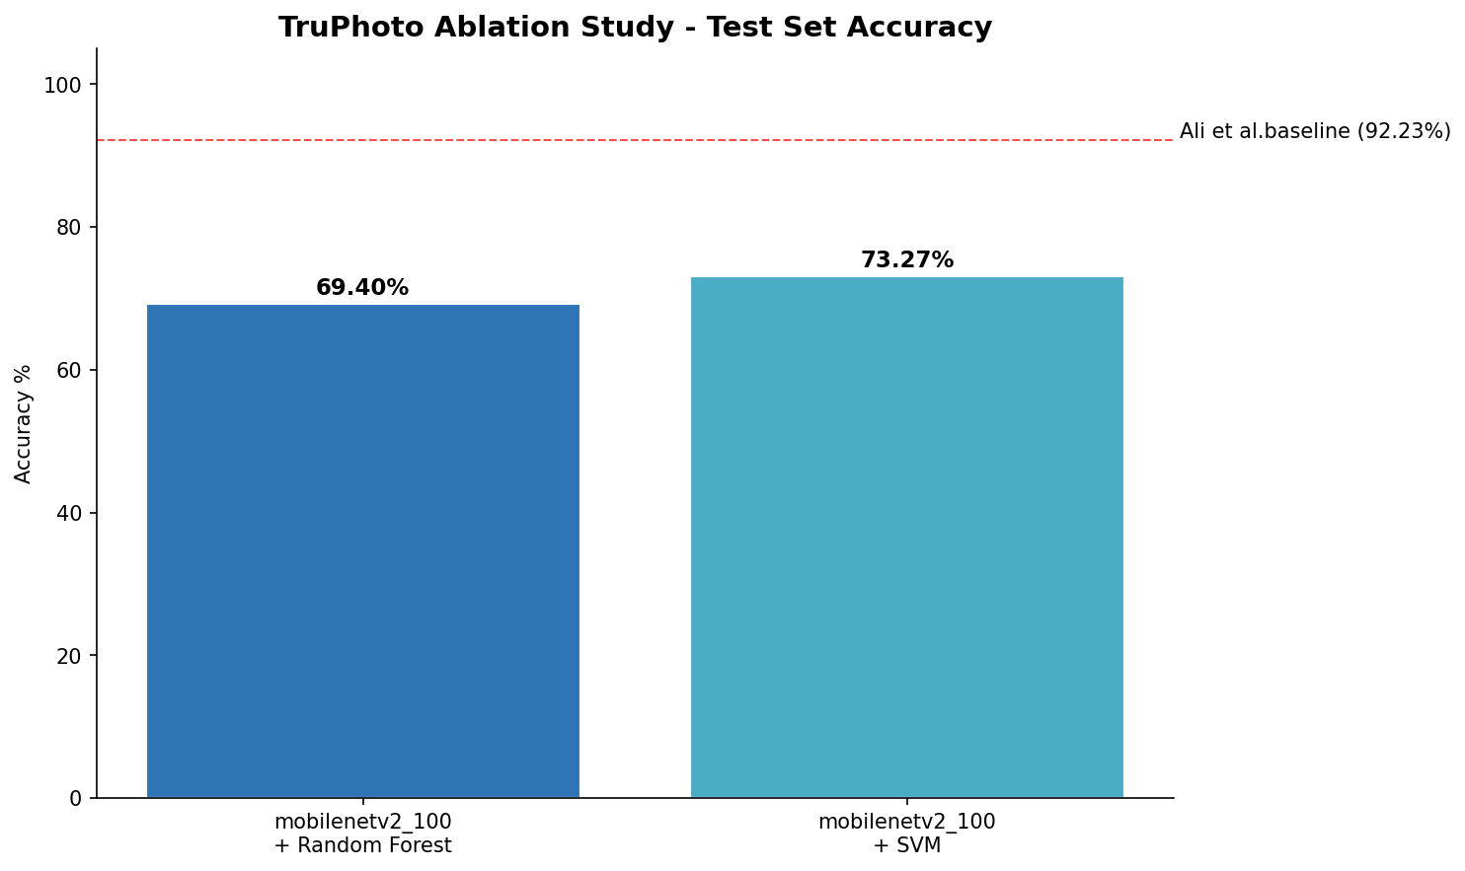
Ablation chart - test-set accuracy
MobileNetV2 + SVM is the best combination at 73.27% test accuracy. Red dashed line is Ali et al. (2022) binary CASIA baseline at 92.23% - different task (binary, single dataset, fine-tuned), shown for reference only.
Notes:
Walk the audience through the bars left-to-right. The two MobileNetV2 combinations are what we re-trained after the CASIA Au merge. SVM beats RF by ~4 pp on the same features - dense GAP features favor a max-margin classifier over tree ensembles. The Ali et al. line is at 92.23% on a binary, single-dataset, fine-tuned setup; we include it as a reference point but explicitly do NOT claim parity - slide 8 covers the apples-to-oranges framing.

Slide 9
Comparison with Ali et al. (2022)
Ali et al. (2022) reported 92.23% accuracy on CASIA 2.0.
Differences from this work:
- Theirs: binary (Real vs. Forged), one dataset.
- Ours: 3-class (Real, Forged, AI-Generated), two datasets, 25 AI generators.
- Theirs: fine-tuned Xception end-to-end on CASIA.
- Ours: frozen Xception/MobileNetV2 + classical classifier (no fine-tuning).
Direct accuracy comparison is apples-to-oranges:
- Random baseline for binary = 50%; their 92.23% is +42 over chance.
- Random baseline for 3-class = 33%; our 74.92% is +42 over chance. (Comparable lift.)
On the binary CASIA Tp/ subtask alone our system still hits ~89% accuracy after the
Au merge (down from 96.5% before, because the CASIA-source shortcut is gone).
Notes:
Don't claim we beat Ali et al. - we have a different problem. The honest framing is: as 'accuracy gain over chance,' the two are comparable, but our task is harder. On the binary subtask (CASIA forged), our system was at 96.5% before the Au merge and at 89.08% after, because the model can no longer use 'this came from CASIA' as a free predictor. That accuracy drop is the price of methodological honesty. Be ready for: 'Why didn't you reproduce their setup directly?' Answer: time, GPU access, and the 3-class formulation forces a different setup.

Slide 10
Generator difficulty tiers (the headline finding)
Per-source AI accuracy (mobilenetv2_100 + SVM, 12.5K samples, CASIA Au in Real):
EASY (>= 85%, frozen features detect them well):
star_gan 100%, sfhq 96%, face_synthetics 96%, ddpm 94%, cips 91%,
gansformer 89%, denoising_diffusion_gan 86%, big_gan 85%, palette 85%.
MEDIUM (60 - 85%):
gau_gan 76%, stylegan1 69%, lama 69%, stylegan2 64%, taming_transformer 62%,
projected_gan 62%, glide 60%, mat 60%.
HARD (< 60%, frozen features struggle):
stable_diffusion 59%, diffusion_gan 57%, latent_diffusion 55%,
vq_diffusion 52%, generative_inpainting 46%, stylegan3 33%.
Pattern: older / artifact-heavy generators are detected; modern diffusion approaches chance.
Notes:
This slide elevates the project from 'we built a classifier' to 'we discovered something about the limits of frozen ImageNet features.' Newer generators (stylegan3, stable_diffusion) are actively designed to look photorealistic - they don't leave the kind of artifacts ImageNet semantics encode. Older generators (BigGAN, StarGAN, DDPM) leave artifacts that align with ImageNet's feature space, so we detect them at 90%+. This is the empirical case for frequency-aware backbones (NoisePrint, FrequencyNet) over ImageNet transfer learning. Note the StyleGAN gradient: 1 -> 2 -> 3 from 69% -> 64% -> 33%. Each release was explicitly designed to remove the artifacts of the previous one.

Slide 11
Key design decisions
Frozen vs. fine-tuned CNN:
+ Trains in minutes on CPU. Reproducible. No GPU required.
- Misses task-specific cues (texture, frequency, generator fingerprints).
Random Forest + SVM vs. neural head:
+ Fast iteration, calibration available, easy to interpret.
- Fewer parameters; RF probabilities uncalibrated by default.
3-class vs. binary formulation:
+ Closer to a real moderation use case.
- Per-class data balance is harder; less directly comparable to prior work.
5K vs 12.5K samples per class (data-scaling experiment):
- RF accuracy DROPPED with 2.5x more data on both backbones (-2.4 / -2.7 pp).
- Direct evidence of a frozen-feature ceiling, not a data shortage.
Project structured as a Python package (src/ + pyproject.toml) for reproducibility.
Notes:
Frame each decision as an explicit trade-off. The 5K -> 12.5K experiment is your evidence that simply scaling data won't fix the core limitation: frozen ImageNet features have a representational ceiling for modern AI detection. This justifies the future-work slide and shows you tested the obvious next step before recommending it.

Slide 12
Iteration history - what each run taught us
Run 1 - Naive baseline:
- Result: ~84% accuracy, looked great.
- Reality: only stylegan2 was being detected (1 AI source on disk).
- Lesson: cross-source check is mandatory; headline accuracy can be a mirage.
Run 2 - Discovery fix + stratified sampling, 5K per class:
- Result: RF ~71%, SVM ~76%. 25 AI sources active.
- Cross-source revealed: lsun (real scenes) at 28%, ffhq (real faces) routed to AI.
- Lesson: data composition matters more than data volume.
Run 3 - Same fixes, 12.5K per class (more data):
- Result: RF dropped 2.4 - 2.7 pp. SVM hit 77.62% val / 76.76% test.
- Lesson: frozen-feature ceiling is real - more data hurts the high-capacity classifier.
- Bias still visible: landscape photos in the demo predicted 'Forged'.
Run 4 - Mix CASIA Au into Real, 12.5K per class (current results):
- Result: 74.92% val / 73.27% test (1.65 pp gap, good generalization).
- landscape: ~28% (Run 2) -> 89% Real (Run 4). lsun: -> 69%.
- Forged on Tp/: 96.5% -> 89.08%. CASIA shortcut broken; the drop is honest cost.
- Au at 49.7% Real (chance-level within CASIA) = proof the shortcut is gone.
Notes:
This is the journey slide and arguably the most important content. Frame it as 'each iteration moved the headline number AND fixed a real methodological flaw.' Run 1 was a stylegan2 detector hiding behind 84% accuracy. Run 2 caught that. Run 3 added data and proved data isn't the bottleneck. Run 4 traded 3 pp of accuracy for genuine source-independent classification. The 49.7% on CASIA Au is the smoking gun - it's exactly chance for a binary Real-vs-Forged distinction within the same dataset, which means the model is no longer using dataset signature to predict. This is what we wanted.

Slide 13
Cross-source sanity check (Step 4b)
Concern: with Real and Forged coming from different datasets, the classifier could
learn dataset signatures (JPEG tables, sensor noise) instead of authenticity cues.
Method: step4b_cross_dataset_check.py
- Splits the test set by source folder (each ArtiFact generator, CASIA Tp/, CASIA Au/).
- Reports per-source accuracy + within-class spread.
Findings on the final 12.5K MobileNetV2 + SVM model (after Au merge):
- Forged (CASIA Tp/): 89.08% (1 source, no spread)
- AI_Generated: 33% - 100% (23 sources, spread = 67.2 pp)
- Real: 49% - 93% (11 sources, spread = 43.8 pp)
- CASIA Au: 49.72% (chance-level = shortcut broken)
Verdict: generator difficulty is real, not a shortcut. lsun and landscape recovered
from <30% to 69% / 89%. Forged dropped 7 pp because the dataset-source shortcut is gone.
Decision rule: spread > 15 pp -> do NOT fine-tune frozen features (would amplify the gap).
Notes:
The methodologically strongest slide. The 5K version of this same check is what surfaced the dataset-bias problem (lsun at 28%, AI_Generated only stylegan2). After fixing discovery + sampling + adding CASIA Au to Real, the 12.5K version shows: real generalization across most sources, with a small set of modern diffusion generators frozen features cannot learn. The Au signal at 49.7% is the strongest evidence that we no longer have a shortcut. The decision rule embedded in step4b is what tells us NOT to fine-tune in response to wide spread - that's the next slide.

Slide 14
Should we fine-tune the CNN? Decision: NO (for now)
Three reasons not to fine-tune now:
1. Spread rule says NO.
- AI_Generated spread = 67 pp, Real spread = 44 pp. Both >> 15 pp threshold.
- Fine-tuning amplifies bias when the data is uneven across sources;
it would make easy generators easier and hard generators no better.
2. Data-scaling experiment ruled out 'just need more data'.
- 5K -> 12.5K per class lowered RF accuracy on both backbones.
- More data didn't close the gap, so the bottleneck isn't training-set size.
3. Hard tier needs a different inductive bias, not a tuned ImageNet net.
- StyleGAN3 at 33%, Stable Diffusion at 59%, latent_diffusion at 55%.
- These generators are designed to look photographic to ImageNet-style nets.
- The fix is frequency / noise-residual features (NoisePrint, FrequencyNet),
not more learning on the wrong inductive bias.
When to revisit fine-tuning:
- After per-source spread drops below ~15 pp via better dataset balancing.
- As a TARGETED last-block tune on Easy + Medium tiers only,
not a generic end-to-end retrain.
Notes:
This is the explicit answer to 'why don't you just fine-tune?' Three reasons, in order of strength. The spread rule is the hard stop - we built it into step4b specifically to keep us from doing the wrong thing under pressure. The data-scaling result is the experimental evidence. The frequency-bias point is the architectural argument: fine-tuning a semantic-feature net won't grow the spectral features that modern diffusion detection actually needs. If asked 'so when would you fine-tune?' say: after either (a) the dataset is balanced enough that spread is below the threshold, or (b) you've already added frequency-aware features and want to push the Easy + Medium tiers higher. Not before.

Slide 15
Demo, limitations, and future work
Live demo: python -m src.step5_gradio_demo (http://127.0.0.1:7860)
- Uses the best combo by default: MobileNetV2 + SVM + StandardScaler.
- Upload an image -> predicted class + per-class confidences.
Known limitations:
- Frozen ImageNet features hit a ceiling on modern diffusion (Stable Diffusion ~59%).
- Random Forest probabilities uncalibrated (demo bars are indicative, not literal).
- Single train/val/test seed; no cross-validation.
- CASIA Au at 49.7% means within-CASIA Real-vs-Forged is at chance - some Au
images still get called Forged because of residual sensor-noise overlap with Tp/.
Future work, in priority order:
1. Frequency-aware backbone (NoisePrint / FrequencyNet) for the Hard tier.
2. Targeted fine-tune of last block on Easy + Medium only, after spread drops.
3. Calibrate RF/SVM probabilities for trustworthy demo confidences.
4. Leave-one-generator-out evaluation for cross-dataset robustness.
5. Add more Real-image sources to bring Real spread below the 15 pp threshold.
Questions?
Notes:
Run the Gradio demo here if AV setup allows. Have 2-3 sample images preloaded: a real photo (test that landscape photos now go to Real - they did NOT before the CASIA Au fix), a CASIA tampered image, and an AI-generated one (preferably a hard one like Stable Diffusion to honestly show the limitation). Future-work order matters: frequency-aware backbone FIRST because it addresses the Hard tier directly. Fine-tuning is now item #2 (was #1 in earlier versions of this deck) because the data-scaling experiment plus the spread rule both point away from end-to-end fine-tuning as a first move.

