Slide 1

POLYTECHNIC UNIVERSITY OF THE PHILIPPINES - BINAN CAMPUS
Brgy. Zapote, City of Binan, Laguna 4024
Fundamentals of elecTRONICs circuits
INSTRUCTIONAL MATERIAL FOR ECEN 011
BS in Computer Engineering, Second Year Level, 2nd Semester, SY 2025-2026
Diploma in Computer Engineering Technology, Second Year Level, 2nd Semester, SY 2025-2026
Prepared By: Kris Rommel R. Ramos, ECE

Slide 2
Module 1:
The pn junction
Overview
In the world where electronic devices are almost around and everywhere, discovery and development of semiconductors had come a long way. Semiconductor materials are negative and positively doped materials, and combining it using different material gave birth to lots of other electronic devices. This is where a pn junction came in; which then was developed and applied into diode, a two-terminal device with vast applications were made.
Module 1

Slide 3
Objectives
After effectively completing the module, you should be able to:
Define what a pn junction is.
Determine built-in voltage of a pn junction.
Know what is depletion region.
Analyze how a forward-biased pn junction operates.
Calculate pn junction current and define what a reverse saturation current is.
Module 1

Slide 4

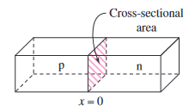
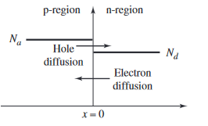
Course Materials
A. What is a pn Junction?
Fig. 1 A typical pn junction.
The real power of semiconductor electronics occurs when p- and n-regions are directly adjacent to each other, forming a pn junction. One important concept to remember is that in most integrated circuit applications, the entire semiconductor material is a single crystal, with one region doped to be p-type and the adjacent region doped to be n-type.
(Fig. 1) is a simplified block diagram of a pn junction. (Fig. 2) is a three-dimensional diagram of the pn junction showing the cross-sectional area of the device. The interface at x=0 is called the metallurgical junction. A large density gradient in both the hole and electron concentrations occurs across this junction. Initially, then, there is a diffusion of holes from the p-region into the n-region, and a diffusion of electrons from the n-region into the p-region (Fig. 3). The flow of holes from the p-region uncovers negatively charged acceptor ions, and the flow of electrons from the n-region uncovers positively charged donor ions. This action creates a charge separation, which sets up an electric field oriented in the direction from the positive charge to the negative charge.
Fig. 2 The sectional area in the middle.
Fig. 3 Diffusion of hole from-and-to
p and n regions.
Module 1

Slide 5

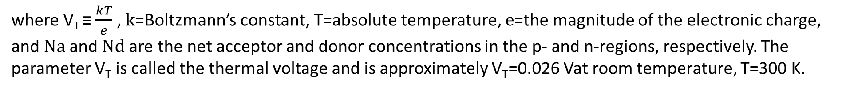
Course Materials
B. The Built-In Potential Barrier
If no voltage is applied to the pn junction, the diffusion of holes and electrons must eventually cease. The direction of the induced electric field will cause the resulting force to repel the diffusion of holes from the p-region and the diffusion of electrons from the n-region. Thermal equilibrium occurs when the force produced by the electric field and the “force” produced by the density gradient exactly balance. The positively charged region and the negatively charged region comprise the space-charge region, or depletion region, of the pn junction, in which there are essentially no mobile electrons or holes. Because of the electric field in the space-charge region, there is a potential difference across that region. This potential difference is called the built-in potential barrier, or built-in voltage, and is given by
(1)
where V_{T} ≡ $\frac{kT}{e}$ , k=Boltzmann’s constant, T=absolute temperature, e=the magnitude of the electronic charge, and Na and Nd are the net acceptor and donor concentrations in the p- and n-regions, respectively. The parameter V_{T} is called the thermal voltage and is approximately V_{T}=0.026 Vat room temperature, T=300 K.
Module 1

Slide 6
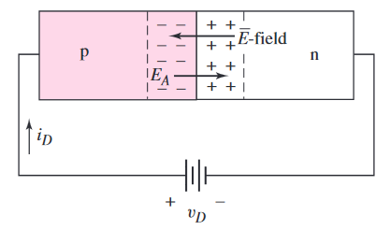
Course Materials
C. Forward biased pn Junction
If a positive voltage v_{D} is applied to the p-region, the potential barrier decreases (Fig. 4). The electric fields in the space-charge region are very large compared to those in the remainder of the p- and n-regions, so essentially all of the applied voltage exists across the pn junction region. The applied electric field, E_{A}, induced by the applied voltage is in the opposite direction from that of the thermal equilibrium space-charge E-field. However, the net electric field is always from then- to the p-region. The net result is that the electric field in the space-charge region is lower than the equilibrium value. This upsets the delicate balance between diffusion and the E-field force.
Fig. 4 A pn junction in forward bias
Majority carrier electrons from the n-region diffuse into the p-region, and majority carrier holes from the p-region diffuse into the n-region. The process continues as long as the voltage v_{D} is applied, thus creating a current in the pn junction. This process would be analogous to lowering a dam wall slightly. A slight drop in the wall height can send a large amount of water (current)over the barrier. This applied voltage polarity (i.e., bias) is known as forward bias. The forward-bias voltage v_{D} must always be less than the built-in potential barrier V_{bi}.
Module 1

Slide 7
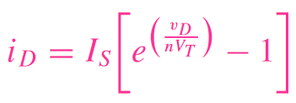
Course Materials
D. Ideal Current-Voltage Relationship
An applied voltage results in a gradient in the minority carrier concentrations, which in turn causes diffusion currents. The theoretical relationship between the voltage and the current in the pn junction is given by
(2)
The parameter I_{S} is the reverse-bias saturation current. For silicon pn junctions, typical values of I_{S} are in the range of 10⁻¹⁸ to 10⁻¹²A. The actual value depends on the doping concentrations and is also proportional to the cross-sectional area of the junction. The parameter V_{T} is the thermal voltage, as defined in Equation (1) and is approximately V_{T} = 0.026 V at room temperature. The parameter n is usually called the emission coefficient or ideality factor, and its value is in the range 1 ≤ n ≤ 2.
Module 1

Slide 8
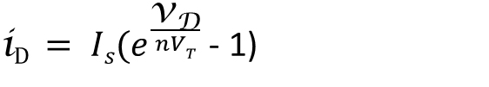
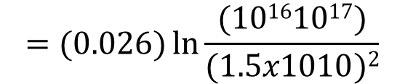


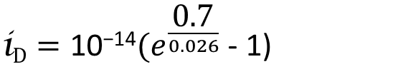
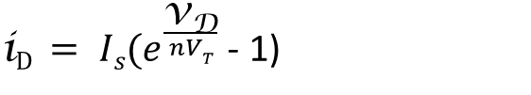


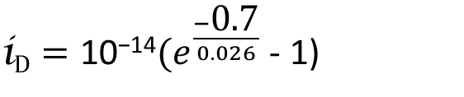
Course Materials
E. Example Problems. Solve for the following.
1.) Calculate the built-in potential barrier V_{bi} of a silicon pn junction at T=300 K, doped at Na=10¹⁶cm⁻³in the p-region and Nd=10¹⁷cm⁻³in the n-region. (Note: ni=1.5×10¹⁰cm⁻³for silicon at room temperature)
Solution
$$Vbi= VT ln{\frac{NaNd}{ni2}}$$
$$=(0.026) ln{\frac{(10161017)}{(1.5x1010)2}}$$
$$=0.757 v$$
2.) Determine the current in a pn junction at T=300K in which I_{S}=10⁻¹⁴A and n=1. Find the current i_{D} for v_{D} = +0.70V and v_{D} = −0.70V.
Solution
For v_{D} = +0.70V, the pn junction is forward-biased
For v_{D} = − 0.70V, the pn junction is reversed-biased
${\text{i}\text{D} = Is(e}^{\frac{\text{v}\text{D}}{nVT}}$ - 1)
${\text{i}\text{D} = Is(e}^{\frac{\text{v}\text{D}}{nVT}}$ - 1)
${\text{i}\text{D}=\text{10}\text{−14}(e}^{\frac{\text{0.7}}{0.026}}$ - 1)
${\text{i}\text{D}=\text{10}\text{−14}(e}^{\frac{−\text{0.7}}{0.026}}$ - 1)
Module 1
i_{D} $=$ 4.93mA
i_{D} $=$ − 10fA (or − 10x10⁻¹⁵ A)

Slide 9
Course Materials
F. Videos to watch:
1. The pn Junction
- Overview of a pn junction
https://www.youtube.com/watch?v=0yyFiJw5emw
2. Formation of Depletion Region
- See what happens inside a pn junction
https://www.youtube.com/watch?v=YiDs8ZnpVD4
Reference book:
- Microelectronics: Circuit Analysis and Design, 4th Edition, By Donald A. Neamen , University of New Mexico, 2009
Module 1

Slide 10
Exercise no. 1
Direction. Solve for the following. You may use a scientific calculator and round-off your final answer up to two decimal places. Use proper SI values if possible, and box your final answer.
Calculate V_{bi} for a GaAs pn junction at T=300K (ni=1.80×10⁶cm⁻³ ) for Na=10¹⁶cm⁻³ and Nd=10¹⁷cm⁻³
Repeat no (1) for a Germanium pn junction (ni=2.40×10¹³cm⁻³ ) with the same doping concentrations.
A silicon pn junction at T=300K has a reverse-saturation current of I_{S}=20fA. Determine the required forward-bias voltage to produce a current of
(a) I_{D}=50μA (b) I_{D}=1mA
Find (a) and (b) in no (3) for I_{S}=2pA
Module 1

Slide 11
Module 2:
The pn junction diode
Overview
As we have learned in the previous module, we found that a pn junction can produce a built-in potential, and thus, generate current. Through this principle we can say that we can now handle and sort of “manage” the current flow, on a specific time, with a specific given potential, for a complex circuit, or even on a s simple board of electronics. The pn junction then, was made into a 2-terminal device, called a “diode”, which is one of the most popular semiconductor device.
Module 2

Slide 12
Objectives
After successfully completing this module, you should be able to:
Familiarize the current-voltage relationship of a pn junction diode.
Observe how a pn junction diode works in a dc analysis.
Learn iteration technique in solving basic diode current and voltages.
Module 2

Slide 13
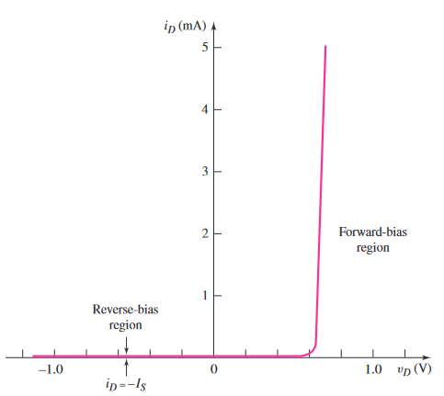
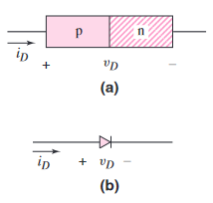
Course Materials
Figure 1.
Current-Voltage relationship of a pn junction diode.
A. The pn Junction Diode
Figure 1 is a plot of the derived current–voltage characteristics of a pn junction. For a forward-bias voltage, the current is an exponential function of voltage. With only a small change in the forward-bias voltage, the corresponding forward-bias current increases by orders of magnitude. For a forward-bias voltage v_{D} > +0.1V. In the reverse-bias direction, the current is al-most zero.
Figure 2 shows the diode circuit symbol and the conventional current direction and voltage polarity. The diode can be thought of and used as a voltage controlled switch that is “off” for a reverse-bias voltage and “on” for a forward-bias voltage. In the forward-bias or “on” state, a relatively large current is produced by a fairly small applied voltage; in the reverse-bias, or “off” state, only a very small current is created.
Figure 2.
pn junction diode (a) geometry and (b) circuit symbol showing polarity and current direction.
Module 2

Slide 14
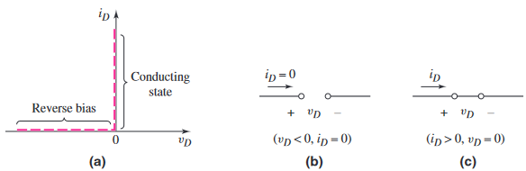
Course Materials
B.1 DC Analysis
As we have seen, the diode is a two-terminal device with nonlinear i–v characteristics, as opposed to a two-terminal resistor, which has a linear relationship between current and voltage. The analysis of nonlinear electronic circuits is not as straight-forward as the analysis of linear electric circuits. However, there are electronic functions that can be implemented only by nonlinear circuits. Examples include the generation of dc voltages from sinusoidal voltages and the implementation of logic functions.
To begin to understand diode circuits, consider a simple diode application. An ideal diode(as opposed to a diode with ideal i–v characteristics) has the characteristics shown in Figure 3(a). When a reverse-bias voltage is applied, the current through the diode is zero Figure 3(b); when current through the diode is greater than zero, the voltage across the diode is zero Figure 3(c). An external circuit connected to the diode must be designed to control the forward current through the diode.
Figure 3.
current i_{D} when v_{D} is at 0.
Diode is “open” at v_{D}<0
Diode is “shorted” when i_{D}>0
Module 2

Slide 15
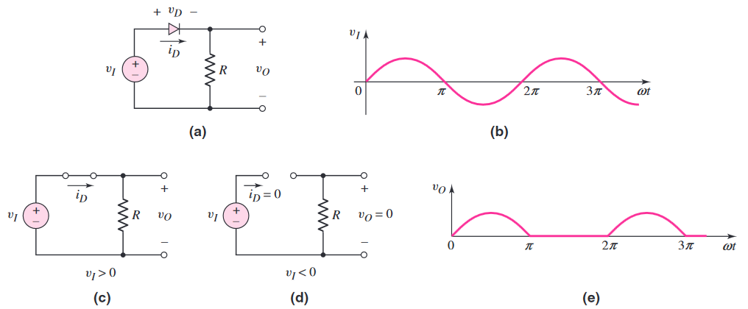
Course Materials
B.2 Diode Response to a Circuit
One diode circuit is the rectifier circuit shown in Figure 4(a). Assume that the input voltage v_{D} is a sinusoidal signal, as shown in Figure 4(b), and the diode is an ideal diode (see Figure 3a). During the positive half-cycle of the sinusoidal input, a forward-bias current exists in the diode and the voltage across the diode is zero. The equivalent circuit for this condition is shown in Figure 4(c). The output voltage v_{O} is then equal to the input voltage. During the negative half-cycle of the sinusoidal input, the diode is reverse biased. The equivalent circuit for this condition is shown in Figure 4(d). In this part of the cycle, the diode acts as an open circuit, the current is zero, and the output voltage is zero. The output voltage of the circuit is shown in Figure 4(e).
Module 2

Slide 16
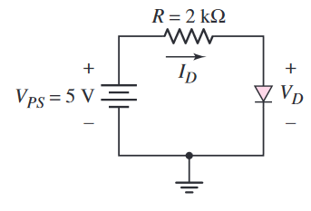
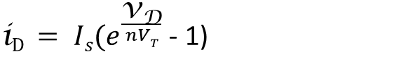
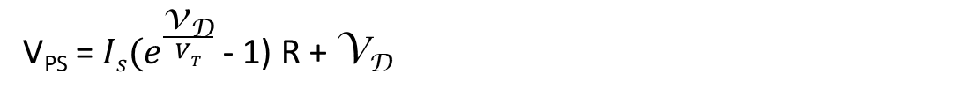
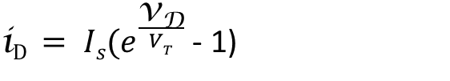
Course Materials
C. Solving for i_{D} and v_{D} using Iteration Technique
Consider an example circuit shown in Figure 5, with a dc voltage V_{PS} applied across a resistor and a diode. Kirchhoff’s voltage law applies both to non-linear and linear circuits, so we can write
(1)
V_{PS} = I_{D}R + V_{D}
Recall:
Or simply: (disregard n since this is always 1 at most times)
${\text{i}\text{D} = Is(e}^{\frac{\text{v}\text{D}}{nVT}}$ - 1)
${\text{i}\text{D} = Is(e}^{\frac{\text{v}\text{D}}{VT}}$ - 1)
Rewriting (1) taking note that I_{S} is known:
Figure 5. A simple diode circuit.
(2)
V_{PS} =${ Is(e}^{\frac{\text{v}\text{D}}{VT}}$ - 1) R + V_{D}
Now let I_{S} = 10⁻¹³A. To solve for V_{D} we use iteration technique.
If V_{D} = 0.6v, V_{PS} = 2.7v ≠ 5v
If V_{D} = 0.65v, V_{PS} = 15.1v ≠ 5v
If V_{D} = 0.619v, V_{PS} = 4.99v ≈ 5v
We choose V_{D} = 0.619v since V_{PS} = 4.99v ≈ 5v
Module 2

Slide 17
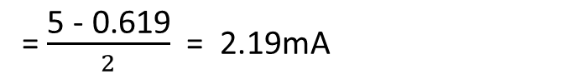
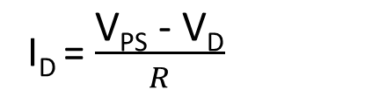
Course Materials
C. Solving for i_{D} and v_{D} using Iteration Technique (cont.)
To solve for current I_{D}, we can use the KVL made in (1) or use the ideal diode current formula. However, it is much easier to use KVL and this is preferred every now and then.
Rewriting:
From (1):
V_{PS} = I_{D}R + V_{D}
I_{D} = $\frac{\text{V}\text{PS}\text{ − }\text{VD}}{R}$
= $\frac{\text{5}\text{ − }\text{0.619}}{2}$ = 2.19mA
Reference book:
- Microelectronics: Circuit Analysis and Design, 4th Edition, By Donald A. Neamen , University of New Mexico, 2009
Module 2

Slide 18
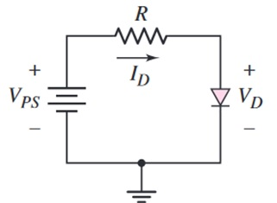
Exercise no. 2
Direction. Solve for the following. You may use a scientific calculator and round-off your final answer up to two decimal places. Use proper SI values if possible, and box your final answer.
Consider the circuit in figure below. Let V_{PS} = 4V, R=4kΩ, and I_{S}=10pA (10x10⁻¹²A). Determine V_{D} and I_{D}, using the ideal diode equation and the iteration method.
Using the same circuit, let V_{PS} = 5V, R=3kΩ, and I_{S}=15pA (15x10⁻¹²A). Determine V_{D} and I_{D}, using the ideal diode equation and the iteration method.
Using the same circuit, what must be the least value of V_{PS} in order to have the current in forward bias, if R=5kΩ, I_{S}=12pA, and V_{D} = 0.71v?
Module 2

Slide 19
Module 3:
BASIC DIODE CIRCUITS
Overview
Since we knew in the previous modules that a pn junction diode generates current as long as it is in forward-biased( not to discount the reversed-biased connection, which sometimes can be used as protection circuits), we can see that a diode can act as a switch; and thus control current flows. Utilizing the diode in a circuit can offer various options in designing and developing electronics technologies.
Module 3

Slide 20
Objectives
After successfully completing this module, the student should be able to:
Analyze basic diode circuits.
Compute V_{D} and I_{D} of a diode within a series or parallel circuit.
Observe how diode works as a switch in a series/parallel circuit.
Module 3

Slide 21
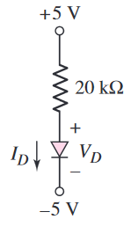
Course Materials
A. Solving diode V_{D} and I_{D} in a series circuit.
1.) Consider a series circuit in Figure 1. Compute for V_{D} and I_{D} if I_{S}=10⁻¹²A.
Solution. Make a KVL loop form +5v to -5v.
5 – 20I_{R} – V_{D} – (-5) = 0 ; Also since this is series, I_{R} = I_{D}
Rewriting,
5 – 20I_{D} – V_{D} + 5 = 0 (1) ; 10 – 20I_{D} = V_{D}
Also,
10 = 20${Is(e}^{\frac{\text{v}\text{D}}{VT}}$ - 1) + V_{D} ; 10 = [20(1x10⁻¹²)${(e}^{\frac{\text{v}\text{D}}{0.026}}$ - 1)] + V_{D}
Using iteration technique, we solved V_{D} :
V_{D} = 0.519v
From (1),
5 – 20I_{D} – V_{D} + 5 = 0 ; $\frac{10 – VD}{20}=ID$ I_{D} = 474.03µA
Module 3

Slide 22
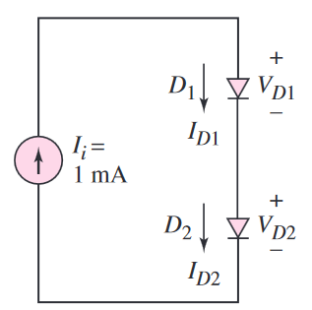
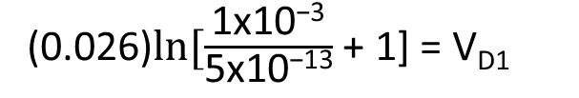
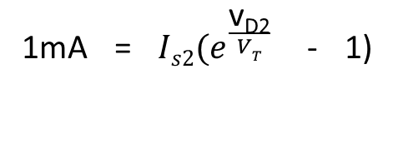
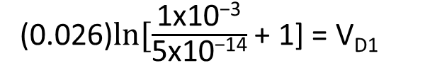
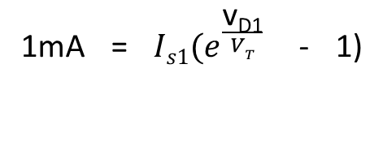
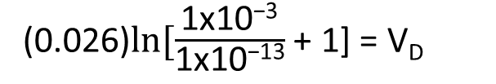
Course Materials
A. Solving diode V_{D} and I_{D} in a series circuit. (cont.)
2.) For the circuit shown, determine I_{D1},I_{D2},V_{D1},and V_{D2} for
(a) I_{S1}=I_{S2}=10⁻¹³A and
(b) I_{S1}=5×10⁻¹⁴A, I_{S2}=5×10⁻¹³A.
(a) Solution. Since the given circuit is purely in series, we can simply say that I₁ = I_{D1} = I_{D2} = 1mA
Then,
1mA = ${Is(e}^{\frac{\text{v}\text{D}}{VT}}$ - 1) ; 1mA = (1x10⁻¹³)${(e}^{\frac{\text{v}\text{D}}{0.026}}$ - 1)
(0.026)$ln⁡[\frac{\text{1}\text{x}\text{10−3}}{\text{1}\text{x}\text{10−13}}$ + 1] = V_{D}
Since I_{D1} = I_{D2} and I_{S1}=I_{S2}, it is obvious that V_{D1} = V_{D2} = 599mv
V_{D} =0.599v or 599mv
(b) Solution. Here still the current values are I₁ = I_{D1} = I_{D2} = 1mA
Then,
1mA = ${Is1(e}^{\frac{\text{v}\text{D}\text{1}}{VT}}$ - 1)
1mA = ${Is2(e}^{\frac{\text{v}\text{D}\text{2}}{VT}}$ - 1)
(0.026)$ln⁡[\frac{\text{1}\text{x}\text{10−3}}{\text{5}\text{x}\text{10−14}}$ + 1] = V_{D1}
(0.026)$ln⁡[\frac{\text{1}\text{x}\text{10−3}}{\text{5}\text{x}\text{10−13}}$ + 1] = V_{D1}
Module 3
V_{D1} = 617mv
V_{D2} = 557mv

Slide 23
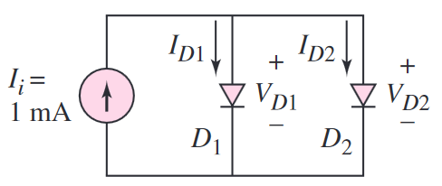
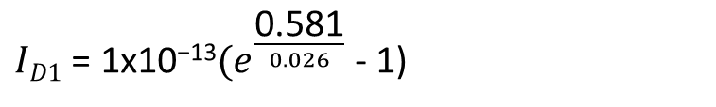
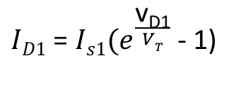
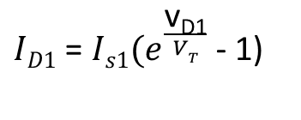
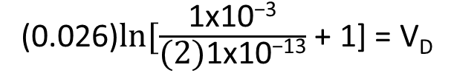
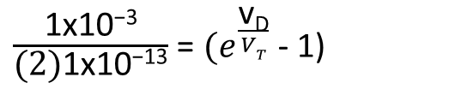


Course Materials
B. Solving diode V_{D} and I_{D} in a parallel circuit.
3.) For the circuit shown, determine I_{D1},I_{D2},V_{D1},and V_{D2} for
(a) I_{S1}=I_{S2}=10⁻¹³A and
(b) I_{S1}=5×10⁻¹⁴A, I_{S2}=5×10⁻¹³A.
(a) Solution. Since the given circuit is in parallel, we can see via KCL that I₁ = I_{D1} + I_{D2} (1)
And
$ID1$ = ${Is1(e}^{\frac{\text{v}\text{D}\text{1}}{VT}}$ - 1)
From (2):
(2)
Since I_{S1}=I_{S2}, then I_{D1}=I_{D2} and V_{D1} = V_{D2}
$ID1$ = ${Is1(e}^{\frac{\text{v}\text{D}\text{1}}{VT}}$ - 1)
Then from (1),
1mA = ${Is(e}^{\frac{\text{v}\text{D}}{VT}}$ - 1) + ${Is(e}^{\frac{\text{v}\text{D}}{VT}}$ - 1)
$ID1$ = ${\text{1}\text{x}\text{10−13}(e}^{\frac{\text{0.581}}{0.026}}$ - 1)
$ID1$ = 0.5mA = $ID2$
$\frac{\text{1}\text{x}\text{10−3}}{\text{(2)}\text{1}\text{x}\text{10−13}}$ = ${(e}^{\frac{\text{v}\text{D}}{VT}}$ - 1)
(0.026)$ln⁡[\frac{\text{1}\text{x}\text{10−3}}{\text{(2)}\text{1}\text{x}\text{10−13}}$ + 1] = V_{D}
Module 3
V_{D} = 581mv

Slide 24
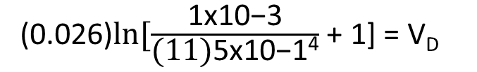
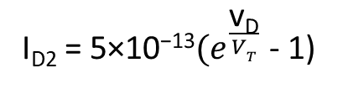
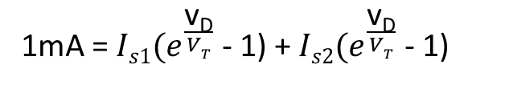
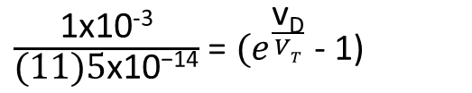
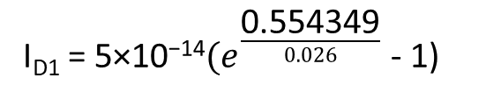
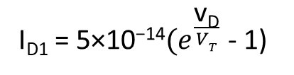
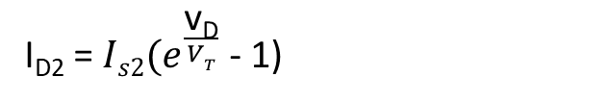
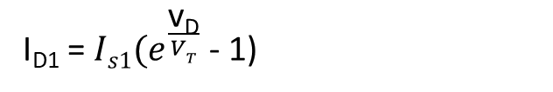
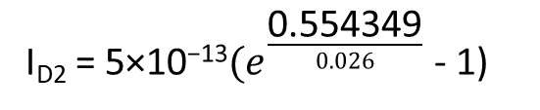
Course Materials
B. Solving diode V_{D} and I_{D} in a parallel circuit. (cont.)
For (b) the solution is almost same like (a), except that the values of I_{S} are different.
Recall that I₁ = I_{D1} + I_{D2}
Then from (1),
Note: Although the values of I_{S} differ, we can see that in the circuit V_{D1} and V_{D2} is in parallel with each other. And as we learned in Kirchhoff’s laws, V_{D1} = V_{D2}
1mA = ${Is1(e}^{\frac{\text{v}\text{D}}{VT}}$ - 1) + ${Is2(e}^{\frac{\text{v}\text{D}}{VT}}$ - 1)
1mA = [${\text{5×10}\text{−14}(e}^{\frac{\text{v}\text{D}}{VT}}$ - 1)] + ${\text{[}\text{5×10}\text{−1}3(e}^{\frac{\text{v}\text{D}}{VT}}$ - 1)]
I_{D2} = ${Is2(e}^{\frac{\text{v}\text{D}}{VT}}$ - 1)
I_{D1} = ${Is1(e}^{\frac{\text{v}\text{D}}{VT}}$ - 1)
1mA = [${\text{5×10}\text{−14}(e}^{\frac{\text{v}\text{D}}{VT}}$ - 1)] + ${\text{[}\text{5}\text{0}\text{×10}\text{−1}4(e}^{\frac{\text{v}\text{D}}{VT}}$ - 1)]
I_{D1} = ${\text{5×10}\text{−14}(e}^{\frac{\text{v}\text{D}}{VT}}$ - 1)
I_{D2} = ${\text{5×10}\text{−1}\text{3}(e}^{\frac{\text{v}\text{D}}{VT}}$ - 1)
1mA = (${\text{5×10}\text{−14})(e}^{\frac{\text{v}\text{D}}{VT}}$ - 1)(1 + 10)
I_{D1} = ${\text{5×10}\text{−14}(e}^{\frac{\text{0.554349}}{0.026}}$ - 1)
I_{D2} = ${\text{5×10}\text{−1}\text{3}(e}^{\frac{\text{0.554349}}{0.026}}$ - 1)
$\frac{\text{1}\text{x}\text{10−3}}{\text{(11)5}\text{x}\text{10−14}}$ = ${(e}^{\frac{\text{v}\text{D}}{VT}}$ - 1)
I_{D1} = 90.9µA
I_{D2} = 909.1µA
(0.026)$ln⁡[\frac{\text{1}\text{x}\text{10−3}}{\text{(11)}\text{5}\text{x}\text{10−14}}$ + 1] = V_{D}
Module 3
V_{D1} = 554.349mv

Slide 25
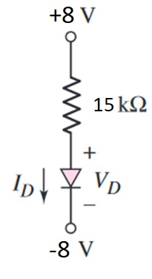
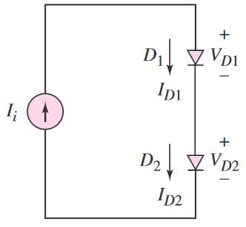
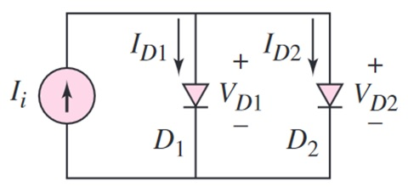
Exercise no. 3
Direction. Solve for the following. You may use a scientific calculator and round-off your final answer up to two decimal places. Use proper SI values if possible, and box your final answer.
Consider the circuit in figure A. Find V_{D} and I_{D}, if I_{S}=25pA.
Referring to figure B, what are the values of V_{D1} and V_{D2} if I_{i} = 2mA, I_{S1}=4×10⁻¹²A, and I_{S2}=25×10⁻¹²A.
See figure C. Find I_{D1}, I_{D2}, V_{D1}, and V_{D2} if I_{i} = 3mA, I_{S1}=12×10⁻¹⁵A, and I_{S2}=5×10⁻¹³A
Figure A
Figure C
Module 3
Figure B

Slide 26
Module 4:
THE PIECEWISE LINEAR MODEL
Overview
Since we already learned how a diode behaves in a circuit, there were cases that computing the values on a complex equations can be very hard, even using the iteration techniques. But then since this is a world of technologies and developments, those devices available in the market comes with its own datasheet and specifications. What does this imply? We can make computations on our designs and learnings with some ready-values, and use other more, easier technique. This is where the Piecewise Linear Model comes in.
Module 4

Slide 27
Objectives
After completing this module, the student should be able to:
Define and learn how a Piecewise linear model works.
Use piecewise linear model in computing current and voltage values of a diode.
Practice more circuit analysis through problem solving.
Module 4

Slide 28
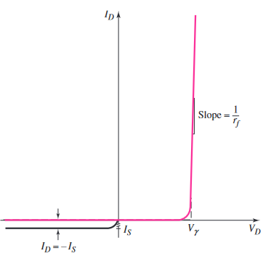
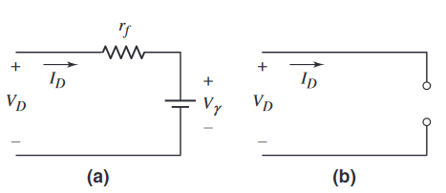
Course Materials
Figure 1.
The ideal current-voltage characteristics
A. The Piecewise Liner Model
Another simpler way to analyze diode circuits is to approximate the diode’s current–voltage characteristics using linear relationships or straight lines. Figure 1 for example, shows the ideal current–voltage characteristics and two linear approximations.
For V_{D} ≥ Vγ, we assume a straight-line approximation whose slope is 1/r_{f}, where Vγ is the turn-on, or cut-in voltage of the diode, and rf is the forward diode resistance. The equivalent circuit for this linear approximation is a constant-voltage source in series with a resistor Figure 2(a). For V_{D} < Vγ, we assume a straight-line approximation parallel with the V_{D} axis at the zero current level. In this case, the equivalent circuit is an open circuit Figure 2(b). This method models the diode with segments of straight lines; thus the name piecewise linear model.
Figure 2.
Equivalent circuit for V_{D} ≥ Vγ.
Equivalent circuit for V_{D} < Vγ.
Module 4

Slide 29
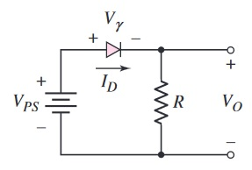
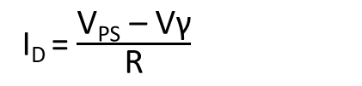

Course Materials
B. Sample Analysis
For the piecewise linear model, the cut-in voltage Vγ and forward diode resistance r_{f} must be specified. In most cases, however, r_{f} is assumed to be zero unless otherwise given.
1.) Let us examine a sample circuit on the right. Let V_{PS} = 5v, R = 5kΩ, and Vγ = 0.6v. (Since r_{f} value was not given, we will assume it be 0.)
Taking a KVL loop, we can say that,
V_{PS} – Vγ – V_{R} = 0
V_{PS} – Vγ – I_{D}R= 0
I_{D} = $\frac{\text{V}\text{PS}\text{ – }\text{V}\text{γ}}{\text{R}}$
Note:
As we can see, it is much easier to compute voltage and current values using the piecewise linear model, since the turn-on voltages are given already.
I_{D} = $\frac{\text{5}\text{ – }\text{0.6}}{\text{5}}$ = 0.88mA
I_{D}R= (0.88mA)(5kΩ) = 4.4v = V_{O}
Module 4

Slide 30





Course Materials
B. Sample Analysis (cont.)
2.) Now consider the circuit shown in Figure 3. The diode can be either a pn junction diode or a Schottky* diode. Assume the cut-in voltages are Vγ =0.7V and Vγ =0.3V for the pn junction diode and Schottky diode, respectively. Let r_{f} =20 Ω for the Schottky diode. Calculate the current I_{D} when each diode is inserted in the circuit.
Figure 3
Considering the diode as a pn junction:
Considering the diode as a Schottky diode :
I_{D} = $\frac{\text{V}\text{PS}\text{ – }\text{V}\text{γ}}{\text{R}}$
I_{D} = $\frac{\text{V}\text{PS}\text{ – }\text{V}\text{γ}}{\text{R}\text{ +}\text{r}\text{f}}$
I_{D} = $\frac{\text{4}\text{ – }\text{0.7}}{\text{4}}$ = 825µA
I_{D} = $\frac{\text{4}\text{ – }\text{0.3}}{\text{4 + 0.02}}$ = 920.4µA
*A Schottky barrier diode, or simply a Schottky diode, is formed when a metal, such as aluminum, is brought into contact with a moderately doped n-type semiconductor to form a rectifying junction.
Module 4

Slide 31

Exercise no. 4
Direction. Solve for the following. You may use a scientific calculator and round-off your final answer up to two decimal places. Use proper SI values if possible, and box your final answer. You may use the table to summarized your answers.
Find I and V_{O} in each circuit shown below if (1) Vγ = 0.7V and (2) Vγ = 0.6V.
Answer Table
 | Vγ = 0.7V | Vγ = 0.6V
(a)
(b)
(c)
(d)
Module 4

Slide 32
Module 5:
OTHER DIODES
Overview
Diodes come in different forms and applications. Some were used to regulate current in a narrow and specific region, while other types can generate current, thus, produce a voltage potential. Other forms where used as “fast-switches” for a more precise controlling device. These few of those various types of two-terminal devices can be designed differently, but nonetheless a diode will be a pn junction device.
Module 5

Slide 33
Objectives
After completing this module, the student should be able to:
Learn some other types of diode like Solar, Photodiode, Zener, and Schottky diodes.
Analyze these diodes’ current-voltage behavior in a given circuit.
Solve basic circuits involving these types of diode.
Module 5

Slide 34




Course Materials
(a)
A. The Solar Cell
A solar cell is a pn junction device with no voltage directly applied across the junction. The pn junction, which converts solar energy into electrical energy, is connected to a load as indicated in Figure 1. When light hits the space-charge region, electrons and holes are generated. They are quickly separated and swept out of the space-charge region by the electric field, thus creating a photocurrent. The generated photocurrent will produce a voltage across the load, which means that the solar cell has supplied power. Solar cells are usually fabricated from silicon, but may be made from GaAs or other III–V compound semiconductors. Solar cells have long been used to power the electronics in satellites and space vehicles, and also as the power supply to some calculators.
(b)
Figure 1.
(a)A pn junction solar cell connected to load
(b) Symbol of a solar cell
B. Photodiode
Photodetectors are devices that convert optical signals into electrical signals. An example is the photodiode(Figure 2), which is similar to a solar cell except that the pn junction is operated with a reverse-bias voltage. Incident photons or light waves create excess electrons and holes in the space-charge region. These excess carriers are quickly separated and swept out of the space-charge region by the electric field, thus creating a “photocurrent.” This generated photocurrent is directly proportional to the incident photon flux.
(a)
(b)
Figure 2
Photodiode construction
Photodiode symbol
Module 5

Slide 35



(b)
Course Materials
C. The Light-Emitting-Diode (LED)
The light-emitting diode (LED) converts current to light. As previously explained, when a forward-bias voltage is applied across a pn junction, electrons and holes flow across the space-charge region and become excess minority carriers. These excess minority carriers diffuse into the neutral semiconductor regions, where they recombine with majority carriers. In an LED, the diode current is directly proportional to the recombination rate, which means that the output light intensity is also proportional to the diode current.
(a)
Figure 3.
(a) LED schematic symbol
(b) LED construction
D. Schottky Diode
A Schottky diode is formed when a metal such as aluminum is brought into contact with a moderately doped n-type semiconductor to form a rectifying junction. Figure 4 shows the metal-semiconductor contact and the circuit symbol
with the current direction and voltage polarity.
The current–voltage characteristics of a Schottky diode are very similar to those of a pn junction diode and same ideal diode equation can be used for both devices. However, there are two important differences between the two diodes that directly affect the response of the Schottky diode. First The current in a Schottky diode results from the flow of majority carriers over the potential barrier at the metallurgical junction which me and switching time from a forward bias to a reverse bias is very short compared to that of a pn junction diode. Second, the reverse-saturation current I_{S} for a Schottky diode is larger than that of a pn junction diode for comparable device areas. This property means that it takes less forward bias voltage to induce a particular current compared to a pn junction diode.
Figure 4
Schottky diode construction
Schottky diode symbol
(a)
(b)
Module 5

Slide 36


Course Materials
E. The Zener Diode
Figure 5(a). Diode I-V characteristics showing breakdown effects.
As learned earlier, the applied reverse-bias voltage cannot increase without limit. At some point, breakdown occurs and the current in the reverse-bias direction increases rapidly. The voltage at this point is called the breakdown voltage. The diode I–V characteristics, including breakdown, are shown in Figure 5(a). This diodes, called Zener diodes, can be designed and fabricated to provide a specified breakdown voltage V_{Zo}. {Although the breakdown voltage is on the negative voltage axis (reverse-bias), its value is given as a positive quantity.} Such a diode can be used as a constant-voltage reference in a circuit. The diode breakdown voltage is essentially constant over a wide range of currents and temperatures. The slope of the I–V characteristics curve in breakdown is quite large, so the incremental resistance r_{z} is small. Typically, r_{z} is in the range of a few ohms or tens of ohms. The circuit symbol of the Zener diode is shown in Figure 5(b). The voltage V_{Z} is the Zener breakdown voltage, and the current I_{Z} is the reverse-bias current when the diode is operating in the breakdown region.
Figure 5(b). Zener diode schematic symbol showing its polarity and current direction.
Module 5

Slide 37




Course Materials
F. Sample Analysis using Zener Diode
Analyze the circuit in the right. Let a voltage source V_{PS} = 10v and a Zener diode used as a voltage regulator is V_{Z} = 5.6v. Determine the value of the resistor if the current diode is to be limited to 5mA. Also find the power rating of both the Zener diode and the resistor.
Doing the current loop, we can see that
I = $\frac{VPS −VZ}{R}$
For Resistor and Diode power ratings:
Note the connection of the Zener diode in an actual circuit, which has to be reversed in order to operate in a normal way.
or
P_{R} = I²R
P_{Z} = V_{Z} I
R = $\frac{VPS −VZ}{I}$
P_{R} = (5x10⁻³)²(880)
P_{Z} = (5.6)(5x10⁻³)
R = $\frac{10 −5.6}{5}$
P_{R} = 22mW
P_{Z} = 28mW
= 880Ω
Module 5

Slide 38

Exercise no. 5
Direction. Solve for the following. You may use a scientific calculator and round-off your final answer up to two decimal places. Use proper SI values if possible, and box your final answer.
Find the proper voltage V_{Z} of the circuit if the required regulated current must be of 2.5mA, in which it is connected to a 3kΩ resistor R and supplied with a 12v V_{PS} power supply.
What must be the value of resistor R if V_{Z} = 4.2v and V_{PS} = 6v? Consider the power rating of the Zener diode be of 10mW.
Assume a load resistor is R_{L} is connected in parallel with the Zener diode. If the Zener voltage V_{Z} = 7.2v, and all resistors (R and R_{L}) comes has a rating of 0.25mW, what must be the value of R given that V_{PS} = 12v?
Module 5

Slide 39
Module 6:
DIODE CIRCUITS
(THE RECTIFIER)
Overview
One application of diodes is in the design of rectifier circuits. A diode rectifier forms the first stage of a dc power supply. A dc voltage is required to power essentially every electronic device, including personal computers, televisions, and stereo systems. An electrical cord that is plugged into a wall socket and attached to a television, for example, is connected to a rectifier circuit inside the TV. In addition, battery chargers for portable electronic devices such as cell phones and laptop computers contain rectifier circuits. Rectification is the process of converting an alternating (ac) voltage into one that is limited to one polarity. The diode is useful for this function because of its non-linear characteristics, that is, current exists for one voltage polarity, but is essentially zero for the opposite polarity. Rectification is classified as half-wave or full-wave, with half-wave being the simpler and full-wave being more efficient.
Module 6

Slide 40
Objectives
After completing this module, the student should be able to:
Define what rectification is.
Understand the difference between half-wave, full wave, and bridge rectifier circuits.
Determine how diode turns on/off during positive and negative cycles.
Learn to design a basic power supply in the future lessons.
Module 6

Slide 41

Course Materials
A. The Power Supply
Below is a simplified block diagram of a typical power supply. The main voltage source (220v 60Hz AC) is being step down into a more manageable low AC signal via a power transformer. Next will be the rectification process through diodes, followed by filtering (done by a capacitor or sometimes, a more complex circuit), then regulated through a voltage regulator (to ensure smooth and more stable DC value), which depends on the requirement of the load, which normally is; a resistive load.
Module 6

Slide 42




Course Materials
Problem-Solving Technique:
In using the piecewise linear model of the diode, the first objective is to determine the linear region (conducting or not conducting) in which the diode is operating. To do this, we can:
1.Determine the input voltage condition such that a diode is conducting (on).Then find the output signal for this condition.
2.Determine the input voltage condition such that a diode is not conducting(off). Then find the output signal for this condition.
[Note: Item 2 can be performed before item 1 if desired.]
B. Half-wave Rectification
Figure 1 shows a power transformer with a diode and resistor connected to the secondary of the transformer. We will use the piecewise linear approach in analyzing this circuit, assuming the diode forward resistance is r_{f}=0 when the diode is “on”. The input signal, $vI$, is in general, a 220 V (rms)-60 Hz AC signal. Recall that the secondary voltage, $vS$, and primary voltage, $vI$, of an ideal transformer are related by
$\frac{vI}{vS}$ = $\frac{N1}{N2}$
where $N1$ and $N2$are the number of primary and secondary turns, respectively. The ratio $N1$/ $N2$is called the transformer turns ratio. The transformer turns ratio will be designed to provide a particular secondary voltage, $vS$, which in turn will produce a particular output voltage $vO$.
Figure 1
Module 6

Slide 43











Course Materials
B. Half-wave Rectification (analysis)
Recall that $Vγ$ is the turn-on voltage of the diode. Now looking at the graph in figure 2(a) and (b), we can say that
$$vO \text{= }\text{0}\text{v}$$
$$\text{if} vS ≤Vγ$$
Taking a current loop, we can say that
$$vO\text{= }vS −Vγ$$
$$\text{if} vS>Vγ$$
i_{D} = $\frac{vS −Vγ}{R}$
and
$vO$= i_{D}R = $vS −Vγ$
We can see that while the input signal $vS$ alternates polarity and has a time-average value of zero, the output voltage $vO$ is uni-directional and has an average value that is not zero. The input signal is therefore rectified. Also, since the output voltage appears only during the positive cycle of the input signal, the circuit is called a half-wave rectifier.
Figure 2
Module 6

Slide 44


Course Materials
C.1 Full-wave Rectification
The full-wave rectifier inverts the negative portions of the sine wave so that a unipolar output signal is generated during both halves of the input sinusoid. One example of a full-wave rectifier circuit appears in Figure 3(a). The input to the rectifier consists of a power transformer, in which the input is normally a 220 V (rms), 60 Hz ac signal, and the two outputs are from a center-tapped secondary winding that provides equal voltages $vS$, with the polarities shown. When the input line voltage is positive, both output signal voltages $vS$ are also positive. The primary winding connected to the 220 V ac source has $N1$ windings, and each half of the secondary winding has $N2$windings. The value of the $vS$ output voltage is 220($N2$/ $N1$) volts (rms). The turns ratio of the transformer, usually designated ($N1$/ $N2$) can be designed to “step down” the input line voltage to a value that will produce a particular dc output voltage from the rectifier. The input power transformer also provides electrical isolation between the powerline circuit and the electronic circuits to be biased by the rectifier circuit. This isolation reduces the risk of electrical shock.
Figure 3(a) An example of a full-wave rectification using a center-tapped transformer.
Module 6

Slide 45









Course Materials
C.1 Full-wave Rectification (with analysis)
During positive cycle, D₁ is turned on, and D₂ is off.
Since a rectified output voltage occurs during both the positive and negative cycles of the input signal, this circuit is called a full-wave rectifier. One of its advantage over half-wave rectification is that the “wasted” signal (i.e. negative cycle) is also being rectified through D₂, thus both the half-cycles can be utilized fully on a single cycle T.
$$vO \text{= }\text{0}\text{v}$$
$$\text{if} +vS ≤Vγ$$
$$vO\text{= }+vS −Vγ$$
$$\text{if} +vS>Vγ$$
During negative cycle, D₂ is turned on, and D₁ is off.
$$vO \text{= }\text{0}\text{v}$$
$$\text{if} −vS ≤Vγ$$
$$vO\text{= }−vS −Vγ$$
$$\text{if} −vS>Vγ$$
Module 6

Slide 46



Course Materials
C.2 Full-wave Rectification: Bridge Type
Figure 4. The Bridge Rectifier
Another example of a full-wave rectifier circuit appears in Figure 4(a). This circuit is a bridge rectifier, which still provides electrical isolation between the input AC powerline and the rectifier output, but does not require a center-tapped secondary winding. However, it does use four diodes, compared to only two in the previous circuit. During the positive half of the input voltage cycle, $vS$ is positive,D₁and D₂ are forward biased, D₃ and D₄ are reverse biased, and the direction of the current is as shown in Figure 4(b). During the negative half-cycle of the input voltage, $vS$ is negative, and D₃ and D₄ are forward biased. The direction of the current, shown in Figure 4(b), produces the same output voltage polarity as before. Figure 4(c) shows the sinusoidal voltage $vS$ and the rectified output voltage $vO$. Because two diodes are in series in the conduction path, the magnitude of $vO$ is two diode drops less than the magnitude of $vS$.
Module 6

Slide 47




Course Materials
D. Sample Problem Analysis
1.) Determine the currents and voltages in a half-wave rectifier circuit. Consider the circuit shown below. Assume $VB$=9V, R=250Ω, and $Vγ$=0.7V. Also assume $vS$(t) =12sinωt. Determine the peak diode current and maximum reverse-bias diode voltage.
Solution
The peak current for diode i_{D}(peak) is the maximum current allowed for the diode. Doing the current loop we have,
i_{D} (peak) = $\frac{vS −VB − Vγ}{R}$
This example circuit can be a simple design of a battery charger.
= $\frac{12 −9 −0.7}{250}$
= 9.2mA
The maximum reverse-bias diode voltage is:
v_{R}(max) =$vS$+ $VB$= 12 + 9 = 21v
Module 6

Slide 48
Module 7:
BIPOLAR JUNCTION TRANSISTOR
(BASICS)
Overview
The invention of the bipolar transistor in 1948 ushered in a revolution in electronics. Technical feats previously requiring relatively large, mechanically fragile, power-hungry vacuum tubes were suddenly achievable with tiny, mechanically rugged, power-thrifty specks of crystalline silicon. This revolution made possible the design and manufacture of lightweight, inexpensive electronic devices that we now take for granted. Understanding how transistors function is of paramount importance to anyone interested in understanding modern electronics.
Through the use of bipolar transistor, engineers were able to develop tons and tons of technologies and decrease its sizes at the same time. After the success of the said bipolar transistor, further devices were developed, like the field-effect transistors, integrated circuit chips, and so on.
Module 7

Slide 49
Objectives
After completing this module, the student should be able to:
Define what a bipolar junction transistor is.
Understand the nature of a bipolar junction transistor and its parts.
Know the 2 kinds of BJT(Bipolar junction Transistor).
Familiarize the DC analysis of a certain transistor circuit.
Module 7

Slide 50


Course Materials
A. The Bipolar Junction Transistor
The bipolar junction transistor (BJT)has three separately doped regions and contains two pn junctions. A single pn junction has two modes of operation—forward bias and reverse bias. The bipolar transistor, with two pn junctions, therefore has four possible modes of operation, depending on the bias condition of each pn junction, which is one reason for the versatility of the device. With three separately doped regions, the bipolar transistor is a three-terminal device. The basic transistor principle is that the voltage between two terminals controls the current through the third terminal.
Electron and hole currents in an npn bipolar transistor biased in the forward-active mode. Emitter, base, and collector currents are proportional to $e^{\text{v}\text{BE}\text{/}\text{VT}}$.
Figure 1. a npn transistor with current flow direction.
Module 7

Slide 51

Course Materials
B. The npn and pnp BJT(Bipolar Junction Transistor)
There are 2 types of BJT(Bipolar Junction Transistor). One is the npn transistor (see figure a and b below), and the other is the pnp transistor (see figure c and d below also). Take note of the current direction, there will always be current flowing at base-emitter terminals, and so with the collector-emitter terminals. The collector-base currents is almost negligible thus no current will flow between those terminals.
(a)
(b)
(c)
(d)
Module 7

Slide 52

Course Materials
C. Some Formulas Applicable to BJTs
Below are some of the useful formulas used in BJTs. Take note of the current relationships of each terminals.
Where,
i_{E} - emitter current
i_{C} - collector current
i_{B} - base current
α - common-base current gain
β - common-emitter current gain
Module 7

Slide 53

Course Materials
D. Sample DC Analysis of a BJT
One of the basic transistor circuit configurations is called the common-emitter circuit. In the figure below, this shows one example of a common-emitter circuit. The emitter terminal is obviously at ground potential, hence the term “common-emitter” came from.
(a)
(b)
(a) Common-emitter circuit with npn transistor and (b) dc equivalent circuit. Transistor equivalent circuit is shown within the dotted lines with piecewise linear transistor parameters.
Module 7

Slide 54

Course Materials
D. Sample DC Analysis of a BJT (cont.)
Now let us find the current values of the given circuit. Taking the B-E loop(base to emitter loop), we could see that
V_{BB} – I_{B}R_{B}-V_{BE} = 0
I_{B} = $\frac{\text{V}\text{BB}\text{ – }\text{VBE}}{\text{R}\text{B}}$
or
(1)
Also,
V_{CC} – I_{C}R_{C}-V_{CE} = 0
or
V_{CE} = V_{CC} – I_{C}R_{C}
Recall that I_{C} =β I_{B} . Therefore,
V_{CE} = V_{CC} – I_{C}R_{C}
V_{CE} = V_{CC} – (β I_{B} R_{C})
or
(2)
Module 7

Slide 55



Course Materials
E. Application (BJT DC Analysis)
Let us try to solve a basic npn BJT having a common-emitter configuration. Below is a circuit with CE (common-emitter) configuration. Find V_{CE}, I_{B} , I_{C} , and I_{E} . Let V_{BE}(on) = 0.7v and β = 200.
Using the formula (1), we can easily obtain I_{B} .
I_{B} = $\frac{\text{V}\text{BB}\text{ – }\text{VBE}}{\text{R}\text{B}}$
I_{B} = $\frac{\text{4}\text{ – }\text{0.7}}{\text{220}\text{k}Ω}$
;
I_{B} = 15µA
I_{C} =βI_{B}
;
I_{C} =200 x 15µA
I_{C} =3mA
I_{E} =I_{B} + I_{C}
;
I_{E} = 15µA + 3mA
I_{E} =3.02mA
From the original form of formula (2):
V_{CE} = V_{CC} – I_{C}R_{C}
V_{CE} = 10 – (3mA )(2kΩ)
V_{CE} = 4v
Module 7

Slide 56

Exercise no. 6
Direction. Solve for the following. You may use a scientific calculator and round-off your final answer up to two decimal places. Use proper SI values if possible, and box your final answer.
Beside is a pnp transistor circuit with CE (common-emitter) configuration. Let V_{BE}(on) = 0.6v , β = 100 and RC = 5kΩ. Find V_{EC}, I_{B} , I_{C} , and I_{E} .
Module 7

Slide 57
Module 8:
BIPOLAR JUNCTION TRANSISTOR
(PRACTICE PROBLEMS)
Overview
We’ve considered the basic transistor characteristics and properties. We can now start analyzing and designing the dc biasing of bipolar transistor circuits. A primary purpose of this module is to become familiar and comfortable with the bipolar transistor and transistor circuits. The dc biasing of transistors, is an important part of designing bipolar amplifiers, to name a few.
Transistors can be used to: switch currents, voltages, and power; perform digital logic functions; and amplify time-varying signals. In this section, we consider the switching properties of the bipolar transistor.
Module 8

Slide 58
Objectives
After completing this module, the student should be able to:
Enhance knowledge in solving transistor DC analysis.
Apply knowledge in making design circuits such as a switch or inverter circuit.
Module 8

Slide 59


Course Materials
A. Commonly Used Bipolar Circuits: dc Analysis
Calculate the characteristics of a circuit containing an emitter resistor. For the circuit shown, let V_{BE}(on)=0.7V and β=75. Note that the circuit has both positive and negative power supply voltages.
(a) npn transistor circuit with emitter resistor
(b) Circuit (a) with current directions and voltage polarities
Module 8

Slide 60
Course Materials
A.1 Commonly Used Bipolar Circuits: dc Analysis (cont.)
Now let us try to solve for V_{CE}. {V_{BE}(on)=0.7V and β=75}
2) Now to solve I_{C} and I_{E} :
1) Taking the B-E loop, we can say that,
V_{BB} $\text{–}$ I_{B}R_{B} $\text{–}$ V_{BE} $\text{–}$ I_{E} R_{E} $\text{–}$ V₍₋₎ $\text{=}$ 0
I_{C} = βI_{B}
Recall:
I_{C} = (75)(2.665µA)
I_{E} =(1 + β )I_{B}
I_{C} = 199.87µA
and
Then:
V_{BB} $\text{–}$ I_{B}R_{B} $\text{–}$ V_{BE} $\text{–}$ [(1 + β )I_{B} R_{E} $] \text{–}$ V₍₋₎ $\text{=}$ 0
I_{E} = (1 + β )I_{B}
I_{E} = (76)(2.665µA)
Manipulating the equation to obtain I_{B} :
I_{E} = 202.54µA
I_{B} = $\frac{\text{V}\text{BB}\text{– }\text{VBE}\text{– }\text{V}\text{(−)}}{\text{R}\text{B} \text{+}\text{ (1 + }\text{β} \text{)}\text{RE}}$
(1)
3) Finally the C-E loop,
V₍₊₎ $\text{–}$ I_{C}R_{C} $\text{–}$ V_{CE} $\text{–}$ I_{E} R_{E} $\text{–}$ V₍₋₎ $\text{=}$ 0
I_{B} = $\frac{\text{1}\text{– }\text{(0.7) }\text{–}\text{ (−1.8)}}{\text{560}\text{k} \text{+}\text{ (1 + }\text{75} \text{)}\text{3}\text{k}}$
V_{CE} = V₍₊₎ $\text{–}$ I_{C}R_{C}$\text{–}$ I_{E} R_{E} $\text{–}$ V₍₋₎
V_{CE} = 1$.8\text{–}$ (199.87µA)(7k)$\text{–}$ (202.54µA)(3k) $\text{–}$ (-1.8)
I_{B} = 2.665µA
Module 8
V_{CE} = 1.59v

Slide 61

Course Materials
B. Application : Switch Circuit
Figure below shows a bipolar circuit called an inverter, in which the transistor in the circuit is switched between cutoff and saturation. The load, for example, could be a motor, a light-emitting diode or some other electrical device. If v_{I} < V_{BE}(on), then I_{B} = I_{C} = 0 and the transistor is cut off. Since I_{C} =0, the voltage drop across the load is zero, so the output voltage is v_{O}=V_{CC}. Also, since the currents in the transistor are zero, the power dissipation in the transistor is zero. If the load were a motor, the motor would be off with zero current. Likewise, if the load were a light-emitting diode, the light output would be zero with zero current.
Module 8

Slide 62

Course Materials
B. Application : Switch Circuit
Design Specifications:
The transistor in the inverter circuit in the figure is used to turn the light-emitting diode (LED) on and off. The required LED current is I_{C}=12mA to produce the specified output light. Assume transistor parameters of β=80, V_{BE}(on)=0.7V, and V_{CE}(sat)=0.2V, and assume the diode cut-in voltage is Vγ=1.5V. Also assume that the voltage supply v_{I} = 5v. [Note: LEDs are fabricated with compound semiconductor materials and have a larger cut-in voltage compared to silicon diodes.]
1) Taking the C-E loop, we can say that,
2) Taking the B-E loop, we can say that,
V₍₊₎ $\text{–}$ I_{C}R₁ $\text{–}$ V_{γ} $\text{–}$ V_{CE}(sat) $\text{=}$ 0
V_{I} $\text{–}$ I_{B}R_{B} $\text{–}$ V_{BE} $\text{=}$ 0
I_{B} = $\frac{\text{I}\text{C}}{\text{β}}$
Restating the equation to obtain R₁:
I_{C} = βI_{B}
or
R₁ = $\frac{\text{V}\text{(+) }\text{–} \text{V}\text{γ} \text{–} \text{V}\text{CE}\text{(}\text{sat})}{\text{I}\text{C} }$
Restating the equation to obtain R_{B}:
R_{B} = $\frac{\text{(}\text{β}\text{)(}\text{V}\text{I}\text{ – }\text{V}\text{B}\text{E}\text{)}}{\text{I}\text{C} }$
R₁ = $\frac{\text{5} \text{–}\text{ 1.5} \text{–}\text{ 0.2 }}{\text{(12)} }$
R₁ = 275Ω
R_{B} = $\frac{\text{(80)(}\text{5} \text{–}\text{ 0.7}\text{)} }{\text{(12)} }$
R_{B} = 28.6kΩ
Module 8

Slide 63


Exercise no. 7
Direction. Solve for the following. You may use a scientific calculator and round-off your final answer up to two decimal places. Use proper SI values if possible, and box your final answer.
(1) Consider the circuit (a). For the transistor, let β=50. Find I_{B}, I_{C}, I_{E}, and V_{O} for V_{I}=5V.
(a)
(2) The inverter circuit (b) uses a pnp transistor. In this case, one side of the load (for example a motor) can be connected to ground potential. The required load current is I_{C2} = 5A. Assume transistor parameters of β = 40, V_{EB}(on) = 0.7V, and V_{EC}(sat) = 0.2V. SOLVE FOR R_{B2}
(b)
Module 8

Slide 64
Module 9:
BIPOLAR JUNCTION TRANSISTOR BIASING
Overview
As we have learned that transistor can be utilized as a switch or other electronic applications, we found out that it is important to bias it properly. The biasing of a certain (or could be multiple) transistor can greatly affect its performance, efficiency, output, and even reliability. A good biasing technique can provide a stable dc output that can serve as reference for lets say, in amplification of an AC signal.
In general, transistor can be biased in different ways, producing different ranges of output and gain factors.
Module 9

Slide 65
Objectives
After completing this module, the student should be able to:
Practice solving circuit values with different types of biasing design.
Recall Thevenin circuitry and apply it in a complex transistor circuit.
Upgrade knowledge and skill in solving transistor circuits.
Module 9

Slide 66

Course Materials
A. Single Base Resistor Biasing
The circuit shown in Figure (a) is one of the simplest transistor circuits. There is a single dc power supply, and the quiescent base current is established through the resistor R_{B}. The coupling capacitor C_{C} acts as an open circuit to dc, isolating the signal source from the dc base current. If the frequency of the input signal is large enough and C_{C} is large enough, the signal can be coupled through C_{C} to the base with little attenuation. Typical values of C_{C} are generally in the range of 1 to 10 μF, although the actual value depends upon the frequency range of interest . Figure (b) is the dc equivalent circuit; the Q-point values are indicated by the additional subscript Q.
(B) dc equivalent circuit
(a) Common-emitter circuit with a single bias resistor in the base
Module 9

Slide 67







Course Materials
B. Application : Single Base Resistor Biasing
Design Specifications:
The circuit configuration to be designed is shown in the figure on the right. The circuit is to be biased with V_{CC} =+12V. The transistor quiescent values are to be I_{CQ}=1mA and V_{CEQ}=6V. Also let β=100 and V_{BE}(on)=0.7V. Find the values of R_{B} and R_{C}.
1) Taking the C-E loop, we can say that,
2) Taking the B-E loop, we can say that,
V_{cc} $\text{–}$ I_{CQ}R_{C} $\text{–}$V_{CE} $\text{=}$ 0
V_{cc} $\text{–}$ I_{BQ}R_{B} $\text{–}$ V_{BE} $\text{=}$ 0
Restating the equation to obtain R_{C}:
I_{B} = $\frac{\text{I}\text{C}\text{Q}}{\text{β}}$
I_{CQ} = βI_{BQ}
or
R_{C} = $\frac{\text{V}\text{CC}\text{ –}\text{V}\text{CE}}{\text{I}\text{CQ} }$
Restating the equation to obtain R_{B}:
R_{B} = $\frac{\text{(}\text{β}\text{)(}\text{V}\text{cc}\text{ – }\text{V}\text{B}\text{E}\text{)}}{\text{I}\text{CQ} }$
R_{C} = $\frac{\text{12 }\text{–} \text{6}}{\text{1}}$
R_{C} = 6k Ω
R_{B} = $\frac{\text{(100)(}\text{12} \text{–}\text{ 0.7}\text{)} }{\text{(1)} }$
R_{B} = 1.13M Ω
Module 9

Slide 68

Course Materials
C. Voltage Divider Biasing and Bias Stability
The circuit in Figure (c) is a classic example of discrete transistor biasing. The single bias resistor R_{B} in the previous circuit is replaced by a pair of resistors R₁ and R₂, and an emitter resistor R_{E} is added. The ac signal is still coupled to the base of the transistor through the coupling capacitor C_{C}. The circuit is most easily analyzed by forming a Thevenin equivalent circuit for the base circuit. The coupling capacitor acts as an open circuit to dc.
(B) the dc circuit with a Thevenin equivalent base circuit
(c) A common-emitter circuit with an emitter resistor and voltage divider bias circuit in the base
Module 9

Slide 69



Course Materials
D. Application : Voltage Divider Biasing and Bias Stability
As mentioned, the dc equivalent circuit is done by using a Thevenin equivalent on the side of the base terminal. For the circuit given, let R₁=56k Ω,R₂=12.2k Ω,R_{C}=2k Ω,R_{E}=0.4k Ω,V_{CC}=10V,V_{BE}(on)=0.7V, and β=100. Solve for V_{CEQ}.
Let us make the Thevenin equivalent in the base terminal.
1) Finding R_{TH}.
R₁||R₂ = R_{TH}
R_{TH} = $\frac{\text{(56}\text{k}\text{)(12.2}\text{k}\text{)}}{\text{(56}\text{k}\text{ + 12.2}\text{k}\text{)}}$
R_{TH} = 10.02k Ω
2) For V_{TH}, we can see that the voltage drop with respect to base-ground terminal is the voltage across R2. We can perform voltage divider then.
V_{TH} = V_{CC}$\frac{\text{R}\text{2}}{\text{R}\text{1}\text{ + }\text{R}\text{2 }}$
V_{TH} = ($10)\frac{\text{1}\text{2.2}}{(56+12.2) }$
V_{TH} = 1.79V
Module 9

Slide 70







Course Materials
D. Application : Voltage Divider Biasing and Bias Stability (cont.)
3) Now taking the B-E loop, we can say that,
I_{CQ} = βI_{BQ}
V_{TH} $\text{–}$ I_{BQ}R_{TH} $\text{–}$ V_{BE} $\text{–}$I_{EQ}R_{E} $\text{=}$ 0
I_{CQ} = (100)(21.6)
Recall: I_{EQ} = (1 + β)I_{BQ}
I_{CQ} = 2.16m A
V_{TH} $\text{–}$ I_{BQ}R_{TH} $\text{–}$ V_{BE} $\text{–}$ (1 + β)I_{BQ}R_{E} $\text{=}$ 0
Restating the equation to obtain I_{BQ}:
3) Finally taking the C-E loop,
I_{BQ} = $\frac{\text{(}\text{V}\text{TH}\text{ – }\text{V}\text{B}\text{E}\text{)}}{\text{R}\text{TH}\text{ + (1 + }\text{β}\text{)} \text{R}\text{E}}$
V_{CC} $\text{–}$ I_{CQ}R_{C} $\text{–}$ V_{CEQ} $\text{–}$I_{EQ}R_{E} $\text{=}$ 0
I_{BQ} = $\frac{\text{(}\text{1}\text{.79} \text{– }\text{0.7}\text{)}}{\text{10.02} \text{+}\text{ (1 + }\text{100}\text{)}\text{ 0.4}}$
V_{CEQ} = V_{CC} $\text{–}$ I_{CQ}R_{C}$\text{–}$I_{EQ}R_{E}
I_{BQ} = 21.6µ A
V_{CEQ} = (10) $\text{–}$ (2.16)(2) $\text{–}$ (21.18)(0.4)
I_{EQ} = (1 + β)I_{BQ}
I_{EQ} = (1 + 100)(21.6)
V_{CEQ} = 4.81V
Module 9
I_{EQ} = 21.18m A

Slide 71


Exercise no. 8
Direction. Solve for the following. You may use a scientific calculator and round-off your final answer up to two decimal places. Use proper SI values if possible, and box your final answer.
(A) For the circuit shown in Figure (a) let β=100. (1) Find R_{TH} and V_{TH} for the base and show the new circuit by re-drawing it. (2) Determine I_{BQ} I_{CQ} I_{EQ} and V_{CEQ}.
(B) For the circuit in Figure (b), assume β=50. (1) Find R_{TH} and V_{TH} for the base and show the new circuit by re-drawing it. (2) Determine I_{BQ} I_{CQ} I_{EQ} and V_{ECQ}.
Figure (a)
Figure (b)
Module 9

