Slide 1



Discrete Mathematics for
Computer Science
Department of Computer Science
Instructor: Dr. Ayesha Altaf
Reference Book: Discrete Mathematics and its applications BY Kenneth H. Rosen – 8th edition

Slide 2

Lecture 3
Chapter 1. The Foundations
Propositional Equivalences
Predicates and Quantifiers

Slide 3


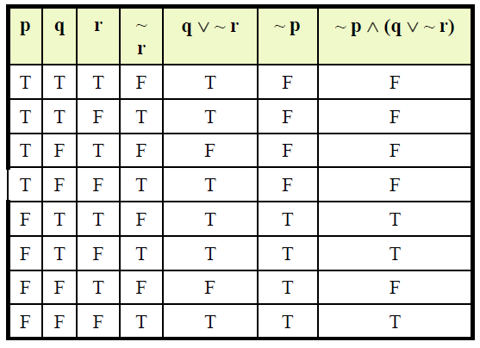
Truth Tables
Truth table for ~p ∧ (q ∨ ~r)

Slide 4
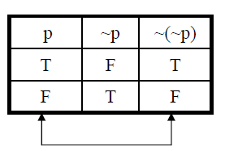
Double Negation
Double Negative Property ~(~p) ≡ p
Example: “It is not true that I am not happy”
Solution:
Let p = “I am happy”
then ~ p = “I am not happy”
and ~(~ p) = “It is not true that I am not happy”
Since ~ (~p) ≡ p
Hence the given statement is equivalent to:“I am happy”

Slide 5
De Morgan’s Laws
The negation of an and statement is logically equivalent to the or statement in which each component is negated.
Symbolically ~(p ∧ q) ≡ ~p ∨ ~q.
The negation of an or statement is logically equivalent to the and statement in which each component is negated.
Symbolically: ~(p ∨ q) ≡ ~p ∧ ~q.

Slide 6
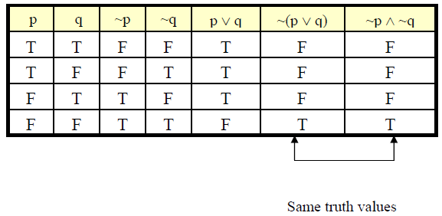
De Morgan’s Laws
How we can prove this?
~(p ∨ q) ≡ ~p ∧ ~q

Slide 7
De Morgan’s Laws
Give negations for each of the following statements:
a. The fan is slow or it is very hot.
b. Akram is unfit and Saleem is injured.
Solution:
a. The fan is not slow and it is not very hot.
b. Akram is not unfit or Saleem is not injured.
INEQUALITIES AND DEMORGAN’S LAWS:
Use DeMorgan’s Laws to write the negation of
-1 < x ≤ 4
-1 < x ≤ 4 means x > –1 and x ≤ 4
By DeMorgan’s Law, the negation is:
x > –1 or x ≤ 4 Which is equivalent to: x ≤ –1 or x > 4

Slide 8
1.2 Propositional Equivalence
A tautology is a compound proposition that is true no matter what the truth values of its atomic propositions are! And represented by a symbol “t”
e.g. p ∨ ¬p (“Today the sun will shine or today the sun will not shine.”) [What is its truth table?]
A contradiction is a compound proposition that is
false no matter what! And represented by a symbol “c”
e.g. p ∧ ¬p (“Today is Wednesday and today is not Wednesday.”) [Truth table?]
A contingency is a compound proposition that is neither a tautology nor a contradiction.
e.g. (p ∨ q) → ¬r

Slide 9

Logical Equivalence
Compound proposition p is logically equivalent to compound proposition q, written p ≡ q or p ⇔ q, iff the compound proposition p ↔ q is a tautology.
Compound propositions p and q are logically equivalent to each other iff p and q contain the same truth values as each other in all corresponding rows of their truth tables.

Slide 10

Proving Equivalence
via Truth Tables
Prove that ¬(p ∧ q) ≡ ¬p ∨ ¬q. (De Morgan’s law)
p q
p∧q ¬p ¬q ¬p ∨ ¬q ¬(p ∧ q)
T T
T F
F T
F F
T F F
F F T
F T F
F T T
F T T T
F T T T
Show that
Check out the solution in the textbook!
¬(p ∨ q) ≡ ¬p ∧ ¬q (De Morgan’s law)
p → q ≡ ¬p ∨ q
p ∨ (q ∧ r) ≡ (p ∨ q) ∧ (p ∨ r) (distributive law)

Slide 11
Equivalence Laws
These are similar to the arithmetic identities you may have learned in algebra, but for propositional equivalences instead.
They provide a pattern or template that can be used to match part of a much more complicated proposition and to find an equivalence for it and possibly simplify it.

Slide 12

Equivalence Laws
Identity: | p ∧ T ≡ p | p ∨ F ≡ p
Domination: | p ∨ T ≡ T | p ∧ F ≡ F
Idempotent: | p ∨ p ≡ p | p ∧ p ≡ p
Double negation: ¬¬p ≡ p
Commutative: p ∨ q ≡ q ∨ p p ∧ q ≡ q ∧ p
Associative:
(p ∨ q) ∨ r ≡ p ∨ (q ∨ r) (p ∧ q) ∧ r ≡ p ∧ (q ∧ r)

Slide 13

More Equivalence Laws
Distributive:
p ∨ (q ∧ r) ≡ (p ∨ q) ∧ (p ∨ r)
p ∧ (q ∨ r) ≡ (p ∧ q) ∨ (p ∧ r)
De Morgan’s:
¬(p ∧ q) ≡ ¬p ∨ ¬q
¬(p ∨ q) ≡ ¬p ∧ ¬q
Absorption
p ∨ (p ∧ q) ≡ p
p ∧ (p ∨ q) ≡ p
Trivial tautology/contradiction: p ∨ ¬p ≡ T p ∧ ¬p ≡ F
See Table 6, 7, and 8 of Section 1.2

Slide 14

Defining Operators via
Equivalences
Using equivalences, we can define operators in terms of other operators.
Exclusive or: p ⊕ q ≡ (p ∧ ¬q) ∨ (¬p ∧ q)
p ⊕ q ≡ (p ∨ q) ∧ ¬(p ∧ q)
Implies: p → q ≡ ¬p ∨ q
Biconditional: p ↔ q ≡ (p → q) ∧ (q → p)
p ↔ q ≡ ¬(p ⊕ q)
This way we can “normalize” propositions

Slide 15
An Example Problem
Show that ¬(p → q) and p ∧ ¬q are logically equivalent.
¬(p → q)
≡ ¬(¬p ∨ q)
≡ ¬(¬p) ∧ ¬q
≡ p ∧ ¬q
[Expand definition of →]
[DeMorgan’s Law]
[Double negation Law]

Slide 16
EXERCISE
Use Logical Equivalence to rewrite each of the following sentences more simply.
It is not true that I am tired and you are smart.
{I am not tired or you are not smart.}
It is not true that I am tired or you are smart.
{I am not tired and you are not smart.}
I forgot my pen or my bag and I forgot my pen or my glasses.
{I forgot my pen or I forgot my bag and glasses.}
It is raining and I have forgotten my umbrella, or it is raining and I have forgotten my hat.
{It is raining and I have forgotten my umbrella or my hat.}

Slide 17
Negation of Implication
Since p→q ≡ ~p∨q therefore
~ (p → q) ≡ ~ (~ p ∨ q)
≡ ~ (~ p) ∧ (~ q) by De Morgan’s law
≡ p ∧ ~ q by the Double Negative law
Thus the negation of “if p then q” is logically equivalent to “p and not q”.
Example:
1. If Ali lives in Pakistan then he lives in Lahore.
Ali lives in Pakistan and he does not live in Lahore.

Slide 18
Example
Show that ~(p→q) → p is a tautology without using truth tables.
~(p→q) → p Given statement form
≡ ~[~(p ∧ ~q)] → p Implication law p→q ≡ ~(p ∧ ~q)
≡ (p ∧ ~q) → p Double negation law
≡ ~(p ∧ ~q) ∨ p Implication law p→q ≡ ~p ∨ q
≡ (~p ∨ q) ∨ p De Morgan’s law
≡ (q ∨ ~p) ∨ p Commutative law
≡ q ∨ (~p ∨ p) Associative law
≡ q ∨ t Negation law
≡ t

Slide 19
Another Example Problem
Check using a symbolic derivation whether
(p ∧ ¬q) → (p ⊕ r) ≡ ¬p ∨ q ∨ ¬r
(p ∧ ¬q) → (p ⊕ r) [Expand definition of →]
≡ ¬(p ∧ ¬q) ∨ (p ⊕ r) [Expand definition of ⊕]
≡ ¬(p ∧ ¬q) ∨ ( (p ∨ r) ∧ ¬(p ∧ r) )
[DeMorgan’s Law]
≡ (¬p ∨ q) ∨ ( (p ∨ r) ∧ ¬(p ∧ r) )
cont.

Slide 20

Example Continued...
(p ∧ ¬q) → (p ⊕ r) ≡ ¬p ∨ q ∨ ¬r
(¬p ∨ q) ∨ ((p ∨ r) ∧ ¬(p ∧ r)) [∨ Commutative]
≡ (q ∨ ¬p) ∨ ((p ∨ r) ∧ ¬(p ∧ r)) [∨ Associative]
≡ q ∨ ( ¬p ∨ ((p ∨ r) ∧ ¬(p ∧ r)) ) [Distribute ∨ over ∧]
≡ q ∨ ( ( (¬p ∨ (p ∨ r)) ∧ (¬p ∨ ¬(p ∧ r) ) ) [∨ Assoc.]
≡ q ∨ ( ( (¬p ∨ p) ∨ r) ∧ (¬p ∨ ¬(p ∧ r) ) ) [Trivial taut.]
≡ q ∨ ( (T ∨ r) ∧ (¬p ∨ ¬(p ∧ r) ) ) [Domination]
≡ q ∨ ( T ∧ (¬p ∨ ¬(p ∧ r)) ) [Identity]
≡ q ∨ ( ¬p ∨ ¬(p ∧ r) )
cont.

Slide 21

End of Long Example
(p ∧ ¬q) → (p ⊕ r) ≡ ¬p ∨ q ∨ ¬r
q ∨ (¬p ∨ ¬(p ∧ r) ) [DeMorgan’s Law]
≡ q ∨ ( ¬p ∨ (¬p ∨ ¬r) )
≡ q ∨ ( (¬p ∨ ¬p) ∨ ¬r )
[∨ Associative] [Idempotent]
≡ q ∨ (¬p ∨ ¬r)
≡ (q ∨ ¬p) ∨ ¬r
≡ ¬p ∨ q ∨ ¬r ■
[Associative]
[∨ Commutative]

Slide 22

Review: Propositional Logic
L
Atomic propositions: p, q, r, …
Boolean operators: ¬ ∧ ∨ ⊕ → ↔
Compound propositions: (p ∧ ¬q) ∨ r
Equivalences: p∧¬q ⇔ ≡ ¬(p → q)
Proving equivalences using:
Truth tables
Symbolic derivations (series of logical equivalences) p ≡ q ≡ r ≡ ⋅⋅⋅

Slide 23

1.3 Predicate Logic
Consider the sentence
“For every x, x > 0”
If this were a true statement about the positive integers, it could not be adequately symbolized using only statement letters, parentheses and logical connectives.
The sentence contains two new features: a
predicate and a quantifier

Slide 24

Subjects and Predicates
In the sentence “The dog is sleeping”:
The phrase “the dog” denotes the subject – the object or entity that the sentence is about.
The phrase “is sleeping” denotes the predicate
– a property that the subject of the statement can have.
In predicate logic, a predicate is modeled as a proposional function P(·) from subjects to propositions.
P(x) = “x is sleeping” (where x is any subject).
P(The cat) = “The cat is sleeping” (proposition!)

Slide 25
More About Predicates
Log
Convention: Lowercase variables x, y, z... denote subjects; uppercase variables P, Q, R… denote propositional functions (or predicates).
Keep in mind that the result of applying a predicate P to a value of subject x is the proposition. But the predicate P, or the statement P(x) itself (e.g. P = “is sleeping” or P(x) = “x is sleeping” ) is not a proposition.
e.g. if P(x) = “x is a prime number”,
P(3) is the proposition “3 is a prime number.”

Slide 26
Propositional Functions
Log
Predicate logic generalizes the grammatical notion of a predicate to also include propositional functions of any number of arguments, each of which may take any grammatical role that a noun can take.
e.g.:
let P(x,y,z) = “x gave y the grade z”
then if
x = “Mike”, y = “Mary”, z = “A”,
then
P(x,y,z) = “Mike gave Mary the grade A.”

Slide 27
Examples
Let P(x): x > 3. Then
P(4) is TRUE/FALSE
P(2) is TRUE/FALSE
4 > 3
2 > 3
Let Q(x, y): x is the capital of y. Then
Q(Washington D.C., U.S.A.) is TRUE
■
Q(Hilo, Hawaii) is FALSE
Q(Massachusetts, Boston) is FALSE
Q(Denver, Colorado) is TRUE
Q(New York, New York) is
Read EXAMPLE 6 (pp.33)
If x > 0 then x:= x + 1 (in a computer program)
FALSE

Slide 28
Universe of Discourse (U.D.)
The power of distinguishing subjects from predicates is that it lets you state things about many objects at once.
e.g., let P(x) = “x + 1 > x”. We can then say, “For any number x, P(x) is true” instead of (0 + 1 > 0) ∧ (1 + 1 > 1) ∧ (2 + 1 > 2) ∧ ...
The collection of values that a variable x can take is called x’s universe of discourse or the domain of discourse (often just referred to as the domain).

Slide 29
Quantifier Expressions
Log
Quantifiers provide a notation that allows us to quantify (count) how many objects in the universe of discourse satisfy the given predicate.
“∀” is the FOR∀LL or universal quantifier.
∀x P(x) means for all x in the domain, P(x).
“∃” is the ∃XISTS or existential quantifier.
∃x P(x) means there exists an x in the domain (that is, 1 or more) such that P(x).

Slide 30
The Universal Quantifier ∀
Log
∀x P(x): For all x in the domain, P(x).
∀x P(x) is
true if P(x) is true for every x in D (D: domain of discourse)
false if P(x) is false for at least one x in D
For every real number x, x² ≥ 0
TRUE
For every real number x, x² – 1 > 0
A counterexample to the statement ∀x P(x) is a value x in the domain D that makes P(x) false
What is the truth value of ∀x P(x) when the domain is empty? TRUE
FALSE

Slide 31

The Universal Quantifier ∀
Log
If all the elements in the domain can be listed as x₁, x₂,…, x_{n} then, ∀x P(x) is the same as the conjunction:
P(x₁) ∧ P(x₂) ∧ ··· ∧ P(x_{n})
Example: Let the domain of x be parking spaces at UH. Let P(x) be the statement “x is full.” Then the universal quantification of P(x), ∀x P(x), is the proposition:
“All parking spaces at UH are full.”
or “Every parking space at UH is full.”
or “For each parking space at UH, that space is full.”

Slide 32
The Existential Quantifier ∃
Log
∃x P(x): There exists an x in the domain (that is, 1 or more) such that P(x).
∃x P(x) is
true if P(x) is true for at least one x in the domain
false if P(x) is false for every x in the domain
What is the truth value of ∃x P(x) when the domain is empty? FALSE
If all the elements in the domain can be listed as x₁, x₂,…, x_{n} then, ∃x P(x) is the same as the disjunction:
P(x₁) ∨ P(x₂) ∨ ··· ∨ P(x_{n})

Slide 33

The Existential Quantifier ∃
Log
Example:
Let the domain of x be parking spaces at UH. Let P(x) be the statement “x is full.”
Then the existential quantification of P(x),
∃x P(x), is the proposition:
“Some parking spaces at UH are full.”
or “There is a parking space at UH that is full.”
or “At least one parking space at UH is full.”

Slide 34
Free and Bound Variables
Log
An expression like P(x) is said to have a free variable x (meaning, x is undefined).
A quantifier (either ∀ or ∃) operates on an expression having one or more free variables, and binds one or more of those variables, to produce an expression having one or more bound variables.

Slide 35


Example of Binding
Log
P(x,y) has 2 free variables, x and y.
∀x P(x,y) has 1 free variable , and one
bound variable . [Which is which?]
“P(x), where x = 3” is another way to bind x.
An expression with zero free variables is a bona-fide (actual) proposition.
An expression with one or more free variables is not a proposition:
e.g. x P(x,y) = Q(y)

Slide 36

Quantifiers with Restricted Domain
Log
Sometimes the universe of discourse is restricted within the quantification, e.g.,
∀x>0 P(x) is shorthand for
“For all x that are greater than zero, P(x).”
= ∀x (x > 0 → P(x))
∃x>0 P(x) is shorthand for
“There is an x greater than zero such that
P(x).”
= ∃x (x > 0 ∧ P(x))

Slide 37
Translating from English
Express the statement “Every student in this class has studied calculus” using predicates and quantifiers.
Let C(x) be the statement: “x has studied calculus.”
If domain for x consists of the students in this class, then
it can be translated as ∀x C(x)
or
If domain for x consists of all people
Let S(x) be the predicate: “x is in this class”
Translation: ∀x (S(x) → C(x))

Slide 38
Translating from English
Express the statement “Some students in this class has visited Mexico” using predicates and quantifiers.
Let M(x) be the statement: “x has visited Mexico”
If domain for x consists of the students in this class, then
it can be translated as ∃x M(x) or
If domain for x consists of all people
Let S(x) be the statement: “x is in this class”
Then, the translation is ∃x (S(x) ∧ M(x))

Slide 39

Translating from English
Express the statement “Every student in this class has visited either Canada or Mexico” using predicates and quantifiers.
Let C(x) be the statement: “x has visited Canada” and M(x) be the statement: “x has visited Mexico”
If domain for x consists of the students in this class, then
it can be translated as ∀x (C(x) ∨ M(x))

Slide 40

Negations of Quantifiers
∀x P(x): “Every student in the class has taken a course in calculus” (P(x): “x has taken a course in calculus”)
“Not every student in the class … calculus”
¬∀x P(x) ≡ ∃x ¬P(x)
Consider ∃x P(x): “There is a student in the class who has taken a course in calculus”
“There is no student in the class who has taken a course in calculus”
¬∃x P(x) ≡ ∀x ¬P(x)

Slide 41

Negations of Quantifiers
Log
Definitions of quantifiers: If the domain = {a, b, c,…}
∀x P(x) ≡ P(a) ∧ P(b) ∧ P(c) ∧ ∙∙∙
∃x P(x) ≡ P(a) ∨ P(b) ∨ P(c) ∨ ∙∙∙
From those, we can prove the laws:
¬∀x P(x) ≡ ¬(P(a) ∧ P(b) ∧ P(c) ∧ ∙∙∙ )
≡ ¬P(a) ∨ ¬P(b) ∨ ¬P(c) ∨ ∙∙∙
≡ ∃x ¬P(x)
¬∃x P(x) ≡ ¬(P(a) ∨ P(b) ∨ P(c) ∨ ∙∙∙ )
≡ ¬P(a) ∧ ¬P(b) ∧ ¬P(c) ∧ ∙∙∙
≡ ∀x ¬P(x)
Which propositional equivalence law was used to prove this?

Slide 42
Negations of Quantifiers
Theorem:
Generalized De Morgan's laws for logic 1. ¬∀x P(x) ≡ ∃x ¬P(x)
2. ¬ ∃x P(x) ≡ ∀x ¬P(x)

Slide 43
Negations: Examples
What are the negations of the statements
∀x (x² > x) and ∃x (x² = 2)?
¬∀x (x² > x) ≡ ∃x ¬(x² > x) ≡ ∃x (x² ≤ x)
¬∃x (x² = 2) ≡ ∀x ¬(x² = 2) ≡ ∀x (x² ≠ 2)
■
Show that ¬∀x(P(x) → Q(x)) and
∃x(P(x) ∧ ¬Q(x)) are logically equivalent.
¬∀x(P(x) → Q(x)) ≡ ∃x ¬(P(x) → Q(x))
≡ ∃x ¬(¬P(x) ∨ Q(x))
≡ ∃x (P(x) ∧ ¬Q(x))

Slide 44
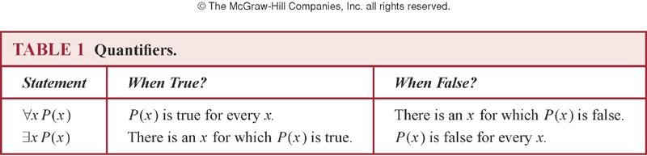
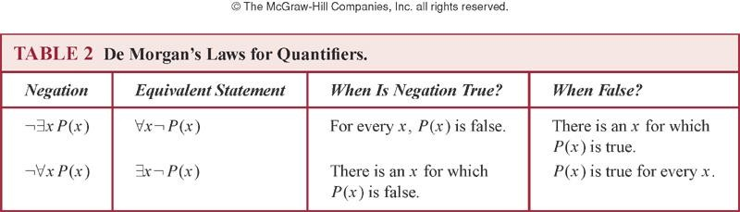
Summary

Slide 45






Nesting of Quantifiers
 Example:
Let the domain of x and y be people.
Let L(x,y) = “x likes y” (A statement with 2 free variables – not a proposition)
 Then ∃y L(x,y) = “There is someone whom
x likes.” (A statement with 1 free variable x
– not a proposition)
 Then ∀x (∃y L(x,y)) =
“Everyone has someone whom they like.” (A with free variables.)

Slide 46

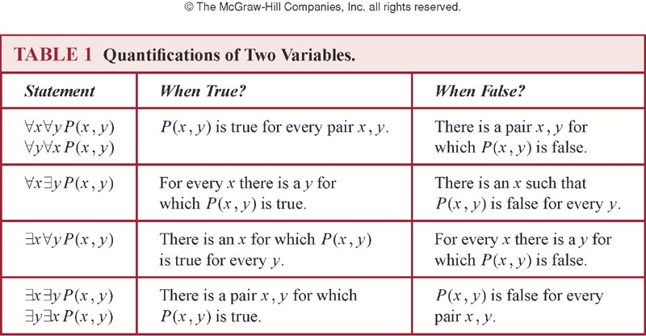
Nested Quantifiers
 Nested quantifiers are quantifiers that occur within the scope of other quantifiers.
 The order of the quantifiers is important, unless all the quantifiers are universal quantifiers or all are existential quantifiers.

Slide 47
Nested Quantifiers
 Let the domain of x and y is R, and P(x,y): xy = 0.
Find the truth value of the following propositions.
 ∀x ∀y P(x, y)
 ∀x ∃y P(x, y)
 ∃x ∀y P(x, y)
 ∃x ∃y P(x, y)
(F)
(T)
(T)
(T)
R:set of real numbers
 ∀x ∃y P(x,y) ≡ ∃y ∀x P(x,y)
 For every x, there exists y such that x + y = 0.
(T)
 There exists y such that, for every x, x + y = 0. (F)

Slide 48
Nested Quantifiers: Example
 Let the domain = {1, 2, 3}. Find an expression equivalent to ∀x ∃y P(x,y) where the variables are bound by substitution instead:
 Expand from inside out or outside in.
 Outside in:
∀x ∃y P(x,y)
≡ ∃y P(1,y) ∧ ∃y P(2,y) ∧ ∃y P(3,y)
≡ [P(1,1) ∨ P(1,2) ∨ P(1,3)] ∧
[P(2,1) ∨ P(2,2) ∨ P(2,3)] ∧
[P(3,1) ∨ P(3,2) ∨ P(3,3)]

Slide 49
Quantifier Exercise
 If R(x,y)=“x relies upon y,” express the following in unambiguous English when the domain is all people
∀x(∃y R(x,y)) = Everyone has someone to rely on.
There’s a poor overburdened soul whom
everyone relies upon (including himself)!
∃y(∀x R(x,y)) =
∃x(∀y R(x,y)) =
There’s some needy person who relies upon everybody (including himself).
∀y(∃x R(x,y)) =
Everyone has someone who relies upon them.
Everyone relies upon everybody, (including themselves)!
∀x(∀y R(x,y)) =

Slide 50
Negating Nested Quantifiers
 Successively apply the rules for negating
statements involving a single quantifier
 Example: Express the negation of the statement
∀x ∃y (P(x,y) ∧ ∃z R(x,y,z)) so that all negation symbols immediately precede predicates.
 ¬∀x ∃y (P(x,y) ∧ ∃z R(x,y,z))
≡ ∃x ¬∃y (P(x,y) ∧ ∃z R(x,y,z))
≡ ∃x ∀y ¬(P(x,y) ∧ ∃z R(x,y,z))
≡ ∃x ∀y (¬P(x,y) ∨ ¬∃z R(x,y,z))
≡ ∃x ∀y (¬P(x,y) ∨ ∀z ¬R(x,y,z))

Slide 51

Equivalence Laws
Logi
 ∀x ∀y P(x,y) ≡ ∀y ∀x P(x,y)
∃x ∃y P(x,y) ≡ ∃y ∃x P(x,y)
 ∀x (P(x) ∧ Q(x)) ≡ (∀x P(x)) ∧ (∀x Q(x))
∃x (P(x) ∨ Q(x)) ≡ (∃x P(x)) ∨ (∃x Q(x))
 Exercise:
See if you can prove these yourself.

Slide 52
Notational Conventions
 Quantifiers have higher precedence than all logical operators from propositional logic:
(∀x P(x))∧ Q(x)
 Consecutive quantifiers of the same type can be combined:
∀x ∀y ∀z P(x,y,z) ≡ ∀x,y,z P(x,y,z) or even ∀xyz P(x,y,z)

