Slide 1



Discrete Mathematics for
Computer Science
Department of Computer Science
Instructor: Dr. Ayesha Altaf
Reference Book: Discrete Mathematics and its applications BY Kenneth H. Rosen – 8th edition

Slide 2


Proof Terminology
 A proof is a valid argument that establishes the truth of a mathematical statement
 Axiom (or postulate): a statement that is assumed to be true
 Theorem
 A statement that has been proven to be true
 Hypothesis, premise
 An assumption/prediction (often unproven) defining the structures about which we are reasoning

Slide 3

More Proof Terminology
 Lemma
 A minor theorem used as a stepping-stone to proving a major theorem.
 Corollary
 A minor theorem proved as an easy consequence of a major theorem.
 Conjecture
 A statement whose truth value has not been proven. (A conjecture may be widely believed to be true, regardless.)
Exp- Every even number can be written as a sum of two prime numbers.
Notes:
Hypothesis is a part of theorem to prove while conjecture becomes theorem if proved.

Slide 4

Proof Methods
 For proving implications p → q, we have:
 Direct proof:
 Indirect proof:
 Proof by Contraposition (¬q → ¬p): Assume ¬q, and prove ¬p.
 Proof by Contradiction:
Assume p ∧ ¬q, and show this leads to a contradiction. (i.e. prove (p ∧ ¬q) → F)
 Vacuous proof: Prove ¬p by itself.

Slide 5
Direct Proof Example
 Definition: An integer n is called odd iff n=2k+1 for some integer k; n is even iff n=2k for some k.
 Theorem: Every integer is either odd or even, but not both.
 This can be proven from even simpler axioms.
 Theorem:
(For all integers n) If n is odd, then n² is odd.
Proof:
If n is odd, then n = 2k + 1 for some integer k.
Thus, n² = (2k + 1)² = 4k² + 4k + 1 = 2(2k² + 2k) + 1.
Therefore n² is of the form 2j + 1 (with j the integer 2k² + 2k), thus n² is odd. ■

Slide 6

Indirect Proof Example:
Proof by Contraposition
 Theorem: (For all integers n)
If 3n + 2 is odd, then n is odd.
 Proof: Can we apply direct proof method? NO
(Contrapositive: If n is even, then 3n + 2 is even)
Suppose that the conclusion is false, i.e., that n is even. Then n = 2k for some integer k.
Then 3n + 2 = 3(2k) + 2 = 6k + 2 = 2(3k + 1).
Thus 3n + 2 is even, because it equals 2j for an integer
j = 3k + 1. So 3n + 2 is not odd.
We have shown that ¬(n is odd) → ¬(3n + 2 is odd), thus its contrapositive (3n + 2 is odd) → (n is odd) is also true. ■

Slide 7
Proof by Contradiction
Example: Implication
 Theorem: (For all integers n)
If 3n + 2 is odd, then n is odd.
 Proof:
Assume that the conclusion is false, i.e., that n is even, and that 3n + 2 is odd.
Then n = 2k for some integer k and 3n + 2 = 3(2k) + 2 = 6k + 2 = 2(3k + 1). Thus 3n + 2 is even, because it equals 2j for an integer j = 3k + 1.
This contradicts the assumption “3n + 2 is odd”.
This completes the proof by contradiction, proving that if 3n + 2 is odd, then n is odd. ■

Slide 8
Trivial and Vacuous Proof
 Trivial Proof: If we know q is true, then
p → q is true as well.
“If it is raining then 1=1.”
 Vacuous Proof: If we know p is false then
p → q is true as well.
“If I am both rich and poor then 2 + 2 = 5.”

Slide 9
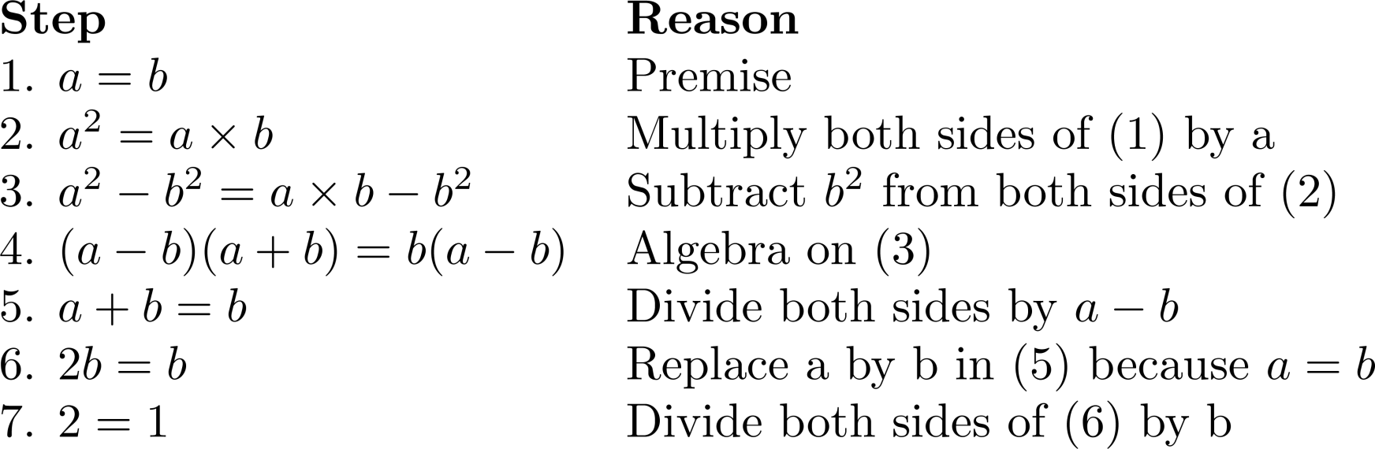
Mistakes in Proof
 Prove that 1=2
 The error is that a-b is zero.

Slide 10
Mistakes in Proof
 Theorem: If n² is positive, then n is positive.
Proof: Suppose that n² is positive. Because the conditional statement “If n is positive, then n² is positive” is true, we can conclude that n is positive.
 Let P(n) be “n is positive” and Q(n) be “n² is positive.” Then our hypothesis is Q(n).
The statement is ∀n(P (n) → Q(n)). From the hypothesis Q(n) and the statement ∀n(P (n) → Q(n)) we cannot conclude P(n), because we are not using a valid rule of inference. A counter example is supplied by n = −1 for which n² = 1 is positive, but n is negative.

Slide 11
Exhaustive Proof
 Prove that (n + 1)³ ≥ 3^{n} if n is a positive integer with n ≤ 4.
Solution: (n + 1)³ ≥ 3^{n} when n = 1, 2, 3, and 4.
For n = 1, we have (n + 1)³ = 2³ = 8 and 3^{n} = 3¹ = 3;
For n = 2, we have (n + 1)³ = 3³ = 27 and 3n = 3² = 9;
For n = 3, we have (n + 1)³ = 4³ = 64 and 3^{n} = 3³ = 27; For n = 4, we have (n + 1)³ = 5³ = 125 and 3^{n} = 3⁴ = 81.
In each of these four cases, we see that (n + 1)³ ≥ 3n. We have used the method of exhaustion to prove
that (n + 1)³ ≥ 3n if n is a positive integer with n ≤ 4.

Slide 12
Proof By Cases
 Prove that if n is an integer, then n² ≥ n.
Solution: We can prove that n² ≥ n for every integer by considering three cases, when n = 0,
when n ≥ 1, and when n ≤ −1
Case (i): When n = 0, because 0² = 0, and 0² ≥ 0. TRUE
Case (ii): When n ≥ 1, when we multiply both sides of the inequality n ≥ 1 n² ≥ n TRUE
Case (iii): When n ≤ −1. However, n² ≥ 0 and n² ≥ n. TRUE
Because the inequality n² ≥ n holds in all three cases, we can conclude that if n is an integer, then n² ≥ n.

Slide 13
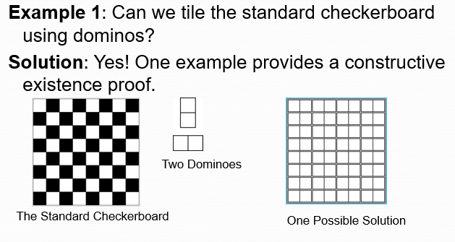
Proof and disproof: Tilings
 Prove that if n is an integer, then n² ≥ n.

Slide 14
Proof and disproof: Tilings
 Example 2: Can we tile a checkerboard obtained by removing one of the four corner squares of a standard checkerboard?
Solution:
Our checkerboard has 64 − 1 = 63 squares.
Since each domino has two squares, a board with a tiling must have an even number of squares.
The number 63 is not even.
We have a contradiction.

Slide 15
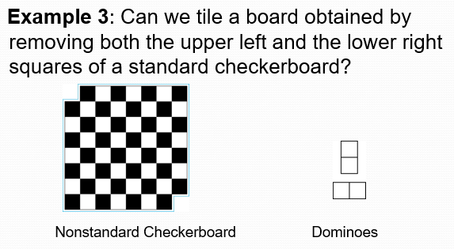
Proof and disproof: Tilings
 Example 2: Can we tile a checkerboard obtained by

Slide 16
Proof and disproof: Tilings
 Solution:
 There are 62 squares in this board.
 To tile it we need 31 dominos.
 Key fact: Each domino covers one black and one white square.
 Therefore, the tiling covers 31 black squares and 31 white squares.
 Our board has either 30 black squares and 32 white squares or 32 black squares and 30 white squares.
Contradiction!

Slide 17
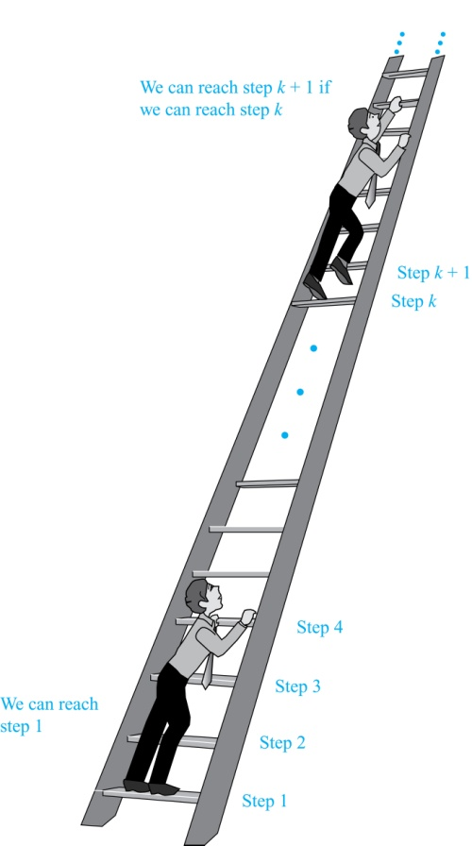
Proof By Mathematical Induction
 Suppose we have an infinite ladder:
We can reach the first rung of the ladder.
If we can reach a particular rung of the ladder, then we can reach the next rung.
From (1), we can reach the first rung. Then by applying (2), we can reach the second rung. Applying (2) again, the third rung. And so on. We can apply (2) any number of times to reach any particular rung, no matter how high up.

Slide 18
Proof By Mathematical Induction
 Principle of Mathematical Induction: To prove that P(n) is true for all positive integers n, we complete these steps:
Basis Step: Show that P(1) is true.
Inductive Step: Show that P(k) → P(k + 1) is true for all positive integers k.
To complete the inductive step, assuming the inductive hypothesis that P(k) holds for an arbitrary integer k, show that must P(k + 1) be true.

Slide 19
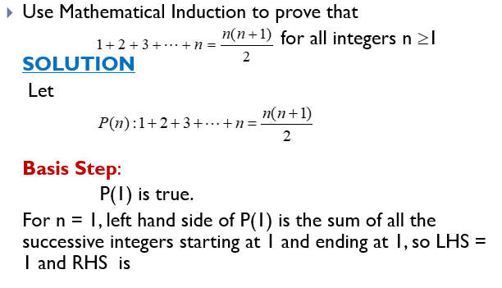
Proof By Mathematical Induction
 Principle of Mathematical Induction: To prove

Slide 20
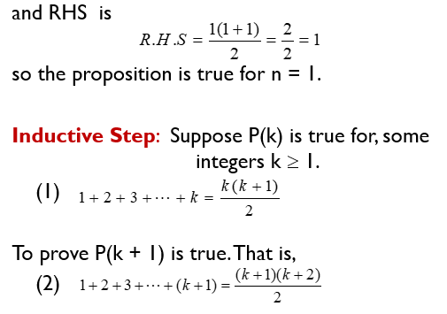
Proof By Mathematical Induction
 Principle of Mathematical Induction: To

Slide 21
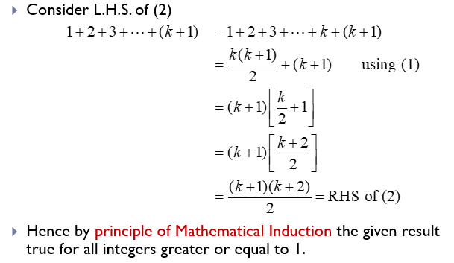
Proof By Mathematical Induction
 Principle of Mathematical Induction: To

Slide 22
Proof By Mathematical Induction
 Prove that n³ − n is divisible by 3, for every positive integer n.
Solution: Let P(n) be the proposition that n³ − n is divisible by 3.
BASIS STEP: P(1) is true since 1³ − 1 = 0, which is divisible by 3.
INDUCTIVE STEP: Assume P(k) holds, i.e., k³ − k is divisible by 3. To show that P(k + 1) follows:
(k + 1)³ − (k + 1) = (k³ + 3k² + 3k + 1) − (k + 1)
= (k³ − k) + 3(k² + k)
Therefore, n³ − n is divisible by 3, for every integer positive integer n.

Slide 23
Proof By Mathematical Induction
DO YOURSELF
 Use mathematical induction to prove that
1+3+5+…+(2n -1) = n² for all integers n ≥1.
 Use mathematical induction to prove that
1+2+2² + … + 2^{n} = 2^{n+1} – 1 for all integers n ≥0
 Prove by mathematical induction for all integers n≥1

Slide 24
Proof By Strong Induction
 STRONG INDUCTION: To prove that P(n) is true for all positive integers n, where P(n) is a propositional function, we complete two steps:
BASIS STEP: We verify that the proposition P(1) is true.
INDUCTIVE STEP: We show that the conditional statement [P(1) ∧ P(2) ∧ · · · ∧ P(k)] → P(k + 1) is true for all positive integers k.
 Also called the second principle of mathematical induction or complete induction.

Slide 25
Proof By Strong Induction
 Example: Suppose we can reach the first and second rungs of an infinite ladder, and we know that if we can reach a rung, then we can reach two rungs higher. Prove that we can reach every rung.
(Try this with mathematical induction.)
Solution: Prove the result using strong induction.
BASIS STEP: We can reach the first step.
INDUCTIVE STEP: The inductive hypothesis is that we can reach the first k rungs, for any k ≥ 2. We can reach (k + 1)st rung since we can reach the (k − 1)st rung by the inductive hypothesis. Hence, we can reach all rungs of the ladder.

Slide 26
Proof By Strong Induction
 Example: Prove that every amount of postage of 12 cents or more can be formed using just 4-cent and 5-cent stamps.
Solution: Let P(n) be the proposition that postage of n cents can be formed using 4-cent and 5-cent stamps.
BASIS STEP: P(12), P(13), P(14), and P(15) hold.
P(12) uses three 4-cent stamps.
P(13) uses two 4-cent stamps and one 5-cent stamp.
P(14) uses one 4-cent stamp and two 5-cent stamps.
P(15) uses three 5-cent stamps.
INDUCTIVE STEP: The inductive hypothesis states that P(j) holds for 12 ≤ j ≤ k, where k ≥ 15. Assuming the inductive hypothesis, it can be shown that P(k + 1) holds.
Using the inductive hypothesis, P(k − 3) holds since k − 3 ≥ 12. To form postage of k + 1 cents, add a 4-cent stamp to the postage for k − 3 cents.
Hence, P(n) holds for all n ≥ 12.

Slide 27
Well Ordering Property
 Definition: Every non-empty set of non-negative integers has a least element.
Example: Use the well-ordering property to prove the division algorithm, which states that if a is an integer and d is a positive integer, then there are unique integers q and r with 0 ≤ r < d, such that a = dq + r.
Solution: Let S be the set of nonnegative integers of the form a − dq, where q is an integer. The set is nonempty since −dq can be made as large as needed.
By the well-ordering property, S has a least element r = a − dq₀. The integer r is nonnegative. It also must be the case that r < d. If it were not, then there would be a smaller nonnegative element in S, namely, a − d(q₀ + 1) = a − dq₀ − d = r − d > 0.Therefore, there are integers q and r with 0 ≤ r < d.

Slide 28
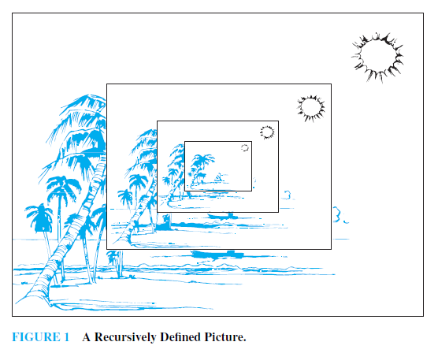
Recursively Defined Functions

Slide 29
Recursively Defined Functions
 Definition: A recursive or inductive definition of a function consists of two steps.
BASIS STEP: Specify the value of the function at zero.
RECURSIVE STEP: Give a rule for finding its value at an integer from its values at smaller integers.

Slide 30
Recursively Defined Functions
 Example: Suppose f is defined by:
f(0) = 3,
f(n + 1) = 2f(n) + 3
Find f(1), f(2), f(3), f(4)
Solution:
f(1) = 2f(0) + 3 = 2∙3 + 3 = 9
f(2) = 2f(1)+ 3 = 2∙9 + 3 = 21
f(3) = 2f(2) + 3 = 2∙21 + 3 = 45
f(4) = 2f(3) + 3 = 2∙45 + 3 = 93
Example: Give a recursive definition of the factorial function n!:
Solution:
f(0) = 1
f(n + 1) = (n + 1)∙ f(n)

Slide 31
Recursively Defined Sets
 Recursive definitions of sets have two parts:
Basis step specifies an initial collection of elements.
Recursive step gives the rules for forming new elements in the set from those already known to be in the set.
Sometimes the recursive definition has an exclusion rule, which specifies that set contains nothing other than those elements specified in the basis step and generated by applications of the recursive step.
We will always assume that the exclusion rule holds, even if it is not explicitly mentioned.

Slide 32
Structural Induction
 Definition: To prove a property of the elements of a recursively defined set, we use structural induction. BASIS STEP: Show that the result holds for all elements specified in the basis step of the recursive definition.
RECURSIVE STEP: Show that if the statement is true for each of the elements used to construct new elements in the recursive step of the definition, the result holds for these new elements.

Slide 33
Full Binary Tree
 Definition: The height h(T) of a full binary tree T is defined recursively as follows:
BASIS STEP: The height of a full binary tree T consisting of only a root r is h(T) = 0.
RECURSIVE STEP: If T₁ and T₂ are full binary trees, then the full binary tree T = T₁∙T₂ has height h(T) = 1+max(h(T₁),h(T₂)).
 The number of vertices n(T) of a full binary tree T satisfies the following recursive formula:
BASIS STEP: The number of vertices of a full binary tree T consisting of only a root r is n(T) = 1.
RECURSIVE STEP: If T₁ and T₂ are full binary trees, then the full binary tree T = T₁∙T₂ has the number of vertices n(T) = 1 + n(T₁) + n(T₂).

Slide 34
Structural Induction Example
 Theorem: If T is a full binary tree, then n(T) ≤ 2^{h(T)+1} – 1.
BASIS STEP: The result holds for a full binary tree consisting only of a root, n(T) = 1 and h(T) = 0. Hence, n(T) = 1 ≤ 2⁰⁺¹ – 1 = 1.
RECURSIVE STEP: Assume n(T₁) ≤ 2^{h(T1)+1} – 1 and also n(T₂) ≤ 2^{h(T2)+1} – 1 whenever T₁ and T₂ are full binary trees.
n(T) = 1 + n(T₁) + n(T₂) (by recursive formula of n(T))
≤ 1 + (2^{h(T1)+1} – 1) + (2^{h(T2)+1} – 1) (by inductive hypothesis)
≤ 2∙max(2^{h(T1)+1} ,2^{h(T2)+1} ) – 1
= 2∙2^{max(h(T1),h(T2))+1} – 1 (max(2^{x} , 2^{y})= 2^{max(x,y)} )
= 2∙2^{h(t)} – 1 (by recursive definition of h(T))
= 2^{h(t)+1} – 1

Slide 35
Generalized Induction
 Generalized induction is used to prove results about sets other than the integers that have the well-ordering property.
 For example, consider an ordering on N⨉ N, ordered pairs of nonnegative integers. Specify that (x₁ ,y₁) is less than or equal to (x₂,y₂) if either x₁ < x₂, or x₁ = x₂ and y₁ <y₂ This is called the lexicographic ordering.
 Strings are also commonly ordered by a lexicographic ordering.

Slide 36
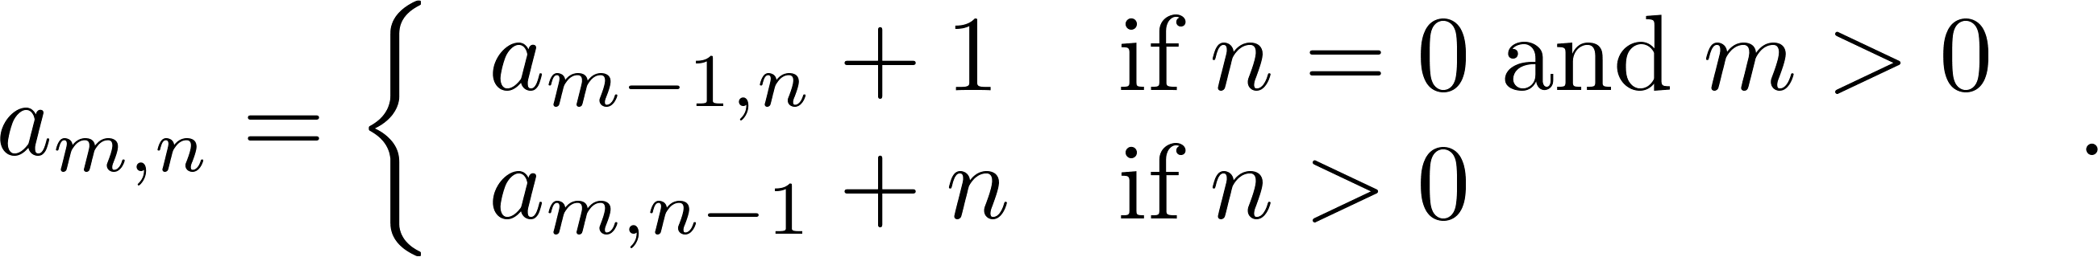
Generalized Induction
 Example: Suppose that a_{m,n} is defined for (m,n)∊N ×N by a_{0,0} = 0 and
show that a_{m,n} = m + n(n + 1)/2 is defined for all (m,n)∊N ×N.
Solution: Use generalized induction.
BASIS STEP: a_{0,0} = 0 = 0 + (0∙1)/2
INDUCTIVE STEP: Assume that a_{m̍,n̍} = m̍+ n̍ (n̍ + 1)/2 whenever(m̍,n̍ ) is less than (m,n) in the lexicographic ordering of N ×N .
If n = 0, by the inductive hypothesis we can conclude a_{m,n} = a_{m−1,n} + 1 = m − 1+ n(n + 1)/2 + 1 = m + n(n + 1)/2 .
If n > 0, by the inductive hypothesis we can conclude a_{m,n} = a_{m−1,n} + 1 = m + n(n − 1)/2 +n = m + n(n + 1)/2 .

