Slide 1
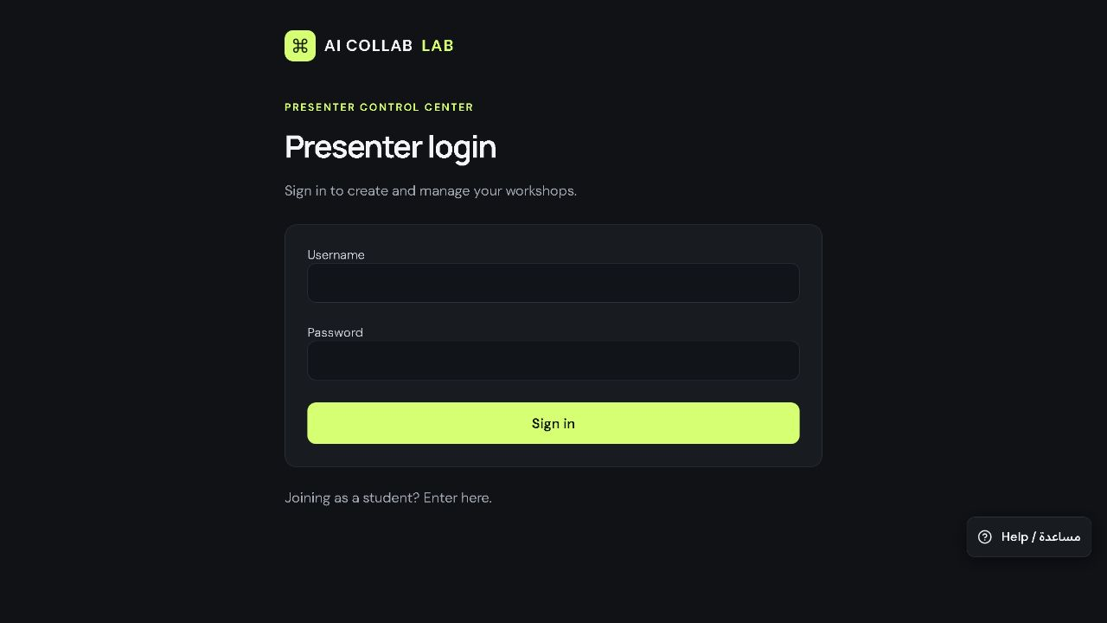
Presenter sign-in
Open the presenter page.
Enter your username and password.
Click Sign in.
AI Collab Lab presenter guide · Real app screenshots · 7 October 2026
1 / 18
Notes:
Before the audience arrives, open https://nasserdiary.com/workshops/presenter. Use your presenter credentials privately. Never project your password. The screenshots use a separate demonstration workshop.
Source: actual live application at https://nasserdiary.com/workshops/ captured 7 October 2026. Example content belongs to the separate Presenter guide demo workshop, UTAS-949110. Use your own workshop code in a live class.

Slide 2
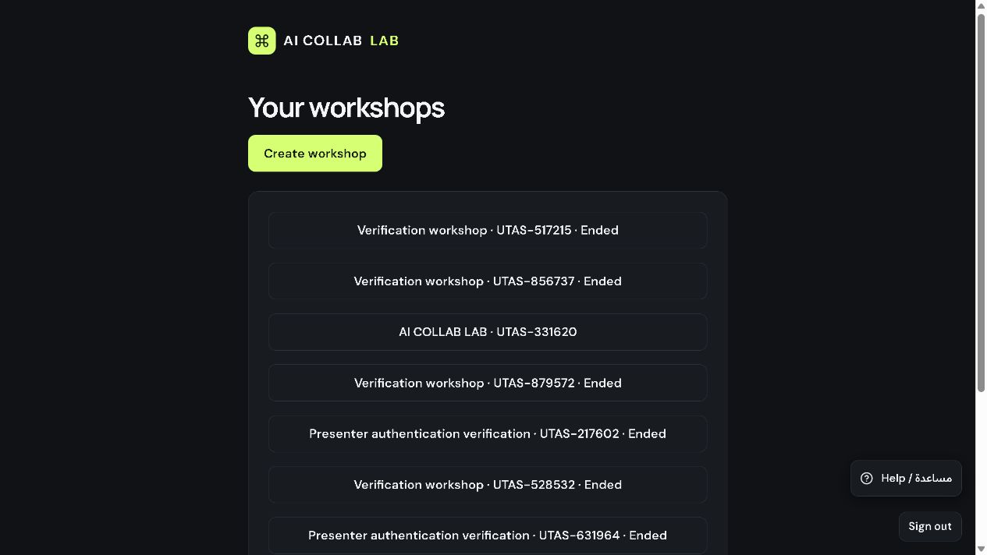
A new workshop
Click Create workshop.
To resume a session, click its name.
AI Collab Lab presenter guide · Real app screenshots · 7 October 2026
2 / 18
Notes:
This page lists saved workshops. Create a fresh workshop for a new class, or choose the existing session you want to continue.
Source: actual live application at https://nasserdiary.com/workshops/ captured 7 October 2026. Example content belongs to the separate Presenter guide demo workshop, UTAS-949110. Use your own workshop code in a live class.

Slide 3
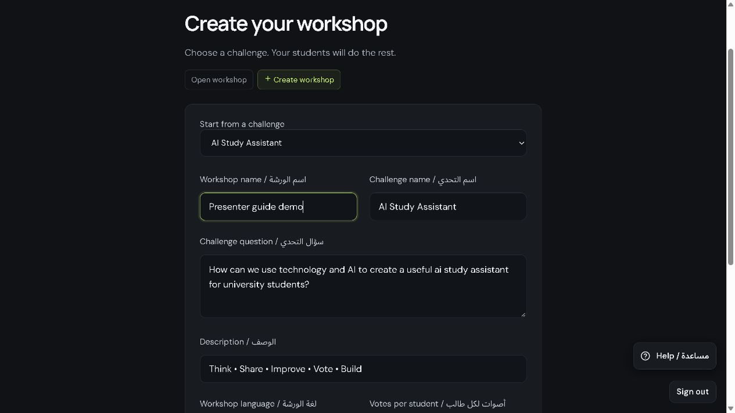
Workshop setup
Choose a challenge.
Set the workshop name and language.
Click Start workshop.
AI Collab Lab presenter guide · Real app screenshots · 7 October 2026
3 / 18
Notes:
Use one clear challenge question that your audience can answer. This example uses AI Study Assistant. If approval is enabled, submissions require presenter review under More tools. Keep your presenter key private if its dialog appears.
Source: actual live application at https://nasserdiary.com/workshops/ captured 7 October 2026. Example content belongs to the separate Presenter guide demo workshop, UTAS-949110. Use your own workshop code in a live class.

Slide 4
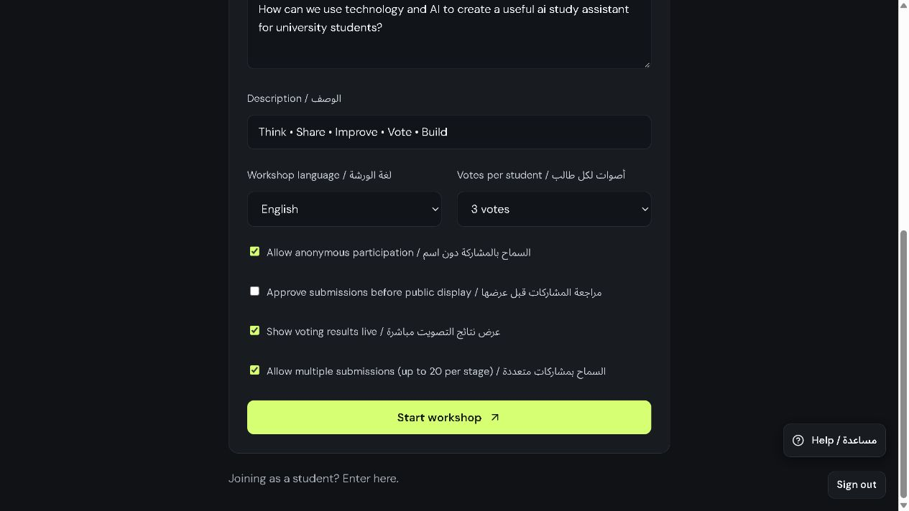
Participation settings
Check the language and participation options.
Scroll down and click Start workshop.
AI Collab Lab presenter guide · Real app screenshots · 7 October 2026
4 / 18
Notes:
Anonymous participation is optional. Approval before display adds a presenter review step. Keep multiple submissions enabled when participants will offer several ideas. Voting settings belong to the optional advanced tools.
Source: actual live application at https://nasserdiary.com/workshops/ captured 7 October 2026. Example content belongs to the separate Presenter guide demo workshop, UTAS-949110. Use your own workshop code in a live class.

Slide 5
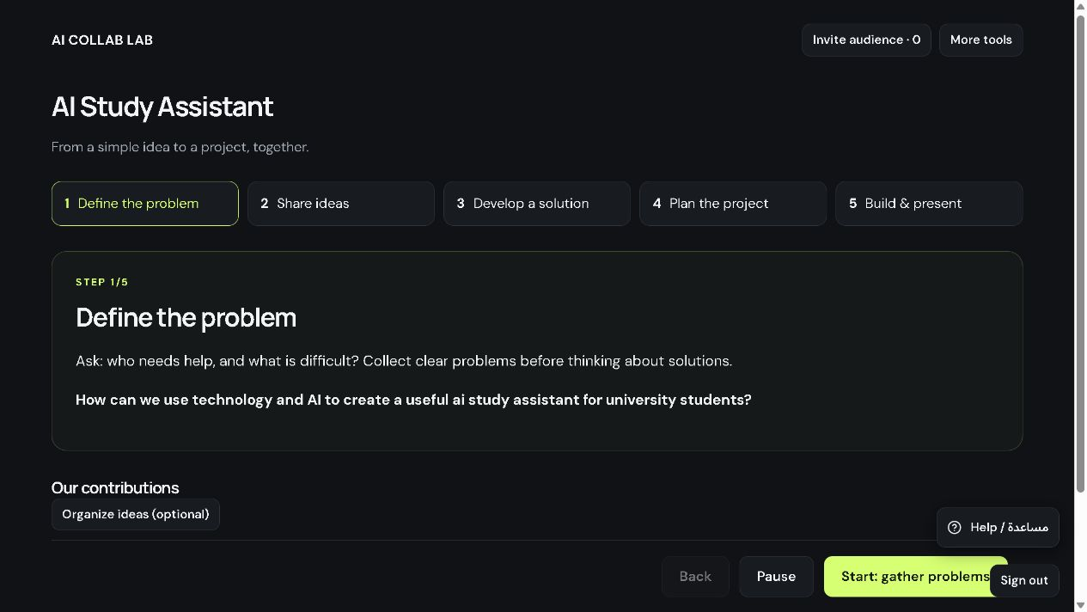
The five-step journey
Use the five steps across the top.
First, click Invite audience.
Then click Start: gather problems.
AI Collab Lab presenter guide · Real app screenshots · 7 October 2026
5 / 18
Notes:
The presenter controls the stage, and participant tasks update when the stage changes. The main sequence is Define the problem, Share ideas, Develop a solution, Plan the project, then Build & present. Pause temporarily stops participation.
Source: actual live application at https://nasserdiary.com/workshops/ captured 7 October 2026. Example content belongs to the separate Presenter guide demo workshop, UTAS-949110. Use your own workshop code in a live class.

Slide 6
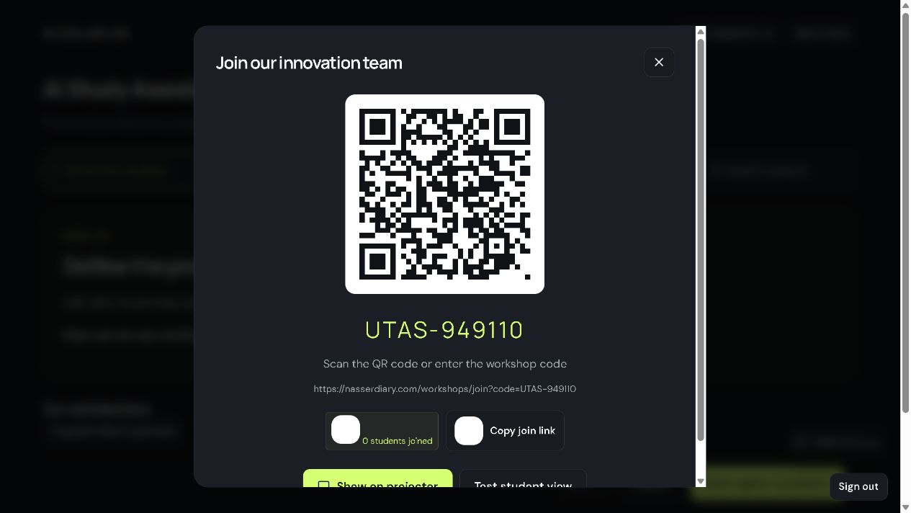
Audience invitation
Show your own workshop QR code.
Participants scan it or use the join link.
This screenshot uses a demo code.
AI Collab Lab presenter guide · Real app screenshots · 7 October 2026
6 / 18
Notes:
This is a demonstration code. In your lecture, show the QR code generated by your own workshop. Copy join link is useful for a class chat or learning platform. Show on projector opens the audience display.
Source: actual live application at https://nasserdiary.com/workshops/ captured 7 October 2026. Example content belongs to the separate Presenter guide demo workshop, UTAS-949110. Use your own workshop code in a live class.

Slide 7
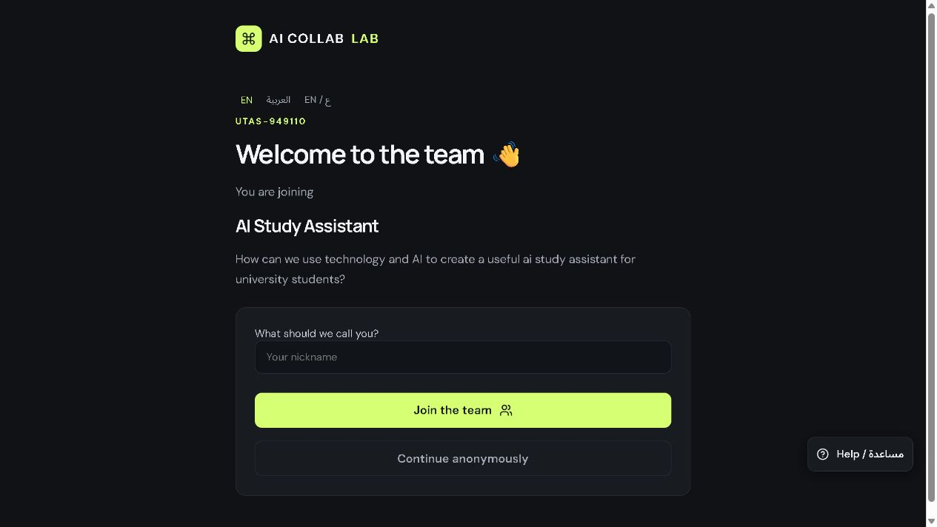
Participant entry
Participants enter a name.
They click Join the team.
Anonymous entry is optional.
AI Collab Lab presenter guide · Real app screenshots · 7 October 2026
7 / 18
Notes:
This screenshot shows the actual participant page. Ask everyone to open the join link on a phone or laptop. They can choose English or Arabic. After joining, they click Let’s build to open their task.
Source: actual live application at https://nasserdiary.com/workshops/ captured 7 October 2026. Example content belongs to the separate Presenter guide demo workshop, UTAS-949110. Use your own workshop code in a live class.

Slide 8
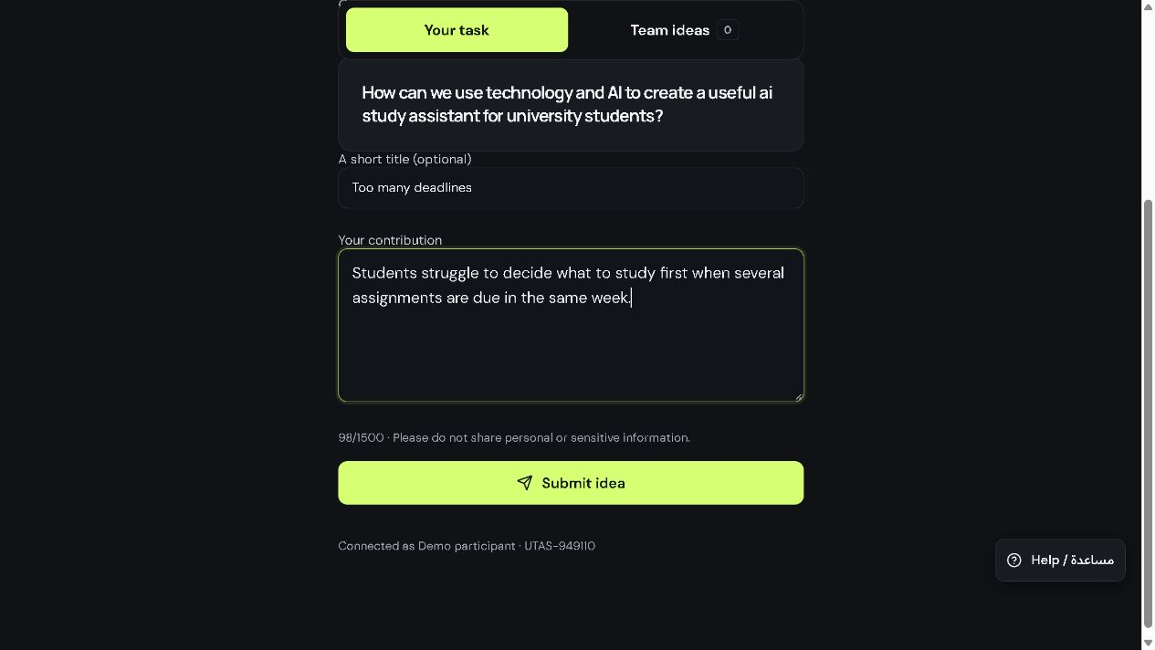
Step 1: the audience’s problem
Describe who needs help and what is difficult.
Click Submit idea.
AI Collab Lab presenter guide · Real app screenshots · 7 October 2026
8 / 18
Notes:
Ask the audience to describe a problem rather than jump to a product. Example: students cannot decide what to study first when deadlines overlap. The button says Submit idea even during the problem task.
Source: actual live application at https://nasserdiary.com/workshops/ captured 7 October 2026. Example content belongs to the separate Presenter guide demo workshop, UTAS-949110. Use your own workshop code in a live class.

Slide 9
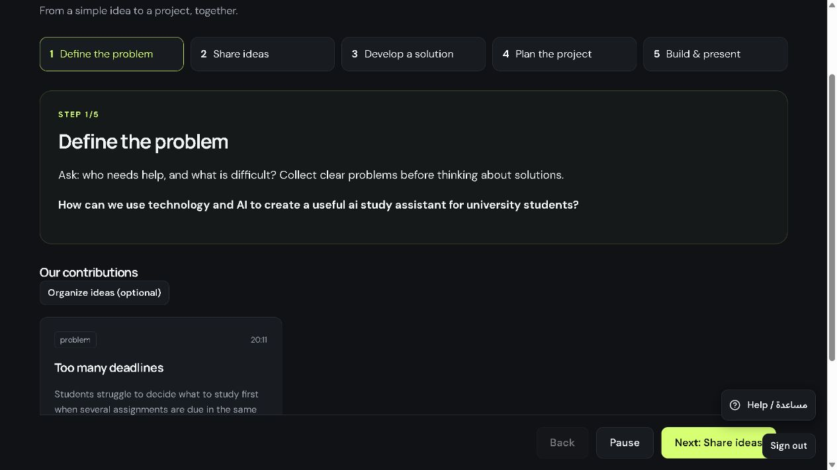
Step 1: shared problems
Read the contributions together.
Agree on a clear problem.
Click Next: Share ideas.
AI Collab Lab presenter guide · Real app screenshots · 7 October 2026
9 / 18
Notes:
Invite a few explanations from the room. A useful problem names the user and the difficulty. You can move back later if the team needs to clarify it. This screen displays the submitted example in the real presenter interface.
Source: actual live application at https://nasserdiary.com/workshops/ captured 7 October 2026. Example content belongs to the separate Presenter guide demo workshop, UTAS-949110. Use your own workshop code in a live class.

Slide 10

Step 2: possible ideas
Suggest a simple solution.
Give it a short title.
Click Submit idea.
AI Collab Lab presenter guide · Real app screenshots · 7 October 2026
10 / 18
Notes:
Ask each participant for a possible way to address the agreed problem. Avoid demanding a finished project at this stage. This example proposes an editable weekly study plan.
Source: actual live application at https://nasserdiary.com/workshops/ captured 7 October 2026. Example content belongs to the separate Presenter guide demo workshop, UTAS-949110. Use your own workshop code in a live class.

Slide 11
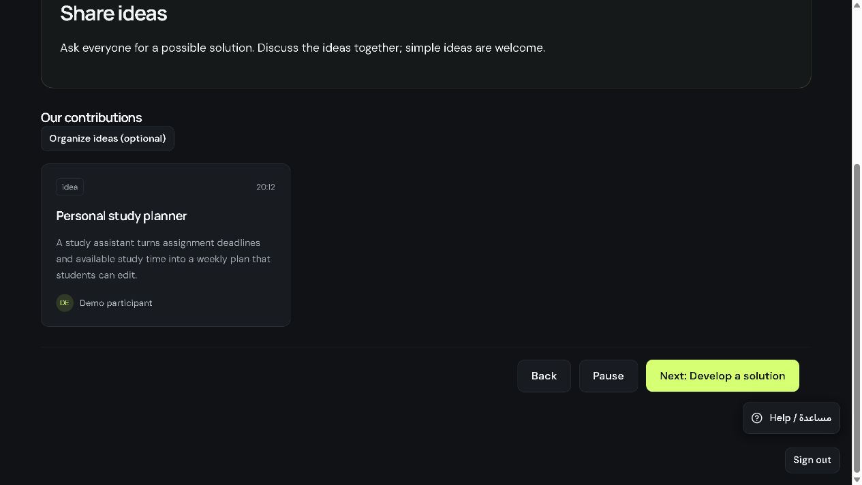
Step 2: discussion
Compare the ideas with the room.
Choose a promising direction.
Click Next: Develop a solution.
AI Collab Lab presenter guide · Real app screenshots · 7 October 2026
11 / 18
Notes:
Discuss usefulness and feasibility. Organize ideas is optional. You can use grouping or links when they help the discussion, but the workshop can proceed with the simple contribution view. At least one idea or solution is needed to continue.
Source: actual live application at https://nasserdiary.com/workshops/ captured 7 October 2026. Example content belongs to the separate Presenter guide demo workshop, UTAS-949110. Use your own workshop code in a live class.

Slide 12
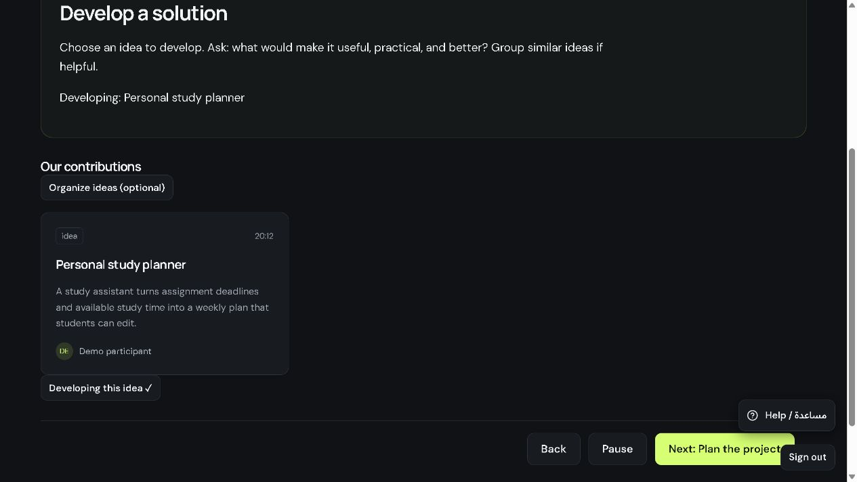
Step 3: the chosen solution
Check the Developing label.
Use Develop this idea to choose another idea.
Ask how it can improve.
AI Collab Lab presenter guide · Real app screenshots · 7 October 2026
12 / 18
Notes:
The chosen idea appears on participant screens. With one idea, the app selects it automatically. With several ideas, choose the one to develop. Ask for a useful feature, a weakness, or a practical improvement before moving on.
Source: actual live application at https://nasserdiary.com/workshops/ captured 7 October 2026. Example content belongs to the separate Presenter guide demo workshop, UTAS-949110. Use your own workshop code in a live class.

Slide 13
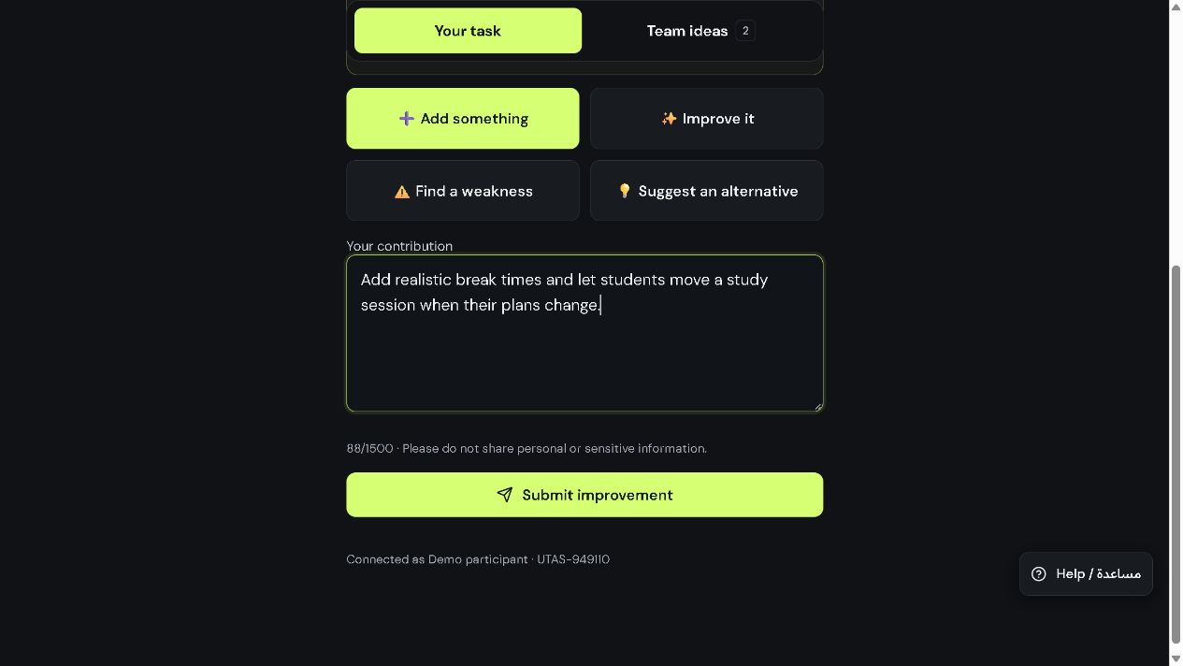
Step 3: audience improvements
Participants build on the selected idea.
They click Submit improvement.
AI Collab Lab presenter guide · Real app screenshots · 7 October 2026
13 / 18
Notes:
Explain that this task develops the current idea. Participants can add a feature, improve it, find a weakness, or suggest an alternative. The example adds breaks and rescheduling. When ready, the presenter clicks Next: Plan the project.
Source: actual live application at https://nasserdiary.com/workshops/ captured 7 October 2026. Example content belongs to the separate Presenter guide demo workshop, UTAS-949110. Use your own workshop code in a live class.

Slide 14
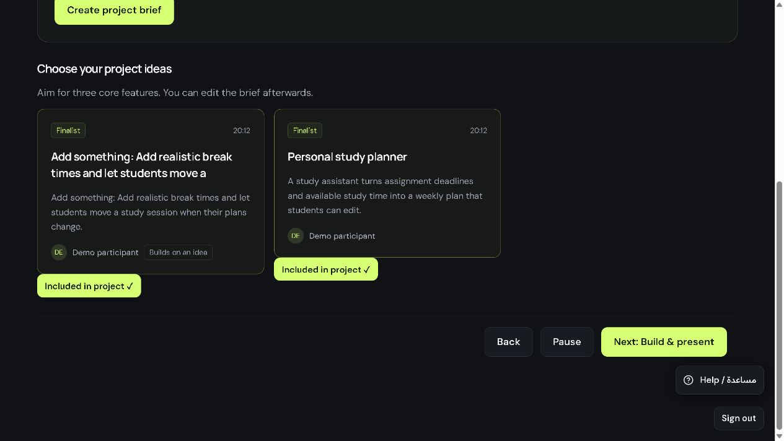
Step 4: project selection
Click Include in project for the ideas you want.
Then click Create project brief.
AI Collab Lab presenter guide · Real app screenshots · 7 October 2026
14 / 18
Notes:
Select the core idea and useful improvements. Keep the first prototype small. In this example, we include the study planner and its scheduling improvement. Included in project confirms the selection.
Source: actual live application at https://nasserdiary.com/workshops/ captured 7 October 2026. Example content belongs to the separate Presenter guide demo workshop, UTAS-949110. Use your own workshop code in a live class.

Slide 15
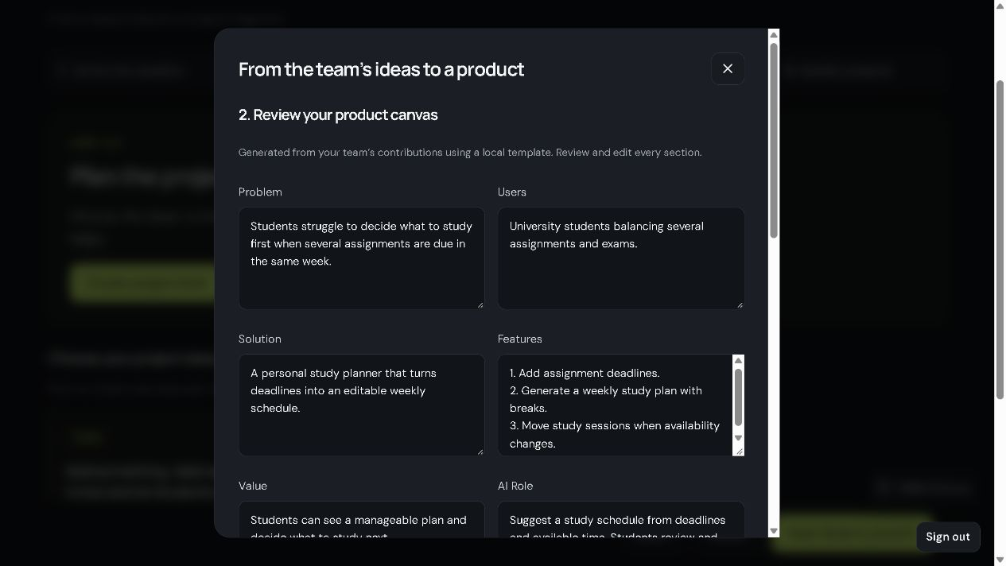
Step 4: the project brief
Review and edit every field.
Name the users and core features.
Explain how AI helps.
AI Collab Lab presenter guide · Real app screenshots · 7 October 2026
15 / 18
Notes:
The app creates a draft from contributions using a local template. It needs your review. Clarify Problem, Users, Solution, Features, Value and AI Role. Aim for a few concrete features the team can test. Scroll down for Refresh build prompt from canvas.
Source: actual live application at https://nasserdiary.com/workshops/ captured 7 October 2026. Example content belongs to the separate Presenter guide demo workshop, UTAS-949110. Use your own workshop code in a live class.

Slide 16
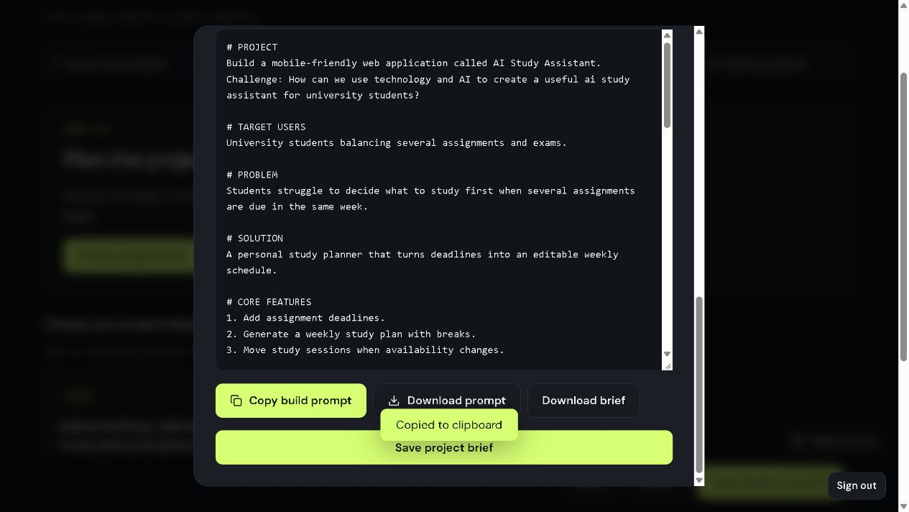
The build prompt
Click Refresh build prompt from canvas after editing.
Copy build prompt.
Save project brief.
AI Collab Lab presenter guide · Real app screenshots · 7 October 2026
16 / 18
Notes:
The screenshot shows the lower part of the same dialog. Refresh transfers your edited brief into the prompt. Copy it into your chosen AI coding tool to request a working prototype. Download prompt and Download brief keep copies. Save project brief stores the workshop’s brief and prompt.
Source: actual live application at https://nasserdiary.com/workshops/ captured 7 October 2026. Example content belongs to the separate Presenter guide demo workshop, UTAS-949110. Use your own workshop code in a live class.

Slide 17
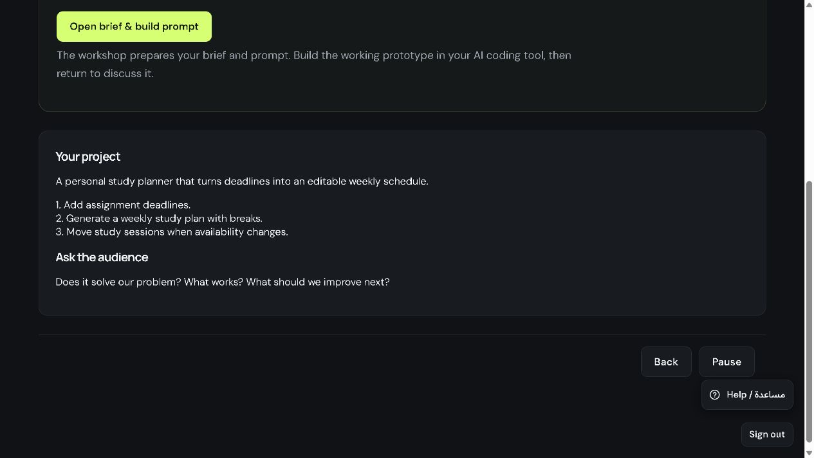
Step 5: building and feedback
Build in your chosen AI coding tool.
Test the core features.
Show the prototype and collect feedback.
AI Collab Lab presenter guide · Real app screenshots · 7 October 2026
17 / 18
Notes:
Use Next: Build & present after saving the brief. This workshop prepares the plan and prompt. The external AI coding tool creates the working prototype. Ask the audience whether it solves the original problem, what works, and what should improve. Open brief & build prompt lets you revisit the saved material.
Source: actual live application at https://nasserdiary.com/workshops/ captured 7 October 2026. Example content belongs to the separate Presenter guide demo workshop, UTAS-949110. Use your own workshop code in a live class.

Slide 18
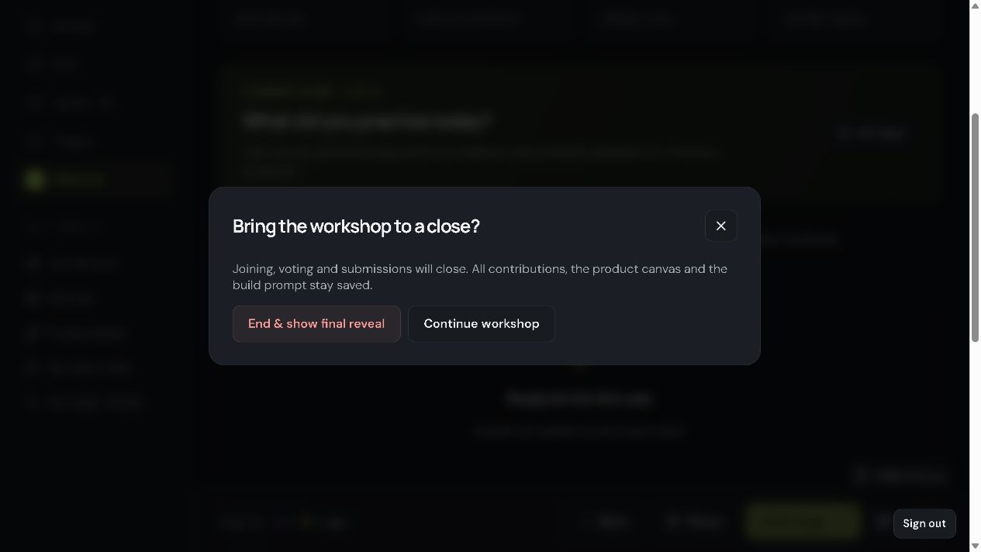
Closing the workshop
Open More tools.
Click End workshop.
Confirm End & show final reveal.
AI Collab Lab presenter guide · Real app screenshots · 7 October 2026
18 / 18
Notes:
Finish after the audience has shared feedback. Ending closes joining, voting and submissions while keeping contributions, the canvas and prompt saved. Export workshop is available in More tools if you need a record. The demonstration workshop shown in these screenshots has been ended.
Source: actual live application at https://nasserdiary.com/workshops/ captured 7 October 2026. Example content belongs to the separate Presenter guide demo workshop, UTAS-949110. Use your own workshop code in a live class.

