Slide 1


Machine Learned Interatomic Potentials:
Why and How?
Nick Hopper and Mark Boyer
Tabor Research Group
Texas A&M University, Department of Chemistry
9/30/2026
Funding and Support

Slide 2
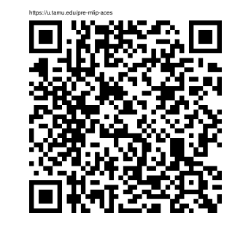
Link to Pre-Workshop Survey
Should take less than 5 minutes
https://u.tamu.edu/pre-mlip-aces

Slide 3
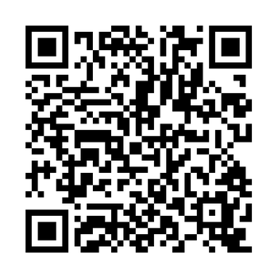
Overview
Introduce Machine-Learned Interatomic Potentials
Five exercises
  Molecular conformers – AIMNet
  Molecular-crystal optimization – MACE
  Oxygen adsorption on Cu(111) – MACE
  Transition-state search – AIMNet
  Molecular dynamics -- AIMNet
  Opening the black box – AIMNet
All demo resources can be found here:
https://github.com/Tabor-Research-Group/mlip-demo

Slide 4
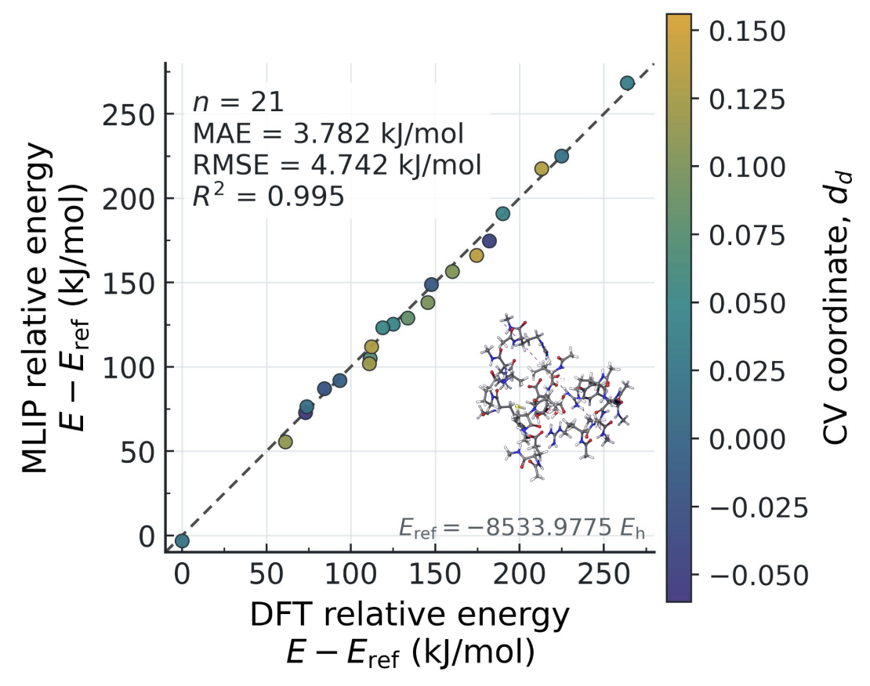
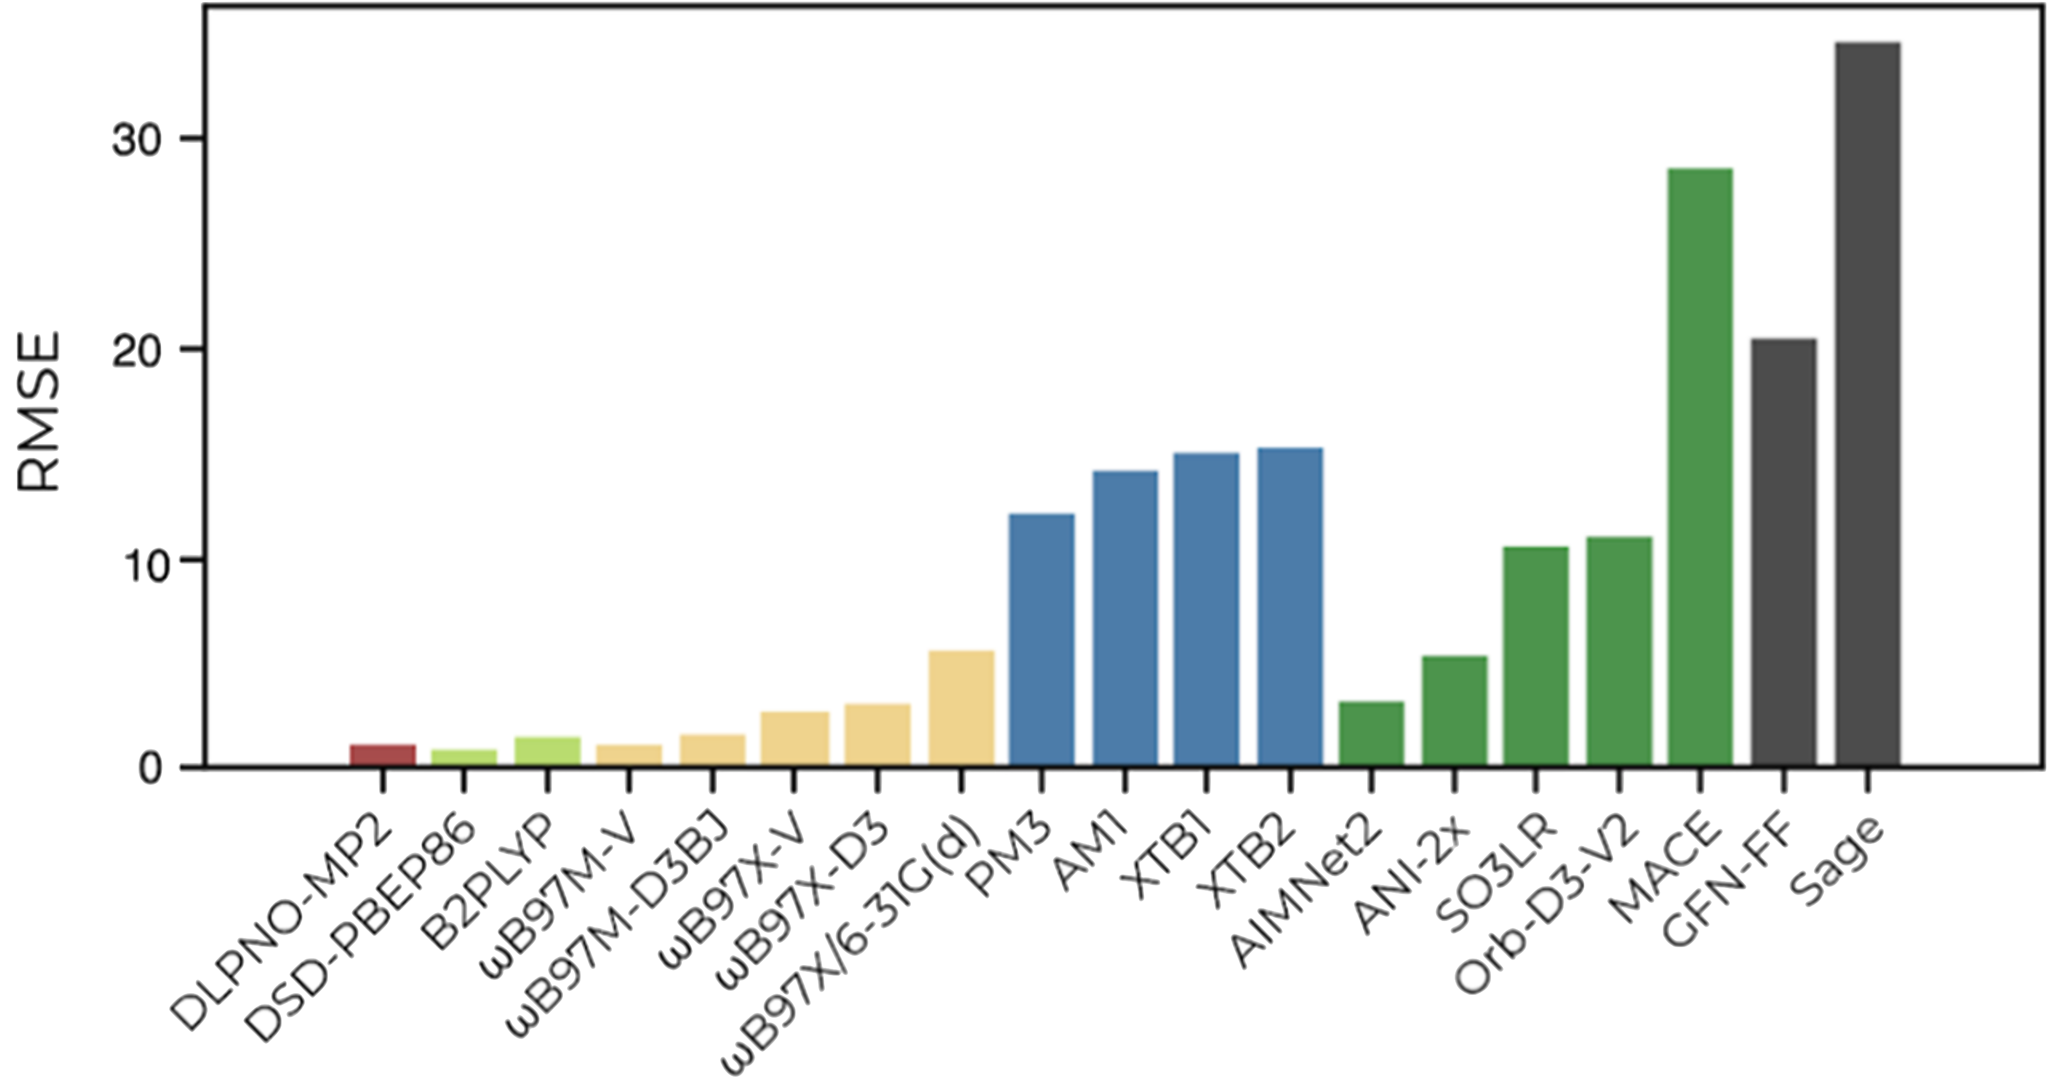
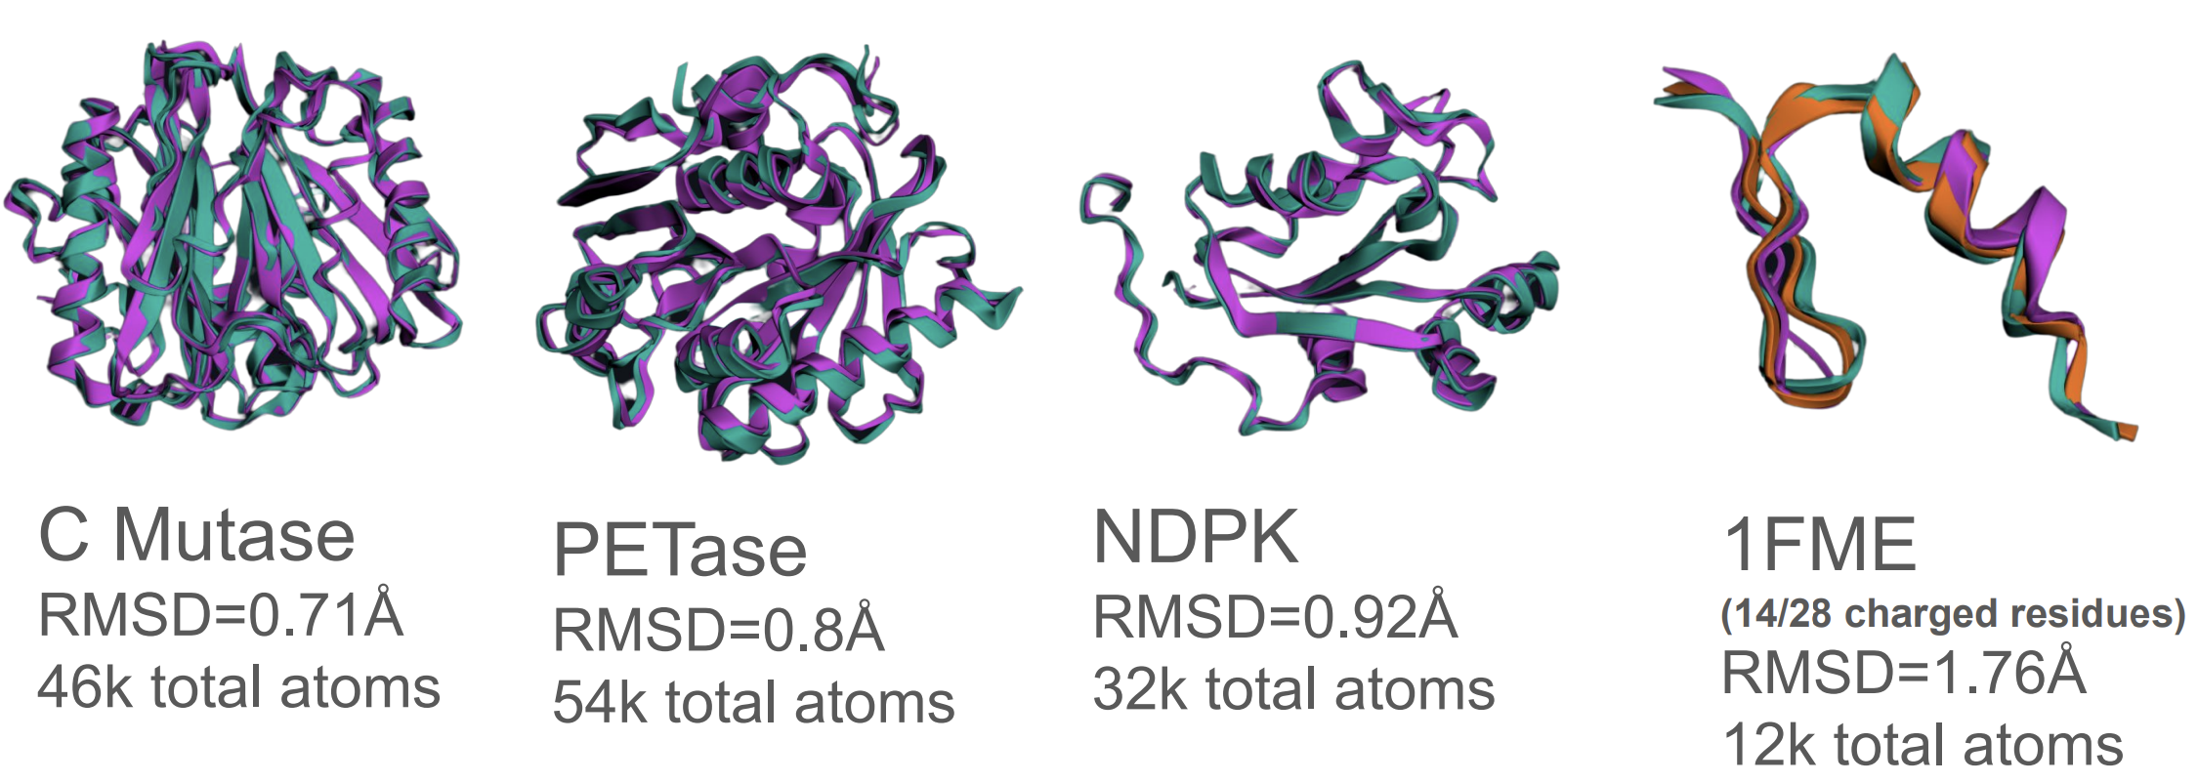
Why MLIPs?
Give DFT-quality energies and geometries at a fraction of the cost
1000x Cheaper
Brew, R. et al. J. Chem. Theory Comput. (2025). doi.org/10.1021/acs.jctc.5c00015
Gao, M. et al. (2026) arxiv.org/pdf/2609.09293

Slide 5
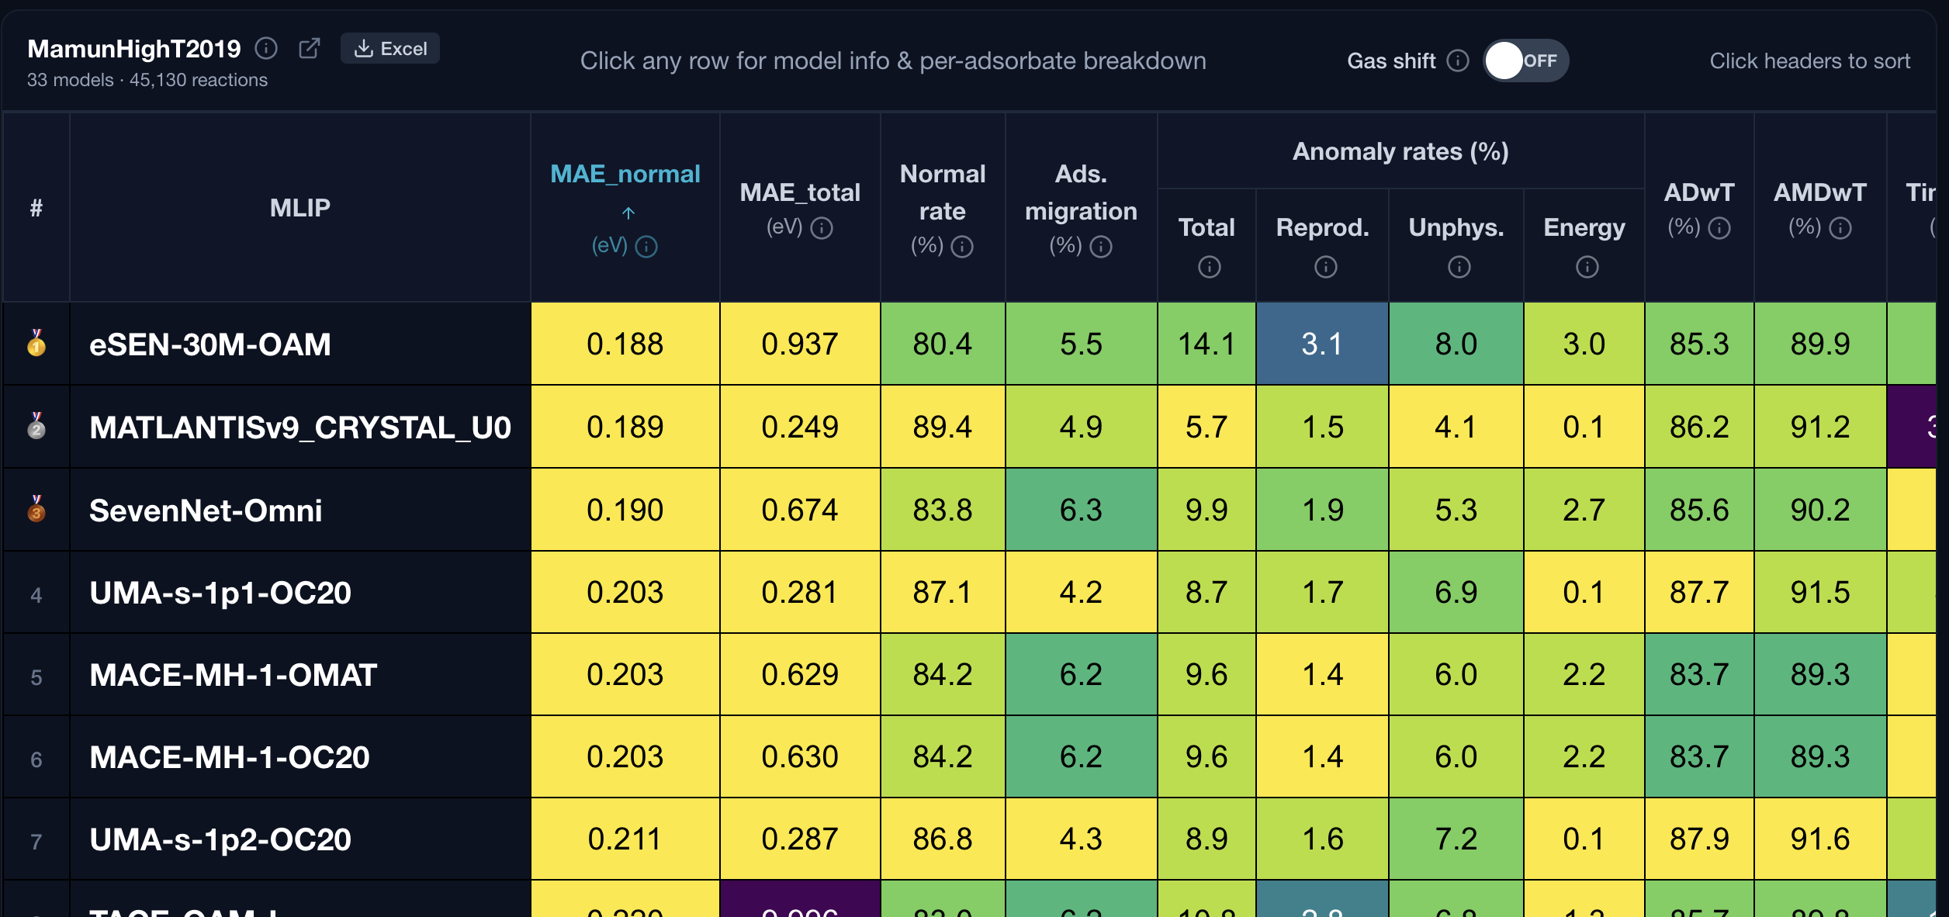
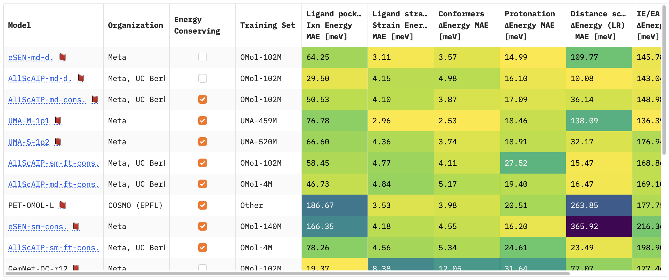
Why MLIPs?
Rapidly growing field, leaderboards help track model performance on benchmarks
https://huggingface.co/spaces/facebook/fairchem_leaderboard
https://catbench.org

Slide 6
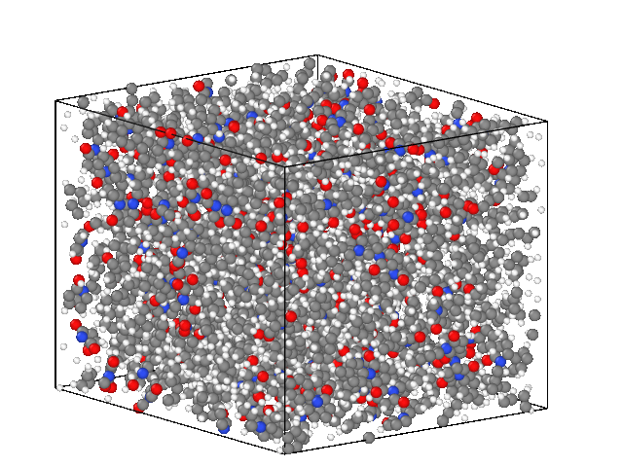
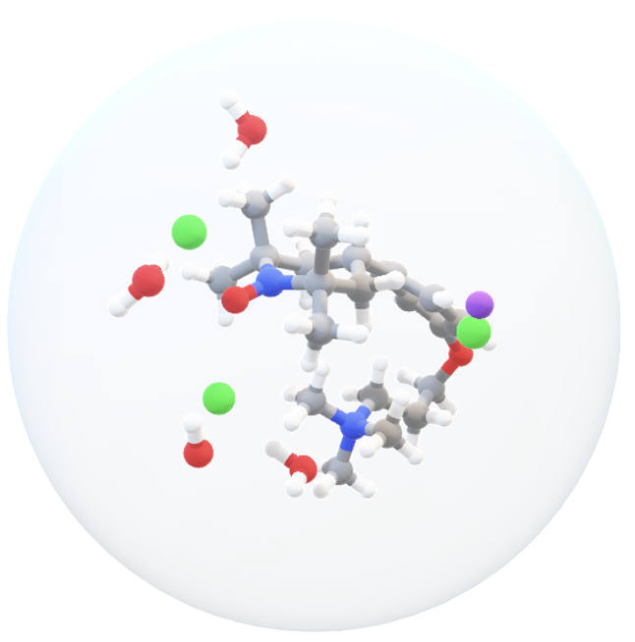
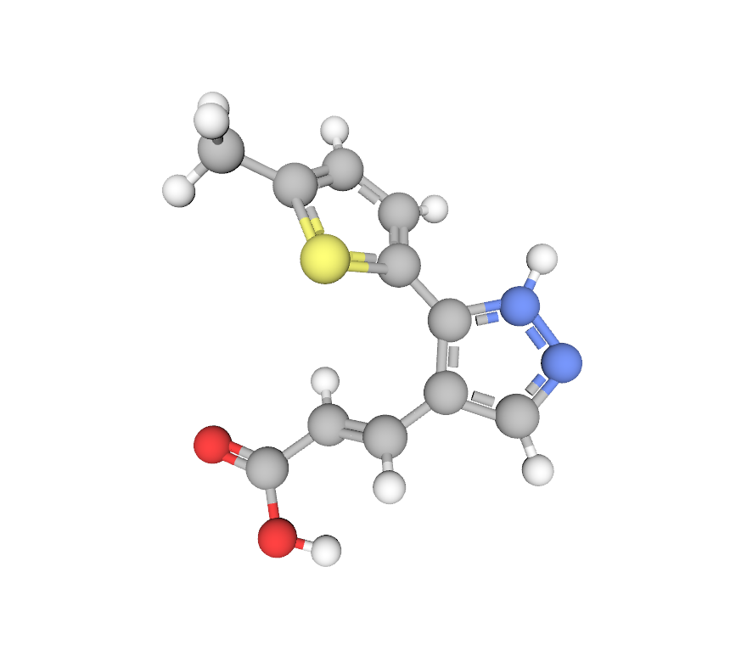
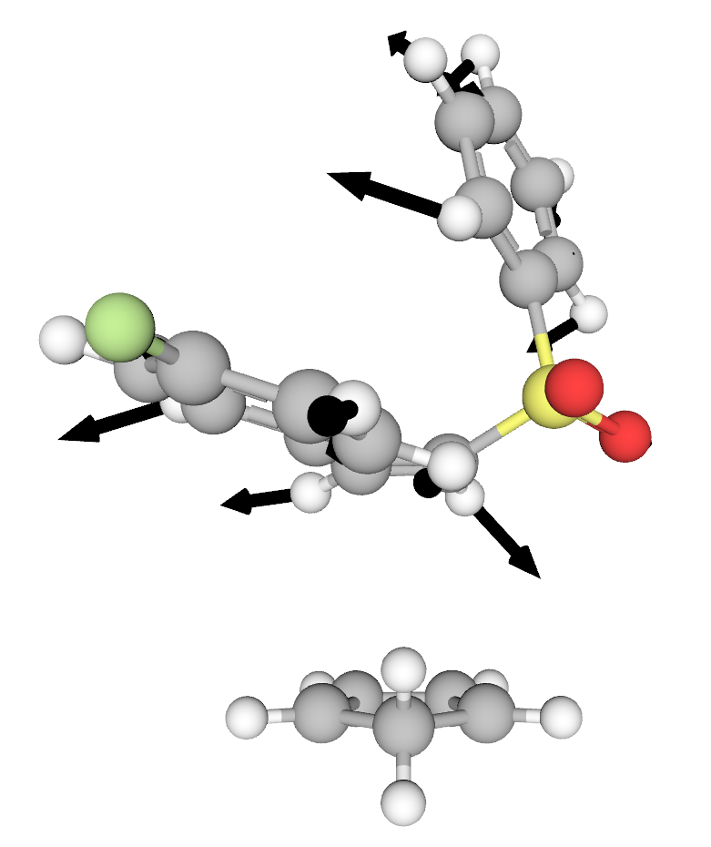
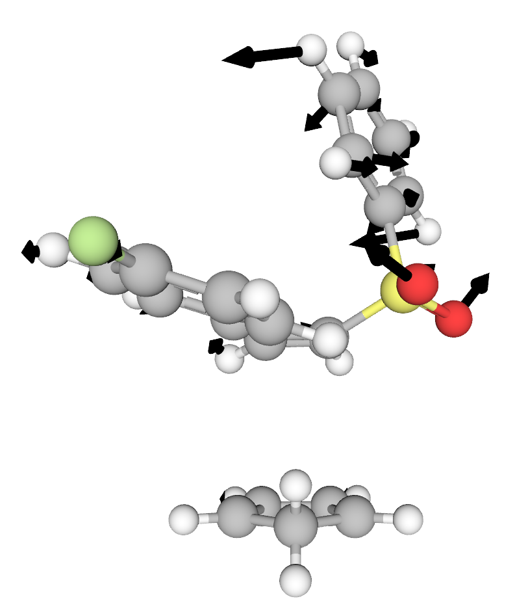
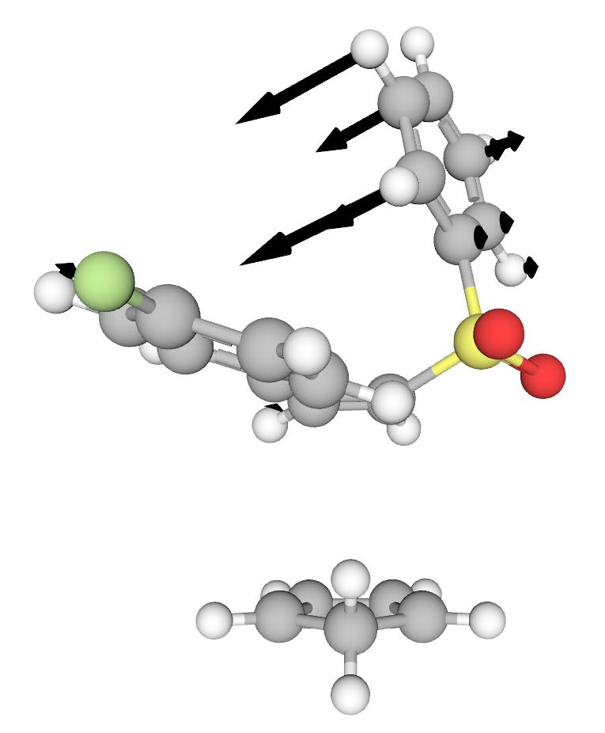
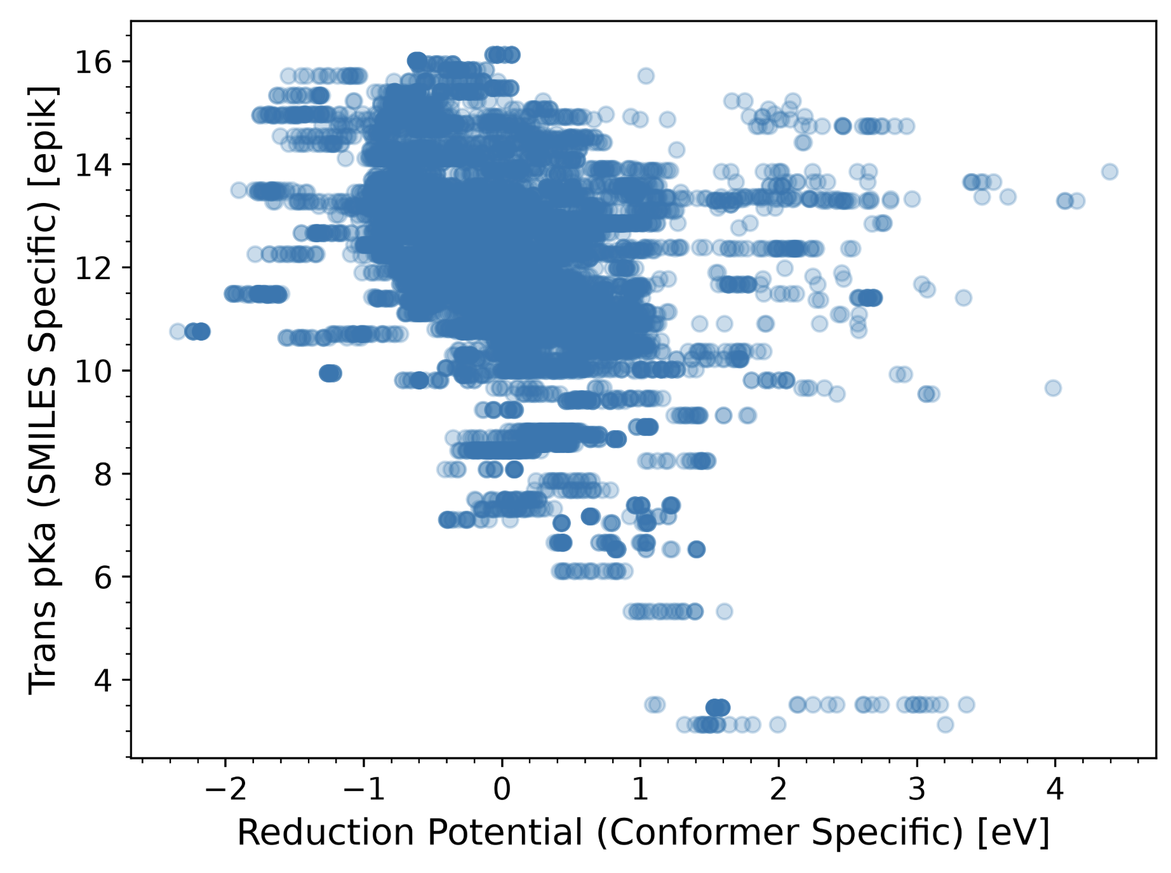
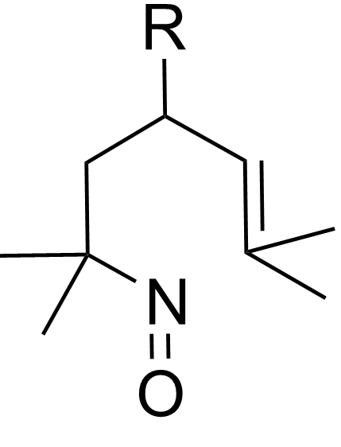
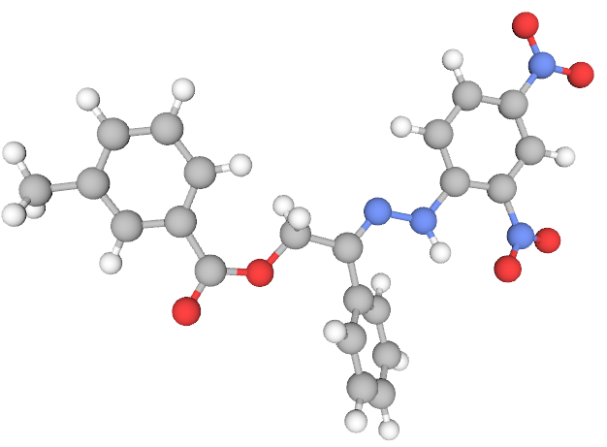
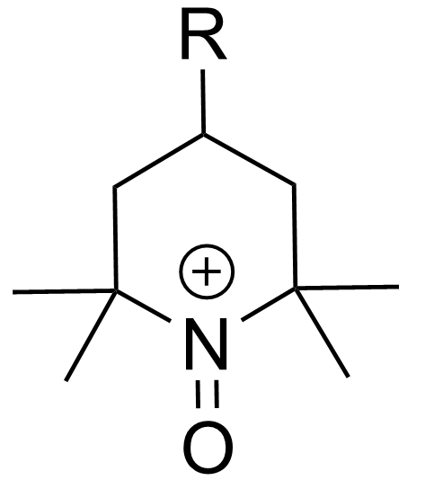
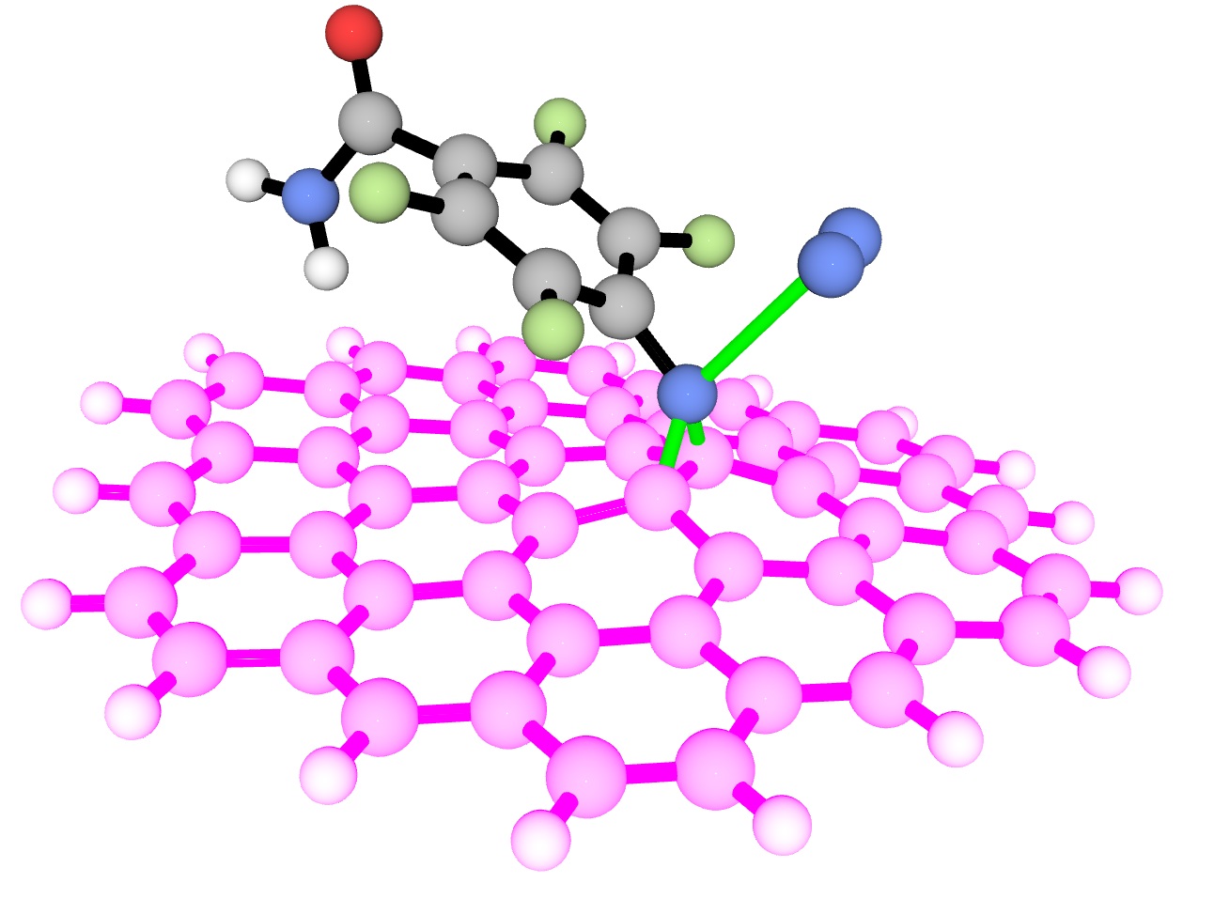
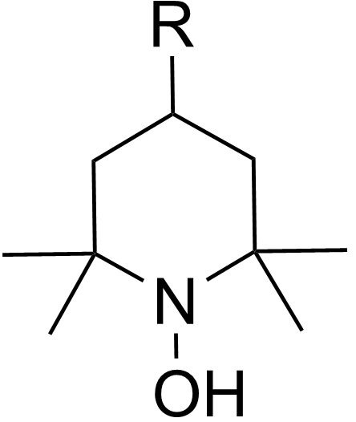
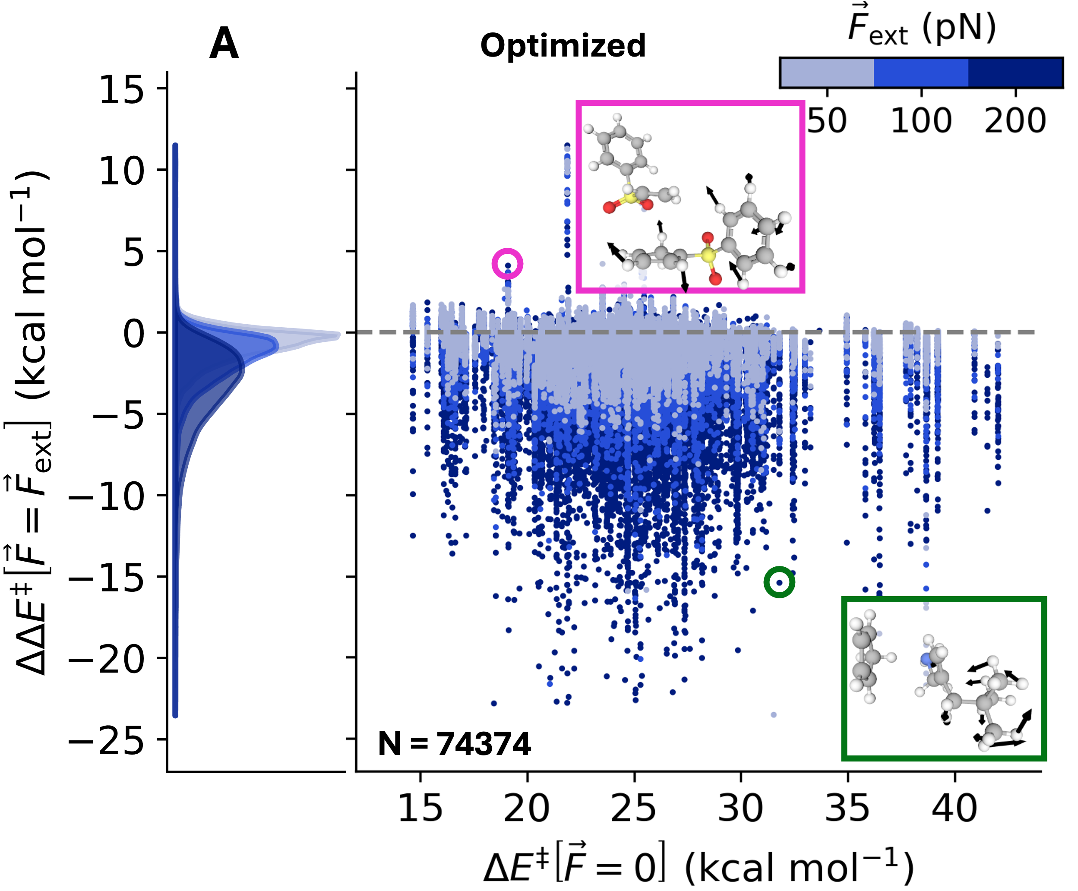
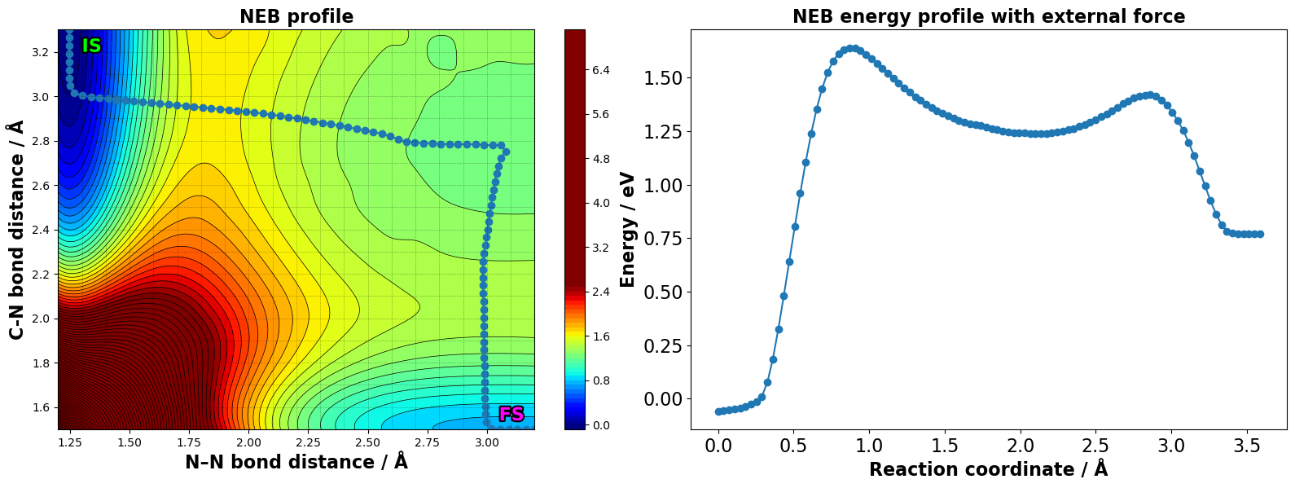
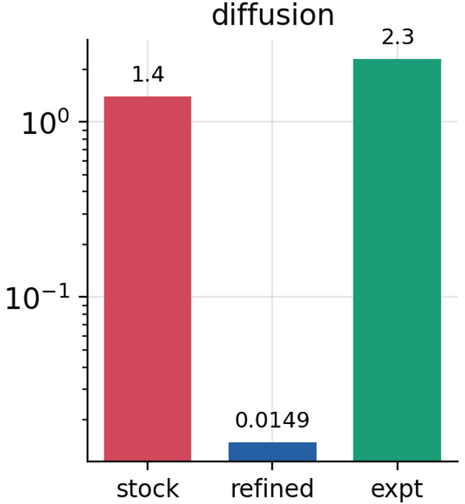
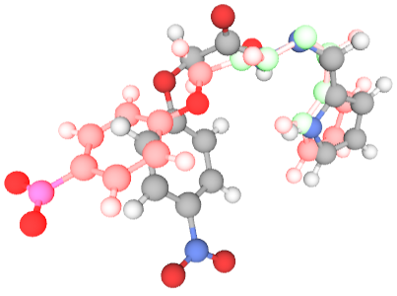
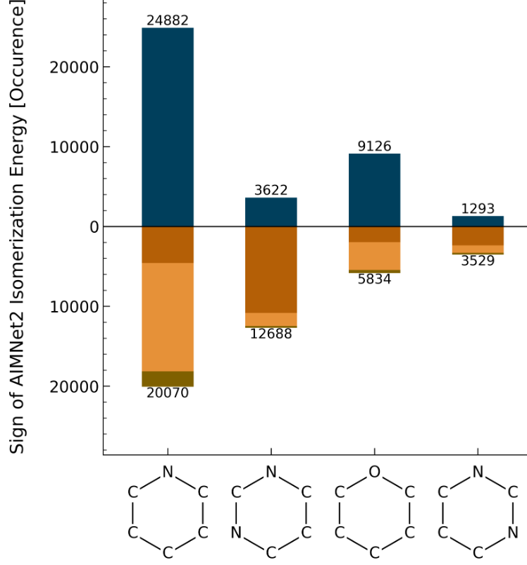
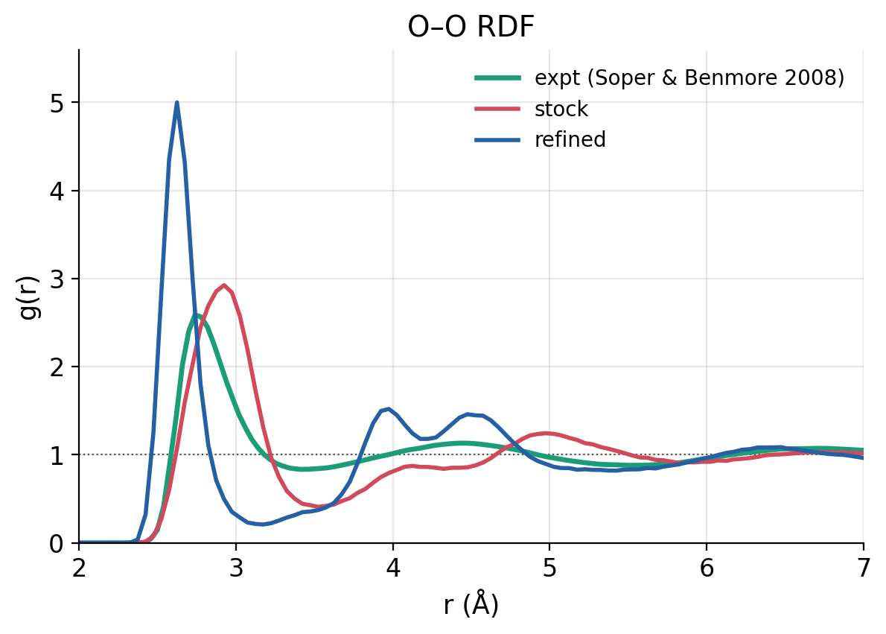
Applications
Molecular Dynamics
Exploring Molecular Stability
Reactivity Under Mechanical Force
Redox Chemistry
pK_{a}
Potential Energy Surface Analysis
Reduction Potential
Differentiable Refinement
Conformer Optimization

Slide 7
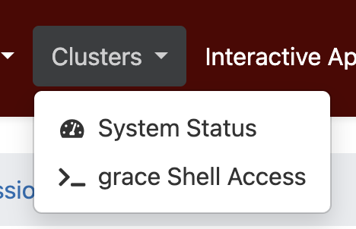
Copy the Files for the MLIP tutorial
Login to the Grace Open OnDemand Portal:
https://portal-aces.hprc.tamu.edu/
Open a terminal:
Copy the demo resource files to your scratch directory:
cp -r /scratch/training/mlip_tutorials/mlip_demo $SCRATCH
Confirm that you have two files demo-tools.sif and prelaunch.sh in $SCRATCH/mlip_demo:
ls $SCRATCH/mlip_demo
The mlip_demo.sif container file holds the environment setup for the MLIPs as well as demo notebooks and model files

Slide 8
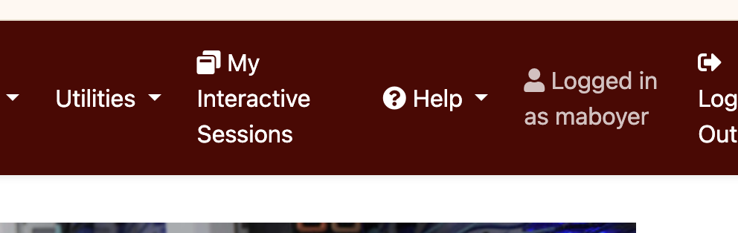
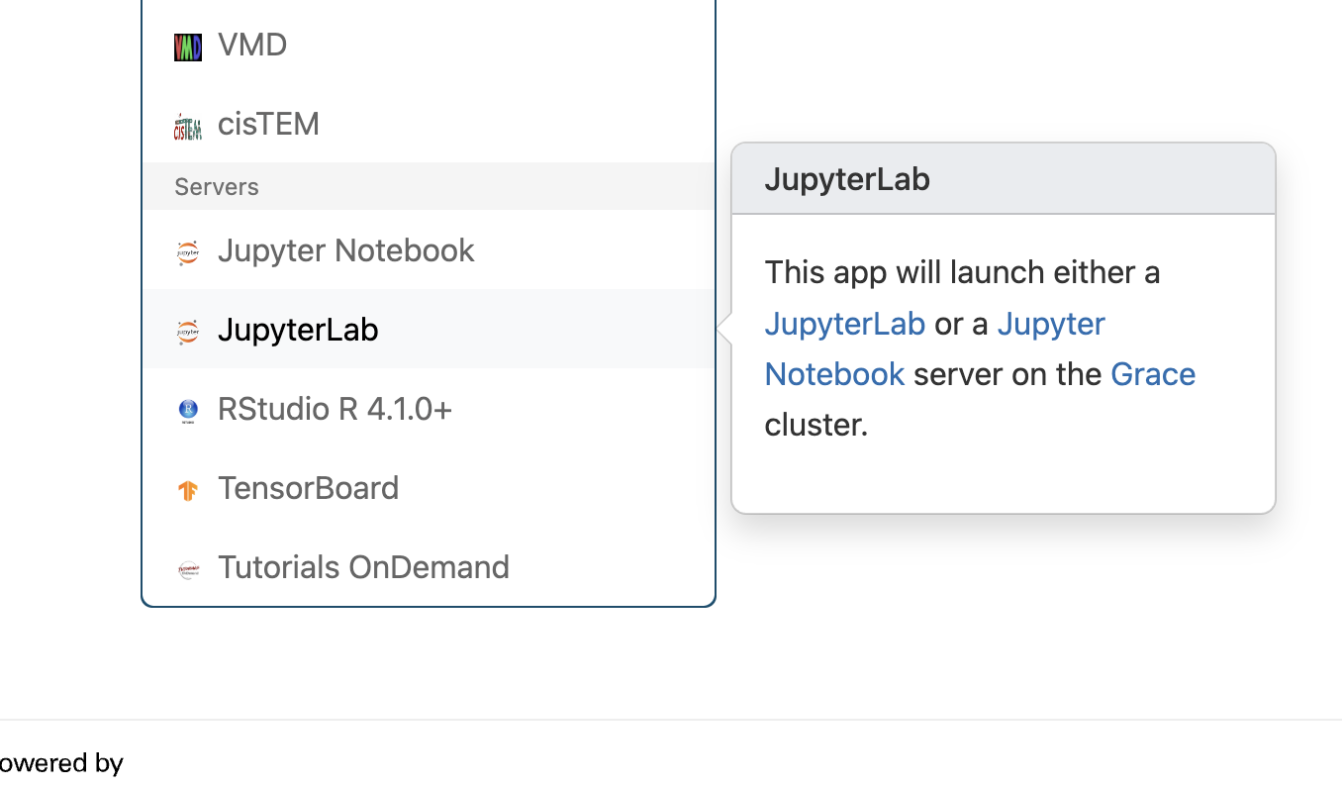
Launch JupyterLab
Click on My Interactive Sessions menu
Then choose JupyterLab

Slide 9
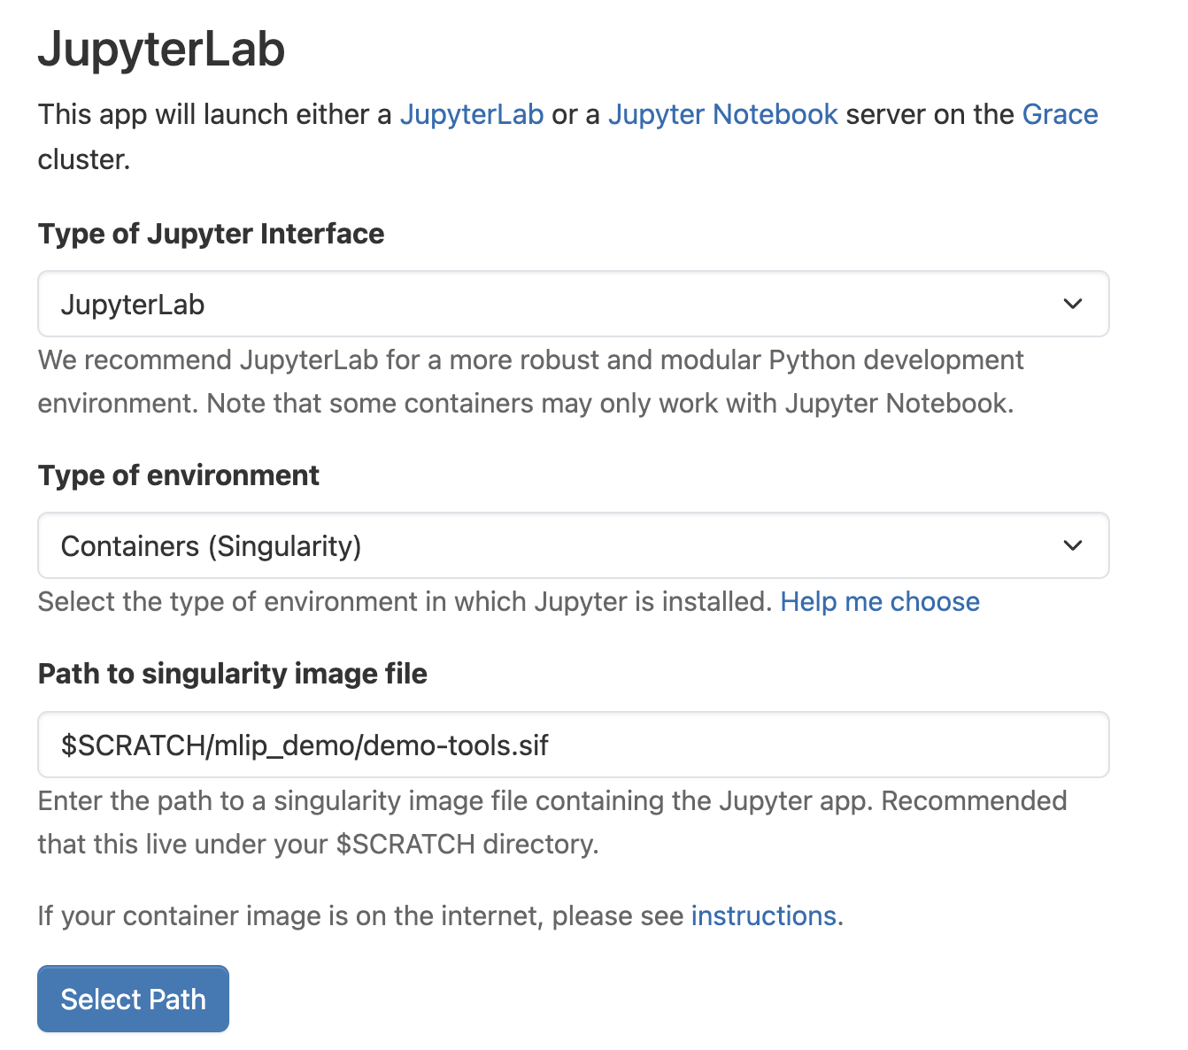
JupyterLab settings
We will start a JupyterLab session
We use the distributed container
Put this in a demo-specific folder
Specify the path to this container file
DON’T CLICK LAUNCH JUST YET
We need to specify resources and “prelaunch” info to work around issues with ACES environments

Slide 10
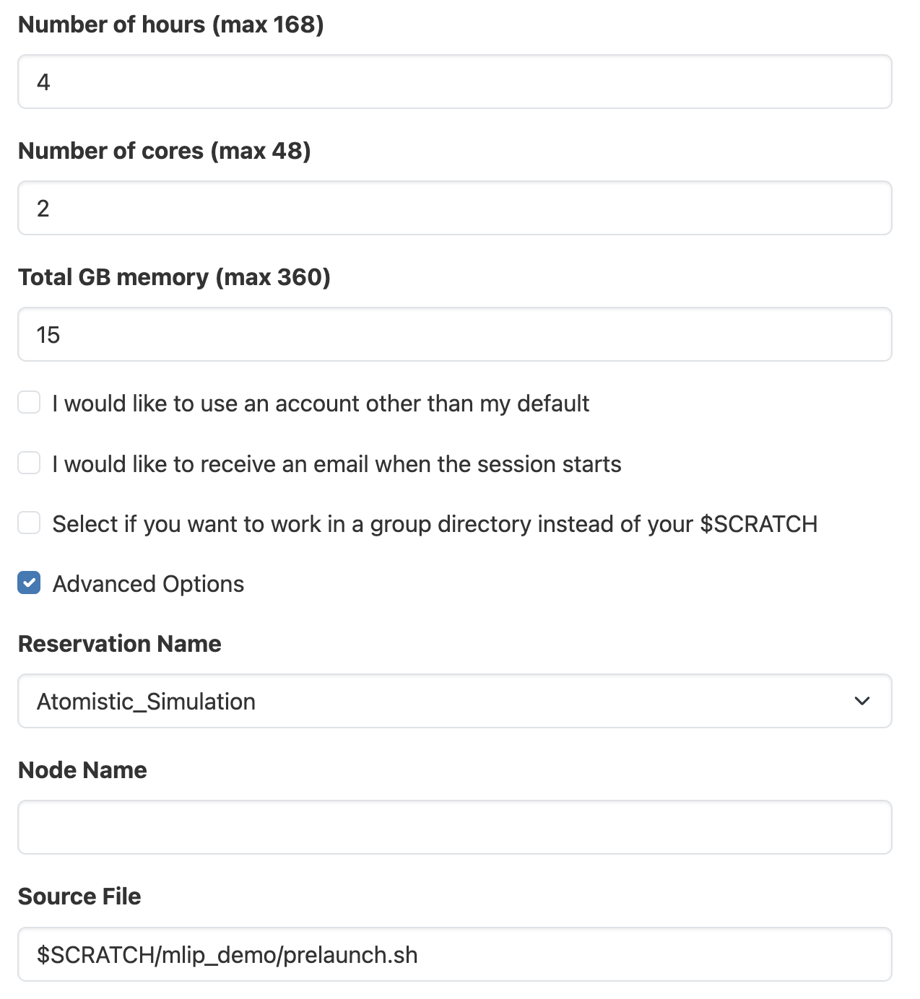
Getting Started with OnDemand
We have 2 cores and 15GB of memory reserved through this demo
Make sure to click Advanced Options so we can specify our prelaunch.sh file and Reservation Name: Atomistic_Simulation
These settings are critical for your JupyterLab to launch properly
Click on the Launch Button

Slide 11
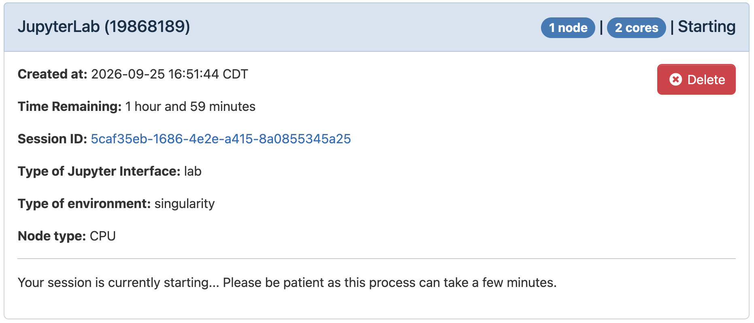
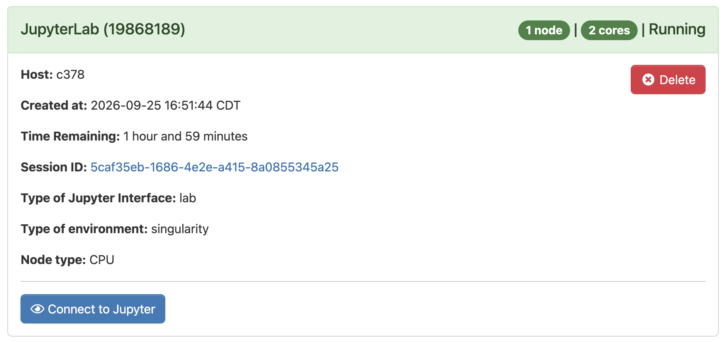
Connecting to JupterLab
Your job will go from the Queued to starting. The starting step can take a few minutes
Once it’s ready the status will change to Running and you can click on Connect to Jupyter
Now we’re ready to start the lesson

Slide 12
Getting Started with OnDemand
Our first step will be to copy the demo resources file at
/scratch/training/mlip_tutorials
Copy this to
/scratch/user/<YOUR_USERNAME_HERE>/mlip_demo
This contains the container file that holds the environment setup for the MLIPs as well as demo notebooks and model files

Slide 13
Getting Started with OnDemand
To log on to JupyterLab go to
https://portal-grace.hprc.tamu.edu/pun/sys/dashboard/batch_connect/sys/jupyterlab
Or https://portal-grace.hprc.tamu.edu/ and click here:
Then choose JupyterLab

Slide 14
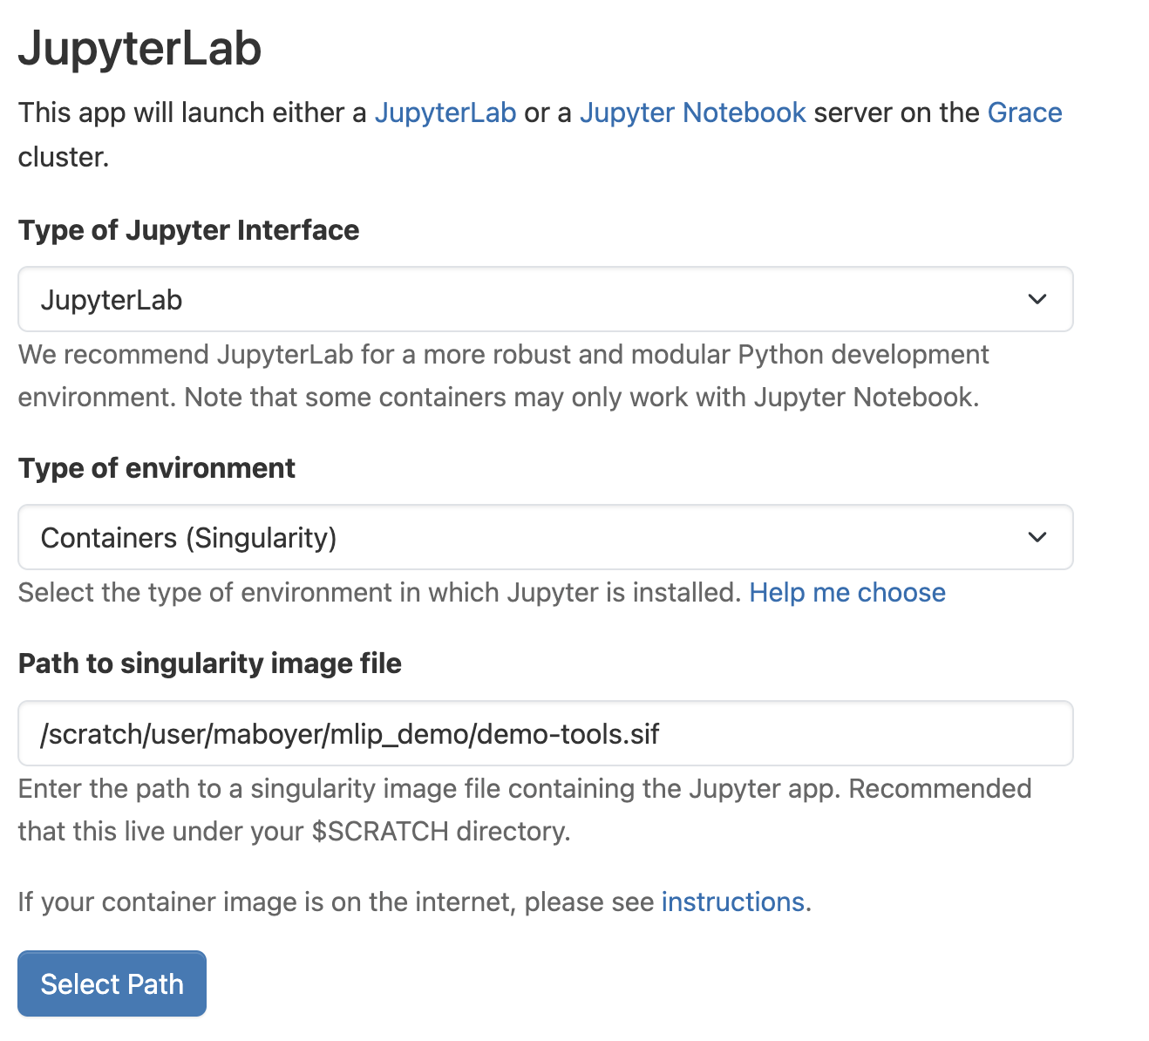
Getting Started with OnDemand
We will start a JupyterLab session
We use the distributed container
Put this in a demo-specific folder
Specify the path to this container file
DON’T CLICK LAUNCH JUST YET
We need to specify resources and “prelaunch” info to work around issues with Grace environments

Slide 15
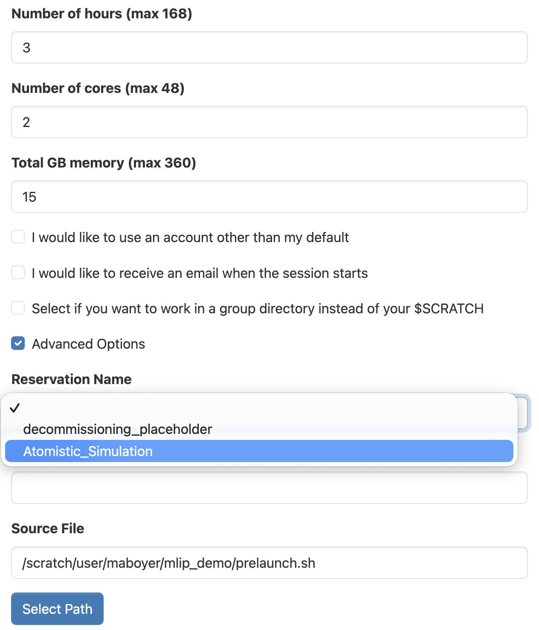
Getting Started with OnDemand
We have 2 cores and 15GB of memory reserved through this demo
Make sure to click Advanced Options so we can specify our prelaunch.sh file
If unspecified, the request can crash due to environment conflicts

Slide 16
Getting Started with OnDemand
Your job will start, this can take a few minutes
Once it’s ready click Connect to Jupyter
Now we’re ready to start the lesson

Slide 17
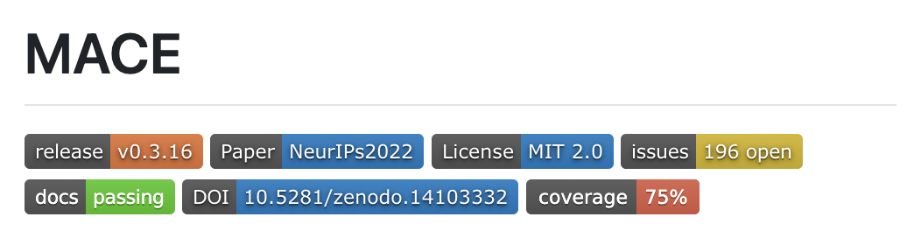
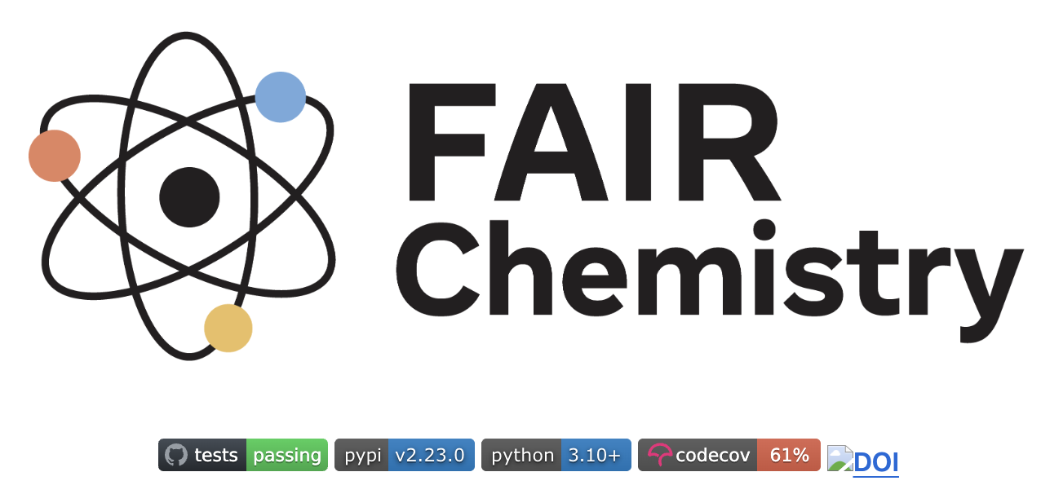
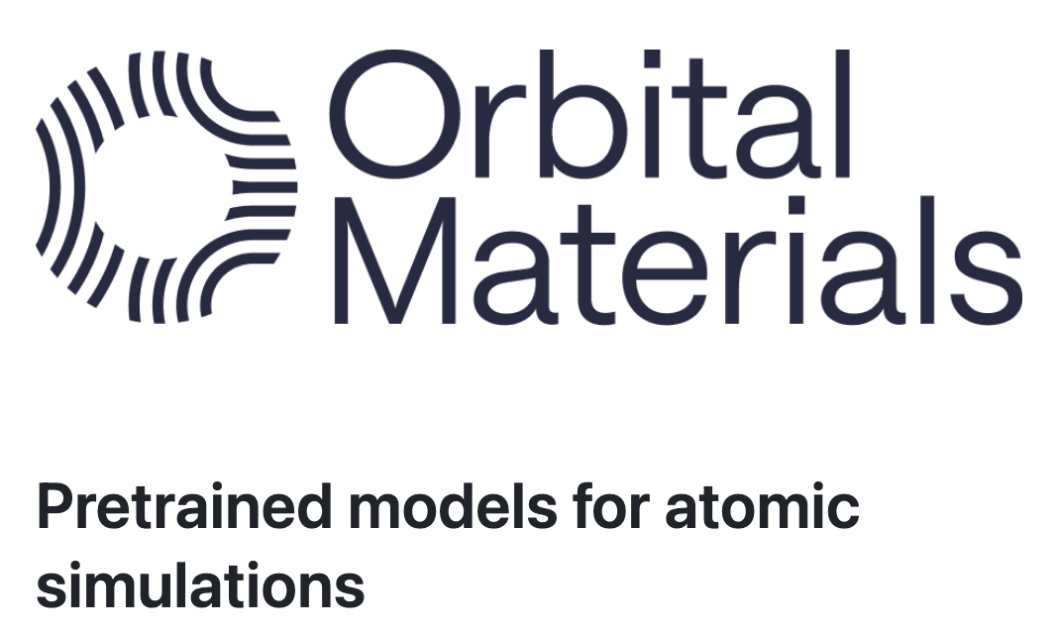
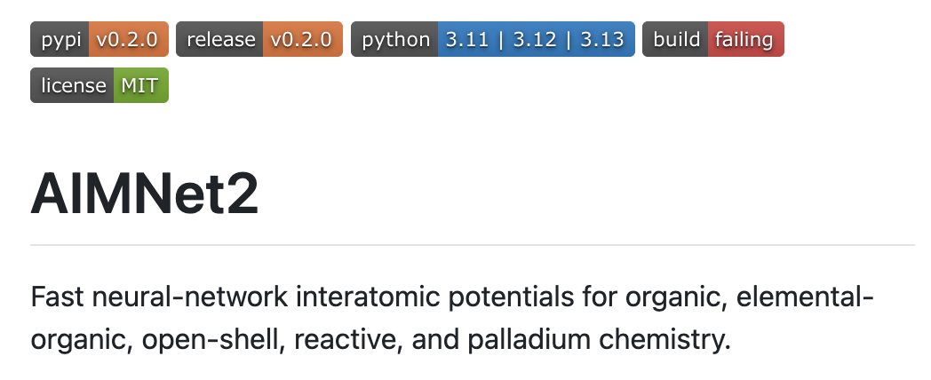
What Now?
Many different models to explore, materials and molecular applications
https://github.com/acesuit/mace
https://github.com/facebookresearch/fairchem
https://github.com/orbital-materials/orb-models
https://github.com/isayevlab/aimnetcentral

Slide 18
What Now?
Find models that perform well for the tasks you need
https://huggingface.co/spaces/facebook/fairchem_leaderboard
https://catbench.org

Slide 19
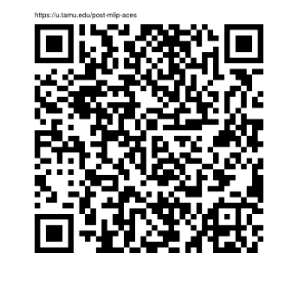
Link to Post-Workshop Survey
Should take less than 10 minutes
https://u.tamu.edu/post-mlip-aces

