Slide 1
Super Learner

Slide 2
Framework
For any given data application, do not know which algorithms will work well
The Super Learner framework is ideal to have diverse set of algorithms and still control for overfitting
Three Components of Super Learner
1. Library
2. Loss function
3. Cross validation

Slide 3
V-fold cross-validation scheme
Test
Example 5 folds
Training
1st
fold

Slide 4
V-fold cross-validation scheme
Test
Example 5 folds
Training
2nd
fold

Slide 5
V-fold cross-validation scheme
Test
Example 5 folds
Training
3rd
fold

Slide 6
V-fold cross-validation scheme
Test
Example 5 folds
Training
4th
fold

Slide 7
V-fold cross-validation scheme
Test
Example 5 folds
Training
5th
fold

Slide 8
V-fold cross-validation scheme
Test
Example 5 folds
Training
TEST
 | TEST
 |  | TEST
 |  |  | TEST
 |  |  |  | TEST
1st fold
2nd fold
3rd fold
4th fold
5th fold

Slide 9
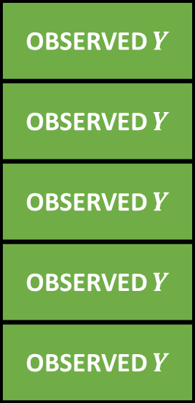
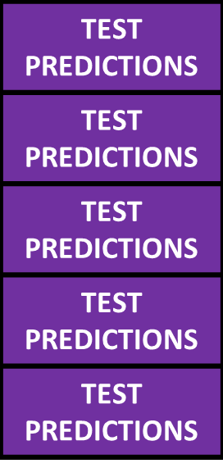
Cross validated Risk
Candidate Algorithm
Cross validated Risk =
Expected loss =
Mean squared error (MSE)= Mean(observed – predicted)²

Slide 10
Discrete Super Learner
0 | 0 | 0 | 0 | 0 | 0 | 1 | 0
weights
Algo 1 | Algo 2 | Algo 3 | Algo 4 | Algo 5 | Algo 6 | Algo 7 | Algo 8
1 . . . . .
.
.
.
.
. n

Slide 11



Ensemble Super Learner
$$Y \sim Xβ+ε$$
0.1 | 0 | 0 | 0.25 | 0.5 | 0.1 | 0.05 | 0
weights
$$X$$
Algo 1 | Algo 2 | Algo 3 | Algo 4 | Algo 5 | Algo 6 | Algo 7 | Algo 8
$$Y$$
1 . . . . .
.
.
.
.
. n
Notes:
Selecting the weights that minimize the cross-validated risk is a simple minimization problem, formulated as a regression of the outcomes Y on the predicted values of the algorithms (Z) according to the user-supplied parametric family of weighted combinations.

Slide 12
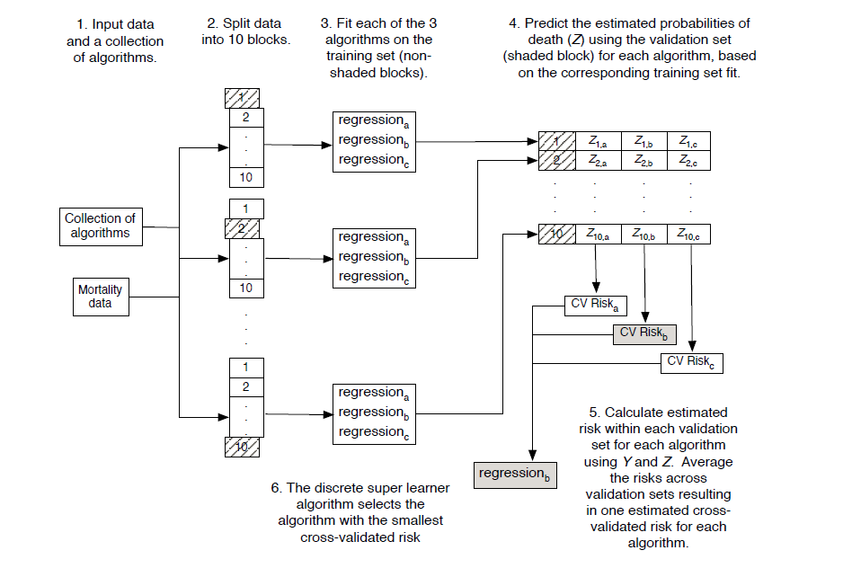
Discrete Super Learner

Slide 13
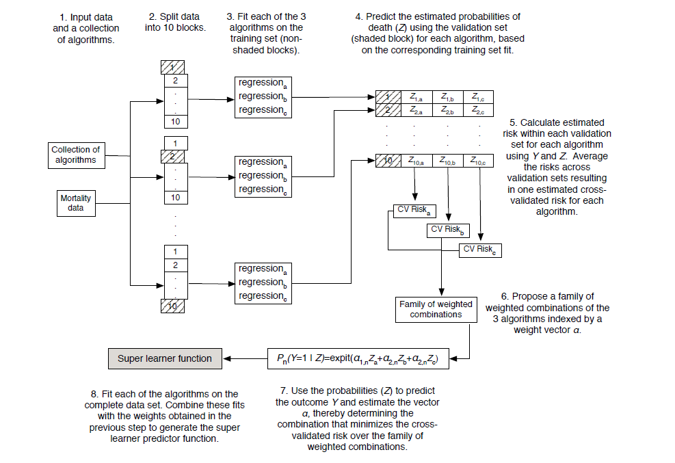
Ensemble Super Learner

Slide 14
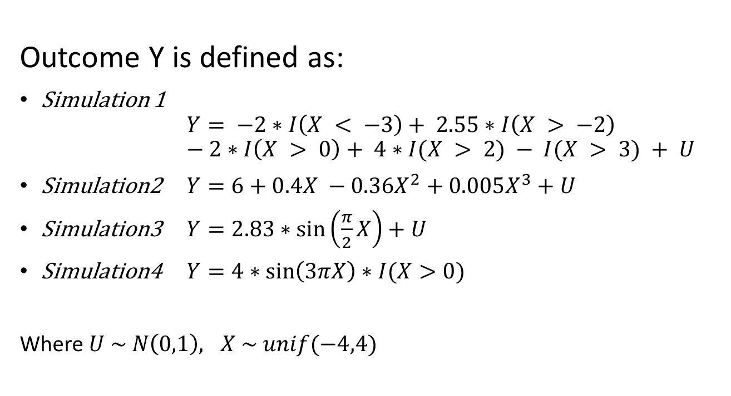
Four Simulations
Outcome Y is defined as:
Simulation 1 $Y= −2∗I\left(X < −3\right)+ 2.55∗I\left(X > −2\right)$ $− 2∗I\left(X > 0\right)+ 4∗I(X > 2) − I(X > 3) + U$
Simulation2 $Y=6+0.4X −0.36X^{2}+0.005X^{3}+U$
Simulation3 $Y=2.83∗\sin\left(\frac{π}{2}X\right)+U$
Simulation4 $Y=4∗\sin\left(3πX\right)∗I(X>0)$
Where $U \sim N\left(0,1\right), X \sim unif(−4,4)$

Slide 15
Set of Algorithms for Super Learner

Slide 16
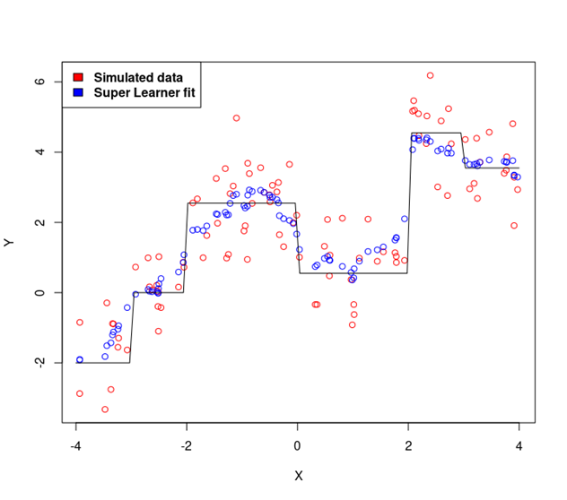
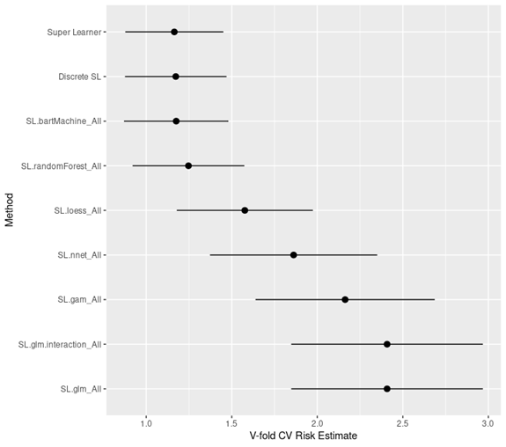
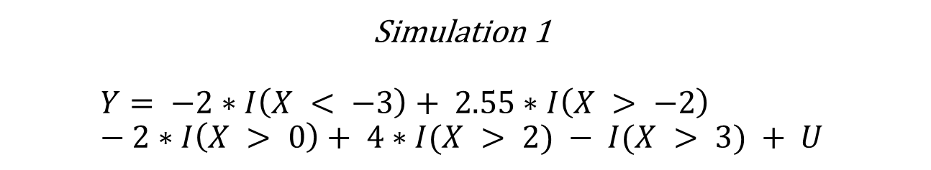
Simulation 1 $$Y= −2∗I\left(X < −3\right)+ 2.55∗I\left(X > −2\right) \\ − 2∗I\left(X > 0\right)+ 4∗I(X > 2) − I(X > 3) + U$$

Slide 17
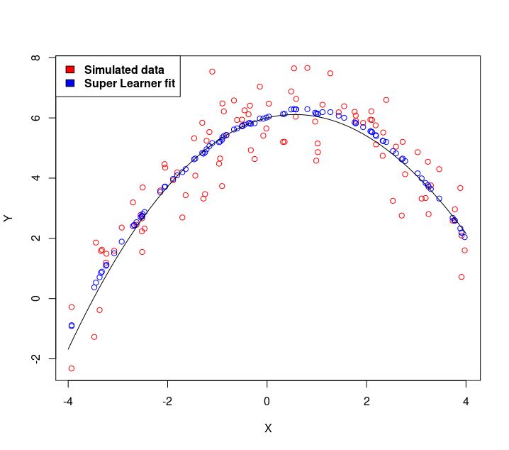
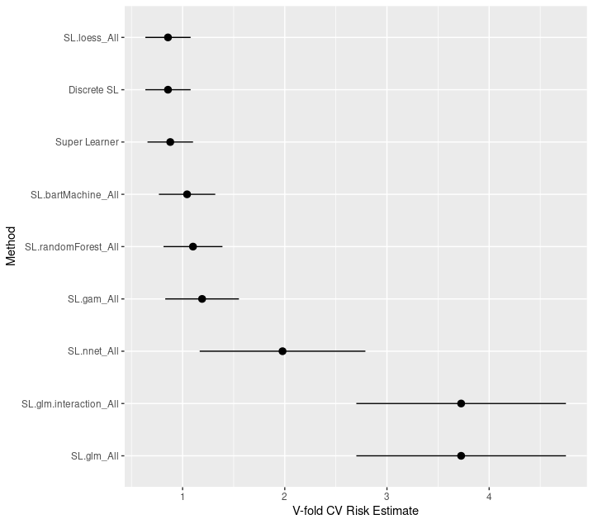

Simulation2 $$Y=6+0.4X −0.36X^{2}+0.005X^{3}+U$$

Slide 18
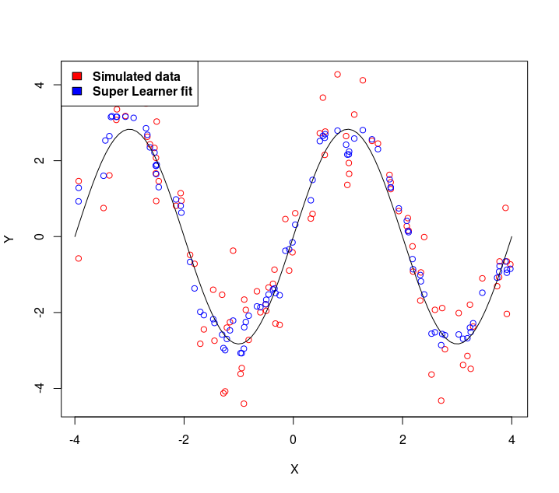
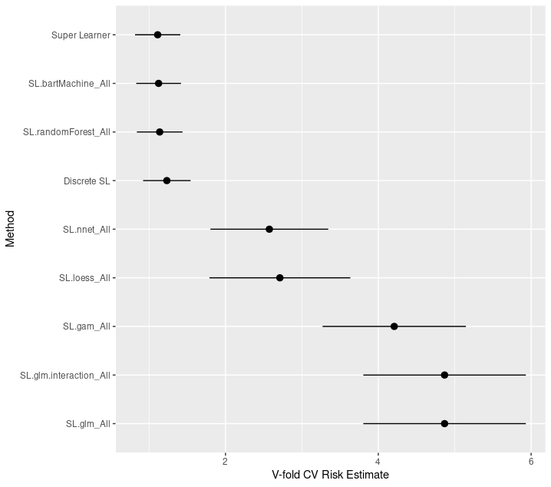

Simulation3 $$Y=2.83∗\sin\left(\frac{π}{2}X\right)+U$$

Slide 19
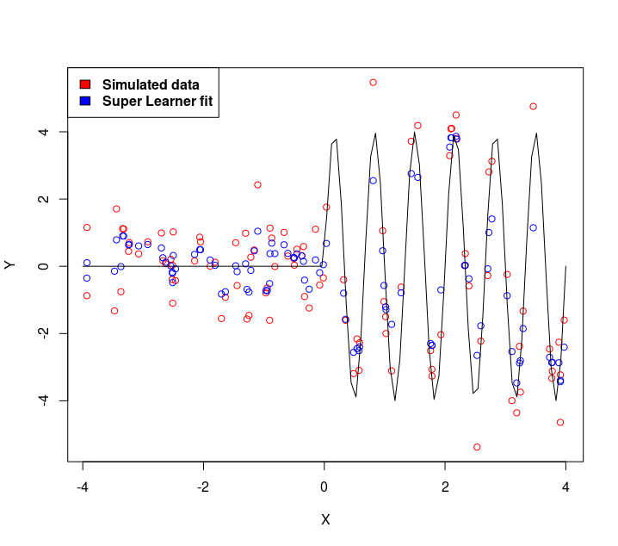
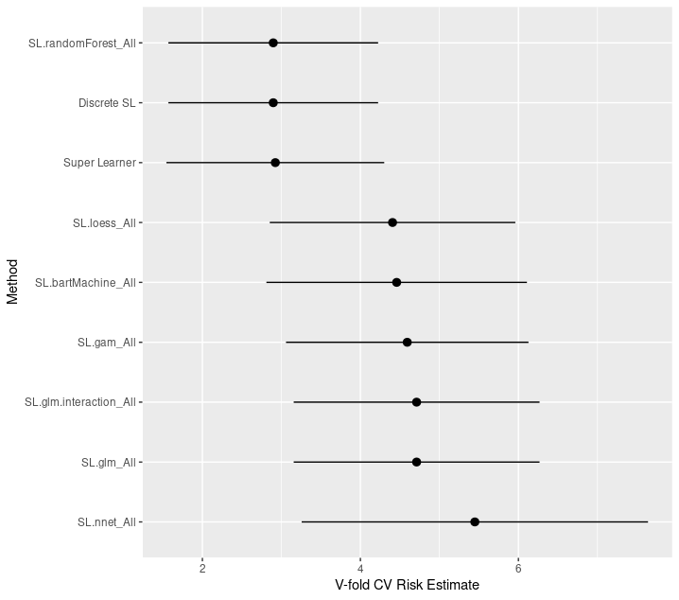

Simulation4 $$Y=4∗\sin\left(3πX\right)∗I(X>0)$$

Slide 20
Summary
The super learner provides a flexible but robust procedure for estimating an ensemble prediction model.
Allows the researcher to evaluate a large library of prediction algorithms, but controls over-fitting with cross-validation.
The framework easily extends to the p >> n setting by only changing the algorithms in the library.
large p examples also increases the number of algorithms in the library because various dimension reduction (screening) algorithms are possible to be used in conjunction with prediction algorithms

Slide 21
TMLE method for Causal Inferences

Slide 22
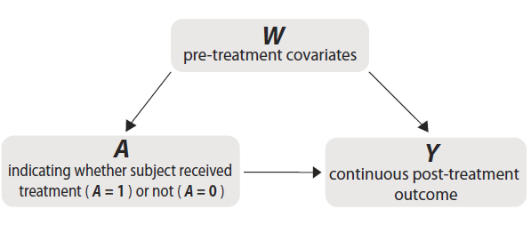
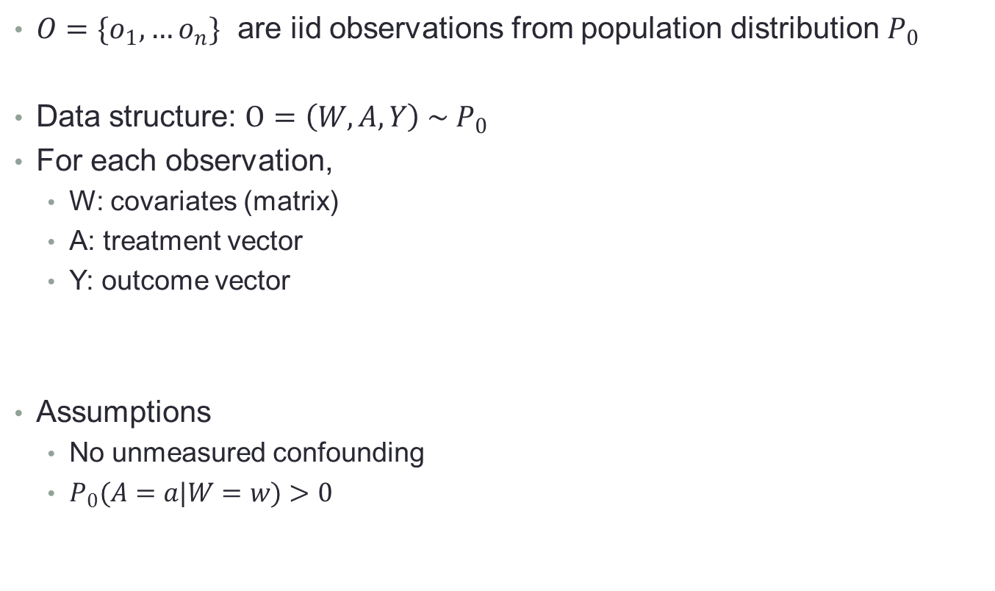
Describe Data
$O=\{o_{1}, …o_{n}\}$ are iid observations from population distribution $P_{0}$
Data structure: $O=\left(W, A, Y\right) \sim P_{0}$
For each observation,
W: covariates (matrix)
A: treatment vector
Y: outcome vector
Assumptions
No unmeasured confounding
$P_{0}(A=a|W=w)>0$

Slide 23
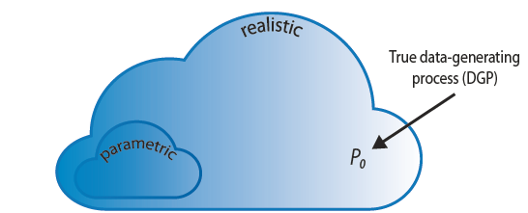

Specify Statistical Model
Standard Approach
Parametric statistical model, may not contain $P_{0}$
Targeted Learning
semiparametric or nonparametric model to ensure $P_{0}$ is contained in model

Slide 24

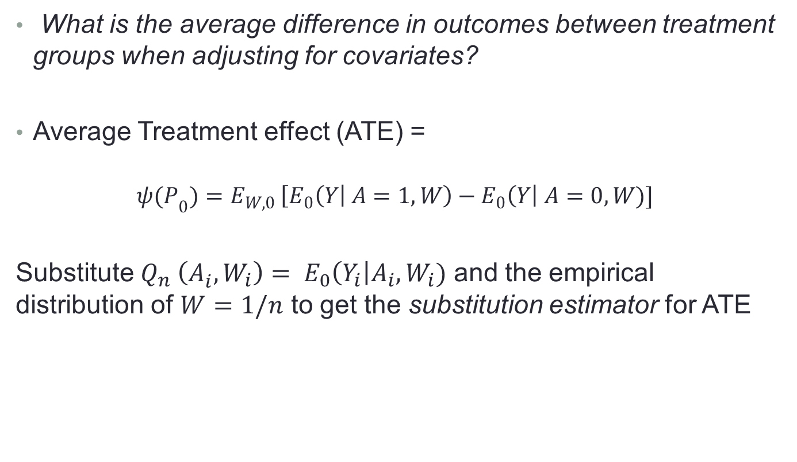
Define Statistical Question
What is the average difference in outcomes between treatment groups when adjusting for covariates?
Average Treatment effect (ATE) =
$${ψ(P}_{0})=E_{W,0 }\left[E_{0}\left(Y\right| A=1, W\right)−E_{0}\left(Y\right| A=0, W)]$$
Substitute $Q_{n}^{} \left(A_{i}^{}, W_{i}\right)= E_{0}\left(Y_{i}\right|A_{i}, W_{i})$ and the empirical distribution of $W=1/n$ to get the substitution estimator for ATE

Slide 25
Causal Effect Methods
Outcome regression methods
Model expected value of outcome given treatment and covariates
Propensity score methods
Model conditional distribution of treatment given covariates
Matching
Inverse probability weighting (IPW)
Double-Robust methods
consistent if either outcome regression or pscore model correct
Targeted maximum likelihood estimation (TMLE)

Slide 26
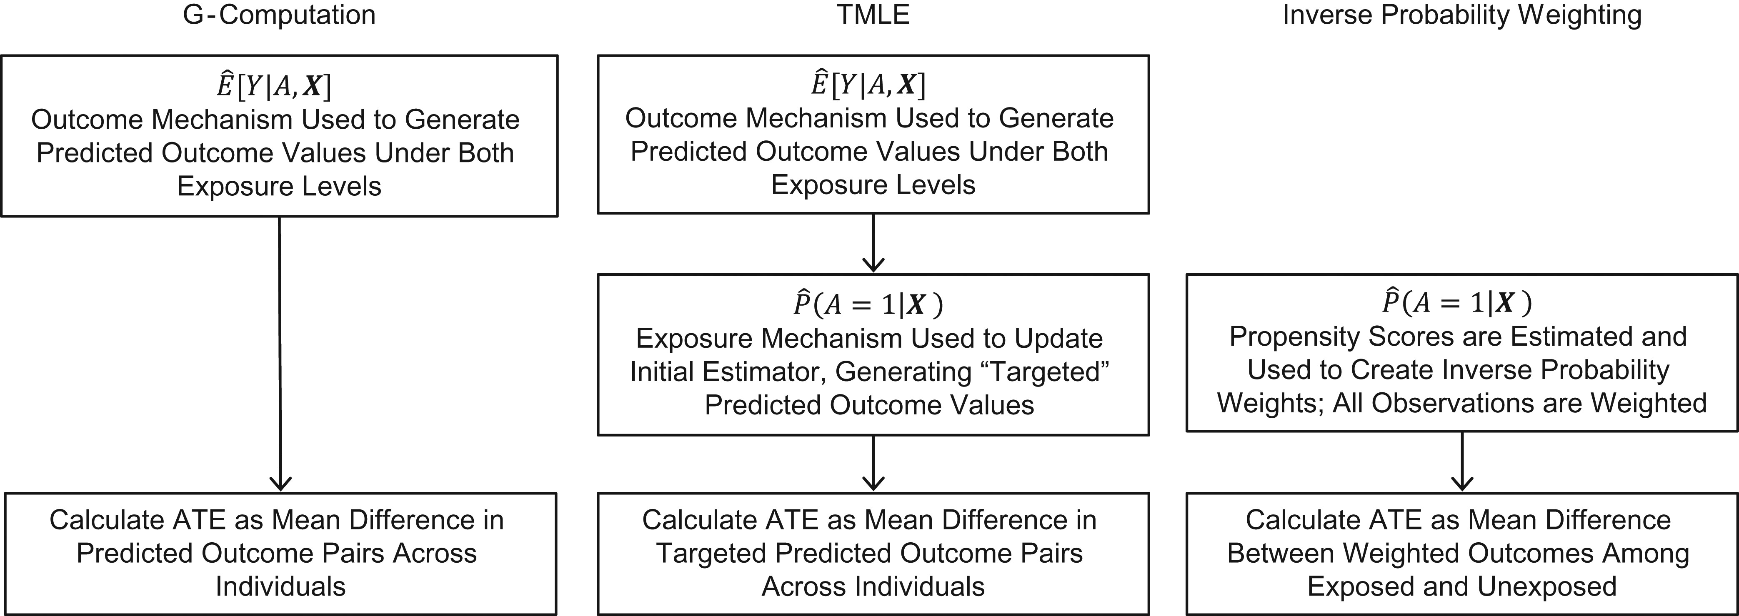
Comparison of 3 different estimators for ATE

Slide 27
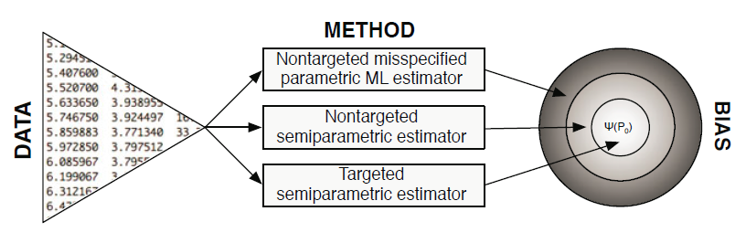

TMLE
TMLE tailors estimation specifically for the parameter of interest, ${\text{ψ}}_{0}$

Slide 28

Two-stage procedure
Stage 1: obtain an estimate of the data-generating distribution $P_{0}$, or the relevant portion $Q_{0}$ of $P_{0}$.
Stage 2: update this initial fit in a step targeted toward making an optimal bias–variance tradeoff for the parameter of interest ${\text{Ψ}(Q}_{0})$, instead of the overall density $P_{0}$

Slide 29

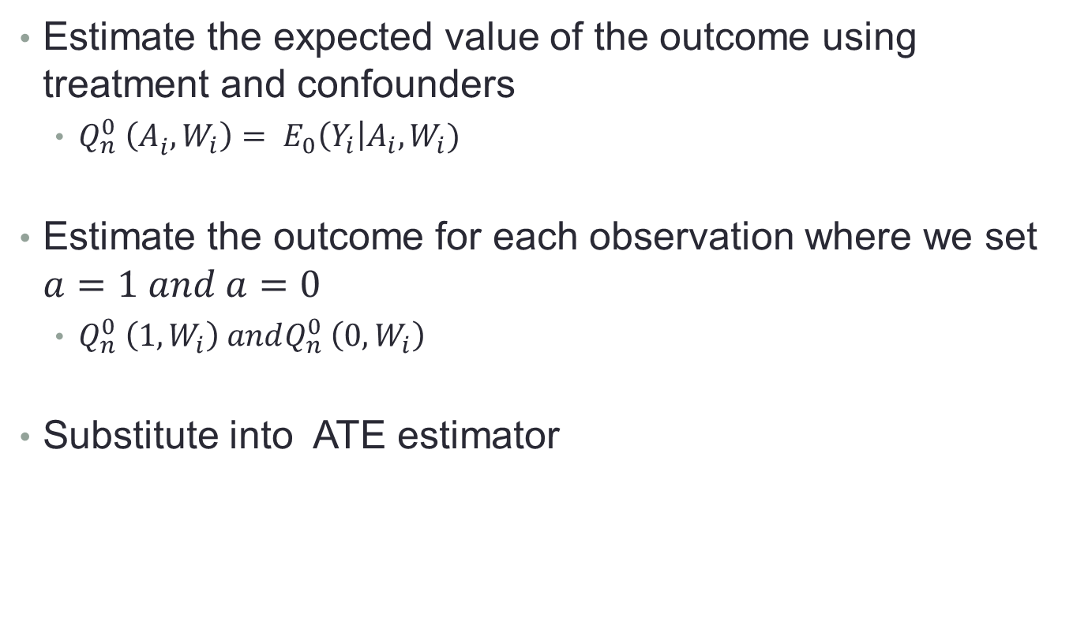
Step1: Estimate the Outcome
Estimate the expected value of the outcome using treatment and confounders
$Q_{n}^{0} \left(A_{i}^{}, W_{i}\right)= E_{0}\left(Y_{i}\right|A_{i}, W_{i})$
Estimate the outcome for each observation where we set $a=1 and a=0$
$Q_{n}^{0} \left(1, W_{i}\right) andQ_{n}^{0} \left(0, W_{i}\right)$
Substitute into ATE estimator

Slide 30
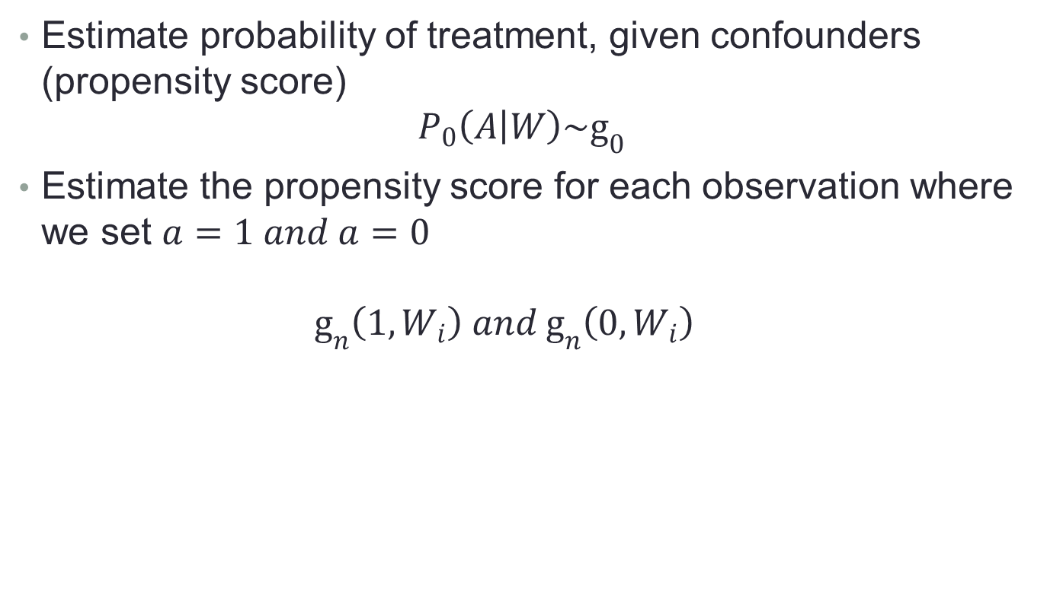
Step2: Estimate the probability of Treatment
Estimate probability of treatment, given confounders (propensity score)
$$P_{0}\left(A | W\right)\sim g_{0}$$
Estimate the propensity score for each observation where we set $a=1 and a=0$
$$g_{n}^{}\left(1, W_{i}\right) and g_{n}^{}\left(0, W_{i}\right)$$

Slide 31

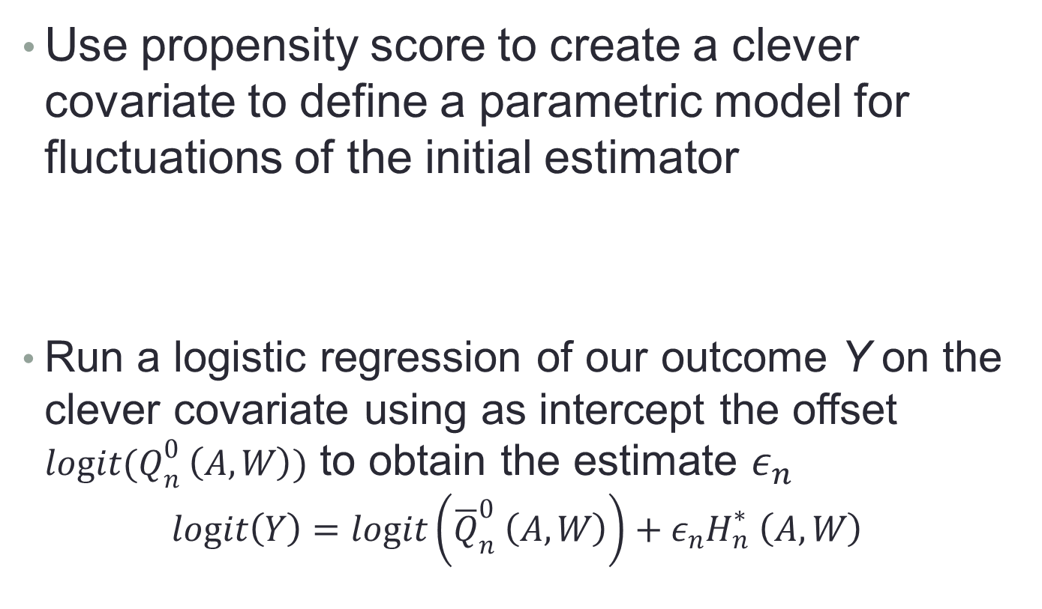
Step3: Estimate the fluctuation parameter
Use propensity score to create a clever covariate to define a parametric model for fluctuations of the initial estimator
Run a logistic regression of our outcome Y on the clever covariate using as intercept the offset $logit(Q_{n}^{0} \left(A, W\right))$ to obtain the estimate $ε_{n}$
$$logit\left(Y\right)=logit\left({\overline{Q}}_{n}^{0} \left(A,W\right)\right)+ε_{n}H_{n}^{∗} \left(A, W\right)$$

Slide 32


Step 4: Update the Initial Estimates of the Expected Outcome
Update the estimate $Q_{n}^{0}$ into a new estimate $Q_{n}^{1}$
Update the prediction at $a=1$ for all observations
Update the prediction at $a=0$ for all observations

Slide 33

Step5: Compute the Statistical Estimand of Interest
Using updated estimates, the formula from step1 becomes

Slide 34
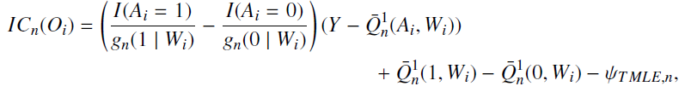
Inferences
Use Influence Curve to obtain statistical inferences
Estimator minus its estimand equals the empirical mean of the influence curve

Slide 35



Inferences
Sample mean
Sample variance
Standard error

Slide 36


Inferences
95% Wald-type confidence interval
P-value

Slide 37
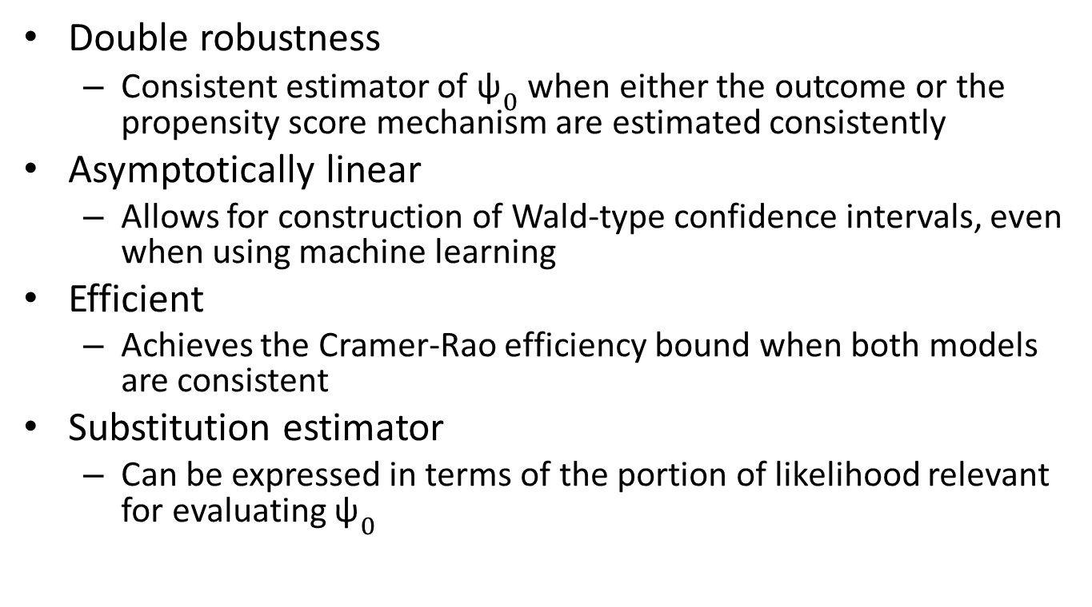
TMLE Properties
Double robustness
Consistent estimator of ${\text{ψ}}_{0}$ when either the outcome or the propensity score mechanism are estimated consistently
Asymptotically linear
Allows for construction of Wald-type confidence intervals, even when using machine learning
Efficient
Achieves the Cramer-Rao efficiency bound when both models are consistent
Substitution estimator
Can be expressed in terms of the portion of likelihood relevant for evaluating ${\text{ψ}}_{0}$

Slide 38
Simulation Dataset
Data structure O=(A, W1, W2, W3,Y)
The confounders W = {W1, W2, W3} are binary with
corresponding mean values of (0.55, 0.30, 0.25)
The exposure A is a binary with
logit(P(A = 1|W1, W2, W3)) = −0.5 + 0.75W1 + W2 +1.5W3.
The outcome Y is normal with standard deviation of 4.5 and the following mean value:
E (Y |A, W1, W2, W3) = 24 − 3A + 3W1 – 4W2 – 6W3−1.5A*W3.

Slide 39
Simulation Design
To check the double robustness property of TMLE, we implemented different types of model misspecifications:
Outcome/Exposure misspecification
the outcome was misspecified
the exposure was misspecified
both outcome and exposure were misspecified.
Variable misspecification
The “main-terms” misspecification
The “omitted variable” misspecification
Unmeasured confounder

Slide 40
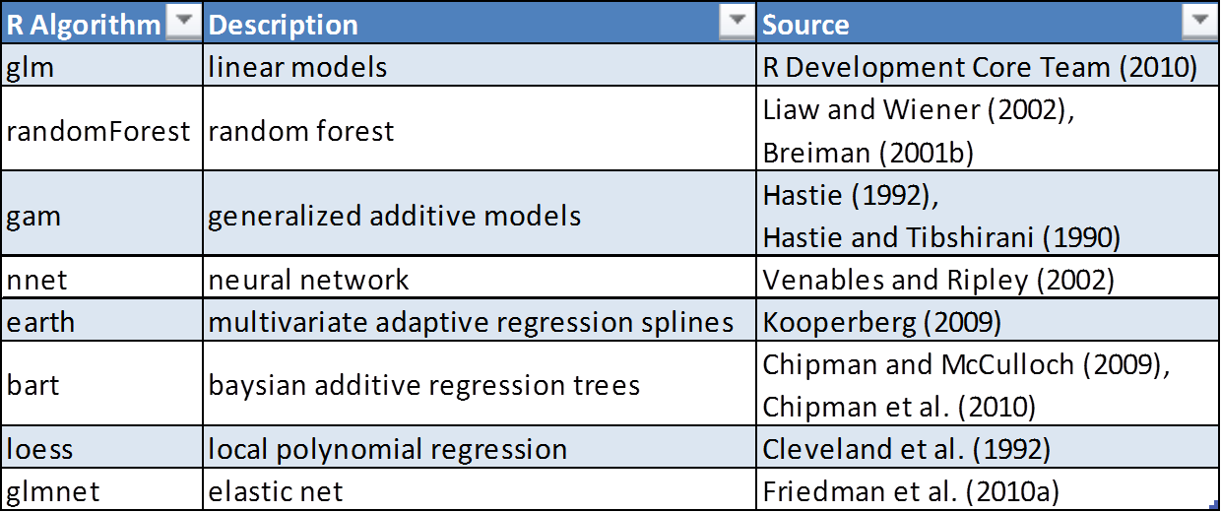
Set of Algorithms for Super Learner

Slide 41
Results

Slide 42
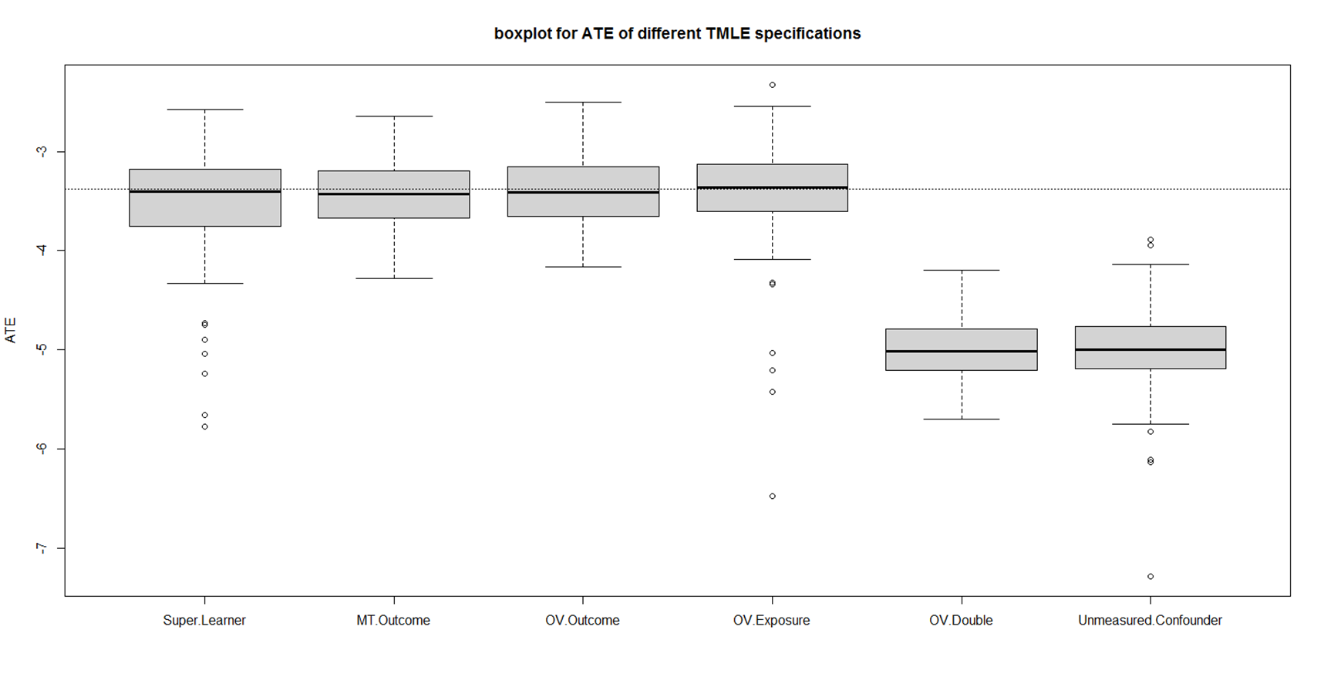
With Neural Networks

Slide 43
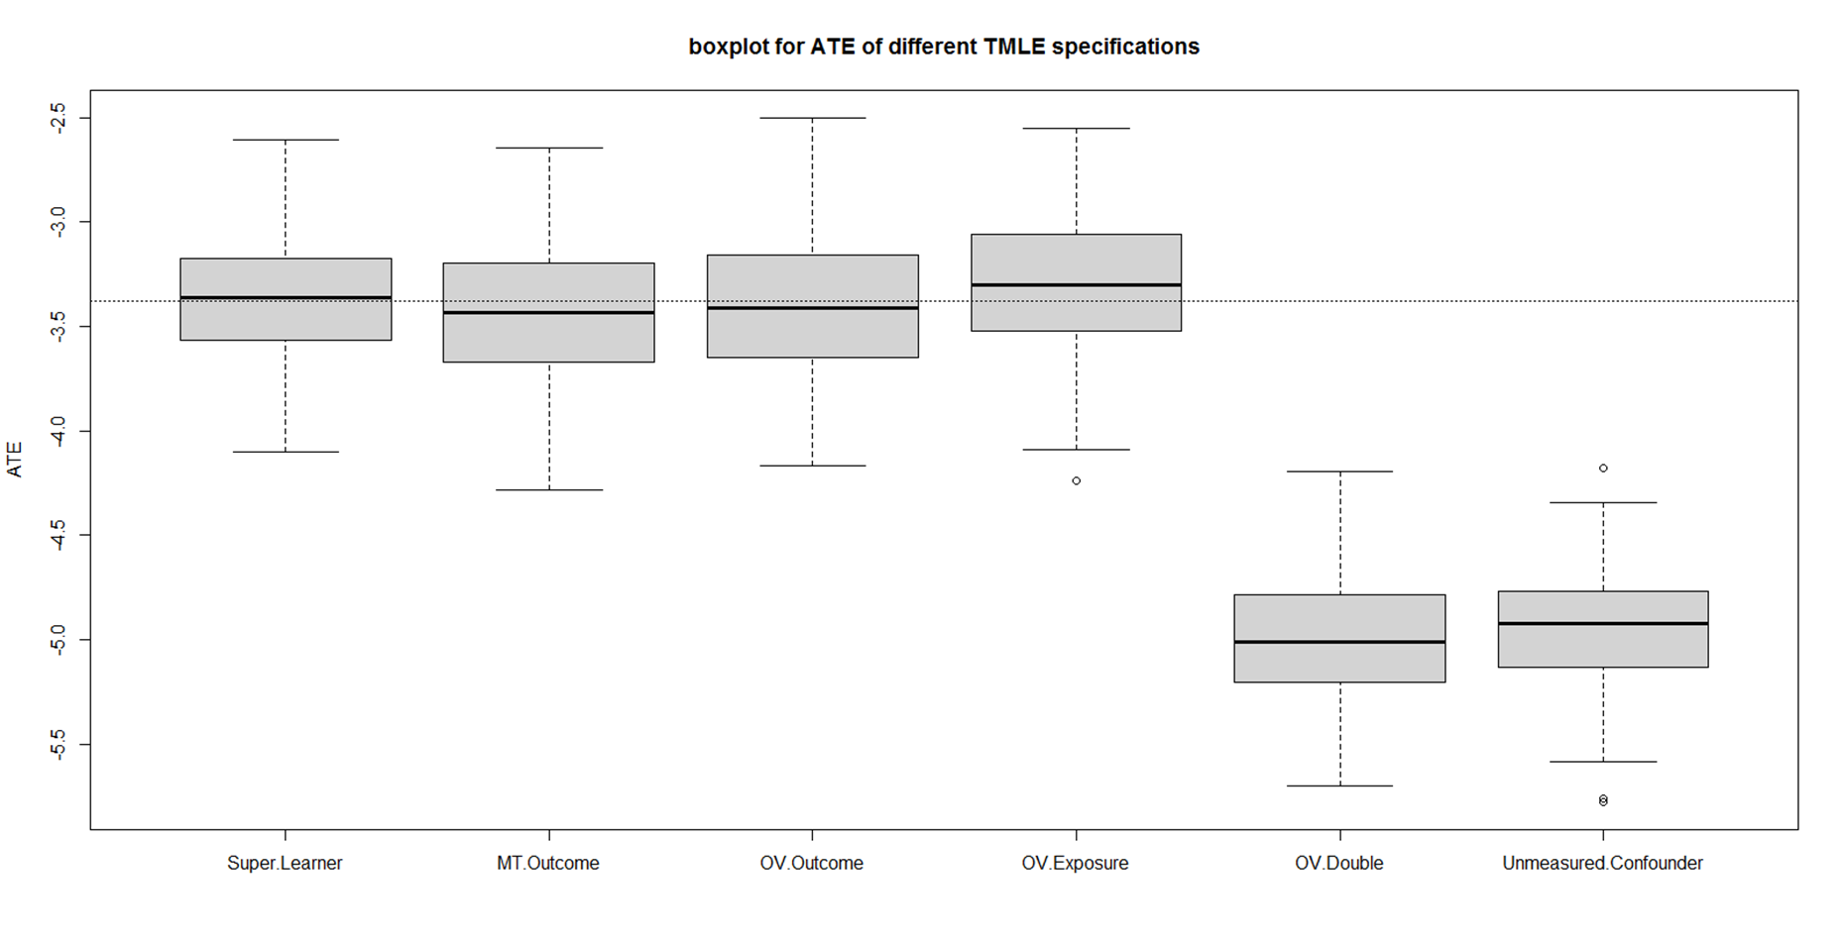
Without Neural Networks

Slide 44
Results
TMLE+ SL produces the best estimate.
TMLE’s double robustness ensures unbiasedness of the ATE if either the exposure or the outcome mechanism is consistently estimated.
If both outcome and exposure are misspecified or we have unmeasured confounder then TMLE cant produce accurate results.
Algorithms such as nnet and xgboost need hyperparameter tuning (time consuming)

Slide 45
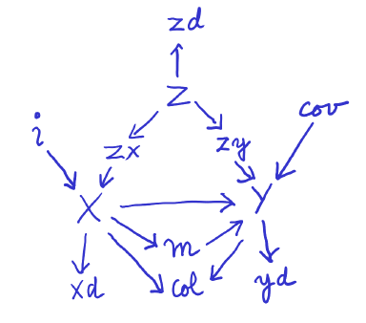
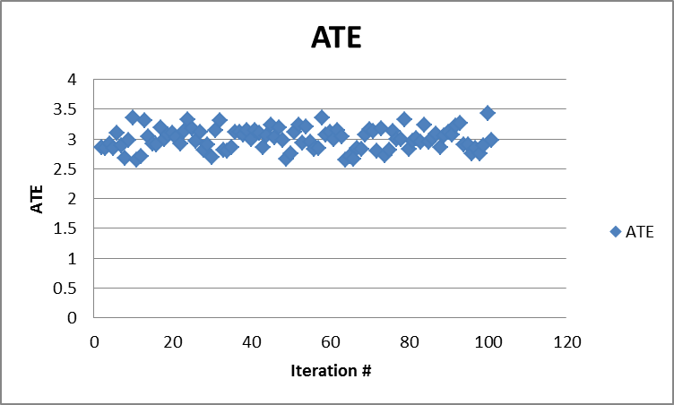
Simulation
Data generating
Results

Slide 46

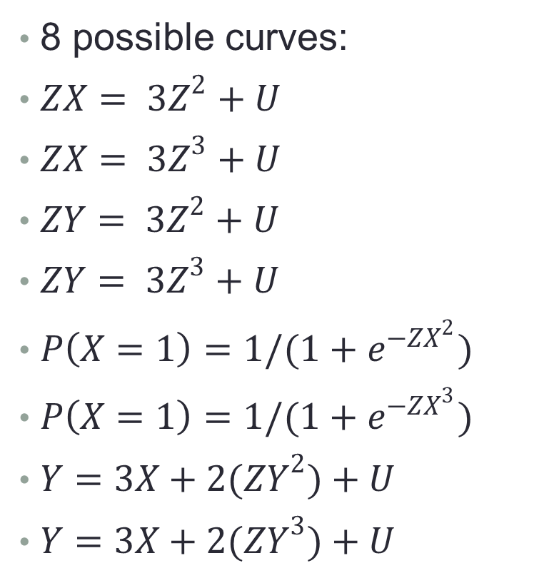
Adding curvature for covariates
8 possible curves:
$ZX= {3Z}^{2}+U$
$ZX= {3Z}^{3}+U$
$ZY= {3Z}^{2}+U$
$ZY= {3Z}^{3}+U$
$P\left(X=1\right)=1/(1+e^{{−ZX}^{2}})$
$P\left(X=1\right)=1/(1+e^{{−ZX}^{3}})$
$Y=3X+2{(ZY}^{2})+U$
$Y=3X+2{(ZY}^{3})+U$

Slide 47
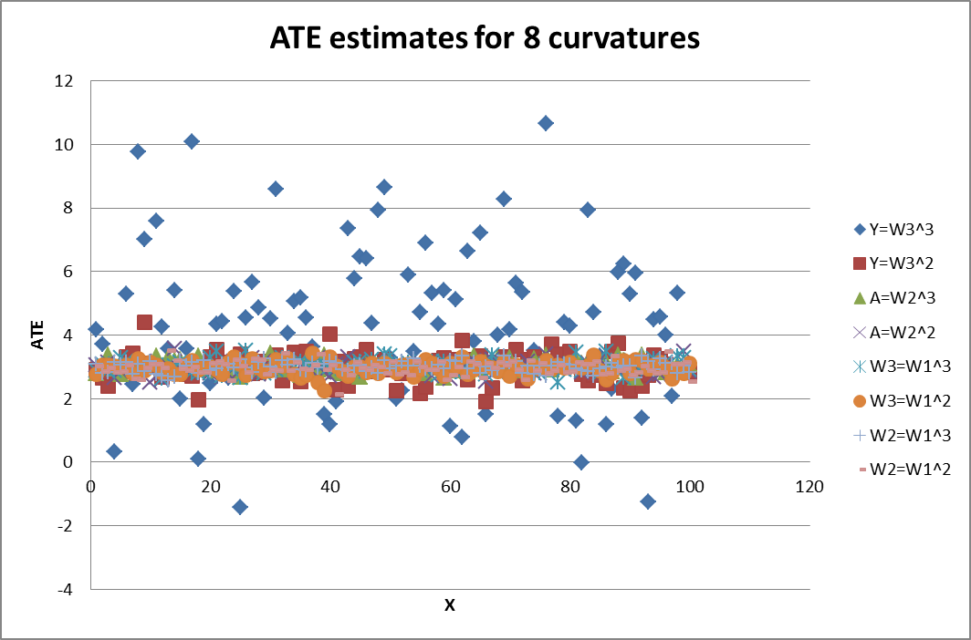
Results

Slide 48
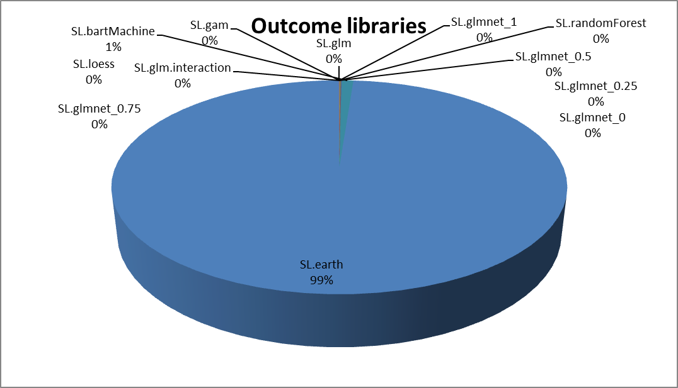
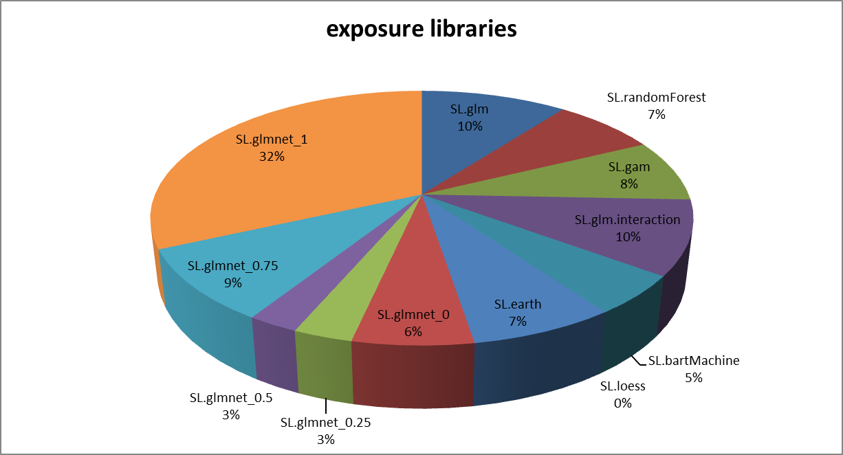
Super Learner Libraries for Y=ZY^3 + U

Slide 49
Solution by C-TMLE?
Challenge: High correlations among some of the covariates makes it difficult to obtain stable, low variance estimates of the association between A and Y
Targeted confounder selection strategy for pscore estimation is guided by effect on Ψ
C-TMLE
collaborative double robustness + TMLE
performs well in challenging scenarios

Slide 50
Conclusion
Targeted Learning integrates causal inference, machine learning, statistical theory.
TMLE provides doubly robust estimation for complex observations, particularly high dimensional data
The estimate is accompanied with confidence interval and p-value

Slide 51
References
van der Laan MJ and Rose S. (2011) Targeted learning: causal inference for observational and experimental data. Springer
Hastie T, Tibshirani R, Friedman J. (2009) The Elements of Statistical Learning. Springer
van der Laan MJ, Polley EC and Hubbard A. (2007) Super Learner. Statistical Applications of Genetics and Molecular Biology, 6, article 25
Petersen M, Porter K, Gruber S, Wang Y, and van der Laan MJ. (2012) Diagnosing and responding to violations in the positivity assumption. Statistical Methods in Medical Research, 21(1):31–54
Schuler M and Rose S. (2016) Targeted Maximum Likelihood Estimation for Causal Inference in Observational Studies. American Journal of Epidemiology, Volume 185, Issue 1

