Slide 1
NYC neighborhoods vs. Moscow neighborhoods
Guretsky Evgeny

Slide 2
Problem
What is better place for launching a new branch of fitness clubs?

Slide 3
Methodology
Download data with neighborhoods and their coordinates, in case of absence scrape from the web.
Get venues for each neighborhood
Prepare data for ML
Conduct ML (k-mean)
Examine clusters
Those of two will be a better place for a new business, cluster of which contains sport gyms in top attendance place

Slide 4
Used Python libraries
Pandas – data wrangling
Request – get html
Numpy – work with tables
Beatifulsoup – parsing
Geocoder – get coordinates
Folium – for visualization
Re – text formatting
Json – certain format refinement
Sklearn – k-mean algorithm
Matplotlib - graphs

Slide 5
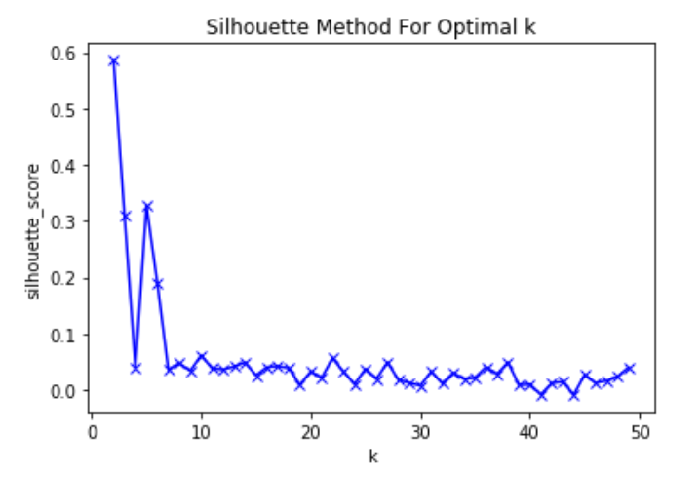
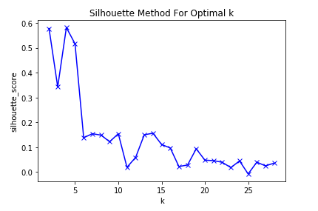
K-mean clustering
NYC “k” = 5
Moscow “k” = 4
In purpose of comparison we will take k=4 for both

Slide 6
Results

Slide 7
Conclusion
In this iteration, with all conditions we have, Moscow is a better place for starting a new branch of sport clubs, as according to data get from Foursquare API, in Moscow cluster 3, gym is in top 2 place for attendance.

