Slide 1
Kigali Wedding Venue Booking Analysis
Tabitha Kunda | ID: 27684 | Event Planning / Hospitality

Slide 2
Problem Statement
Wedding venue availability is a major challenge in Kigali.
Couples struggle to secure venues on preferred dates, and prices vary widely by district.
This project provides insights into demand, pricing, and availability using data analytics.

Slide 3
Dataset & Methods
• Dataset: 23 wedding venues with details on name, location, capacity, price, booking status, and date.
• Python: Used for data cleaning, exploration, and summary statistics.
• Power BI: Used to create interactive dashboards and visual insights.

Slide 4
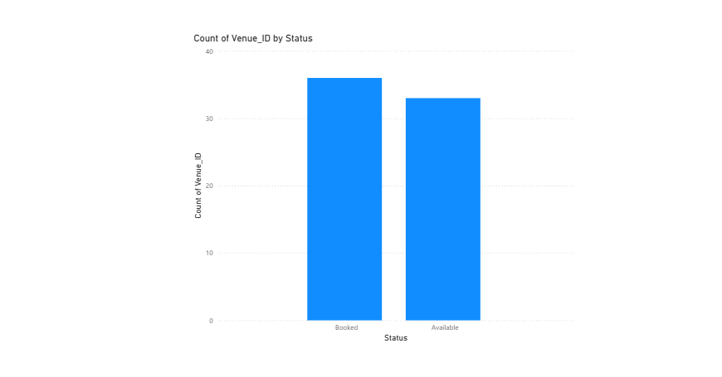
Count of Venue ID by Booking Status
This chart shows how many venues are booked vs available.
• Over 50% of venues are already booked, indicating high demand.

Slide 5
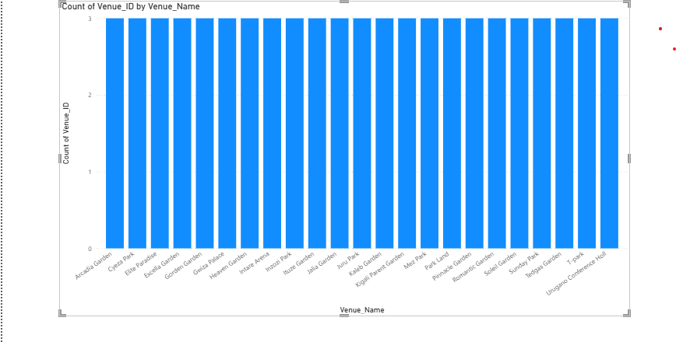
Venue Count by Venue Name
This bar chart highlights the most booked venues.
• Mez Park, Arcadia Garden, and Heaven Garden are the top choices among couples.

Slide 6
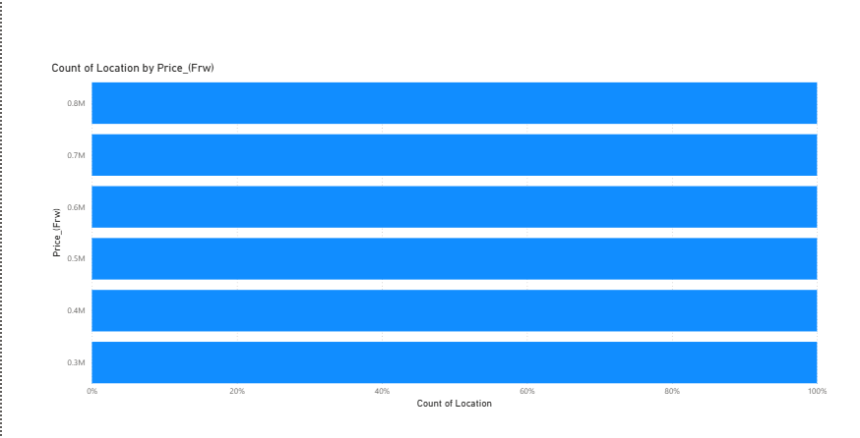
Average Venue Price by Location
This chart compares average venue prices by district.
• Kicukiro is the most expensive on average, followed by Gasabo and Nyarugenge.

Slide 7
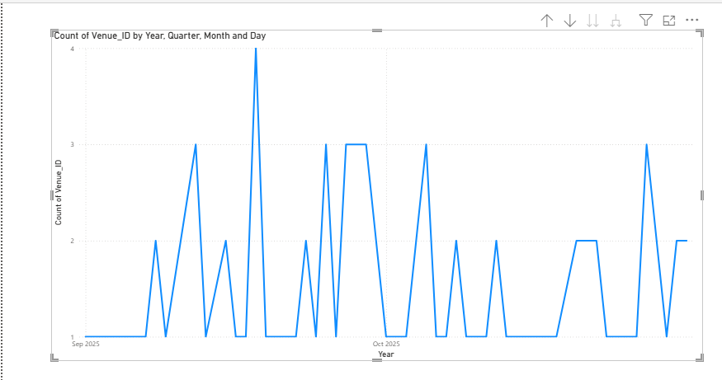
Bookings Over Time
This line chart shows booking patterns by date.
• Peak bookings occur in late September, revealing popular wedding periods.

Slide 8
Key Insights
• Over half of venues are already booked, showing strong demand.
• Mez Park, Arcadia Garden, and Heaven Garden are the most booked venues.
• Kicukiro has the highest average prices.
• Peak wedding bookings occur in late September.

Slide 9
Conclusion
This analysis helps couples plan weddings more effectively and assists venue managers in understanding demand trends.
Tools Used: Python & Power BI.

