Slide 1






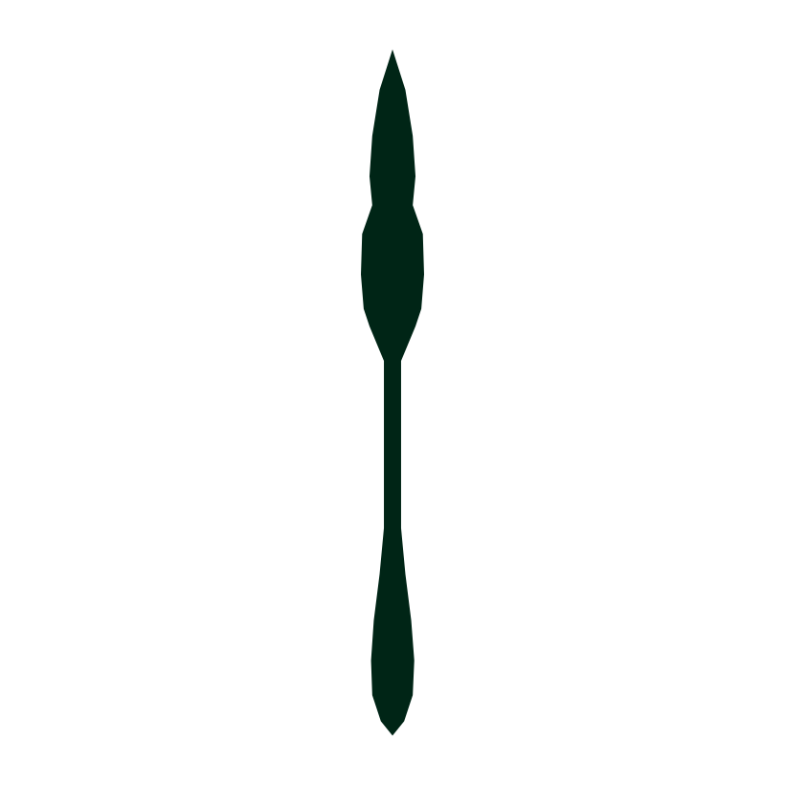
COMBAT MINDSET BRANDMARK
The taiaha at the centre
Army Command School
August 2026
The taiaha is a stronger centre than a spearhead. It is a rangatira's weapon, carrying skill, discipline and mana rather than force alone, and it already sits in NZ Army heraldry. It is drawn here in silhouette only: arero, upoko, ate and rau, with no carving detail.
Three arcs
The pressure that surrounds, and the Prepare, Perform, Recover cycle.
A solid core
Self-command. The centre holds while the environment does not.
The taiaha
Trained, disciplined capability. Held ready, used decisively.
See clearly. Remain controlled. Act decisively.
APPLICATIONS
On white
Single colour
In the patch
Reduced
AT SIZE
30 mm
20 mm
12 mm
7 mm
WHY THE HEAD, NOT THE WHOLE WEAPON
Drawn to true proportions the taiaha is very slender: the ate is roughly one fiftieth of its length. At badge size that shaft becomes a hairline and the weapon reads as a stick. The mark therefore carries the arero and upoko, the part that is unmistakably a taiaha, with the collar binding struck in red.
Note. The taiaha already appears in NZ Army heraldry, so this draws on the Army's own device rather than introducing new imagery. Even so, a mark that places a taiaha at its centre should be confirmed through the appropriate cultural advice before it is adopted.

