Slide 1

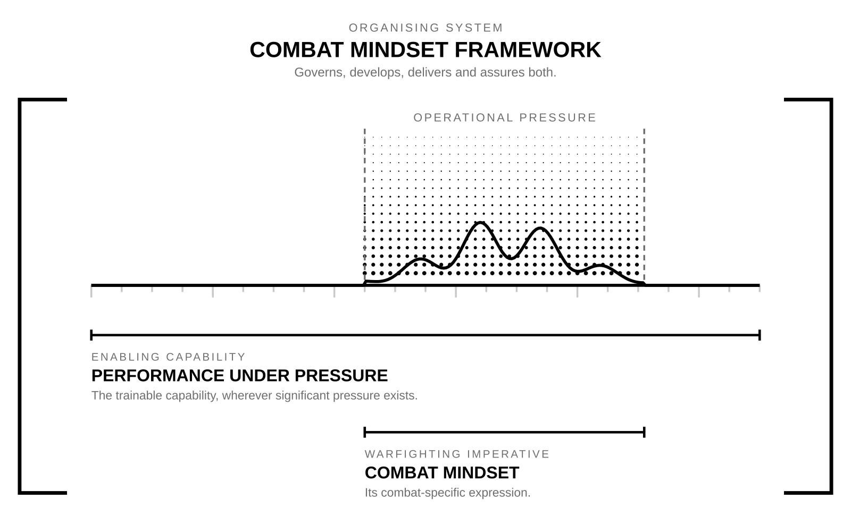

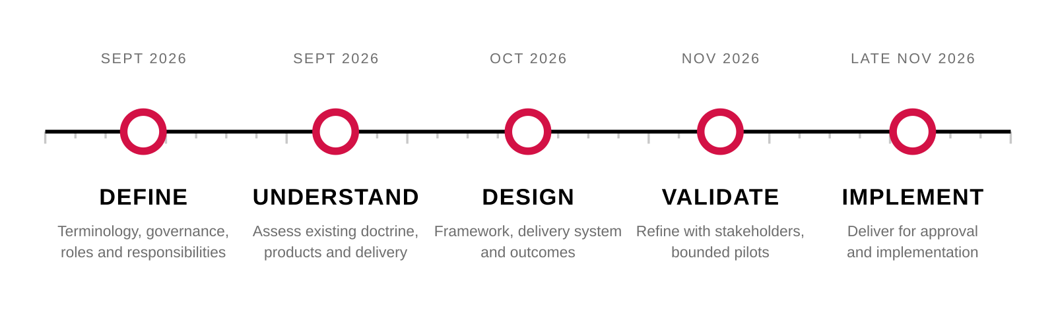
NZ ARMY COMBAT MINDSET FRAMEWORK PROPOSAL
The model on a page
Army Command School
THE MODEL
THE OUTCOME
Remain effective. Act decisively.
Harder to kill.
THE FRAMEWORK DEVELOPMENT PROGRAMME
Each node marks the point at which a phase output is committed. Phases may overlap, but each depends on the endorsed outputs of the one before it.
FRAMEWORK
August 2026

