Slide 1



UNCLASSIFIED
NZALC
Lead Teams
Lead Self. Lead Teams. Win the Mission.
UNCLASSIFIED

Slide 2

UNCLASSIFIED
NZALC Vision
To support, educate and enable NZ Army Commanders.
To maximise individual potential, so they succeed in garrison and win on operations.
COURAGE COMMITMENT COMRADESHIP INTEGRITY
2
UNCLASSIFIED

Slide 3
UNCLASSIFIED
The Transition
LEAD SELF
→
LEAD TEAMS
The most significant shift in your career.
You are no longer responsible only for your own standards. You are responsible for the standards, performance and welfare of others: under pressure, in the field, and in garrison.
This course is built around that transition.
3
UNCLASSIFIED

Slide 4
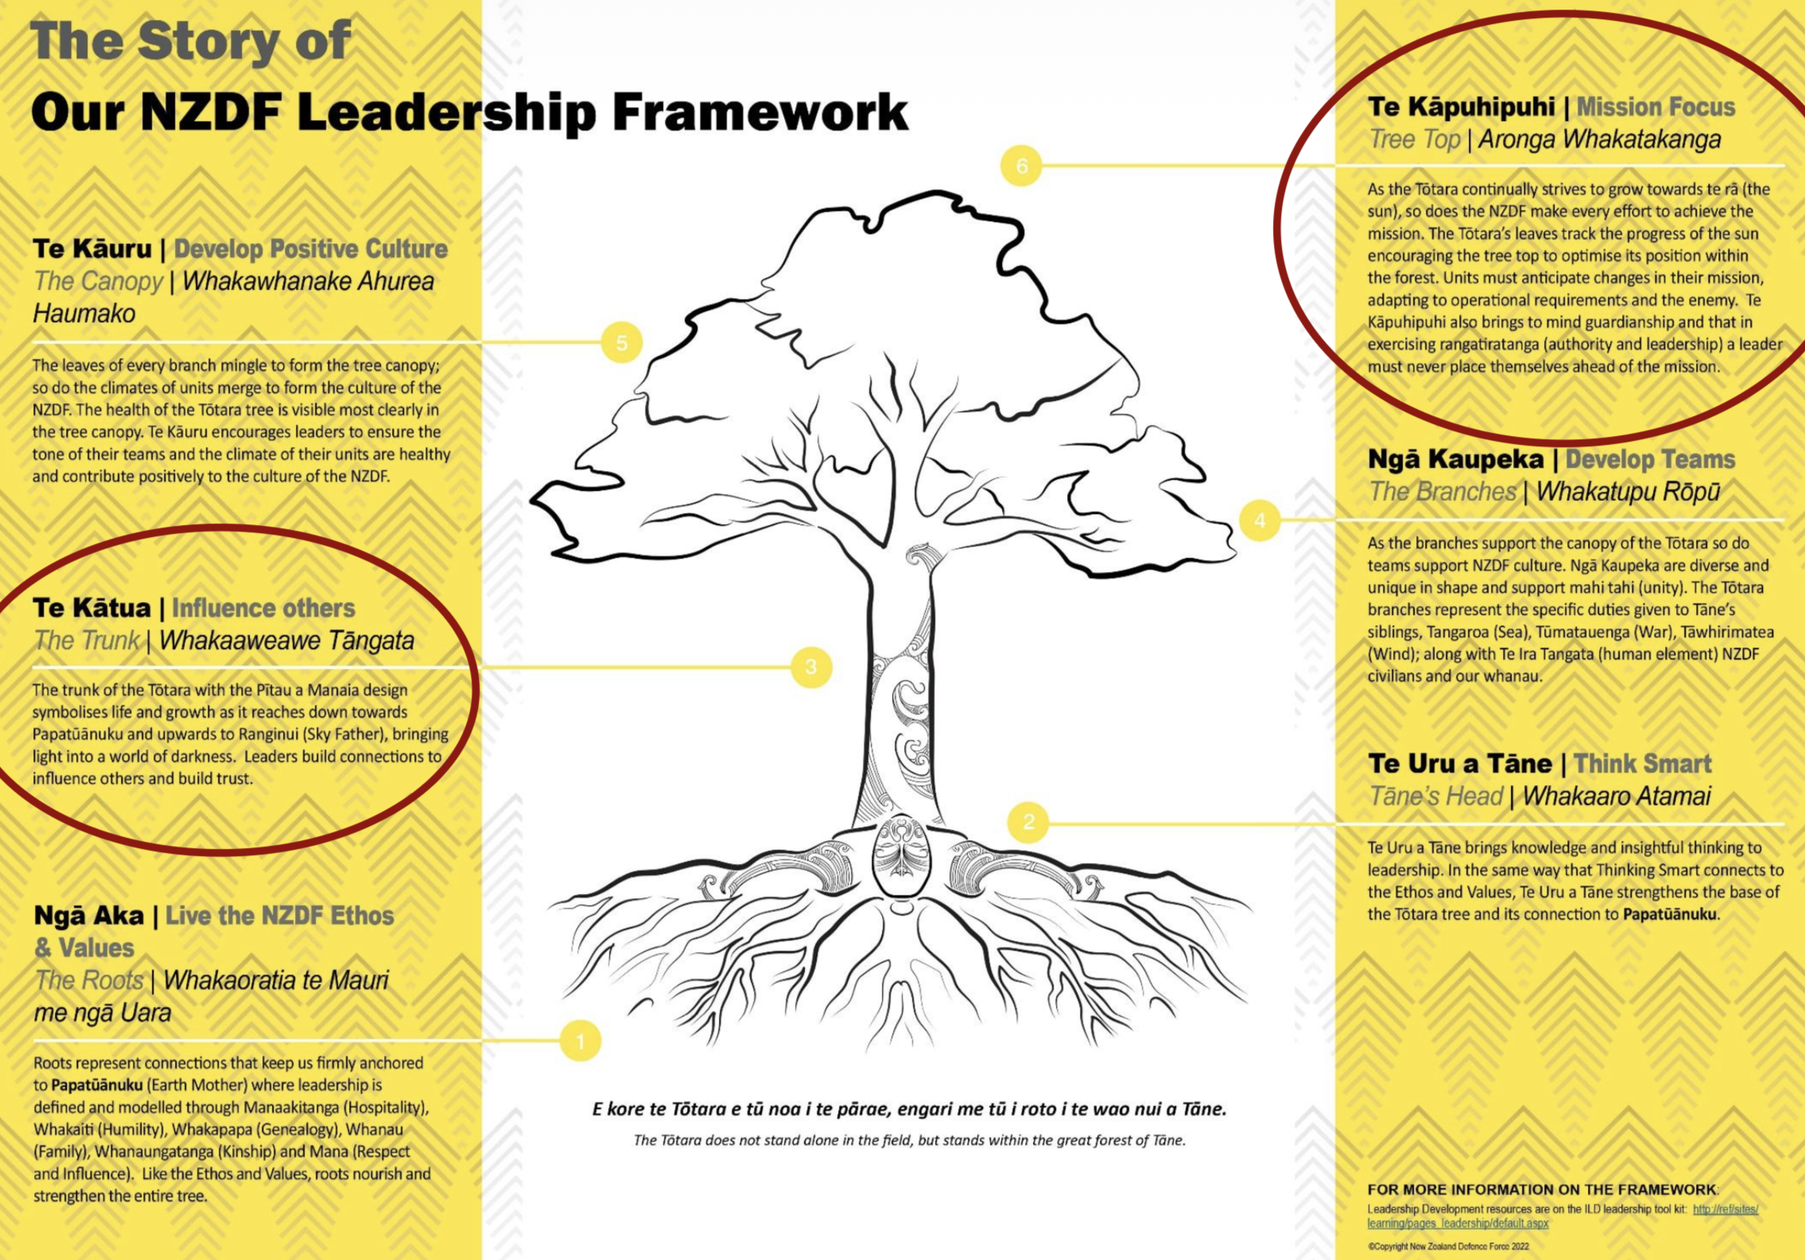
UNCLASSIFIED
The Framework
YOUR FOCUS
MISSION FOCUS
YOUR FOCUS
INFLUENCE OTHERS
4
UNCLASSIFIED

Slide 5
UNCLASSIFIED
Your Two Weeks
WEEK 1
WEEK 2
THIS WEEK
ELDA Lead Teams
LDS Lead Teams
Mon – Sat
Mon – Fri
→
Performance under pressure. You experience and practise leadership under physical and mental pressure.
Self-awareness and leadership development. You process, understand and integrate what you have experienced into your development as leaders.
EXPERIENCE → REFLECT & UNDERSTAND → DEVELOP
5
UNCLASSIFIED

Slide 6
UNCLASSIFIED
The Domain Model
Four domains of leadership competency.
INTRAPERSONAL
INTERPERSONAL
LEADERSHIP
TECHNICAL
How you behave
How you relate
How you lead
How you think & plan
Self-control & resilience
Build & sustain relationships
Develop individuals & teams
Knowledge, management & decision-making
WHICH COURSE COVERS WHICH DOMAINS
ELDA Lead Teams
LDS Lead Teams
RF JNCO Course
6
UNCLASSIFIED

Slide 7
UNCLASSIFIED
What ELDA Means
E
Experiential
You learn by doing.
L
Leadership
Under pressure, with consequences.
D
Development
Growth, not assessment.
A
Activity
In tough country, on your feet.
7
UNCLASSIFIED

Slide 8
UNCLASSIFIED
The Aim
To enhance individual performance and resilience through small team leadership in a physically and mentally challenging environment.
We are not testing you. We are developing you.
8
UNCLASSIFIED

Slide 9
UNCLASSIFIED
Why It Matters
Pressure exposes leadership.
TASK
The goal is to minimise the adverse effects of pressure on tasks and relationships: yours, and your team's.
Resilient leaders carry less risk. Resilient teams sustain output, morale and performance when others fall away.
INDIVIDUAL
TEAM
Your job: keep all three in play, especially when pressure is on.
9
UNCLASSIFIED

Slide 10
UNCLASSIFIED
Prepare. Perform. Recover.
By the end of this week you will understand and demonstrate how your actions and words can help, or hinder, team performance under pressure.
PREPARE
PERFORM
RECOVER
Day 1
Day 1 – 5
Day 6
Develop a performance mindset
Conduct the activity
Build your Leadership Development Plan
10
UNCLASSIFIED

Slide 11
UNCLASSIFIED
The Activity
Non-tactical close country navigation.
MT RICHARDSON
40 KM
3,000 M
NIGHT
training area
of movement
vertical gain
travel required
SELF-SUPPORTED / SELF-LED
SCOPE
LOGISTICS
Tracked and untracked terrain
Close country navigation
No huts en-route: issue field kit
Food: ORP and gas cookers
Equipment: FSMO + NZALC issue
Accommodation: Half shelter
Transport: Drivers provided
NZALC cookers & torches only. Missing kit? Tell DS now. Leave no trace.
11
UNCLASSIFIED

Slide 12
UNCLASSIFIED
Day 1: Today
0900 – 1200
Introduction. NZDF performance under pressure tools.
1200 – 1245
Lunch.
1245 – 1715
Task, team and individual expectations. Gear issue and equipment check.
1715 – 1840
Dinner. Individual prep.
1905
Move to training area. Activity commences NLT 2100.
WELFARE: FAMILY CONTACT
Family emergency during the field phase: NZALC Duty Phone: 027 441 4352. Brief your family before Monday night.
12
UNCLASSIFIED

Slide 13
UNCLASSIFIED
A Final Word
This week is not about whether you can carry a pack 40 kilometres.
It is about whether, when you are tired, cold, and the team is looking at you, your actions and your words lift the team or break it.
That is what we are here to develop.
LEAD SELF.
LEAD TEAMS.
WIN THE MISSION.
13
UNCLASSIFIED

Slide 14
UNCLASSIFIED
Over to you.
Questions, comments, concerns.
14
UNCLASSIFIED

Slide 15
UNCLASSIFIED
HEI MANA MŌ AOTEAROA
A FORCE FOR NEW ZEALAND
UNCLASSIFIED

