Slide 1

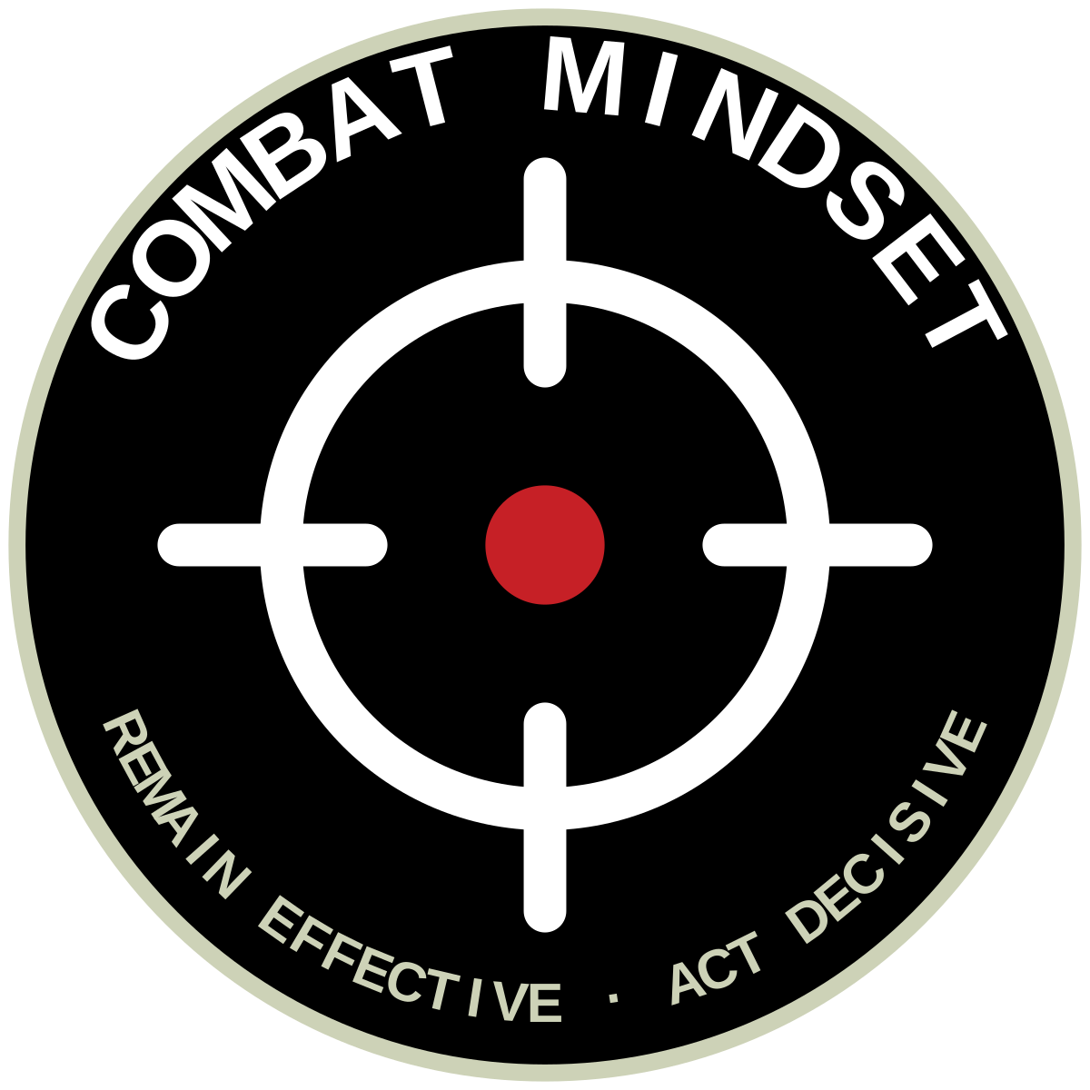
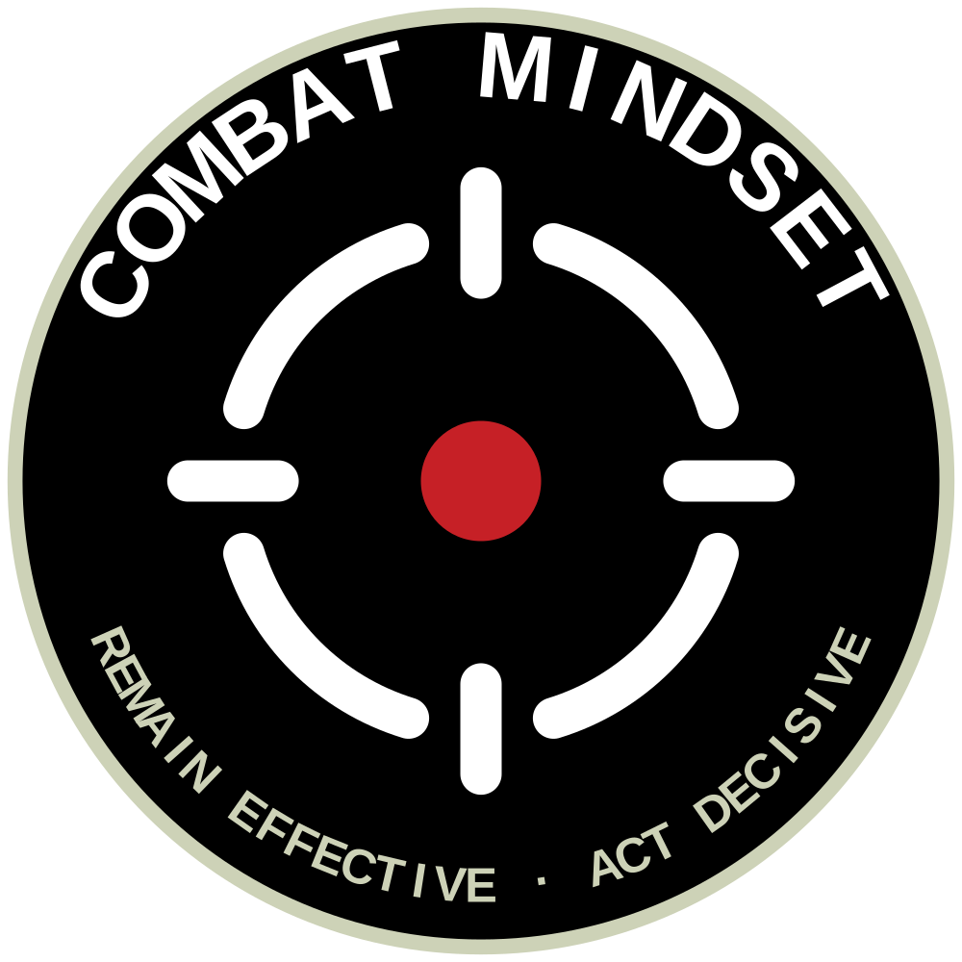
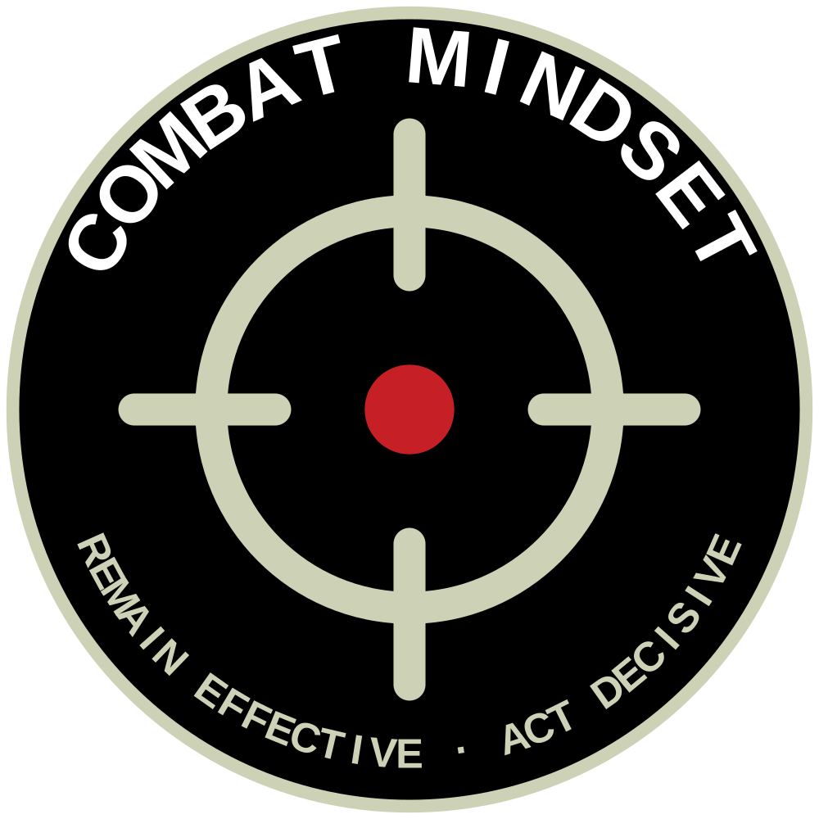
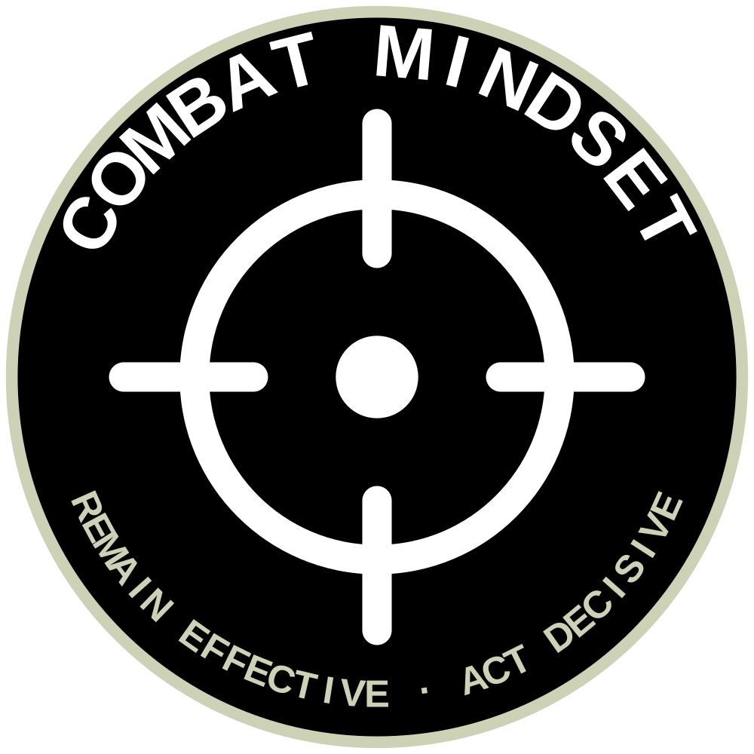
UNCLASSIFIED
PATCH — CLEAN RETICLE CENTRE
The 7G patch chassis retained; sword and taiaha removed; centre replaced with the clean-board reticle. Exploration only.
9B OBJECTIVE PATCH
The clean objective reticle at the heart of the patch: sight ticks crossing the ring on a single red centre — the mission remains the centre. No weapons, no letters; one idea.
alternative — focus-point centre
tonal — subdued field wear
single ink — embroidery
size ladder
Chassis unchanged from 7G: black disc, Moawhango ring, arc wordmark and tagline.
Centre reticle drawn from the clean brandmark exploration, option 3 — Objective (focus point offered as alternative).
Tagline wording (“Act Decisive” vs “Act decisively”) remains to be confirmed.
All marks remain subject to sponsor endorsement and Defence heraldry check.
UNCLASSIFIED
Army Command School · ACS 2026
Concept board 7 · July 2026

