Slide 1
1
2
3
4

Slide 2

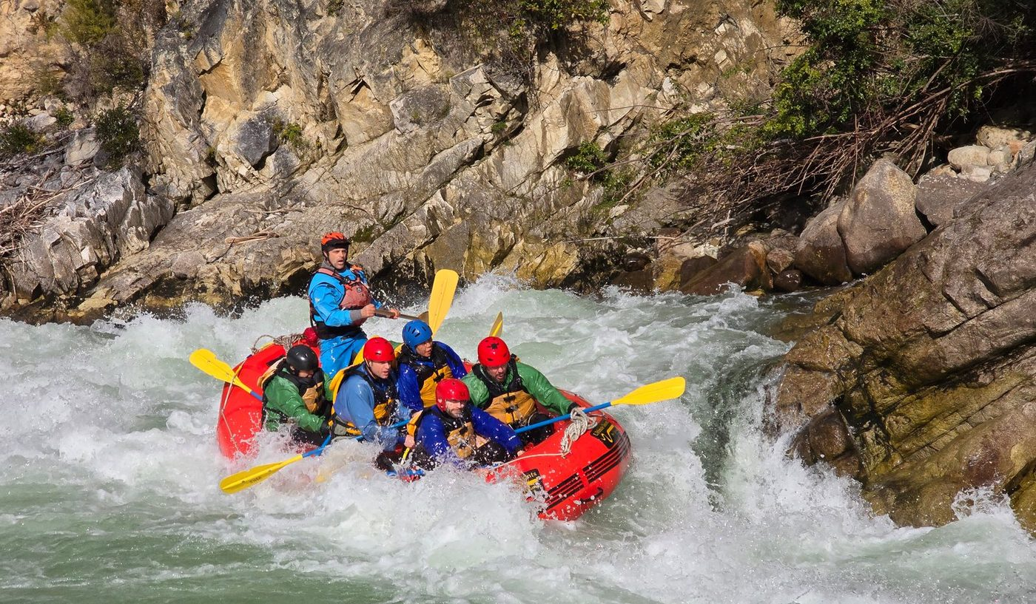
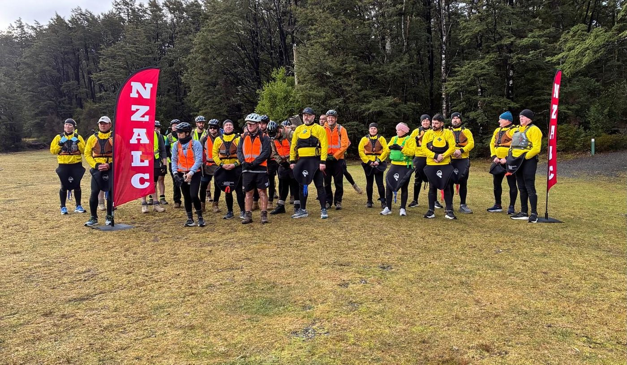
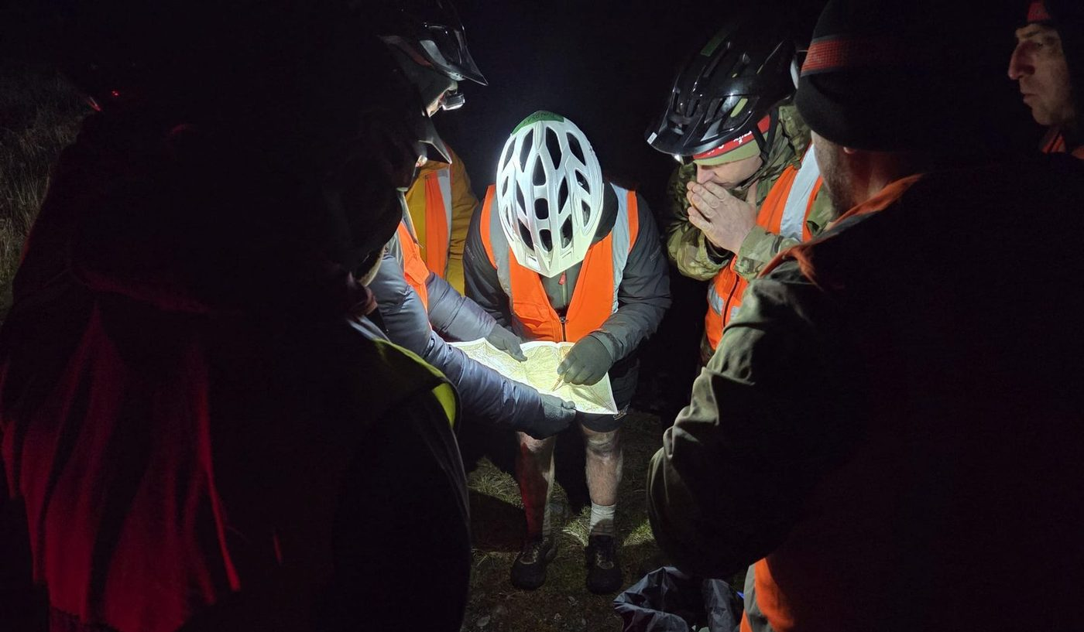
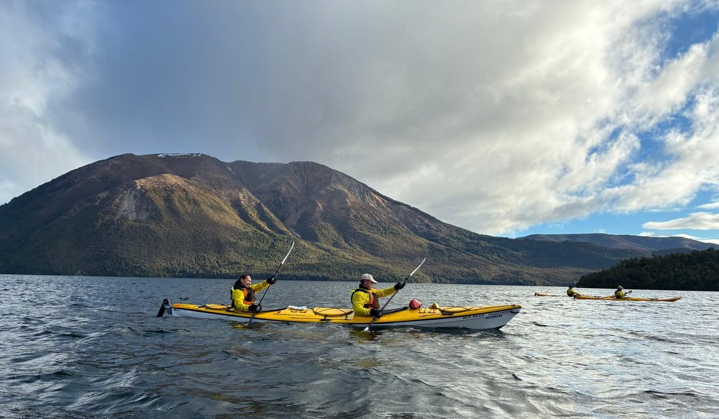
Army Command School · NZ Army Leadership Centre
ELDA Lead Systems NCO Course · 7 – 14 Aug 26
To enhance leadership and warrior ethos through the conduct of a challenging multisport activity, supported by leadership tools, psychometrics, reflection and behaviour selection.
1
2
27 NZ Army and Australian Defence Force personnel completed ELDA Lead Systems together, strengthening joint leadership development ties.
The three-day rogaine, culminating in a whitewater rafting descent, forced planning and execution against incomplete information: direct evidence of resilience, judgement and teamwork under pressure.
Leadership diagnostics, structured debriefs and individual Leadership Development Plans converted reflection into readiness, building the combat mindset required at lead systems level.
3
4
“An excellent course that required a high level of personal drive and commitment, whilst also reinforcing the importance of working as a team towards a common goal.” Student evaluation
1 Whitewater descent, day three · 2 Lake leg of the rogaine · 3 Night navigation planning · 4 Course group with ADF personnel
EXAMPLE
Notes:
Worked example of the ATG storyboard. Content and photographs from the NZALC ELDA Lead Systems NCO Course storyboard; photo captions are illustrative.

Slide 3
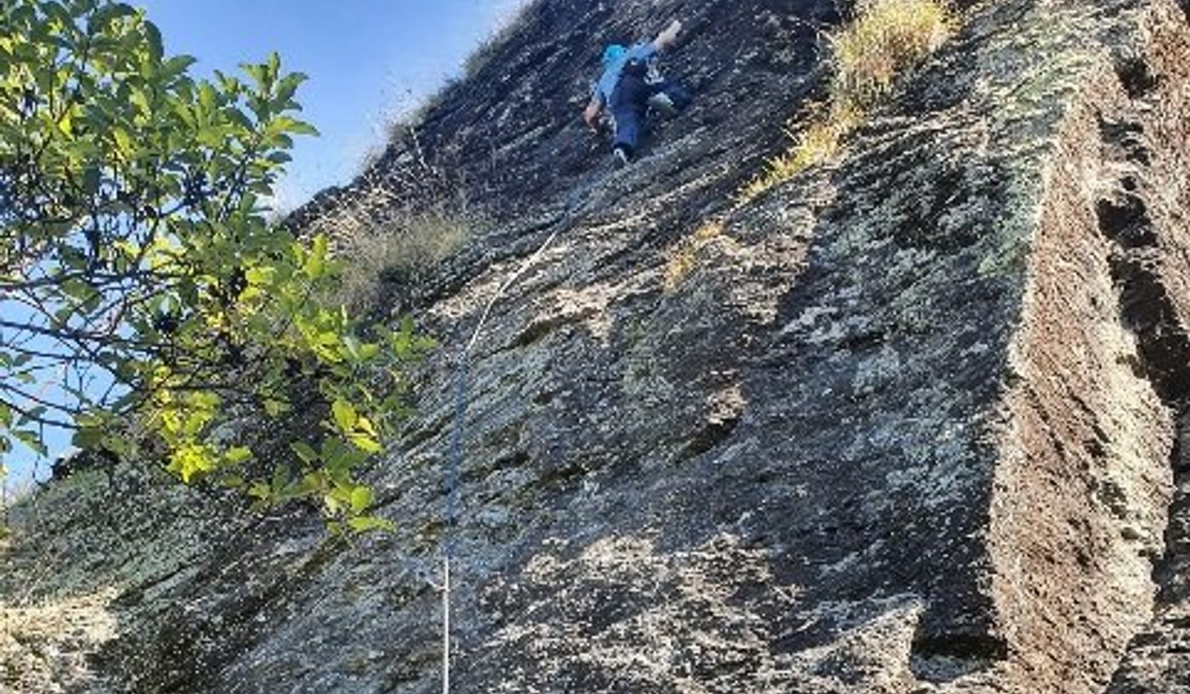
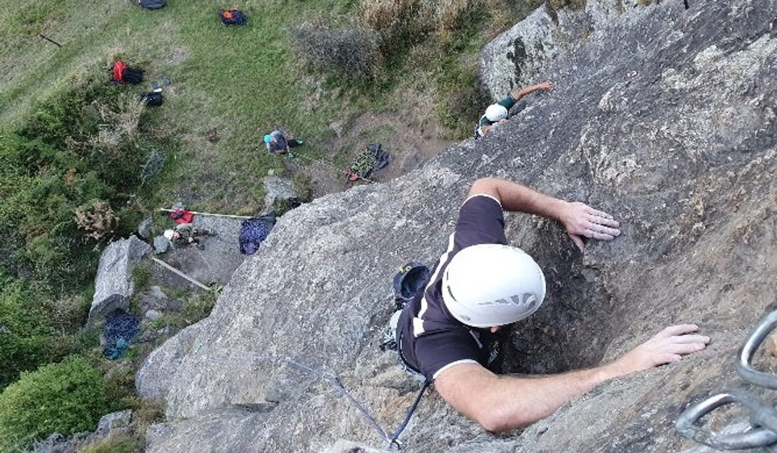
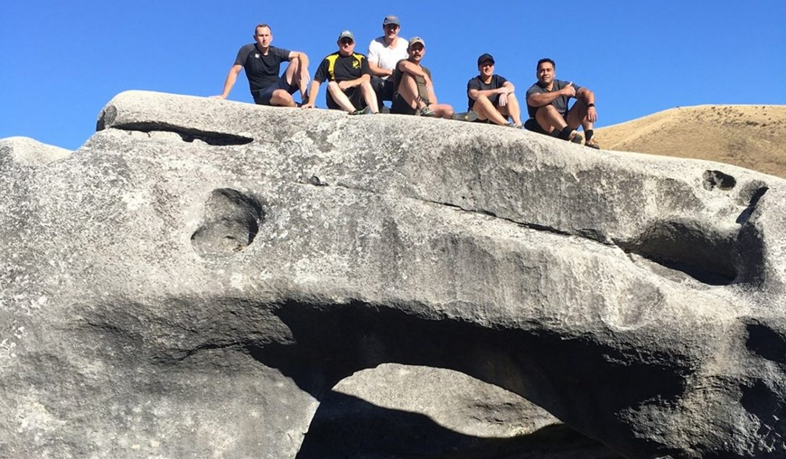
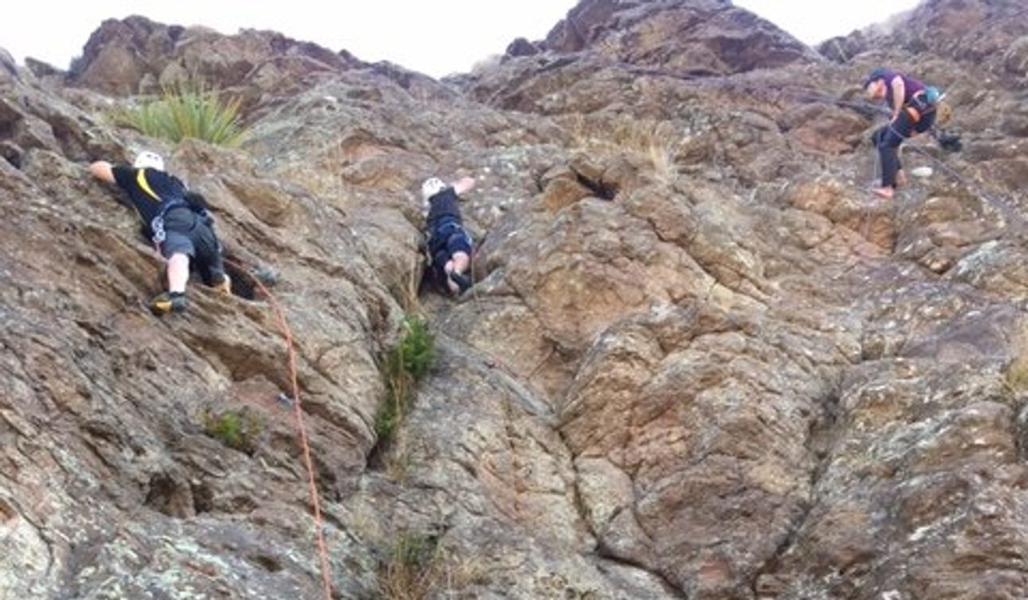
Army Command School · NZ Army Leadership Centre
ELDA Lead Leaders, SNCO Promotion Course · Christchurch and Wanaka
To enhance leadership and maintain warrior ethos in order to provide world-class, operationally focused leaders, through a challenging rock-climbing activity supported by leadership tools, a Hogan psychometric report, reflection and behaviour selection.
1
2
30 students completed the ELDA phase of Lead Leaders: 21 from the SNCO Promotion Course and seven junior officers, in syndicates of up to eight across Christchurch and Wanaka.
Facilitation content combined with rock climbing enabled behaviour-based peer feedback: an accurate snapshot of each student's current behaviour and its impact on others.
Peer-endorsed strategies gave every student a practical plan to lift intrapersonal and interpersonal effectiveness under the Domain Model.
3
4
Student evaluations indicate the course was well conducted, with students extremely pleased with the facilitation content and its delivery by instructors. Student evaluation summary
1 Lead climb on the main face · 2 Top-rope pitch, Wanaka · 3 Syndicate on the summit block · 4 Abseil descent
EXAMPLE
Notes:
Second worked example, from the example board in the previous ATG template (Lead Leaders rock-climbing ELDA). The source carried no dates, so the activity line names the locations; photo captions are illustrative.

Slide 4





ATG Storyboard
How to complete and submit the board · template in use from 15 Oct 25
01 SUBMISSION
The board moves from the unit to ATG Registry, is checked, and is released once approved.
Unit
ATG Registry
ATG S75 check
CoS
Approved
ATG Registry releases to OLCC
Not approved
Returned to the unit for resubmission
02 COMPLETING THE BOARD
03 UNIT BADGES
Fill each field on the template slide; the frame itself is locked in the layout.
Copy your unit's badge into the header.
Header
Text
Photos
Captions
Unit and sub-unit, activity name and dates. Insert your unit badge from the set at right.
Purpose, then delivery and effect in three or four points, then a line of participant feedback. Each field shrinks to fit.
Four landscape photos, numbered 1 to 4. Click a frame to insert; PowerPoint crops to fit.
One line beneath the photos, numbered to match. Name the activity, place and date where useful.
OCS (NZ)
The Army Depot
MCTC
ATG
LOTC
Notes:
Submission flow as issued by ATG on 13 Oct 25. Unit badges carried over from the previous template.

