Slide 1

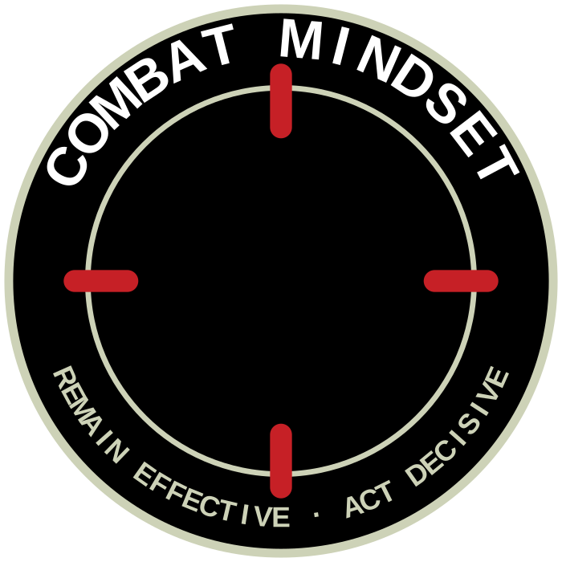

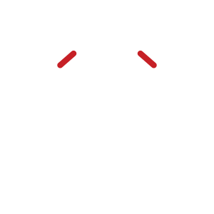




UNCLASSIFIED
CREST CENTRE SYMBOLS — ITERATIONS
Replacing the CM monogram with a combat-oriented symbol. Exploration only; no mark is endorsed.
7A CROSSED SWORDS
7B CROSSED TAIAHA
The traditional combat symbol — already the Combat Mindset icon on the Way Forward model.
Ngāti Tūmatauenga — the Army's own weapon. Combat rooted in New Zealand warrior identity. [cultural consultation required]
7C SPEARHEAD
7D AIMING POINT
The point of the spear — offensive spirit, momentum and the will to close with the enemy.
The pure reticle: one point of focus. Most minimal, most ownable, strongest tie to the roundel.
7E INNER FIRE
7F DECISIVE STRIKE
The warrior spirit that endures pressure — controlled, not extinguished.
Speed and violence of action — act decisively, rendered literally.
Any centre symbol must clear Defence heraldry and, where Māori design elements are used, appropriate cultural consultation, before adoption.
UNCLASSIFIED
Army Command School · ACS 2026
Concept board 4 · July 2026

