Slide 1



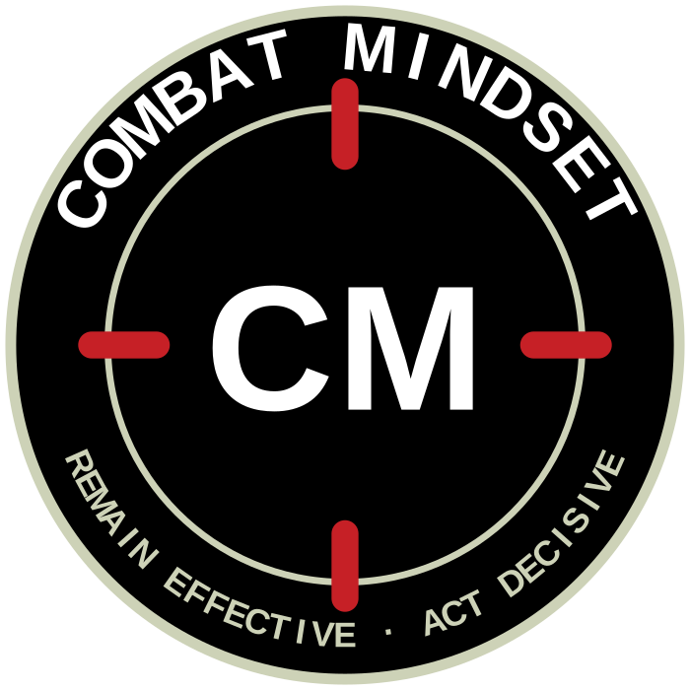
UNCLASSIFIED
CM RETICLE ROUNDEL — LOCKUP SYSTEM
Brandmark, wordmark and tagline. Exploration only; no mark is endorsed. NZ Army wordmark remains the sole official logo.
COMBAT MINDSET
REMAIN EFFECTIVE. ACT DECISIVE.
PRIMARY LOCKUP — HORIZONTAL
COMBAT MINDSET
COMBAT MINDSET
REMAIN EFFECTIVE. ACT DECISIVE.
REMAIN EFFECTIVE. ACT DECISIVE.
STACKED — CENTRED
REVERSED
COMBAT MINDSET · REMAIN EFFECTIVE. ACT DECISIVE.
COMBAT MINDSET
course handbook
Roundel stands alone once the association is established — slide corners, coins, signage.
CREST — PATCH AND COLOURS
COMPACT IN-LINE
Minimum sizes: roundel alone 8 mm; horizontal lockup 40 mm wide; crest 25 mm.
Clear space around the mark equals one tick length on all sides.
Tagline always set in Army Red, capitals, letterspaced; never reworded or split.
Tagline as directed: “Remain Effective. Act Decisive.” The Way Forward suite currently uses “Act decisively” — confirm final form before rollout.
Mark, wordmark and tagline remain subject to sponsor endorsement and Defence heraldry check.
COMBAT MINDSET
COMBAT
MINDSET
REMAIN EFFECTIVE. ACT DECISIVE.
slide master
cover
UNCLASSIFIED
Army Command School · ACS 2026
Concept board 3 · July 2026

