Slide 1

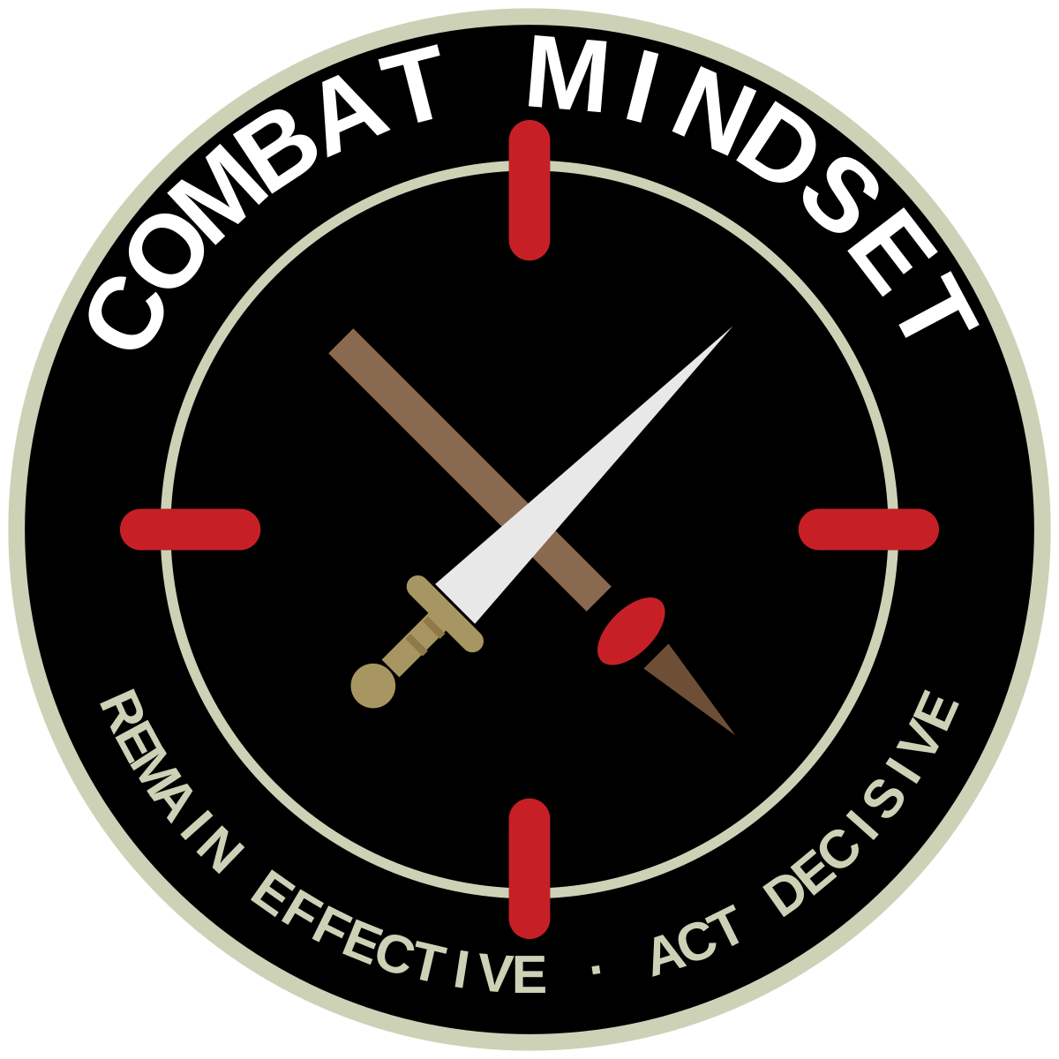
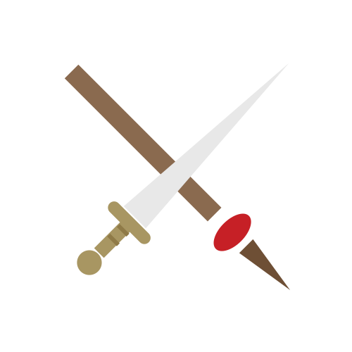
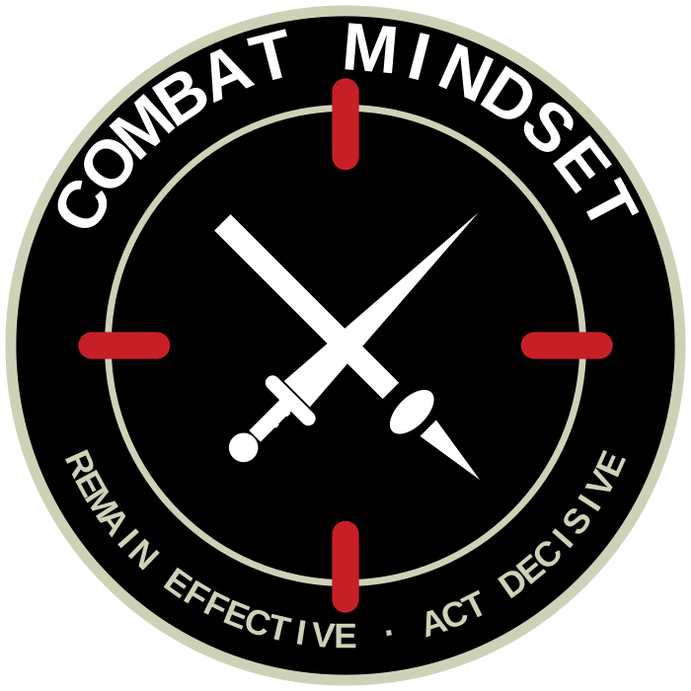
UNCLASSIFIED
CREST — SWORD AND TAIAHA
Centre symbol drawn from the crossed sword and taiaha of the Badge of the New Zealand Army. Exploration only; no mark is endorsed.
7G NGĀTI TŪMATAUENGA ARMS
The sword and taiaha carried together — the two traditions of the profession of arms in Aotearoa, crossed at the point of focus. Crown, lion, cypher and scroll deliberately omitted: this is a training-culture mark, not a replacement badge.
centre symbol alone
single ink — embroidery
size ladder
Weapons are simplified redrawings of the sword and taiaha from the Badge of the New Zealand Army — not traced artwork.
Use of elements derived from the Army badge requires Defence heraldry approval.
Use of the taiaha and any Māori design element requires appropriate cultural consultation (Ngāti Tūmatauenga kaitiaki).
Tagline wording (“Act Decisive” vs “Act decisively”) remains to be confirmed.
UNCLASSIFIED
Army Command School · ACS 2026
Concept board 5 · July 2026

