Slide 1

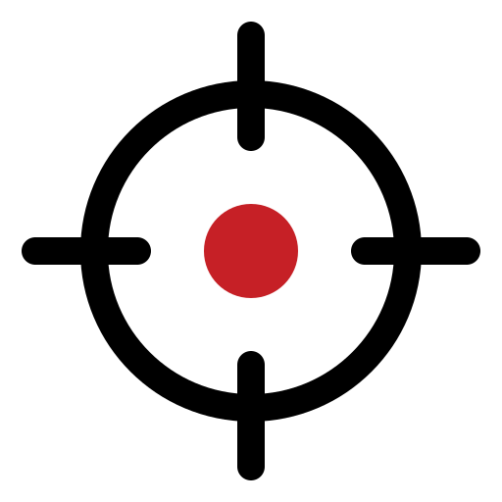






UNCLASSIFIED
COMBAT MINDSET — BRANDMARK CONCEPTS
Exploration board for discussion. No mark is endorsed; the NZ Army wordmark remains the sole official logo.
01 THE RETICLE
02 TWO STATES, ONE MIND
COMBAT MINDSET
Remain effective. Act decisively.
COMBAT MINDSET
Remain effective. Act decisively.
Focus under threat. Extends the crosshair motif already used across the Way Forward suite.
Red head–blue head heritage: arousal mastered, not suppressed. One mind holding both states.
03 THE CORE HOLDS
04 STEADY UNDER FIRE
COMBAT MINDSET
Remain effective. Act decisively.
COMBAT MINDSET
Remain effective. Act decisively.
Pressure bears down in waves; the core remains intact. Direct read of Performance Under Pressure.
Interference settles into effective action: performance = potential − interference, drawn as a line.
05 THE KORU COIL
06 CM STENCIL ROUNDEL
COMBAT MINDSET
Remain effective. Act decisively.
COMBAT MINDSET
Remain effective. Act decisively.
NZ identity: a koru wound like a spring under load — strength and growth through pressure.
Utilitarian military stencil for patches, course materials and slides. Reads at any size.
Selection criteria: reads at patch size · monochrome-safe · consistent with NZDF Visual Identity Standards palette · distinct from existing NZDF unit insignia [verify against Defence heraldry before adoption].
UNCLASSIFIED
Army Command School · ACS 2026
Concept board · July 2026

