Slide 1






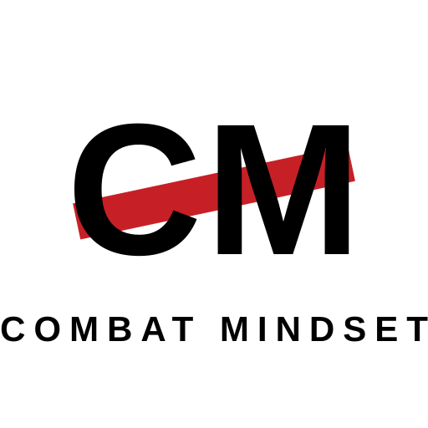



UNCLASSIFIED
CM STENCIL ROUNDEL — EVOLUTIONS
Developing concept 06. Exploration only; no mark is endorsed. NZ Army wordmark remains the sole official logo.
6A RING STENCIL
6B CUT STENCIL
The baseline: ringed roundel, stencil bar behind the monogram. Formal, badge-like.
Sliced letterforms carry the stencil idea without the bar; red underline as the only accent.
6C CHEVRON ROUNDEL
6D RETICLE ROUNDEL
Rank-style chevron beneath the monogram — soldierly, ties to the pressure chevrons of concept 03.
Sight ticks cross the ring — merges the stencil with concept 01 and the Way Forward hero motif.
6E EMBROIDERED PATCH
6F FLAT WORDSTACK
Olive field with stitched border and microtype — ready for uniform patch or course badge.
Container-free lockup for document covers, slide masters and letterheads.
APPLICATION TESTS — 6D RETICLE ROUNDEL
size ladder
one colour
reversed
subdued
Check any preferred mark against Defence heraldry and existing unit insignia before adoption.
UNCLASSIFIED
Army Command School · ACS 2026
Concept board 2 · July 2026

