Slide 1


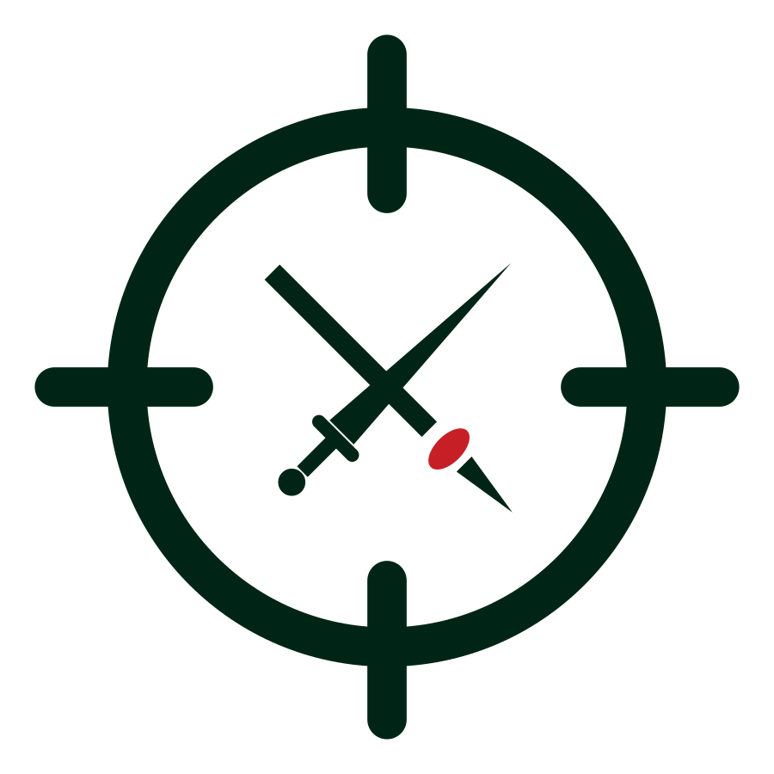
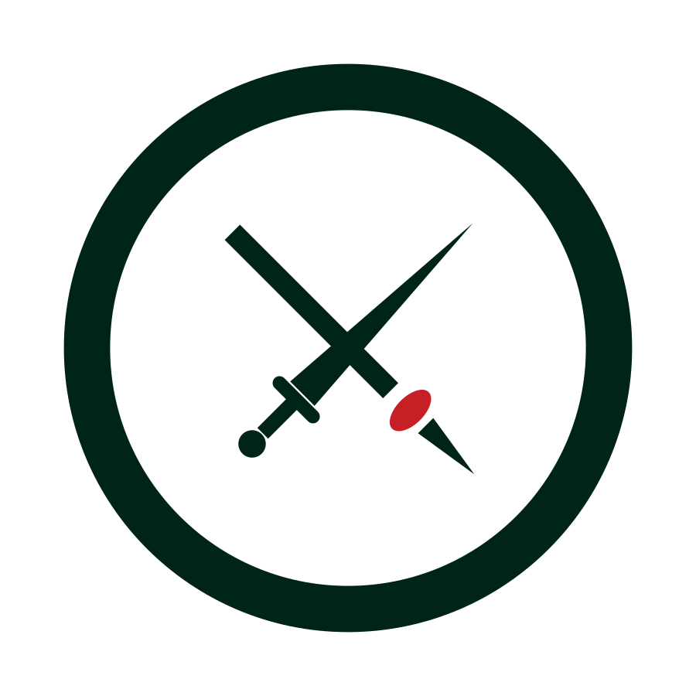


UNCLASSIFIED
SWORD AND TAIAHA — CLEAN MARKS
The crossed arms rendered in the clean brandmark language: dark green on white, red reserved for the tauri. Exploration only.
8A FOCUS POINT
8B OBJECTIVE
8C ENDURING CENTRE
The broken ring holds the arms loosely — focus gathering around the profession of arms.
Sight ticks cross the ring: the crossed arms as the objective. Strongest reticle read.
A heavy unbroken ring: pressure surrounds, the arms remain. Simplest and boldest.
OUR PROMISE: REMAIN EFFECTIVE IN COMBAT. ACT DECISIVELY.
APPLICATION EXAMPLES
COMBAT MINDSET
REMAIN EFFECTIVE. ACT DECISIVELY.
slide master header
COMBAT MINDSET
REMAIN EFFECTIVE. ACT DECISIVELY.
COMBAT MINDSET
REMAIN EFFECTIVE.
ACT DECISIVELY.
COURSE HANDBOOK
compact horizontal lockup
course handbook cover
The NZ Army wordmark remains the sole official logo; these marks are exploration only.
Weapons are simplified redrawings from the Badge of the New Zealand Army — Defence heraldry approval and cultural consultation (taiaha) required before adoption.
This option's tagline reads “Act decisively” (per the clean exploration board) — final wording still to be confirmed.
UNCLASSIFIED
Army Command School · ACS 2026
Concept board 6 · July 2026

