Slide 1

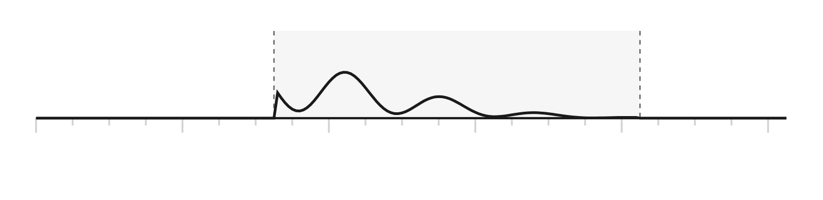
COMBAT
MINDSET
Visual identity system
A subordinate identity for an Army capability framework, developed against the
NZDF and NZ Army Visual Identity Guidelines v1.0.
Developed by
Army Command School and NZ Army Leadership Centre,
for internal consideration
Proposed reviewers
COMDT ACS; HPC; Head of Visual Identity and Design, Defence Public Affairs
Status
Governing concept selected. Draft for review; not an approved standard.
Version
V0.6, August 2026

Slide 2
CONTENTS
02
What this document argues
Thirteen outputs were requested. They resolve into one argument, set out below, and a specification that follows from it.
THE ARGUMENT IN FOUR STEPS
01
Combat Mindset is not a programme, so programme branding is the wrong precedent.
The guidelines forbid programmes creating logos. Correct, but the more useful observation is that a capability framework is closer to doctrine and controlled military information systems than to a branded project. Doctrine has a visual system: format, hierarchy, notation, numbering. That is the precedent to follow.
02
The identity must therefore be a grammar, not a mark.
A mark is recognised. A grammar is trusted. Personnel should know a Combat Mindset product by how it is built, not by a badge in the corner.
03
The organising idea is signal held under load.
The framework exists because capability degrades under pressure. The visual system should say that, structurally, in every artefact: a datum that is measured, disturbed and returned to true.
04
Longevity comes from structure, not style.
Rules, grids, notation and typographic hierarchy survive decades. Gradients, fields and illustrative devices carry a date stamp. The recommendation is built on the first and rations the second.
STRUCTURE OF THIS DOCUMENT
03 Position and compliance
04 Identity philosophy
05 Brand attributes
06 Visual principles
07 Selected concept: Datum
08 Considered: Threshold
09 Considered: Trace
10 Evaluation and decision
11 Title treatment explorations
12 Title treatment specification
13 Graphic language
14 Notation family
15 Colour system
16 Information architecture
17 Photography direction
18 Motion language
19 Digital application
20 Brand voice
21 Identity evolution
22 Governance and next steps
COMBAT MINDSET VISUAL IDENTITY
DRAFT V0.6 | AUGUST 2026

Slide 3
POSITION
03
What kind of thing is this?
The single most consequential decision in this document is made here, because it determines what the identity is permitted to be.
THREE POSSIBLE READINGS, AND THEIR CONSEQUENCES
AS A PROGRAMME
No logo. Name in plain text beside the Army logo. Nothing more.
Guidelines p34
Compliant but inert. Produces no system, and no reason for anyone to trust one product over another.
AS AN ORGANISATION
A badge or unit patch. Explicitly ruled out for communication use.
Guidelines p9, p54
Non-compliant, and wrong in substance. Combat Mindset commands nothing and has no establishment.
DOCTRINE AS PRECEDENT
A publication system: format, hierarchy, notation, numbering, classification.
The recommended position
Compliant, and it borrows doctrine's enduring qualities without claiming doctrinal status. What the framework becomes is decided through the programme, not by its identity.
WHAT FOLLOWS FROM TAKING DOCTRINE AS THE PRECEDENT
No freestanding brand mark, badge, patch or symbol. The identity is carried by typography, structure and functional notation.
The Army logo appears unaltered on every complete formal artefact. Combat Mindset never competes with it.
Authority is signalled the way doctrine signals it: consistent format, visible hierarchy, explicit classification of content, and a controlled identifier on every governed content item.
Every element is specifiable in a written standard, so it can be applied by people who are not designers. This is the practical test the system must pass inside a training establishment.
COMPLIANCE POSITION
This system creates no new logo and modifies nothing in the NZDF or NZ Army identity. It uses the published Army palette, the published typefaces, and the published graphic elements. It is a subordinate application, in the same sense that a doctrine publication is a subordinate application.
It should nonetheless be put to the Head of Visual Identity and Design, Defence Public Affairs, before issue. Adopting a system without that endorsement would repeat the error this document exists to avoid.
THE PRECEDENT BEING FOLLOWED
Doctrine publications
Range cards and orders formats
Map and chart conventions
Numbered, classified, formatted identically across decades, and recognisable at a glance without a logo.
Authority carried entirely by structure. Nobody has ever needed to brand a set of orders.
A notation learned once and applied everywhere. The reader interprets symbols never seen before.
None of these is branded. All of them are instantly recognisable to the people who use them. That is the standard this system is aiming at.
COMBAT MINDSET VISUAL IDENTITY
DRAFT V0.6 | AUGUST 2026

Slide 4
PHILOSOPHY
04
What Combat Mindset should feel like
Not what it looks like. Feel is the harder specification and the one that determines whether the system is used or quietly abandoned.
THE FEELING TO ACHIEVE
It should feel like something that was already there.
Not launched. Not campaigned. A soldier meeting a Combat Mindset product for the first time should assume it has existed for years and that they simply had not needed it until now. Visible novelty is a liability in an enduring capability framework.
It should feel like it has been checked.
The strongest emotional response the system can produce is the quiet assumption that someone competent has been over this. That is what evidence-based means in practice: not citations on display, but the felt absence of guesswork.
It should feel calm at the moment the reader is not.
These products will be opened by people under load: before a serial, after a poor performance, during a difficult command decision. The identity must lower the temperature of the page, not raise it.
It should feel like it respects the reader's time.
Hierarchy that answers questions in the order they are asked. No persuasion, no preamble, no motivational framing. Get to the thing.
It should feel institutional rather than authored.
No individual's taste should be visible in it. The system belongs to Army, and personal signature is what makes identity systems fragile when their author posts out.
WHAT IT MUST NOT FEEL LIKE
Inspiring
Elite
Commercial
Clever
Motivation fades. Institutional systems endure.
The framework is for the whole Army, not a selected minority.
Nothing is being sold. Nothing is being competed for.
Wit in an institutional system reads as unseriousness on the second reading.
COMBAT MINDSET VISUAL IDENTITY
DRAFT V0.6 | AUGUST 2026

Slide 5
ATTRIBUTES
05
Brand attributes
Thirteen adjectives. Each is paired with the adjective it is most often confused with, because the distinction is where the system is actually held.
THE ATTRIBUTES, AND THEIR NEAR MISSES
Measured
Precise
Composed
not cautious
not fussy
not detached
Disciplined
Credible
Structured
not rigid
not authoritative in tone
not bureaucratic
Clear
Enduring
Technical
not simplified
not old
not cold
Operational
Adaptive
Human
not tactical in styling
not fashionable
not warm
Unshowy
not plain
THE TEST
If an artefact could be mistaken for recruitment material, fitness branding, or a
commercial resilience product, it has failed. If it could be mistaken for a well made
doctrine publication, it has succeeded.
This is a deliberately low ceiling on expressiveness. It is the correct ceiling for a system that has to survive twenty years and four changes of sponsor.
COMBAT MINDSET VISUAL IDENTITY
DRAFT V0.6 | AUGUST 2026

Slide 6
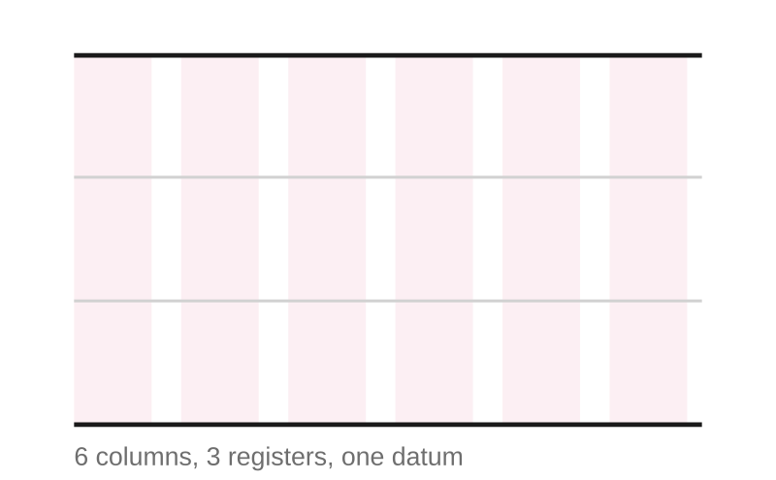
PRINCIPLES
06
Visual principles
Seven principles. Each is written so that a non-designer can apply it and a designer can be held to it.
THE DESIGN LANGUAGE
01
Everything is measured against a line.
DATUM
A single horizontal reference governs each surface. Elements align to it, hang from it or sit on it. Nothing floats. This is the structural expression of the framework's own subject: a standard held under load.
02
Structure is visible.
LEGIBLE CONSTRUCTION
Rules, columns and registers are shown rather than concealed. The reader can see how the page was built, which is the visual equivalent of showing method.
03
Contrast carries hierarchy, not colour.
HIGH CONTRAST
Black on white, at real weight differences. Colour classifies content; it never ranks it. A page printed on a unit's mono printer must lose nothing.
04
Space is a material, not a leftover.
MEASURED
Generous, consistent intervals. Density is reserved for texture and never applied to text. Crowding reads as haste, and haste is the opposite of what the framework teaches.
05
Direction is meaningful.
DIRECTIONAL
Movement along the datum means sequence. Departure from the datum means decision. A break in the datum means risk. Direction is never used decoratively.
06
Complexity resolves.
CLARITY FROM COMPLEXITY
Where a field of competing signal is shown, it must resolve into a single clear element. Unresolved complexity is a picture of the problem, not the framework.
07
Restraint is the house style.
UNSHOWY
If an element cannot be justified in one sentence in the specification, it is removed. The system should look under-designed to a designer and obvious to a soldier.
The page is built from six columns and three registers, all hung from a single datum. Every surface in the system, printed or digital, is a variation on this construction.
COMBAT MINDSET VISUAL IDENTITY
DRAFT V0.6 | AUGUST 2026

Slide 7
SELECTED CONCEPT
07
Concept A: DATUM
A standard is held. Load displaces it. It returns to true.
SELECTED. Datum is the governing system for Combat Mindset.
THE IDEA
The page is governed by a single measured reference line. Content aligns to it. Where pressure is represented, the line deviates and then recovers. Ticks, registers and intervals come from the language of instruments, maps and range cards.
WHAT IT SAYS ABOUT THE FRAMEWORK
This is what the framework is for. Under pressure, access to trained capability can be displaced or degraded, and the system exists to preserve effectiveness and shorten the return to true.
STRENGTHS
RISKS
Structural rather than illustrative, so it dates slowly. A ruled line with tick marks is as legible in 2046 as in 1946.
Scales without loss from a favicon to a wall, because it is composed of rules rather than detail.
Applies to non-designers. A datum and a tick interval can be specified in words and reproduced in Word, PowerPoint, HTML and print.
Reads as instrumentation, which is the correct register for an evidence-based capability framework.
Quiet to the point of invisibility if applied timidly. Requires real weight contrast to carry a cover.
Adjacent to financial and engineering identities. Distinctiveness must come from typography and colour discipline, not from the line itself.
TESTED AT SIZE
Cover, 72 mm
Slide, 44 mm
Favicon, 24 mm
The datum survives reduction because it is composed of rules. At favicon size the tick interval is lost but the line and the displacement remain legible.
COMBAT MINDSET VISUAL IDENTITY
DRAFT V0.6 | AUGUST 2026

Slide 8

CONSIDERED
08
Concept B: THRESHOLD
Pressure accumulates. The line holds. Beyond it, clarity.
NOT ADOPTED. The density field is retained as rationed texture only.
THE IDEA
Pressure is drawn as an accumulating density field, built from the Army halftone chevron pattern. The field intensifies towards a hard edge and stops. Beyond the edge the surface is clear and ordered.
WHAT IT SAYS ABOUT THE FRAMEWORK
The framework is the threshold. It is what stands between accumulating load and the collapse of performance.
STRENGTHS
RISKS
The most emotionally direct of the three. A reader grasps it without explanation.
Uses an existing sanctioned Army element, so it is already inside the visual family.
Produces striking covers and divider surfaces with very little effort.
Density gradients are a period signature. They read as 2015 to 2025 and will date the system within a decade.
Hard to apply consistently at small size or in mono. The field either disappears or blocks up.
Tends toward the decorative. Once a texture exists, it gets used everywhere, and the discipline is lost within two years.
TESTED AT SIZE
Cover, 72 mm
Slide, 44 mm
Favicon, 24 mm
The field collapses at slide size and reads as a grey block at favicon size. The threshold edge survives, but the idea that produced it does not.
COMBAT MINDSET VISUAL IDENTITY
DRAFT V0.6 | AUGUST 2026

Slide 9
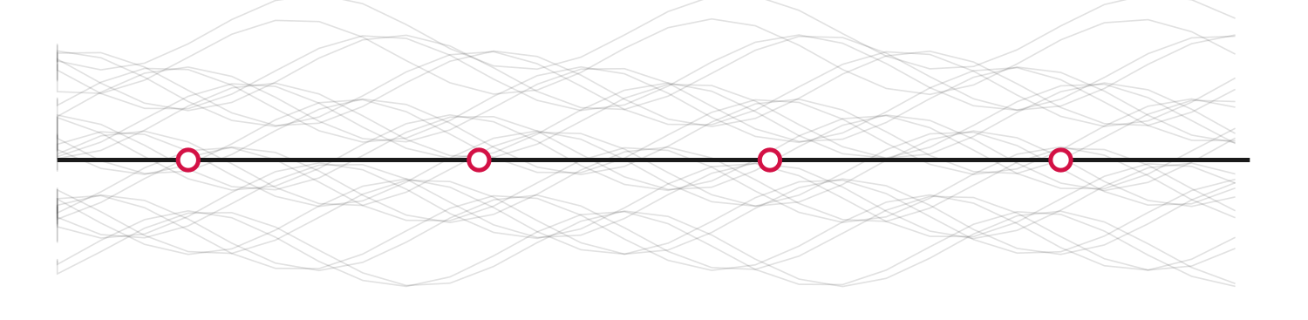
CONSIDERED
09
Concept C: TRACE
One resolved path through competing signal.
NOT ADOPTED. The node and departure are retained to mark decision.
THE IDEA
A field of weak, conflicting traces sits behind a single strong path. Nodes mark the points at which the path is committed. The eye is drawn to the resolved line, not to the noise.
WHAT IT SAYS ABOUT THE FRAMEWORK
Decision under pressure is not the absence of competing information. It is the selection of one line through it, and the willingness to commit at nodes.
STRENGTHS
RISKS
The only concept that directly represents decision, which is central to the framework and absent from the other two.
Gives an immediately useful device for phase diagrams, decision support and pathway documentation.
Nodes provide a natural interactive affordance in digital products.
Closest of the three to contemporary technology branding. Without severe restraint it reads as a data-visualisation aesthetic.
The noise field is easily overdone and becomes ornament.
Weakest at very small size, where the field collapses into grey.
TESTED AT SIZE
Cover, 72 mm
Slide, 44 mm
Favicon, 24 mm
The noise field is the first thing to go. At favicon size the concept reduces to a plain line with dots, which is indistinguishable from Concept A.
COMBAT MINDSET VISUAL IDENTITY
DRAFT V0.6 | AUGUST 2026

Slide 10
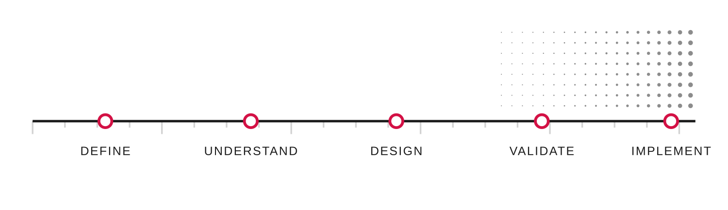
DECISION
10
Evaluation and decision
Scored against the criteria that matter for a system intended to last twenty years, not against which concept looks best on a cover. The decision below is taken; it is the constraint the specification is built on, not an option left open for review.
EVALUATION
A DATUM
B THRESHOLD
C TRACE
Longevity
Scalability
Mono and small size
Applied by non-designers
Distinctiveness
Says what the framework is
DECISION
Datum is adopted as the governing system.
The node and departure from Concept C are retained as its only dynamic element, used solely to mark decision. The density field from Concept B is retained as texture, rationed to divider surfaces and never behind text. Threshold and Trace are not adopted, and are recorded so the reasons survive the people who rejected them.
WHY, AND WHAT WAS GIVEN UP
Datum wins on the criteria that decide whether a system survives. It is the only one of the three that a staff officer can reproduce correctly in PowerPoint at 2200 hours without a designer present, and that is the real durability test inside a training establishment.
What was given up is immediate emotional impact. Threshold is the stronger first impression and it was deliberately declined, because the objective stated in the brief is trust rather than recognition, and trust is built by the twentieth artefact rather than the first. Trace is the sharpest expression of decision, which is why its node was retained rather than the whole concept: adopted wholesale it would have pulled the system toward a data-visualisation aesthetic that will age badly.
The adopted system: datum as spine, nodes for decision, density rationed to texture. Shown here carrying the five phase framework development programme.
COMBAT MINDSET VISUAL IDENTITY
DRAFT V0.6 | AUGUST 2026

Slide 11
TITLE TREATMENT
11
Title treatment explorations
Six typographic approaches to presenting the Combat Mindset title. None is a logo and none is a freestanding asset: these are repeatable heading constructions. Set in Arial; production is Neue Haas Grotesk.
01
STACKED MASS
COMBAT
Bold, tight leading, datum rule beneath.
MINDSET
Authority through mass. The rule anchors the mark to the system. Reads at any size and reverses cleanly.
02
SINGLE LINE, LETTERSPACED
C O M B A T M I N D S E T
Light weight, wide tracking, uppercase.
Institutional and quiet. Excellent as a running header or a spine. Too weak to carry a cover alone.
03
HUNG FROM THE DATUM
Rule above, mark below, aligned left.
COMBAT MINDSET
Expresses the governing principle in the mark itself. The strongest structural fit with the system.
NZ ARMY COMBAT MINDSET FRAMEWORK
04
WITH REFERENCE NUMBER
CM
COMBAT MINDSET
Doctrine publication convention.
CM-FWK-001 | FRAMEWORK
Draws on doctrine-publication conventions of numbering and hierarchy. Recommended as the formal variant on covers and title pages.
05
TWO WEIGHT RELATIONSHIP
NOT RECOMMENDED
Combat bold, Mindset light.
COMBAT MINDSET
Attempts to show the capability relationship typographically. Rejected: it implies Mindset is subordinate to Combat, which inverts the actual hierarchy.
06
MONOGRAM
CM
NOT RECOMMENDED
CM in a bounded field.
Rejected. However typographic its construction, a bounded monogram functions as a logo and would breach the guidelines and this document's own position.
SELECTION
Carry 03 as the primary title treatment and 04 as the formal variant on covers, title pages and formal framework publications. Retain 02 for running headers and spines. Options 05 and 06 are recorded so that the reasons for rejecting them survive the people who rejected them.
COMBAT MINDSET VISUAL IDENTITY
DRAFT V0.6 | AUGUST 2026

Slide 12
TITLE TREATMENT
12
Title treatment specification
Written so it can be applied without a designer, and audited without a debate. Deliberately not called a wordmark: this is a heading construction inside Army collateral, not a brand asset.
PRIMARY TITLE TREATMENT
COMBAT MINDSET
NZ ARMY COMBAT MINDSET FRAMEWORK
CONSTRUCTION RULES
Datum rule
Width equals the treatment measure. Weight equals one tenth of the cap height. Colour black, or white when reversed. Never red.
Clear space
One cap height on all four sides. Nothing enters it, including the Army logo.
Minimum size
28 mm measure in print. 180 px in digital. Below this, use the single line variant without the descriptor.
Descriptor
One third of the title size, letterspaced 1.6. Wording settled at endorsement; until then, NZ Army Combat Mindset Framework. Omit where context establishes it; never reword locally.
Colour
Black on light grounds, white on dark. One colour only. The treatment is never red, never tinted, never outlined and never set on a photograph without a solid panel behind it.
Relationship to the Army logo
Appears on every complete formal artefact, at greater visual weight. It need not repeat inside every internal component or screen. The treatment stays outside the logo's clear space and off its baseline.
VARIANTS
COMBAT MINDSET
COMBAT MINDSET
COMBAT MINDSET
FORMAL
RUNNING
REVERSED
Covers and title pages. Carries the reference number.
Headers, spines and footers. Single line, no descriptor.
Divider surfaces and dark applications.
COMBAT MINDSET VISUAL IDENTITY
DRAFT V0.6 | AUGUST 2026

Slide 13
GRAPHIC LANGUAGE
13
Graphic language
Six elements. Nothing else is permitted, and each carries a fixed meaning so the language cannot drift into decoration.
THE PERMITTED ELEMENTS
THE DATUM
Governs the surface. Everything aligns to it. Its meaning is a standard being held. It is never dashed, never coloured and never curved.
A single black rule, weight 1.5 pt at A4.
TICKS AND REGISTERS
Provide measure. Their presence signals that something is being assessed rather than asserted. Used on evidence, assessment and progress surfaces only.
Short marks at a fixed interval, major every fourth.
THE NODE
Marks a decision point. It is the only element permitted to interrupt the datum, and the only routine use of red. A surface with four nodes is making four claims about where commitment occurs.
An open circle on the datum, red stroke.
THE DEPARTURE
Represents a decision taken and its consequence. Only one departure per node. Multiple departures would represent optionality, which is a different and rarer claim.
A single line leaving the datum at a node.
THE FIELD
Represents accumulated pressure. Permitted on covers and dividers, never behind text, never as a page background, and never at more than 18 per cent opacity.
Halftone density drawn from the Army chevron pattern.
THE DISPLACEMENT TRACE
Represents load, interference and recovery. The only curve in the system, defined so the Datum concept can be drawn without breaking its own rules. It always returns to the datum, is never red, and is never decorative.
A curved deviation from the datum, black, at the datum's weight.
THE GRAMMAR
Along the datum
Away from the datum
Break in the datum
Return to the datum
Density above the datum
SEQUENCE
DECISION
RISK
RECOVERY
PRESSURE
Visual conventions for reading Combat Mindset surfaces, not definitions of the concepts they mark.
WHAT IS FORBIDDEN, AND WHY
Curves outside the displacement trace. The datum itself is always straight, and no other element bends.
Gradients other than the sanctioned halftone field. Gradients carry a date.
Drop shadows, glows, bevels and any depth effect. Depth implies a physical object; this is a notation, not an artefact.
Red used as a surface, a heading colour or a fill. Red marks decision nodes and defined threshold states; risk is otherwise carried structurally by the broken datum. Spending it elsewhere destroys the only signal in the system that carries urgency.
Any new element added without an accompanying sentence in the specification stating what it means.
COMBAT MINDSET VISUAL IDENTITY
DRAFT V0.6 | AUGUST 2026

Slide 14
















NOTATION
14
Notation family
Twelve marks, one grammar. These are not pictograms: nothing is a picture of a thing. Each mark is a statement about how a piece of content relates to the datum.
THE CONSTRUCTION
Every mark is drawn on a 24 unit grid at 2 unit stroke, and every mark contains the datum at y=17. What differs is what happens to that datum, and what sits on it. A reader who learns the grammar once can interpret a mark they have never seen, which is the property a pictogram set can never have. Six marks form the pilot set: Framework, Governance, Evidence, Assessment, Product and Decision, the minimum spread across the four families. Doctrine and the other marks are drafted to prove the grammar extends, and join when authority arrangements and repository content warrant them.
FOUR FAMILIES
STRUCTURE
ANALYSIS
DELIVERY
ACTION
Content that carries authority. The datum is complete and unbroken.
Content that examines. The datum carries measures, intervals or returns.
Content that is used. Discrete objects sit on the datum.
Content that requires a person to do something. The datum is left or broken.
THE TWELVE MARKS
PILOT
PILOT
FRAMEWORK
DOCTRINE
POLICY
GOVERNANCE
STRUCTURE
STRUCTURE
STRUCTURE
STRUCTURE
The governing architecture. Used once, at the top of a hierarchy.
The solid bar: endorsed institutional guidance rather than open inquiry.
Bounded above and below: the convention for rules that carry limits.
Brackets on both sides. Something is being held, not merely described.
PILOT
PILOT
EVIDENCE
RESEARCH
ASSESSMENT
REVIEW
ANALYSIS
ANALYSIS
ANALYSIS
ANALYSIS
Rising measures. Evidence accumulates and is read against the datum.
An open bracket and a dashed continuation. The question is not yet closed.
A measured gap. Assessment is the act of reading the interval.
A return to a prior point. Review is deliberate, not repetition.
PILOT
PILOT
PRODUCT
REFERENCE
DECISION
RISK
DELIVERY
DELIVERY
ACTION
ACTION
A block on the datum. Products are discrete, identifiable and issued for use.
A single tick and a marker. Points elsewhere; carries no authority itself.
A node and a departure. The only mark that leaves the datum.
A break in the datum identifies risk. A reading convention, not a definition.
AT SIZE, AND IN MONO
48 32 24 16 px
in classification colour
mono, meaning intact
COMBAT MINDSET VISUAL IDENTITY
DRAFT V0.6 | AUGUST 2026

Slide 15
COLOUR
15
Colour system
No colour is invented. Every value is published in the NZ Army Visual Identity Guidelines p58. What is added here is a set of rules about what each colour is allowed to mean.
PRIMARY
Black
White
Army Red
#000000
Process Black C
rgb 0 0 0
#FFFFFF
White
rgb 255 255 255
#D31145
Pantone 200 C
rgb 211 17 69
Structure, type and the datum. The default. Carries all hierarchy.
Space, and the reversed state. Space is a material and is budgeted, not filled.
Decision nodes, the action notation, and defined threshold states. Otherwise risk is carried by the broken datum.
SECONDARY: CLASSIFICATION, NOT DECORATION
ANALYSIS
DELIVERY
LAYERING
GROUND
5605 C #00261B
5747 C #444D06
5853 C #B3A650
5855 C #DFD8AD
Evidence, research, assessment, review.
Products, references, training material.
Secondary surfaces, table banding, inactive states.
Panels and callouts beneath text. Never text itself.
PROPORTION RULE
Red never exceeds five per cent of any surface. This is the only hard numerical constraint in the colour system, and it is the one that keeps the signal working. A page where red marks four decision nodes tells the reader something. A page where red also carries headings, rules and callouts tells them nothing.
MONO AND ACCESSIBILITY
Every artefact must survive a mono print with no loss of meaning. Classification is therefore carried by the notation mark as well as by colour, never by colour alone.
Body text is black on white or white on black. The greens are never used for running text.
Army Red on white calculates at roughly 5.3 to 1, which passes AA for body text; Army Red on black fails and is not permitted for type. Every claim here is re-verified with accredited tooling at step 03, and the repository tests contrast, minimum sizes, mono output and reduced motion automatically.
Colour blindness affects roughly one in twelve men. Red against the four greens is the least safe pairing in the palette, which is a further reason red is reserved for a marker shape rather than a fill.
COMBAT MINDSET VISUAL IDENTITY
DRAFT V0.6 | AUGUST 2026

Slide 16
ARCHITECTURE
16
Information architecture
Twelve content types, each with a fixed treatment. A reader should be able to tell what kind of thing they are holding before they have read a word of it.
THE COMPONENT
Every piece of Combat Mindset content is presented in the same component: a notation mark, a type label, an identifier, a title, and a status line. The component is identical in print, in a slide, in a repository and on a phone; only its scale changes. Identifiers separate content type, item and version, because a number that means two things eventually means nothing. The scheme shown is illustrative: allocation authority, and its relationship to existing Army and NZDF reference series, is resolved at step 03 before any identifier is issued. The pilot also tests whether some types are better held as status or relationship metadata than as primary types.
EVIDENCE
Cognitive load and decision quality under physical stress
CM-EVD-004 v0.3
Endorsed | Reviewed Aug 2026 | Owner NZALC
notation
type and reference
title and status
THE TWELVE TREATMENTS
FRAMEWORK
STRUCTURE
CM-FWK-001
Governing architecture
DOCTRINE
STRUCTURE
CM-DOC-001
Endorsed and enduring statements
POLICY
STRUCTURE
CM-POL-001
Rules with limits
GOVERNANCE
STRUCTURE
CM-GOV-001
Who holds and assures what
EVIDENCE
ANALYSIS
CM-EVD-001
Findings and their strength
RESEARCH
ANALYSIS
CM-RES-001
Open questions and method
ASSESSMENT
ANALYSIS
CM-ASM-001
Measurement against a standard
REVIEW
ANALYSIS
CM-REV-001
Deliberate return to a prior position
PRODUCT
DELIVERY
CM-PRD-001
Material issued for use
REFERENCE
DELIVERY
CM-REF-001
Pointers to work held elsewhere
DECISION
ACTION
CM-DEC-001
A point at which commitment is required
RISK
ACTION
CM-RSK-001
A discontinuity to be managed
Greyed rows are candidate extensions: drafted to prove the grammar extends, and introduced only when the pilot shows the distinction is needed.
COMBAT MINDSET VISUAL IDENTITY
DRAFT V0.6 | AUGUST 2026

Slide 17
PHOTOGRAPHY
17
Photography direction
Photography is the element most likely to break this system, because it is the element most often chosen by someone in a hurry. The direction below is written to be enforceable.
THE GOVERNING INSTRUCTION
Photograph the load, not the outcome.
The framework is about what happens to people under pressure. The imagery should show pressure being carried, not victory being celebrated.
DIRECTION
LIGHTING
Available light only. Overcast, dawn, dusk, interior fluorescent, vehicle interior. No fill, no flash, no colour grading beyond correction. If the light was poor, the photograph shows poor light.
COMPOSITION
Eye level. The camera stands where another soldier would stand. High and low angles are permitted only where the operational reality requires it, never for drama.
FRAMING
Wide enough to show the environment doing the work. The context is the pressure; a tight portrait removes the very thing being documented.
SUBJECT
The whole Army. Ranks from private to colonel, all trades, all body types, both regular and reserve. If the imagery set skews young, male and infantry, the framework will be read as belonging to them.
EMOTION
Concentration, fatigue, recovery, deliberation, the flat expression of someone thinking hard. Never aggression, never triumph, never the shouted moment.
MOMENT
The moment before or the moment after. The moment itself is almost always the least informative frame and the most theatrical.
EYE CONTACT
None, except in a named environmental portrait where a person is being quoted or credited. A soldier looking into the lens is performing.
POST
Correction only. No vignettes, no crushed blacks, no teal and orange, no monochrome conversion to add gravity.
AUTOMATIC REJECTIONS
Silhouettes against a sunset
Generic gym imagery as shorthand for performance
Weapon-forward hero framing
Shouted faces
Staged planning shots around a map
Stock imagery of any kind
Anything shot for recruitment
Composites and montage
COMBAT MINDSET VISUAL IDENTITY
DRAFT V0.6 | AUGUST 2026

Slide 18
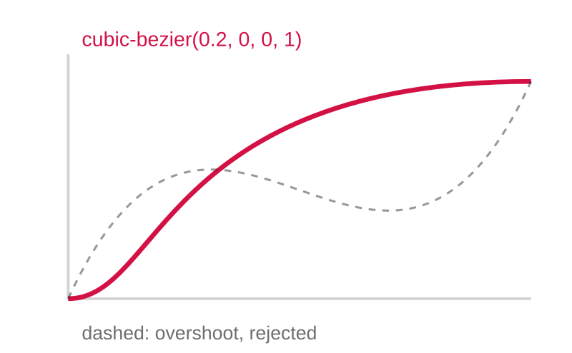
MOTION
18
Motion language
Motion is the newest part of the system and the part most likely to date it. The specification is therefore deliberately narrow.
THE PRINCIPLE
Motion confirms. It does not perform.
Easing
cubic-bezier(0.2, 0, 0, 1). Decelerate into position. No overshoot, no bounce, no elastic.
Duration
180 ms for state change. 240 ms for element entry. 320 ms for view transition. Nothing exceeds 400 ms.
Entry
Elements arrive along the datum, by wipe or by translation on one axis. Nothing fades in from nowhere and nothing scales up.
Emphasis
A node may draw its stroke once, in 240 ms, on first appearance only. It never pulses, never loops and never glows.
Reduced motion
Honour the operating system preference. With reduced motion set, every transition becomes an instant state change with no substitute effect.
WHY SO NARROW
Every generation of interface has an animation signature, and it is always the first thing that makes an old product look old. Skeuomorphic easing dated in five years. Material motion dated in seven. A system intended to run for twenty must spend as little as possible on motion, so that when the signature of this decade becomes visible, there is almost nothing of it to remove.
FORBIDDEN
Parallax, particles, glow, blur transitions, and anything that draws attention to the transition itself.
Looping animation of any kind. A loop is a demand for attention, and these products are read by people who have somewhere to be.
Motion that conveys information not otherwise available. If a reader with reduced motion enabled loses meaning, the design has failed.
Animated logos or title treatments. The title treatment is a fixed thing; animating it makes it a performance.
COMBAT MINDSET VISUAL IDENTITY
DRAFT V0.6 | AUGUST 2026

Slide 19
DIGITAL
19
Digital application
The system is digital-first, which means the specification must survive contact with markdown, a repository theme and a phone screen.
APPLICATION BY SURFACE
01
REPOSITORY AND GITHUB DOCUMENTATION
Markdown is the constraint. The notation family is issued as inline SVG so a mark can precede a heading in a README without an image pipeline. The datum becomes a horizontal rule. The reference number goes in the front matter and the file name, so a document remains identifiable when detached from its interface.
02
FRAMEWORK BROWSER
The pilot content types form the initial primary filter, not a search box. A user arrives asking what kind of thing they need before they know its title. Left rail carries the notation; content pane carries the component.
03
CONTROLLED CONTENT READER
Endorsed text at full measure, with evidence and assessment collapsed beneath it and marked with their own notation. Doctrine is one content class this reader eventually carries. The reader can see that evidence exists without being made to read it, which is the behaviour the framework wants to encourage.
04
DECISION SUPPORT
The only place the departure element is used interactively. A node expands to show what commitment at that point entails. No wizard, no scoring, no recommendation engine; the tool documents the decision, it does not make it.
05
DASHBOARDS
Ticks and registers, black on white, no chart junk. Red marks only thresholds crossed. A dashboard where several things are red is reporting a genuine problem, not a styling choice.
06
PRESENTATIONS
One template, three slide types: statement, component list, diagram. The datum runs across every slide at a fixed height so a deck reads as one continuous surface.
07
TRAINING PRODUCTS
Printable at unit level on a mono printer. Every classification survives without colour because the notation carries it. This is the constraint that most often breaks identity systems in a training establishment, and it is designed for rather than discovered.
08
MOBILE
Single column, datum at the top of the viewport, notation at 24 px. Content types collapse to the mark and the reference number. Offline first, because the reader is frequently somewhere without signal.
THE SINGLE SOURCE
The specification, the notation family, the colour tokens and the component markup are held in one repository and consumed by every surface. Nothing is redrawn per product. This is what makes the twenty year claim credible: the identity is maintained as code with a version number, not as a PDF that people copy from.
COMBAT MINDSET VISUAL IDENTITY
DRAFT V0.6 | AUGUST 2026

Slide 20
VOICE
20
Brand voice
The identity fails at the first sentence if the writing does not match it. Voice is specified here as pairs, because writers learn faster from contrast than from adjectives.
HOW COMBAT MINDSET SPEAKS
Confident
It states. It does not argue with an imagined sceptic, and it does not hedge every claim into meaninglessness.
Measured
Short sentences. One idea each. The register of a good set of orders, not a good speech.
Evidence-based
Claims carry their strength. Where the evidence is thin, the text says so, because a framework that overclaims once is discounted permanently.
Operational
Written for someone who will act on it. Every paragraph should survive the question: what does the reader do differently now.
Plain
No jargon that a corporal would have to look up, and no psychology terminology used decoratively.
Never motivational
It does not exhort, inspire, challenge or remind anyone what they are capable of. The moment it does, it becomes a poster, and posters are ignored.
WRITE THIS, NOT THAT
WRITE
NOT
Under pressure, trained people lose access to capability they demonstrably hold.
Unlock your true potential when it matters most.
The evidence for transfer to operational performance is currently limited.
Proven to deliver results on operations.
Phase 2 assesses existing products against the endorsed outcomes.
We are on an exciting journey to transform how Army thinks about performance.
Do this before the serial. Record what happened. Review it within 48 hours.
Embrace the challenge and push through your limits.
THE TAGLINE
Remain effective. Act decisively. Harder to kill. It works because the first two lines are instructions and the third is a consequence, not a boast. It should be used sparingly, on covers and dividers, and never as a heading inside a document. Overused, it becomes the motivational register the rest of the voice is written to avoid.
COMBAT MINDSET VISUAL IDENTITY
DRAFT V0.6 | AUGUST 2026

Slide 21
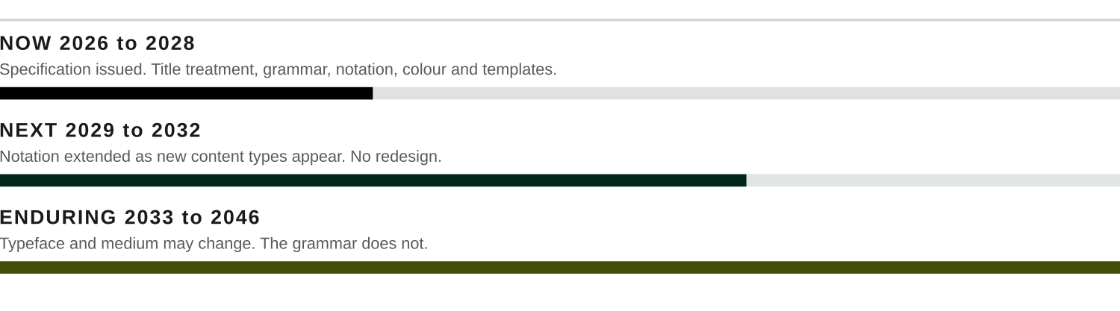
EVOLUTION
21
Identity evolution
How the system matures over ten years, and why it should never need a redesign.
THE MECHANISM
The system is a grammar, not a set of assets. New content types are added by extending the notation according to the existing rules, not by commissioning new marks. New surfaces are built from the datum, the grid and the component. Because meaning lives in the grammar rather than in any particular drawing, the drawings can be replaced without the identity changing.
WHAT IS ALLOWED TO CHANGE, AND WHAT IS NOT
MAY CHANGE
MUST NOT CHANGE
The typeface, if NZDF changes its own. The system specifies weight relationships and measure, not a named font.
The medium. Print, web, native application, whatever follows. The component survives the transport.
The notation set, by extension. New marks are added when new content types genuinely appear.
Photography, continuously. Imagery should always look like this year's Army.
The datum itself. It is the governing device, selected against five criteria, and the system has no second spine.
The meaning of the grammar. Away from the datum is decision, permanently.
The reservation of red for decision, action and defined threshold states, with risk otherwise identified structurally by the broken datum. This is the single constraint that keeps the system readable.
The primacy of the Army logo, and the absence of a Combat Mindset logo.
The requirement that every artefact survives a mono print.
THE FAILURE MODE TO WATCH FOR
Identity systems in defence do not usually die of obsolescence. They die when a capable person arrives, finds the system constraining, and improves it locally. Within three years there are four versions and the signal is gone. The defence against this is not enforcement, it is making the specification good enough, and available enough, that improvising is more work than complying.
COMBAT MINDSET VISUAL IDENTITY
DRAFT V0.6 | AUGUST 2026

Slide 22
GOVERNANCE
22
Governance and next steps
What this document is, what it is not, and what would have to happen for it to become a standard.
STATUS OF THIS DOCUMENT
This is a proposal, not an approved standard.
It was developed inside ACS and NZALC against the published guidelines. It has not been reviewed by Defence Public Affairs, and no part of it should be issued as authoritative until it has been.
SEQUENCE
01
Internal agreement on position
ACS, NZALC, HPC
Agree that doctrine and controlled information systems are the visual precedent, without claiming doctrinal status for the framework itself. The governing concept is settled: Datum is adopted, and the review is not asked to reopen it. No production assets or enduring templates should be issued before the position is agreed.
02
Review by Defence Public Affairs
Head of Visual Identity and Design
Put the position, the adopted concept and the specification to DPA. Expect challenge on the title treatment, the notation family, and the derivation of the field from the Army chevron pattern. Obtain the vector Army logo at the same time.
03
Specification written
ACS with a design agency
Convert this document into a written standard with measurable rules, plus the asset set: notation SVGs, colour tokens, component markup, templates.
04
Pilot on real products
The framework proposal and ELDA material
Apply it to two live products before issuing it. A system that has never been used is a system that has never been tested.
05
Issue and version
NZALC as custodian
Publish under a validated identifier with a version number and a named owner. Review annually, extend by amendment, and resist redesign.
THE TEST TO APPLY IN TEN YEARS
Open two Combat Mindset products made a decade apart, by different people, in different
media. If they are recognisably the same system, and neither looks like it is trying to
persuade anyone of anything, the identity has done its work.
COMBAT MINDSET VISUAL IDENTITY
DRAFT V0.6 | AUGUST 2026

