Slide 2

github.com/TaceoLabs/noir_workshop_0625/

Slide 3
Our mission
Building a coSNARK-powered DApp with coNoir
Shuffling Cards with MPC

Slide 4


tomorrow

Slide 5
tomorrow
Let’s play cards

Slide 6
tomorrow
Sure, but I’ll shuffle you cheat

Slide 7

tomorrow
No, I’ll shuffle you scoundrel

Slide 8

tomorrow
Please shuffle the cards for us

Slide 9
tomorrow
I like Alice more

Slide 10
tomorrow
hey Charlette – I’ll pay you 5$

Slide 11
tomorrow

Slide 12
What now?
Private State only gets you that far

Slide 13

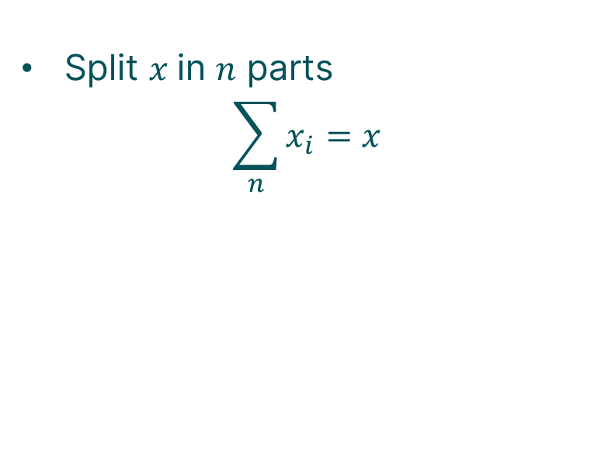

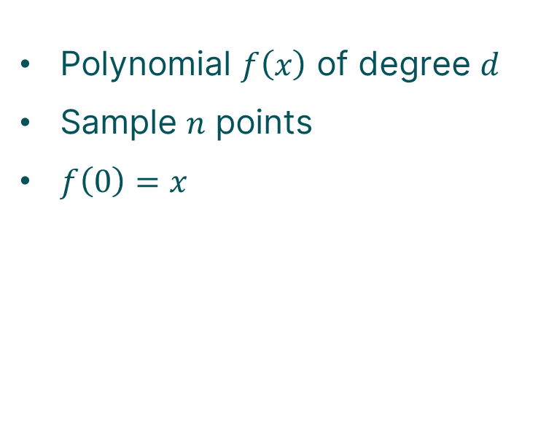



Mpc 101
How to share a secret?
Shamir Secret Sharing
Additive Secret Sharing
Polynomial $f\left(x\right)$ of degree $d$
Sample $n$ points
$f\left(0\right)=x$
Split $x$in $n$ parts
$$\sum_{n}{x_{i}}=x$$
$$x$$
$$x_{1}$$
$$x_{2}$$
$$x_{3}$$

Slide 14



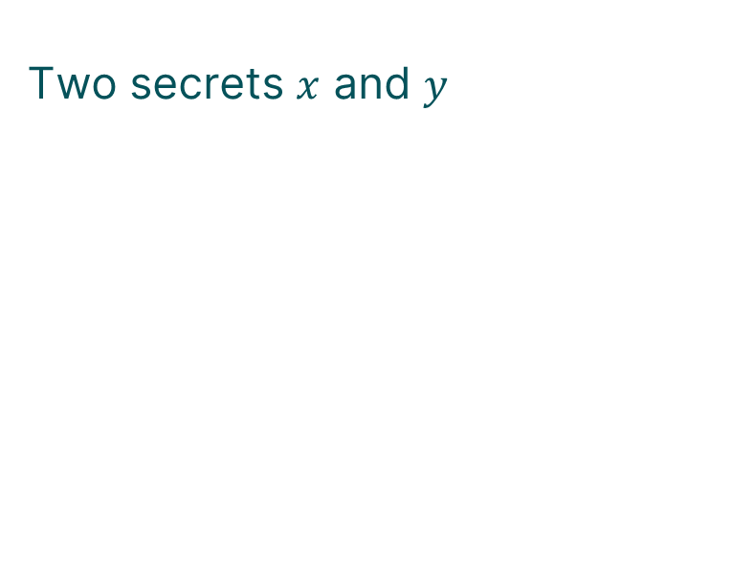



Mpc 101
Computing on secrets
Addition
Two secrets $x$ and $y$
$$x_{1}$$
$$y_{1}$$
$$x_{2}$$
$$y_{2}$$
$$x_{3}$$
$$y_{3}$$

Slide 15




Mpc 101
Computing on secrets
Addition
Two secrets $x$ and $y$
$$x_{1}$$
$$y_{1}$$
$$x_{2}$$
$$y_{2}$$
$$x_{3}$$
$$y_{3}$$
$$x_{1}+y_{1}$$
$$x_{2}+y_{2}$$
$$=x+y$$
$$x_{3}+y_{3}$$

Slide 16

Mpc 101
Computing on secrets
Addition
Multiplication
Two secrets $x$ and $y$
$$x_{1}$$
$$y_{1}$$
$$x_{2}$$
$$y_{2}$$
$$x_{3}$$
$$y_{3}$$
$$x_{1}+y_{1}$$
$$x_{2}+y_{2}$$
$$=x+y$$
$$x_{3}+y_{3}$$

Slide 17

Mpc 101
Non-linear Operations
Beaver triples
Generate helper triples $\left(\left[a\right],\left[b\right],\left[c\right]\right)$ and $ab=c$
Open $\left[a+x\right]=A$ and $\left[b+y\right]=B$
Compute $Ay+\left(−B\right)\left[a\right]+\left[c\right]=[xy]$

Slide 18
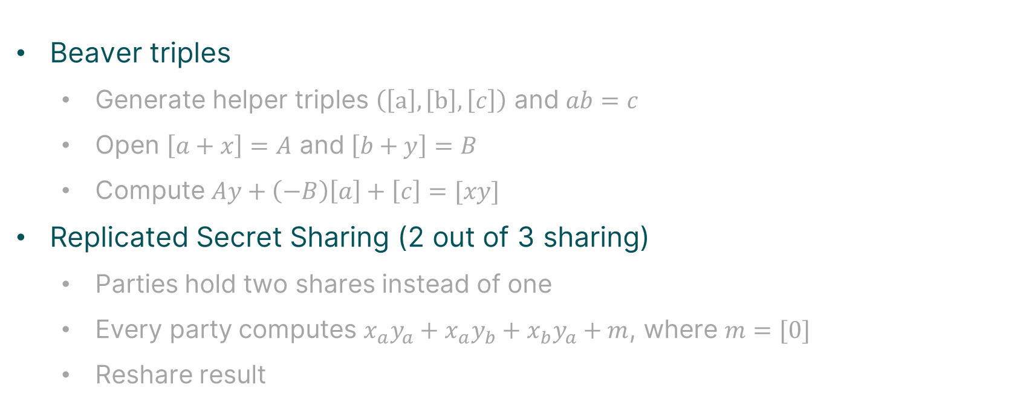
Mpc 101
Non-linear Operations
Beaver triples
Generate helper triples $\left(\left[a\right],\left[b\right],\left[c\right]\right)$ and $ab=c$
Open $\left[a+x\right]=A$ and $\left[b+y\right]=B$
Compute $Ay+\left(−B\right)\left[a\right]+\left[c\right]=[xy]$
Replicated Secret Sharing (2 out of 3 sharing)
Parties hold two shares instead of one
Every party computes $x_{a}y_{a}+x_{a}y_{b}+x_{b}y_{a}+m$, where $m=[0]$
Reshare result

Slide 19
Great – what now?

Slide 20
How did we get here
zkSNARKs 101
Succinct proof for computational integrity
Keeping secret input hidden (potentially)

Slide 21

How did we get here
zkSNARKs 101
Succinct proof for computational integrity
Keeping secret input hidden (potentially)

Slide 22
How did we get here
MPC 101
Mutually untrusting parties jointly compute a function
Inputs and intermediate values private (secret-shared)

Slide 23

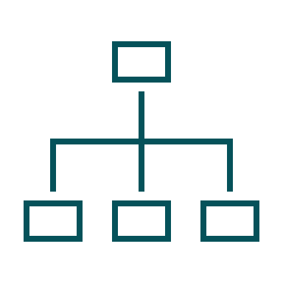
how did we get here
What are coSNARKs?
Zero-Knowledge
MPC

Slide 24

how did we get here
What are coSNARKs?
Zero-Knowledge
MPC
co-SNARKs

Slide 25

tomorrow
[r1]
[r2]

Slide 26


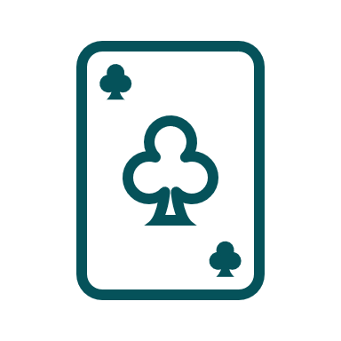
tomorrow
Here is a shuffled deck and a proof

Slide 27
tomorrow
Look we have a shuffled
And we don’t know what we’ll draw

Slide 28

tomorrow
Look we have a shuffled
And we don’t know what we’ll draw

Slide 29
We are done, right?

Slide 30
tomorrow
Let’s think this through

Slide 31
tomorrow
Let’s think this through
Playing a game of cards
Shuffled the deck

Slide 32
tomorrow
Let’s think this through
Playing a game of cards
Shuffled the deck
Only distribute cards to respective players (verifiable encryption)

Slide 33
tomorrow
Let’s think this through
Playing a game of cards
Shuffled the deck
Only distribute cards to respective players (verifiable encryption)
No one knows the
structure of deck!

Slide 34
tomorrow
Let’s think this through
Playing a game of cards
Private Shared State
Shuffled the deck
Only distribute cards to respective players (verifiable encryption)
Not simply composing Alice and Bobs private state
We generate new private state that nobody knows
No one knows the
structure of deck!

Slide 35
tomorrow
Look we have a shuffled
And we don’t know what we’ll draw

Slide 36
tomorrow
Look we have a shuffled
Really?
And we don’t know what we’ll draw

Slide 37
tomorrow
Towards publicly-auditable MPC
[r1]
[r2]

Slide 38
tomorrow
Towards publicly-auditable MPC
I don’t like r1, lets take r5
[r1]
[r2]

Slide 39
Towards publicly-auditable MPC

Slide 40
github.com/TaceoLabs/noir_workshop_0625/

Slide 41
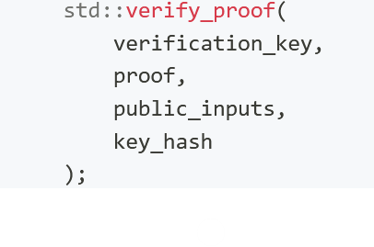
Interop with Barretenberg
UH-flavor with recursion
MH-flavor with Client-IVC
Currently supported by coNoir
Prove whole Aztec transactions in MPC
Create Aztec keys that are secret-shared that owns Private State

Slide 42
Follow us!

