Slide 2

github.com/TaceoLabs/noir_workshop_0625/

Slide 3
Our mission
Building a coSNARK-powered DApp with coNoir
Shuffling Cards with MPC

Slide 4



Slide 5
Let’s play cards

Slide 6
Sure, but I’ll shuffle you cheat

Slide 7

No, I’ll shuffle you scoundrel

Slide 8

Please shuffle the cards for us

Slide 9
I like Alice more

Slide 10
hey Charlette – I’ll pay you 5$

Slide 12
What now?
Private State only gets you that far

Slide 13

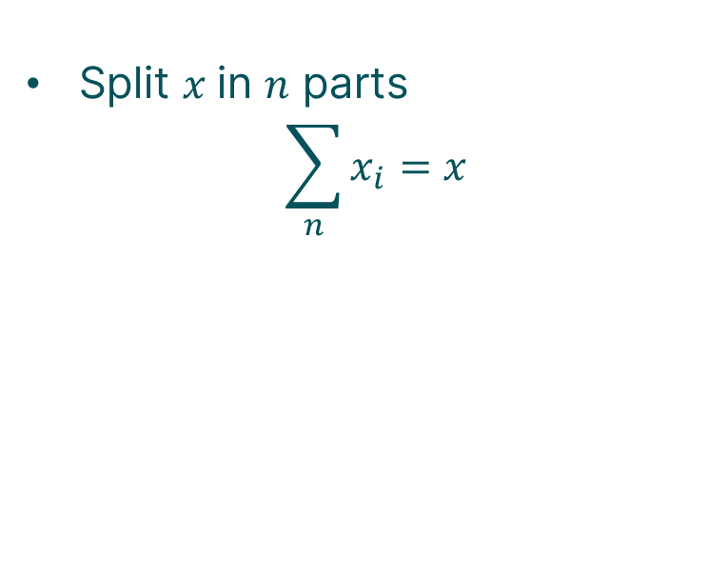

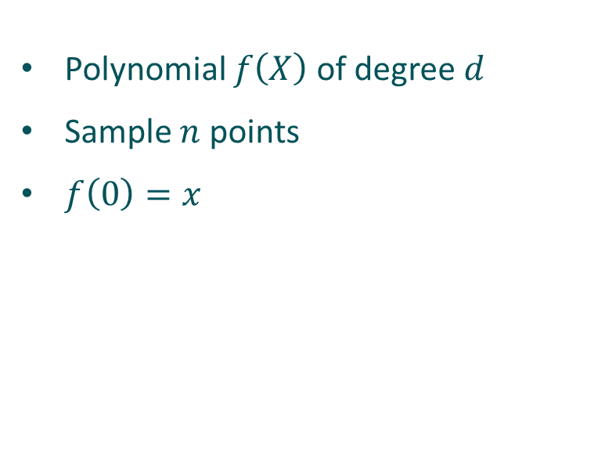



Mpc 101
How to share a secret?
Shamir Secret Sharing
Additive Secret Sharing
Polynomial $f\left(X\right)$ of degree $d$
Sample $n$ points
$f\left(0\right)=x$
Split $x$in $n$ parts
$$\sum_{n}{x_{i}}=x$$
$$x$$
$$x_{1}$$
$$x_{2}$$
$$x_{3}$$

Slide 14



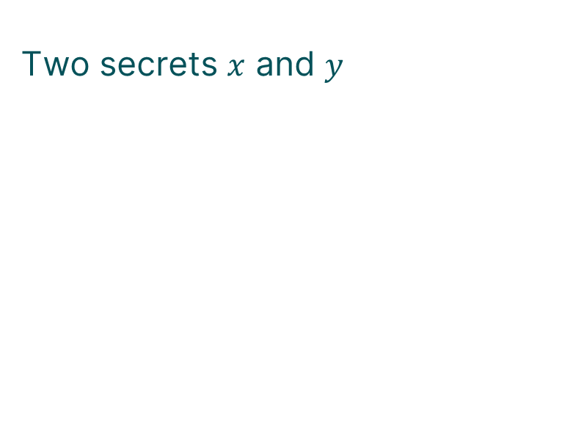



Mpc 101
Computing on secrets
Addition
Two secrets $x$ and $y$
$$x_{1}$$
$$y_{1}$$
$$x_{2}$$
$$y_{2}$$
$$x_{3}$$
$$y_{3}$$

Slide 15




Mpc 101
Computing on secrets
Addition
Two secrets $x$ and $y$
$$x_{1}$$
$$y_{1}$$
$$x_{2}$$
$$y_{2}$$
$$x_{3}$$
$$y_{3}$$
$$x_{1}+y_{1}$$
$$x_{2}+y_{2}$$
$$=x+y$$
$$x_{3}+y_{3}$$

Slide 16

Mpc 101
Computing on secrets
Addition
Multiplication
Two secrets $x$ and $y$
$$x_{1}$$
$$y_{1}$$
$$x_{2}$$
$$y_{2}$$
$$x_{3}$$
$$y_{3}$$
$$x_{1}+y_{1}$$
$$x_{2}+y_{2}$$
$$=x+y$$
$$x_{3}+y_{3}$$

Slide 17

Mpc 101
Non-linear Operations
Beaver triples
Generate helper triples $\left(\left[a\right],\left[b\right],\left[c\right]\right)$ and $ab=c$
Open $\left[a+x\right]=A$ and $\left[b+y\right]=B$
Compute $Ay+\left(−B\right)\left[a\right]+\left[c\right]=[xy]$

Slide 18
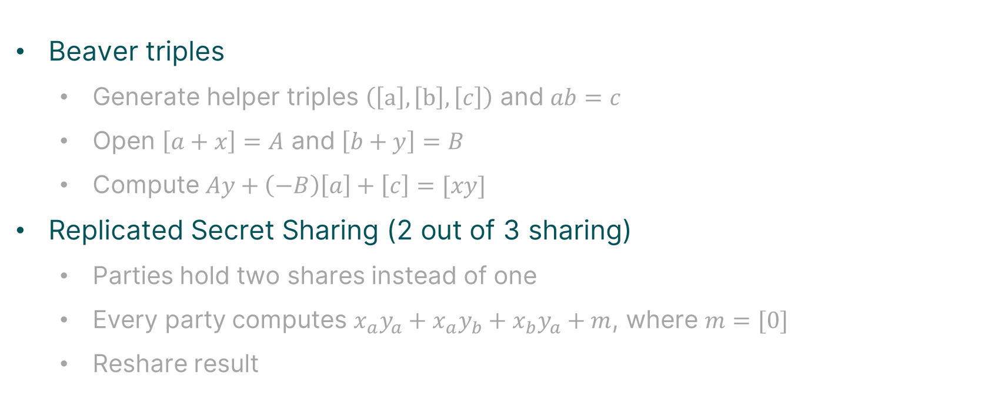
Mpc 101
Non-linear Operations
Beaver triples
Generate helper triples $\left(\left[a\right],\left[b\right],\left[c\right]\right)$ and $ab=c$
Open $\left[a+x\right]=A$ and $\left[b+y\right]=B$
Compute $Ay+\left(−B\right)\left[a\right]+\left[c\right]=[xy]$
Replicated Secret Sharing (2 out of 3 sharing)
Parties hold two shares instead of one
Every party computes $x_{a}y_{a}+x_{a}y_{b}+x_{b}y_{a}+m$, where $m=[0]$
Reshare result

Slide 19
Great – what now?

Slide 20
How did we get here
zkSNARKs 101
Succinct proof for computational integrity
Keeping secret input hidden (potentially)

Slide 21

How did we get here
zkSNARKs 101
Succinct proof for computational integrity
Keeping secret input hidden (potentially)

Slide 22
How did we get here
MPC 101
Mutually untrusting parties jointly compute a function
Inputs and intermediate values private (secret-shared)

Slide 23

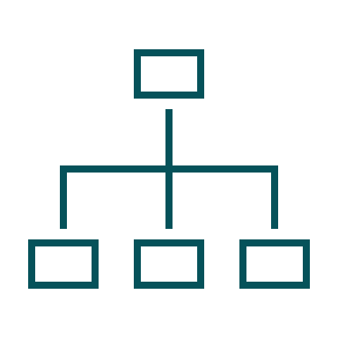
how did we get here
What are coSNARKs?
Zero-Knowledge
MPC

Slide 24

how did we get here
What are coSNARKs?
Zero-Knowledge
MPC
co-SNARKs

Slide 25

[r1]
[r2]

Slide 26


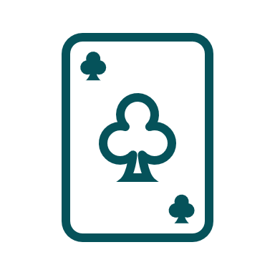
Here is a shuffled deck and a proof

Slide 27
Look we have a shuffled deck
And we don’t know what we’ll draw

Slide 28

Look we have a shuffled deck
And we don’t know what we’ll draw

Slide 29
We are done, right?

Slide 30
Let’s think this through

Slide 31
Let’s think this through
Playing a game of cards
Shuffled the deck

Slide 32
Let’s think this through
Playing a game of cards
Shuffled the deck
Only distribute cards to respective players (verifiable encryption)

Slide 33
Let’s think this through
Playing a game of cards
Shuffled the deck
Only distribute cards to respective players (verifiable encryption)
No one knows the
structure of deck!

Slide 34
Let’s think this through
Playing a game of cards
Private Shared State
Shuffled the deck
Only distribute cards to respective players (verifiable encryption)
Not simply composing Alice and Bobs private state
We generate new private state that nobody knows
No one knows the
structure of deck!

Slide 35
Look we have a shuffled deck
And we don’t know what we’ll draw

Slide 36
Look we have a shuffled deck
Really?
And we don’t know what we’ll draw

Slide 37
Towards publicly-auditable MPC
[r1]
[r2]

Slide 38
Towards publicly-auditable MPC
I don’t like r1, let’s take r5
[r1]
[r2]

Slide 39
Towards publicly-auditable MPC

Slide 40
github.com/TaceoLabs/noir_workshop_0625/

Slide 41
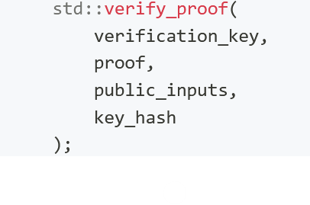
Interop with Barretenberg
UltraHonk Proof System
Full Client-IVC Proof System
Currently supported by coNoir
Recurse into smart contract
Prove whole Aztec transactions in MPC
Create Aztec keys that are secret-shared and own Private State

Slide 42
Follow us!

