Slide 1
DATA ANALYST PROJECT
RETAIL TRANSACTION INSIGHT
Diagnosing the Feb-Apr Revenue decline: A deep Dive into Retail Transaction Behavior (May 2023-April 2024)
Analysis for the period May 2023 – April 2024
Product Analysis • Transaction Time • Regional • Payment Method

Slide 2
Project Overview
This project analyzes retail transaction data from May 2023 to April 2024 to investigate the sharp revenue decline that occurred during February–April 2024. The analysis focuses on identifying whether the decline was caused by changes in product performance, customer purchasing behavior, transaction timing, regional contribution, or payment preferences. The business maintained relatively stable monthly revenue around $2.0M–$2.1M for most of the observed period. However, revenue suddenly dropped in February 2024 and continued declining into April 2024, signaling a potential shift in customer behavior or external market conditions.To identify the root cause, this project explores multiple business dimensions including:
Monthly revenue performance and MoM growth
Product category contribution
Unit sales distribution
Customer transaction timing
Regional purchasing behavior* Payment method performance

Slide 3
Problem Statement
Understanding Retail Transaction Behavior to identify Potential drivers of the Feb-April Revenue Decline.
Tools I used to deal with this problem
Microsoft Excel (cleaning, reporting & chart)• SQL/PostgreSQL (analysis) • Power BI (Dashboard Visualization)

Slide 4
Analysis Breakdown
01
04
Monthly Revenue & MoM Growth Rate %
Regional Behavior
Monthly revenue and MoM growth percentage
Look the regional activity by transaction and revenue
02
05
Product Distribution
Payment Method
The most popular products and their transactions volume
Identify most recommendation payment method for transactions
03
06
Transaction Time
Summary & Recommendations
Identify the peak and volume of transaction time
Key find (insight) and Recommendations

Slide 5
01 | Revenue declines sharply in Early 2024, Dropping -10.7% MoM in April, Signaling a Weakening Trend into Q1
Latest Revenue
$ 1.86 M
April 2024
MOM Change
-10.70%
VS March 2024
Peak Month
$ 2.10 M
January 2024
Quick Insight
Revenue remain stable around $2.0M – $2.1M for 8 months (May 2023 – Jan 2024), before sharply declining in Feb 2024 at -7.2% and -10.7% MoM perspectively. This suddent reversal warrants a deeper evaluation on product performance, regional contribution, and payment behavior to identify the root cause
Avg MOM Growth
-1.08%
11 Months

Slide 6
02 |All 4 Products Categories perform closely, With only $73K (1.2%) gap between Books and Home Decor
Top Products
$ 6.16 M
Books Products
Bottom Products
$73K (1.2% Gap)
$ 6.08 M
Home Décor Product
Total Revenue
$ 24.4 M
All Categories
Quick Insight
Net revenue relatively balanced across all product categories , with only 1,2% gap between the highest-performing (books, $6.16M) and lowest-performing (Home Décor,$6.08M) categories.
This Suggest no single product is driving or dragging overall revenue, making it harder to pinpoint the root cause of the Feb-April decline.
Revenue Gap
$ 73k (1.2%)
11 Months

Slide 7
02.a |Unit Sales mirror product revenue pattern — Only 1,491 Units (1,22%) gap across all 4 categories
Top Products
124.164 unit sold
Books Products
Bottom Products
122,673 unit sold
Home Decor Product
Total Unit Sold
493,656 units
All Categories
Quick Insight
Total unit sold relatively balanced across all product categories , with only 1,22% gap between the highest-performing (books, 124K units) and lowest-performing (Home Décor, 122K units).This confirm that product performance is not the driver of the feb-April decline — shifting our focus to transaction patterns and payment behavior
Unit Sold Gap
1491 Units / 1.22%
11 Months

Slide 8
03 | Transactions Peak at 7PM (4,221), Yet customer remain consistently active around the clock — event midnight sees 4000+ transactions
Peak Hours
07 : 00 PM
Late Night Peak
01 : 00 AM
Quick Insight
Afternoon Dip
Transaction activity peaks at 7PM (4,221) but remains consistently high throughout the day, with no significant drop even at midnight (4,060 transactions). The narrow gap only 275 transactions between peak and lowest hour, suggests customers demand is active 24/7 – indicating that operational readiness and marketing campaigns should not be limited to peak hours alone .
12:00 PM
Lunch Break

Slide 9
04 | Military-Based regions (Armed Forces) lead transaction volume at 3,500+, nearby 2x higher than regular regions
Top Regional
10,675 transaction in total
Armed Forces
Transaction gap on regular regions
31 transactions
Quick Insight
7 regions
Armed Forces regions (Europe,Americas,Pacific) lead transaction volume at 3,500+, nearly 2x higher than regular regions (1,500+). This suggests that military based customers represent a highly active segment, likely driven by collective and frequent purchasing needs. Meanwhile regular regions shows remarkably balanced activity, with only a 31 transactions gap across the bottom 7 regions.

Slide 10
04.a | Military-Based regions dominate net revenue, with armed forces Americas leading at $902k, nearly 2x higher then regular regions
Top Regional
$902,032
Armed Forces Americas
Revenue Gap Top - Bottom
2,3%
Quick Insight
Top 10 Regions
Armed Forces regions (Europe,Americas,Pacific) not only lead in transaction volume but also in net revenue, with Armed Forces Americas topping at $902k, nearly 2x higher than regular regions (~$385k-$395k). This confirms that higher transaction activity directly translates to higher revenue, making Armed Forces as critical customer segment that significantly drives overall business performance

Slide 11
05 | All 4 payment methods perform almost equally, with PayPal leading at 24,711, only 0,86% gap from Debit Card
Most Used Payment
24,711 transaction
PayPal
Least Used Payment
24,498 transaction
Debit Card
Transaction Gap
0.86% (213 transactions)
Quick Insight
Armed Forces
PayPal leads transaction volume at 24,711, yet all 4 payments methods perform almost equally with only a 0,86% gap between the highest (PayPal) and lowest (Debit Card). This suggests customers show no strong preference toward any single payment method, indicating that all payment channels are equally accessible and utilized
Total Transactions
98,501 transactions
All Payment Method

Slide 12
05.a | All 4 payment methods generate almost equal revenue, with PayPal leading at $6.14M—Only 0,49% gap from credit card
Top Payment Revenue
$6.14 M
PayPal
Revenue Gap
$29,987 (0,49%)
PayPal to Credit Card
Most Used Method
24,711 transactions
Quick Insight
PayPal
PayPal leads revenue generated at $6.14M, yet all 4 payment methods perform almost equally with only 0,49% gap between the highest (Paypal) and lowest (Credit Card). This suggests customers show no strong preference toward any single payment method, indicating that all payment channels generate revenue equally
Total Revenue
$24.47 M
All Payment Method

Slide 13
05.b | Payment Method distribution is nearly identical across all 4 methods, even Avg transaction value shows no meaningful difference
PayPal
Net Revenue
Avg Transaksi
Median
$ 6.13 M
$ 248
$ 198
Cash
Net Revenue
Avg Transaksi
Median
$ 6.18 M
$ 248
$ 201
Debit Card
Net Revenue
Avg Transaksi
Median
$ 6.11 M
$ 249
$ 202
Payment method distribution is remarkably balanced across all 4methods, ranging from 24.87% to 25.09%, a difference of only 0.22%. Even average transaction value ($248-$249) and median ($198-$202) show virtually no meaningful difference between method. This strongly confirms that customers have no strong preference toward any single payment method, and that payment behavior is not the contributing factor to the feb-apr revenue decline, shifting ourt investigation toward external factors such as seasonality or market conditions.
Credit Card
Net Revenue
Avg Transaksi
Median
$ 6.10 M
$ 248
$ 201

Slide 14
06 | Summary of Key Findings
📈 Revenue
🕐 Transaction Time
Revenue remained stable at ~$2.0M-$2.1M for 8 months (May 2023 – Jan 2024), before sharply declining in Feb (-7.02%) and Apr (-10.70%) 2024 , the steepest fall of the entire period
Transactions peak at 7 PM (4,221) but remain consistently active 24/7 – even midnight sees 4,000+ transactions. No significant dead hours detected throughout the day
📦 Product
🎖 Regional
All 4 product categories perform almost equally in both revenue ($6.08M-$6.16M) and unit sold (122,673-124,164), with gapse under 1.5%. Product performance is not the root cause of the Feb-Apr decline
Armed Force regions (Europe, Americas, Pacific) dominate both transaction volume (~3.500+) and revenue (~$870k-$920k) – nearly 2x higher than regular regions (~$385k-$395k), driven by collective purchasing behavior of military-based customers.
💳 Payment Method
All 4 payment methods show virtually identical distribution (24.87%-25.09%), revenue ($6.10M-$6.14M), and average transaction value ($248-$249).Payment behavior is not the root cause of the Feb-Apr decline
Retail Transaction Analysis • May 2023 – April 2024

Slide 15
06.a | Recommendations
01 | Investigate Seasonal Patterns as the Primary Root Cause
04 | Maintain Payment Channel Diversity
The Feb-Apr revenue decline cannot be attributed to product, payment, or transaction behavior – all of which remained stable and balanced. This strongly points toward seasonality or external market conditions as the primary driver. A deeper time-series analysis across multiple years is recommended to confirm seasonal trends and anticipate future dips.
Since all payment methods perform equally, the business should maintain and support all 4 channels without over-investing in one. Ensuring seamless payment experiences across PayPal, Cash, Credit Card and Debit Card will help retain customer convenience and avoid drop-offs
02 | Optimize Marketing Strategy for Armed Forces Segment
05 | Prioritize Further Investigation on Feb-Apr Anomaly
Armed Forces regions generate nearly 2x more revenue and transaction volume than regular regions. The business should double down this segment, through exclusive promotions, loyalty programs, or tailored product bundles for military-based customers. Meanwhile, regular regions show untapped potential and could benefit from targeted regional campaigns to close the gap
Despite stable product, payment and transaction behavior, revenue dropped significantly in Feb & Apr. Recommend conducting a deeper drill-down analysis on:
External Factor (holidays, economic conditions, competitor activity)
Customer retention & churn rate during that period
Whether Armed Forces segment also experienced the same drop
03 | Leverage 24/7 Customer Activity for Always-On Operations
With transactions consistently active around the clock, even at midnight the business must ensure system scalability, uptime, and operational readiness 24/7. Marketing campaigns and promotions should not be limited to peak hours (7 PM) but distributed throughout the day maximize reach.
Retail Transaction Analysis • May 2023 – April 2024

Slide 16
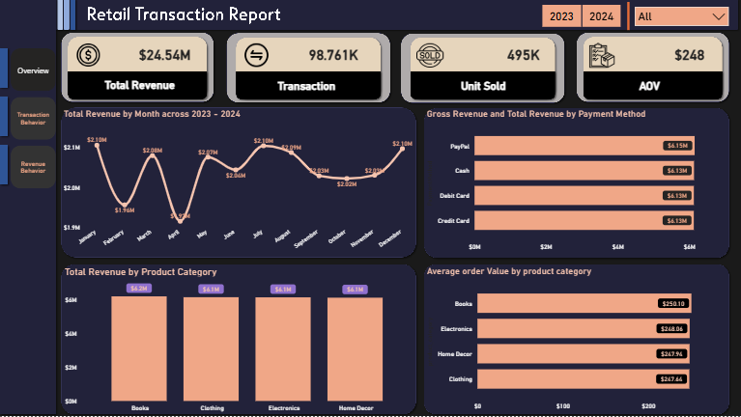
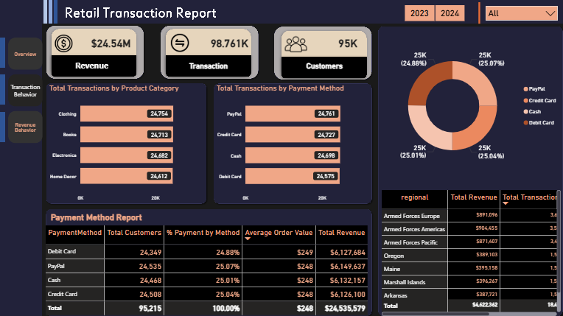
Dashboard

Slide 17
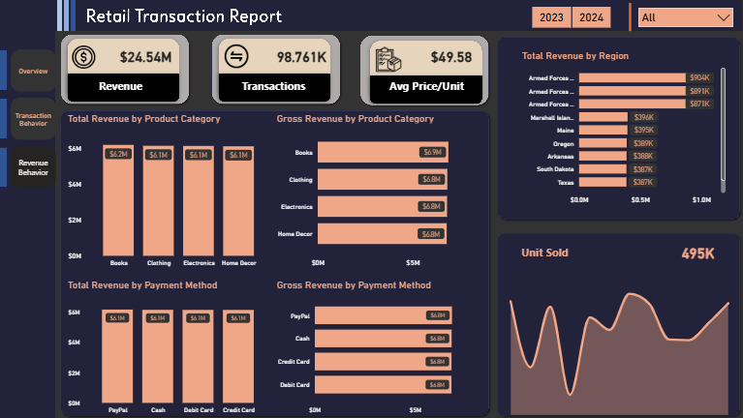

Slide 18
Thank You
Social Media Link :
Linkedin : www.linkedin.com/in/faraj-hafidh
Instagram : https://www.instagram.com/hahahafidh_/
Portfolio : https://farajhafidh.vercel.app/
Analysis for the period May 2023 – April 2024
Data: Retail Transaction Dataset

