Slide 1
Introduction on NodeMCU

Slide 2
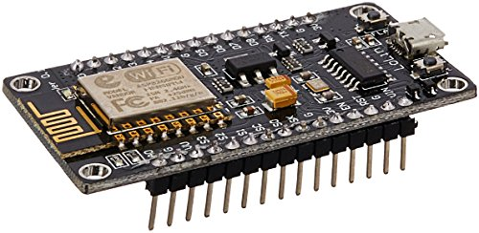

Slide 3
Advantages
ESP8266 WiFi module built-in
Compact Size
Can use Arduino IDE to program

Slide 4
Disadvantages
Uses a lot of Power
Only 1 Analog pin

Slide 5
Task #1
Blink an LED on pin 10

Slide 6

Adafruit.io

