Slide 1
28th SPVM National Physics Conference (SPVM 2026)
A Practical System for Optimizing
Large-Scale Conference Programs
Tokyo University of Science Faculty of Science Division II, Department of Physics (4th year) Umemura Laboratory
Shogo Tsuruta, Kazuo Umemura
October 22–24, 2026 Ateneo de Davao University
Notes:
[Script] ~12 s (cumulative 0:12)
Hello, everyone. My name is Shogo Tsuruta, from Tokyo University of Science. Today, I will talk about a system that helps us make conference programs.

Slide 2
Contents
01
02
03
04
Background and Objective
System Design
Results and Discussion
Conclusion
2
Notes:
[Script] ~7 s (cumulative 0:19)
This talk has four parts: the background, the system, the results, and the conclusion.

Slide 3
01
Background and Objective
Survey / Previous Studies / Objective
3
Notes:
[Script] ~2 s (cumulative 0:21)
First, the background.

Slide 4
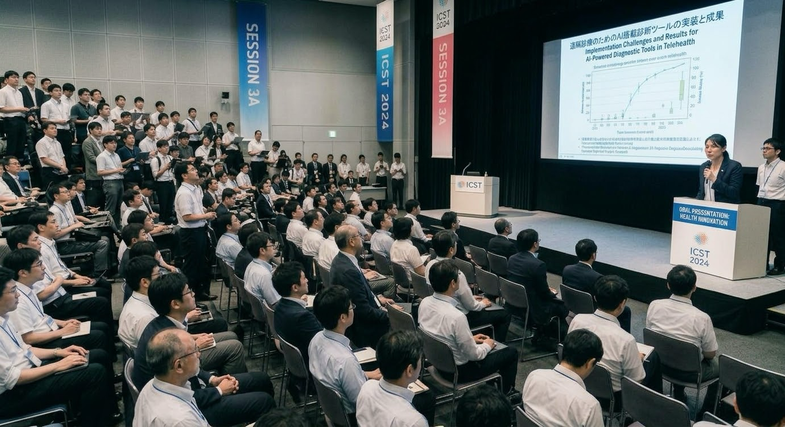
1. Background and Objective
What Is an Academic Conference?
At a conference
1
Oral presentations
2
Poster presentations
3
Networking among researchers
Advancing science
Generated by Gemini
4
Notes:
[Script] ~38 s (cumulative 0:59)
Some of you may be at a conference for the first time. So, let me start by explaining what a conference is. At a conference, researchers give oral talks and poster presentations, and they meet other researchers. This is how science moves forward. At a large conference, many talks run at the same time in different rooms. So someone has to make a program: a timetable that shows which talk is in which room, and when.

Slide 5
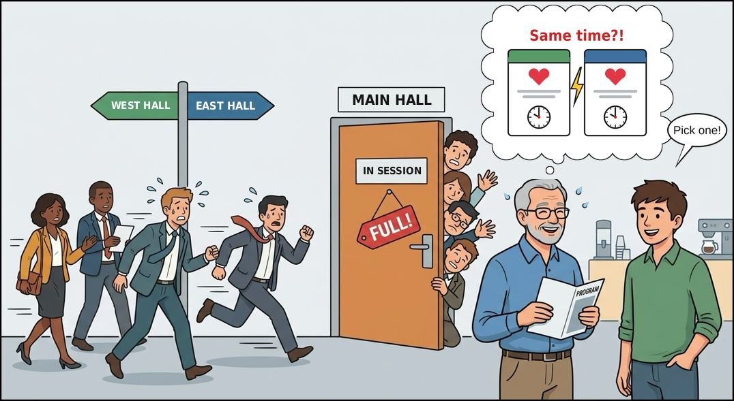
1. Background and Objective
The Problem: Making a Good Program Is Hard
A bad program causes...
A
Moving between rooms
B
Two talks you want, at the same time
C
Full rooms (or empty rooms)
A good program avoids
A, B and C
Generated by Gemini
5
Notes:
[Script] ~44 s (cumulative 1:43)
But making a good program is hard. Look at this picture. A: these people are running to another room, because the next talk on their topic is somewhere else. B: two talks this man wants to hear are at the same time. He has to choose one. C: this room is full, so people cannot get in. On the other hand, another room may be almost empty. A good program avoids these three problems: A, B, and C. Please remember these letters. They will come back later.

Slide 6
1. Background and Objective
Survey: Administration of the Academic Conference
Scheduling is “a lot of work”
Done by hand
in spreadsheets
Open to automated tools
A lot of work, done by hand — and tools are welcome
All answers → Appendix A2
6
Notes:
[Script] ~32 s (cumulative 2:15)
Is making a program really hard? And is there a need for automation? We asked the organizers of three conferences: a large one, a medium one, and a small one. Two of the three said that making the program is a lot of work. Two of the three make it by hand, in spreadsheets. And all three said they are open to automatic tools.

Slide 7
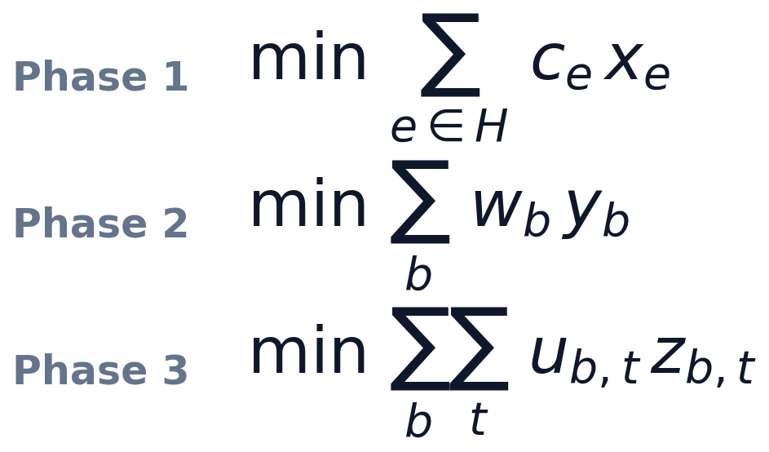
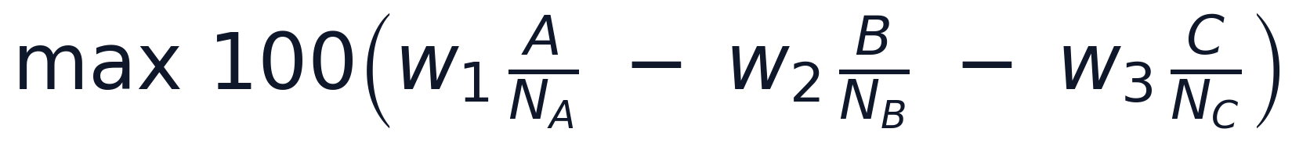
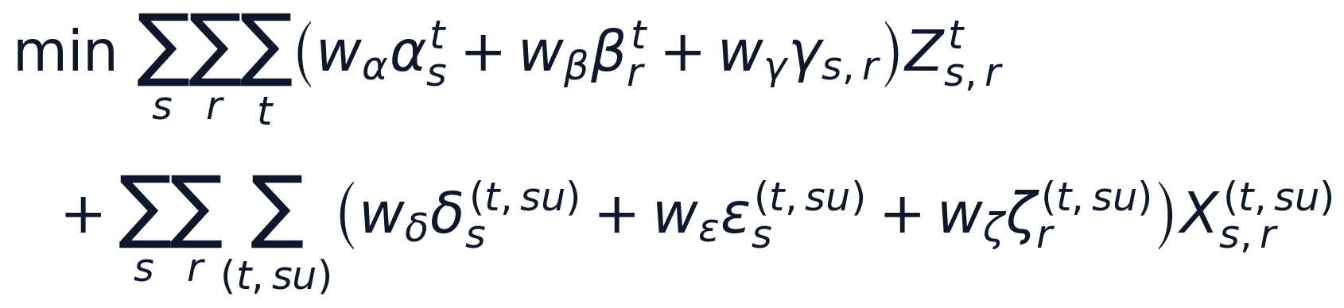
1. Background and Objective
Previous Studies: Powerful, but Hard to Use
Previous studies
This study
[1]
3 problems solved in a row
[2]
6 weights × 6 penalty tables
A continuity B conflicts C empty seats
Input: every participant’s preferences [1] / 9 sheets + 6 weights [2]
Input: 3 sheets + 3 weights
[1] Vangerven et al. 2018, Eqs. (1)(4)(8) [2] Pylyavskyy et al. 2024, Eq. (11) Details → Appendix A13
7
Notes:
[Script] ~40 s (cumulative 2:55)
Automatic scheduling has been studied before. Here are the score formulas of two previous studies, and ours. You do not need to read them. Just compare how complex they look. The first study needs the preferences of every participant, and it solves three problems in a row. The second study needs nine input sheets and six weights. They are powerful, but they need a lot of preparation. Our formula is short, and the input is three sheets and three weights.

Slide 8

1. Background and Objective
Our Goal
Creating a “Simple Conference Scheduler”
What we did
Build
the system
Check
that it works
Evaluate
with a real conference
1
2
3
We want to make running a conference easier.
8
Notes:
[Script] ~27 s (cumulative 3:22)
So, our goal is to create a Simple Conference Scheduler. It uses mathematical optimization to make a first draft of the program. With this system, we want to make running a conference easier. We did three things: we built the system, we checked that it works, and we evaluated it with a real conference.

Slide 9
02
System Design
Mathematical Optimization / Formulation / Using the App
9
Notes:
[Script] ~2 s (cumulative 3:24)
Next, the system.

Slide 10
2. System Design
Updated Since the Abstract
The system has been updated since the Abstract → Today we present the new version
Today
B Topic conflicts
Counted
Score
Each term ÷ N (same scale)
Time (40 talks, equal weights)
≈ 1,400 s
Details → Appendix A3
10
Notes:
[Script] ~27 s (cumulative 3:51)
First, one note. We kept improving the system after the Abstract. In the Abstract version, topic conflicts, B, were not counted correctly. We fixed this. We also put the three parts of the score on the same scale. Because of these changes, the computation time became longer. Today, I present the new version.

Slide 11
2. System Design
System Overview
① Input Excel
② Compute App
③ Output Excel
Conference Presentation Scheduler
► Run
Rooms
TimeSlots
Presentations
Timetable
List
Report
3 sheets · 7 columns
1 click
Timetable · List · Report
Prepare Excel → Press Run → Get the timetable
11
Notes:
[Script] ~17 s (cumulative 4:08)
This is the whole system. You prepare an Excel file with three sheets: rooms, time slots, and presentations. The app calculates. Then you get the timetable, a list, and a report, again in Excel.

Slide 12
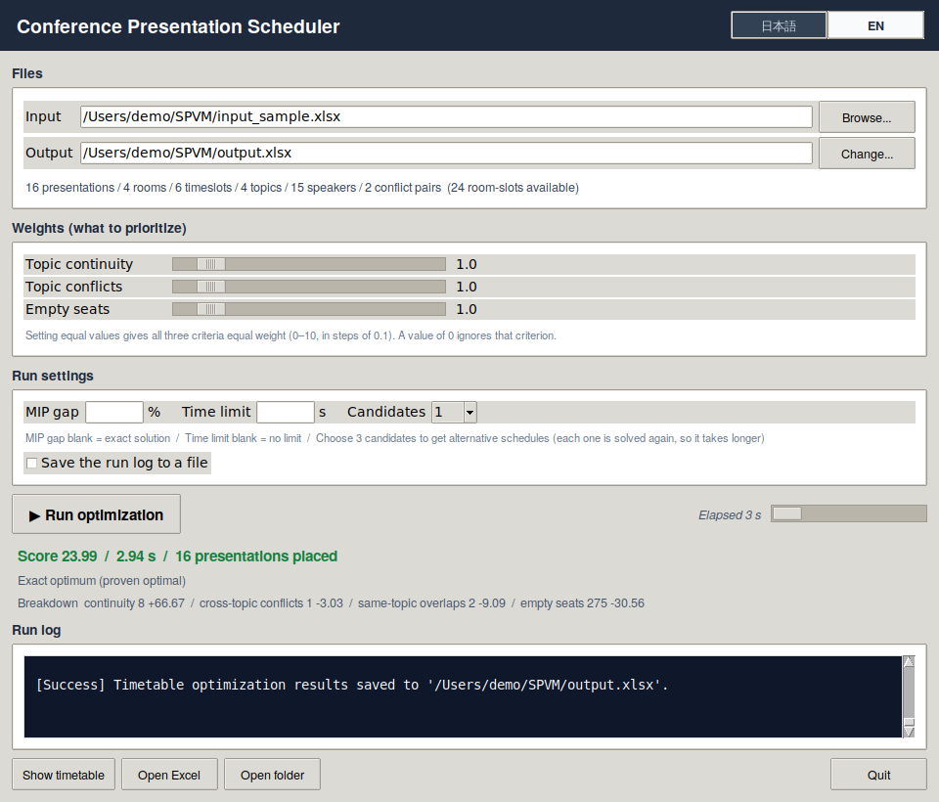
2. System Design
App Screen: How to Use
Required
Required steps
1
1
Choose the input file
2
“Run optimization”
3
Optional (defaults work)
Optional
3
Weights (0–10, default 1.0)
4
5
4
Gap · time limit · candidates
2
5
Save the run log
6
Result
Check the result
6
Score and breakdown
Settings → Appendix A4
12
Notes:
[Script] ~20 s (cumulative 4:28)
This is the app. Only two steps are required: choose the input file, and press Run. Other settings, such as the weights and the time limit, are optional. After the run, the app shows the score and its breakdown.

Slide 13
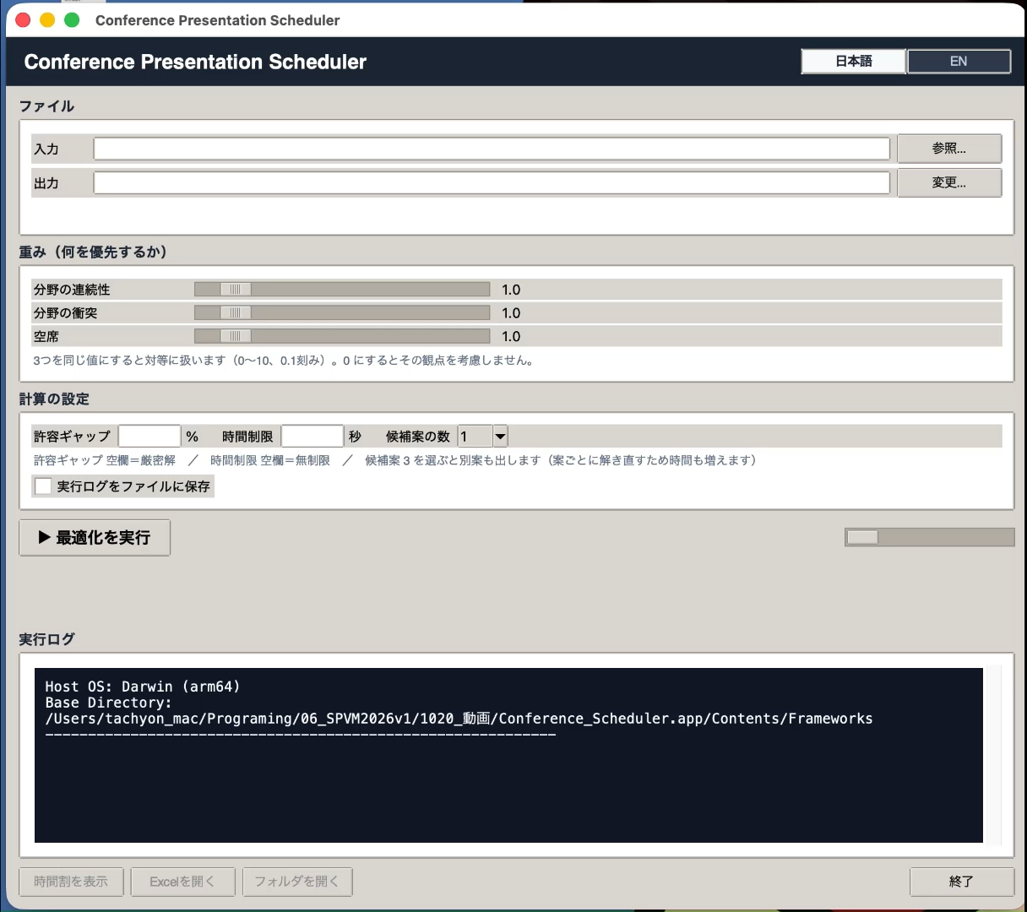
2. System Design
App Screen: How It Works
13
Notes:
[Script] ~33 s incl. 27 s video (cumulative 5:01)
Now, let me show you the actual app in a short video.
[Click to play the video. About 27 s.]

Slide 14
2. System Design
What Is Mathematical Optimization?
Find the best choice that follows the rules
Variables
Constraints
Objective function
What we decide
Rules to follow
A score for “how good”
Limit
?
?
?
Max
x₁
x₂
x₃
Choose within this range
Compared
with AI
Always follows the rules
Reasoning is transparent
Scores are reproducible
✓
✓
✓
14
Notes:
[Script] ~41 s (cumulative 5:42)
Now, let's look at how the app works. Inside the app, we use mathematical optimization. What is mathematical optimization? It means: find the best choice that follows the rules. It has three parts. Variables are what we decide. Constraints are the rules, for example a limit that we cannot go over. And the objective function is a score. We look for the highest score. Compared with AI, it always follows the rules, we can explain the result, and the score is reproducible.

Slide 15
2. System Design
Formulation ①: Variables and Constraints
Variable: is this talk here? (1 = yes, 0 = no)
Always
Time 1
Time 2
Time 3
Time 4
Time 5
Each talk: exactly one place
1
Room A
0
0
0
0
0
2
Each room and slot: at most one talk
Room B
0
0
1
0
0
3
Audience ≤ room capacity
Room C
0
0
0
0
0
Room D
0
0
0
0
0
Only if the column is filled
Screen
Same speaker
Unavailable slot
Talk P01 → Room B, Time 3
More → Appendix A6
15
Notes:
[Script] ~38 s (cumulative 6:20)
In our system, the variable is very simple: is this talk in this room at this time? Yes is 1, and no is 0. Here, talk P01 is in Room B at Time 3. Three rules are always used: each talk is placed exactly once, each room has at most one talk at a time, and the room must be big enough. Three more rules are used only if you fill in that column in Excel.

Slide 16
2. System Design
Formulation ②: Objective Function
Score = 100 × ( w₁ · A / N_{A} − w₂ · B / N_{B} − w₃ · C / N_{C} ) → maximize
A
Maximize
B
Minimize
C
Minimize
Same topic continues in the same room
Similar topics overlap at the same time
Empty seats (capacity − attendees)
+1
+1
B1
B2
Room
Attendees 60
Empty 40
Same slot
Slot →
Room with capacity 100
+ Level
+ 3
The audience need not change rooms
B1: similar topics B2: same topic
Match room size to audience size
w: how important each point is (0–10, set in the app) N: puts A, B, C on the same scale
Limitation: all talks must be about the same length (1 talk = 1 time slot)
More → Appendix A7
16
Notes:
[Script] ~54 s (cumulative 7:14)
And this is the score. It has the three parts you saw in the picture. A is topic continuity: when the same topic continues in the same room, we add one. We want more of this. B is topic conflicts: when similar topics run at the same time, we add a penalty. We want less. C is empty seats: the room size should match the audience. We want less. The weights, w, let the user choose what is important, and N puts the three parts on the same scale. There is one limitation: all talks must be about the same length, because one talk uses one time slot.

Slide 17
03
Results and Discussion
Testing the Weights / Data Modeled on a Real Conference
17
Notes:
[Script] ~2 s (cumulative 7:16)
Now, the results.

Slide 18


3. Results and Discussion
Two Tests
Test 1: Does it work?
Test 2: Is it practical?
Same data as the Abstract
Based on a real conference
40
10
89
4
talks
rooms
talks
rooms
5
7
24
8
slots
topics
slots
topics
All runs: my laptop — MacBook Air (M4, 16 GB)
18
Notes:
[Script] ~30 s (cumulative 7:46)
We ran two tests. Test 1 asks: does it work? We used the same data as in the Abstract: 40 talks, 10 rooms, 5 time slots, and 7 topics. Test 2 asks: is it practical? We used data based on a real conference: 89 talks, 4 rooms, 24 time slots, and 8 topics. Everything ran on my laptop, a MacBook Air.

Slide 19
3. Results and Discussion
Test 1: The Weights Work as Intended
A
Topic continuity
B
Topic conflicts (penalty)
C
Empty seats
higher is better
lower is better
lower is better
best for that point
equal weights (1 : 1 : 1)
Each weight improves its own point — equal weights are near the best on all three
Input data and timetables → Appendix A8, A9
19
Notes:
[Script] ~36 s (cumulative 8:22)
Here is Test 1. Because of time, I will show only the summary. We tried four weight settings. With weight only on A, continuity was the highest: 23. With weight only on B, the conflict penalty was the lowest: 53. With weight only on C, empty seats were the lowest: 1,270. With equal weights, all three were close to the best at the same time. So, the weights work as intended.

Slide 20

3. Results and Discussion
Test 2: Input data and conditions
Input: based on real physics conference
89
4
24
8
Talks
Rooms
Time slots
Topics
Settings: equal weights (1 : 1 : 1), time limit 90 s
Data details → Appendix A10
Public data is for imitation; unknown data is for inference.
20
Notes:
[Script] ~27 s (cumulative 8:49)
Next, is it practical? We took the past program of a real physics conference, which was made by hand, and changed it into our input format. We ran our system with equal weights and a time limit of 90 seconds. Then we scored both programs with the same three points, A, B, and C.

Slide 21
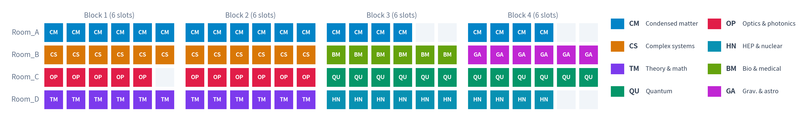
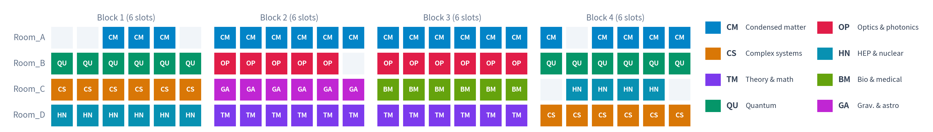
3. Results and Discussion
Test 2: Demonstrated its practicality
Real program (made by hand)
This system (90 s)
A
Topic continuity
B
Topic conflicts
C
Empty seats
Time
73 → 72
−1%
51 → 39
−24%
1,640 → 1,640
±0%
90 s
Similar to the real program → Practical
21
Notes:
[Script] ~42 s (cumulative 9:31)
Here is the result. The top is the real program, and the bottom is ours. You can see that they look similar. Next, let's compare the numbers. Continuity: 73 and 72, almost the same. Empty seats: exactly the same. And the conflict penalty: 39 instead of 51, about 24 percent lower. However, please note that these three points, A, B, and C, are our own measures, not universal ones. Our system made this draft in 90 seconds. So, we judge that the system is practical.

Slide 22
04
Conclusion
Summary / Released on GitHub
22
Notes:
[Script] ~2 s (cumulative 9:33)
Finally, the conclusion.

Slide 23
4. Conclusion
Summary
Built a system that makes a first draft of a conference program with mathematical optimization
1
3 sheets · 7 columns · 1 click
Confirmed that it works with test data
2
weights work: 4 / 4 settings
Showed that it is practical, using a real conference as a model
3
A −1% · B −24% · C ±0% · 90 s
Weak point: only for conferences where talks are about the same length
4
1 talk = 1 time slot
23
Notes:
[Script] ~35 s (cumulative 10:08)
To summarize. One: we built a system that makes a first draft of a conference program with mathematical optimization. Two: we confirmed that it works with test data. Three: using a real conference as a model, we showed that it is practical. Four: the weak point is that it works only when talks are about the same length. We hope this system can make running conferences a little easier.

Slide 24

4. Conclusion
Thank You for Your Attention
References
[1] B. Vangerven et al. Omega. 38 (81) 2018
[2] Y. Pylyavskyy et al. Eur. J. Oper. Res. 487 (317) 2024
GitHub
Appendix (A1–A13)
A1
Roadmap
A8
Test 1: input data
A2
Survey answers
A9
Test 1: results
A3
Changes since the Abstract
A10
Test 2: data
A4
App settings
A11
Test 2: results
A5
Optimization (more)
A12
PuLP / CBC / HiGHS
A6
Variables & constraints
A13
Previous studies
https://github.com/Tachyon327/Conference-Scheduler
A7
Objective function
These slides and the code are also on GitHub
24
Notes:
[Script] ~18 s (cumulative 10:26)
You can find the detailed data and specifications in the Appendix. These slides, the code, and the app are all on GitHub. If you are interested, please scan this QR code.
[Time check: 11:00 or earlier → type 27 + Enter (A1 Roadmap). Otherwise, finish here.]
Thank you for your attention.

Slide 25
A
Appendix
Supplementary material for Q&A
25

Slide 26
APPENDIX
Appendix Contents
One topic per page. During Q&A, jump to a page by its number.
Supplements to the talk
How the system works
Data and results
Solver
A1
Roadmap
A4
App settings
A8
Test 1: input data
A12
PuLP / CBC / HiGHS
Planned updates until March 2027
Weights, gap, time limit, candidates
40 talks / 10 rooms / 5 slots
Why another solver may be faster
A2
Survey answers
A5
Optimization (more)
A9
Test 1: results
All answers from 3 conferences
MILP and branch-and-bound
Timetables and numbers
A3
Changes since the Abstract
A6
Variables & constraints
A10
Test 2: data
What was fixed, and why time grew
All rules, with formulas
What is real, what is assumed
A13
Previous studies
A7
Objective function
A11
Test 2: results
Input, time, solver
A, B, C and the scale N
Both timetables, A / B / C
26

Slide 27
APPENDIX A1
Roadmap (updates planned until around March 2027)
1
Switch the solver from CBC to HiGHS
Become faster
Improve the definition of objective B (conflicts between simultaneous presentations)
2
More useful
3
Build a Windows app and support more macOS versions
Delivering to everyone
Scheduled for maintenance and improvements through March 2027
4
Until My Graduation
27
Notes:
[Script] ~57 s (only if time remains; cumulative 11:23)
Before I finish, let me briefly talk about our plans. There are three. First, we will switch the solver from CBC to HiGHS. In a first test on another computer, HiGHS found the same best timetable much faster. Second, we will improve B, topic conflicts. For similar topics, B now checks only whether they meet in the same slot, not how many talks meet. We are still looking for the best way to fix this. Third, we will build a Windows app and support more macOS versions, so that more people can use the system. I plan to finish all of this by March 2027, when I graduate.
[Type 24 + Enter to go back to the Thank You slide.]
Thank you for your attention.

Slide 28
APPENDIX A2
Survey Answers (3 Conferences, Anonymous)
Three interviews. All three conferences agreed to publication if anonymous.
Question | Conference A | Conference B | Conference C
Respondent’s role | Program / organizing committee (researcher, faculty) | Conference secretariat staff | Program / organizing committee (researcher, faculty)
How the program is made | Manual work and adjustment in spreadsheets | Schedule in spreadsheets; program in an in-house submission and program-editing system | Manual work in spreadsheets (Excel, Google Sheets)
External vendor tools | — | In-house program and optimization tool | None (done in-house with Google Forms)
Scheduling burden | Takes considerable effort | Not much effort | Takes considerable effort
Main difficulties / focus | Handling incomplete submissions and individual requests | Avoiding speaker double-booking / individual availability and equipment / avoiding conflicts between similar topics / room capacity (standing, empty seats) | Topic continuity (same topic in the same room) / last-minute cancellations and changes
Interest in using a tool | Would consider it, depending on conditions (usability, cost, etc.) | Would consider it, depending on conditions (usability, cost, etc.) | Would definitely like to try
Free comments | — | — | Choosing which accepted submissions beyond the oral slots move to posters, and notifying authors, takes effort (summary)
28

Slide 29
APPENDIX A3
Changes Since the Abstract
Abstract
Now
Topic conflicts
Penalty was always 0 (bug)
Fixed; split into B1 (similar topics) and B2 (same topic)
Score
W1·A − W2·B − W3·C
Each part ÷ its possible range, × 100
Computation time
≈ 566 s / 7 s / 0.1 s
Longer: 1,360–1,455 s (equal weights, 3 runs)
Interface
Excel only
Desktop app (weights, MIP gap, time limit, candidates)
New rule
—
Same speaker not in two rooms at once
29

Slide 30
APPENDIX A4
App Settings
Setting | Range / default | What it does
Input / output file | required | Excel in, Excel out
Weights A, B, C | 0–10 (step 0.1), default 1.0 | Which point matters more. 0 = ignore it
MIP gap | %, blank = 0 (exact) | Stop when the score is this close to the proven best
Time limit | seconds, blank = none | Stop and return the best timetable so far
Candidates | 1–3, default 1 | Alternative timetables (each is solved again)
Run log | on / off | Save the solver log to a file
Result panel | — | Score, breakdown (A, B1, B2, C), quality: proven / time limit
30

Slide 31
APPENDIX A5
Mathematical Optimization in More Detail
Variables
x = 0 or 1 → integer
Branch-and-bound (how the solver searches)
Relaxed problem
(x may be 0.3)
Constraints
sums of x ≤, = numbers → linear
Objective
sum of x with weights → linear
fix x = 0
fix x = 1
Mixed-Integer Linear Programming (MILP)
Solver: CBC (free) through PuLP (Python).
Exact run: the solver proves that no better timetable exists (gap 0).
Time-limited run: returns the best timetable found so far (not proven).
bound ≤ best
→ stop
search on
new best
timetable
bound ≤ best
→ stop
Branches that cannot beat the best timetable are cut. Proving “no better one exists” is often the slow part.
31

Slide 32
APPENDIX A6
Variables and Constraints in Detail
x(s, r, t) = 1 if presentation s is in room r at time slot t, otherwise 0
Rule | Formula | When
Each presentation exactly once | Σ_r Σ_t x(s, r, t) = 1 for every s | Always
At most one presentation per room and slot | Σ_s x(s, r, t) ≤ 1 for every r, t | Always
Room large enough | x(s, r, t) = 0 if capacity(r) < audience(s) | Always
Screen | x(s, r, t) = 0 if s needs a screen and r has none | If Needs_Screen is filled
Unavailable slot | x(s, r, t) = 0 for t in NG(s) | If NG_TimeSlot_ID is filled
Same speaker | Σ_{s of speaker p} Σ_r x(s, r, t) ≤ 1 for every p, t | If Speaker is filled
Same length | 1 presentation = 1 time slot | Model assumption
Variables that break an “x = 0” rule are not created at all, which keeps the model small.
32

Slide 33
APPENDIX A7
Objective Function in Detail
Term | What is counted | Scale N (the range it can move) | N: Test 1 / Test 2
A continuity ↑ | +1 when the same topic is in the same room in two neighbouring slots (same day) | N_A = talks − topics | 33 / 81
B1 cross-topic ↓ | +Level (1–3) for each pair of similar topics in the same slot | N_B = slots × ΣLevel + 3 × (talks − topics) | 139 / 651
B2 same topic ↓ | +3 for each extra talk of the same topic in the same slot | (included in N_B) | —
C empty seats ↓ | capacity − expected audience, summed over all talks | N_C = Σ (largest − smallest usable room) | 4,910 / 2,760
Why divide by N: the raw sizes differ (empty seats ≈ 1,000, continuity ≈ 20). After ÷N each term is 0–1, so w1 : w2 : w3 means what it says.
Known issue: B1 counts whether two topics meet in a slot, not how many talks meet.
With weight only on B, one topic can be packed into one slot (Test 1). A fix is planned.
33

Slide 34
APPENDIX A8
Test 1: Input Data (Same as the Abstract)
40
10
5
7
talks
rooms
slots (Day 1: 3, Day 2: 2)
topics
Room | Capacity | Screen
R01 | 200 | yes
R02, R03 | 150 | yes
R04 | 100 | yes
R05, R06 | 80 | yes
R07 | 40 | yes
R08 | 40 | no
R09, R10 | 30 | no
Topic | Talks
Mathematical Physics | 9
Cosmology | 7
Quantum Information | 7
Biophysics | 5
Particle Physics | 5
Semiconductors | 4
Electromagnetism | 3
Similar topics (Level): Particle–Cosmology 3, Particle–Math. Phys. 2, Bio–Quantum Info. 2, Semicond.–EM 1
Audience 20–150 people per talk · 20 talks need a screen · 3 talks have an unavailable slot (P32: T05, P33: T01, P36: T01)
34

Slide 35
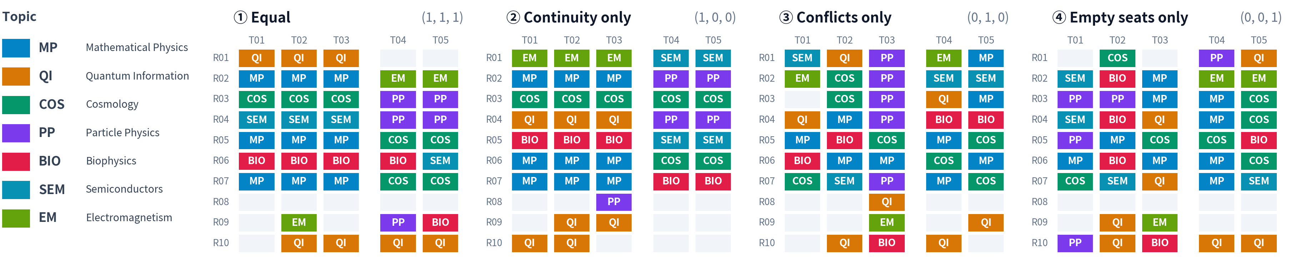
APPENDIX A9
Test 1: Detailed Results
Exact solutions (gap 0, no time limit) · MacBook Air M4 · bundled CBC 2.10.13 · 3 runs each, same timetable every run
Weights (A, B, C) | Score | A continuity | B1 pairs | B2 overlaps | B penalty | C empty seats | Time (s), 3 runs
① Equal (1, 1, 1) | −3.24 | 21 | 9 | 13 | 57 | 1,270 | 1,455 / 1,425 / 1,360
② A only (1, 0, 0) | 69.70 | 23 | 7 | 16 | 65 | 1,620 | 148 / 157 / 161
③ B only (0, 1, 0) | −38.13 | 3 | 9 | 12 | 53 | 1,500 | 0.21 × 3
④ C only (0, 0, 1) | −25.87 | 3 | 10 | 15 | 67 | 1,270 | 0.02 × 3
B penalty = Σ Level (B1) + 3 × B2. The score of each run uses its own weights, so scores are not compared across rows.
35

Slide 36
APPENDIX A10
Test 2: Data Based on a Real Conference
Based on the public program of a physics conference (name, dates and venue withheld)
Item | Content | Grounds
Presentations | 89 parallel oral presentations (16 sessions) | Excluded: special sessions incl. invited talks (different length, separate venue), plenaries, posters
Rooms / slots | 4 rooms, 20 min × 6 slots × 4 blocks = 24 slots | As in the public program (times also as actual)
Topics | 8 topics (max 20, min 6 talks) | Topics taken from session names. No one speaks twice (2 pairs sharing a surname confirmed to be different people)
Capacity | Room_A 100, Room_B–D 60 each | No public capacity data. Room_A always hosts the largest topic and is used for plenary events, so it is assumed to be larger
Expected attendees | Proportional to topic size (largest topic, 20 talks = 80 people) | No audience data. Consequence: the largest topic fits only in Room_A (as in reality)
Conflicting topic pairs | 9 pairs (Level 1–3) | Set by topic similarity (e.g., high energy – gravitation/astro 3, quantum – optics 2)
Blocks / equipment | Continuity across blocks is not counted. Screens and unavailable slots are not used | In reality, room topics change between morning and afternoon. All rooms assumed to have screens
36

Slide 37
APPENDIX A11
Test 2: Detailed Results
Real program (made by hand)
This system: equal weights, time limit 90 s
 | A continuity | B1 pairs | B penalty | B2 overlaps | C empty seats | Score (1 : 1 : 1) | Time
Real program | 73 | 35 | 51 | 0 | 1,640 | 22.87 | —
This system | 72 | 25 | 39 | 0 | 1,640 | 23.48 | 88.8 s (limit 90 s)
Difference | −1.4% | −29% | −24% | ±0 | ±0% | +0.61
37

Slide 38
APPENDIX A12
PuLP / CBC, and Why HiGHS May Be Faster
PuLP
CBC
HiGHS
Python library.
We write the variables,
rules and score here.
Free solver bundled with PuLP.
Used in this study.
No symmetry detection by default.
Newer free solver (MIT).
Detects symmetry
(e.g. identical rooms) automatically.
Test 1 weights | CBC (MacBook Air, s) | HiGHS (other PC, s) | Same optimum?
(1, 1, 1) | 1,360–1,455 | 227 | yes (−3.24)
(1, 0, 0) | 148–161 | 8.5 | yes (69.70)
(0, 1, 0) | 0.21 | 4.2 | yes (−38.13)
• Second run of (1, 1, 1) with HiGHS: 254 s with symmetry detection, 832 s without → one reason, not the only one.
• Public benchmark (Mittelmann, MIPLIB 2017, 240 problems, Oct 2025): HiGHS solved 157, CBC 107.
• PuLP can call HiGHS (pip install highspy). Not yet built into the app.
Different machines: this is not a strict comparison. To be re-measured on the MacBook Air.
38

Slide 39
APPENDIX A13
Detailed Comparison with Previous Studies
Aspect | [1] Vangerven et al. (2018) Omega 81, 38–47 | [2] Pylyavskyy et al. (2024) EJOR 317, 487–499 | This study
Aim / strengths | Maximizes attendance from participants’ session preferences, then also considers room hopping and presenter availability step by step (3-phase hierarchical optimization). Used at 4 real conferences | A system of penalties and weights handles in-person, hybrid and online formats, multi-slot presentations, topic–room matching, keeping similar topics apart, etc. in one model | Make a first draft from minimal input, with free software
Input | Session preferences of all participants (e.g., ORBEL 2017: 1,200 in total from 101 of 140 participants) and presenter availability | 9 sheets (Submissions, Tracks, Sessions, Rooms, Parameters, penalty tables, Similar Tracks) and 6 weights | 3 sheets, 7 required columns + 3 weights
Computation time | 0.03–61 s per phase; but the k-block search (arrangements with less room hopping) takes hours | Time limit 1 h. Most runs finish within minutes (exact model: 0.1–137 s except GECCO19), but GECCO19 and 3 cases of the extended model hit the limit. OR60F3 takes 1,072.7 s just to build the model | 40 talks: 1,360–1,455 s (exact, equal weights) · 89 talks: 90 s limit
Solver / environment | CPLEX 12.6.3 (commercial), laptop (Core i7, 8 GB) | Gurobi 9.5.0 (commercial) + Python 3.8.3, Core i7, 16 GB | CBC (free) via PuLP, MacBook Air M4 16 GB
Relation to this study | Same assumption as this study: all presentations have the same length | Handles multi-slot presentations, topic–room matching, etc. This study omits these to keep the input minimal | All presentations have the same length (1 slot)
39

