Slide 1
The Two Pizza Team Rule
Trevor McLaurine

Slide 2
What is the two pizza rule?
The Two-Pizza rule is a rule coined by Jeff Bezos, the founder of Amazon, that no meeting should be larger than can be fed by two pizzas.

Slide 3
Why two pizzas?
Whether this is a great analogy for team size, or Bezos was hungry at the time, the two-pizza rule is designed to ensure no one is drowned out and that each member can contribute equally.
To clarify, a large pizza, which is generally a 14" pie, will usually have up to eight to ten slices and would roughly feed 6 to 10 people. Thus, giving us our ideal group range.

Slide 4
But, Why two Pizzas?
The two pizza rule higlights the ideal group size. How this is determined is not just based on food, but real evidence that shows how group size affects group productivity.
While there is no such thing as an ideal group size, and the ideal group size varies differently on the organization and it's goals, we can still see how group size affects overall productivity.

Slide 5
The ringelmann effect
The Ringelmann effect is the tendency for individual members of a group to become increasingly less productive as the size of their group increases. As we will see on the next slide, it is generally thought that more people contributing to a project is a net positive overall. However, this is not the case.
A good example of this is called the team-scaling fallacy. A group of professors asked a group of two and four people to assemble a Lego figure. The more people, the longer it took. The group of two finished it in 36 minutes while the other groups finished in 52.

Slide 6
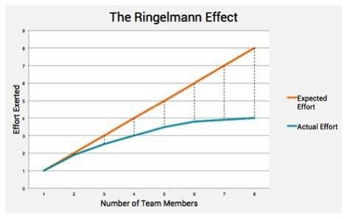
The ringelmann effect cont.d

Slide 7
Social Interactions
Another factors that can derail groups based on their size is the number of social interactions that can occur. These social interactions can range from simple conversations to full blown disruptiveness. A smaller group does not need to worry about this as the group is small enough to easily hold the attention of the group without derailing it from productivity. A larger group, however, will carry the risk of more social interactions th​at can distract from the original goal of the meeting.

Slide 8
Links
Another formula for group size and interactions is to reduce the number of "links". The term coined by J. Richard Hackman to describe the social interconnectedness of group members. This generally means how each member is connected based on various social factors, such as title, job position, etc.
Reducing the number of links is essential. Too many links can cause to much of a distraction and risk creating more social interactions that can derail the meeting.

Slide 9
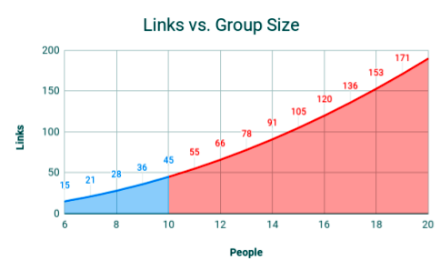
Visualizing Links
The following shows how as group sizes increase, so do links. A smaller group size is ideal to reduce the number of links possible.

Slide 10
Summary
The Two-Pizza rule shows, based on various research, that the ideal group need not be more than 10 people. Maintaining a small group with relatively few links that can make for an efficient team. This efficiency comes from a lack of social interactions, links and reduced risk of meetings being derailed by other factors.

Slide 11
Sources
Administrator. (2016, January 22). Ringelmann effect . Psychology. https://psychology.iresearchnet.com/social-psychology/group/ringelmann-effect/
Amazon’s Two pizza rule: Maximizing meeting effectiveness. Directorpoint. (2019, January 6). https://landing.directorpoint.com/blog/amazon-two-pizza-rule/
Coutu, D. (2015, July 15). Why teams don’t work. Harvard Business Review. https://hbr.org/2009/05/why-teams-dont-work

