Slide 1
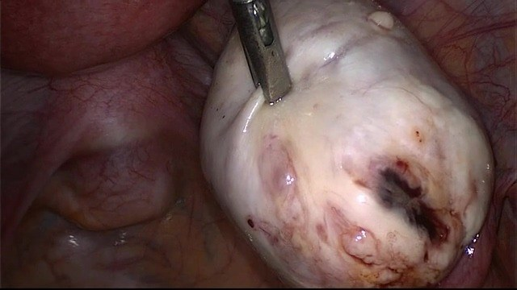
A PROJECT JOURNEY ON THE GLENDA v1.5 DATASET
AI-Assisted Detection of Endometriosis
A deep learning approach to laparoscopic lesion localisation
Laparoscopic view: ovary with a dark endometriotic lesion
[Dave Gituma]
Notes:
Good morning. Today I will walk you through a project on using artificial intelligence to detect and outline endometriosis lesions in laparoscopic images. We start with the medical problem, then the data, then the models I built, what worked, what failed, and how far the results can be trusted.

Slide 2
Key words: medical terms
Peritoneum
Laparoscopy
Laparotomy
Membrane lining the abdominal cavity and pelvic organs
Keyhole surgery with a camera; our data source
Open abdominal surgery through a large incision
Lesion
Endometrioma
Adhesions
An area of abnormal tissue, here an endometriosis patch
"Chocolate cyst" on the ovary filled with old blood
Bands of scar tissue binding organs together
Cysts
DIE / TIE
Dyspareunia
Fluid-filled sacs, often on the ovaries here
Deep infiltrating endometriosis (German: TIE)
Painful sexual intercourse
Dysuria
Hysterectomy
Hormonal therapy
Painful or difficult urination
Surgical removal of the uterus
Medicines that regulate hormones and pause the cycle
Notes:
Before the AI, a quick vocabulary. The peritoneum is the lining of the abdomen. Laparoscopy is keyhole surgery with a camera, and it is where every image in this project comes from. Laparotomy is the older open operation. An endometrioma is the chocolate cyst on the ovary. DIE, or TIE in the German label used by the dataset, means deep infiltrating endometriosis.

Slide 3
Problem statement: an under-diagnosed disease
10%
4.6–8.9%
4–11 yrs
5
of women of reproductive age worldwide
found in Kenyan hospital studies
average time from symptoms to diagnosis
trained laparoscopic gynaecological surgeons reported nationally (2024)
Why it matters in Kenya
This project
Low awareness, and severe period pain is often normalised.
Few specialist surgeons and costly laparoscopy limit access to diagnosis.
Delay means years of pain, adhesions and infertility.
Automated visual support could help surgeons find lesions and widen access to expertise.
Detect and outline lesions in laparoscopic frames.
Act as a second pair of eyes for the surgeon.
Honest test of what deep learning can and cannot do today.
Sources: Kenyatta National Hospital study 2018–2021 (4.6%); Nairobi laparoscopy sample 2021 (8.9%); Ministry of Health reply to Parliament 2024; Kenyan qualitative study, IJERPH 2023.
Notes:
Endometriosis affects roughly one in ten women worldwide. Kenyan hospital studies report prevalence between about five and nine percent in the groups studied, and diagnosis is slow: even in high-income countries the average delay is four to eleven years. Awareness is low, pain is normalised, and the Ministry of Health told Parliament in 2024 that only five trained laparoscopic gynaecological surgeons were reported nationally. Please verify the exact figures against the cited sources before presenting.

Slide 4
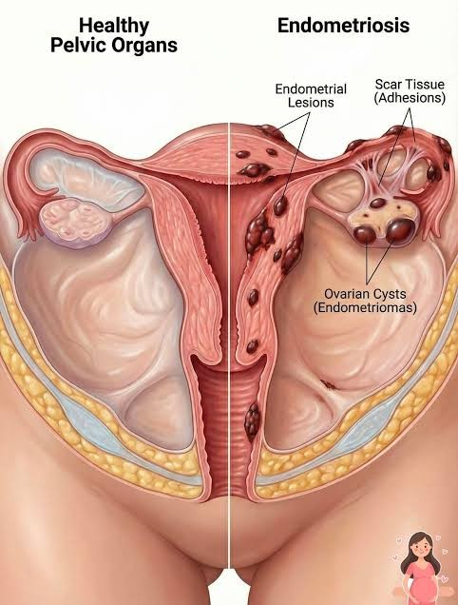
What is endometriosis?
Chronic, inflammatory condition: tissue like the uterine lining grows outside the uterus.
Where: peritoneum, ovaries, fallopian tubes and outer surfaces of pelvic organs.
Appearance: varies in colour (red, white, black), size and depth.
Affects roughly 10% of women of reproductive age.
The essence of the project
Build an AI pipeline that acts as a "second pair of eyes" for the surgeon, highlighting lesions that are easy to miss.
Healthy pelvic organs (left) vs endometriosis (right)
Notes:
Normally the inside of the pelvis is smooth. In endometriosis we see dark lesions, scar tissue binding organs and cysts on the ovaries, as in the right half of the picture. Because they vary so much in colour and size, they are hard to spot during a long operation. The idea of this project is a second pair of eyes for the surgeon.

Slide 5
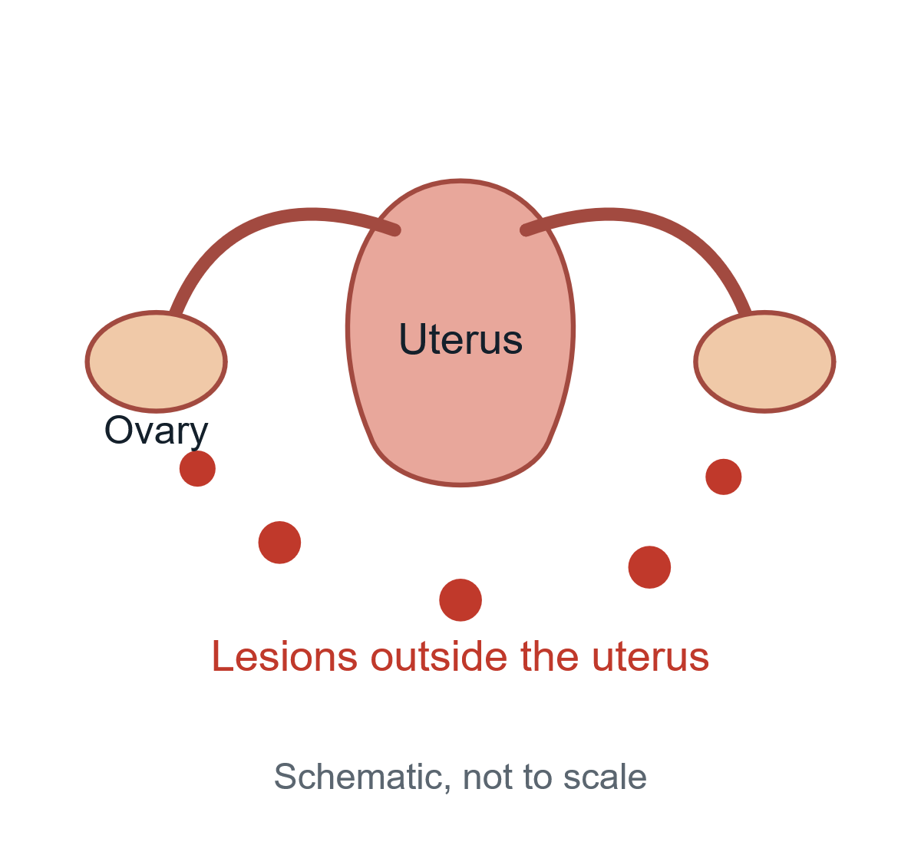
How does it happen? Pathogenesis
Sampson’s theory
Coelomic metaplasia
Retrograde menstruation: menstrual blood flows backwards into the pelvis.
Normal pelvic lining cells turn into endometrial-like cells under hormones and inflammation.
Stem-cell recruitment
Lymphatic / blood spread
Bone-marrow stem cells travel to the pelvis and form lesions.
Explains rare lesions far away, for example in the lungs.
Schematic: lesions outside the uterus (not to scale)
Notes:
How does uterine-like tissue end up elsewhere? The most accepted idea is Sampson’s theory of retrograde menstruation. We also know that pelvic lining cells can transform, that stem cells may migrate, and that lymph and blood can carry cells to distant organs in rare cases. No single theory explains everything.

Slide 6
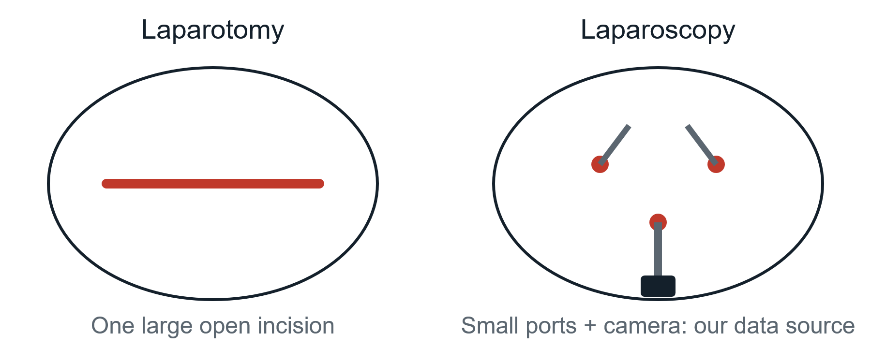
Symptoms and diagnosis
Symptoms
Pelvic pain, mostly during menstruation
Dyspareunia (painful intercourse) and dysuria
Infertility
Diagnosis
Clinical evaluation: history, symptoms, physical exam.
Imaging: ultrasound or MRI shows large cysts, misses small lesions.
Laparoscopy (gold standard): camera inspection to confirm and take a biopsy.
Laparotomy : open surgical procedure; making large incision through abdominal wall to access and examine peritoneal content
Laparotomy: one large incision. Laparoscopy: small ports and a camera.
Why AI can help
The camera only shows what is directly in front of it. Lesions can be small, hidden or subtle, so decision support may reduce missed disease.
Notes:
Symptoms are pelvic pain, painful intercourse, painful urination and infertility. Ultrasound and MRI find large cysts but miss small lesions, so laparoscopy remains the gold standard: small ports and a camera instead of open surgery. But the camera has limits, and that is where decision support can help.

Slide 7
Treatment and complications
Treatment
Complications
Pain relievers
1
Adhesions
NSAIDs such as ibuprofen (non-steroidal anti-inflammatory drugs).
2
Ovarian cysts (endometriomas)
Hormonal therapy
3
Infertility
Birth-control pills, progestins or GnRH agonists/antagonists that suppress the cycle and slow tissue growth.
4
Chronic, continuous pelvic pain
Surgery
Laparoscopic excision of lesions; hysterectomy in selected cases.
5
Deep infiltrating endometriosis (DIE)
Notes:
There is no cure. Treatment relies on pain relievers, hormones that suppress the cycle, or surgery. If the disease is left untreated, or lesions are missed at surgery, complications include adhesions, ovarian cysts, infertility, continuous pelvic pain and deep infiltrating disease.

Slide 8
Staging with the rASRM system
Stage | Points | Characteristic signs
I · Minimal | 1–5 | Few isolated, superficial implants on the pelvic lining; no significant scar tissue.
II · Mild | 6–15 | More implants, possibly deeper; minor or filmy scar tissue.
III · Moderate | 16–40 | Many deep implants; small endometriomas on one or both ovaries; thin, filmy adhesions.
IV · Severe | >40 | Numerous deep implants; large chocolate cysts; dense, thick adhesions fusing pelvic organs.
Pain does not equal stage
Staging needs surgery
A Stage I patient can be in severe pain; a Stage IV patient may have no symptoms.
It cannot be done from MRI alone; the surgeon must see the lesions.
Notes:
Surgeons stage the disease from one to four by points for depth, spread and adhesions. But the key insight is that pain does not equal stage. A minimal-stage patient can be in agony and a severe-stage patient can be silent. Because staging needs direct visualisation, the surgeon’s eyes matter, which is where AI support fits.

Slide 9
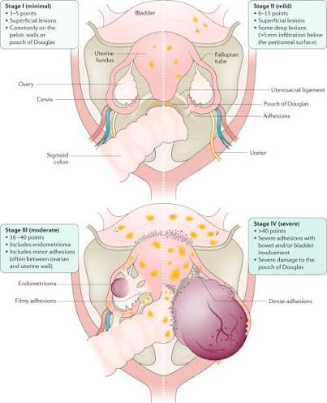
What the stages look like
Early stages (I–II)
Small superficial lesions, easy to overlook: the hardest cases for a surgeon and for an AI model.
Late stages (III–IV)
Endometriomas and dense adhesions are larger and more visible, but make the anatomy complex.
In this project
A system that acts as a second pair of eyes and highlights lesions for the surgeon.
Stages I to IV of endometriosis
Notes:
This chart from the literature shows how the disease progresses: a few small dots in stage one, to large cysts and organs fused together by dense adhesions in stage four. Early lesions are the hardest to see, which is exactly where a second pair of eyes helps most.

Slide 10
What lesions look like
Peritoneal implants
Early: red or pink vascular spots. Older: blue-black or brown "powder-burn" spots.
Ovarian endometriomas
Cysts filled with thick, dark brown fluid (old blood).
Ovary with a dark endometriotic lesion (GLENDA frame)
Dense fibrous adhesions
Chronic inflammation forms scar tissue that fuses organs together.
Notes:
Visually, early peritoneal lesions are red or pink; older ones turn blue-black, the so-called powder-burn spots. The ovaries develop chocolate cysts filled with old blood, and chronic inflammation glues organs together with dense scar tissue. This variety is a core difficulty for any automated system.

Slide 11
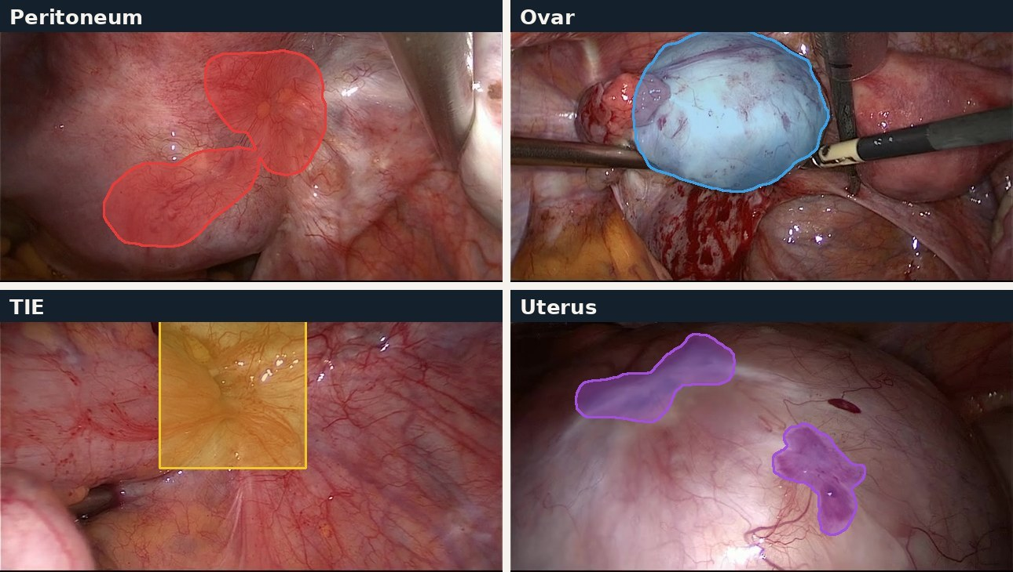
The four lesion types in GLENDA
Peritoneum
489 annotations · flat, patchy, diffuse
Ovary
54 · distinct, rounded cysts
TIE / DIE
59 · deep infiltrating lesions
Uterus
26 · rarest class, on the uterine wall
One annotated example per class (coloured outline = surgeon’s annotation)
373 annotated frames · 628 annotations · 102 surgical cases
Dataset: GLENDA v1.5, ITEC, University of Klagenfurt (CC BY-NC 4.0)
Notes:
The GLENDA dataset divides lesions into four classes. Look at how different they are: peritoneal lesions are large and diffuse, ovarian lesions are round cysts, TIE is deep infiltrating disease, and uterine lesions are the rarest with only 26 annotations. This variety makes it hard for one model to learn everything.

Slide 12
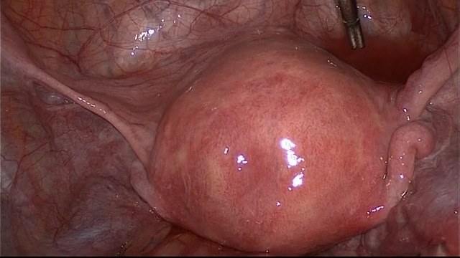
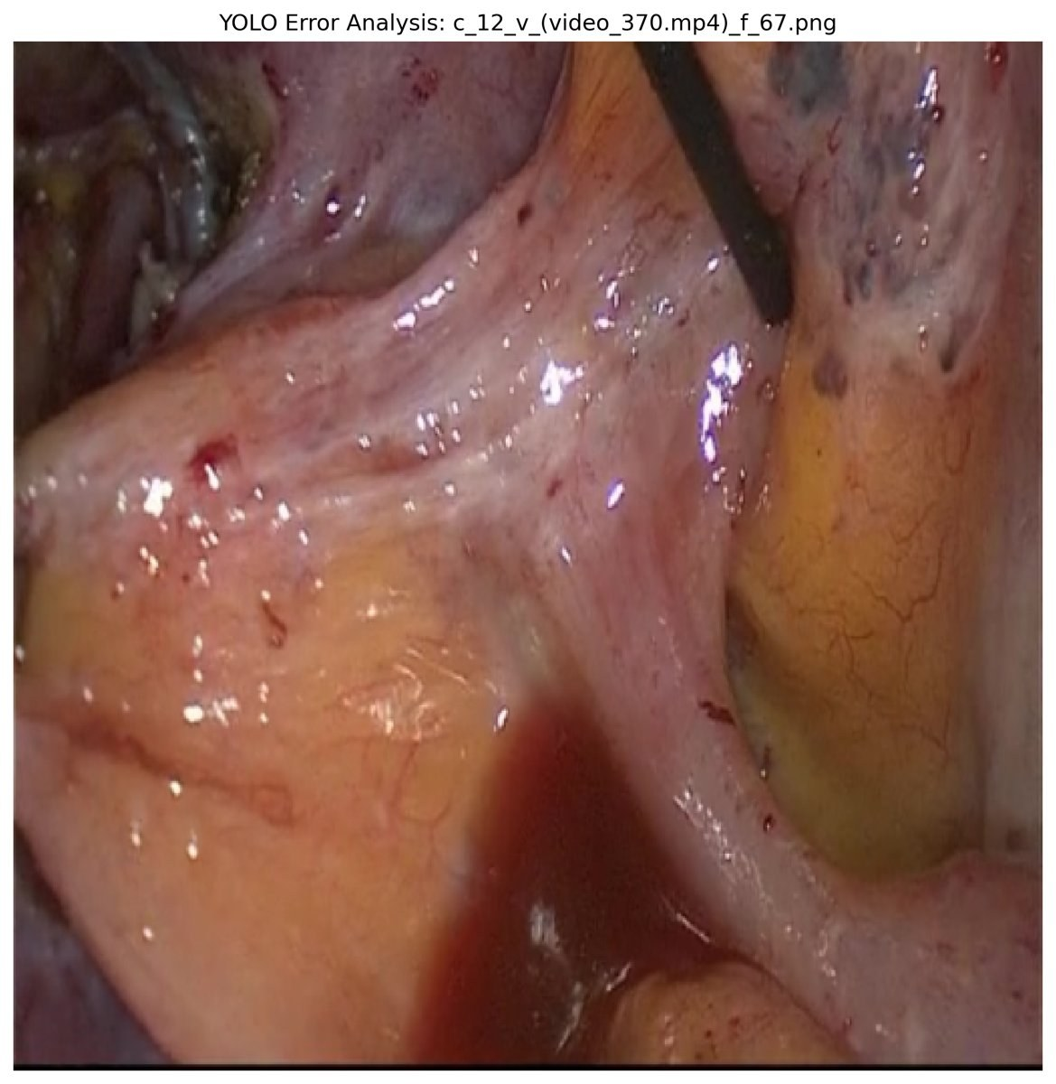
Why is it hard? What the surgeon sees
Lesion frame: dark cyst lesion
Healthy frame: similar anatomy and lighting
Blood, glare, instrument
Variable appearance
Obscured view
Human fatigue
Lesions differ in colour (red, white, black), size and depth.
Blood, surgical smoke and bright glare hide lesions.
Operations last hours; a small missed lesion can mean recurrence.
Notes:
This is what the surgeon actually sees. The left frame has a lesion, the middle one does not, and the lighting and anatomy look very similar. In the right frame blood, glare and an instrument obscure the view. If a small lesion is missed, the patient may be back in surgery within a year.

Slide 13
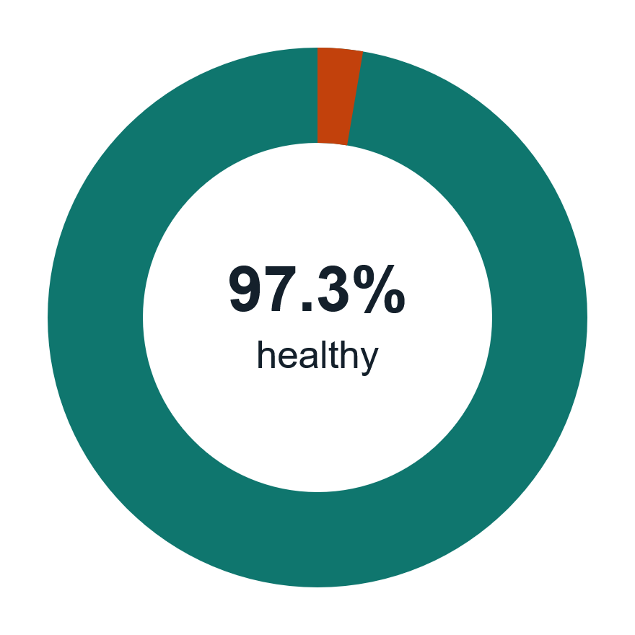
The data and its central problem: imbalance
373
13,438
annotated lesion frames (628 annotations)
healthy frames, about 36 per lesion frame
The trap
Always answering "healthy" gives about 97% accuracy and finds no lesion at all.
The response
Use AUROC and Dice instead of accuracy, and a loss function that cares about rare lesions.
Notes:
This is the villain of the story. For every lesion frame there are about 36 healthy frames. If a model says healthy every time it scores 97 percent accuracy and is completely useless, so I judge models with AUROC and Dice, not accuracy, and later change the loss function.

Slide 14
Key words: AI terms
COCO annotation / mask
Class imbalance
Transfer learning
Lesion outline as coordinates; a mask paints it in pixels
Far more healthy frames than lesion frames
Start from a model pretrained on millions of everyday images
Data augmentation
Cross-validation (fold)
Overfitting
Random crops, colour changes and flips of training images
Split by patient; each fold takes a turn as the test set
Memorising training data instead of learning general patterns
Loss function
AUROC
Dice score
The score the model tries to minimise while learning
How well lesion and healthy frames are separated; 0.5 guess, 1.0 perfect
Pixel overlap of prediction and surgeon’s mask; 1.0 perfect
mAP50
Grad-CAM
False positive / negative
Detection quality when the overlap with truth is at least 50%
Heatmap of where a classifier looked
A false alarm / a missed lesion
Notes:
A short glossary of the technical terms. A mask is the lesion outline painted into pixels. AUROC measures how well two groups are separated, where 0.5 is guessing. Dice measures pixel overlap with the surgeon’s mask. Grad-CAM shows where a classifier looked. A false positive is a false alarm, a false negative a missed lesion.

Slide 15
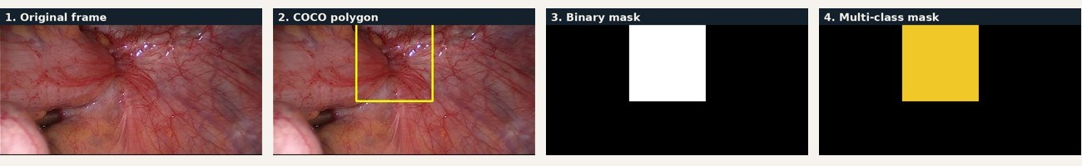
From annotations to masks
Source
Two mask types
Sizes
Annotations came as COCO JSON polygons.
The provided PNG masks had stray anti-aliasing colours.
Masks were rebuilt with OpenCV from the polygons.
Binary (black/white): training.
Multi-class (4 colours): evaluation only. The U-Net’s single white mask is compared with each coloured class; the model never learns to output classes.
Stored at 512 × 512
Classifier input 224
U-Net input 256
Augmentations applied during training
Notes:
The dataset gave coordinates, not ready masks. I drew them with OpenCV into black-and-white masks for training and into colour-coded masks for evaluation. The colour masks were used only to ask whether the single-lesion U-Net did better on rare classes; the model was never trained to output the classes because of the imbalance.

Slide 16
Preventing data leakage
Fold 0 (test)
Fold 1
Fold 2
Fold 3
Fold 4
The rule
Fold 0 | Train | Held out
Cases (groups) | 97 | 25
Peritoneum annotations | 193 | 64
Ovary / TIE / Uterus | 45 / 44 / 15 | 8 / 11 / 2
Healthy frames | 11,080 | 2,358
The trap: frames from one patient in both train and test let the model memorise anatomy, not disease.
The fix: case-grouped 5-fold cross-validation.
Result: every frame of a patient stays in one fold.
Scope: all results here use Fold 0.
Healthy frames are grouped by video ID; their overlap with annotated cases was not checked.
Notes:
To keep the test scores honest I split by patient, not by image. If a patient had frames in both train and test, the AI could memorise that patient’s anatomy. Here Fold 0 is the test fold. I only ran Fold 0 because of time and compute, and the other folds are the next step. Healthy frames are grouped by video ID, and I have not checked their overlap with annotated cases.

Slide 17
Step 1: can a model detect a lesion?
Metric: AUROC, 0.5 is guessing and 1.0 is perfect.
Custom CNN (from scratch): failed at 0.48; 373 images are too few.
Pretrained ResNet-50: 0.89; EfficientNet-B0 about 0.87.
Conclusion: transfer learning is essential for small medical datasets.
Caution: ResNet-50 train AUROC is 0.999, so it overfits.
Notes:
Can the AI tell whether a lesion is present? A custom CNN built from scratch scored 0.48, no better than guessing, because 373 images are not enough. A pretrained ResNet-50 scored 0.89 and EfficientNet about 0.87. So the pretrained knowledge matters more than the exact architecture. The train AUROC of 0.999 against 0.89 on test shows overfitting, so I report the test figures.

Slide 18
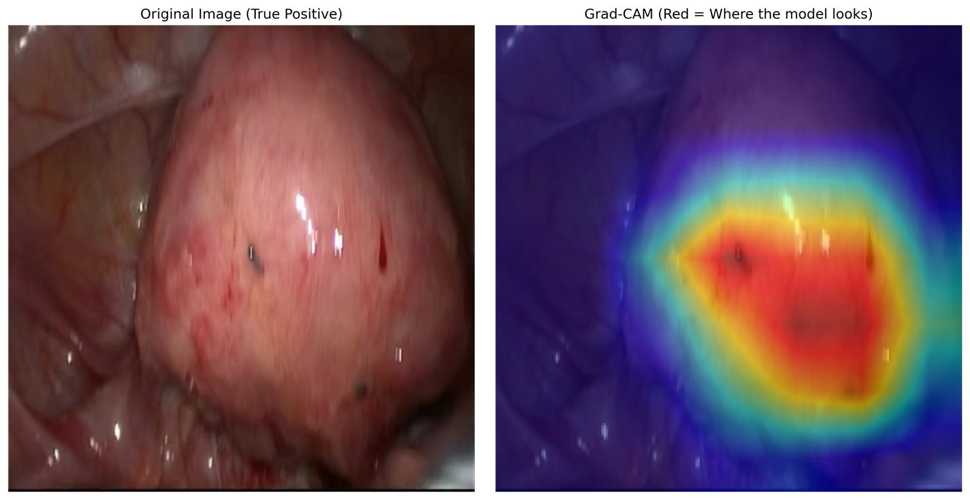
Plot twist: is it looking at the lesion?
0.999 to 0.846
AUROC with lesions blacked out (Fold 0)
Probe: we masked the lesion using the surgeon’s mask.
Result: AUROC fell only slightly, so the model still "knew".
Heatmap: heat covers the organ surface around the dark spots, not only the lesion.
Grad-CAM: red marks where the classifier looks
Shortcut learning risk
Part of the signal comes from background context (lighting, anatomy, instruments). Held-out probes and more heatmaps are needed to confirm.
Notes:
We suspected the classifier might be cheating. I used the surgeon’s masks to black out the lesions. If it were reading the disease, the score should fall towards 0.5; instead it only dropped from 0.999 to 0.846 on training data. The heatmap covers the whole organ surface around the dark spots, so context is clearly in play. This is suggestive of shortcut learning but one image is not proof, and a held-out probe is a next step.

Slide 19
Solution: anti-cheat training and tuning
Random crop
Colour jitter
Random grayscale
Random crop: zoom into random parts of the image.
Colour jitter: change brightness, contrast and saturation.
Random grayscale: turn images black and white.
Goal: force the model to stop leaning on background and colour.
Result: AUROC dropped after retraining (about 0.79 in my notes; confirm).
Notes:
To push the model away from the background I retrained a ResNet with aggressive augmentation: random crops, colour jitter and random grayscale. The score dropped, which is expected when shortcuts are removed. I also tuned the learning rate, which controls how fast the weights change: 1e-3 and 1e-4 were practically tied, and 1e-5 barely learned.

Slide 20
Step 2: from "is it there?" to "where is it?"
Why segment?
Classification only says "present". Drawing the boundary shows the surgeon where to look.
Two approaches
small lesion inside one grid cell
YOLO11-seg (instance): finds each lesion as an object; metric mAP50.
U-Net (dense): labels every pixel; metric Dice.
Dice score
Pixel overlap between the AI mask and the surgeon’s mask: 1.0 is perfect, 0.0 is no overlap.
Why YOLO struggles: it predicts on a coarse grid (illustrative)
Notes:
Instead of classifying the whole image, I asked the AI to draw the exact boundary. YOLO predicts objects on a coarse grid; U-Net classifies every pixel. Dice measures how much the AI mask overlaps the surgeon’s mask, and mAP50 measures detection quality at 50 percent overlap.

Slide 21
Failures: YOLO and the first U-Net
0.19
YOLO: wrong tool for diffuse lesions
Its coarse grid suits cars and dogs. Our lesions are often small or diffuse with fuzzy edges, so it missed many.
YOLO11-seg mask mAP50
0.255
U-Net baseline: the loss favours background
U-Net with Dice + BCE loss (Dice)
About 97% of pixels are healthy, so a standard BCE loss rewards predicting nothing.
The model drifts towards empty or too-small masks; in our example the baseline found 1 of 2 lesions.
Notes:
Both first attempts failed. YOLO scored mAP 0.19 because a coarse grid is a poor fit for small, diffuse lesions. The U-Net scored Dice 0.255. Because 97 percent of pixels are healthy, a standard BCE loss treats every pixel equally and the easiest way to lower it is to predict empty or very small masks. In the example image the baseline found only one of the two lesions.

Slide 22
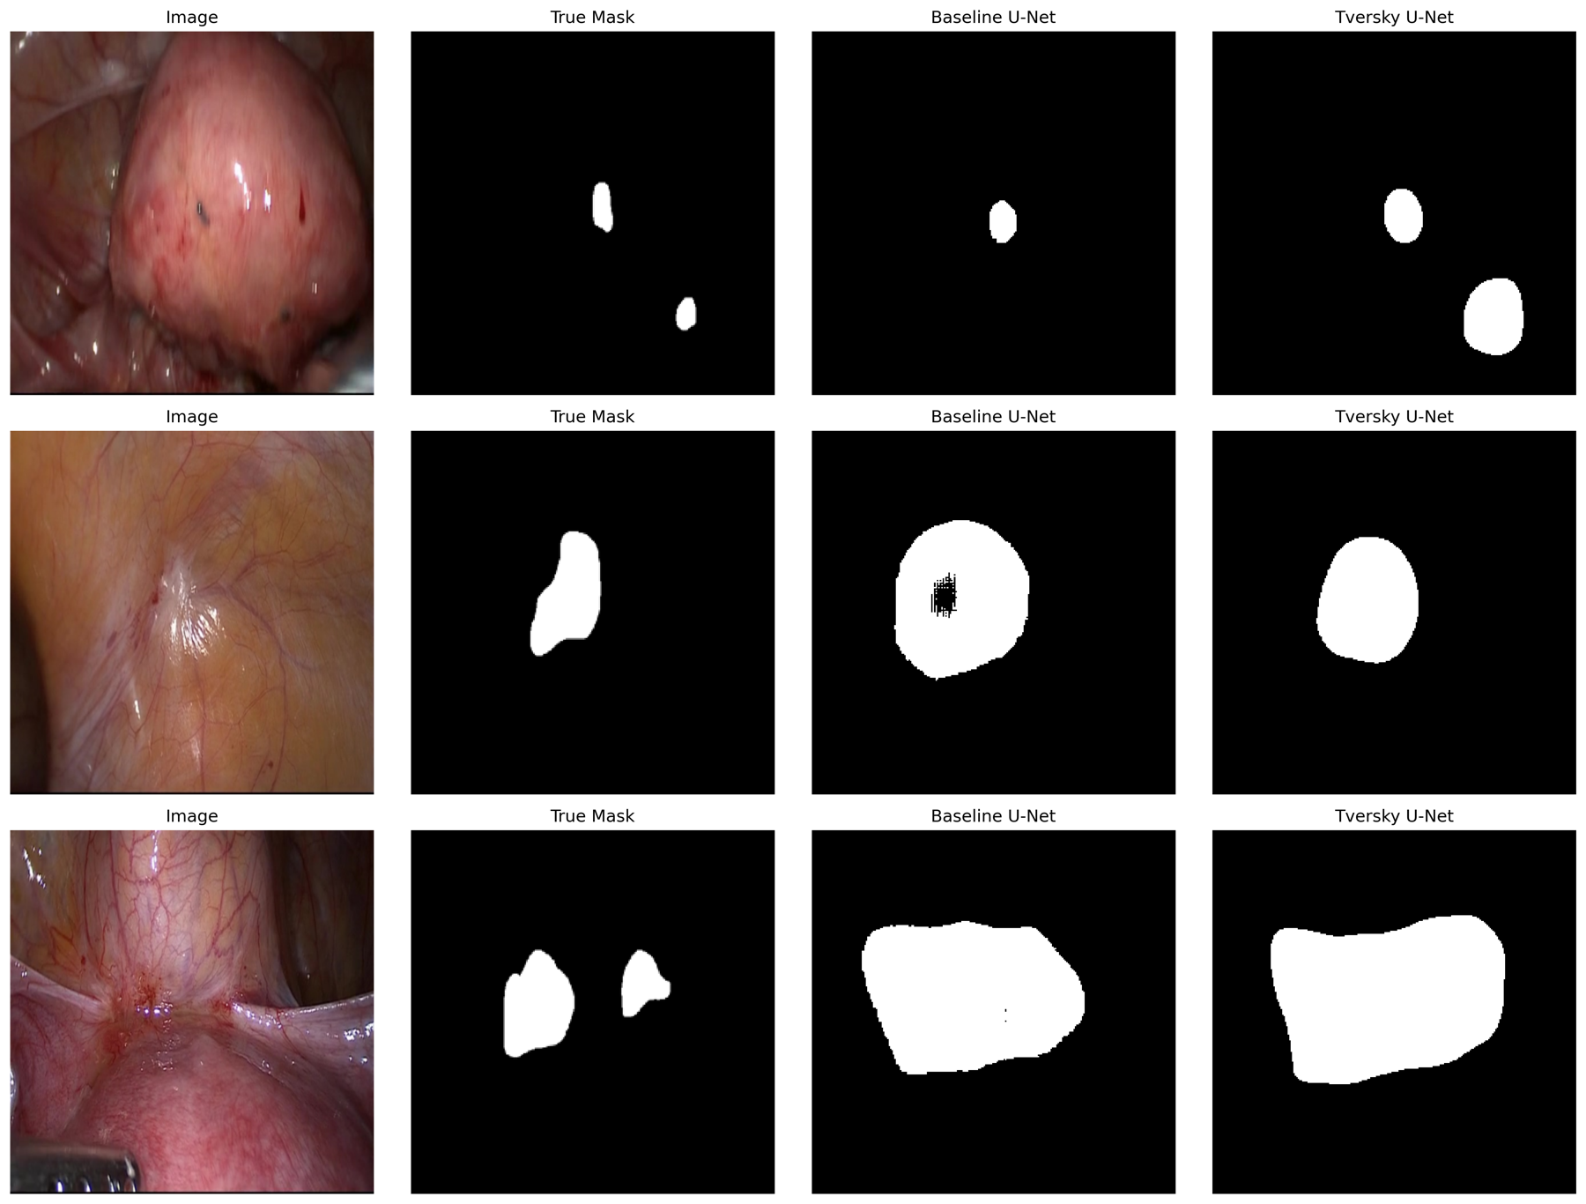
The fix: Focal Tversky loss
0.255
0.378
Dice, Dice+BCE
Dice, Focal Tversky
+48% relative gain
Same U-Net, only the loss changed (Fold 0).
Tversky weights missed lesion pixels (false negatives) more heavily.
Forces the model to take risks and find the lesions.
Trade-off: masks become larger than the true lesion (row 3).
Columns: image, true mask, baseline U-Net, Tversky U-Net
Notes:
I changed the loss to Focal Tversky, which penalises missing a lesion much more than a false alarm. With the same U-Net the Dice score rose from 0.255 to 0.378, a 48 percent relative gain. The images show the baseline finding one of two lesions where Tversky finds both, but Tversky also draws larger blobs than the truth. My results file labels the baseline Dice as training-set, so confirm that both numbers use the same split before presenting.

Slide 23
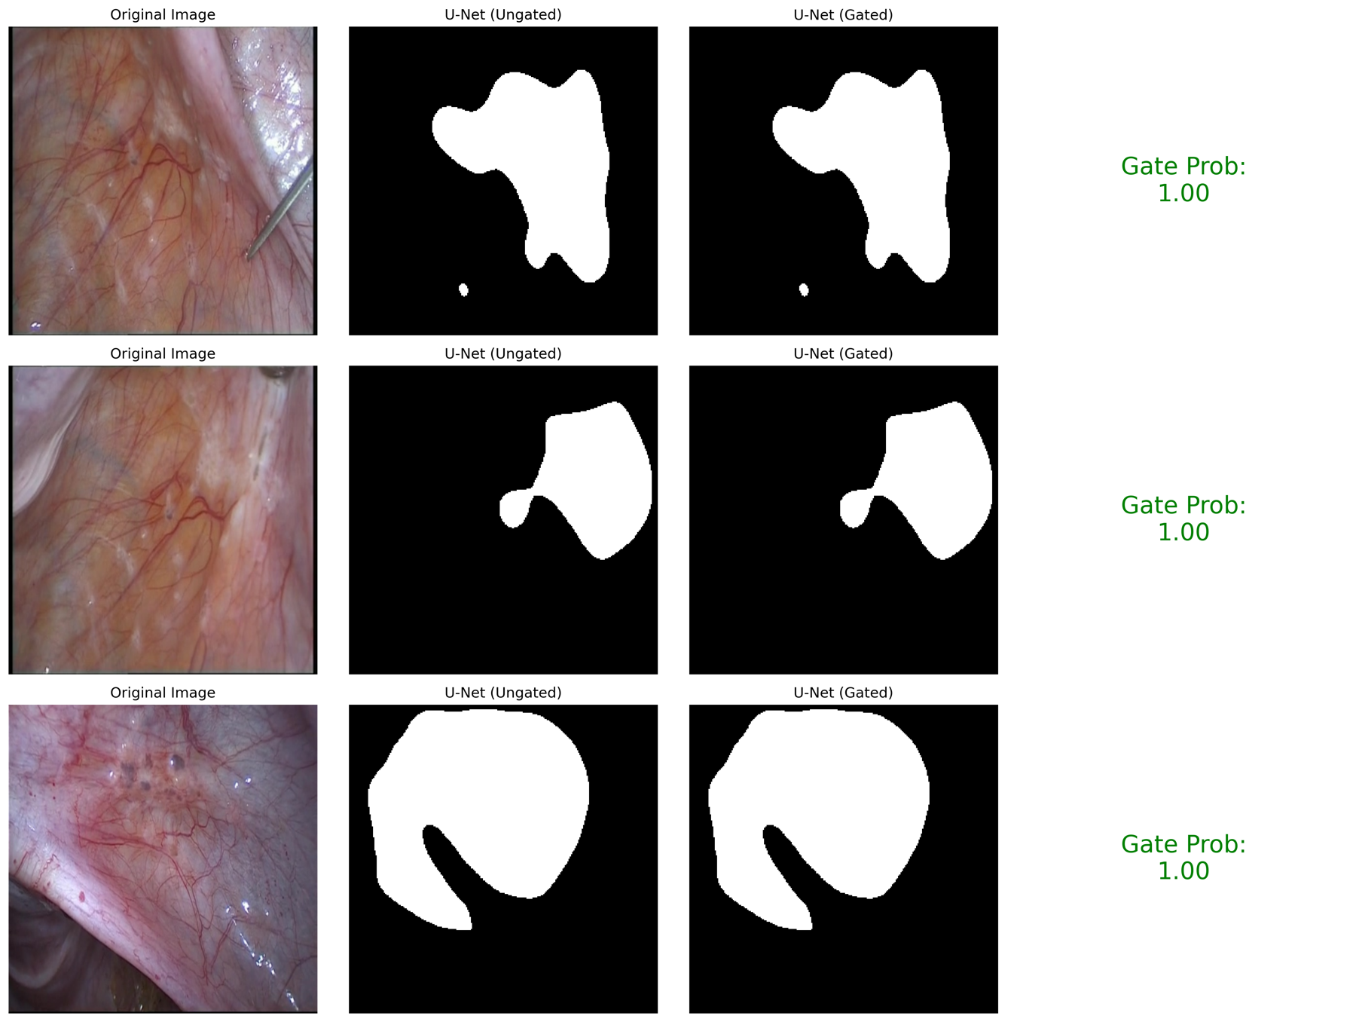
The gate: use the classifier to block false alarms
Frame
›
ResNet-50
classifier
›
Lesion? pass to U-Net
Healthy? block
 | TP | FN | FP | TN
Ungated | 282 | 7 | 280 | 10,800
Gated | 278 | 11 | 6 | 11,074
False positives fell from 2.5% to 0.1%; sensitivity 97.6% to 96.2%.
Verdict: not adopted
Training-set numbers only, and the classifier leans on context, so it could fail in a new hospital.
All three examples score 1.00, so the mask passes through
Notes:
I tried using the ResNet as a gate for the U-Net: if it says healthy, block the mask. On the training data false positives fell from 2.5 percent to 0.1 percent while sensitivity went from 97.6 to 96.2 percent. But these are training-set numbers and the classifier uses context, so I rejected the gate for clinical use. The counts in the table are derived from the results file.

Slide 24
Do rare classes do worse?
Finding
Rare classes scored higher: Ovary 0.311 and TIE 0.338 vs Peritoneum 0.214.
Likely reason
Cysts and deep lesions are compact; peritoneal lesions are patchy. With 2 to 11 annotations this is only a hypothesis.
Notes:
Surprisingly the rare classes scored higher than the common peritoneum class. Ovarian cysts and deep lesions are compact and distinct, while peritoneal lesions are patchy and blend in. But with only 2 to 11 held-out annotations per rare class this is a hypothesis, and uterus with 2 is anecdotal. This evaluation uses the multi-class masks only for scoring.

Slide 25
Results at a glance: comparing every model
Model | Task | Metric | Score | Verdict
Custom CNN | Detection | AUROC | 0.48 | Failed: too little data
EfficientNet-B0 | Detection | AUROC | ~0.87 | Good: pretraining matters
ResNet-50 | Detection | AUROC | 0.89 | Best classifier; uses context
YOLO11-seg | Instance segmentation | mAP50 | 0.19 | Failed on diffuse lesions
U-Net, Dice+BCE | Dense segmentation | Dice | 0.255 | Under-segments
U-Net, Focal Tversky | Dense segmentation | Dice | 0.378 | Best segmenter; oversized masks
Detection scores are held-out test AUROC (Fold 0). Segmentation scores are Fold 0; the baseline is labelled training-set in the results file.
Notes:
Putting it together: the custom CNN failed, the pretrained classifiers worked with ResNet-50 best at 0.89, YOLO failed at 0.19, and the U-Net improved from 0.255 to 0.378 once the loss function was fixed. Detection is easier than outlining.

Slide 26
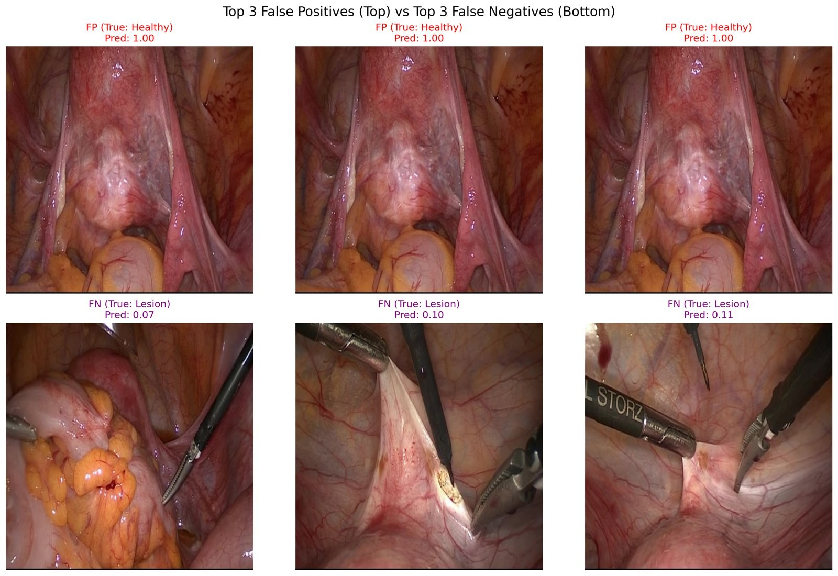
Error analysis: classifier
False positives
All three are the same near-duplicate healthy frame, scored 1.00: one mistake repeated.
False negatives
Small lesions beside instruments, scored only 0.07 to 0.11.
Top 3 false positives (top row) and false negatives (bottom row)
Notes:
The top row shows the three most confident false alarms: they are the same frame repeated, which shows that the healthy frames come from few videos and one mistake gets counted many times. The bottom row shows missed lesions: small, beside instruments, with scores of 0.07 to 0.11.

Slide 27
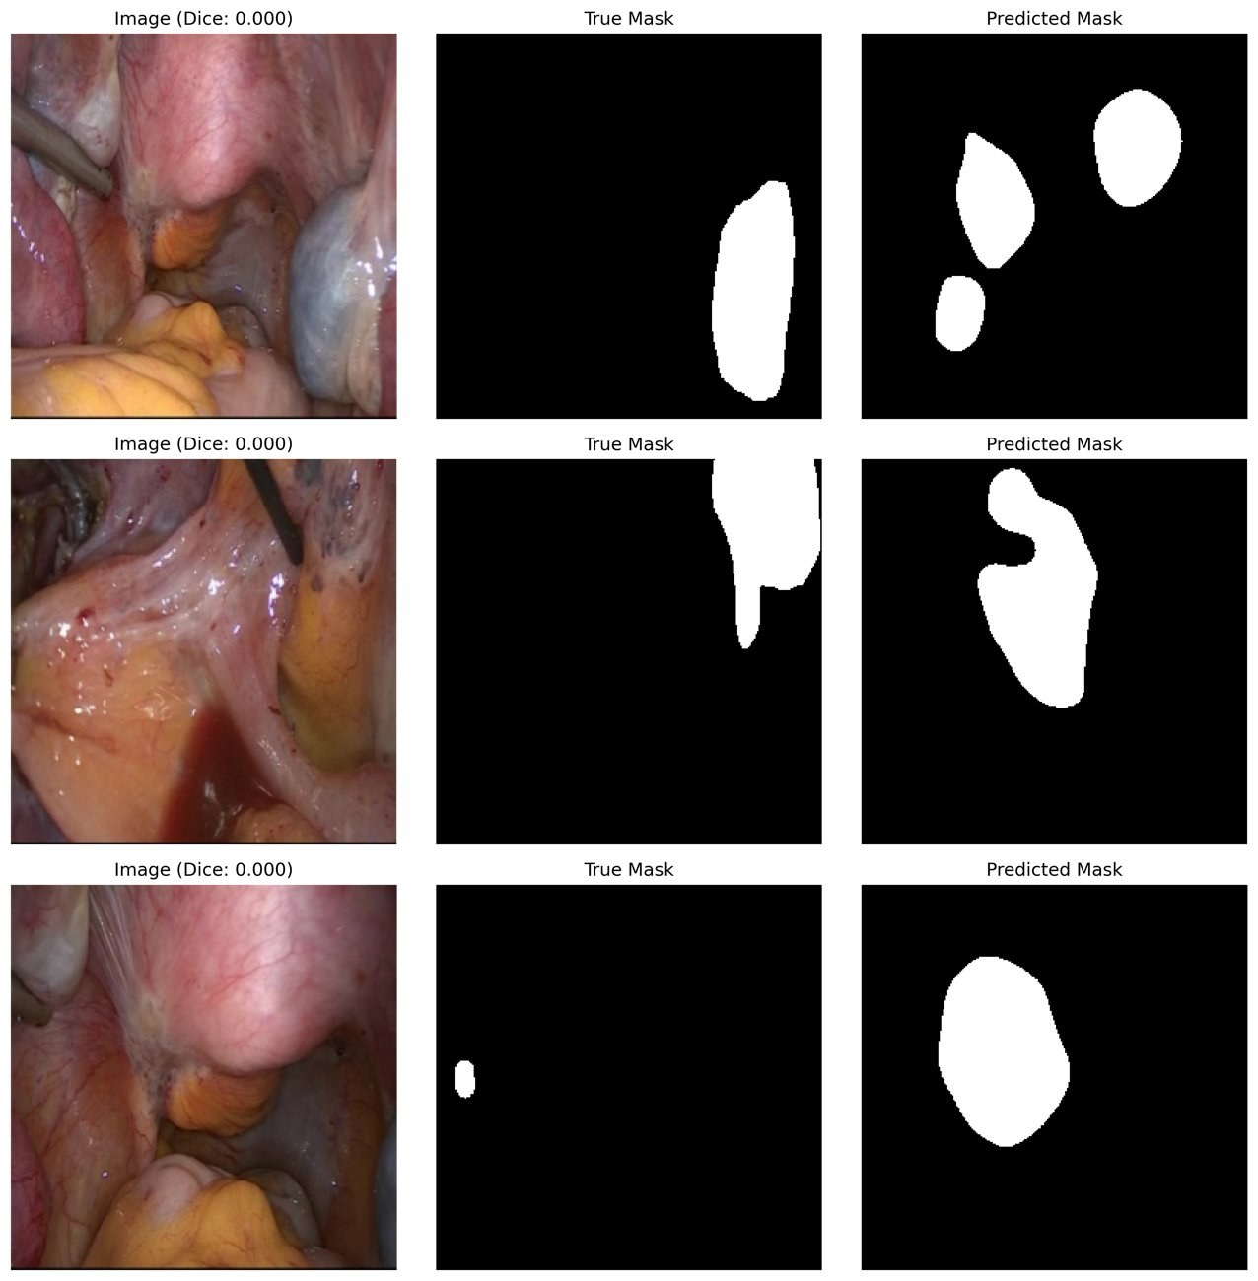
Error analysis: segmentation
U-Net
Blobs in the wrong place or far too large; lesions at the frame edge missed.
YOLO
Found no mask on a diffuse bluish lesion; the U-Net also misses it (row 2).
U-Net worst cases (Dice 0)
YOLO: no detection
Notes:
These are the worst U-Net cases with Dice of zero: predictions in the wrong place, or far larger than the true lesion, and edge lesions missed. The YOLO image is the same frame as row 2 of the U-Net image: a diffuse bluish lesion that neither model finds.

Slide 28
How far can the results be trusted?
Claim | Evidence | Confidence
Pretraining enables detection | Held-out AUROC 0.89 vs 0.48 | Good
Classifier uses context | Probe on training data; one heatmap | Suggestive
Tversky beats Dice+BCE | Split behind 0.378 to be confirmed | Moderate
Gate removes false positives | Training data only | Not established
Rare classes score higher | 2 to 11 annotations | Anecdotal
Scope
One fold and one seed. The proposal plans 5 folds × 3 seeds, bootstrap intervals, and nnU-Net, SegFormer, Mask R-CNN and ViT.
Notes:
As a researcher I must be honest about the limits. This is one fold and one seed. The pretraining result is solid. The shortcut finding is suggestive. The Tversky gain is moderate until I confirm the split. The gate is not established because it was tested on training data, and the rare-class result is anecdotal. The proposal plans five folds with three seeds and stronger models.

Slide 29
Future work
1. Name the lesion type
2. Use video
3. Validate widely
Train a dedicated one-vs-rest type classifier.
Use a 5-channel multi-class U-Net so masks are colour-coded by type.
Today the system only says whether a lesion exists and where.
Move from single frames to video (LSTM / 3D CNN).
Track a lesion as the camera moves.
Shows the lesion is a real object on tissue, not background.
Run all 5 folds and 3 seeds with confidence intervals.
Test on other hospitals, including Kenyan surgical video.
Compare nnU-Net, SegFormer, Mask R-CNN.
Why it matters locally
Where laparoscopic specialists are few, a validated visual assistant could support surgeons and training; this needs Kenyan data and clinical testing first.
Notes:
First, I would train a dedicated type classifier and a five-channel U-Net so masks are colour-coded by lesion type; today I only say whether and where. Second, video: tracking lesions as the camera moves should help the AI see a lesion as a physical object rather than background. Third, validation: all folds, more seeds, other hospitals including Kenyan surgical data.

Slide 30
Conclusions
Transfer learning is essential: custom CNN 0.48, pretrained ResNet-50 0.89.
The loss function matters: Focal Tversky lifted Dice by 48%.
Detection is easier than outlining: diffuse lesions remain hard.
Scientific honesty: evidence of context use led me to reject the gate.
Thank you
Live Streamlit demo
Notes:
To conclude: transfer learning is mandatory, the loss function is critical for small objects, detection is easier than outlining, and the careful analysis showed the classifier leans on context, so I rejected the gate. Thank you, I am happy to take questions.

