Slide 1
ML for Demand Systems
Greg Lewis (MSR + NBER) Matt Taddy (MSR + Chicago) Kui Tang (Columbia)
Jason Hartford (UBC) Richard Li (UW) Mengting Wan (UCSD) James Zou (Stanford)
Matt Goldman (MSFT) Justin Rao (MSR) Di Wang (MSR)

Slide 2
Outline
What is a demand system
ML prediction for [parts of] the system
AIDS and its advantages
Bringing embedding to AIDS
Just a few first steps

Slide 3
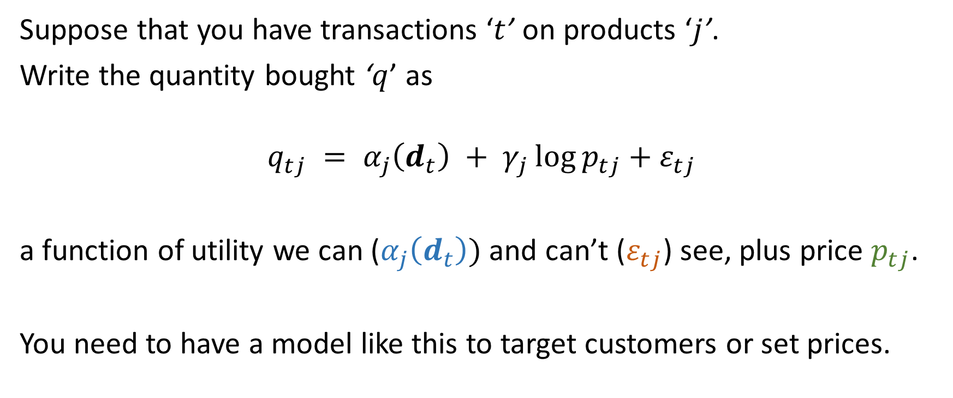
What is a demand system?
Suppose that you have transactions ‘$t$’ on products ‘$j$’.
Write the quantity bought ‘$q$’ as
$$q_{tj} = α_{j}\left(d_{t}\right) + γ_{j}\log{p_{tj}}+ε_{tj}$$
a function of utility we can ($α_{j}\left(d_{t}\right))$ and can’t ($ε_{tj}$) see, plus price $p_{tj}$.
You need to have a model like this to target customers or set prices.
Notes:
You can also have $γ_{tj}$ and $α_{j}$ can get arbitrarily complex.

Slide 4
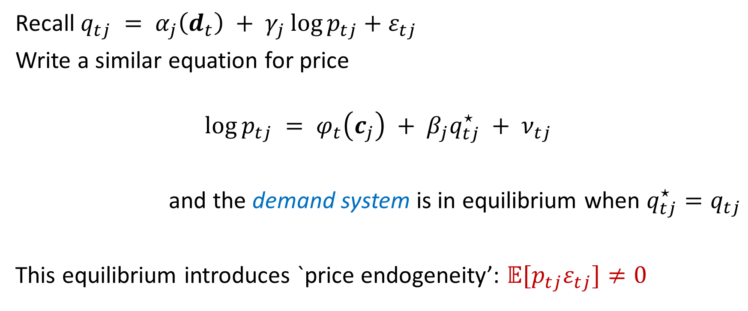
Where does price come from?
Recall $q_{tj} = α_{j}\left(d_{t}\right) + γ_{j}\log{p_{tj}}+ε_{tj}$
Write a similar equation for price
$$\log{p_{tj}} = φ_{t}\left(c_{j}\right) + β_{j}q_{tj}^{⋆} + ν_{tj}$$
and the demand system is in equilibrium when $q_{tj}^{⋆}=q_{tj}$
This equilibrium introduces `price endogeneity’: $𝔼[p_{tj}ε_{tj}]≠0$
Notes:
$c_{j}$ are cost shifters that are independent of demand.

Slide 5
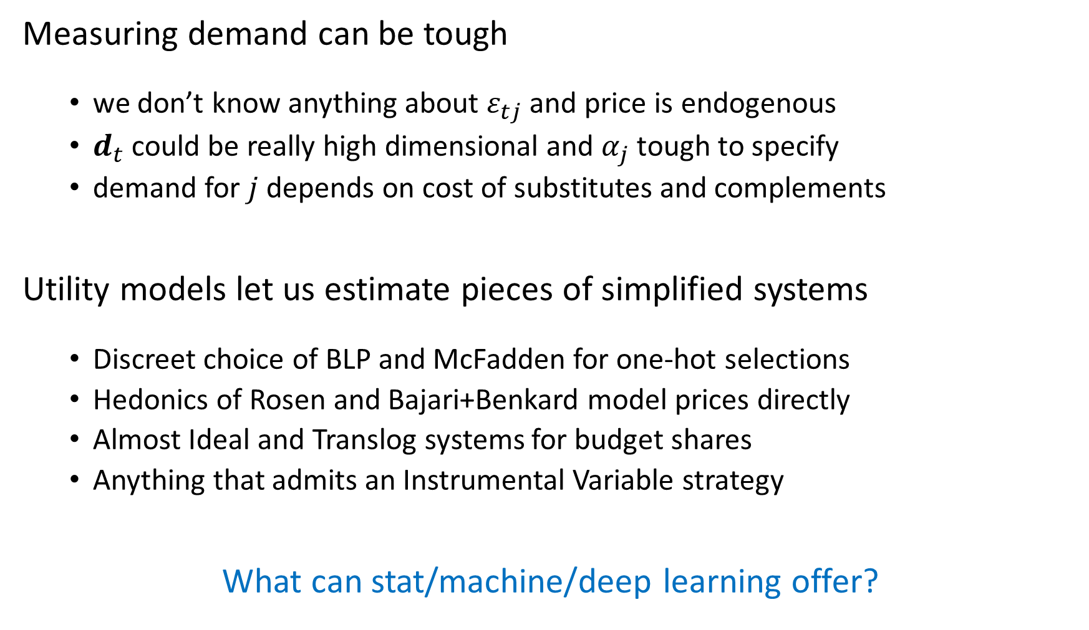
Measuring demand can be tough
we don’t know anything about $ε_{tj}$ and price is endogenous
$d_{t}$ could be really high dimensional and $α_{j}$ tough to specify
demand for $j$ depends on cost of substitutes and complements
Utility models let us estimate pieces of simplified systems
Discreet choice of BLP and McFadden for one-hot selections
Hedonics of Rosen and Bajari+Benkard model prices directly
Almost Ideal and Translog systems for budget shares
Anything that admits an Instrumental Variable strategy
What can stat/machine/deep learning offer?

Slide 6
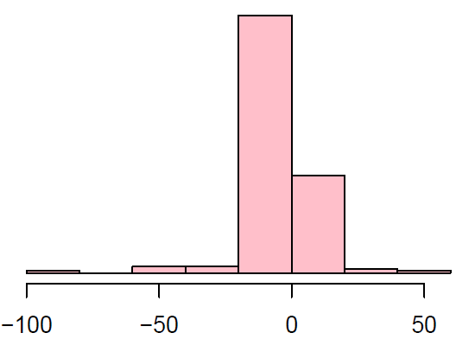
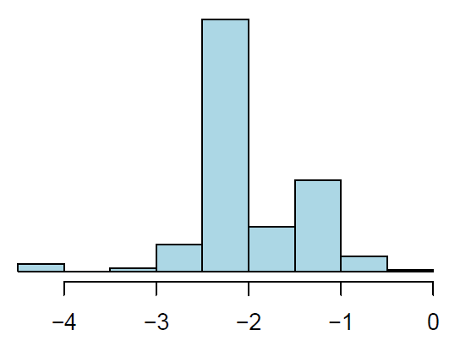

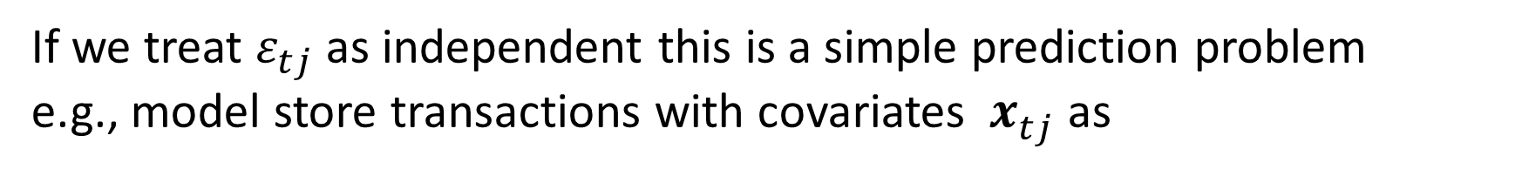
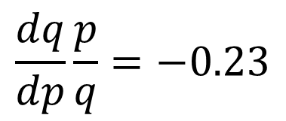
Sometimes it’s just regression
If we treat $ε_{tj}$ as independent this is a simple prediction problem
e.g., model store transactions with covariates ${ x}_{tj}^{ }$ as
$$𝔼\log{q_{tj}} ={ x}_{tj}^{′}β +\log{p_{tj}}x_{tj}^{′}γ$$
Elasticities:
one shared: $x_{tj}=1$ brand-specific: $x_{tjk}= 𝟙_{\left[k=j\right]}$ $x_{tj}^{ }$= featurized description
$$\frac{dq}{dp}\frac{p}{q}=−0.23$$

Slide 7
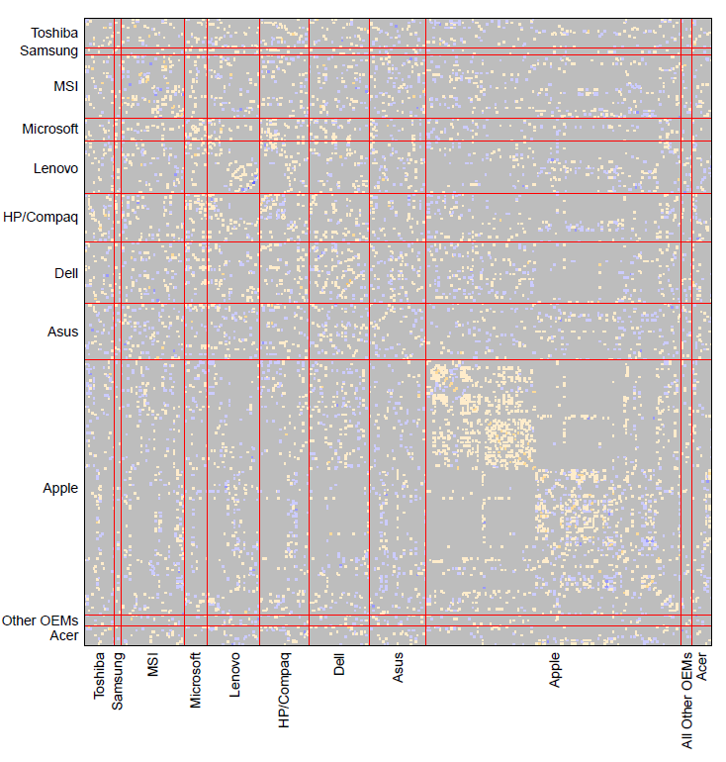
Cross-Product Sales Effects
fitted precision matrix
Products move together
We can fit a graph of conditional
dependencies (i.e., the precision)
as a function of distance in both
observables and latent space.
(using roll-outs for identification)

Slide 8
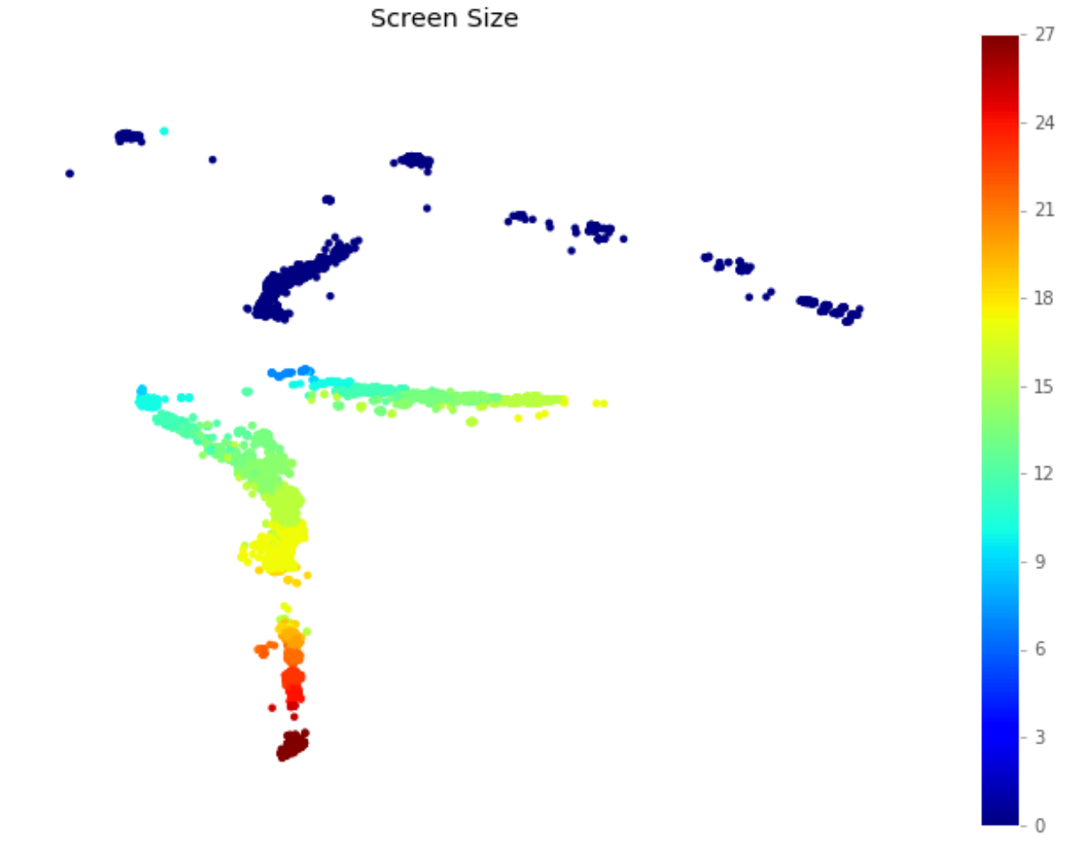
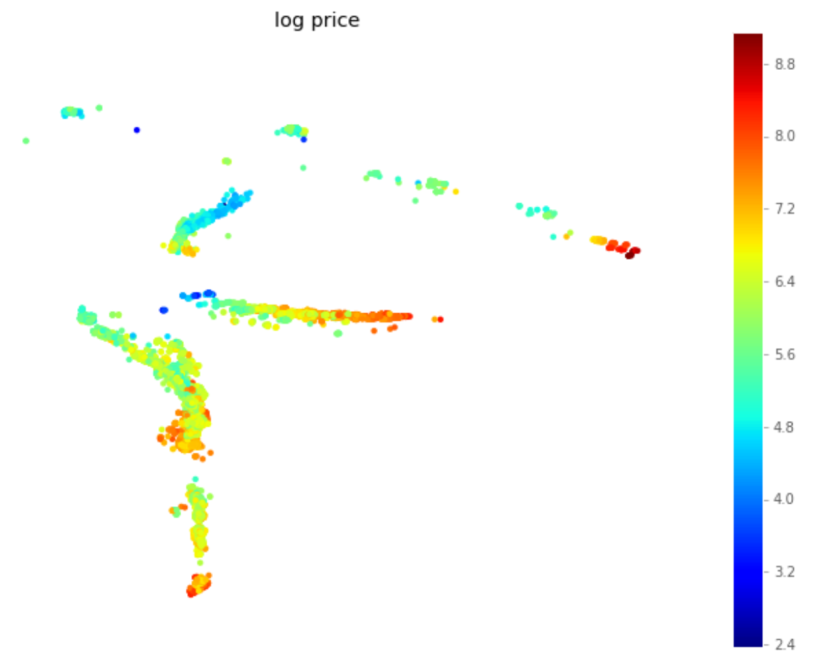
Deep Hedonics
Hedonic regression models prices from product characteristics
If the characteristic space is continuous and low-D then you can invert this to get demand for characteristics
We use auto-encoders to learn low-D latent characteristics

Slide 9

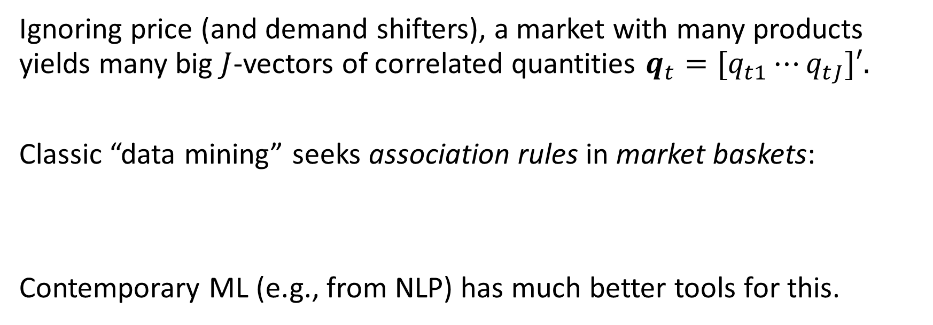
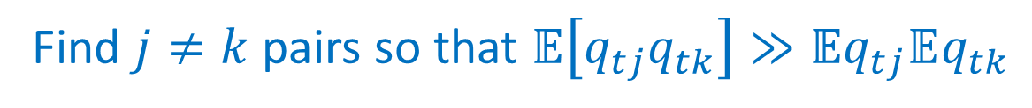
Product Co-occurrence
$$q_{tj} = α_{j}\left(d_{t}\right) + γ_{j}\log{p_{tj}}+ε_{tj}$$
Ignoring price (and demand shifters), a market with many products yields many big $J$-vectors of correlated quantities ${q_{t}=[q}_{t1}⋯q_{tJ}]′.$
Classic “data mining” seeks association rules in market baskets:
Contemporary ML (e.g., from NLP) has much better tools for this.
Find $j≠k$pairs so that $𝔼\left[q_{tj}q_{tk}\right]≫𝔼q_{tj}𝔼q_{tk}$

Slide 10
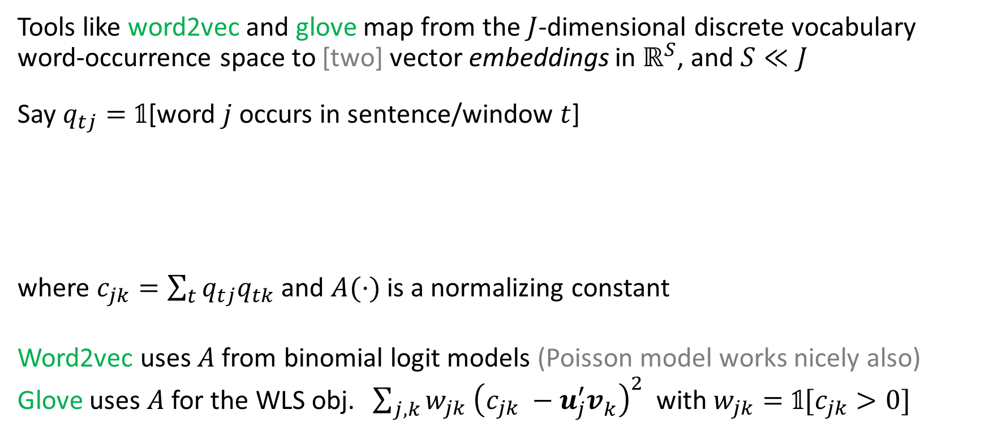
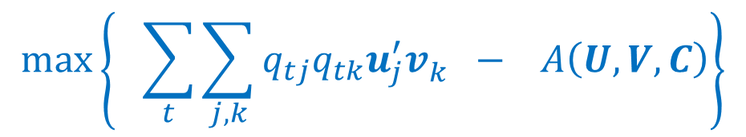
Word Embedding in NLP
Tools like word2vec and glove map from the $J$-dimensional discrete vocabulary word-occurrence space to [two] vector embeddings in $ℝ^{S}$, and $S≪J$
Say $q_{tj}=𝟙$[word $j$ occurs in sentence/window $t$]
where $c_{jk}=\sum_{t}{q_{tj}q_{tk}}$ and $A(⋅)$ is a normalizing constant
Word2vec uses $A$ from binomial logit models (Poisson model works nicely also)
Glove uses $A$ for the WLS obj. ${\sum_{j,k}{w_{jk} {\left(c_{jk} −u_{j}^{′}v_{k}^{ }\right)}^{2}}}$ with $w_{jk}=𝟙[c_{jk}>0]$
$$\max\left\{ \sum_{t}{\sum_{j,k}{q_{tj}q_{tk}u_{j}^{′}v_{k}^{ } }} − A\left(U,V,C\right)\right\}$$

Slide 11
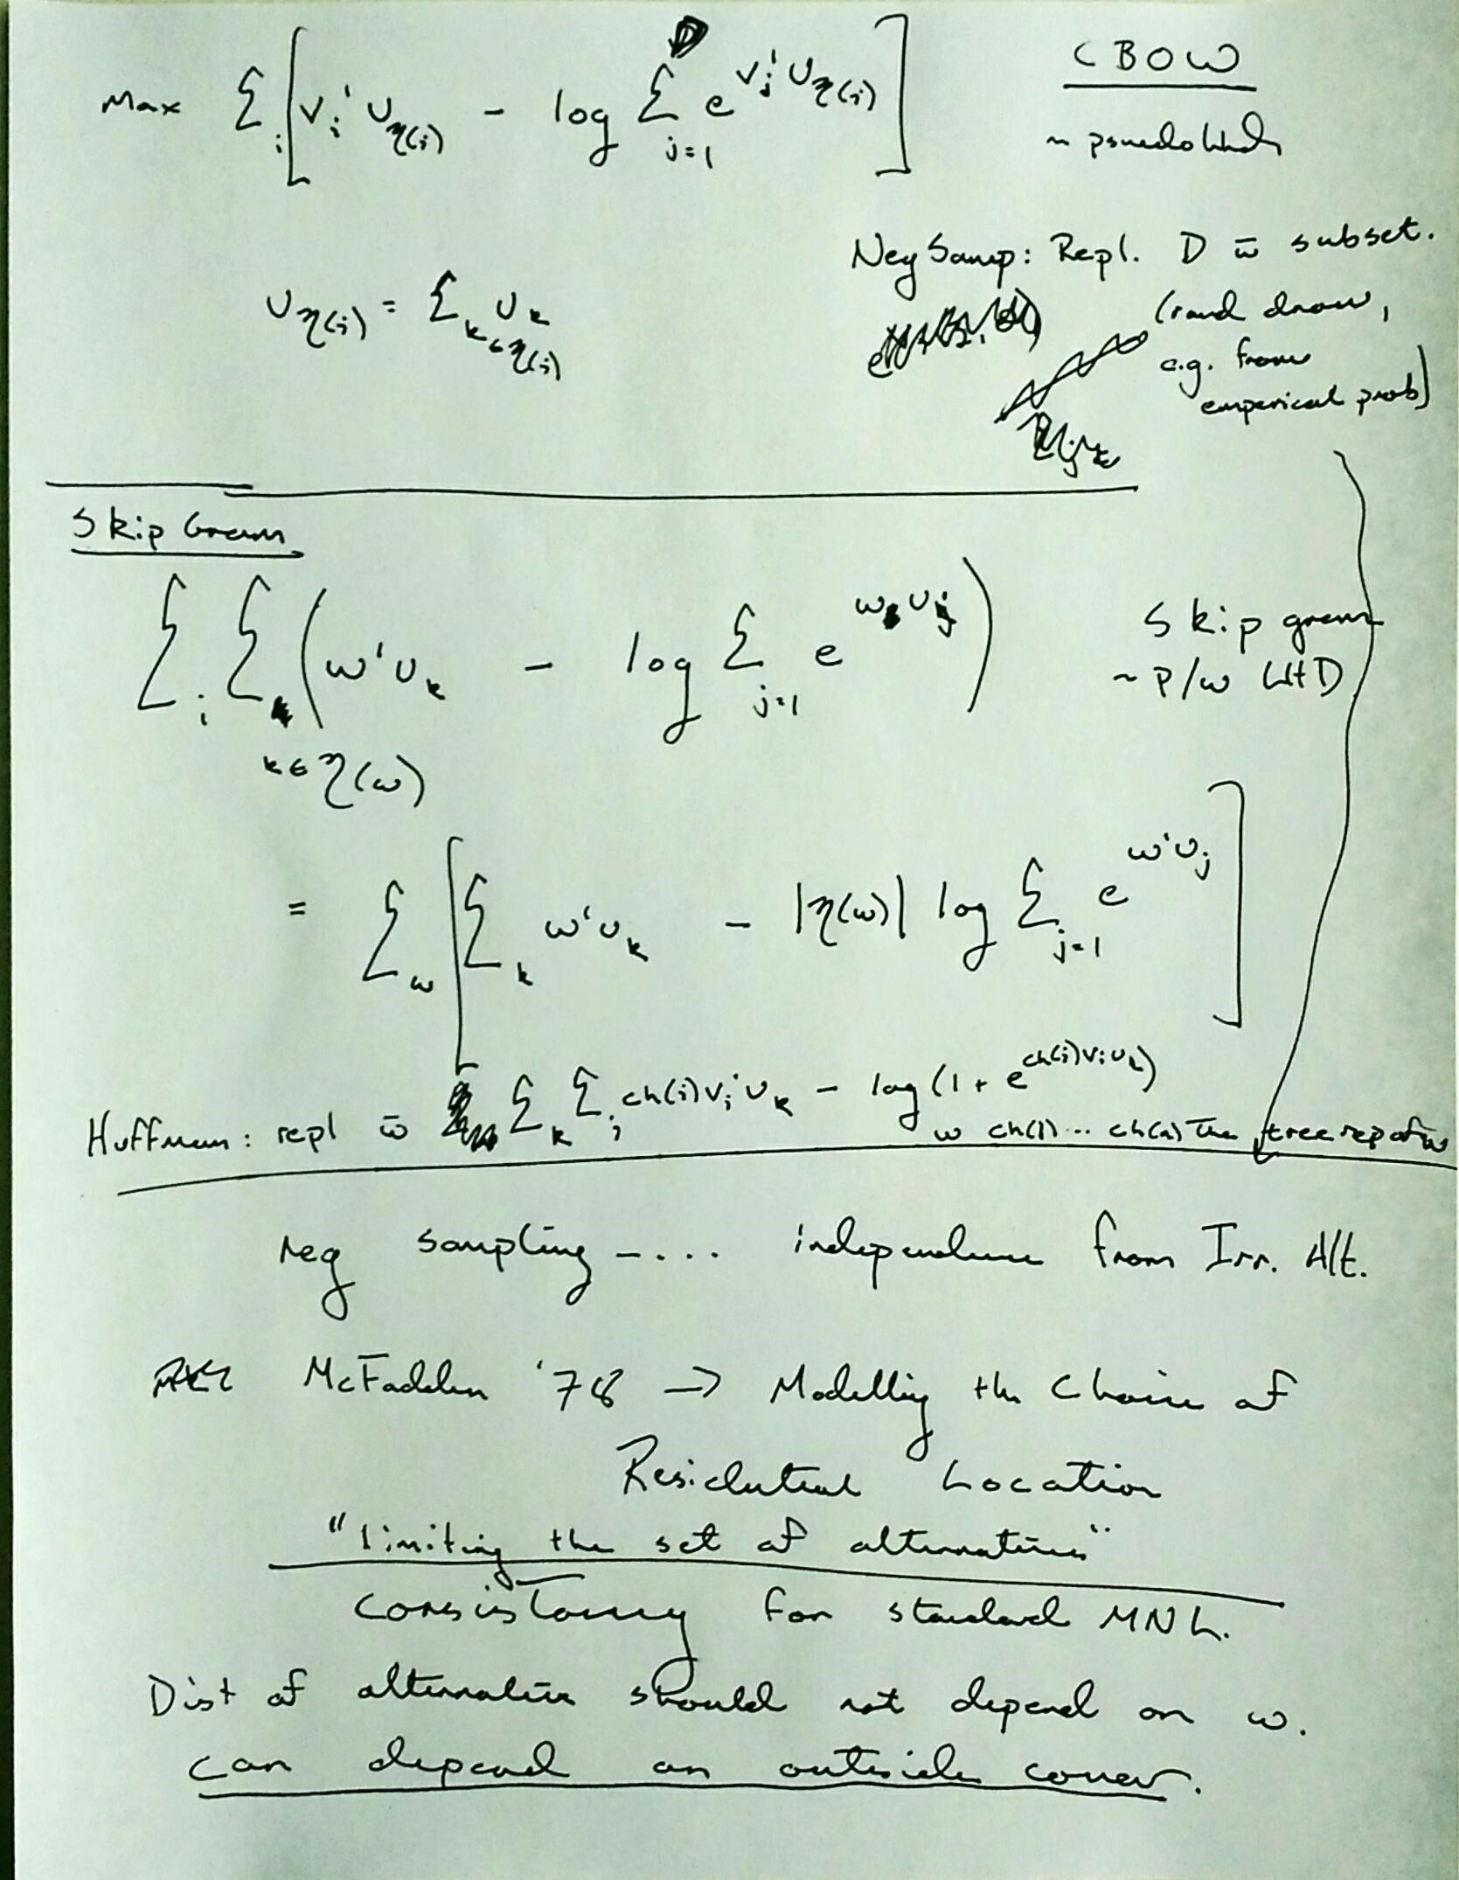

Slide 12
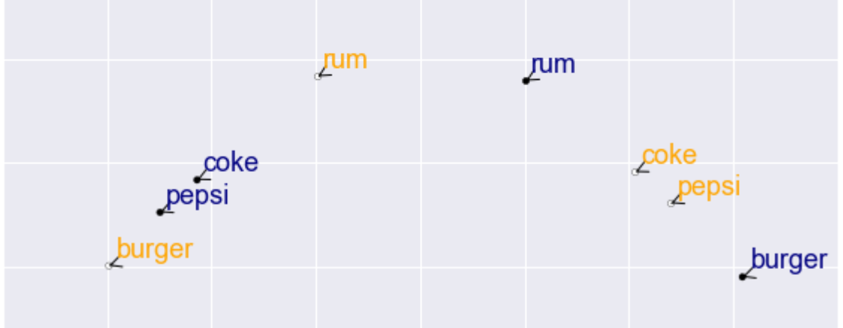
Product Embeddings
words are like products and sentences are like baskets
substitutes (synonyms) are close in the same vector space
complements (topical words) are close across vector spaces

Slide 13
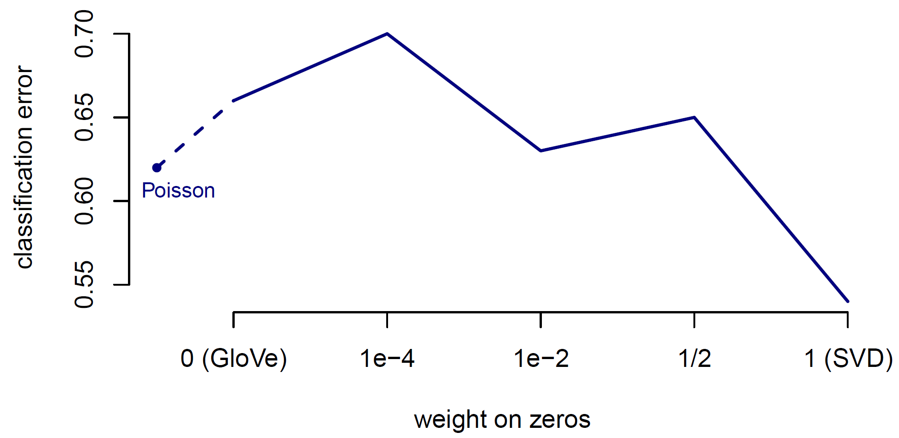
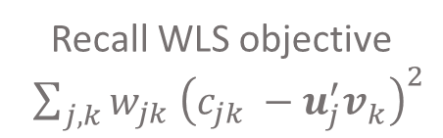
Supermarkets products are organized into narrowly defined modules
If we believe that modules contain mostly substitutes, then
same-space embedding neighbors should often be in the same module
1-Nearest Neighbor Module Prediction
Recall WLS objective ${\sum_{j,k}{w_{jk} {\left(c_{jk} −u_{j}^{′}v_{k}^{ }\right)}^{2}}}$

Slide 14
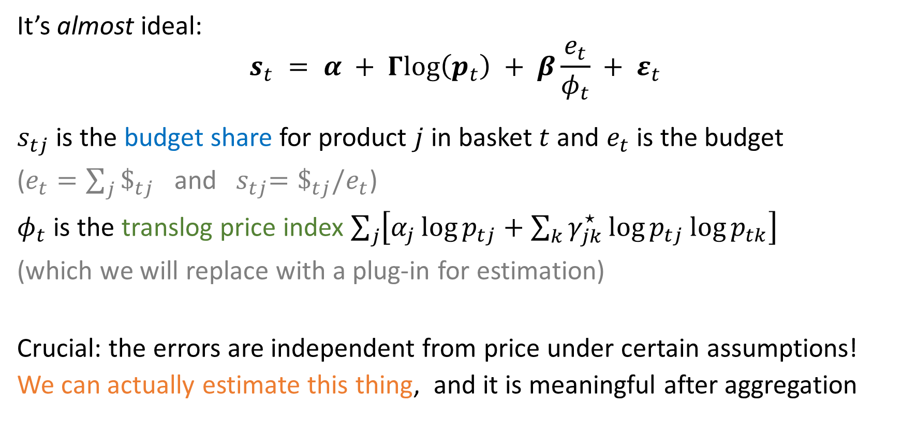
Moving inside a demand system (AIDS)
It’s almost ideal:
$$s_{t} = α + Γlog\left(p_{t}\right) + β\frac{e_{t}}{φ_{t}} + ε_{t}$$
$s_{tj}$ is the budget share for product $j$ in basket $t$ and $e_{t}$ is the budget
($e_{t}=\sum_{j}{\$_{tj}}$ and ${ s}_{tj}=\$_{tj}/e_{t}$)
$φ_{t}$ is the translog price index $\sum_{j}{\left[α_{j}\log{p_{tj}}+\sum_{k}{γ_{jk}^{⋆}\log{p_{tj}\log{p_{tk}}}}\right]}$
(which we will replace with a plug-in for estimation)
Crucial: the errors are independent from price under certain assumptions!
We can actually estimate this thing, and it is meaningful after aggregation

Slide 15

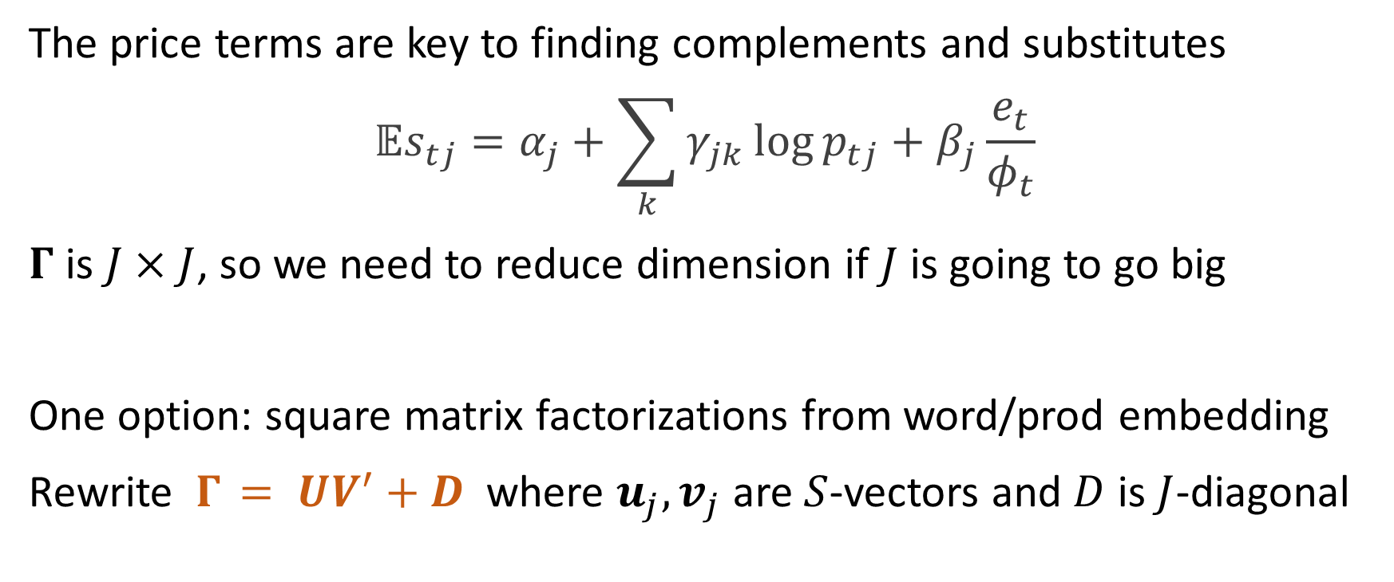
Factorizing $Γ$
The price terms are key to finding complements and substitutes
$${𝔼s}_{tj}=α_{j}+\sum_{k}{γ_{jk}\log{p_{tj}}}+β_{j}\frac{e_{t}}{φ_{t}}$$
$Γ$ is $J×J$, so we need to reduce dimension if $J$ is going to go big
One option: square matrix factorizations from word/prod embedding
Rewrite $Γ_{ }= UV^{′}+D$ where $u_{j},v_{j}$ are $S$-vectors and $D$ is $J$-diagonal
Notes:
as another option, we could parametrize $Γ$ as a function of product feature distances

Slide 16
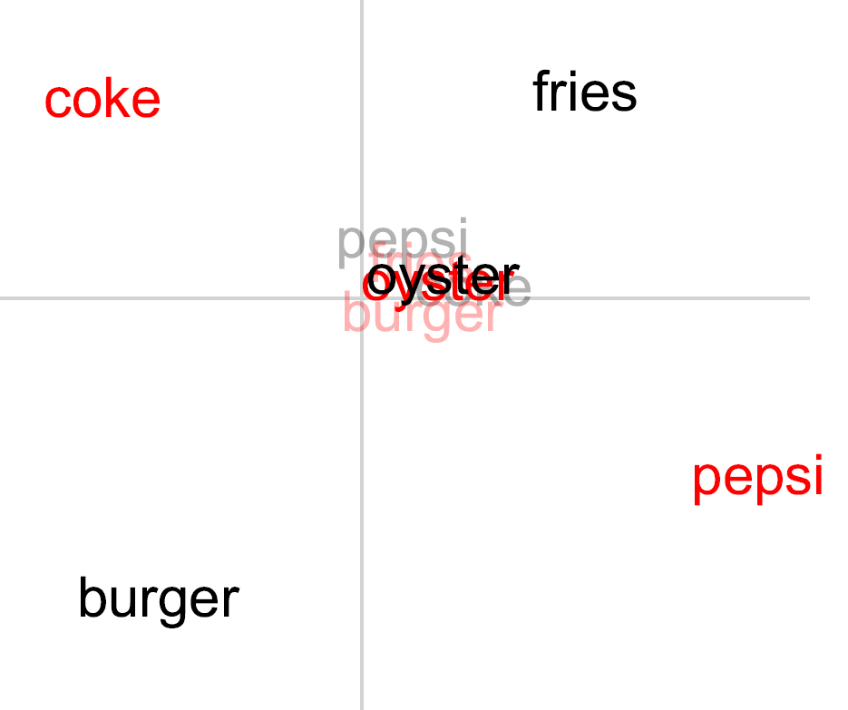
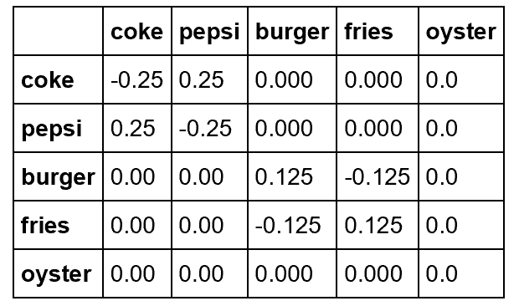
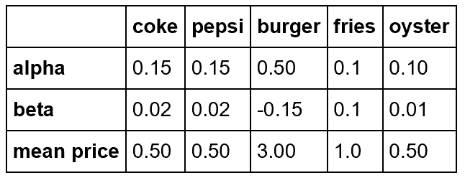

Embedding lunch on the cape
$$Γ$$

Slide 17
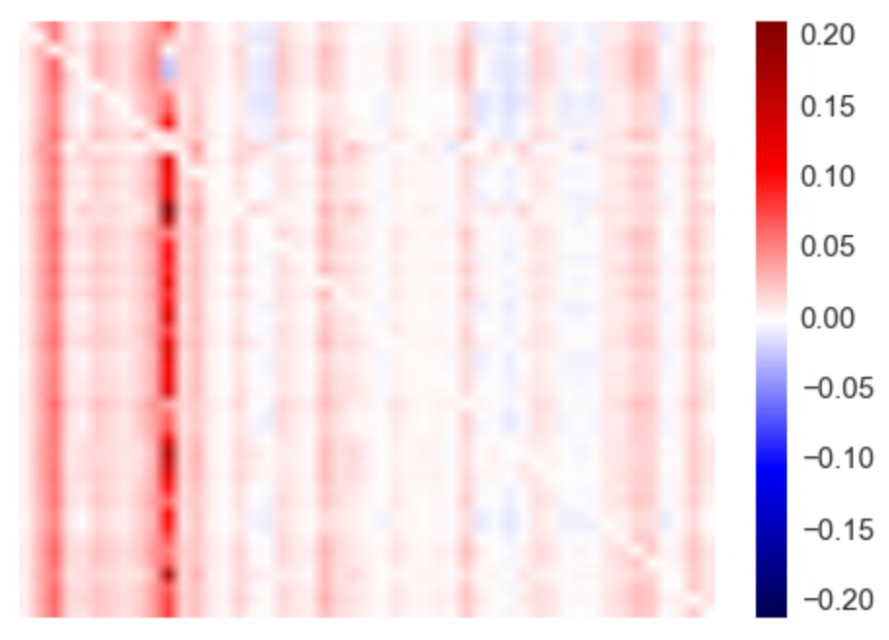



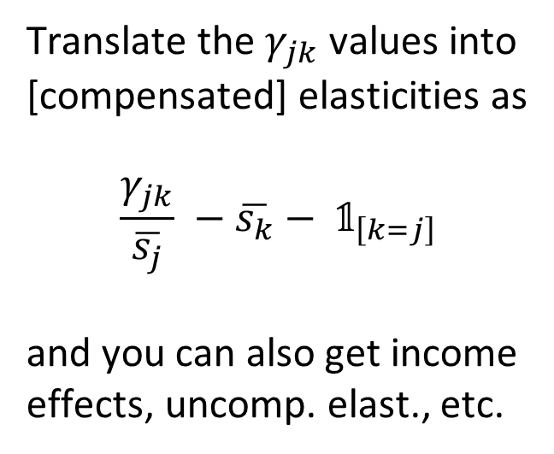
Back to beer
Elasticity matrix (omitting diagonal)
Translate the $γ_{jk}$ values into
[compensated] elasticities as
$$\frac{γ_{jk}}{\overline{s_{j}}} −\overline{s_{k}}− 𝟙_{\left[k=j\right]}$$
and you can also get income
effects, uncomp. elast., etc.

Slide 18
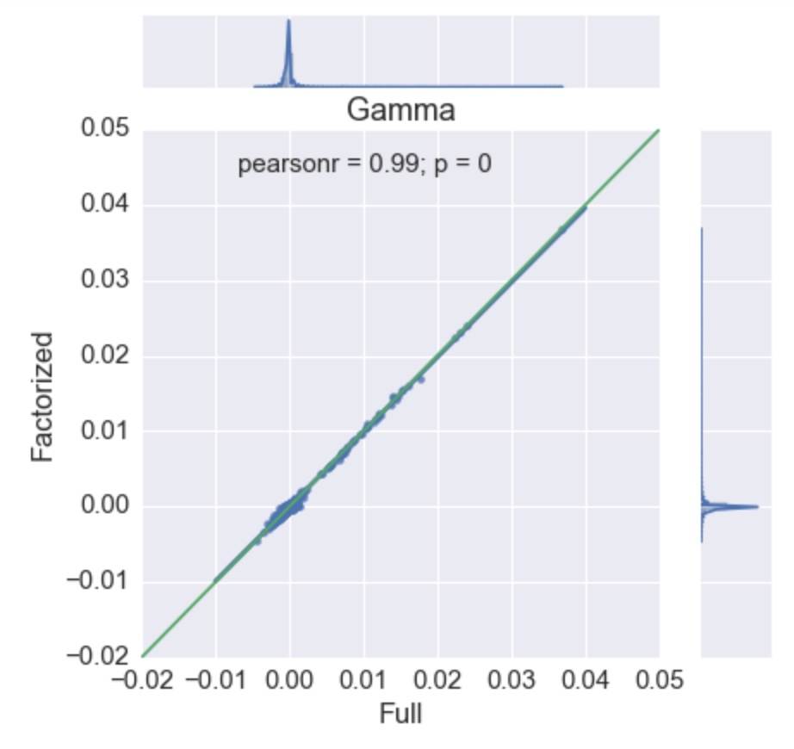
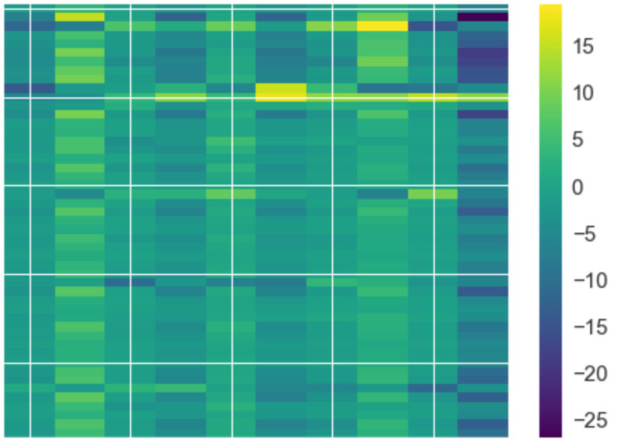
S=10 dimensional embedding

Slide 19
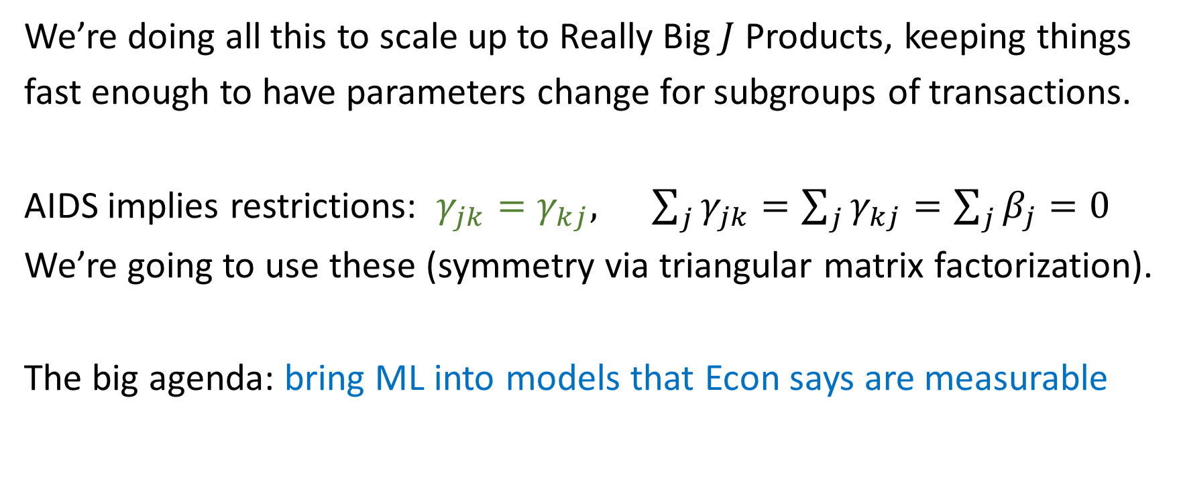
Just a start
We’re doing all this to scale up to Really Big $J$ Products, keeping things
fast enough to have parameters change for subgroups of transactions.
AIDS implies restrictions: $γ_{jk}=γ_{kj}, \sum_{j}{γ_{jk}=\sum_{j}{γ_{kj}}=\sum_{j}{β_{j}=0}}$
We’re going to use these (symmetry via triangular matrix factorization).
The big agenda: bring ML into models that Econ says are measurable

