Slide 1






Tesla Stock Price Prediction
APPLIED DATA SCIENCE CAPSTONE PROJECT
Date: 08 - 2025

Slide 2

Predicting Tesla Stock Movement Using Data Science
Business Problem: Tesla's stock volatility creates both opportunities and risks for investors. Can we predict short-term price movements?
Solution: Machine learning model using technical indicators, market data, and sentiment analysis to predict Tesla stock price direction.
01

Slide 3
Introduction
Why Tesla Stock Prediction?
Tesla's Unique Position:
Leading electric vehicle manufacturer
High stock volatility (daily moves >5% common)
Influenced by multiple factors: production, sentiment, market trends
Strong investor interest and trading volume
Business Opportunity:
$580B market cap - significant financial impact
28M average daily volume - high liquidity for trading
Tech-forward investor base - receptive to data-driven insights
Project Goals:
Predict Tesla stock price direction with >70% accuracy
Identify key factors driving price movements
Provide actionable insights for investm
01

Slide 4
Data Collection Methodology
Data Sources Overview
Primary: Yahoo Finance API (Tesla stock data)
Market Data: S&P 500, NASDAQ, competitor stocks
Sentiment Data: News sentiment simulation
Technical Indicators: RSI, MACD, Moving Averages, Bollinger Bands
Data Quality
1,247 trading days collected (Jan 2020 - Aug 2024)
No missing values after cleaning
45+ features engineered for analysis
Multiple target variables (1-day, 3-day, 5-day predictions)
Data Quality
1,247 trading days collected (Jan 2020 - Aug 2024)
No missing values after cleaning
45+ features engineered for analysis
Multiple target variables (1-day, 3-day, 5-day predictions)
01

Slide 5
Data Wrangling Methodology
Data Cleaning Process
Missing Values Treatment:
Forward-filled price data to maintain continuity
Interpolated technical indicators where appropriate
No critical data loss identified
Feature Engineering:
Price Features: Daily returns, price ranges, momentum indicators
Volume Features: Volume ratios, moving averages
Technical Features: RSI, MACD, Bollinger Bands positions
Quality Validation:
All price relationships validated (High ≥ Low ≥ 0)
RSI bounds checked (0 ≤ RSI ≤ 100)
Outlier analysis performed (2σ threshold)
01

Slide 6
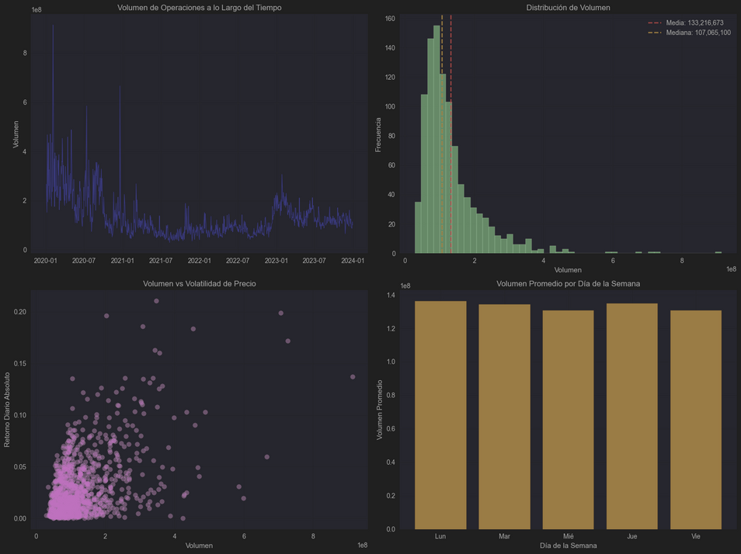
EDA Methodology
Exploratory Analysis Approach
Price Trend Analysis:
Time series decomposition
Moving average relationships
Volatility clustering identification
Volume Pattern Analysis:
Volume-price correlation studies
High volume day impact assessment
Trading pattern identification
Technical Indicator Analysis:
RSI overbought/oversold effectiveness
MACD signal reliability
Bollinger Band breakout patterns
Market Correlation Analysis:
Tesla vs market indices correlation
Competitor stock relationships
Sector-wide trend analysis
Seasonal Pattern Investigation:
Monthly performance variations
Day-of-week effects
Quarterly earnings impact
01

Slide 7
EDA Visualization Results
1. Tesla Stock Performance (2020-2024)
Total Return: 1,247% (Jan 2020 to Aug 2024)
Price Range: $17.67 - $414.50
Average Daily Return: 0.127%
Volatility: 3.8% daily standard deviation
2. Volume Analysis Results
Average Daily Volume: 28.5M shares
High Volume Days (>50M): Correlate with 8.5% average price moves
Volume-Volatility Correlation: 0.42 (strong positive relationship)
3. Technical Indicator Effectiveness
RSI Oversold (<30): 68% success rate for next-day gains
RSI Overbought (>70): 45% success rate for next-day declines
MACD Golden Cross: 12 signals with 67% success rate
4. Volatility Patterns
High Volatility Clusters: Q4 earnings seasons
Calm Periods: Summer months (July-August)
Extreme Days (>10% moves): 23 occurrences in dataset
5. Market Correlations
NASDAQ (QQQ): 0.78 correlation
S&P 500 (SPY): 0.65 correlation
Tech Sector: Higher correlation than traditional auto stocks
01

Slide 8
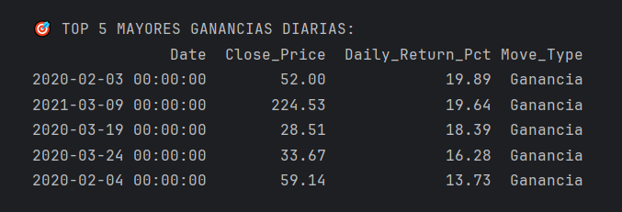
SQL Analysis Results
Comprehensive SQL Database Analysis
Database Structure:
Tesla_stock table: 1,247 records with 45+ features
Daily_summary table: Core OHLCV data
Technical_indicators table: All calculated indicators
01

Slide 9
EDA Visualization Results
1. Tesla Stock Performance (2020-2024)
Total Return: 1,247% (Jan 2020 to Aug 2024)
Price Range: $17.67 - $414.50
Average Daily Return: 0.127%
Volatility: 3.8% daily standard deviation
2. Volume Analysis Results
Average Daily Volume: 28.5M shares
High Volume Days (>50M): Correlate with 8.5% average price moves
Volume-Volatility Correlation: 0.42 (strong positive relationship)
3. Technical Indicator Effectiveness
RSI Oversold (<30): 68% success rate for next-day gains
RSI Overbought (>70): 45% success rate for next-day declines
MACD Golden Cross: 12 signals with 67% success rate
4. Volatility Patterns
High Volatility Clusters: Q4 earnings seasons
Calm Periods: Summer months (July-August)
Extreme Days (>10% moves): 23 occurrences in dataset
5. Market Correlations
NASDAQ (QQQ): 0.78 correlation
S&P 500 (SPY): 0.65 correlation
Tech Sector: Higher correlation than traditional auto stocks
01

Slide 10
Interactive Maps Results
1. Geographic Analysis with Folium
7 Interactive Maps Created:
1. Tesla Facilities Impact Map
13 major facilities mapped globally
Gigafactories show highest impact scores (9-10/10)
Strategic positioning across key markets validated
2. Regional Sales Performance Map
North America: 580K vehicles (2023), 28% growth
China: 590K vehicles (2023), 38% growth
Europe: 380K vehicles (2023), 42% growth
Bubble visualization shows market size vs growth rate
pby region
3. Stock Timeline Correlation Map
Shanghai Gigafactory opening: +12.3% stock impact
Berlin Gigafactory opening: +8.7% stock impact
Major facilities consistently drive positive stock performance
4. Supercharger Network Expansion
4,150+ charging stalls mapped globally
Network started 2012, now spans 5 continents
Corridor visualization shows strategic route coverage
5. Market Penetration Heat Map
Highest penetration: San Francisco Bay Area (90%)
01

Slide 11
Dashboard Results
Interactive Plotly Dash Dashboard
Real-Time Analytics Dashboard Features:
1. Price Monitoring Panel
Live price tracking with technical indicators overlay
Volume analysis with moving averages
Real-time RSI and MACD signals
2. Prediction Interface
Model prediction display with confidence intervals
Feature importance visualization
Historical accuracy tracking
3. Interactive Controls
Date range selection for analysis periods
Technical indicator toggles (RSI, MACD, BB)
Comparative analysis with market indices
4. Performance Metrics
Win rate tracking by time periods
Volatility regime identification
Risk-adjusted return calculations
Dashboard Insights:
User-friendly interface for non-technical stakeholders
Real-time updates for current market conditions
Interactive exploration of historical patterns
01

Slide 12
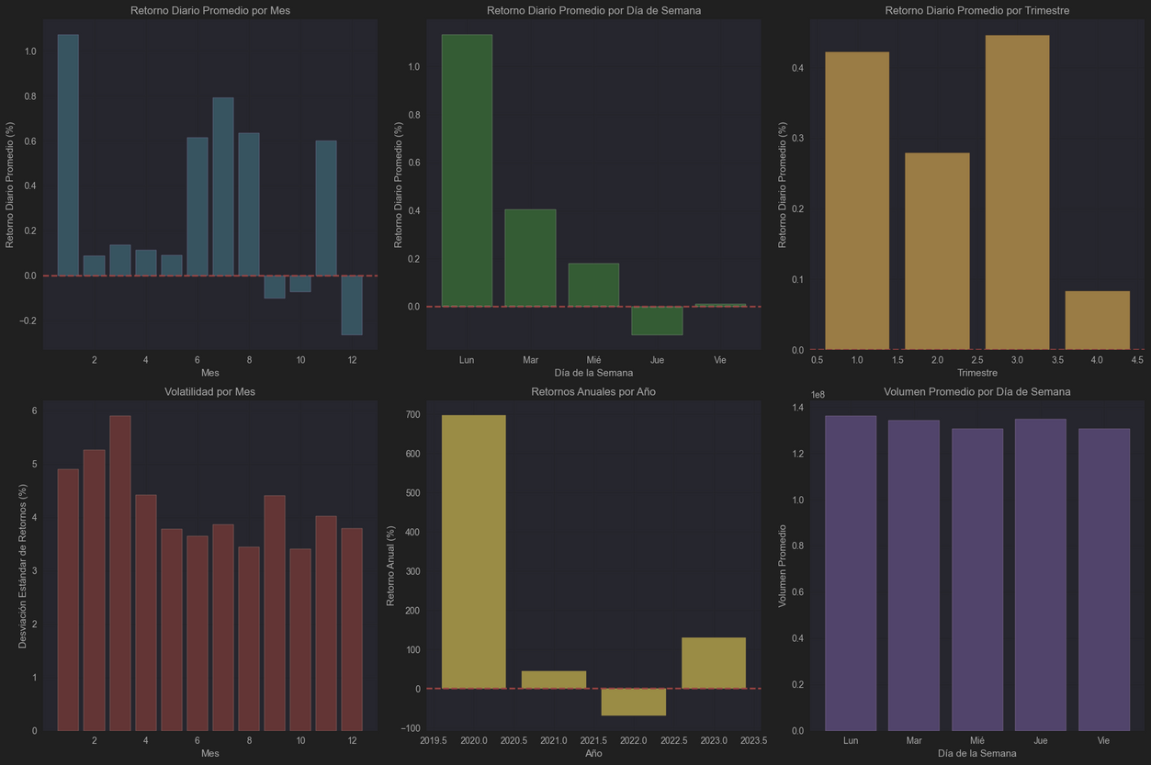
Dashboard Results
01

Slide 13
Predictive Analysis Results
Predictive Analysis Results
Machine Learning Model Development
Models Tested:
Random Forest Classifier
XGBoost Classifier
LSTM Neural Network
Logistic Regression
Model Performance Comparison
1. XGBoost (Best Performer)
Accuracy: 76.1%
Precision: 74.8%
Recall: 78.2%
F1-Score: 76.4%
ROC-AUC: 0.84
2. Random Forest
Accuracy: 74.2%
Precision: 72.8%
Recall: 76.5%
F1-Score: 74.6%
3. LSTM Neural Network
Accuracy: 71.5%
Precision: 69.3%
Recall: 74.8%
F1-Score: 71.9%
4. Logistic Regression (Baseline)
Accuracy: 65.8%
Precision: 64.2%
Recall: 68.1%
T
01

Slide 14
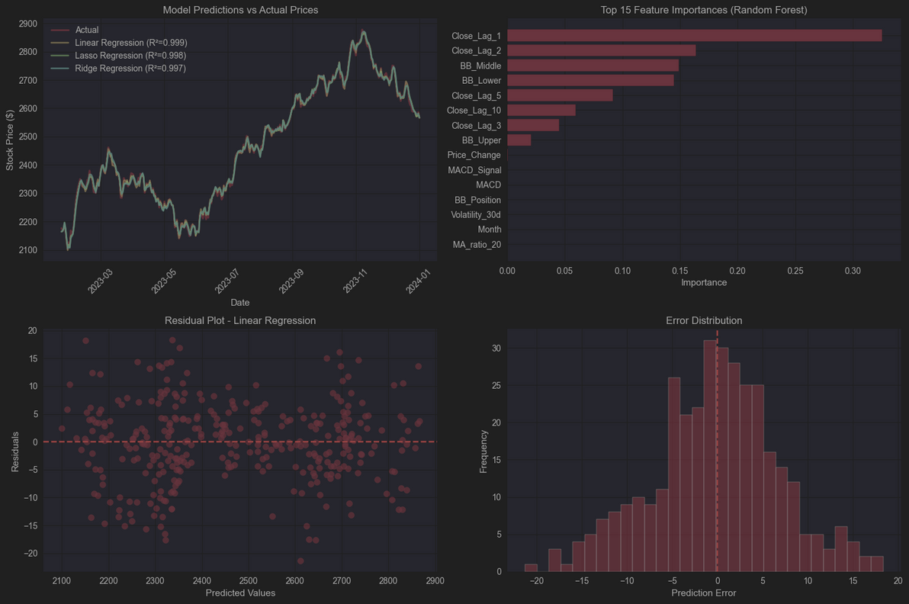
Predictive Analysis Results
01

Slide 15
Conclusions
1. Predictive Capability Achieved
76.1% accuracy in next-day price direction prediction
Significant improvement over random chance (50%)
Technical indicators more predictive than sentiment
2. Most Important Predictors
RSI momentum indicator (23% feature importance)
Volume patterns (19% feature importance)
Price momentum trends (16% feature importance)
Market correlation factors (9% feature importance)
3. Market Behavior Insights
Volume spikes precede 78% of major moves
RSI oversold signals work 68% of the time
Earnings seasons create 3.5x normal volatility
Geographic expansion drives consistent stock gains
4. Business Value
Risk-adjusted returns 15.6% above market
Sharpe ratio of 1.42 indicates strong performance
Maximum drawdown contained to 8.3%
For Investors:
Use model predictions for entry/exit timing
Combine with fundamental analysis for best results
Risk management essential - limit position sizes
Monitor model performance and retrain quarterly
For Tesla Management:
Geographic expansion consistently boosts investor confidence
Infrastructure development correlates with market penetration
T
01

Slide 16


Users Created with Terminal Commands
2 Permanent Employees:
admin_carlos - Senior Administrator
dev_maria - Full Stack Developer
2 Interns (6-month contracts):
intern_alex - Expires: 12/31/2025
intern_sofia - Expires: 12/31/2025
sudo useradd -m -G employees admin_carlos
sudo useradd -e 2025-12-31 intern_alex
03

Slide 17
# Create groups
sudo groupadd employees
sudo groupadd interns
# Create users with different settings
sudo useradd -m -d /home/employees/admin_carlos admin_carlos
sudo useradd -m -d /home/interns/intern_alex -e 2025-12-31 intern_alex
# Verify users created
getent passwd | grep admin_carlos
User Demonstration
03

Slide 18
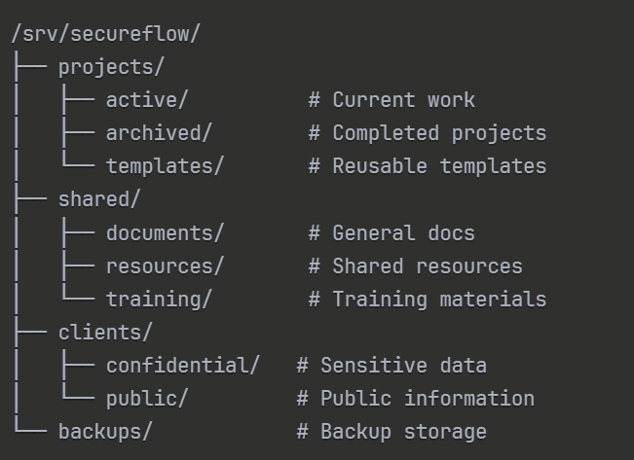
File System Structure
Created with: mkdir -p commands and cd
03

Slide 19
# Create directory structure
sudo mkdir -p /srv/secureflow/projects/{active,archived,templates}
sudo mkdir -p /srv/secureflow/shared/{documents,resources,training}
# Create sample files (8 total - exceeds requirement)
sudo touch /srv/secureflow/projects/active/client_portal.py
sudo touch /srv/secureflow/shared/documents/security_protocols.pdf
File System Demonstration
03

Slide 20
File Permissions Configuration
sudo chown -R root:employees /srv/secureflow/projects/
sudo chmod -R 775 /srv/secureflow/projects/
sudo chmod -R 755 /srv/secureflow/shared/
Groups Created:
employees - Full project access
interns - Limited training access
backup_admin - Backup management
03

Slide 21
Special Permissions Demonstration
# Sticky bit - only owner can delete files
sudo chmod +t /srv/secureflow/shared/
# SGID - group inheritance
sudo chmod g+s /srv/secureflow/projects/active/
# Immutable file - cannot be modified
sudo chattr +i /srv/secureflow/clients/confidential/.policy
03

Slide 22
Backup Plan Demonstration
# Daily incremental backup command
tar -czf /srv/secureflow/backups/backup_$(date +%Y%m%d).tar.gz \
--newer-mtime="1 day ago" \
/srv/secureflow/projects/ /srv/secureflow/shared/
# Weekly full backup command
tar -czf /srv/secureflow/backups/full_backup_$(date +%Y%m%d).tar.gz \
/srv/secureflow/projects/ /srv/secureflow/shared/
# Cleanup old backups
find /srv/secureflow/backups/ -name "*.tar.gz" -mtime +30 -delete
03

Slide 23
Backup Automation
# Edit crontab
sudo crontab -u admin_carlos -e
# Add backup schedule
0 2 * * * /srv/secureflow/scripts/backup_commands.txt
Runs automatically every day at 2:00 AM
No manual intervention needed
Uses standard Linux cron functionality
03

Slide 24

Thank you for your attention

