Slide 1
ALY6070 SIGNATURE ASSIGNMENT GROUP PRESENTATION
Professor
Kayal chandrasekaran
Presented By
Rahul Reddy Taduri
sINGAPORE Government Budget and Fiscal Position Annual DATASET

Slide 2
INTRODUCTION TO DATASET AND DESCRIPTION OF ATTRIBUTES
financial_year: This variable represents the fiscal year in which the budget data was recorded. The range is from 1997 to 2021.
actual_revised_estimated: This variable indicates the status of the budget figures. The categories include,
Actual: The actual spending or revenue recorded for that financial year.
Revised: Updated figures after some adjustments have been made to the initial budget.
Estimated: A projection or forecast for the budget in a given financial year.
sector: This variable categorizes the different areas of government spending. The sectors include,
Social Development
Security and External Relations
Economic Development
Government Administration
ministry: This variable represents the specific government ministries or departments responsible for the budget allocation. Some examples include Education, Health, Defence, etc
type: This variable classifies the budget allocation into two categories:
Operating: Recurrent expenditures such as wages, maintenance, and running costs.
Development: Expenditures related to capital investments, infrastructure, and long-term projects.
amount: This variable indicates the monetary value of the budget allocation in millions.
percent_of_gdp: This variable shows the budget allocation as a percentage of the country's Gross Domestic Product (GDP).

Slide 3
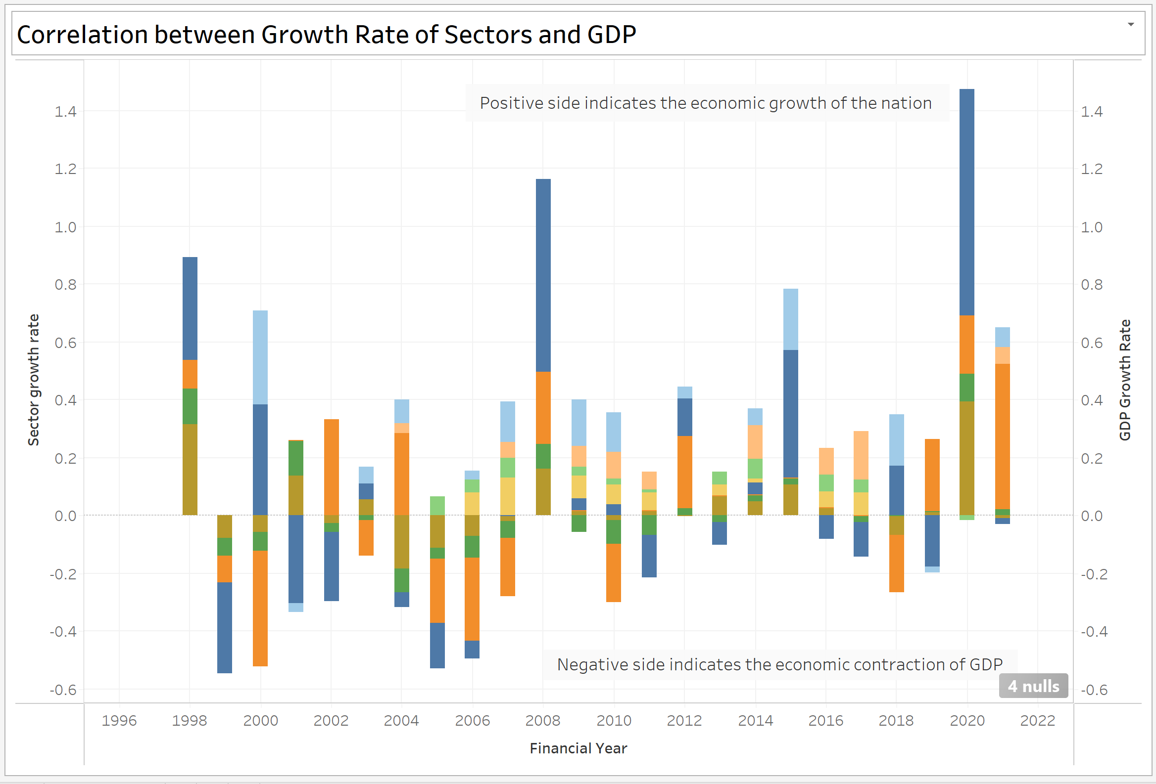
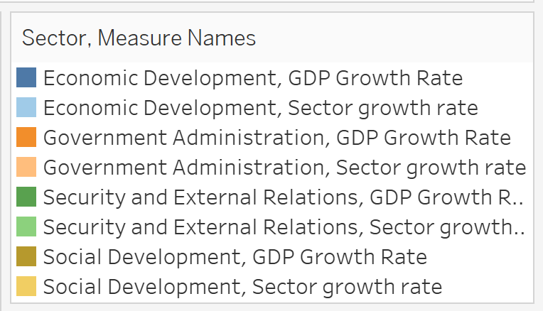
How do different sectors' growth rates correlate with GDP growth, and can we identify any key drivers of future economic development?

Slide 4
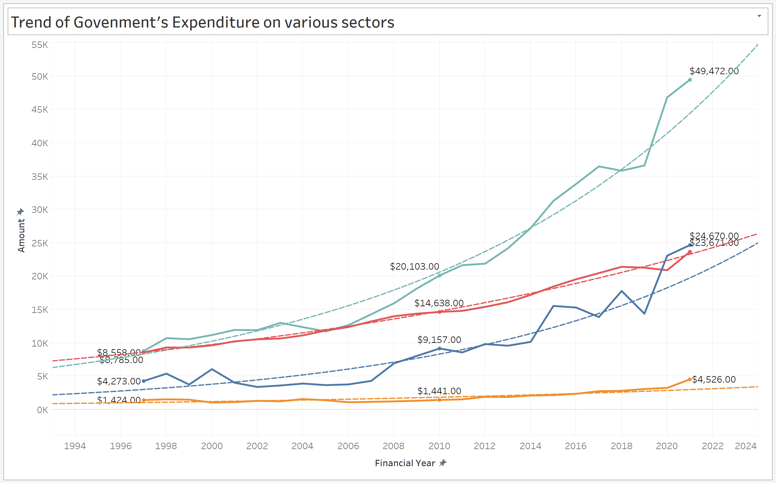
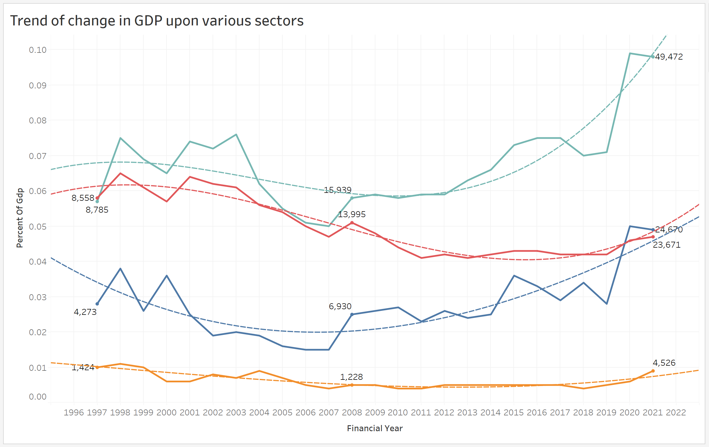
How has the government expenditure by sector, evolved over the financial years as a percentage of GDP?

Slide 5
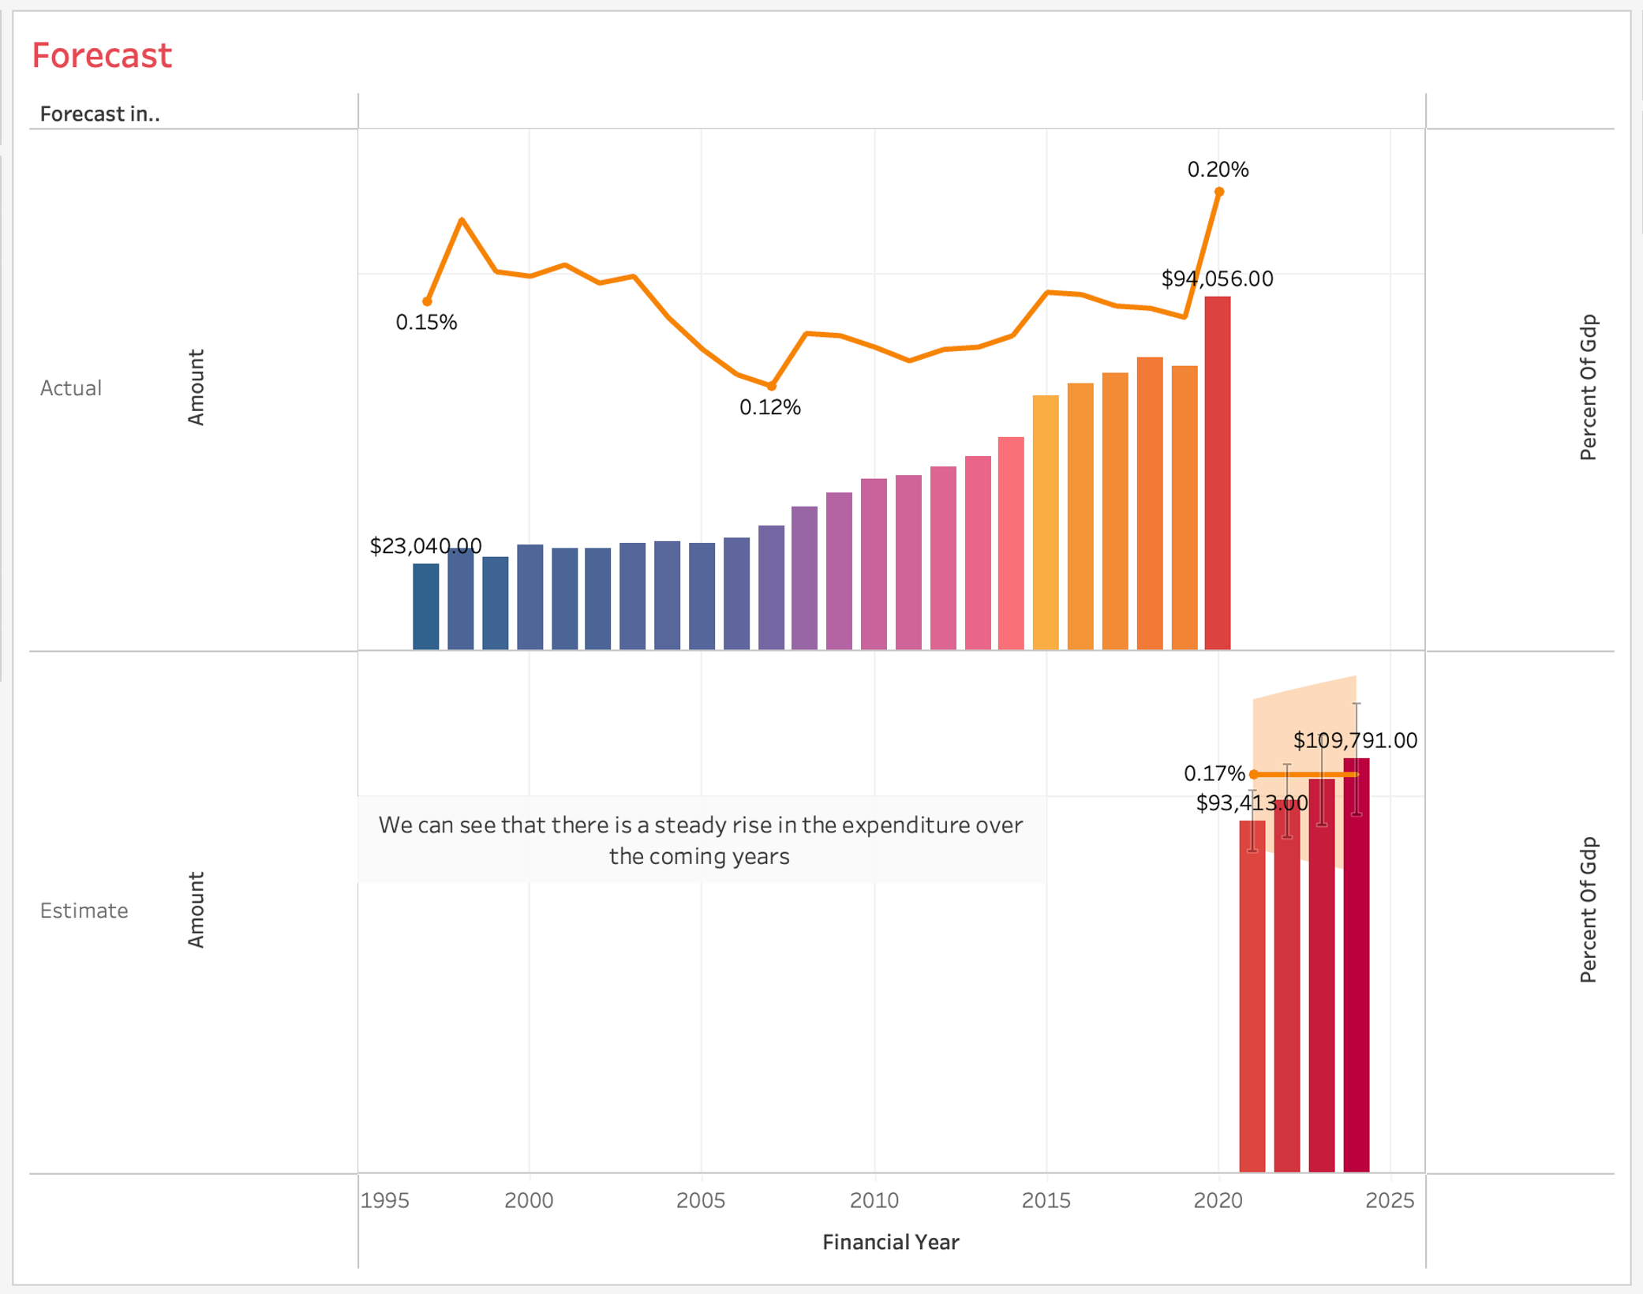
Forecast for the years 2021-2024

Slide 6
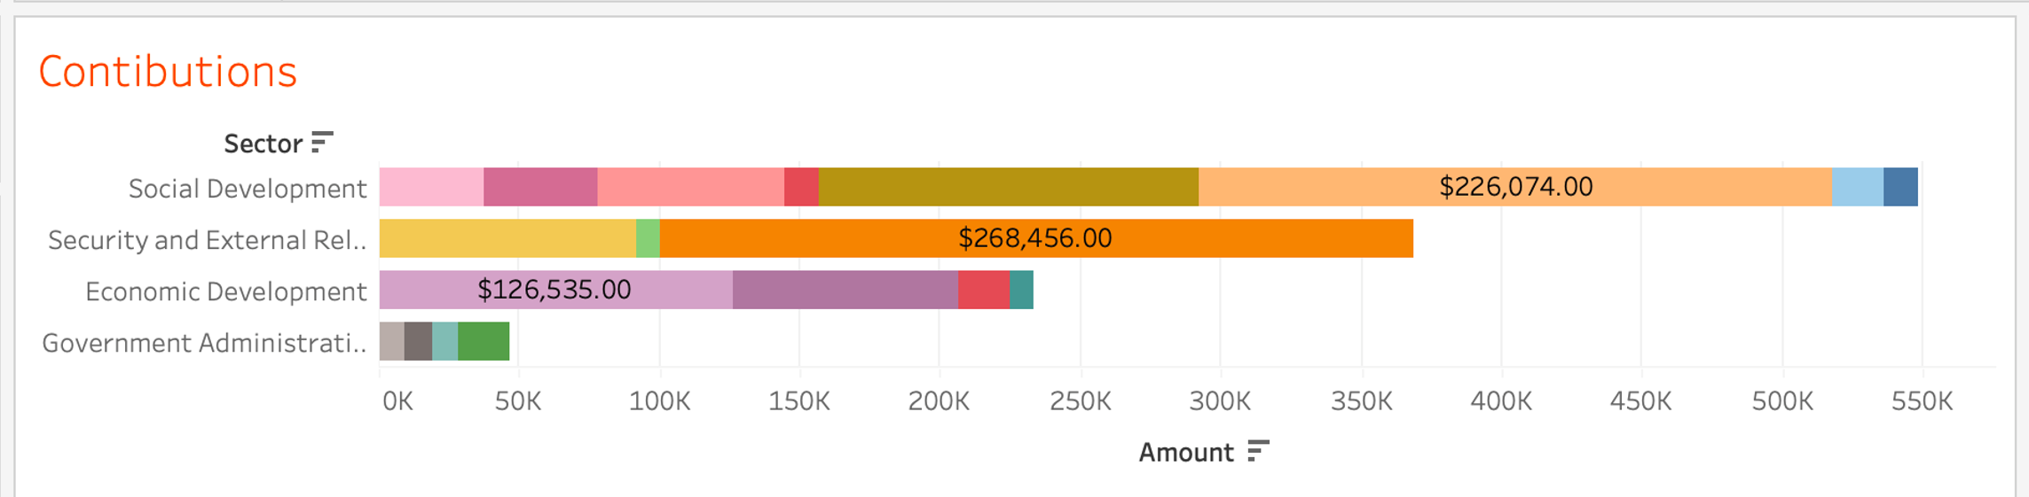
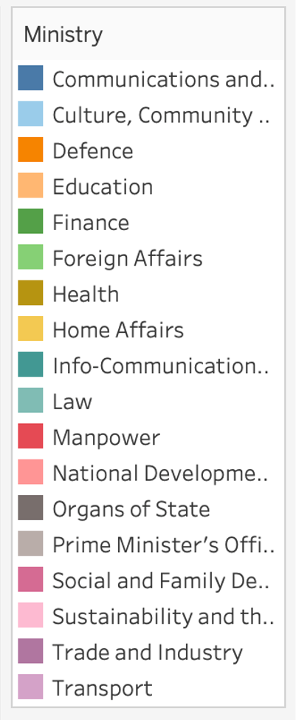
Sector wise contributions

Slide 7
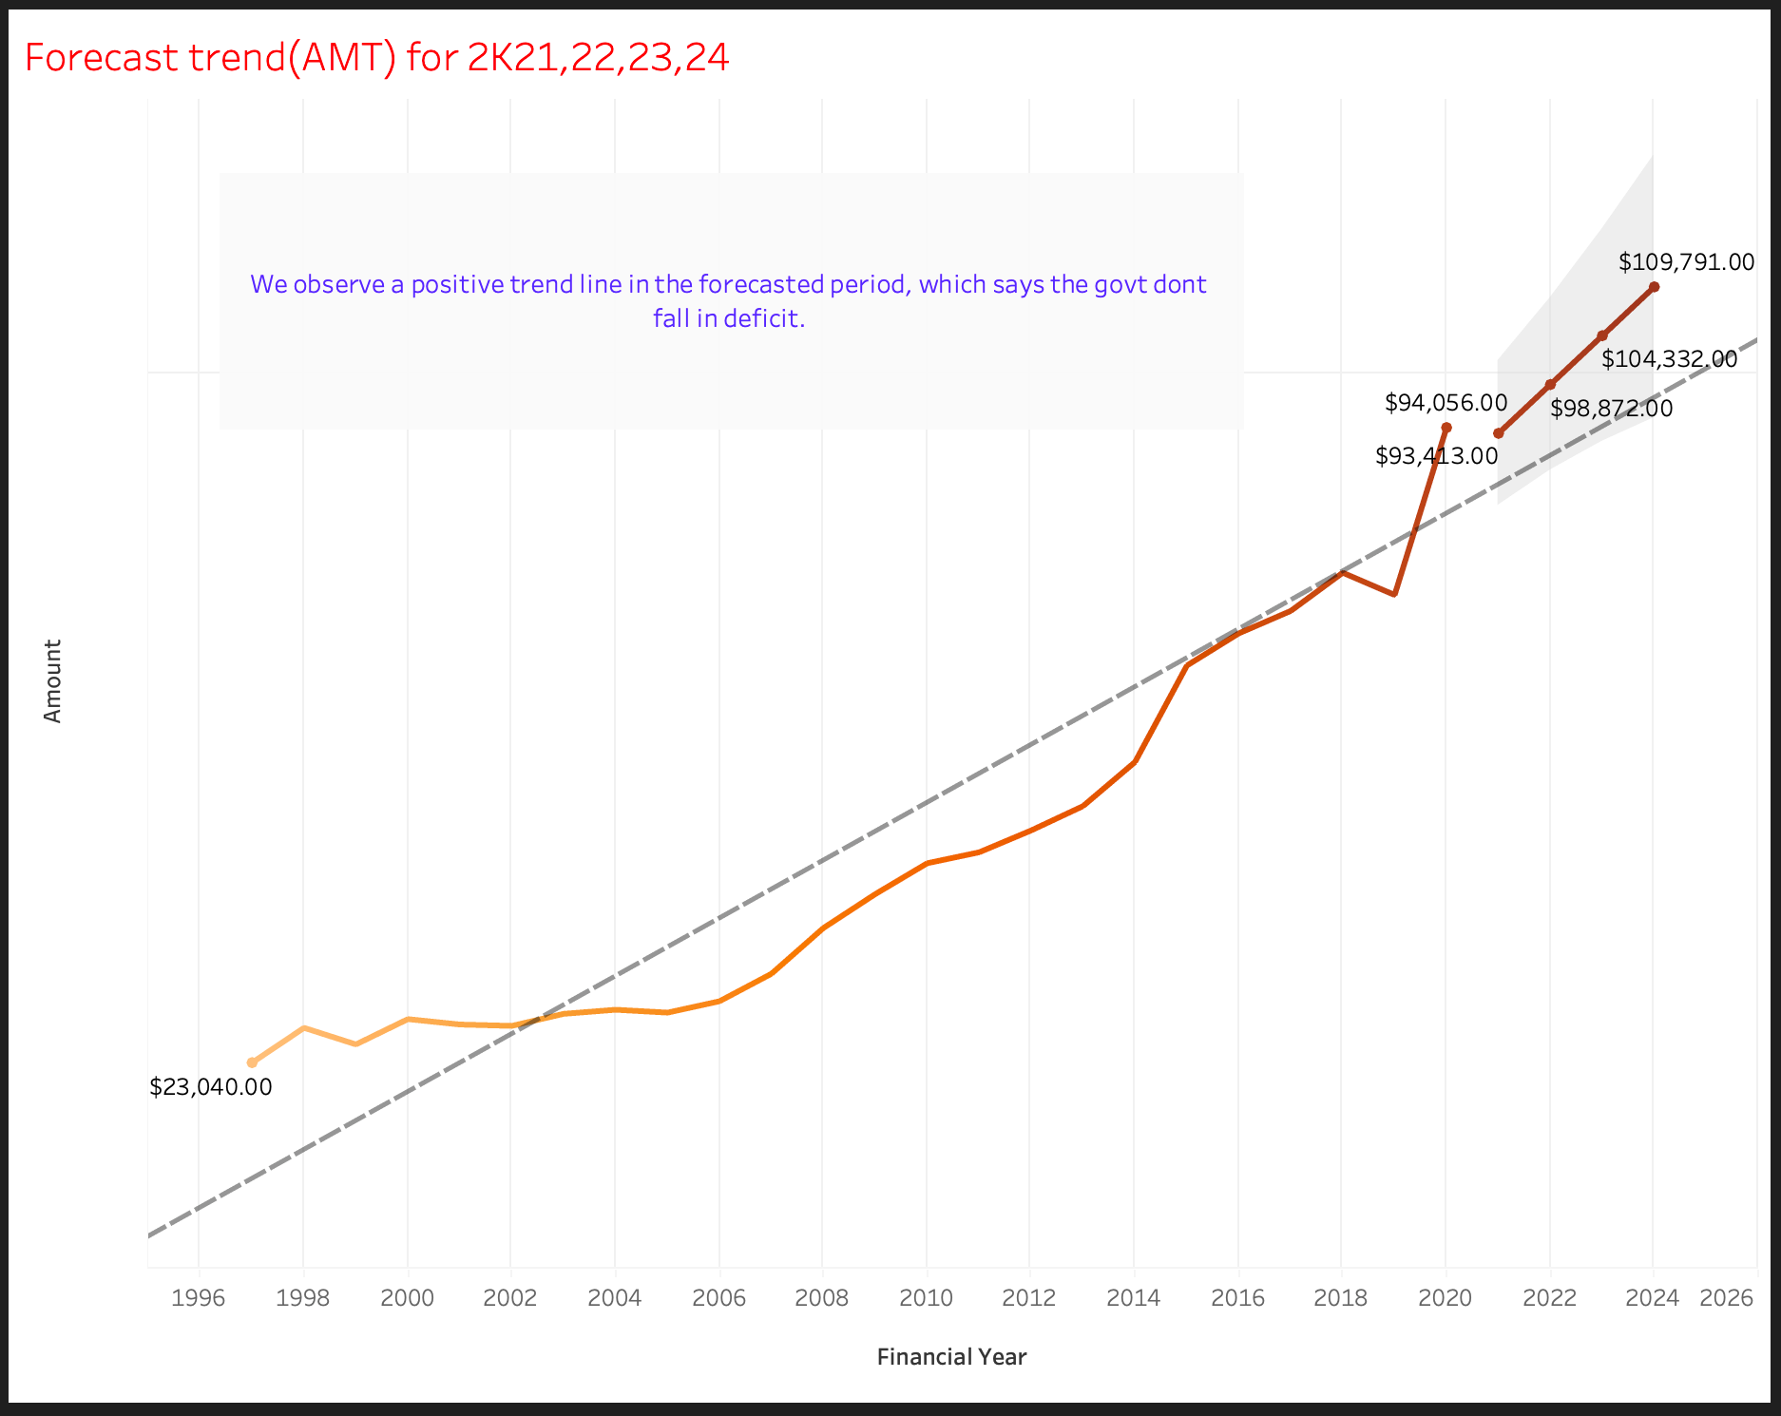
Forecast trend for the years 2021-24 in terms of amount

Slide 8
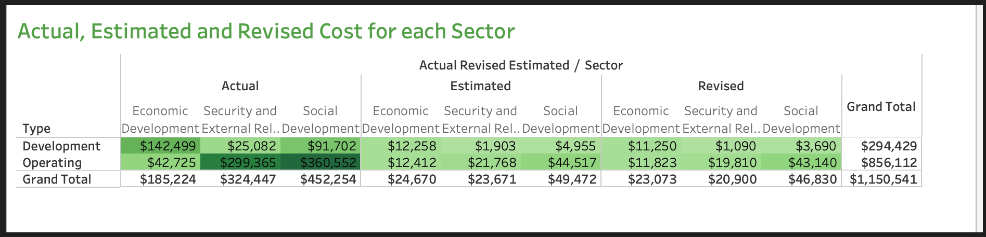
Sector wise expenditure

Slide 9
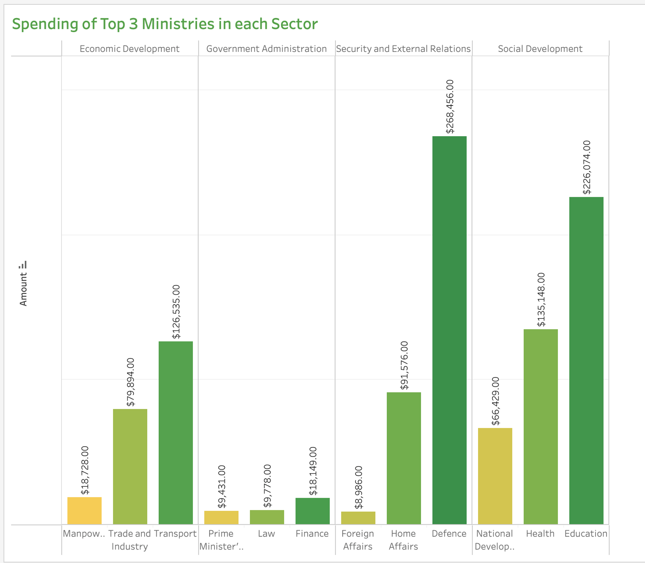
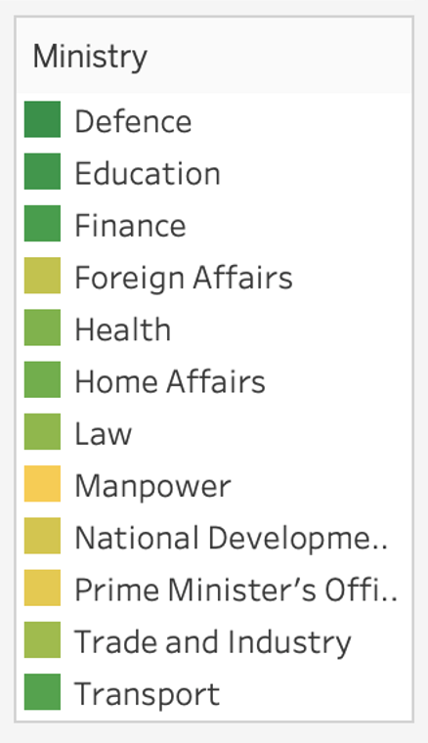
Ministries spending according sector

Slide 10
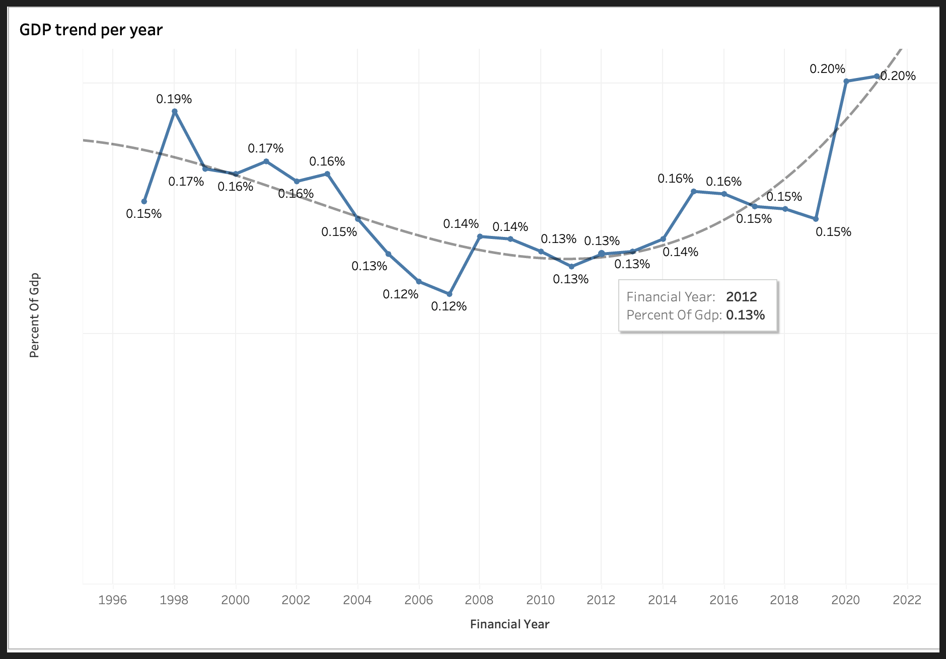
TREND OF GDP OVER THE YEARS

Slide 11
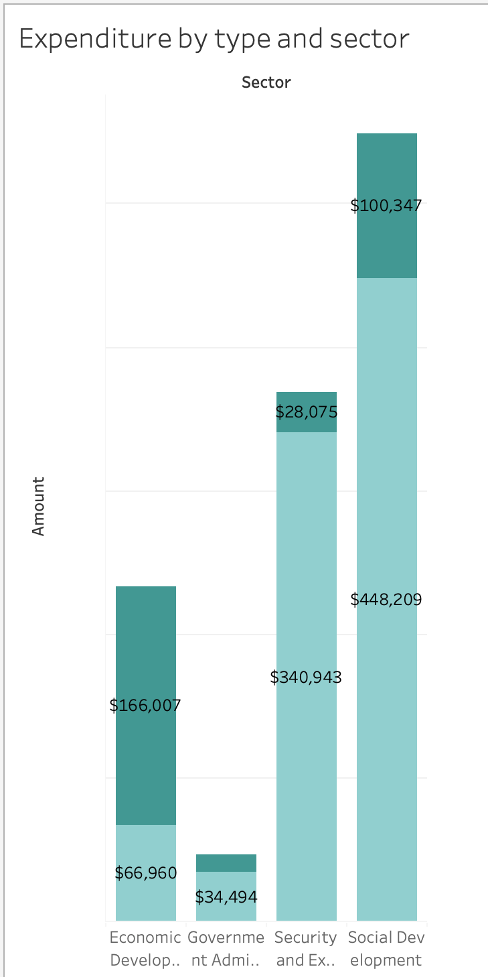
EXPENDITURE BY TYPE AND SECTOR

Slide 12
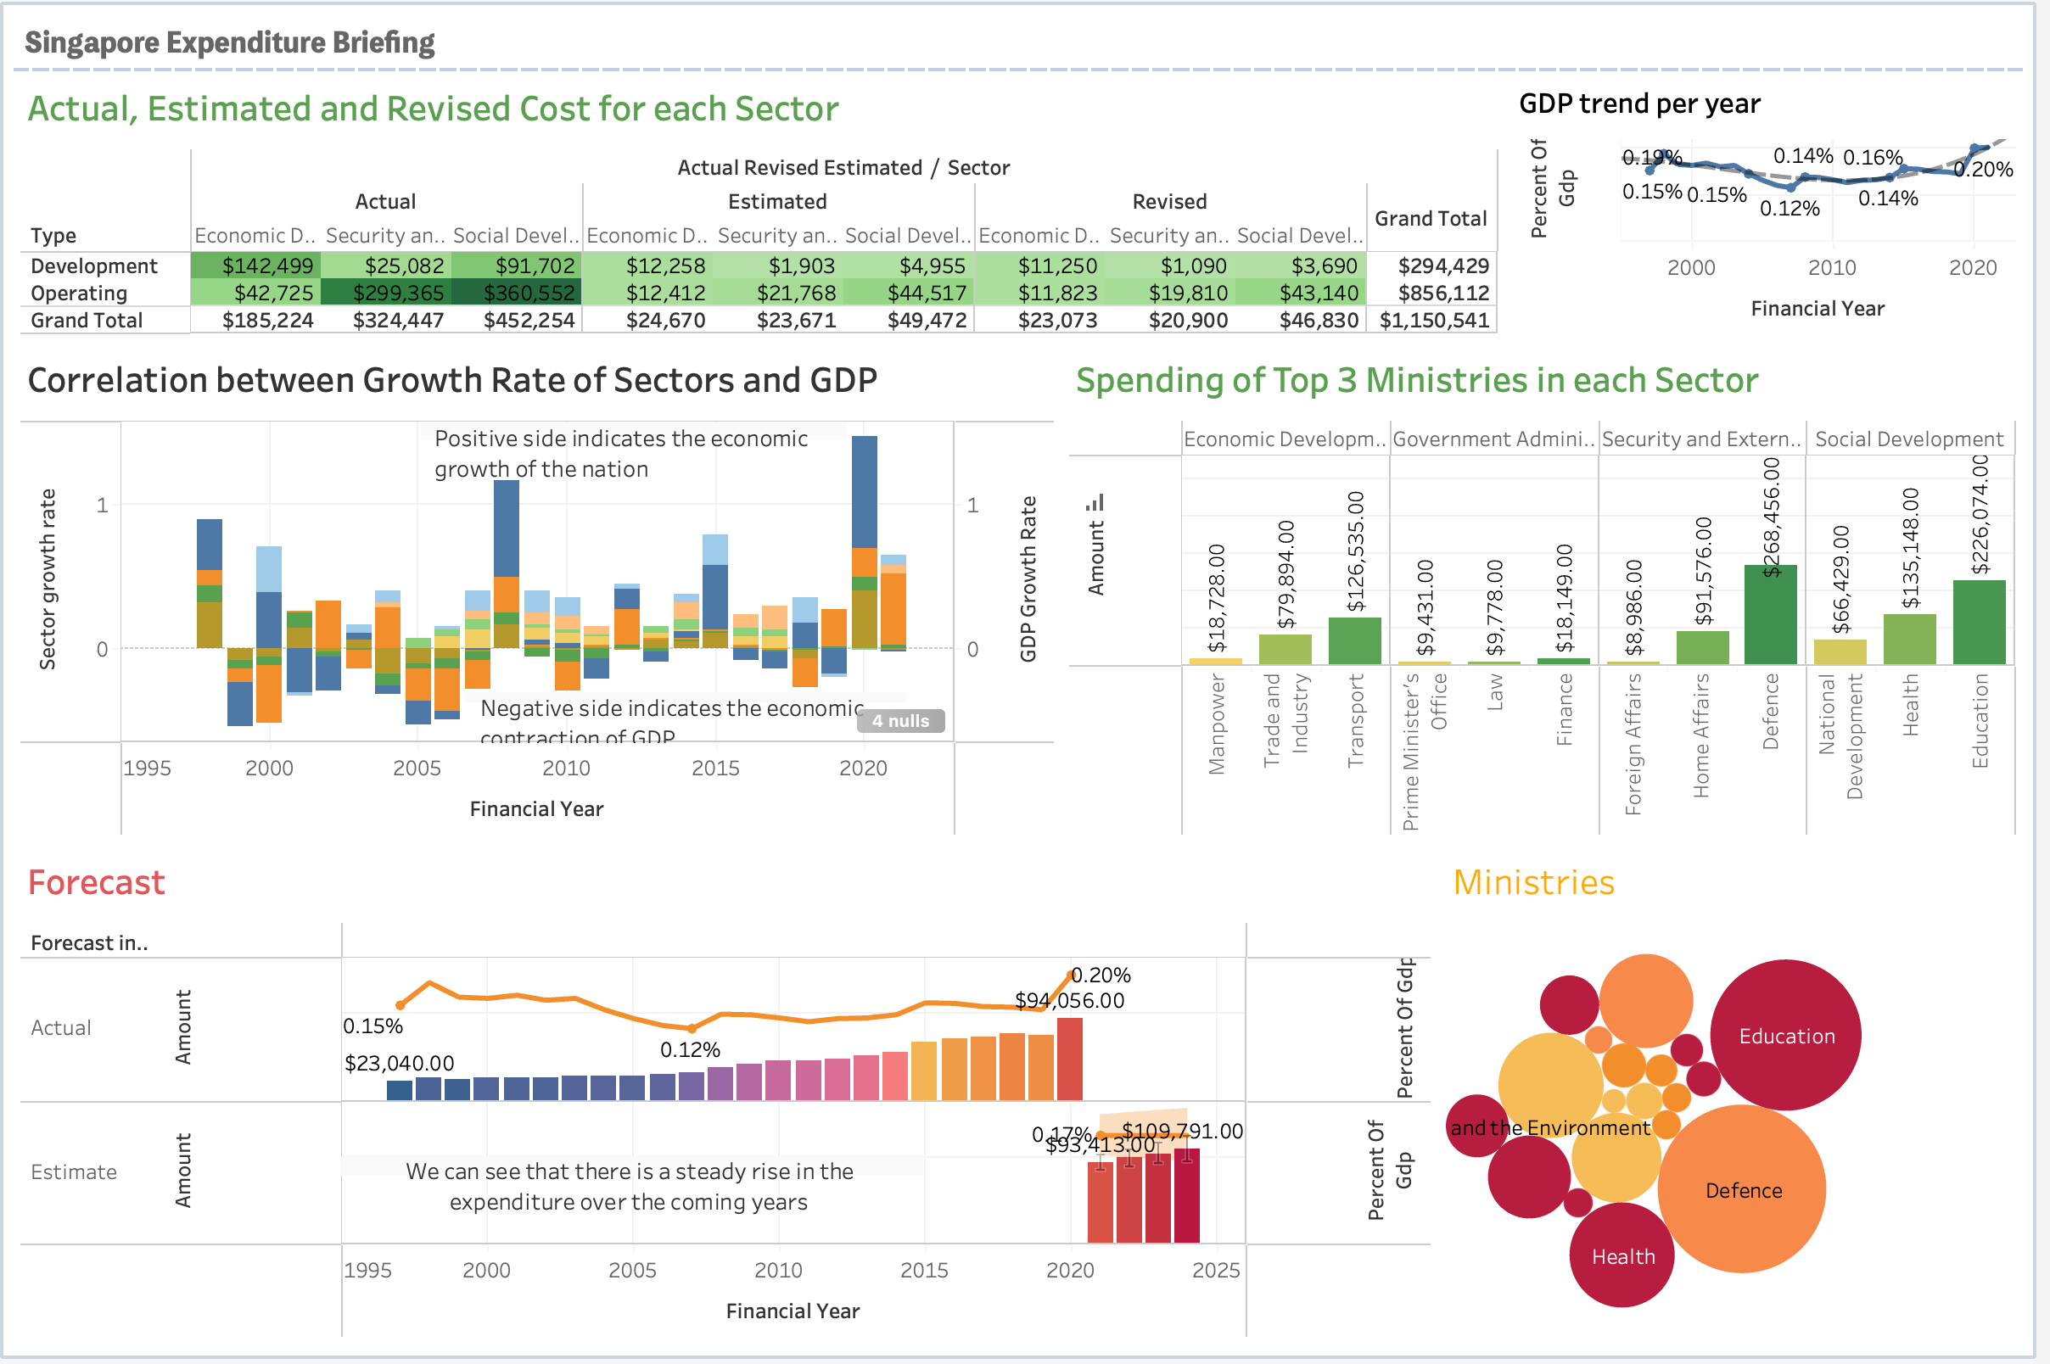
FINAL DASHBOARD

Slide 13
THANK YOU!

