Slide 1
Music School
IFB299- Group 63
Tae Lim Son, Christopher Yin, Minsu Kim, Soohyun Choi, Connor, Jordan

Slide 2

Group 63
Christopher Yin - ISStudent - Documentation, Testing
Tae Lim Son - CSStudent - Designing, Debugging, Coding
Minsu Kim - CSStudent - Coding, Database
Soohyun Choi - CSStudent - Coding Web, Database
Connor - CSStudent - Web hosting
Jordan – CSStudent – Assisting

Slide 3
Project introduce & summary
Manage the student’s scheduling easier
Owner can control teachers and students personal information
Promoting to potential student

Slide 4
Flowchart of Project
User Stories
Week 3
Release 1
Week 5
Release 2
Week 9
Current Product
Week 13
Designing
Week 4
Peer Review 1
Week 7
Peer Review 2
Week 11

Slide 5
Music School Architecture
PHP
HTML
JQuery
Database
Bootstrap
CSS
JavaScript
JSon

Slide 6
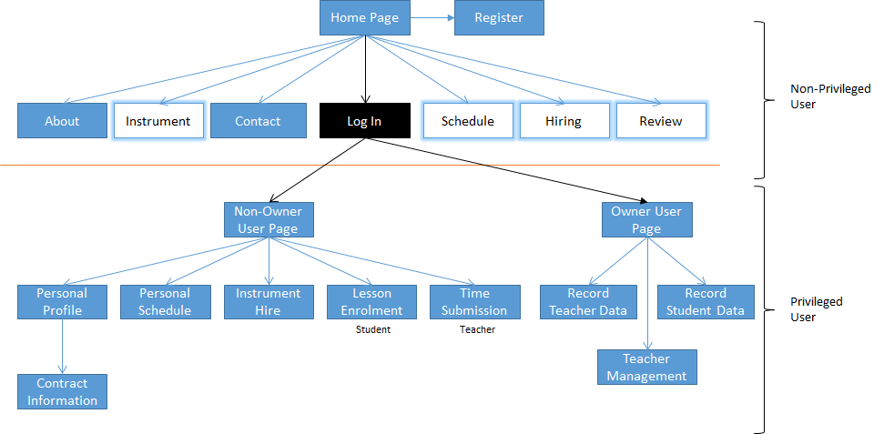
Web, Music School

Slide 7
Project Goals
Release 1
- Register
- Log in
- Personal Profile
- Privilege Control
- Contract

Slide 8
Project Goals
Release 2
- Time Submission
- Lesson Enrolment
- Owner’s Contact Detail
- Teacher management
- Record Student Data
- Record Teacher Data
- Hire Instrument
- Personal schedule

Slide 9
Project actual progress
User Stories
Design DB
Regi & Login
Teacher Pg
Student Pg
Owner Pg
Finalising
Presenting
W1
W2
W3
W4
W5
W6
W7
W8
W9
W10
W11
W12
Complete!

Slide 10
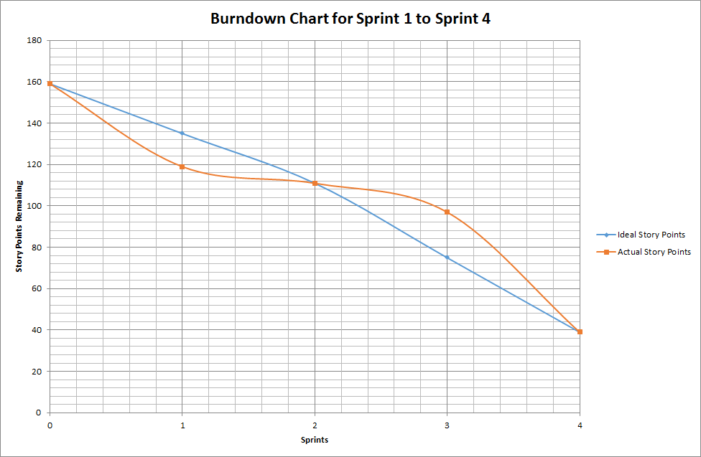
Project Burndown chart

Slide 11
Final Deliverables
Registry Page for Student and Teacher
Login for Owner, Student and Teacher
Owner Permission page
Contract page
Enrollment page
Owner Scheduling page
Based on Bootstrap UI
Web hosting
Email Server

Slide 12
Music School

Slide 13
Questions?

Slide 14
Thank you
- Group 63

