Slide 1

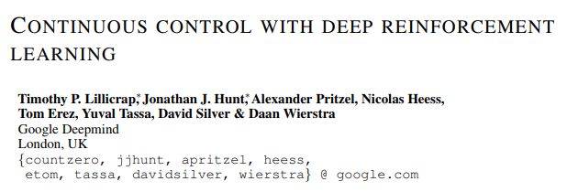
Deep Deterministic Policy Gradient (DDPG)
Timothy et al. (2016)
Copyright(C) 2022. Applied Probability Lab. All right reserved

Slide 2
What is DDPG?
DDPG = DPG + DQN
Deterministic
Continuous action space
Stable
Copyright(C) 2022. Applied Probability Lab. All right reserved

Slide 3
Background of DPG
Main reason : To compensate for the shortcomings of the DQN algorithm
DQN can solves problems with high-dimensional observation spaces. But, it can only handle discrete and low-dimensional action spaces.
In real world, the most of problem are have continuous (real valued) and high dimensional action spaces.
DQN shows that powerful performance, but it is hard to applied in real world problem
Make the new algorithm deterministic & continuous action space
DPG Algorithm (Silver et al., 2014)
Copyright(C) 2022. Applied Probability Lab. All right reserved

Slide 4
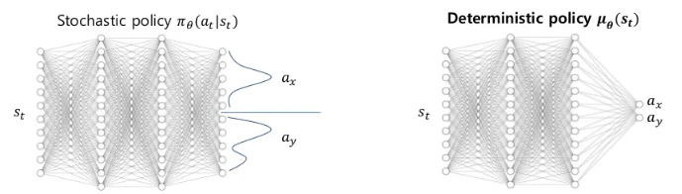
Background of DPG
Copyright(C) 2022. Applied Probability Lab. All right reserved

Slide 5
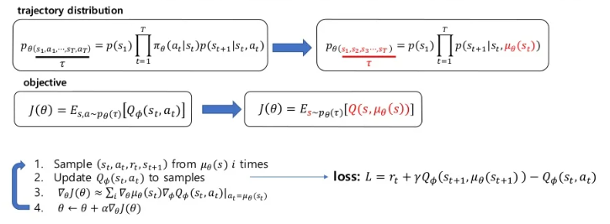
Background of DPG
Copyright(C) 2022. Applied Probability Lab. All right reserved

Slide 6
DDPG Algorithm
DQN
DPG
Replay buffer
Target network
High dimensional observation space
Continuous action space
DDPG
Off policy (replay buffer)
Stable update (target network)
High dimensional observation space
Real world problem (Continuous action space)
Copyright(C) 2022. Applied Probability Lab. All right reserved

Slide 7
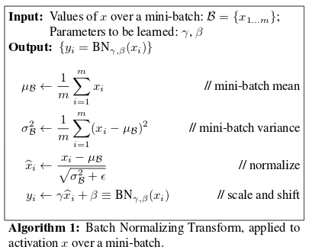

DDPG Algorithm
1. Ornstein-Uhlenback (ou-noise)
3. Batch Normalization
Add noise for exploration
2. Soft update
Slowing the network being trained to follow the target network
It makes training to stable
If learning is carried out with the observed low-dimensional feature vector, the network suffers from learning difficulties due to the difference in the scale of the features.
Put the samples in one minibatch and normalize for all dimensions.
Copyright(C) 2022. Applied Probability Lab. All right reserved

Slide 8
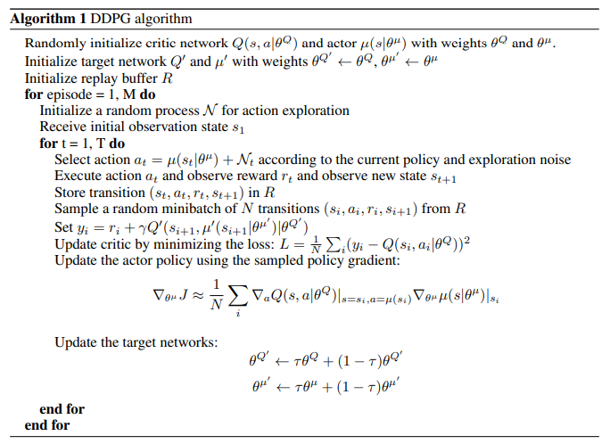
DDPG Algorithm
Initialize components
Ou-noise
Transition
Store the transition & sampling the minibatch from replay buffer
DDPG's target value : Calculate target value through target critic network
(input : next state & actor networks' output(action))
actor network update: update the actor's policy using the policy gradient algorithm
critic-network updates the network parameters (weights), while actor-net updates the actor's policy
Soft update
Copyright(C) 2022. Applied Probability Lab. All right reserved

Slide 9
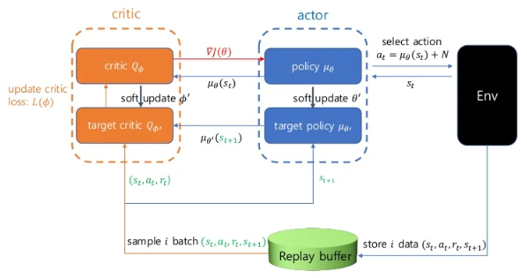
DDPG Algorithm
Copyright(C) 2022. Applied Probability Lab. All right reserved

Slide 10
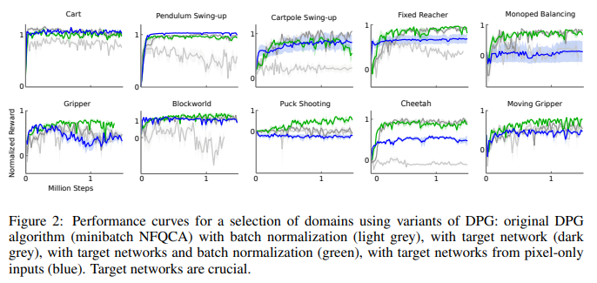
DDPG Algorithm
Copyright(C) 2022. Applied Probability Lab. All right reserved

