Slide 1
셰이더프로그래밍
Lecture 11
이택희

Slide 2
개요지난시간
Framebuffer (프레임 버퍼)
Vertex Shader
Primitive Assembly
Rasterization and Interpolation
Fragment Shader
Frame Buffer

Slide 3
개요
Particle Animation with Bloom
HDR Frame Buffer Object

Slide 4
Bloom

Slide 5
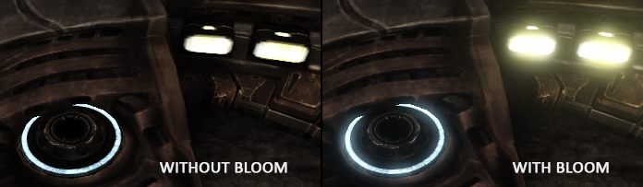
Bloom
빛샘효과
강한 빛은 실제로 빛이 발생하고 있는 영역 보다 넓은 영역을 차지함

Slide 6
Bloom
파티클과 같이 빛을 발생시키는 오브젝트의 경우 Bloom 효과가 필수적

Slide 7
Bloom
Bloom 효과는 아래와 같은 단계로 이루어 짐
Color 의 세기를 HDR Texture에 출력
HDR Texture를 Blur 시켜 빛이 퍼지는 영역 계산
원래 영상과 합성하여 최종 렌더링

Slide 8
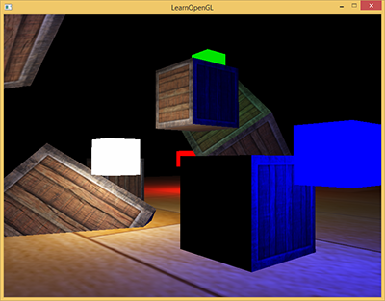
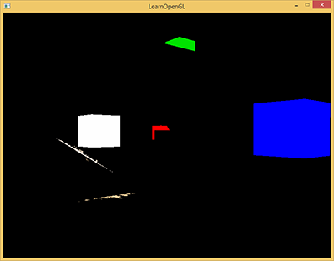
Bloom
Color 의 세기를 HDR Texture에 Rendering

Slide 9
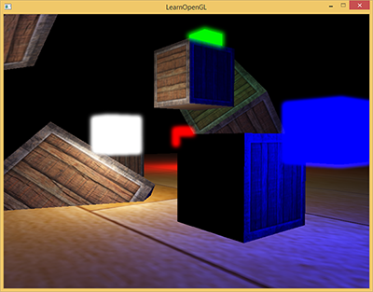
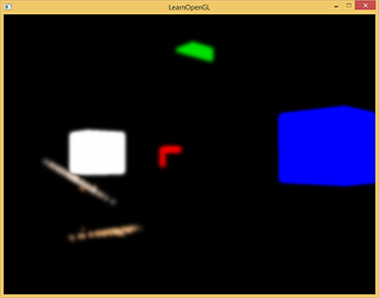
Bloom
Color의 세기가 1보다 큰 부분 Blur 시킨 후 원본 이미지와 합성

Slide 10
Bloom (구현)
Emissive Color 를 HDR texture 에 출력
Color < 1.0
Fragment Shader
Color > 1.0
Color 가 1.0 보다 클 경우 emissive color 로 취급함

Slide 11
Bloom (구현)
Fragment Shader
FBO 에 Emissive Color 값을 활용하여 Blur 시킴
여기에 원래 값을 더하여 출력
출력
Blur

Slide 12
실습

Slide 13
FBO 관련 코드
GLuint Renderer::CreateFBO(int sx, int sy, GLuint *tex, GLuint *depthTex)
{
//Gen render target
GLuint tempTex = 0;
glGenTextures(1, &tempTex);
glBindTexture(GL_TEXTURE_2D, tempTex);
glTexParameterf(GL_TEXTURE_2D, GL_TEXTURE_MAG_FILTER, GL_LINEAR);
glTexParameterf(GL_TEXTURE_2D, GL_TEXTURE_MIN_FILTER, GL_LINEAR);
glTexParameterf(GL_TEXTURE_2D, GL_TEXTURE_WRAP_S, GL_CLAMP_TO_EDGE);
glTexParameterf(GL_TEXTURE_2D, GL_TEXTURE_WRAP_T, GL_CLAMP_TO_EDGE);
glTexImage2D(GL_TEXTURE_2D, 0, GL_RGBA8, sx, sy, 0, GL_RGBA, GL_UNSIGNED_BYTE, 0);
*tex = tempTex;
//Gen depth texture
GLuint tempDepthTex = 0;
glGenTextures(1, &tempDepthTex);
glBindTexture(GL_TEXTURE_2D, tempDepthTex);
glTexParameterf(GL_TEXTURE_2D, GL_TEXTURE_MAG_FILTER, GL_NEAREST);
glTexParameterf(GL_TEXTURE_2D, GL_TEXTURE_MIN_FILTER, GL_NEAREST);
glTexParameterf(GL_TEXTURE_2D, GL_TEXTURE_WRAP_S, GL_CLAMP_TO_EDGE);
glTexParameterf(GL_TEXTURE_2D, GL_TEXTURE_WRAP_T, GL_CLAMP_TO_EDGE);
glTexImage2D(GL_TEXTURE_2D, 0, GL_DEPTH_COMPONENT24, sx, sy, 0, GL_DEPTH_COMPONENT, GL_FLOAT, 0);
*depthTex = tempDepthTex;
GLuint tempFBO;
glGenFramebuffers(1, &tempFBO);
glBindFramebuffer(GL_FRAMEBUFFER, tempFBO);
glFramebufferTexture(GL_FRAMEBUFFER, GL_COLOR_ATTACHMENT0, tempTex, 0);
glFramebufferTexture(GL_FRAMEBUFFER, GL_DEPTH_ATTACHMENT, tempDepthTex, 0);
GLenum status = glCheckFramebufferStatus(GL_FRAMEBUFFER);
if (status != GL_FRAMEBUFFER_COMPLETE)
{
std::cout << "Error while attach fbo. \n";
return 0;
}
glBindFramebuffer(GL_FRAMEBUFFER, 0);
return tempFBO;
}
GLuint Renderer::CreateHDRFBO(int sx, int sy, GLuint *tex, GLuint *depthTex)
{
//Gen render target
GLuint tempTex = 0;
glGenTextures(1, &tempTex);
glBindTexture(GL_TEXTURE_2D, tempTex);
glTexParameterf(GL_TEXTURE_2D, GL_TEXTURE_MAG_FILTER, GL_LINEAR);
glTexParameterf(GL_TEXTURE_2D, GL_TEXTURE_MIN_FILTER, GL_LINEAR);
glTexParameterf(GL_TEXTURE_2D, GL_TEXTURE_WRAP_S, GL_CLAMP_TO_EDGE);
glTexParameterf(GL_TEXTURE_2D, GL_TEXTURE_WRAP_T, GL_CLAMP_TO_EDGE);
glTexImage2D(GL_TEXTURE_2D, 0, GL_RGBA32F, sx, sy, 0, GL_RGBA, GL_FLOAT, 0);
*tex = tempTex;
//Gen depth texture
GLuint tempDepthTex = 0;
glGenTextures(1, &tempDepthTex);
glBindTexture(GL_TEXTURE_2D, tempDepthTex);
glTexParameterf(GL_TEXTURE_2D, GL_TEXTURE_MAG_FILTER, GL_NEAREST);
glTexParameterf(GL_TEXTURE_2D, GL_TEXTURE_MIN_FILTER, GL_NEAREST);
glTexParameterf(GL_TEXTURE_2D, GL_TEXTURE_WRAP_S, GL_CLAMP_TO_EDGE);
glTexParameterf(GL_TEXTURE_2D, GL_TEXTURE_WRAP_T, GL_CLAMP_TO_EDGE);
glTexImage2D(GL_TEXTURE_2D, 0, GL_DEPTH_COMPONENT24, sx, sy, 0, GL_DEPTH_COMPONENT, GL_FLOAT, 0);
*depthTex = tempDepthTex;
GLuint tempFBO;
glGenFramebuffers(1, &tempFBO);
glBindFramebuffer(GL_FRAMEBUFFER, tempFBO);
glFramebufferTexture(GL_FRAMEBUFFER, GL_COLOR_ATTACHMENT0, tempTex, 0);
glFramebufferTexture(GL_FRAMEBUFFER, GL_DEPTH_ATTACHMENT, tempDepthTex, 0);
GLenum status = glCheckFramebufferStatus(GL_FRAMEBUFFER);
if (status != GL_FRAMEBUFFER_COMPLETE)
{
std::cout << "Error while attach fbo. \n";
return 0;
}
glBindFramebuffer(GL_FRAMEBUFFER, 0);
return tempFBO;
}

Slide 14
Bloom shaders (vs)
#version 450
uniform vec2 u_Pos;
uniform vec2 u_Size;
in vec3 a_Position;
in vec2 a_Tex;
out vec2 v_Tex;
void main()
{
vec3 newPos = vec3(a_Position.xy * u_Size.xy + u_Pos.xy, 0);
gl_Position = vec4(newPos.xyz, 1);
v_Tex = a_Tex;
}

Slide 15
Bloom shaders (fs)
#version 450
layout(location=0) out vec4 FragColor;
uniform sampler2D u_Texture;
uniform vec2 u_TexOffset = vec2(1.0/1024.0, 1.0/1024.0);
uniform int u_BlurSize = 50;
in vec2 v_Tex;
const float pi = 3.14159265;
void main()
{
float numBlurPixelsPerSide = float(u_BlurSize / 2.0);
vec4 avgValue = vec4(0.0, 0.0, 0.0, 0.0);
float count = 0.0;
vec2 hori = vec2(1.0, 0.0);
vec2 vert = vec2(0.0, 1.0);
float maxDis = length(numBlurPixelsPerSide * hori * u_TexOffset);
for (float x = -numBlurPixelsPerSide; x <= numBlurPixelsPerSide; x+=1.0)
{
for(float y = -numBlurPixelsPerSide; y <= numBlurPixelsPerSide; y+=1.0)
{
vec2 newTex = v_Tex + x * hori * u_TexOffset + y * vert * u_TexOffset;
vec2 diff = x * hori * u_TexOffset + y * vert * u_TexOffset;
float distance = length(diff);
avgValue += clamp(texture2D(u_Texture, newTex)-vec4(1.0), 0, 100)*(clamp((maxDis-distance)/maxDis, 0.0, 1.0));
count += 1.0;
}
}
count /= 5;
FragColor = clamp(avgValue/count + texture2D(u_Texture, v_Tex), 0, 1);
}

