Slide 1
An End-to-End Trainable Neural Network for Image-based Sequence Recognition and Its Application to Scene Text Recognition
(in short, “CRNN”)
Baoguang Shi, Xiang Bai, & Cong Yao (2015)
Presenter: Yeachan Choi
Date: May 28, 2021
Notes:
이미지 기반의 시퀀스 인식을 위한 종단간 훈련가능한 신경망과 STR에 대한 적용
*STR: 이미지(scene) 내 존재하는 글자(text)를 인식하는 과제

Slide 2
Table of Contents
Overview
Main Idea
Implementation
Results
Reference
Notes:
Conditions: Overview, Core technology, Implementation and Results (> 10 slides)

Slide 3
Overview
Context: Image-based sequence recognition, STR
Topic: CRNN (CNN + RNN + CTC)
Features:
E2E trainable
Conv Frs & CharGT-Free
Unconstrained
Model Size
Experiments: IC03, IC13, IIIT5k, SVT (+𝛂: OMR)
Introduction
The Proposed Network Architecture
Feature Sequence Extraction
Sequence Labeling
Transcription
Probability of label sequence
Lexicon-free transcription
Lexicon-based transcription
Network Training
Experiments
Datasets
Implementation Details
Comparative Evaluation
Musical Score Recognition
Conclusion

Slide 4
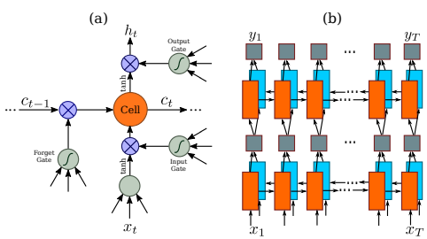
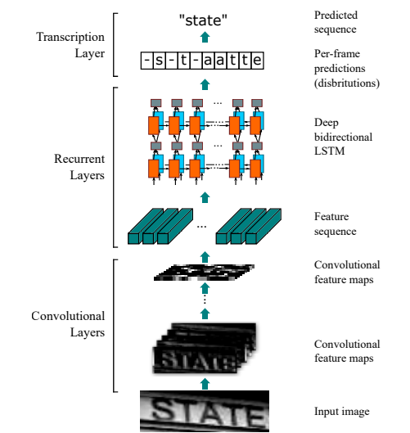
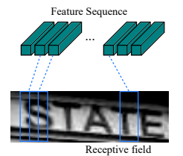
Main Idea
The core ideas behind this paper are:
CNN + RNN architecture
CTC layer
⇒ feature extraction (CNN) + sequence modeling (RNN) + transcription (CTC)

Slide 5
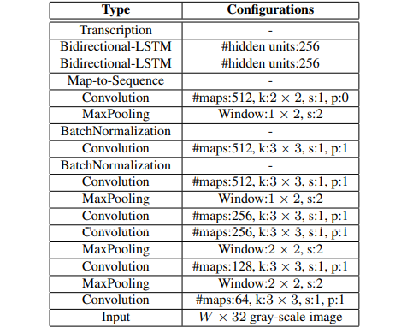
CNN + RNN Architecture
RNN
CNN:
VggNet
with some
minor
adjustment

Slide 6
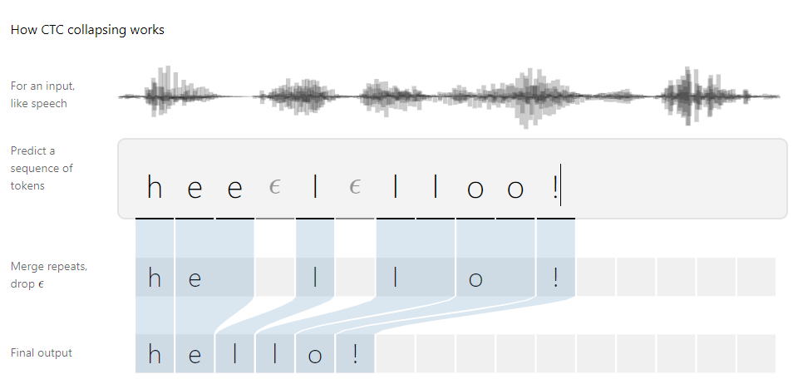

CTC
Encoding
Loss function
Decoding
“blank”

Slide 7

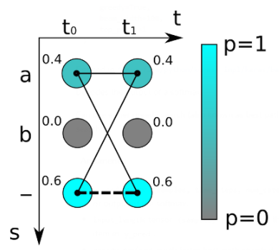

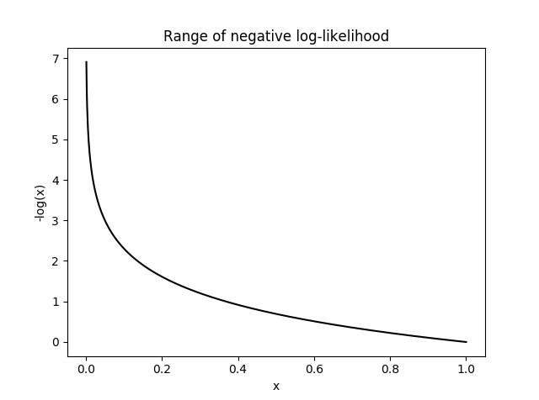
CTC
Negative log-likelihood of the following conditional probability
Example
Encoding
Loss function
Decoding
“a” score = 0.4·0.4 + 0.4·0.6 + 0.6·0.4 = 0.64
“-” score = 0.6·0.6 = 0.36
Notes:
사실 CTC loss도 여느 기계 학습 방법과 같이 조건부 확률의 음의 로그값 (negative log likelihood)이다.
CTC alignment를 통해 이미지 X가 주어졌을 때 글자 Y가 나타날 조건부 확률을 계산하는 방법은 다음과 같습니다.
여기서 map(Y)는 글자 Y를 모델의 step-size T만큼으로 표현할 때 가능한 모든 alignment의 집합이며, l t는 L의 t 번째 글자이다. L이 map(Y) 가 되려면 다음 변환을 거쳤을 때 L이 Y가 되면 된다. (1) 인접한 똑같은 글자는 하나로 합친다. (2) blank 토큰을 지운다.
map(Y)는 hello를 완성시킬 수 있는 패스(path)들의 집합이며, 각 패스에 대해 확률을 더한 것이 ‘hello’가 될 조건부 확률이다.

Slide 8
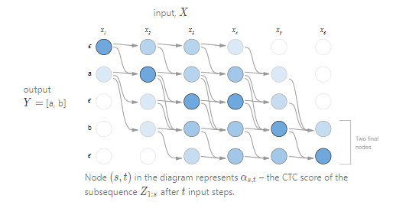
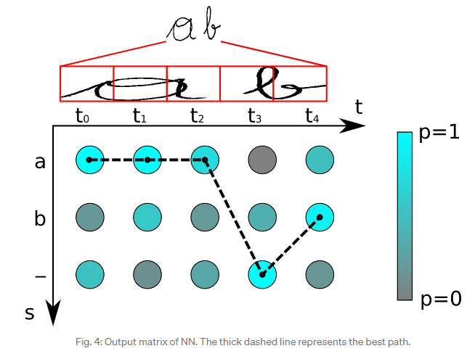
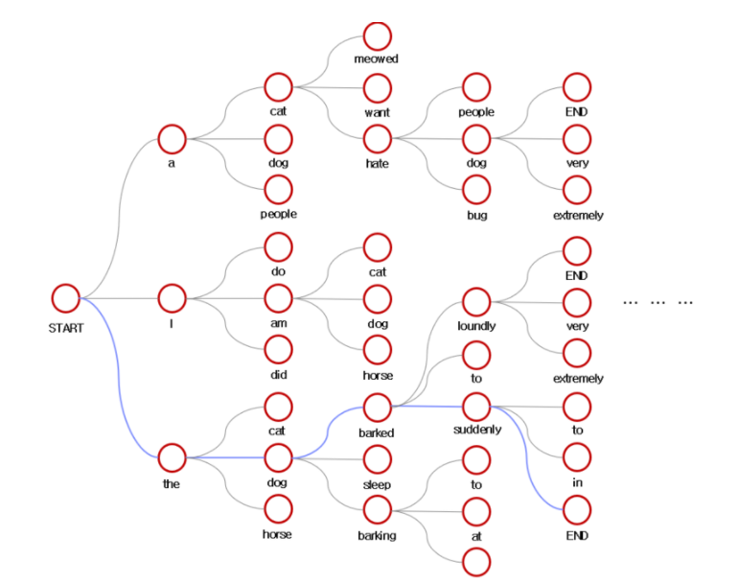
CTC
Encoding
Loss function
Decoding
Best Path Decoding
Beam Search Decoding

Slide 9
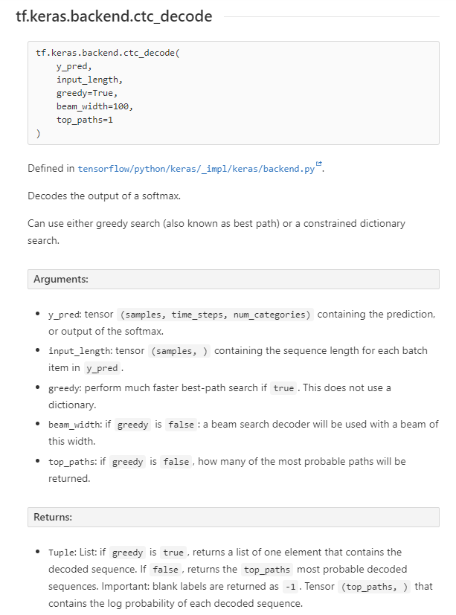
CTC

Slide 10
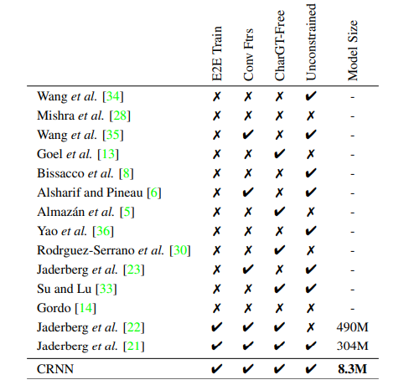
Properties
E2E trainable
Conv Frs & CharGT-Free
Unconstrained
Model Size

Slide 11
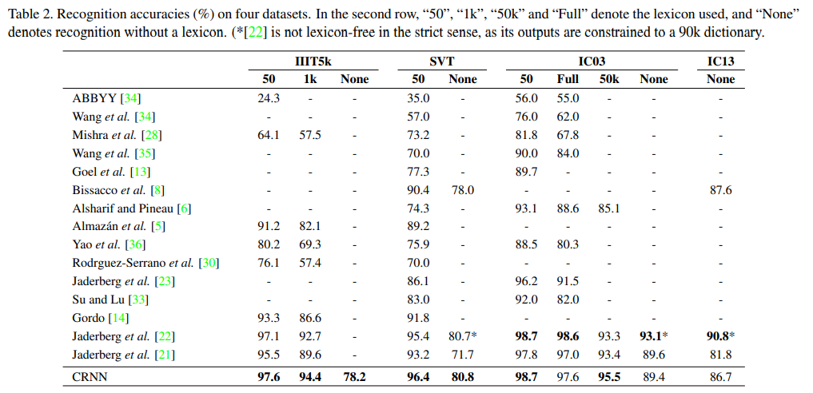
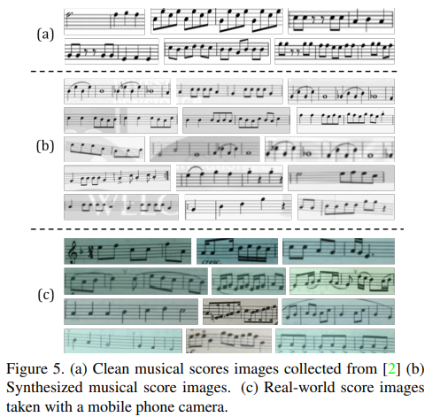
Experiments

Slide 12
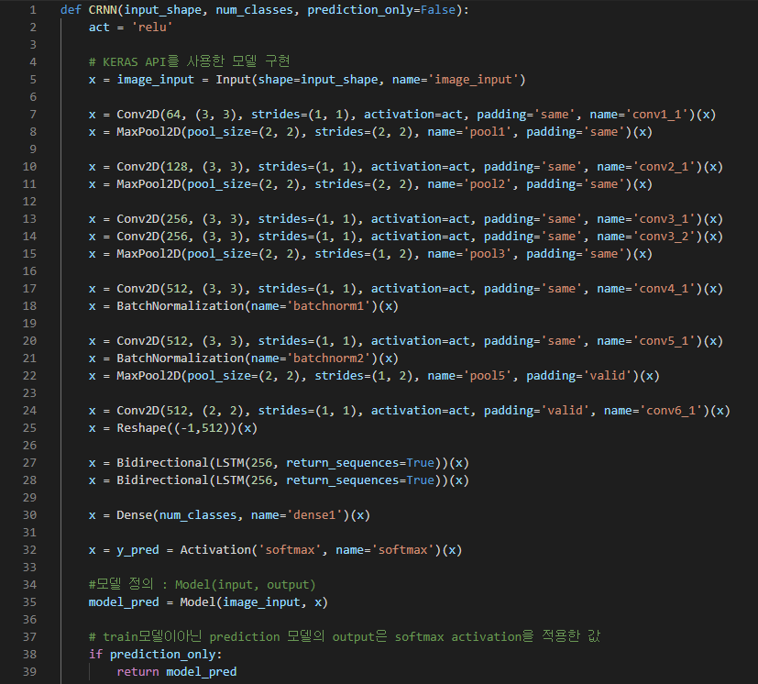
Implementation
CNN
RNN

Slide 13
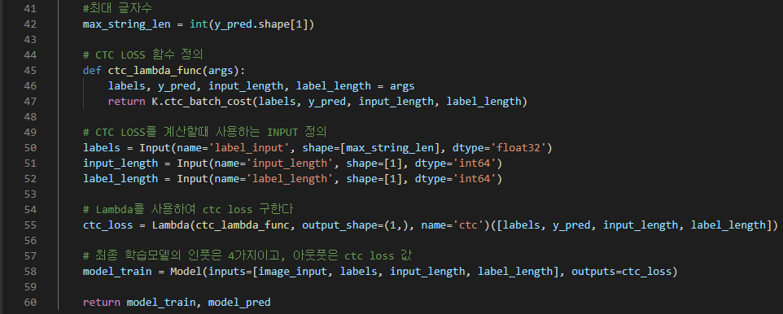
Implementation

Slide 14
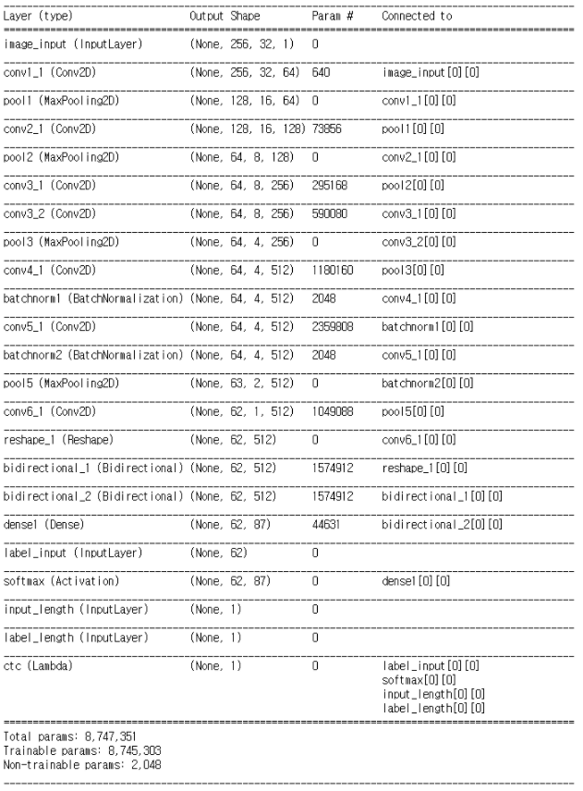
Model summary
CNN
Batch size: 16
Train : Validation = 9 : 1
Epochs: 100
Early Stopping: 10 (patience)
RNN
86 classes +
1 blank
Transcription

Slide 15
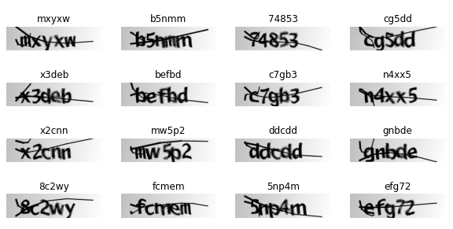
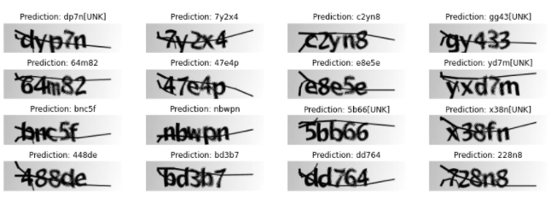
Results
Test result
Training Dataset

Slide 16
Reference
Main paper
An End-to-End Trainable Neural Network for Image-based Sequence Recognition and Its Application to Scene Text Recognition | Papers With Code
CTC
Sequence Modeling with CTC (distill.pub)
An Intuitive Explanation of Connectionist Temporal Classification | by Harald Scheidl | Towards Data Science
PyTorch CRNN: Seq2Seq Digits Recognition w/ CTC | coding.vision (codingvision.net)
Sequence Modeling with CTC (distill.pub)
tf.keras.backend.ctc_decode - TensorFlow Python - W3cubDocs
카카오 OCR 시스템 구성과 모델 (brunch.co.kr)
Notes:
Extra
BK-tree search (BK-Tree | Introduction & Implementation - GeeksforGeeks) Beam search ([Sooftware 머신러닝] Beam Search (빔서치) : 네이버 블로그 (naver.com))

