Slide 1
기본 프로그래밍 02(A1)
자바에 삼 주만 빠져보자!
데이터융합SW과
김규석 교수
JAVA

Slide 2
A1, A2
Multiplication Table III
Use an “if” statement
Use a double “for” loop
Print 2 to 9 times table
Multiplication Table IV
Use an “switch” statement
Use a double “while” loop
Print 2 to 9 times table

Slide 3
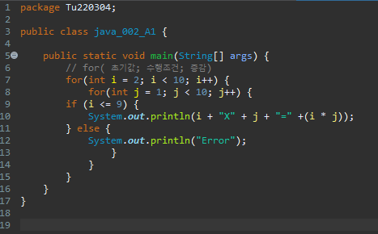

Slide 4
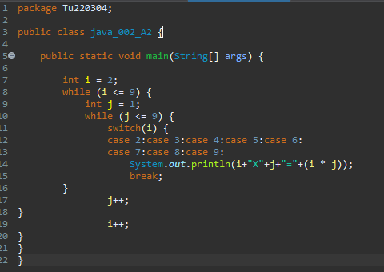

Slide 5
A3
Draw a Right Triangle
User inputs a number, N
Print an N height of the right triangle with “*”
Use a “for” loop
5
*
**
***
****
*****

Slide 6
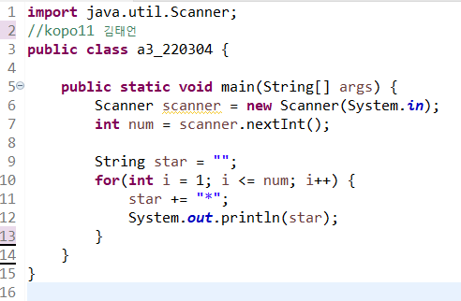
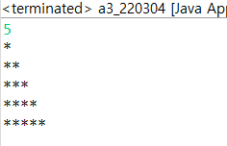

Slide 7
A4
Draw an Equilateral Triangle
User inputs a number, N
Print an N height of the equilateral triangle with “*”
Use a “for” loop
5
*
***
*****
*******
*********

Slide 8
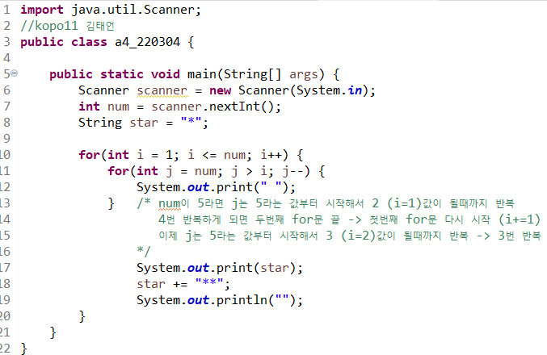
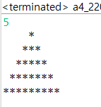

Slide 9
A5
Draw an Inverted Equilateral Triangle
User inputs a number, N
Print an N height of the inverted equilateral triangle with “*”
Use a “for” or “while” loop
5
*********
*******
*****
***
*

Slide 10
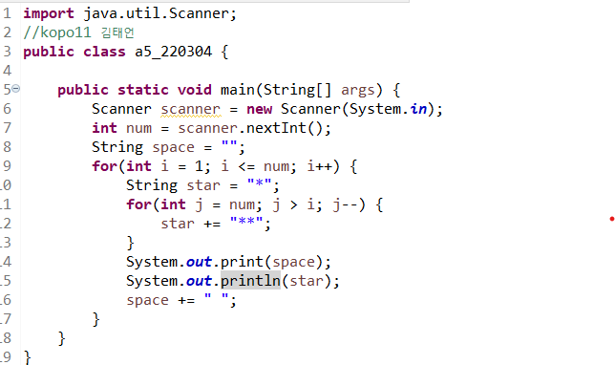
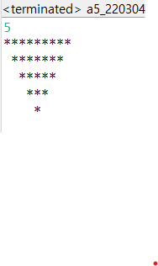

Slide 11
A6
Find the Factors of N
User inputs a number, N
Print the factors of N
10
1
2
5

Slide 12
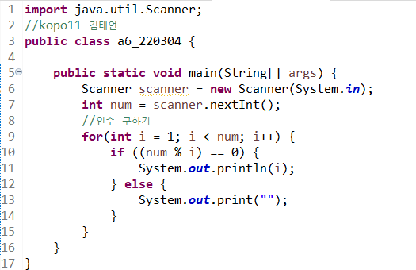
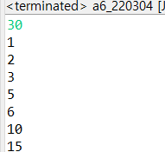

Slide 13
A7
Find the LCM(Least Common Multiple)
User inputs the two numbers, N and M
Print the LCM
5
7
35

Slide 14
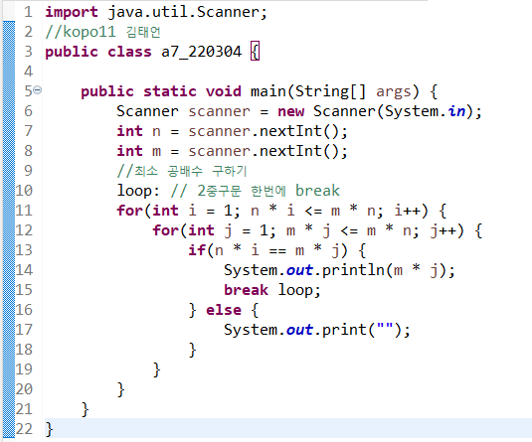
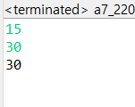
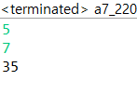

Slide 15
A8
Find the GCD(Greatest Common Divisor)
User inputs the two numbers, N and M
Print the GCD
24
18
6

Slide 16
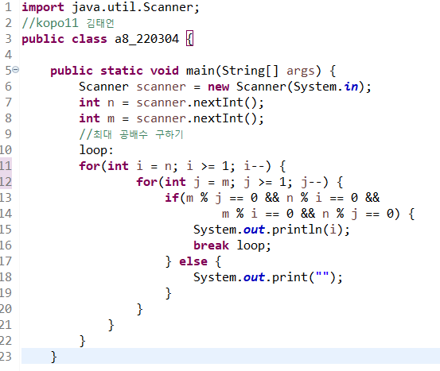
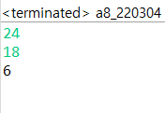
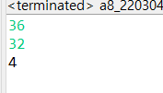

Slide 17
A9
Find the Prime Numbers
User inputs a numbers, N
Print the prime number to N
11
2
3
5
7
11

Slide 18
