Slide 1
기본 프로그래밍 03(A1)
자바에 삼 주만 빠져보자!
데이터융합SW과
김규석 교수
JAVA

Slide 2
A1
Descriptive Statistics Calculation
User inputs a number
Prints the number of numbers, mean, maximum, minimum
This is performed indefinitely
5
Result : 1 - Mean 5, Max 5, Min 5
3
Result : 2 – Mean 4, Max 5, Min 3
1
Result : 3 – Mean 3, Max 5, Min 1

Slide 3
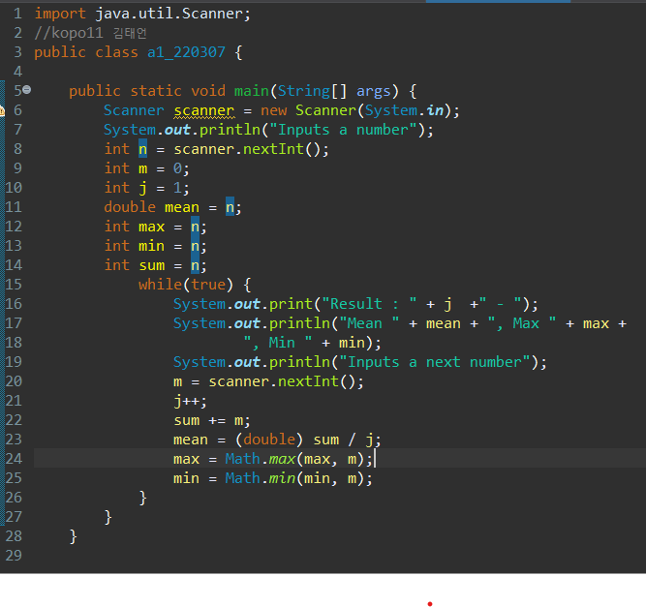
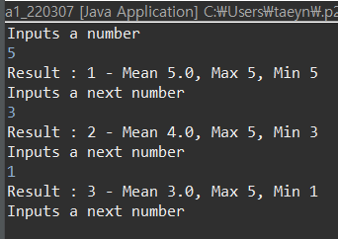

Slide 4
A2
Counting by Time of Number
User inputs a number
Prints the numbers of positive, negative, odd and even numbers
This is performed indefinitely
2
P – 1, N – 0, O – 0, E – 1
-3
P – 1, N – 1, O – 1, E - 1
4
P – 2, N – 1, O – 1, E - 2

Slide 5
