Slide 1
Big Data Analysis Final Term Project
Clustering Overseas Traveling Destination
with Instagram Hashtag Crawler
2017313008
Kim Tae Eun

Slide 2
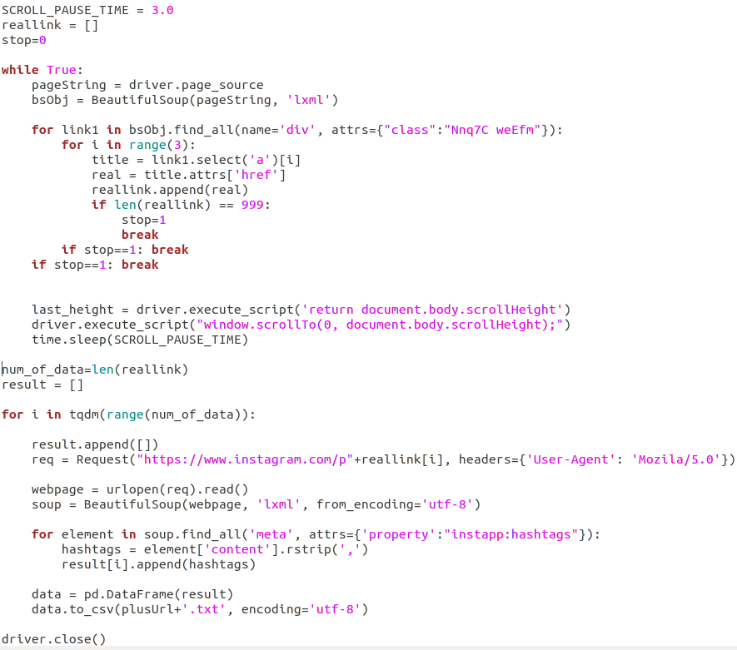
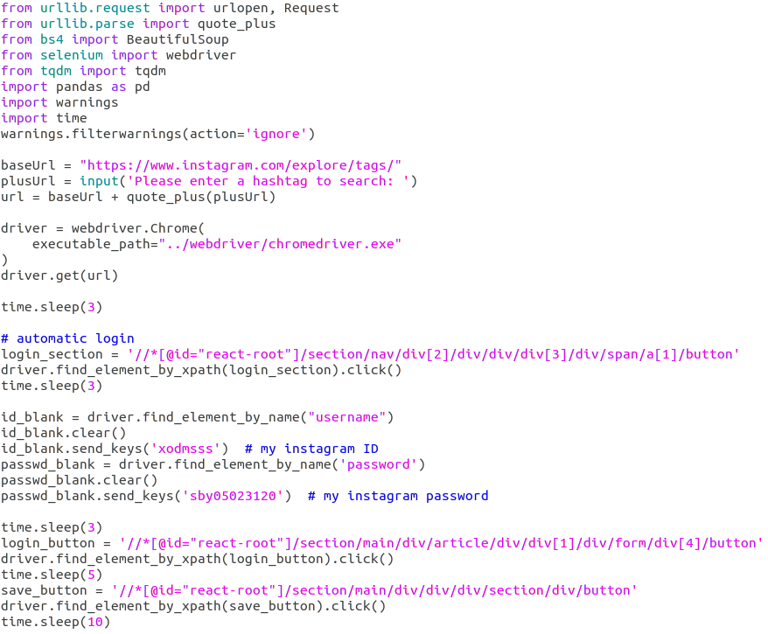
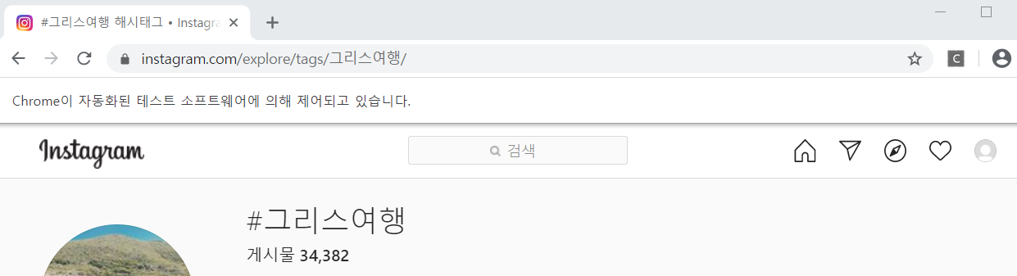
1. Instagram Hashtag Crawler
Store hashtags of 999 posts.
Input format: [“country name”+ 여행]
Chrome driver is automatically searching hashtag

Slide 3
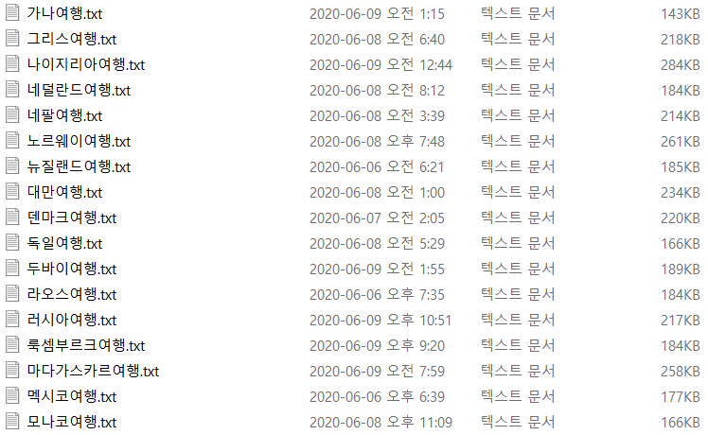
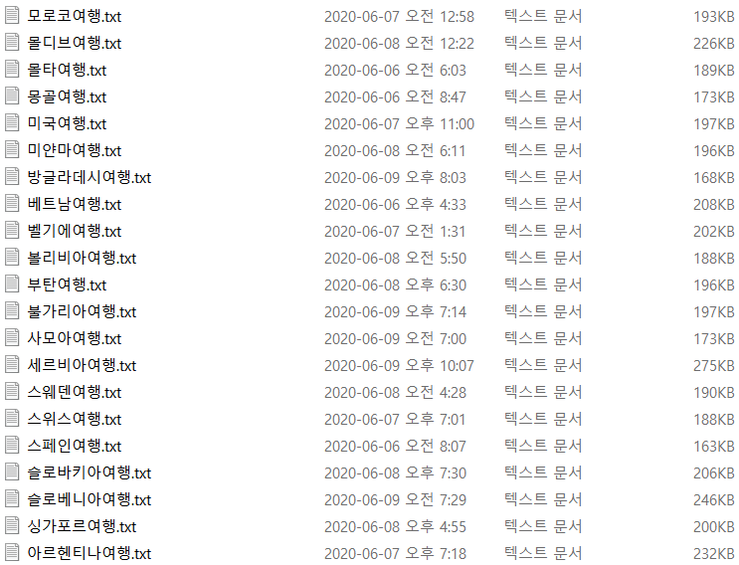
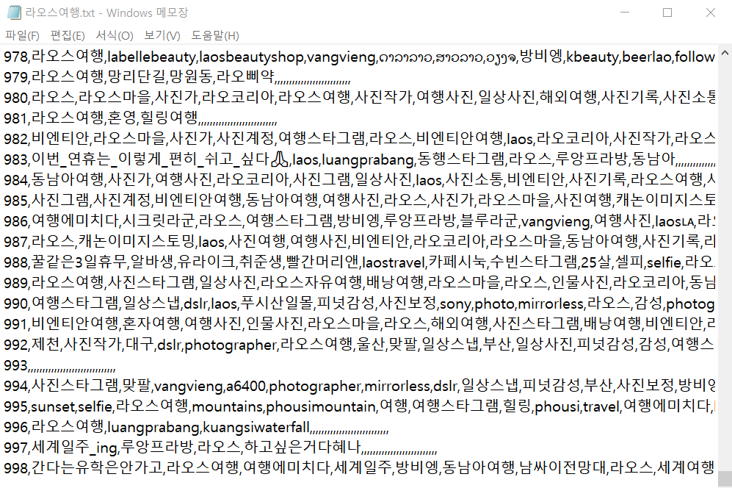
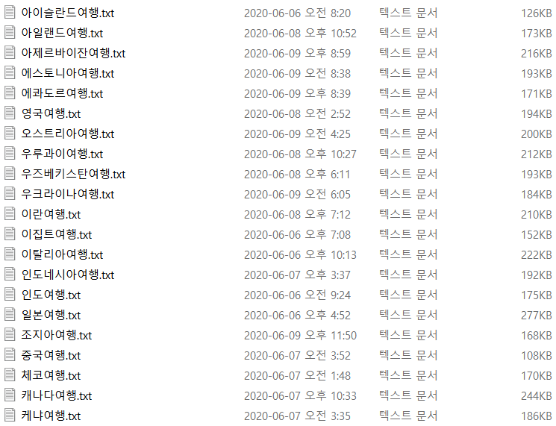
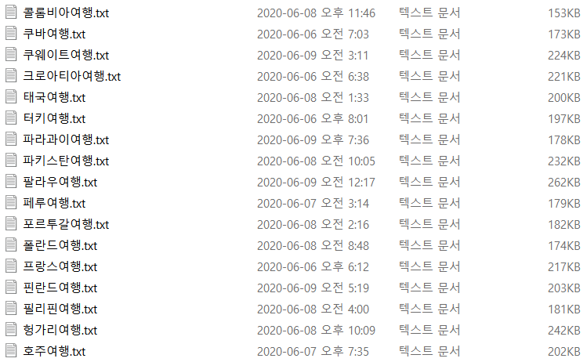
1. Instagram Hashtag Crawler
0~998 index in each txt (hashtags of 999 posts)
Crawl up to 30 hashtags at each post.
Collected 76 country’s hashtag result txt files.

Slide 4
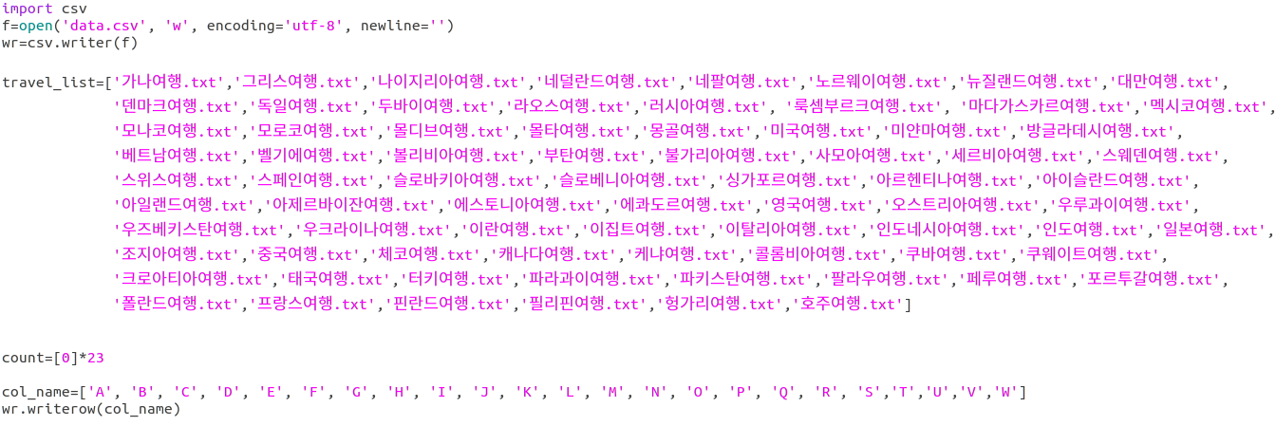
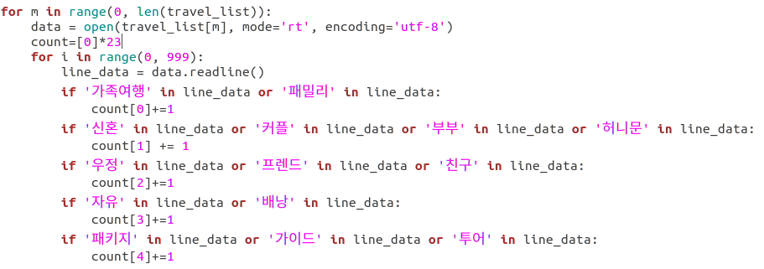
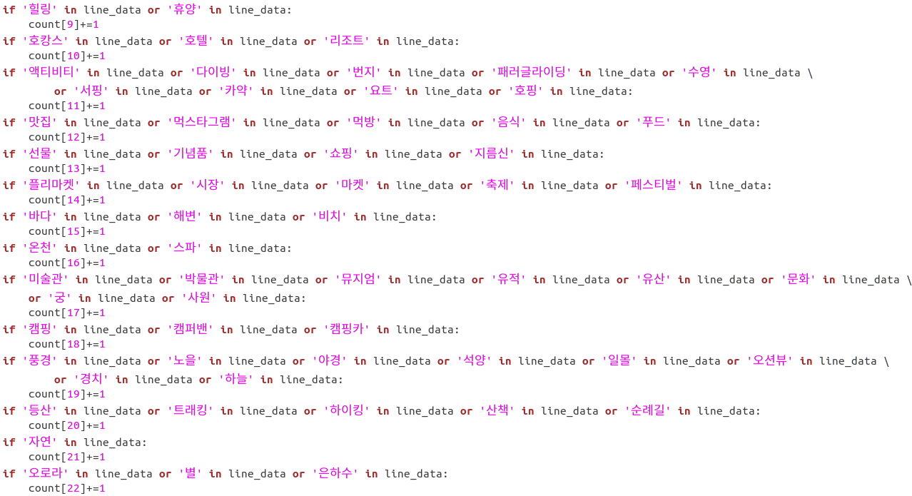
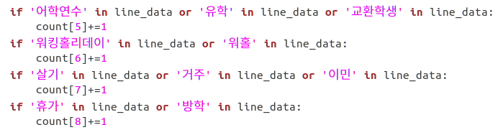
2. Crawling Data preprocessing
Count the number of specific keywords per file to indicate the characteristics of each destination.
Type of traveling
Purpose of traveling
Activities of traveling

Slide 5
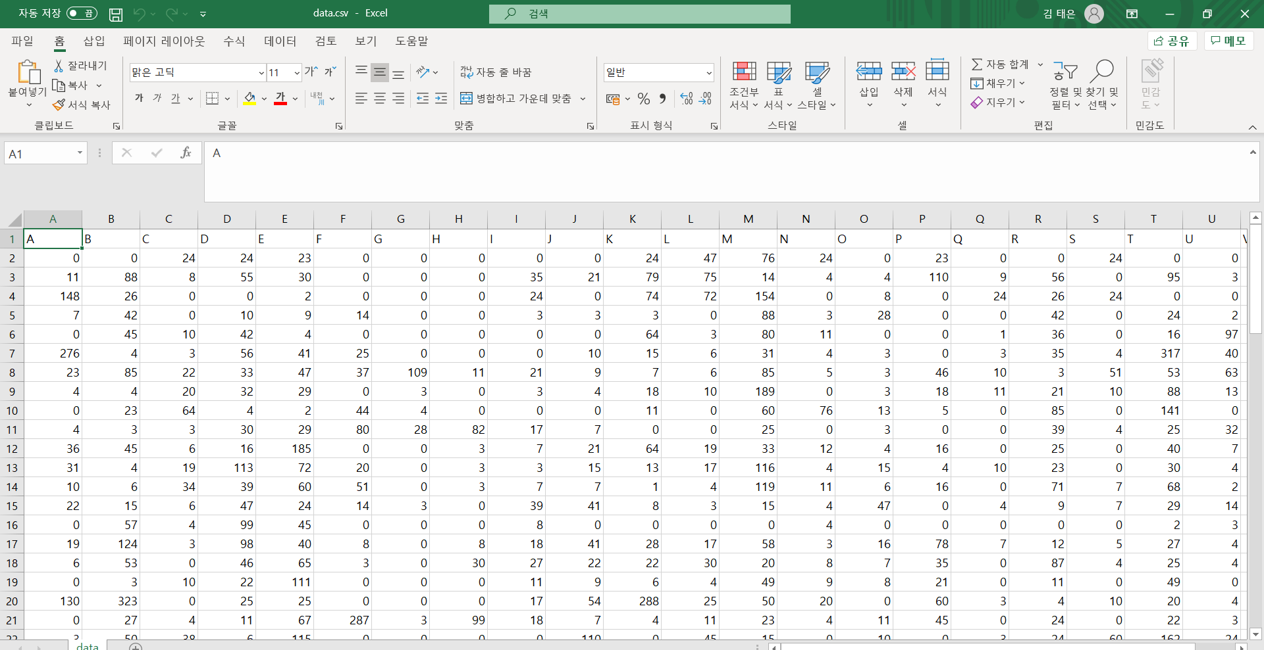
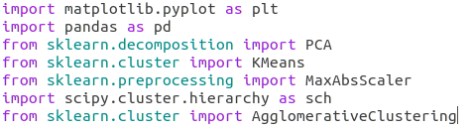

data.csv
K-means clustering & Hierarchical clustering
[Feature vector select]
1. Type & Purpose of traveling
Columns represent the characteristics of each traveling destination.
2. Activities of traveling
Each row means the feature vector of each traveling destination.
[Feature Scaling]

Slide 6
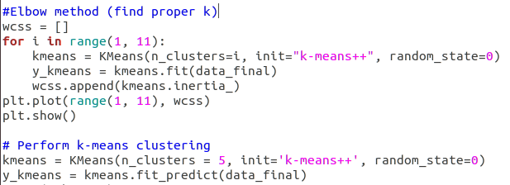
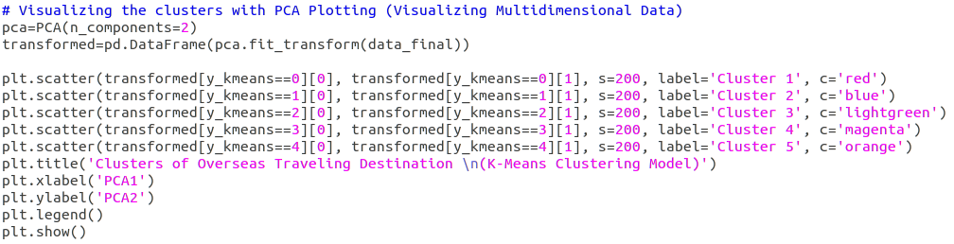
3. K-means Clustering
To visualize multidimensional data, I used PCA plotting
vary depending on the value of k, in this case k=5

Slide 7
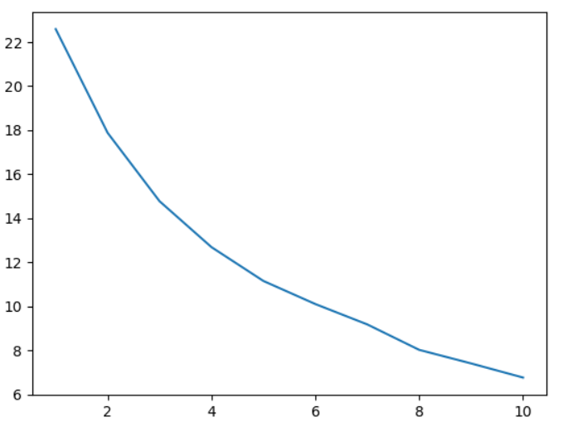
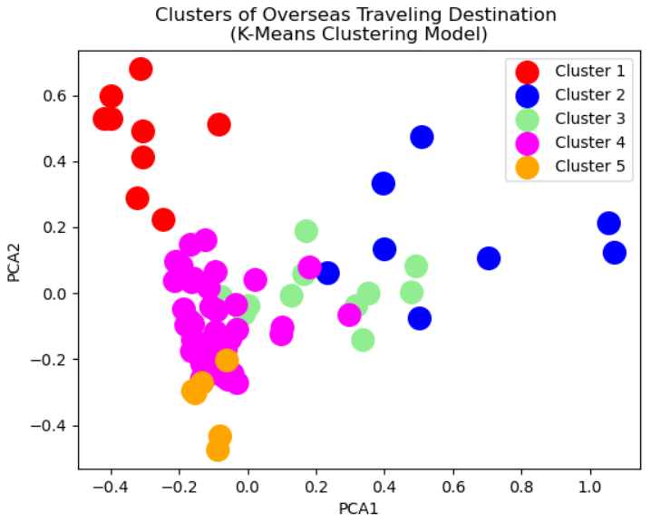
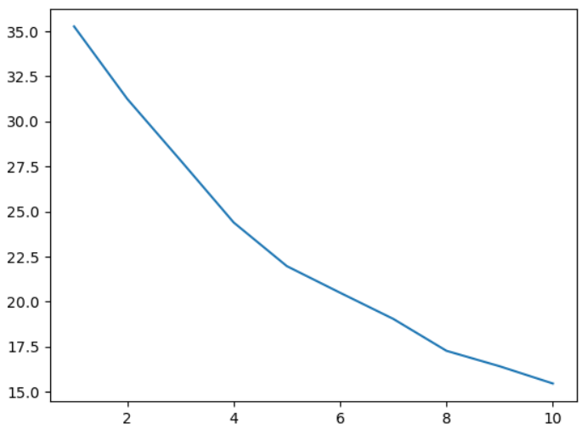
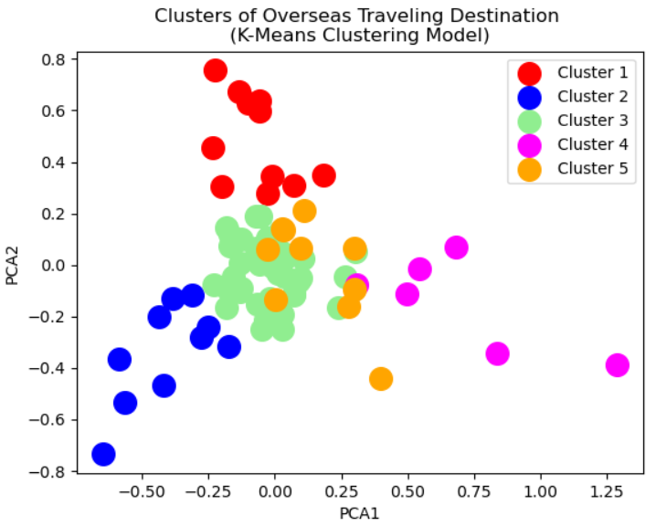
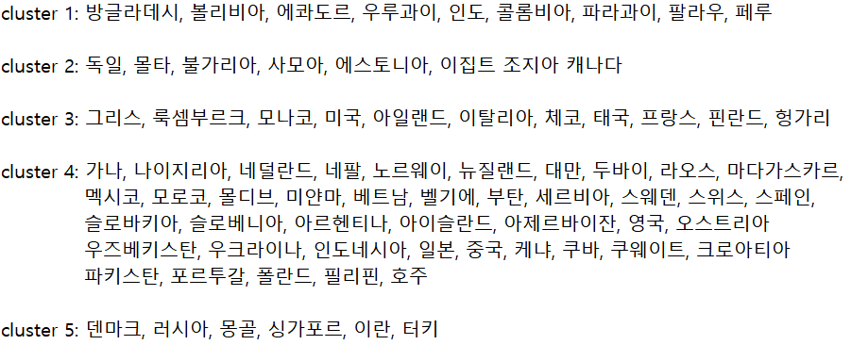
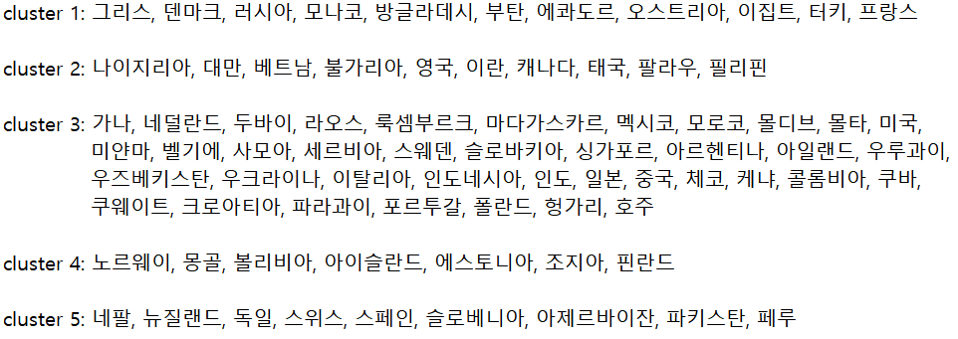
3. K-means Clustering
[Elbow method & k-means clustering result]
1. Type & Purpose of traveling
2. Activities of traveling
k=5
k=5

Slide 8
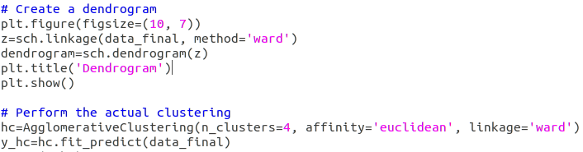
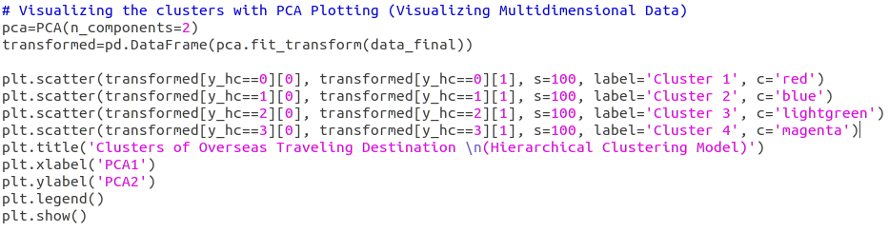
4. Hierarchical Clustering
To visualize multidimensional data, I used PCA plotting
vary depending on the value of k, in this case k=4

Slide 9
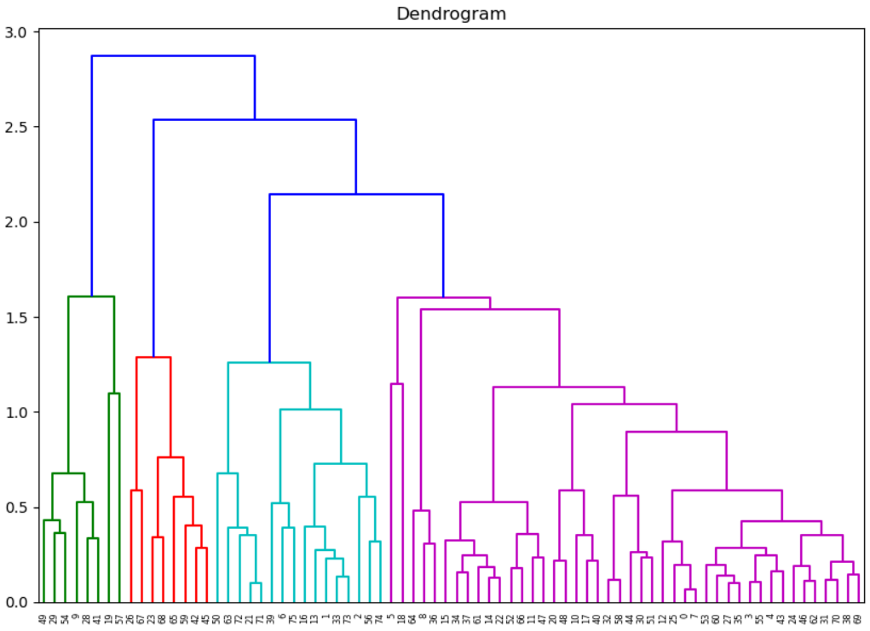
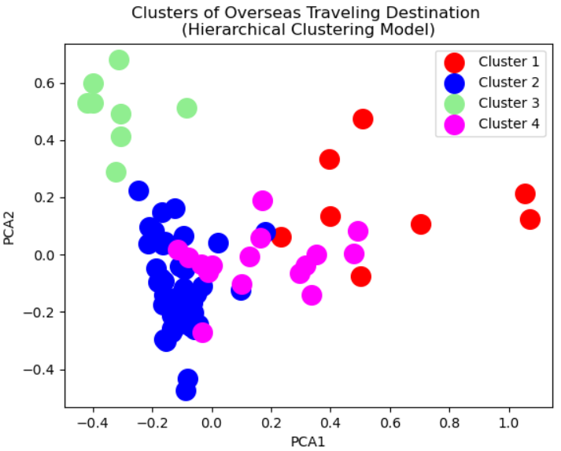
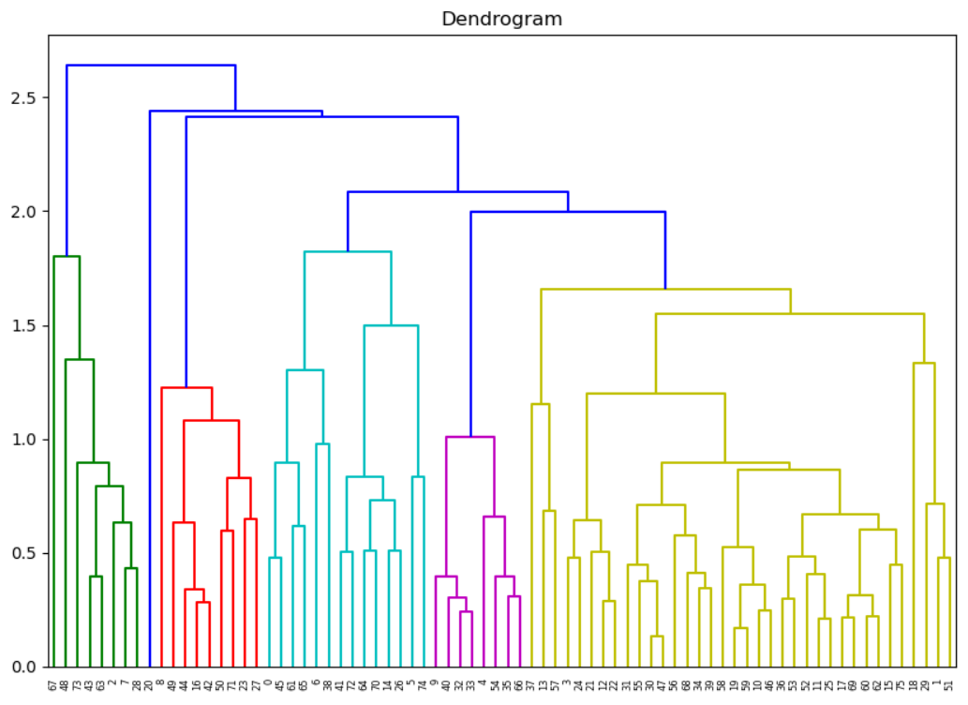
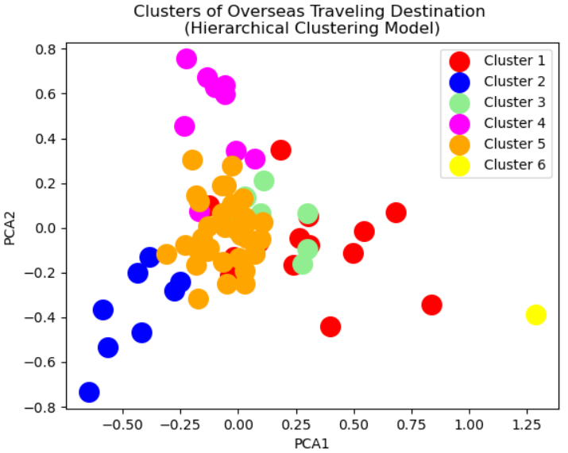
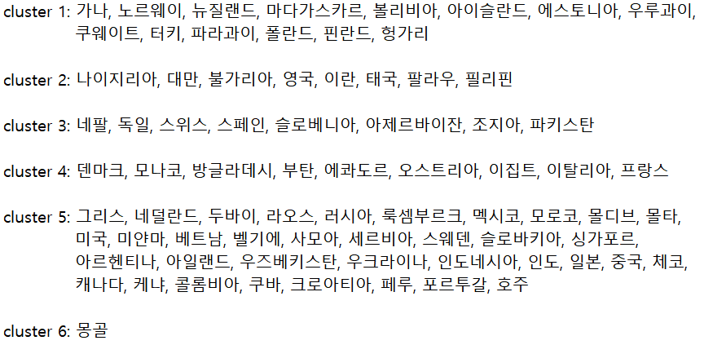
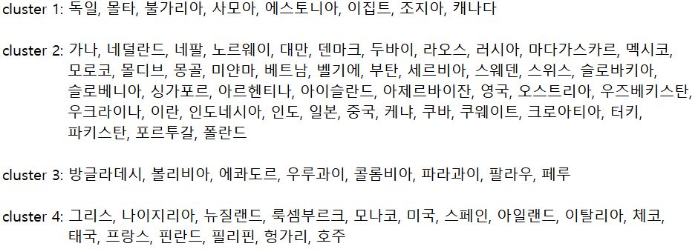
4. Hierarchical Clustering
1. Type & Purpose of traveling
2. Activities of traveling
k=4
k=6

Slide 10
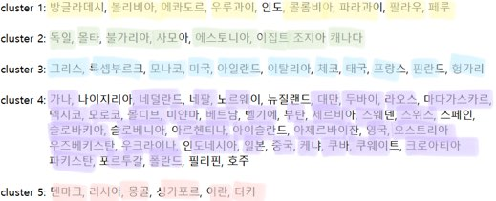
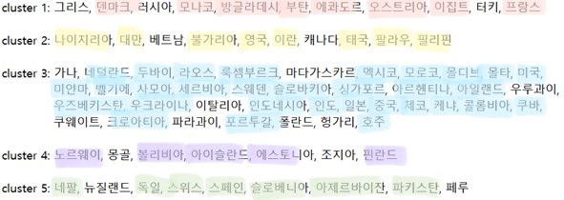
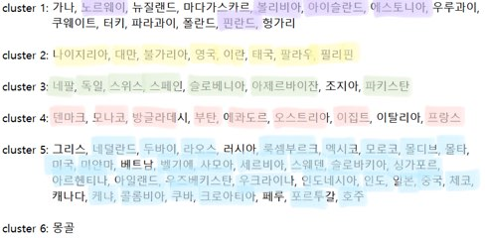
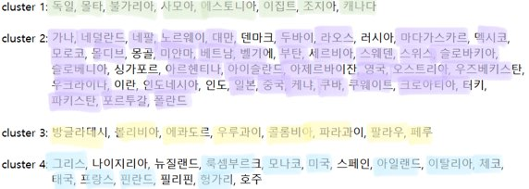
clustering overseas traveling destination : 4 different clustering results were obtained.
1. Type & Purpose of traveling
2. Activities of traveling
<K-means clustering>
<K-means clustering>
<Hierarchical clustering>
<Hierarchical clustering>
We can select or recommend similar destinations through cluster information.

