Slide 1


On Hand Application

Slide 2
One Hand app helps people to find the lost things , When a person loses his property ,
The app can be accessed Enter a picture or description The missing thing then all People who have the app They get data and help Find it faster

Slide 3


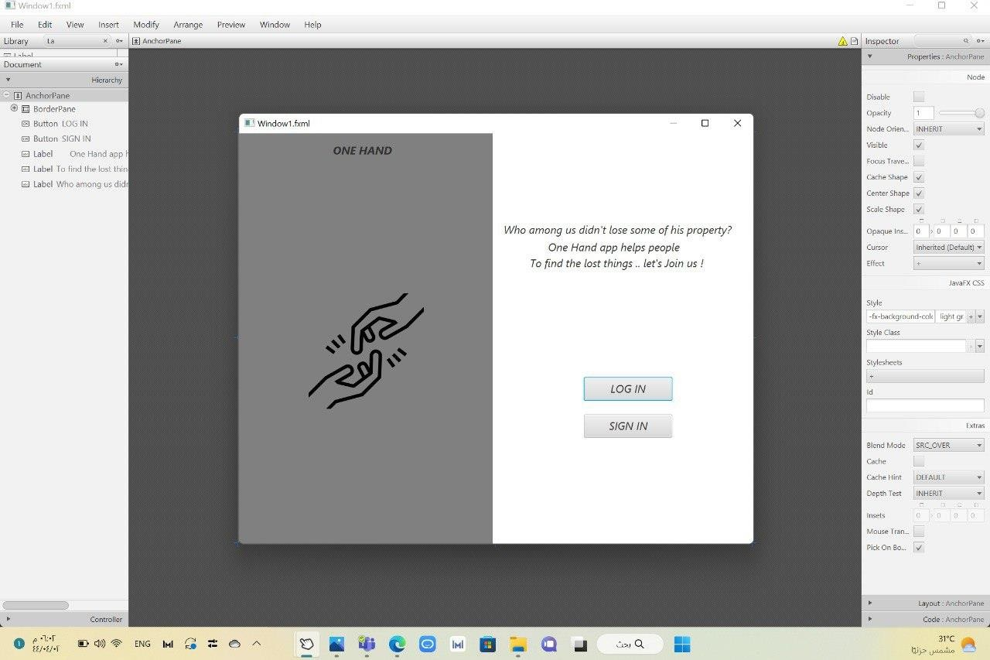
Window 1

Slide 4


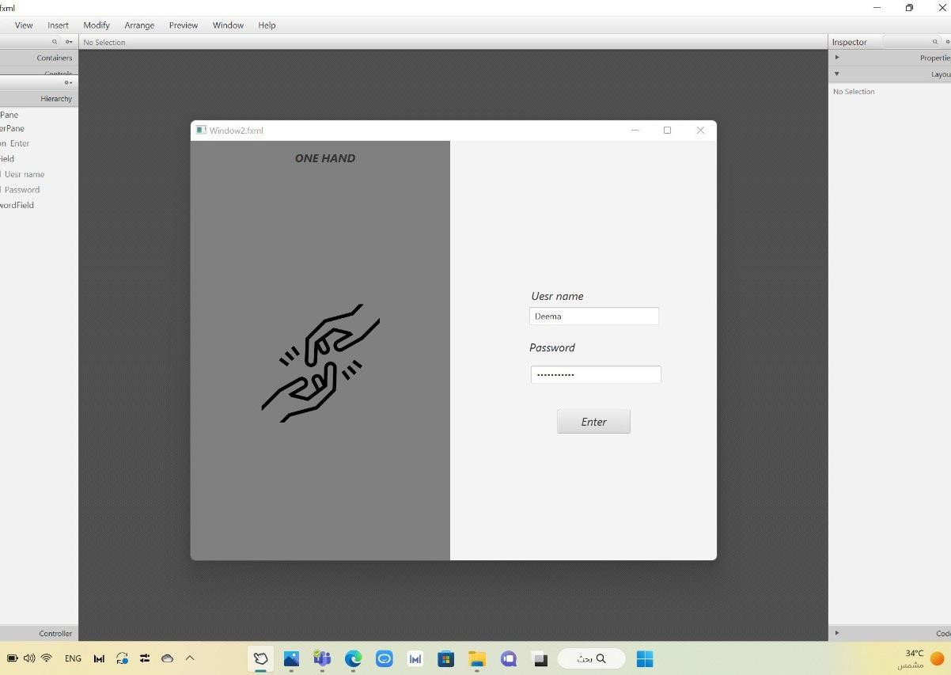
Window 2

Slide 5
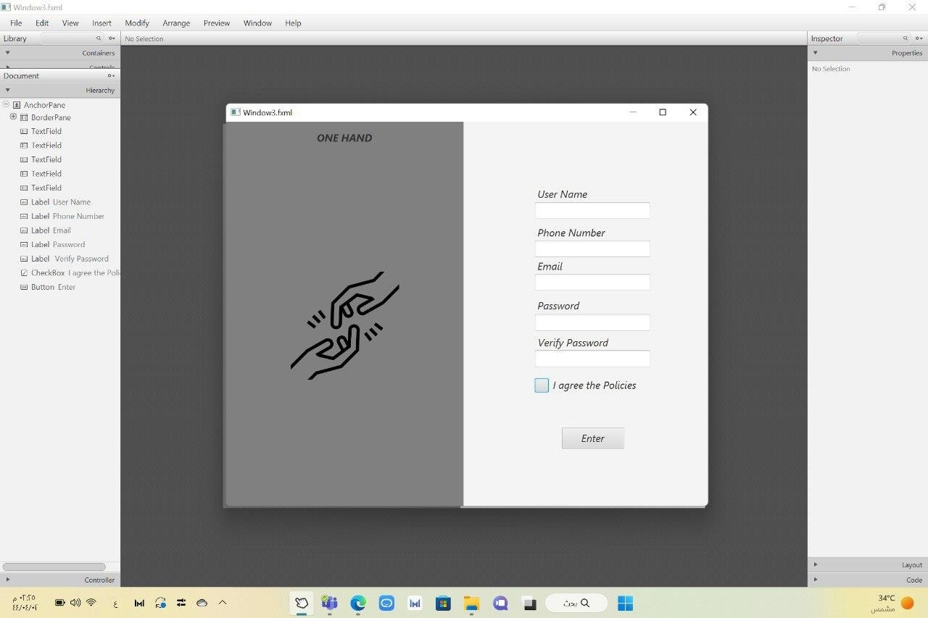
Window 3

Slide 6
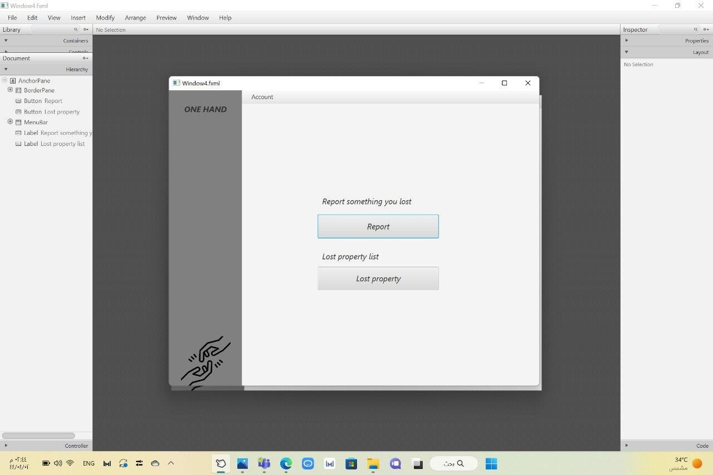
Window 4

Slide 7
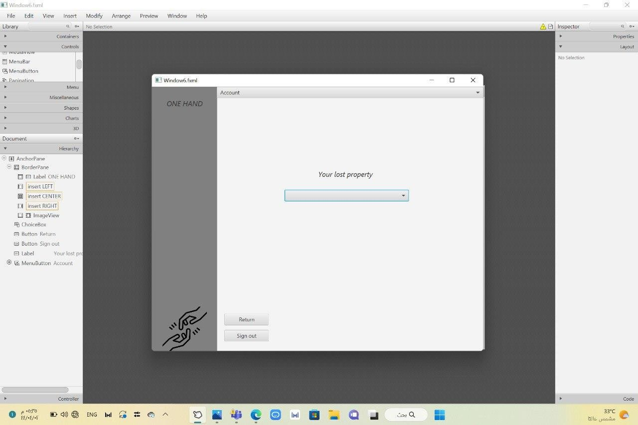
Window 5

Slide 8
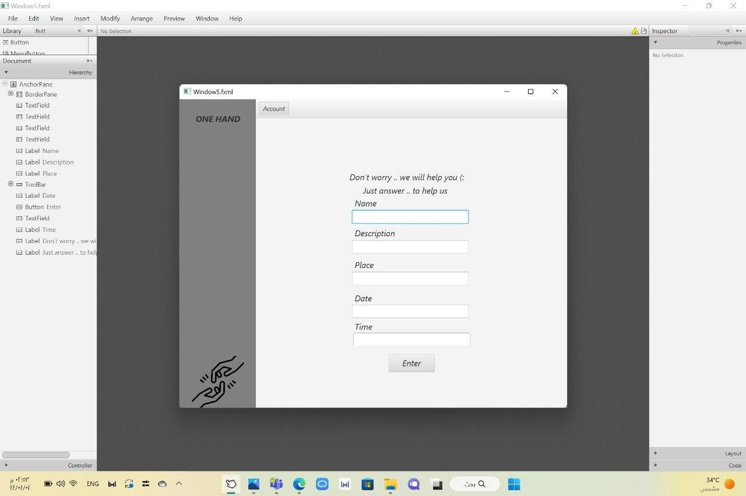
Window 6

Slide 9
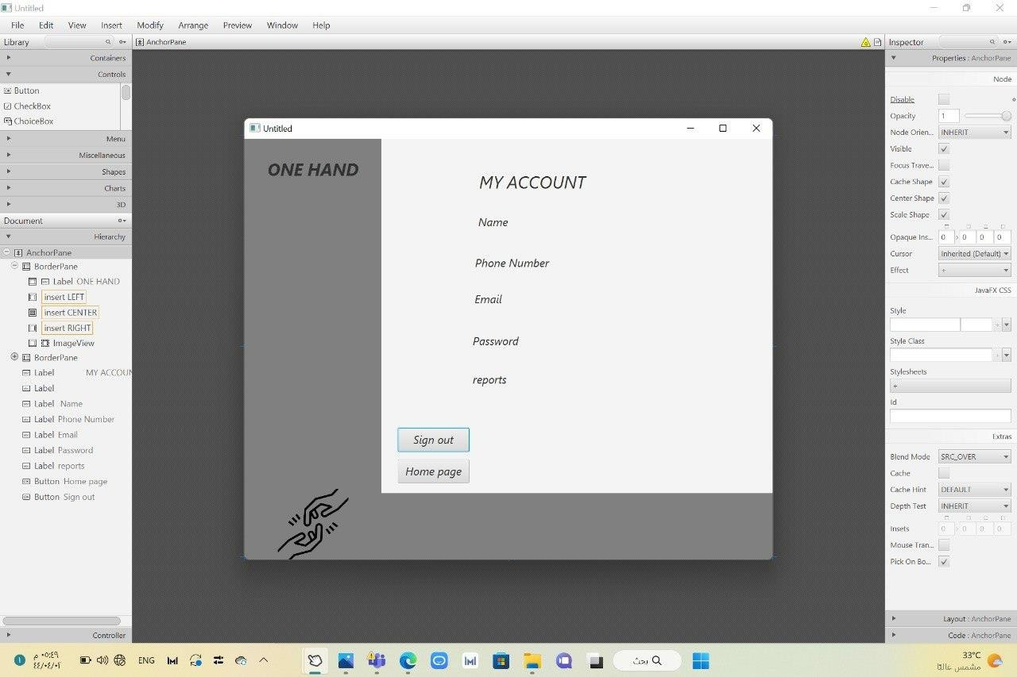
Window 7

