Slide 1
Physics-Based Modeling of the
Magnetometer Array
Simulation, observability, and synthetic-aperture localization
SCOPE & FRAMING
Context: The hardware team is developing and testing the physical sensor array. My work runs in parallel on the modeling and simulation side.
My contribution: A physics-based simulation of the array, used to study geometry, observability, and the limits of static sensing — and to identify what experiments would be most informative.
Today: I'll walk through what I built, how I validated it, and what the simulations suggest about array geometry, localization limits, and motion-based sensing.
Notes:
My work has focused on building a controllable physics-based simulation of the magnetometer array, using it to study array geometry and observability, and then using those results to identify limitations of a stationary array and investigate whether controlled motion can resolve them.
I won't spend time reviewing the overall magnetometer project — you all know the research context. I'll jump straight into what I built and what I found.

Slide 2
OVERVIEW
What I've Built and Investigated
Simulation
• Physics-based magnetic dipole model
• 3×3 planar sensor array, Bz measurements
• Noise model and detection threshold
• Parameter sweeps and visualization
Analysis
• Array geometry and aperture/depth scaling
• 6-parameter sensitivity (Jacobian / SVD)
• Observability mapping over source space
• Static ambiguity search
Motion (Simulation)
• Multi-pose Jacobian stacking
• X and Z translation comparison
• Measurement separation under motion
• Proposed hardware validation experiment
Goal: understand what information the current array can recover, and what geometry or motion is needed to recover more.
Notes:
I'll organize my talk around three blocks of work.
First, the simulator itself and its validation.
Second, a series of geometry and observability analyses.
Third, a preliminary investigation of whether motion can recover the information a static array cannot.
Each block feeds into the next. The simulation enables the analysis. The analysis identifies the limitations. And the motion study suggests what we should test with the hardware.

Slide 3
SIMULATION
Simulation Setup
Exactly what the simulation controls, and what it assumes
Simulation Pipeline
Source state θ = [x, y, z, mx, my, mz]ᵀ
↓ Magnetic dipole model (point dipole, far field)
↓ 3×3 planar sensor array (9 sensors, z-plane)
↓ 9 Bz measurements (± Gaussian noise)
↓ Inverse / observability analysis
Assumptions
Array: 3×3 sensors, equidistant grid, z = 0 plane
Measurements: Bz component only (single-axis)
Source model: Ideal magnetic dipole (point source, far field)
Aperture: L = 2s (outer sensor separation)
Detection: Assumed 10 nT threshold (simulation parameter)
Noise: Gaussian, IID, for uncertainty studies
Near field: Point-dipole model breaks down at small r/d; not modeled here (see appendix)
All six source parameters are treated as free. Dipole field and Jacobian equations are in the appendix.
Notes:
The simulator takes a six-parameter source state — 3D position and magnetic moment vector — and computes the nine Bz readings the array would produce.
I want to be explicit about the assumptions: single-axis sensors, ideal point-dipole source model, and a 10 nT detection threshold that I've used as a simulation parameter — not a measured hardware floor.
I'll put the dipole equation details in the appendix for anyone who wants them.

Slide 4
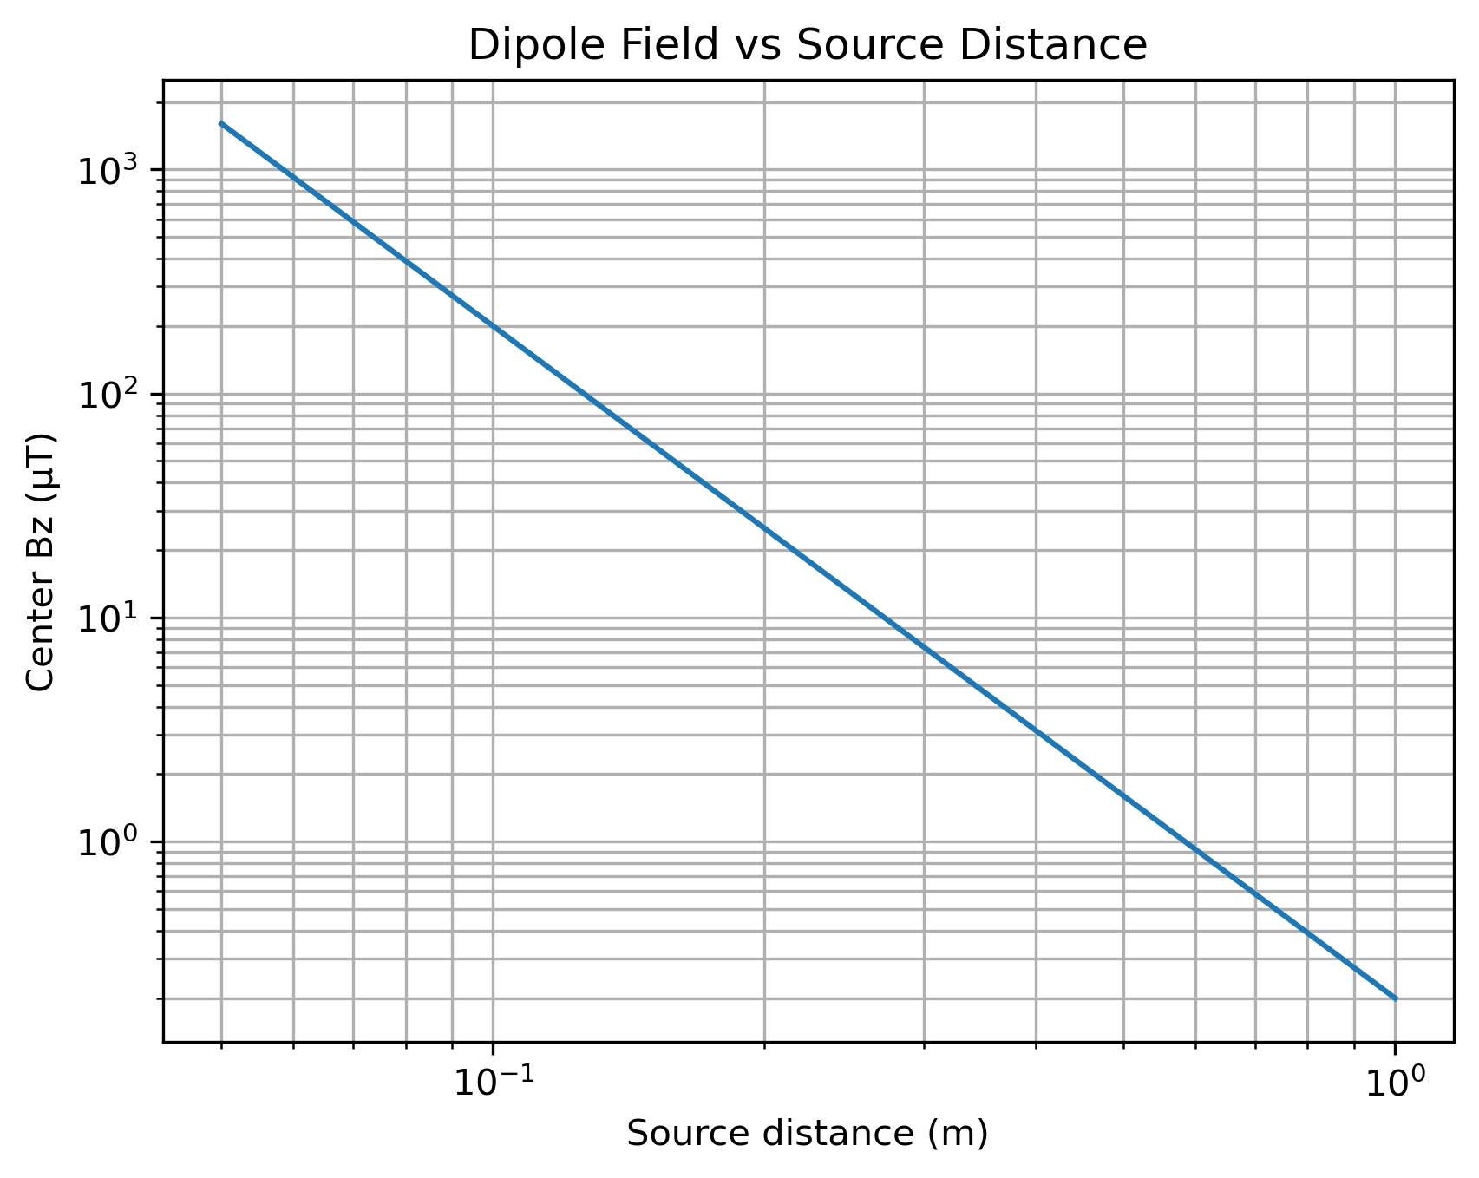
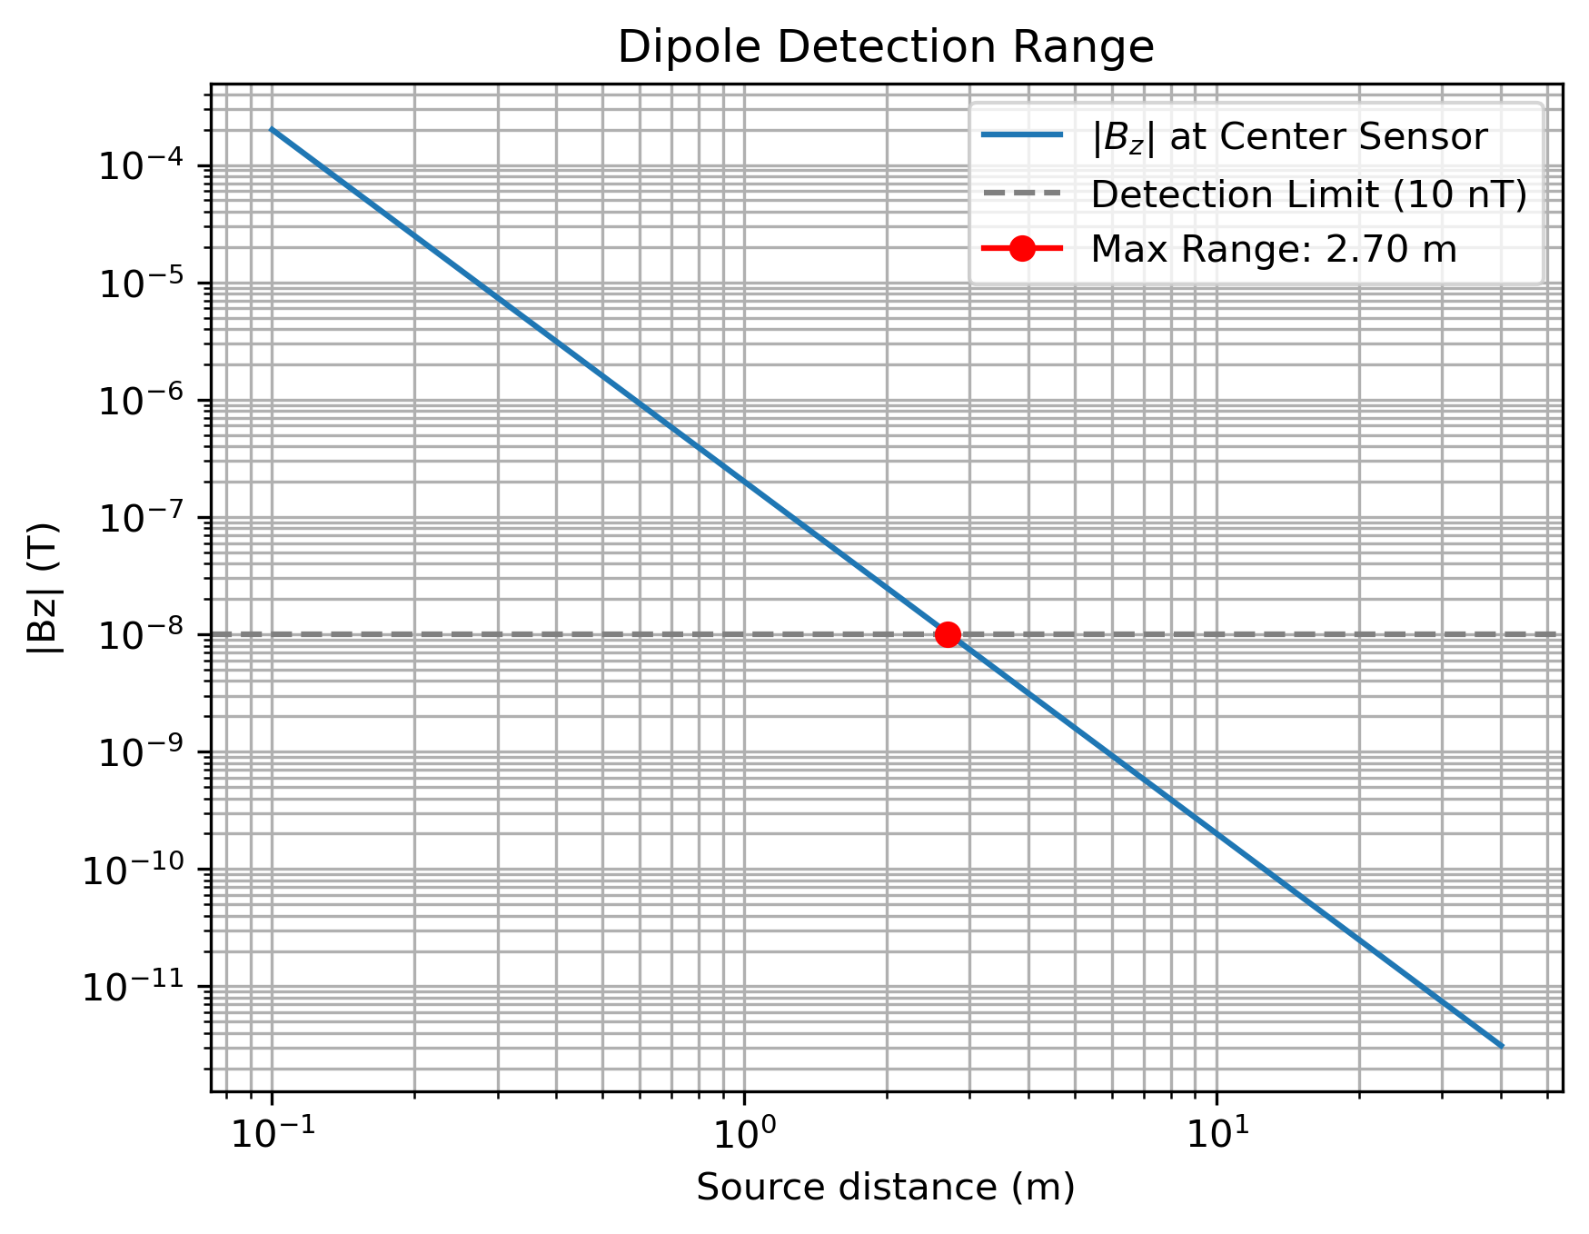
VALIDATION
Validation: The Simulator Reproduces Known Physics
Three quantitative checks before using the simulator for design questions
Inverse-cube field decay
B ∝ r⁻³
Measured log-log slope: −3.0000
Expected: −3 ✓
Moment scaling
r_max ∝ m^(1/3)
Measured slope: 0.3350
Expected: 1/3 = 0.3333 ✓
Detection boundary
(m = 1 A·m², B_min = 10 nT)
Analytical: 2.7144 m
Simulation: ~2.70 m ✓
Validation complete. The simulator matches known analytical behavior across field decay, moment scaling, and detection boundaries.
Notes:
Before using the simulator to answer design questions, I ran three quantitative checks against analytical predictions.
The field amplitude drops with a log-log slope of exactly -3.0000 — as expected for a magnetic dipole. The maximum detection range scales as m^(1/3) with a measured exponent of 0.3350, within 0.5% of the theoretical 1/3. And the numerical detection boundary for a 1 A·m² source at a 10 nT threshold is 2.70 m, versus the analytical 2.7144 m.
This gives me confidence that the simulator is correctly implementing the dipole physics before I use it to explore geometry and observability questions.

Slide 5
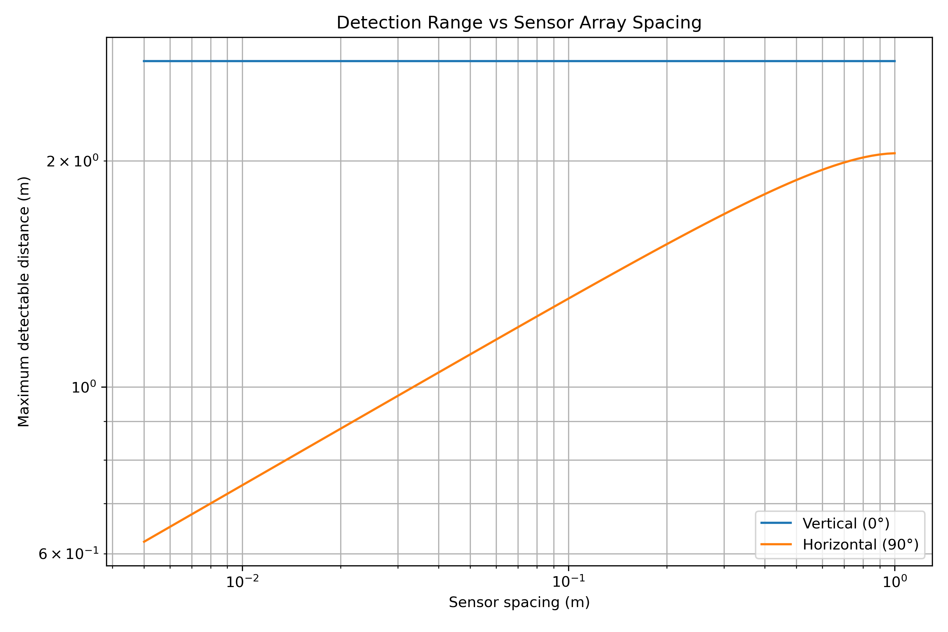
GEOMETRY STUDY
Array Geometry Changes What the Sensors Can See
Spacing does not simply increase sensitivity — it changes which field structure the array samples
Spacing sweep: 1 cm – 1 m
Vertical dipole — Detection range stays at ~2.71 m across all spacings. The on-axis field peak always falls on the center sensor; outer sensor position is irrelevant.
Horizontal dipole — Center Bz measurement is at a field null (Bz ≡ 0 on-axis). Detection range depends on outer sensors reaching the off-axis field lobes.
Horizontal range: 0.74 m at 1 cm spacing → 2.05 m at 1 m spacing (nearly 3× increase)
This shows that the array geometry determines which features of the source field are sampled — not simply 'more is better.' The implication for aperture sizing depends on the source orientation and target depth. That is addressed in the next two slides.
Notes:
I swept sensor spacing from 1 cm to 1 meter and recorded detection range for both vertical and horizontal dipole orientations.
For a vertical dipole, spacing has no effect. The center sensor always sits directly below the source and captures the on-axis peak field. Outer sensors are irrelevant for detection purposes.
For a horizontal dipole, the story is different. The vertical field is exactly zero on the dipole's axis — so the center sensor is blind. Detection relies entirely on outer sensors sampling the off-axis lobes. With tight spacing, all sensors are in the null. Wider spacing allows the outer sensors to escape that null, expanding detection range from 0.74 m to 2.05 m.
The point is that geometry doesn't simply scale sensitivity uniformly — it changes which field structure the array samples.

Slide 6
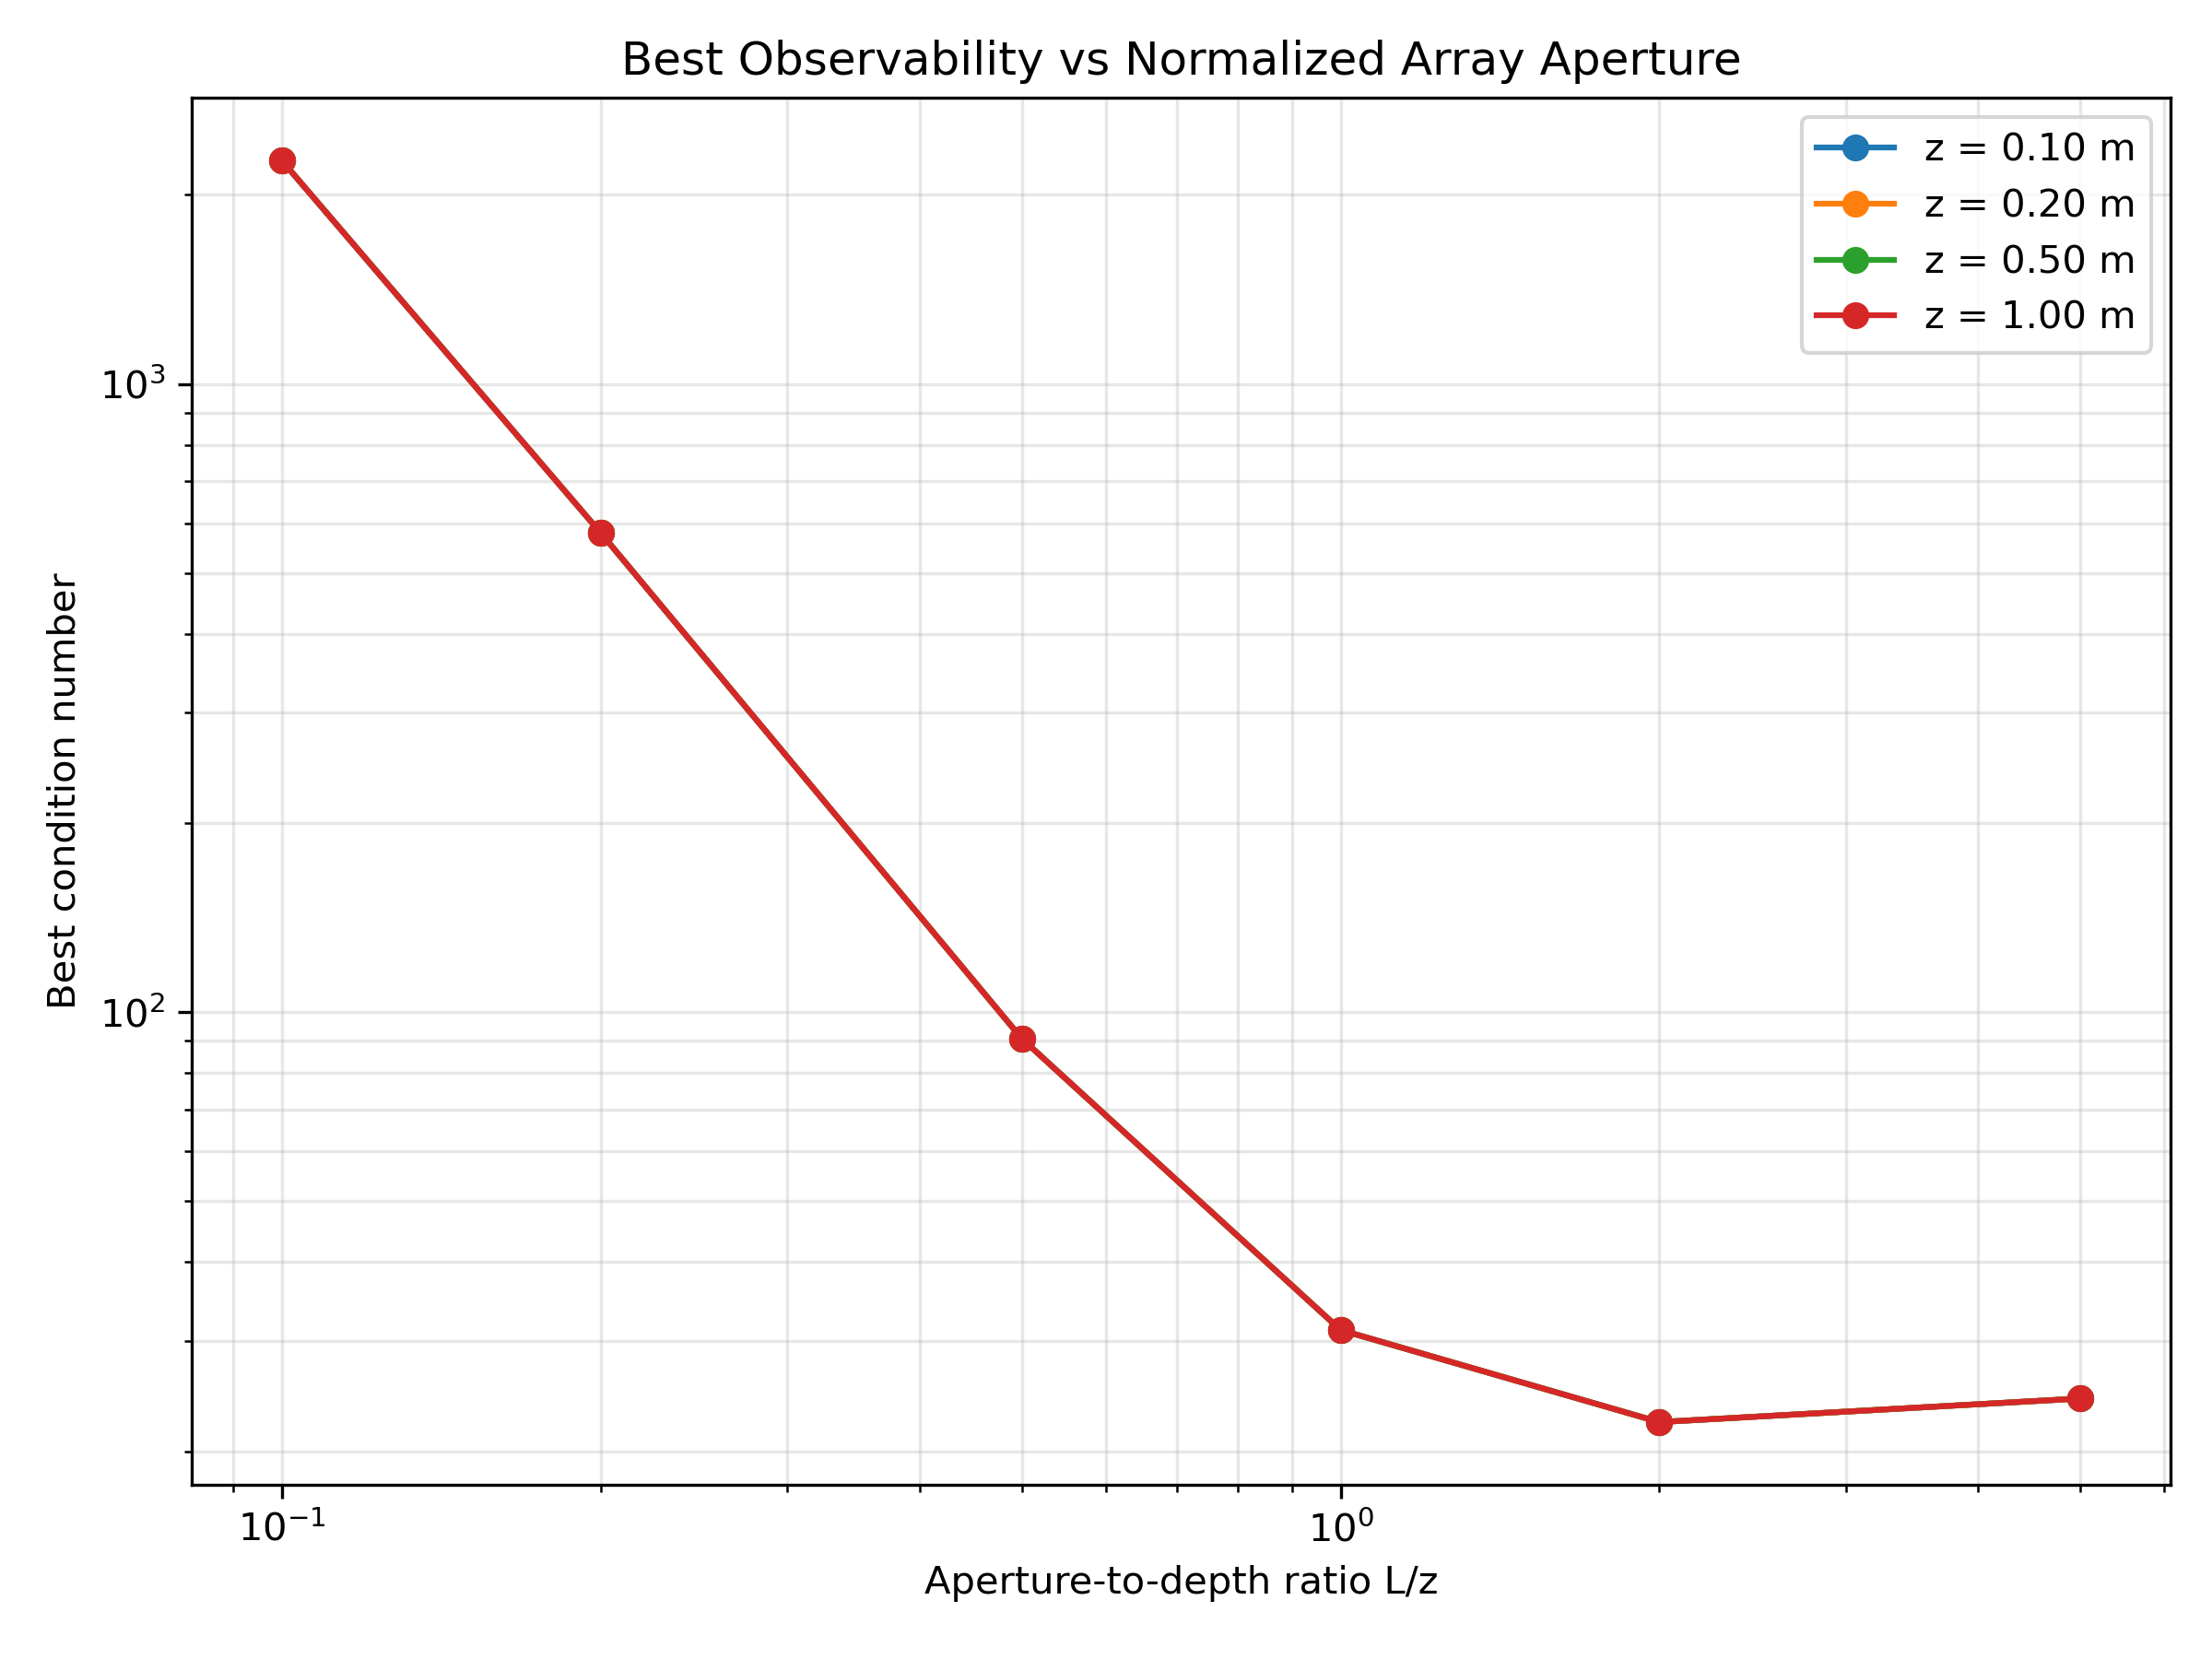
GEOMETRY STUDY
The Key Geometry Parameter Is L/z
Conditioning is largely controlled by the dimensionless aperture-to-depth ratio
L/z = array aperture / source depth
Small L/z (<0.5): All sensors see similar field values. Little spatial gradient information. Very poor conditioning.
L/z ≈ 1–2: Sensors span the peak and the inflection region of the field profile. Best conditioning observed for this 3×3 geometry.
Very large L/z (>5): Outer sensors contribute progressively less useful signal, and conditioning degrades again.
When aperture and depth are scaled together, the conditioning behavior is approximately invariant. Curves for z = 0.1, 0.2, 0.5, and 1.0 m collapse onto each other when plotted against L/z.
Observed for the simulated 3×3 geometry — not a universal hardware rule.
Notes:
When I swept aperture L across multiple depths, the condition-number curves for z = 0.1, 0.2, 0.5, and 1.0 m all collapsed onto the same curve when plotted against L/z.
This makes sense: the condition number is dimensionless, and dipole field geometry is scale-invariant under uniform spatial scaling.
The practical message is that conditioning is largely determined by L/z. The best-conditioned region I found for this 3×3 geometry is L/z ≈ 1–2. Below that, sensors are all sampling nearly the same flat peak. Above it, outer sensors fall into noise.
Important caveat: this is the observed regime for this specific simulation geometry. It is not a universal engineering law.

Slide 7
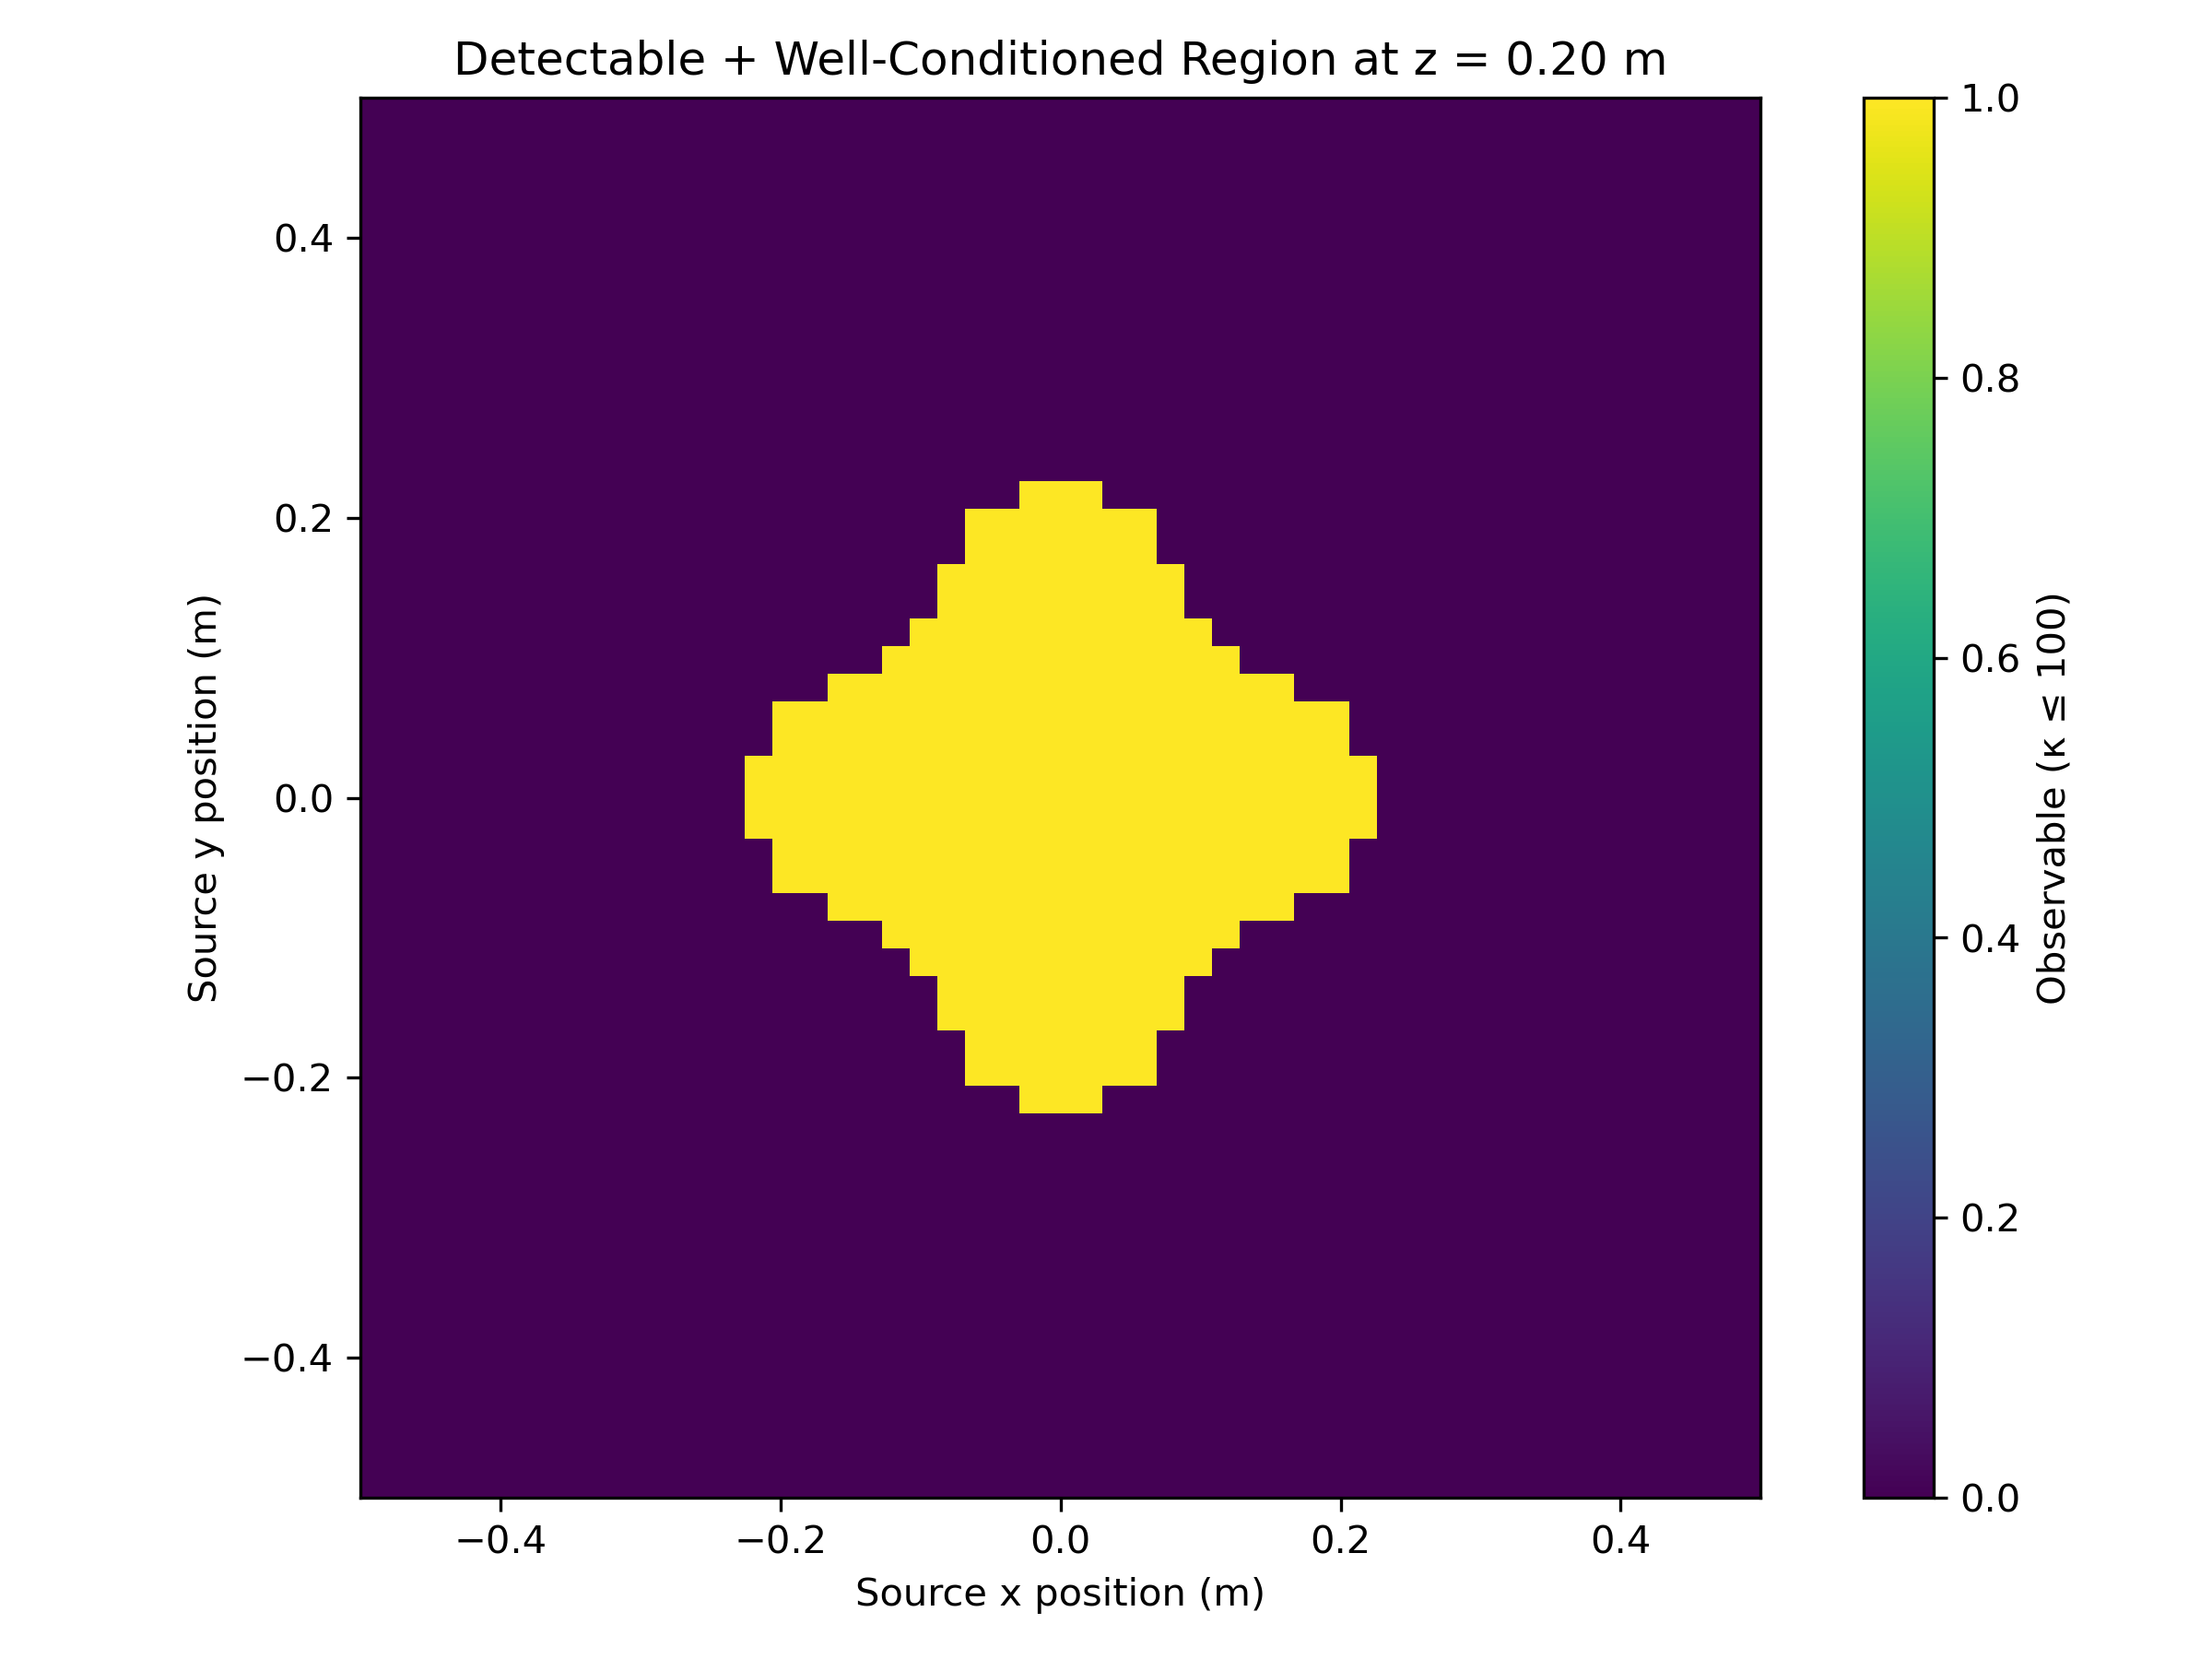
OBSERVABILITY ANALYSIS
Detection Does Not Imply Localization
A source can remain detectable while the array no longer satisfies the observability criterion
Array: L = 0.20 m (10 cm sensor spacing)
z = 0.20 m → L/z = 1.0 Well-conditioned region exists ✓
z = 0.50 m → L/z = 0.40 Zero locations satisfy κ ≤ 100 ✗
What κ ≤ 100 means in this simulation
κ is a dimensionless measure of how unevenly the inverse problem is conditioned. κ ≤ 100 is the practical classification threshold used here — not a universal guarantee of millimeter accuracy.
For this 20 cm aperture, increasing L toward L/z ≈ 1–2 is one way to move back into the well-conditioned regime.
Left: z = 0.2 m (L/z = 1.0) — well-conditioned zone visible. At z = 0.5 m (L/z = 0.4), that zone disappears.
Notes:
I computed two observability maps for the 20 cm aperture array: one at z = 0.2 m and one at z = 0.5 m.
At z = 0.2 m, L/z = 1.0. The map shows a clear well-conditioned region — the yellow zone in the center where κ ≤ 100.
At z = 0.5 m, L/z drops to 0.4. The well-conditioned map is completely empty — no grid point satisfies the criterion. The source is still detectable everywhere, but the array doesn't contain enough spatial gradient information for reliable inversion under this criterion.
I want to be careful here: κ ≤ 100 is a practical simulation threshold, not a universal engineering law. But the result does illustrate the core point: detection and localization have different spatial limits, and those limits depend on L/z.

Slide 8
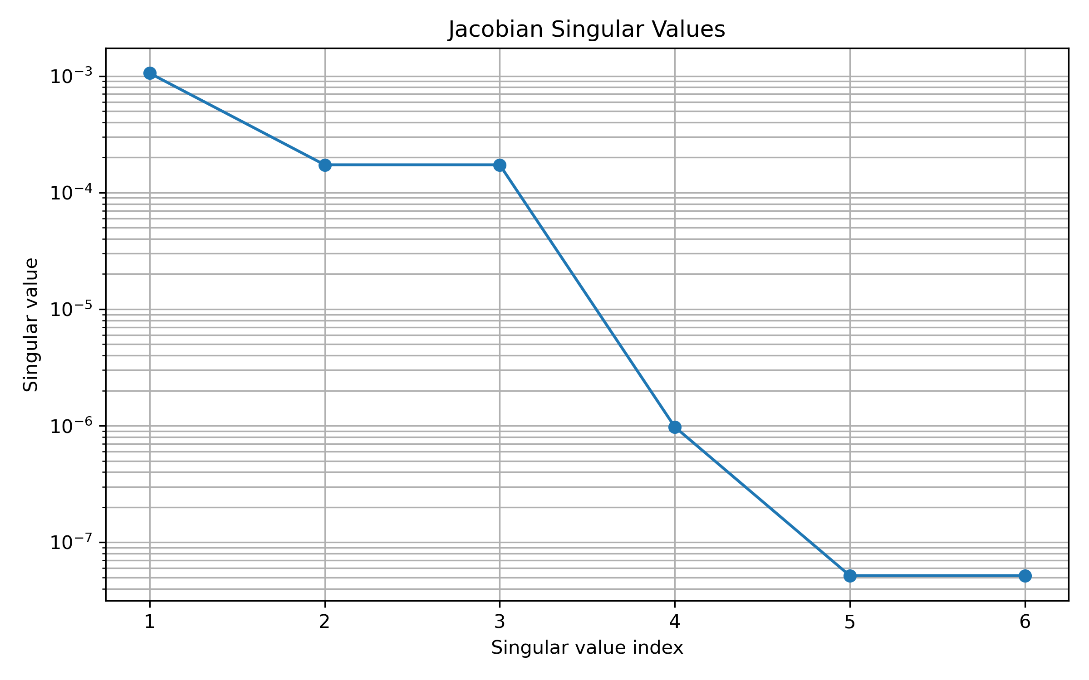
OBSERVABILITY ANALYSIS
Which Source Changes Are Hardest to Distinguish?
Jacobian singular values quantify the six distinguishable directions in parameter space
J = ∂f/∂θ (9×6 sensitivity matrix)
Each entry tells me how much one sensor reading changes when one source parameter nudges. SVD then finds the six distinguishable directions in parameter space, ranked by strength.
Large σ → That combination of parameter changes produces strong, distinct signal across sensors. Easier to distinguish.
Small σ → That combination produces very little signal variation. Hard to distinguish from noise.
Local analysis at r = [0, 0, 0.2], m = [0, 0, 1] (2 cm spacing):
• z sensitivity is strongest
• x / y sensitivity is weaker
• mx / my have the weakest local sensitivity, roughly 120× below z
• z and mz are coupled in the dominant modes
The six source parameters are not equally observable.
Note: singular values (σ₁–σ₆) correspond to orthogonal combinations of parameter changes, not individual coordinates.
Notes:
To understand which aspects of the source are hardest to estimate, I compute the Jacobian — the 9×6 matrix of partial derivatives — and decompose it with SVD.
Each singular value tells me how strongly a particular combination of source-parameter changes shows up across the nine sensor readings. Large singular value means easy to distinguish. Small singular value means nearly invisible.
Important: the singular values do not map one-to-one onto x, y, z, mx, my, mz. They correspond to orthogonal combinations of those parameters.
In the local analysis at 0.2 m depth with 2 cm spacing: z dominates in column norm. The mx/my column norms are roughly 120× smaller than z — meaning those parameter changes produce much less variation across the sensors. The full SV spread is much larger because SVD combines across all parameters; the 120× is the column-norm comparison for individual parameters. This tells me that moment orientation is much harder to recover than depth from this configuration.

Slide 9
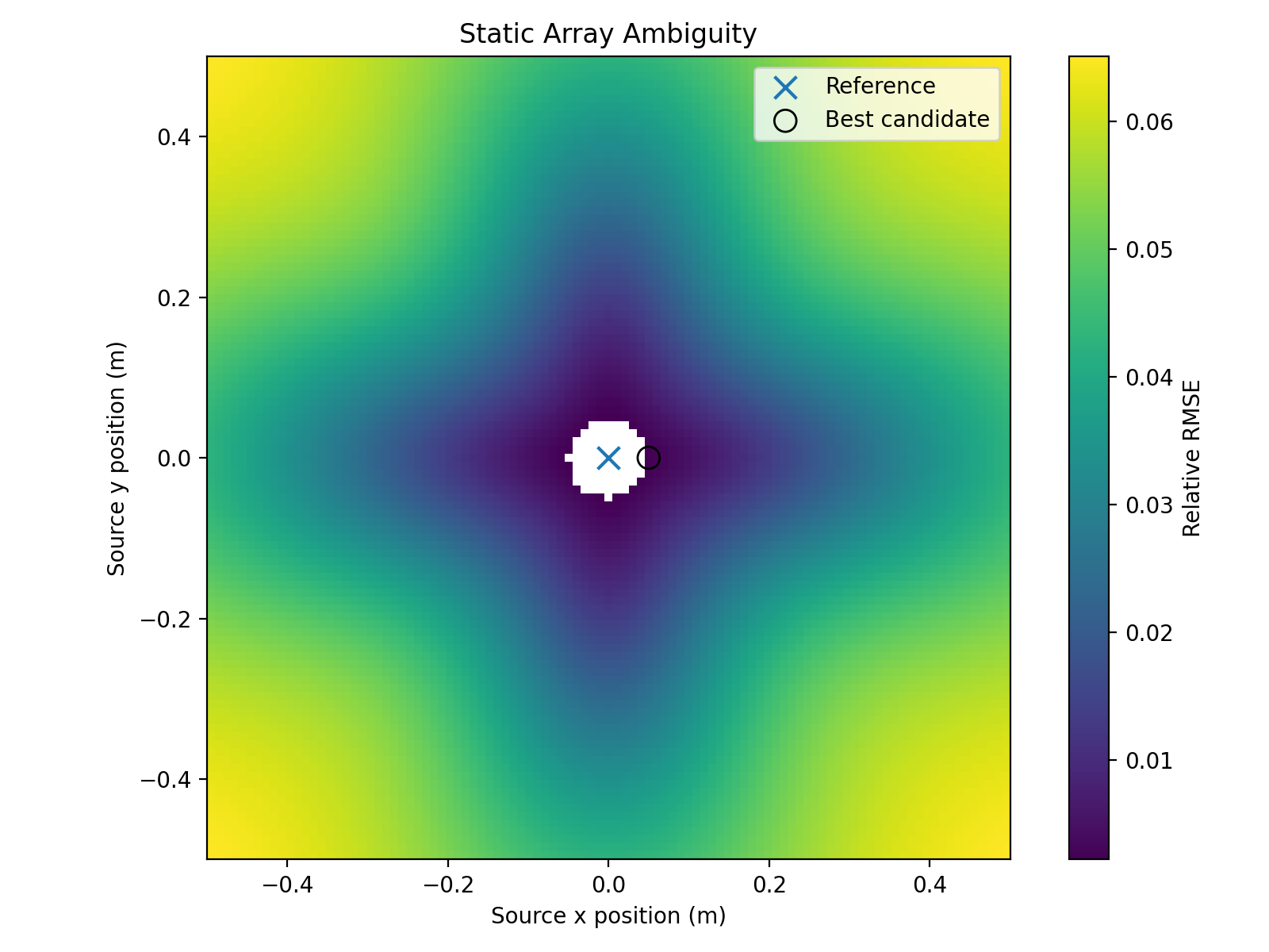
KEY FINDING
A Static Array Can Produce Ambiguous Solutions
Two physically different configurations produce measurements that are indistinguishable at the assumed noise level
Reference source (Source A)
r = [0, 0, 0.50] m m = [0, 0, 1.0] A·m² (vertical)
Alternative source (Source B)
r = [0.05, 0, 0.50] m (5 cm lateral offset)
Moment tilt: ≈ 21° (mx = 0.372, mz = 0.973)
|m| ≈ 1.042 A·m²
Measurement discrepancy
Measurement RMSE across all 9 sensors: 3.067 nT
Peak single-sensor difference: 6.5 nT Assumed noise floor: 10 nT
A stationary inversion can admit multiple comparably good source configurations because the measurements themselves are ambiguous.
Notes:
This is probably the strongest concrete finding from the static analysis.
I ran a search: fix Source A as a vertical dipole directly over the center at 0.5 m. Then sweep candidate positions and orientations to find the alternative configuration that best matches Source A's nine sensor readings.
The closest match I found was Source B: 5 cm lateral offset, 21° tilt, moment magnitude 1.042 A·m². Across all nine sensors, the measurement RMSE between Source A and Source B is 3.067 nT. The worst single-sensor difference is 6.5 nT.
With an assumed noise floor of 10 nT, those two configurations are effectively indistinguishable from a static snapshot.
I want to be careful with the language here: I'm not saying the inversion will definitely jump between solutions — that depends on the specific algorithm. But the measurements themselves are ambiguous, so any inversion has to deal with that degeneracy.

Slide 10
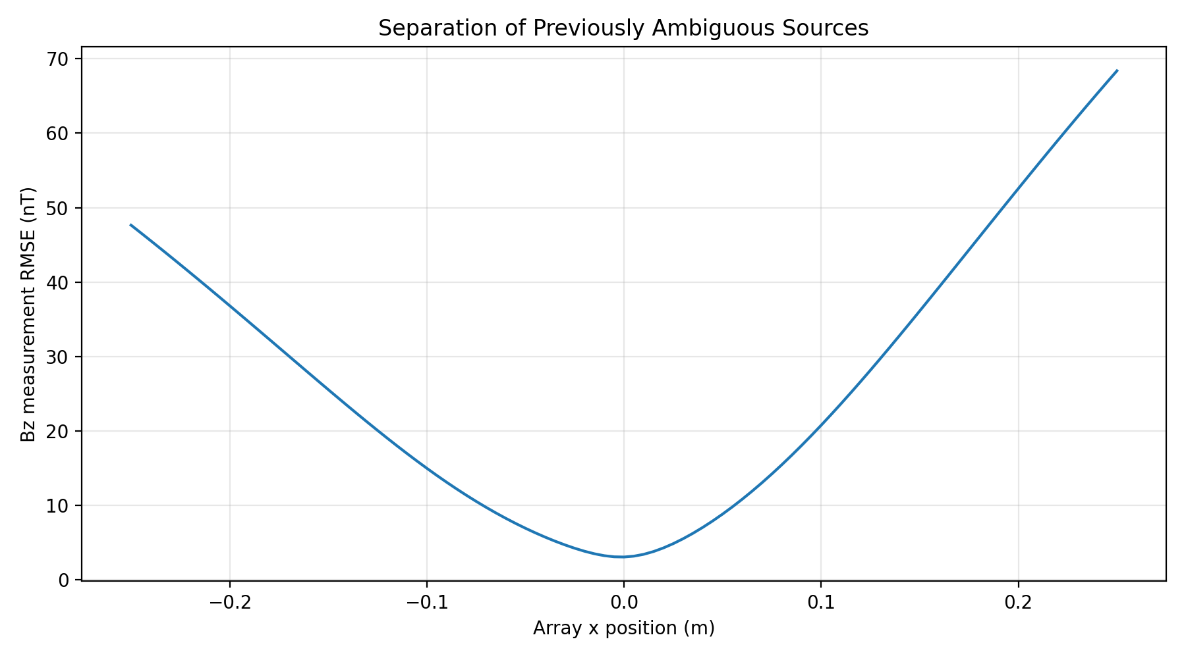
MOTION STUDY
Motion Breaks the Static Ambiguity
The same two configurations become clearly distinguishable when the array moves
Effect of translating the array to x = 0.25 m
Static (x = 0): RMSE = 3.067 nT
At x = 0.25 m: RMSE = 68.38 nT (~22× larger)
Peak sensor diff: 102.06 nT (>10× assumed noise floor)
Motion creates a synthetic aperture by providing additional viewpoints. The geometric cancellation that makes the two sources indistinguishable from the center position does not hold across multiple viewing angles.
This suggests that controlled platform motion could substantially reduce the static ambiguity problem.
Proposed implementation: Arduino-controlled linear stage (see Slide 12)
Notes:
Having found the static ambiguity, I asked whether motion can break it.
I simulated translating the array along x and computed the measurement discrepancy between Source A and Source B at each position.
At x = 0 — the static position — RMSE is 3.067 nT, below the assumed noise floor.
At x = 0.25 m, RMSE jumps to 68.38 nT — roughly 22 times larger. The peak single-sensor difference reaches 102 nT.
The intuition is that the lateral offset and tilt of Source B happen to cancel each other from the center viewpoint. Translating the array breaks that symmetry and makes the two sources clearly distinguishable.
Motion creates a synthetic aperture — instead of adding hardware, motion gives the same sensors additional viewpoints.

Slide 11
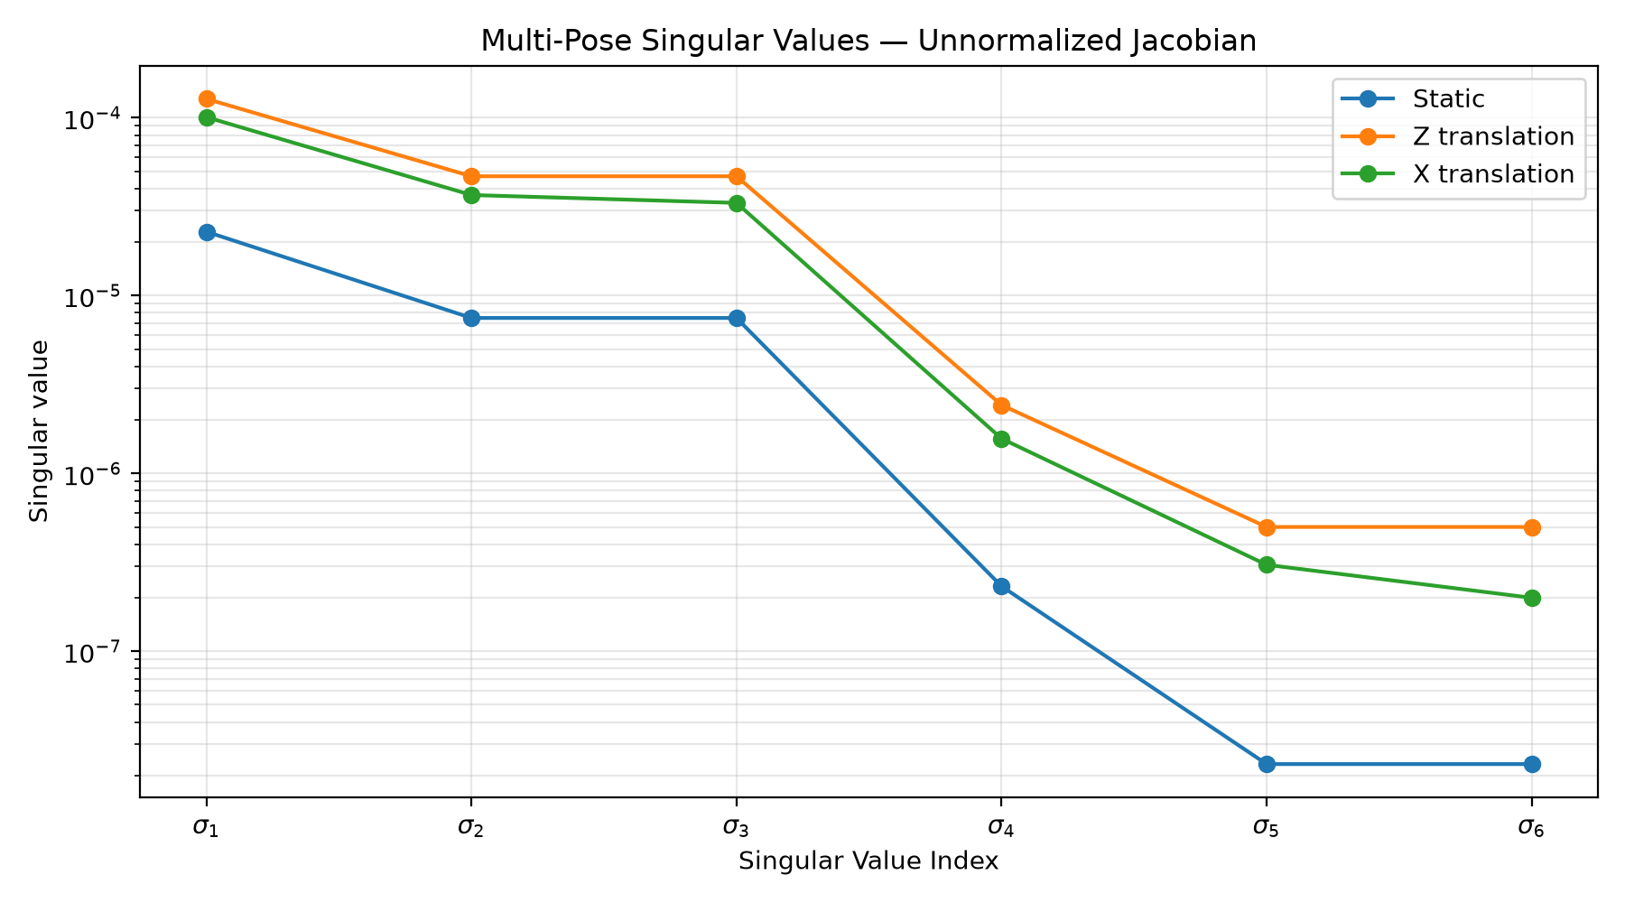
MOTION STUDY
Multiple Poses Add Information
Combining 21 poses (±0.1 m, 9 sensors each) substantially strengthens the weakest observable directions
Unnormalized multi-pose Jacobian results (21 poses, 189 total measurements)
Configuration
κ (cond.)
Weakest σ
Static (1 pose)
986.42
2.319 × 10⁻⁸
Z translation
255.59
4.998 × 10⁻⁷
X translation
504.78
1.998 × 10⁻⁷
Z translation: κ improves by ~3.86×, weakest σ improves by ~21.5×
X translation: κ improves by ~1.95×, weakest σ improves by ~8.6×
Z translation produces the largest improvement in the weakest observable direction in this simulation.
⚠ Normalization caveat
This multi-pose analysis uses an unnormalized Jacobian. The static geometry study uses a normalized Jacobian. The absolute κ values are not directly comparable across the two analyses; only the within-motion relative improvements are.
σ₁–σ₆ are orthogonal combinations of source-parameter changes, not individual coordinates (x, y, z, mx, my, mz).
Notes:
To get a global picture of how motion improves observability, I stacked the Jacobians from 21 array poses — 10 cm to each side in either X or Z, for a total of 189 sensor measurements — and computed the SVD of the combined matrix.
Static: κ = 986, weakest σ = 2.3×10⁻⁸.
Z translation: κ = 256, weakest σ = 5.0×10⁻⁷ — a 21.5× improvement in the weakest direction.
X translation: κ = 505, weakest σ = 2.0×10⁻⁷ — an 8.6× improvement.
Z translation produces the largest improvement in the weakest observable direction. X translation is the more practical option for a benchtop rig.
Important caveat: I need to flag that this multi-pose analysis currently uses an unnormalized Jacobian, while the static observability study uses normalized Jacobians. I'm not hiding this — the absolute κ values are not directly comparable, but the within-motion relative improvements are meaningful.
Also: the σ labels in the plot represent orthogonal combinations of source parameters, not individual x, y, z coordinates.

Slide 12
NEXT STEPS
From Simulation to Hardware
Proposed experiment to test the simulation predictions against physical sensor data
❓ Question
Does the static ambiguity predicted by the simulation appear in the real sensor data, and does controlled motion reduce it as predicted?
⚙ Proposed Experiment
Move the physical 3×3 array through controlled X and/or Z positions while measuring a fixed, calibrated magnetic source. Record raw sensor readings at each pose.
📏 What to Measure
• Actual sensor noise (spectral density, not assumed)
• Sensor-to-sensor offset and calibration variation
• Mechanical positioning repeatability
• Background field contribution
🔁 Compare
B_simulation ↔ B_hardware
Use measured hardware noise and errors to replace the idealized simulation assumptions and re-evaluate the ambiguity metric.
Completed: simulator, validation, geometry sweeps, observability, ambiguity search, preliminary motion simulation. Proposed: Arduino linear stage, motion experiment, hardware noise characterization, simulation/hardware comparison.
Notes:
The simulation results generate a concrete prediction: the static ambiguity should appear in real hardware data, and motion should reduce it.
The proposed experiment is to move the physical array through controlled X and/or Z positions — using an Arduino-controlled linear stage — while measuring a fixed calibrated source, and compare the raw sensor readings against simulation predictions.
The key things to measure on the hardware side are the actual sensor noise, sensor-to-sensor offsets, and mechanical positioning error. Those replace the idealized assumptions currently in the simulator.
I want to be explicit about what is done versus what is proposed. Everything through the motion simulation is completed. The physical linear stage and hardware experiment are next steps.

Slide 13
APPENDIX — MATHEMATICAL REFERENCE
Equations and Model Definitions
Dipole field (3D): B(r) = (μ₀/4π) [ 3(m·r̂)r̂ − m ] / r³
Condition number: κ = σ_max / σ_min (dimensionless, measures conditioning unevenness)
Bz component: Bz = (μ₀/4π) [ 3mz(z/r)²/r³ + terms from mx, my ] (full form in source)
Fisher information (position only): F = (1/σ²) JᵀJ
Source parameter vector: θ = [x, y, z, mx, my, mz]ᵀ
CRLB: Cov(θ̂) ≥ F⁻¹
Measurement model: b = f(θ) + ε, ε ~ N(0, σ²I)
Linear moment model: b = A m, A constructed from unit-moment dipole fields
Jacobian: J = ∂f/∂θ (9×6)
Detection threshold: max|Bz| ≥ B_min = 10 nT (simulation parameter, not measured hardware floor)
Jacobian normalization: J_norm = J · diag(scales), scales = [z, z, z, |m|, |m|, |m|]
Ambiguity RMSE: RMSE = √(mean_i (b_A,i − b_B,i)²)
SVD: J = U Σ Vᵀ, σ₁ ≥ σ₂ ≥ … ≥ σ₆ ≥ 0
Multi-pose Jacobian: J_stack = [J(pose₁)ᵀ J(pose₂)ᵀ … J(pose_N)ᵀ]ᵀ (unnormalized in motion study)
Note: singular values σ₁–σ₆ represent orthogonal combinations of source-parameter changes — they do not correspond one-to-one to individual parameters (x, y, z, mx, my, mz).
Notes:
Full equation reference for discussion. Key reminder: singular values are not individual parameter sensitivities — they are the principal axes of the combined 9×6 measurement-to-parameter map.

