Slide 1
팀프로젝트2:문제해결
유현탁
이지원
이태호
하승훈

Slide 2
Slide Title
- Part 1. Problem
- Part 2. Data Set
- Part 3. Implementation Plan
- Part 4. Expectation Effectiveness

Slide 3
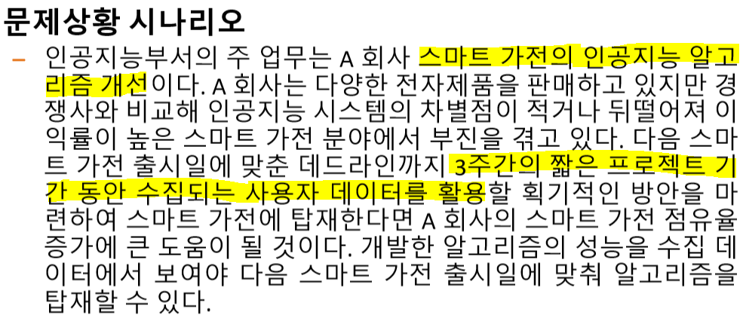
Part 1. Problem

Slide 4
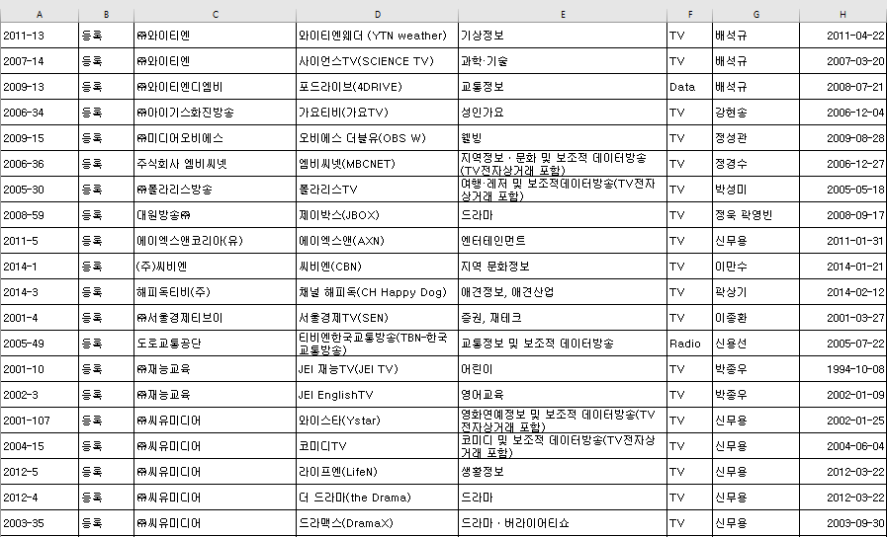
Part 2. Data Set
방송채널사용사업자 승인등록 현황(2014.12.10)
공공데이터포털(www.data.go.kr)

Slide 5
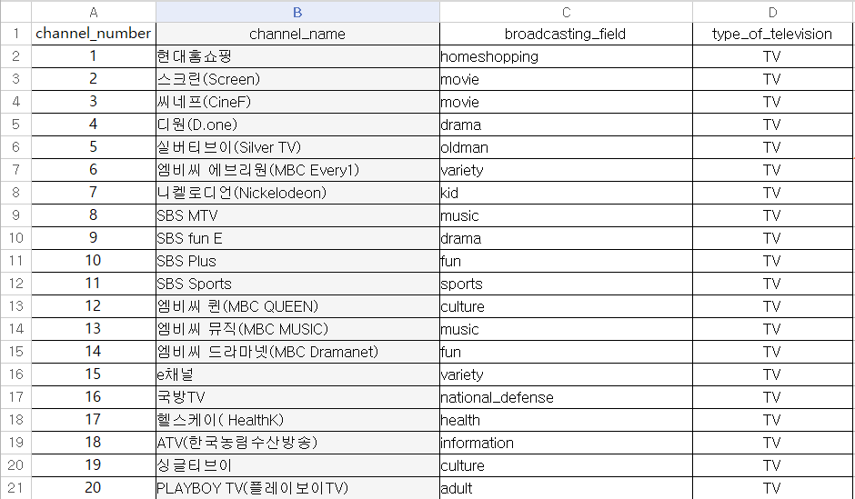
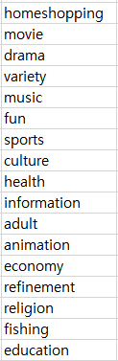
Part 2. Data Set
총 17개
총 274개
수정된 Data set
Broadcasting_field

Slide 6
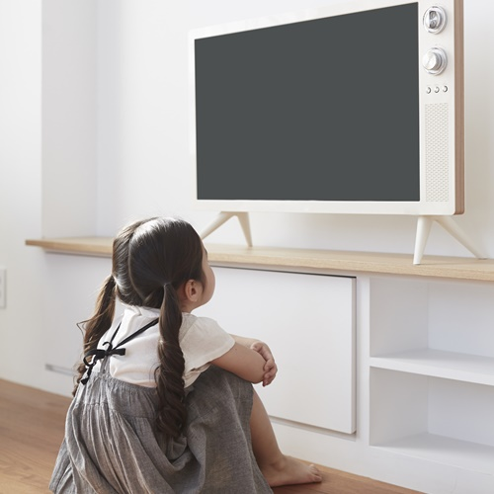
Part 3. Implementation Plan

Slide 7

Part 3. Implementation Plan
Genre

Slide 8


Part 3. Implementation Plan
1차 채널 스킵

Slide 9
Part 3. Implementation Plan

Slide 10
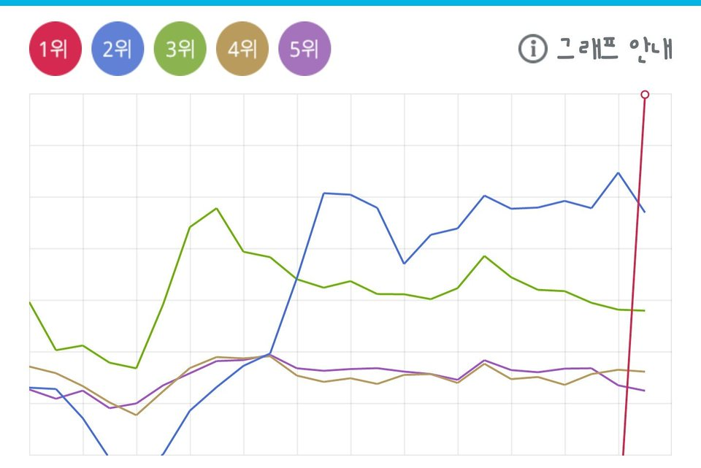
Part 3. Implementation Plan
Reward

Slide 11
Part 3. Implementation Plan
Deep-Q Network
2차 채널 스킵

Slide 12
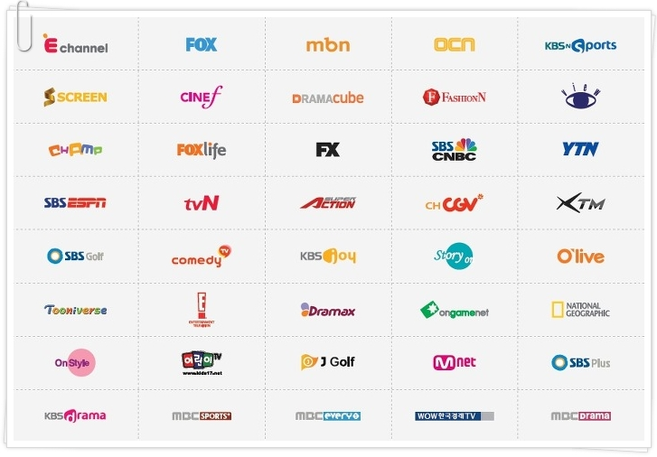
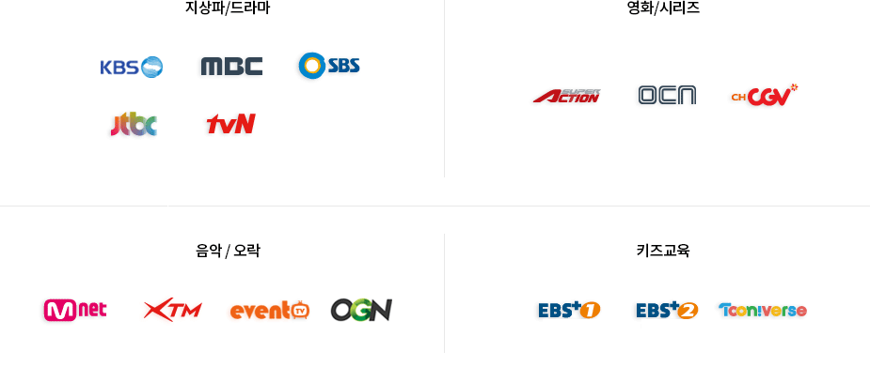


Part 3. Implementation Plan

Slide 13

Part 4. Expectation Effectiveness

