Slide 1
Similar trademark search system
based on images using deep learning
Taehyun Kim

Slide 2
How to create
Google image search service?

Slide 3



상표권 분쟁

Slide 4
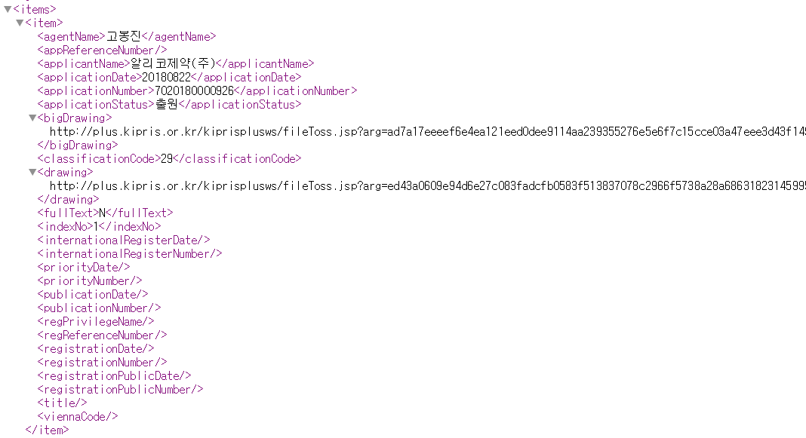
REST API, XML format

Slide 5

3,575,205
2,108,739
1,200,000
Total data
XML Parsing – SQLite DB
URL Retrieve – 100x100 Image
1,080,000
Model Creation

Slide 6

GraphLab Create API
Python library, backed by a C++ engine, for quickly building large-scale, high-performance data products.

Slide 7
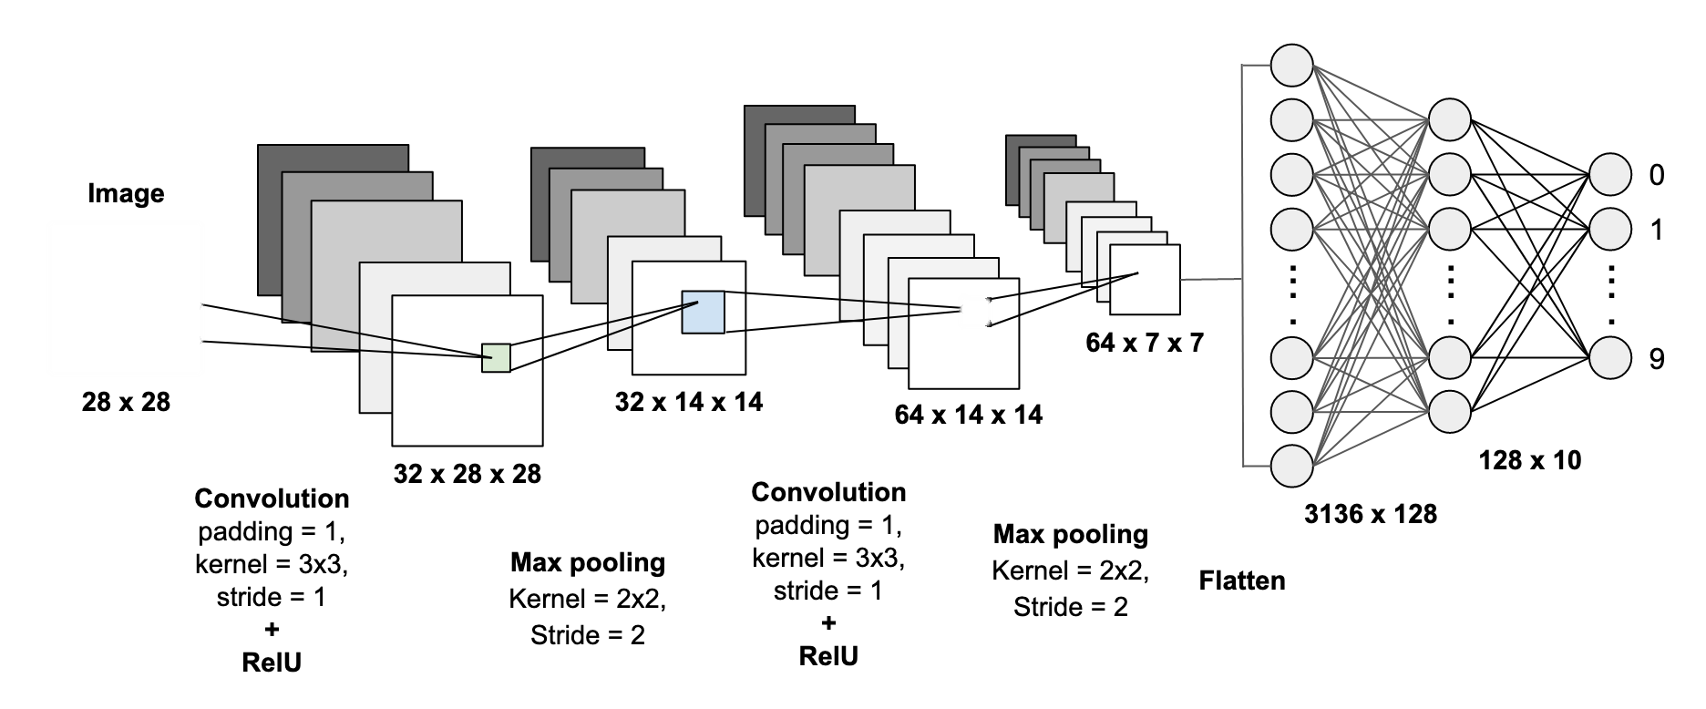
1.
CNN – feature extraction

Slide 8
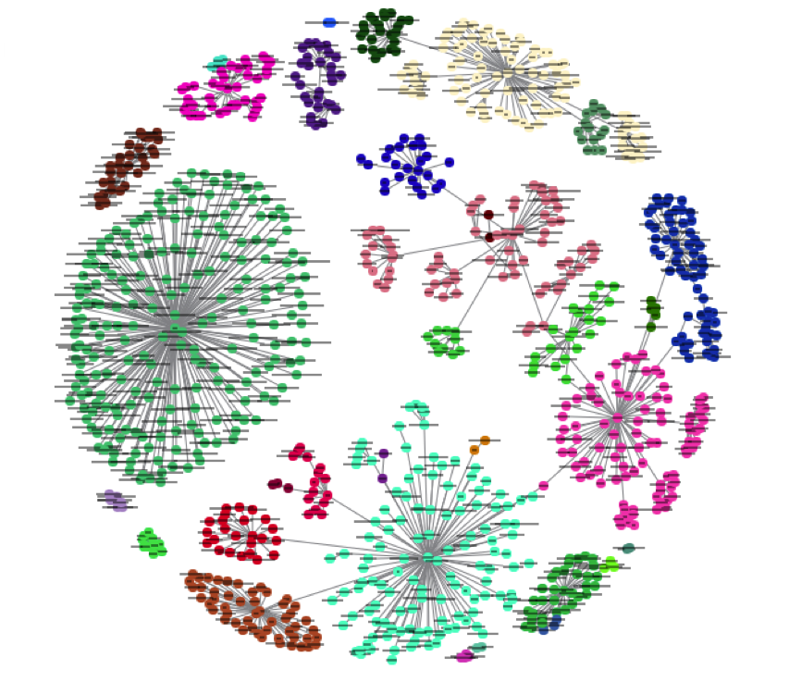
2.
Clustering – K nearest neighbor

Slide 9
3.
Measure Distance
D(a,b)=2 ∗ d_{euclidean}(a[X1,X2],b[X1,X2])
+ 0.3∗d_{levenshtein}(a[cluster],b[cluster])

Slide 10

Flask Framework
Flask depends on the Jinja template engine and the Werkzeug WSGI toolkit.

Slide 11
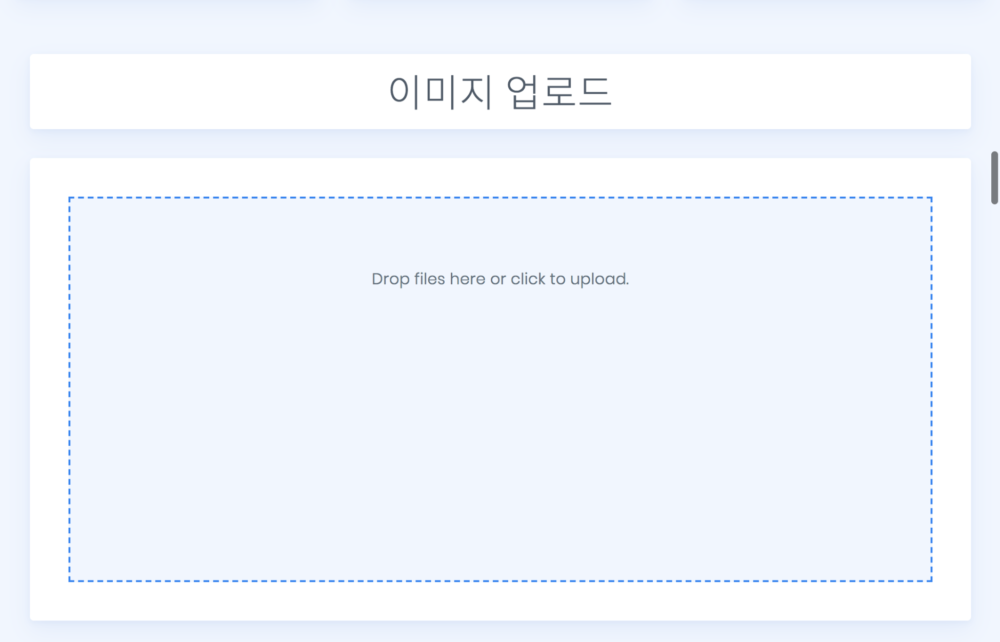
Image Upload

Slide 12
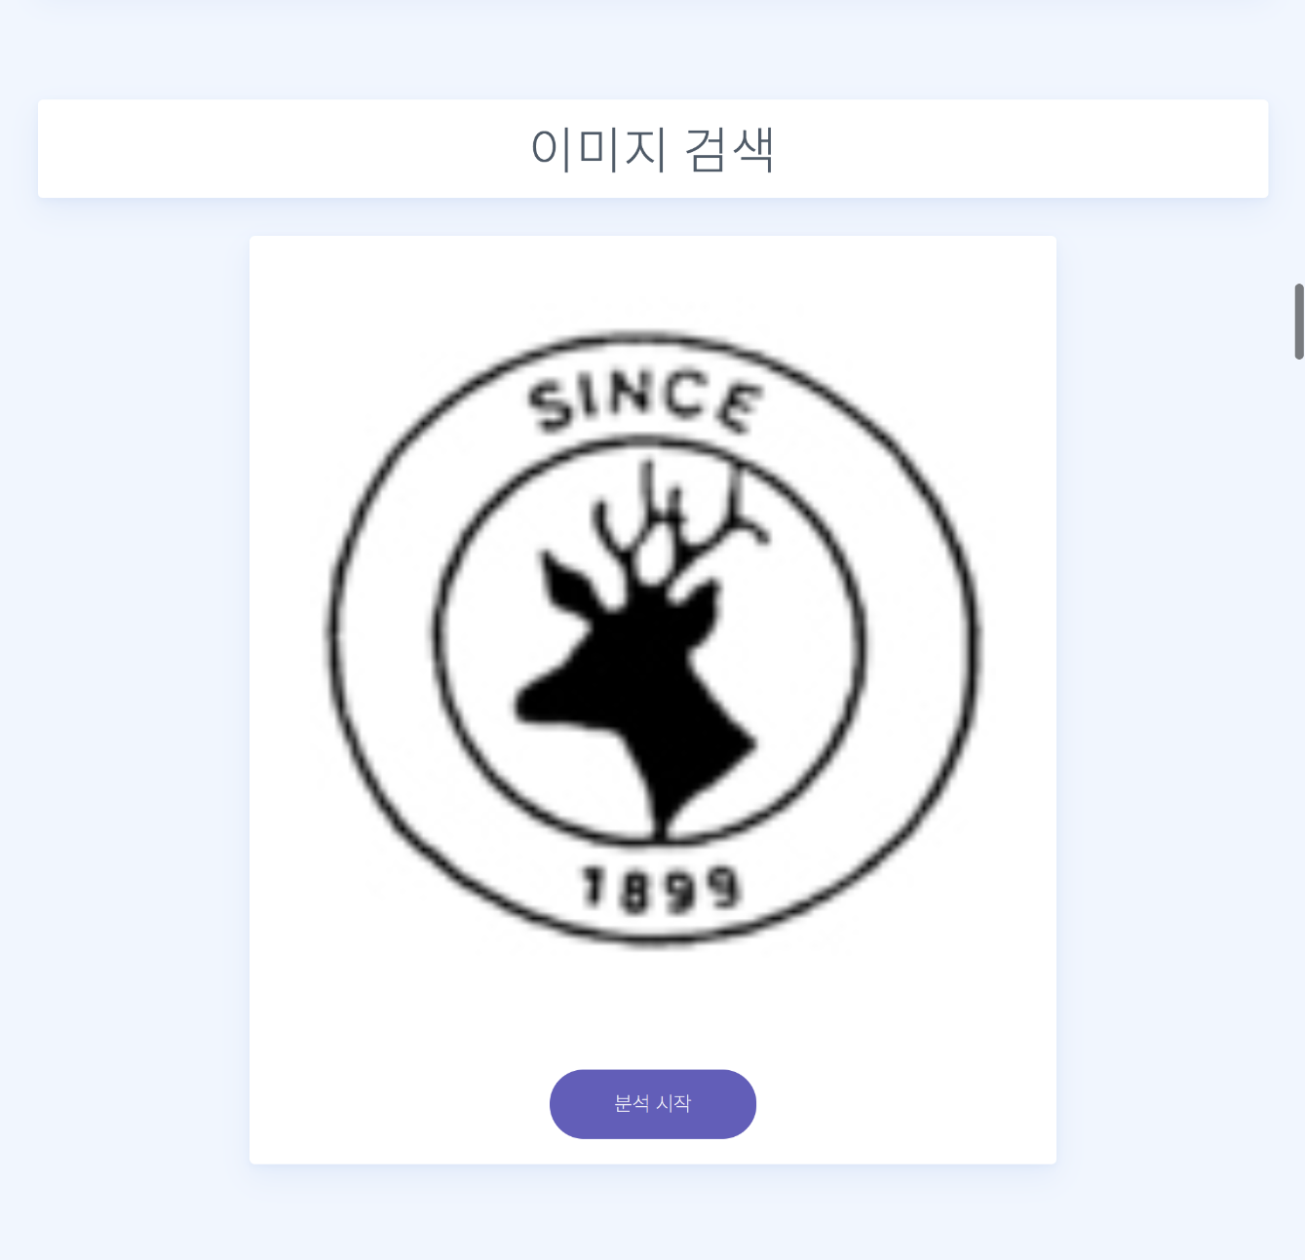
Measure Distance

Slide 13
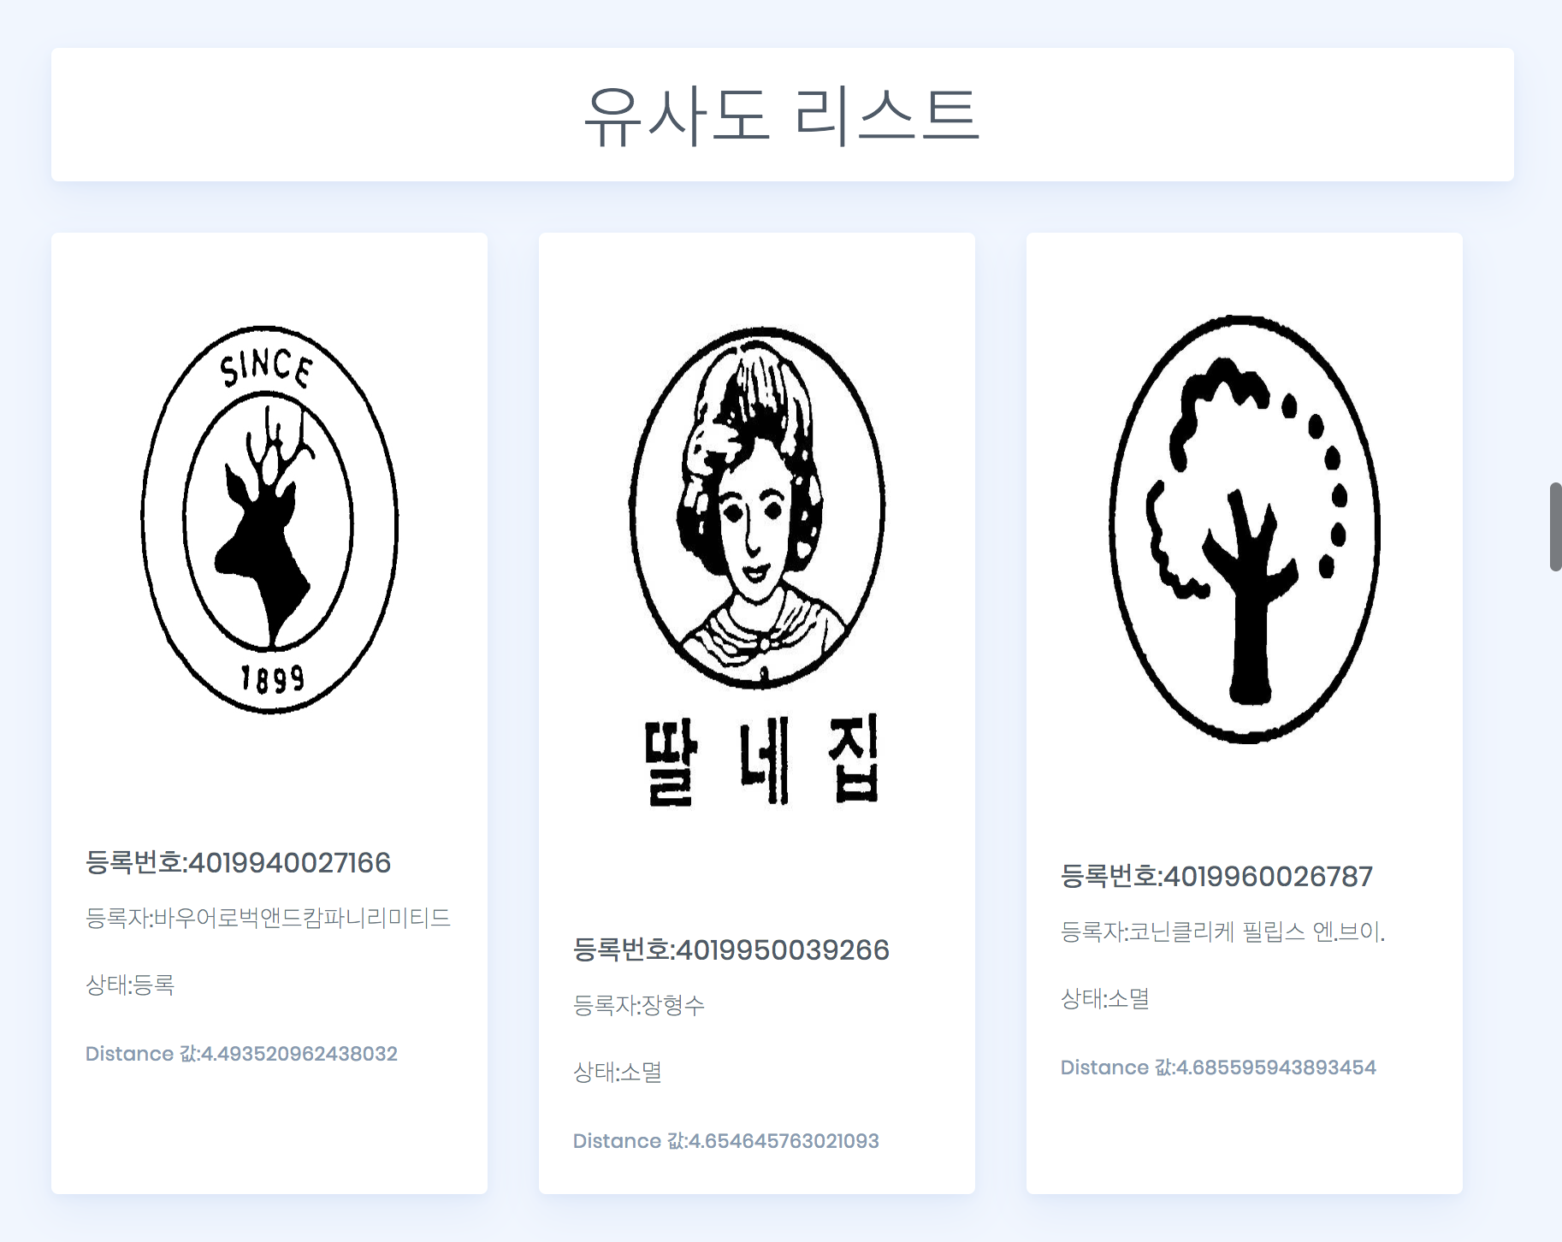
Result

Slide 14
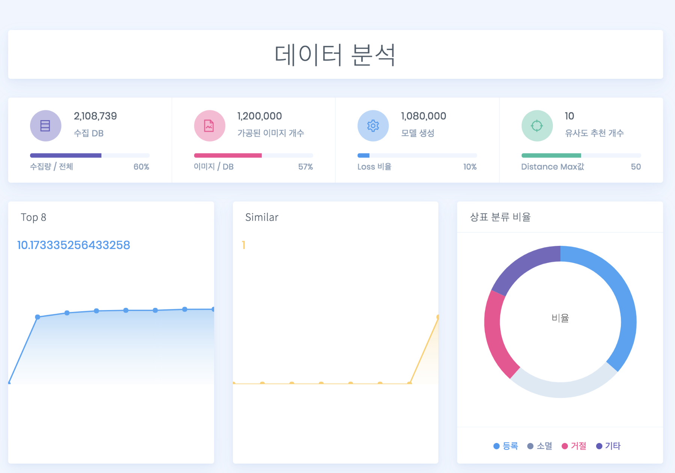
Analysis

Slide 15
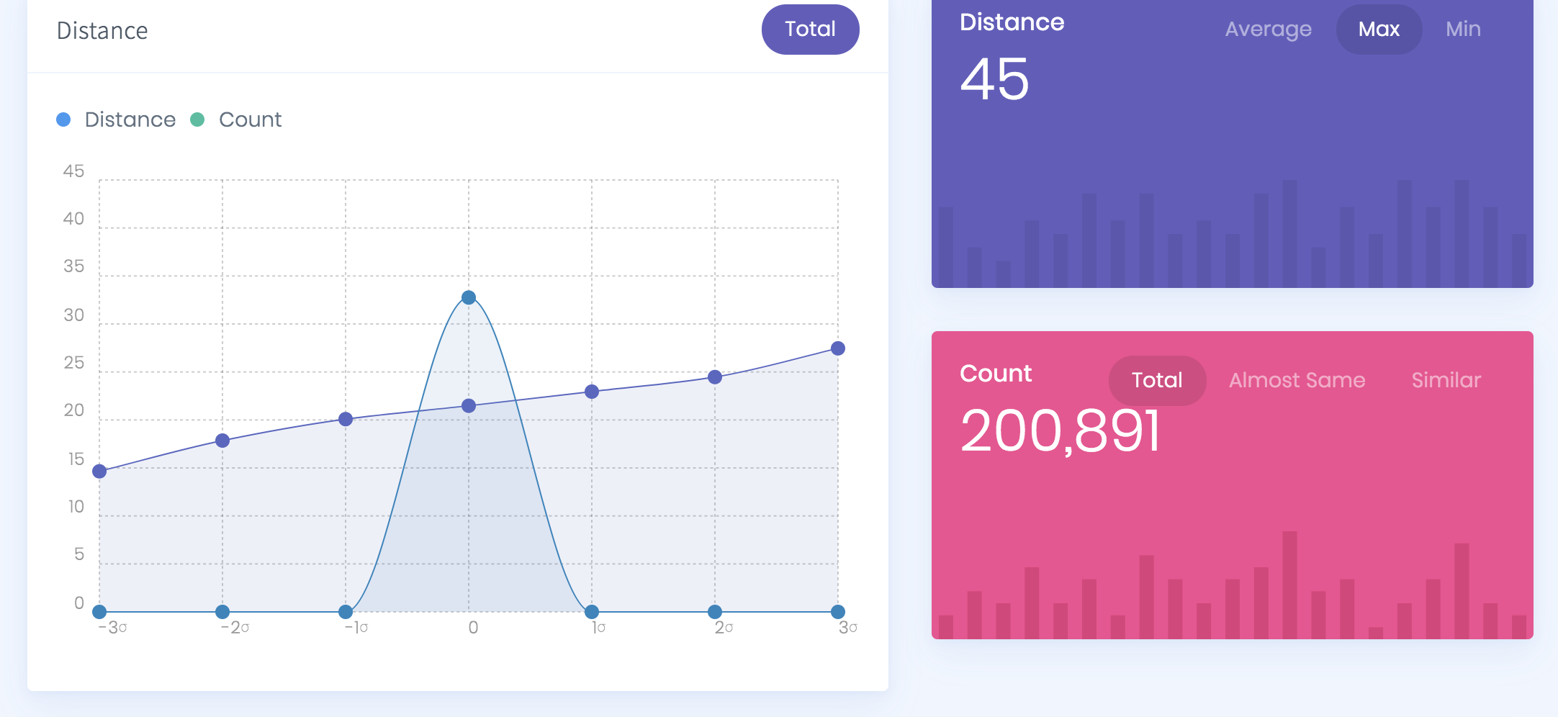
Analysis - Distribution

Slide 16
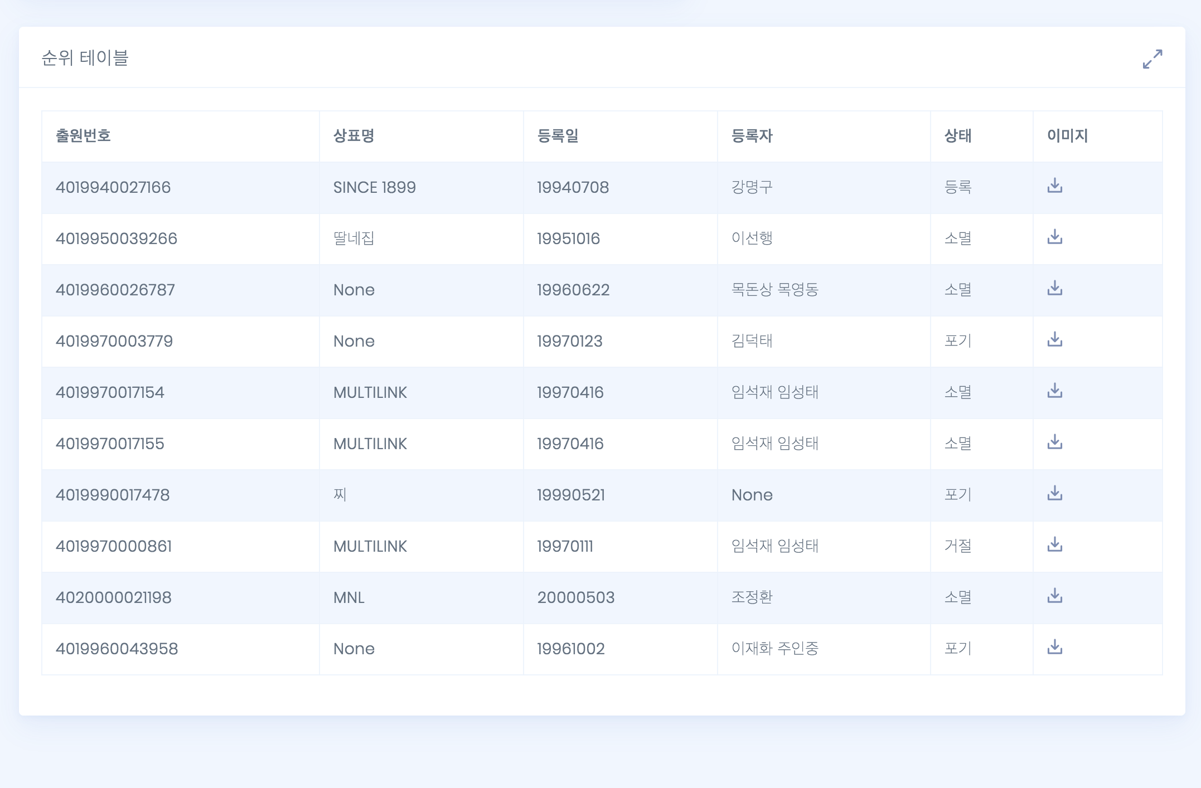
Analysis – Top 10 Meta Data

Slide 17
감사합니다

