Slide 1



SQLite Overview
오기환
wurikiji@skku.edu
Notes:
Thank you for introduction. (사회자 진행후)
My name is Gihwan Oh.
Today,/ I will present our recent work/ on SQLite Optimization with Phase Change Memory for Mobile Applications.
As far as we know,/ this is the first work/ in database community/ using real PCM Chips.
This is a joint work with my advisor/ Sang-Won Lee at S K K U,(천천히) Sangchul Kim/ and Bongki Moon at Se Na Un.
====
====== dGood afternoon everyone
We designed and Implemented a new physiological Logging system for SQLite with a Real PCM
We call this new approach Per-page-logging with PCM, and in short PPL.

Slide 2
What is SQLite?
Open source
SQL database engine Library
Self-contained, serverless, zero-configuration, transactional
Well suited for use in embedded devices
Tables, indices, triggers, and views
All in a single disk file
File format is cross-platform
Replacement for normal file (fopen)

Slide 3
About SQLite
Compact size
Less than 500KB with all features enabled
Run in minimal stack and heap
4KB stack space and 100KB heap space
Transactions are ACID

Slide 4
Datatypes In SQLite
Dynamic typing
Datatype is associated with the value itself
Types
Text, Numeric, Integer, Real, Blob

Slide 5
Appropriate Uses For SQLite
Embedded and IoT
Alternative of file
Light-weight websites
Simple Data analysis
Cache for server-client RDBMS

Slide 6
The architecture of sqlite

Slide 7
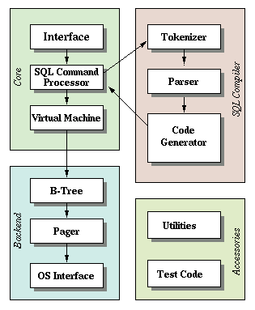
Block Diagram Of SQLite
3 Parts + 1 Util 의 구성
Library core
SQL compiler (parser)
Backend (engine)
Accessories

Slide 8
Core - Interface
Public interface to the SQLite library
Mostly implemented in the main.c, legacy.c, vbdeapi.c
All symbols in the SQLite begin with the prefix sqlite3
sqlite3_initialize(), sqlite3_shutdown() …

Slide 9
Core – Virtual Machine
VM executes virtual machine codes generated by code generator
Coded in vdbe.c, vdbe.h, vdbeInt.h, vdbeapi.c, vdbemem.c
Implements built-in SQL functions
count(), substr(), date(), sum() …
Coded in func.c, date.c

Slide 10
SQL Compiler
Tokenizer breaks the original string and call parser
Hand-coded in tokenize.c
Parser assigns meaning to tokens
Coded in tokenize.c, parse.y, tool/lemon.c
Code generator produces virtual machine codes
Distributed to many source files

Slide 11
Backend
B-Tree
Main structure of database
Codes in btree.c, btree.h
Page Cache
Reading, writing, caching the data chunks
Rollback, atomic commit, locking
Codes in pager.c, pager.h
OS Interface
Provides portability between POSIX and Win32
An abstraction layer to OS
os_unix.c for unix, os_win.c for windows

Slide 12
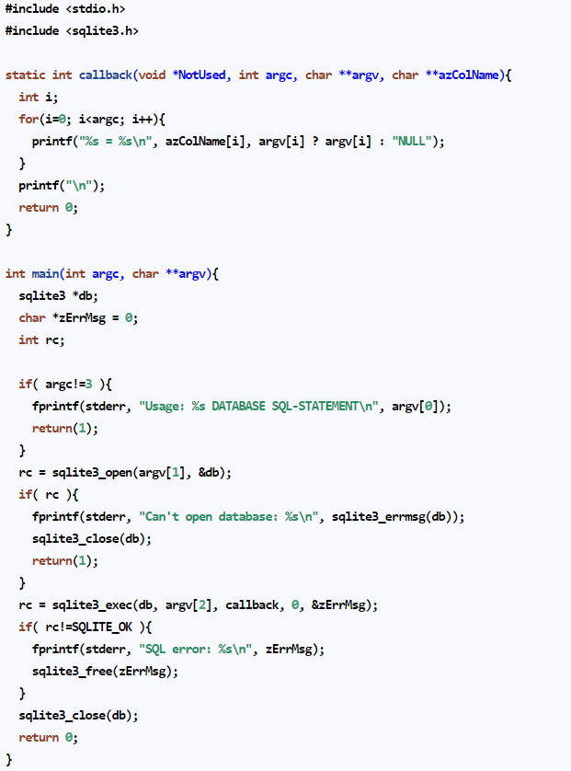
Sample programs

Slide 13
Internals of sqlite

Slide 14
Atomic Commit
Pager module manages atomicity
Provides journal
Rollback journal, WAL journal
Each journal guarantees the atomicity of single file commit
Master journal is used for multi file commit

Slide 15
Database locking
SQLite uses file locking with POSIX advisory file locks
Pager module manages locking
UNLOCKED, SHARED, RESERVED, PENDING, EXCLUSIVE mode
Only one process can write

Slide 16
Isolation
Reader is only able complete committed transactions to see from writer
Except for read-uncommitted mode
All transactions show serializable
In rollback journal mode
All readers are prohibited while writer is running
In WAL mode
Readers and writers can run simultaneous

Slide 17
Roll back journal

Slide 18
RBJ
Rollback Journal (RBJ)
Old page images are backed up in RBJ file for undo
RBJ file should be deleted at commit time
Transaction commit is regarded as success only after RBJ file is deleted
RAM
P1_old
P2_old
Transaction Commit
P1_new
P2_new
before Update
fsync() DB file
2 fsync()s RBJ file
Storage
P1_old
P2_old
Journal file is deleted
RBJ file (per TX)
Notes:
Now I will explain two journal modes of SQLite.
First Rollback journal mode.
If a transaction updates pages in rollback journal mode,
the original content of the page is copied to the rollback journal before updating it in the database, so that the change can always be undone if the transaction aborts.
When transaction commits, SQLite syncs rollback journal file first,
then flushes updated pages to original database file.
Original database file is also required to sync before commit.
Rollback journal file should be deleted at commit time.
In addition, A transaction commit is regarded as success only after journal file is deleted.
there are some run-time overheads in rollback journal mode:
It is described in right figure.
First a journal file is created and deleted whenever a new transaction begins and ends.
Second, it invokes 3 fsync operations per transaction, and it incurs 2 writes per each updated page.
According to recent study, one logical page update in SQLite which runs in rollback journal mode, may invoke 22 physical page writes in the worst case.

Slide 19
WAL journal

Slide 20
WAL
The original content is preserved in the database file
Changes are appended into a WAL file
Check-point when it becomes full
No file creation/deletion overhead
RAM
P1_new
P2_new
Transaction Commit
P1_old
P2_old
after Update
FULL
fsync() DB file
Check point
fsync() WAL file
Commit Done
Storage
P1_old
P2_old
P1_new
P2_new
WAL file
20

Slide 21
실습 예제
sqlite3_exec()
sqlite3_step(), sqlite3Step()
sqlite3VdbeExec()
sqlite3BtreeInsert()

Slide 22
References
공식 홈페이지
www.sqlite.org

