Slide 1
Sorting in SQLite
오기환
(wurikiji@gmail.com)
SKKU VLDB Lab. (27334)

Slide 2
Contents
Sorting in SQLite
Execution query plan analysis
VDBE level analysis
SQLite Internals
Assignment #4

Slide 3
Sorting in sqlite
Sorting Basics

Slide 4
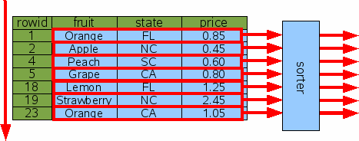
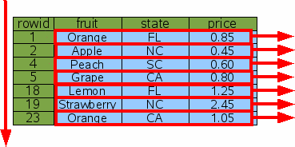
Sorting Scenarios - 1
Sorting without an index
SELECT * FROM fruitsforsale ORDER BY fruit;
Sorting by rowid
SELECT * FROM fruitsforsale ORDER BY rowid;

Slide 5
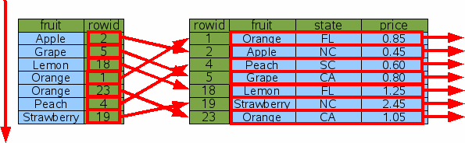
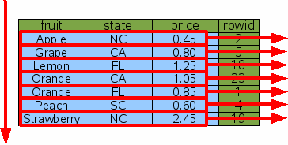
Sorting Scenarios - 1
Sorting by index (ex. index on fruit)
SELECT * FROM fruitsforsale ORDER BY fruit;
Sorting by Covering index
SELECT * FROM fruitsforsale ORDER BY fruit;

Slide 6


Sorter in SQLite - OLD
SQLite always uses B-tree to sort data
Simply insert records into B-tree
http://sqlite.org/eqp.html#temporary_sorting_b_trees

Slide 7
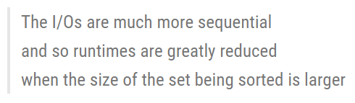
Sorter in SQLite - NEW
Version 3.7.8 features “external merge sort”
Order by, Group by, Create Index
http://sqlite.org/oldnews.html

Slide 8
Execution query plan analysis
Send order by Queries

Slide 9
Using Execution Query Plan
sqlite> .eqp full
You can see execution query plan for what you request
sqlite> select * from a order by a;
Send ‘order by’ query to execute sort

Slide 10
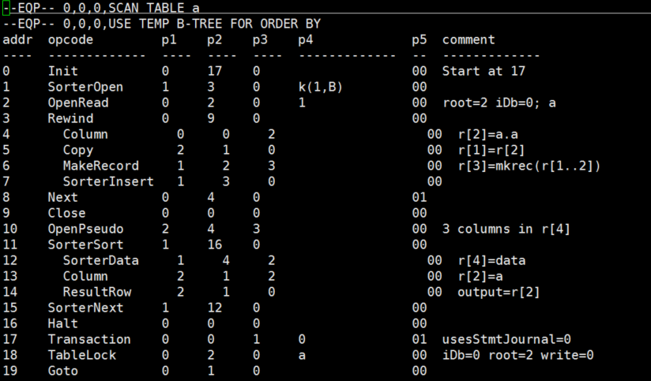
Execution Query Plan - Sort

Slide 11
VDBE level analysis
VDBE Opcodes

Slide 12
OP-codes related to Sort
OP_SorterOpen
Open a transient index that is specifically designed to sort large tables using external merge sort
OP_SorterInsert
Add a record to sorter
OP_SorterSort
Move cursor to forward and Sort data
OP_SorterNext
Get next elements in sorter
See details on vdbe.c

Slide 13
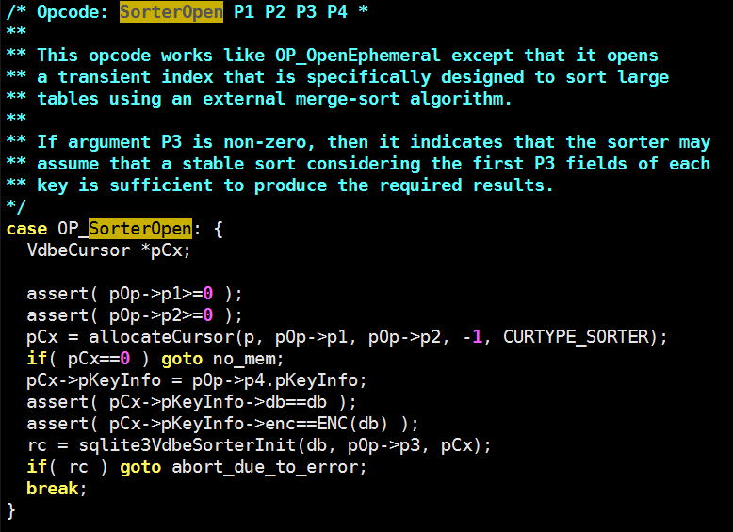
OP_SorterOpen

Slide 14
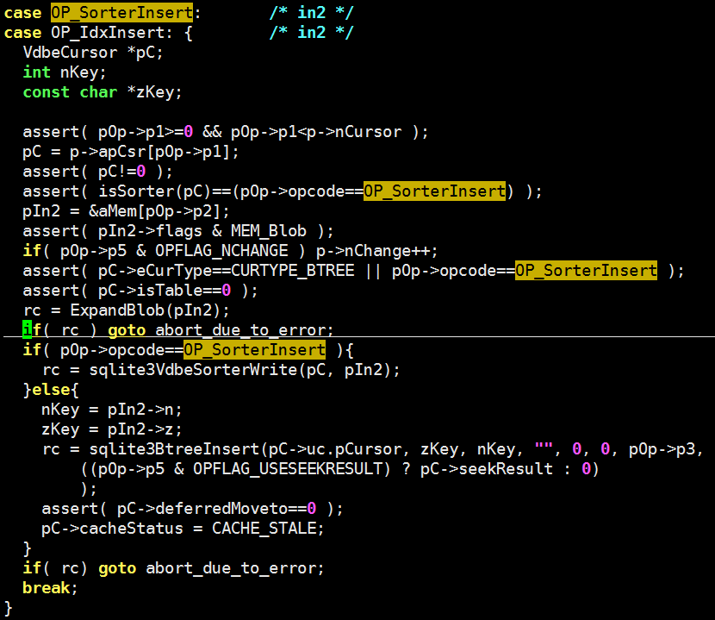
OP_SorterInsert

Slide 15
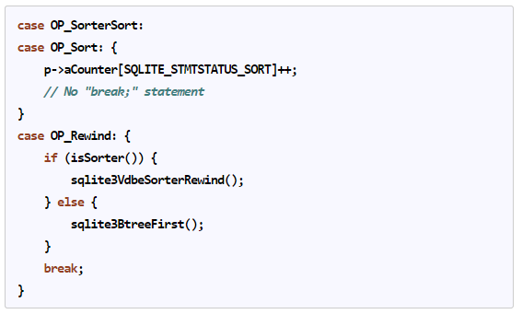
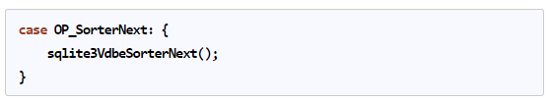
OP_SorterSort & OP_SorterNext

Slide 16
SQLite internals
SQLite sort code examples

Slide 17
Overview
Temp Memory
PMA or Page
Record
Record
Record
Record
Record
Record
Record
Record
Record
Record
Record
Record
Record
Record
Record
Record
Record
Record
Record
Record
Record
Record
Record
Record

Slide 18
Basic Terms - 1
All codes related to sort are in vdbesort.c
Sorter
Sorting module
PMA – Packed Memory Array
Data format to write ‘sorted data’ to file
Same terms with “run”
Temp Memory
Used to sort data
Default: Set to same as buffer cache size

Slide 19
Sorter Structure
SorterList
SorterRecord
Union
pList
Linked list of records
aMemory
Bulk SorterRecord
szPMA
Size of list as PMA
nVal
Size of Record
pNext/iNext
Next record
Using Pointer pNext
Using offset iNext
nVal
Size of Record
iNext
Next offset
nVal
Size of Record
pNext
Next address
nVal
Size of Record
iNext
Next offset
nVal
Size of Record
iNext
Next offset
nVal
Size of Record
pNext/iNext
Next address
nVal
Size of Record
iNext
Next offset
Allocate SorterRecord
Separately
Allocate Bulk Memory
For SorterRecord

Slide 20
Making PMA
SorterRecord
nVal
Size of Record
pNext/iNext
Next record
Record
Space for Record
sizeof(SorterRecord)
nVal bytes
Packed Memory Array Element
nVal
Size of Record
Record
Space for Record
Length <= 4 bytes

Slide 21
Basic Terms - 2
MergeEngine
Has multiple PMAs
Combine multiple PMAs (default: <= 16) into one big PMA using merge operation
MergeEngine
nTree
Size of array
pTask
For multi thread sorting
aTree
Merge Result Tree
aReadr
Input data

Slide 22
MergeEngine
Uses Incremental Merge Tree
aReader
Banana
Feijoa
Elderberry
Currant
Grapefruit
Apple
Durian
0
1
2
3
4
5
6
aTree
5
0
5
0
3
5
6

Slide 23
MergeEngine (cont’d)
Uses Incremental Merge Tree
aReader
Banana
Feijoa
Elderberry
Currant
Eggplant
Grapefruit
Apple
Durian
0
1
2
3
4
5
6
0
5
0
aTree
0
6
3
5
6
5

Slide 24
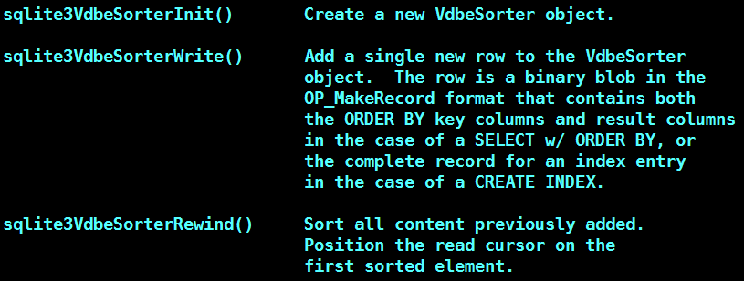
Sort-related Functions – 1/2

Slide 25
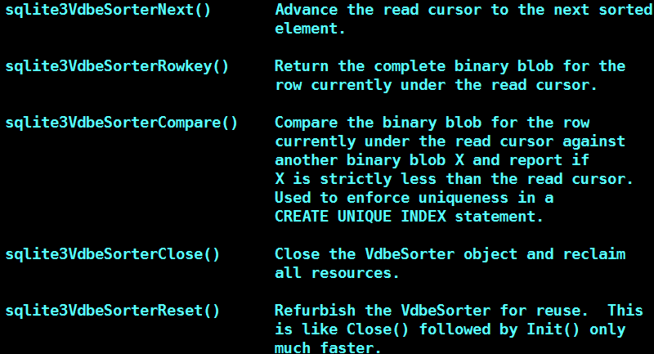
Sort-related Functions – 2/2

Slide 26
Merge Sort in SQLite
If data fit to the memory size
Collect records to be sorted
Use in-memory merge sort
If data exceeds the memory size
Use external merge sort
Sort collected records
Write sorted records to a file in PMA format

Slide 27
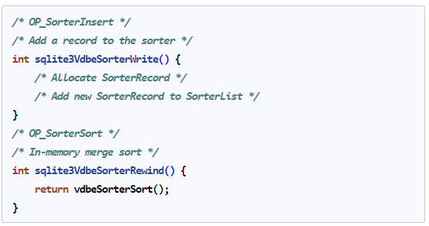
Case 1 – in-memory
If data fit to the memory size

Slide 28
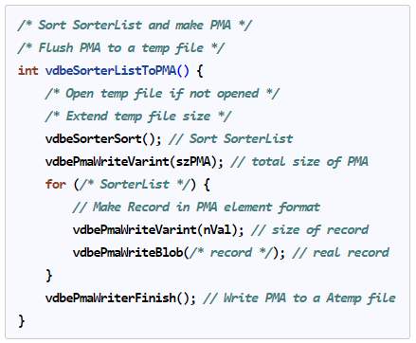
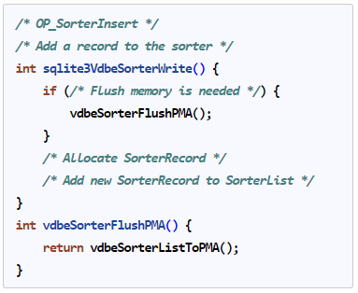
Case 2 – EMS
If data exceeds the memory size
OP_SorterInsert

Slide 29
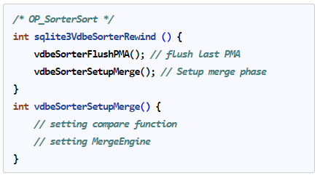
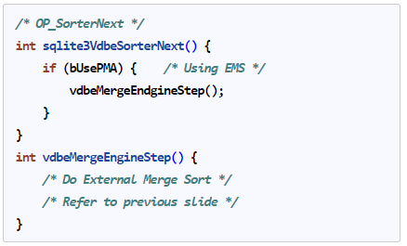
Case 2 – EMS (cont’d)
OP_SorterSort & OP_SorterNext

Slide 30
EMS with Multi Thread
struct SortSubtask
Representation of a single thread sorter
pThread: Thread information
bDone: Progress information
pSorter: Sorter object
list: SorterList
nPMA: # of PMAs in a file
file, file2: Level-0 and other

Slide 31
EMS with Multi Thread (cont’d)
vdbeSorterFlushPMA()
Select idle background thread
Use round-robin for searching
Use foreground (main) thread if all threads are busy
Launch a thread to call vdbeSorterListToPMA()
Go back to vdbeSorterWrite() right after launching the thread
Flush PMA and Add records to memory can be overlapped

Slide 32
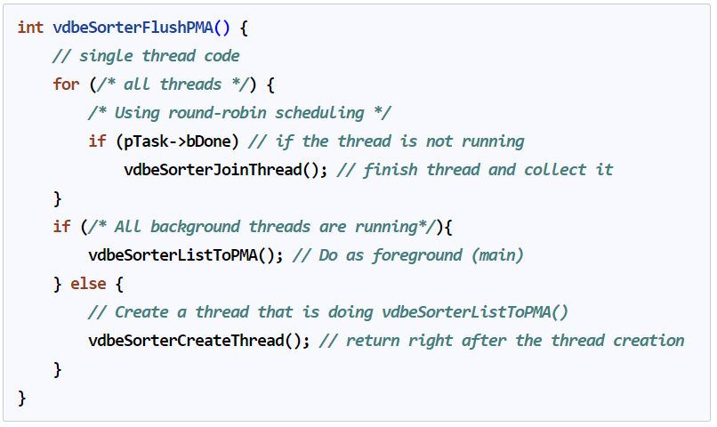
EMS with Multi Thread (cont’d)

Slide 33
EMS with Multi Thread (cont’d)
sqlite3VdbeSorterRewind()
Wait background flusher using vdbeSorterJoinAll()
Setup MergeEngine for all threads
Read a first PMA for all threads concurrently
All threads also create a new thread to read a next PMA after reading the first PMA
Next step like OP_SorterNext can be overlapped with reading a next PMA

Slide 34
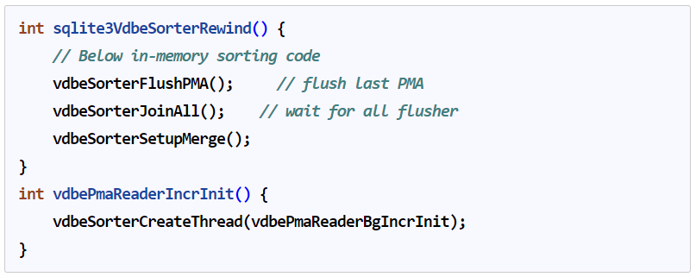
EMS with Multi Thread (cont’d)

Slide 35
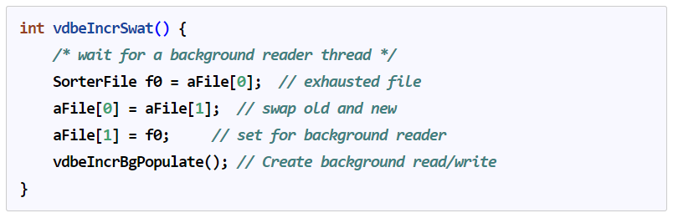
EMS with Multi Thread (cont’d)
sqlite3VdbeSorterNext()
If one of the threads reaches to the end of PMA
Swap an exhausted PMA and a new PMA
Wait until the background thread is finished reading
Create a new thread to read a new PMA
Merge and read a new PMA can be overlapped

Slide 36
Tips 1
https://github.com/wurikiji/2016-db-programming-fall
4주차/4주차 pcache 할당.md
함수 포인터 추적하기
Sqlite에서 pcache 관련 함수 포인터 설정하는 루틴
리눅스에서 개발 환경 만들기
https://ysoh.wordpress.com/2012/04/09/리눅스-커널-개발을-위한-vim-설정-vimrc/
Vim 에디터를 활용하여 쉽고 빠르게 코드 분석하는 방법
다른사람과 질문 공유하기
https://github.com/wurikiji/2016-db-programming-fall/issues

Slide 37
Tips 2
유닉스 리눅스 프로그래밍 필수 유틸리티
백창우 저, 한빛미디어
Vim, make, gcc, gdb 등에 대한 필수 설명서
How to Git
https://help.github.com/articles/good-resources-for-learning-git-and-github/
https://git-scm.com/

Slide 38
References
http://sqlite.org/queryplanner.html
select and sort in SQLite

