Slide 1
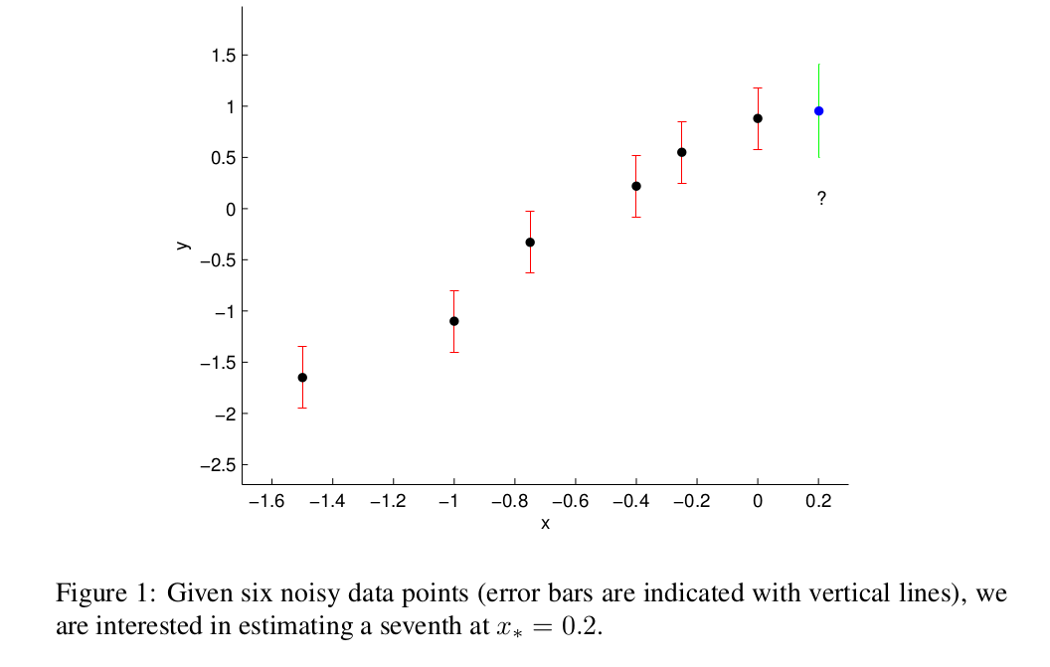
Gaussian Processes for Regression:
A Quick Introduction
Motivation
M. Ebden, “Gaussian Processes for Regression: A Quick Introduction”, 2008

Slide 2

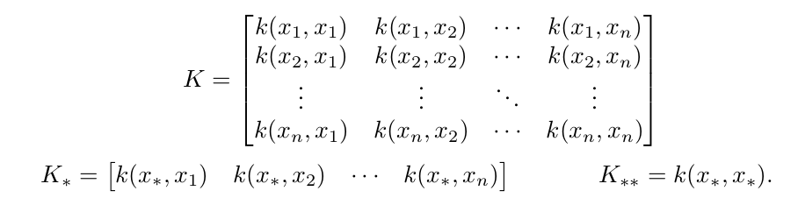

Gaussian Processes for Regression:
A Quick Introduction
Kernel Function and Covariance Matrix
Prediction
M. Ebden, “Gaussian Processes for Regression: A Quick Introduction”, 2008

Slide 3
Gaussian Processes for Regression:
A Quick Introduction
Example
M. Ebden, “Gaussian Processes for Regression: A Quick Introduction”, 2008

Slide 4
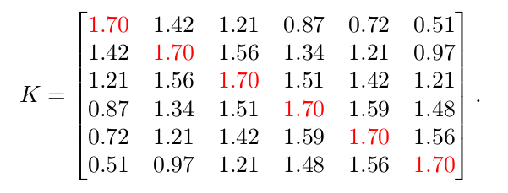


Gaussian Processes for Regression:
A Quick Introduction
Calculate Covariance Matrix
M. Ebden, “Gaussian Processes for Regression: A Quick Introduction”, 2008

Slide 5
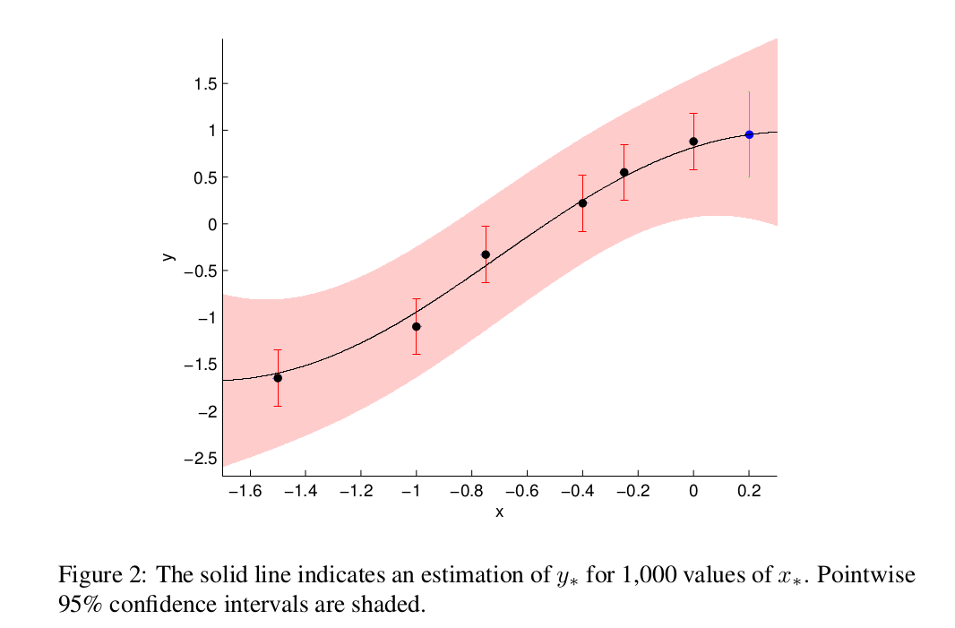

Gaussian Processes for Regression:
A Quick Introduction
Prediction and Result
M. Ebden, “Gaussian Processes for Regression: A Quick Introduction”, 2008

Slide 6
Gaussian Processes for Regression:
A Quick Introduction
Practical Writing Python Code
M. Ebden, “Gaussian Processes for Regression: A Quick Introduction”, 2008

