Slide 1
Summary of Work (18.07.22)
DONE
TODO
new args added for controlling parameters of avgpooling: kernel_size, stride, padding
PoolingLayer is now class attribute which ensures that everywhere same pooling layer is used
New info is added to csv: parameters of PoolingLayer & number of feautures resulting after AvgPool Filter and Embedding
New args added for controlling the maps that are used for feature extraction
Latence measurement of different feature maps / layers
Results plotted
Img auc and pixel auc are saved (yet to run) for analysing influence of performance
Validation run for both patch size and feature_maps
take auccuracy into account
Different search methods
Better plots (different scales, stacked bar)
Reduce feature extraction time by just computing necessary parts and neglect everything else

Slide 2
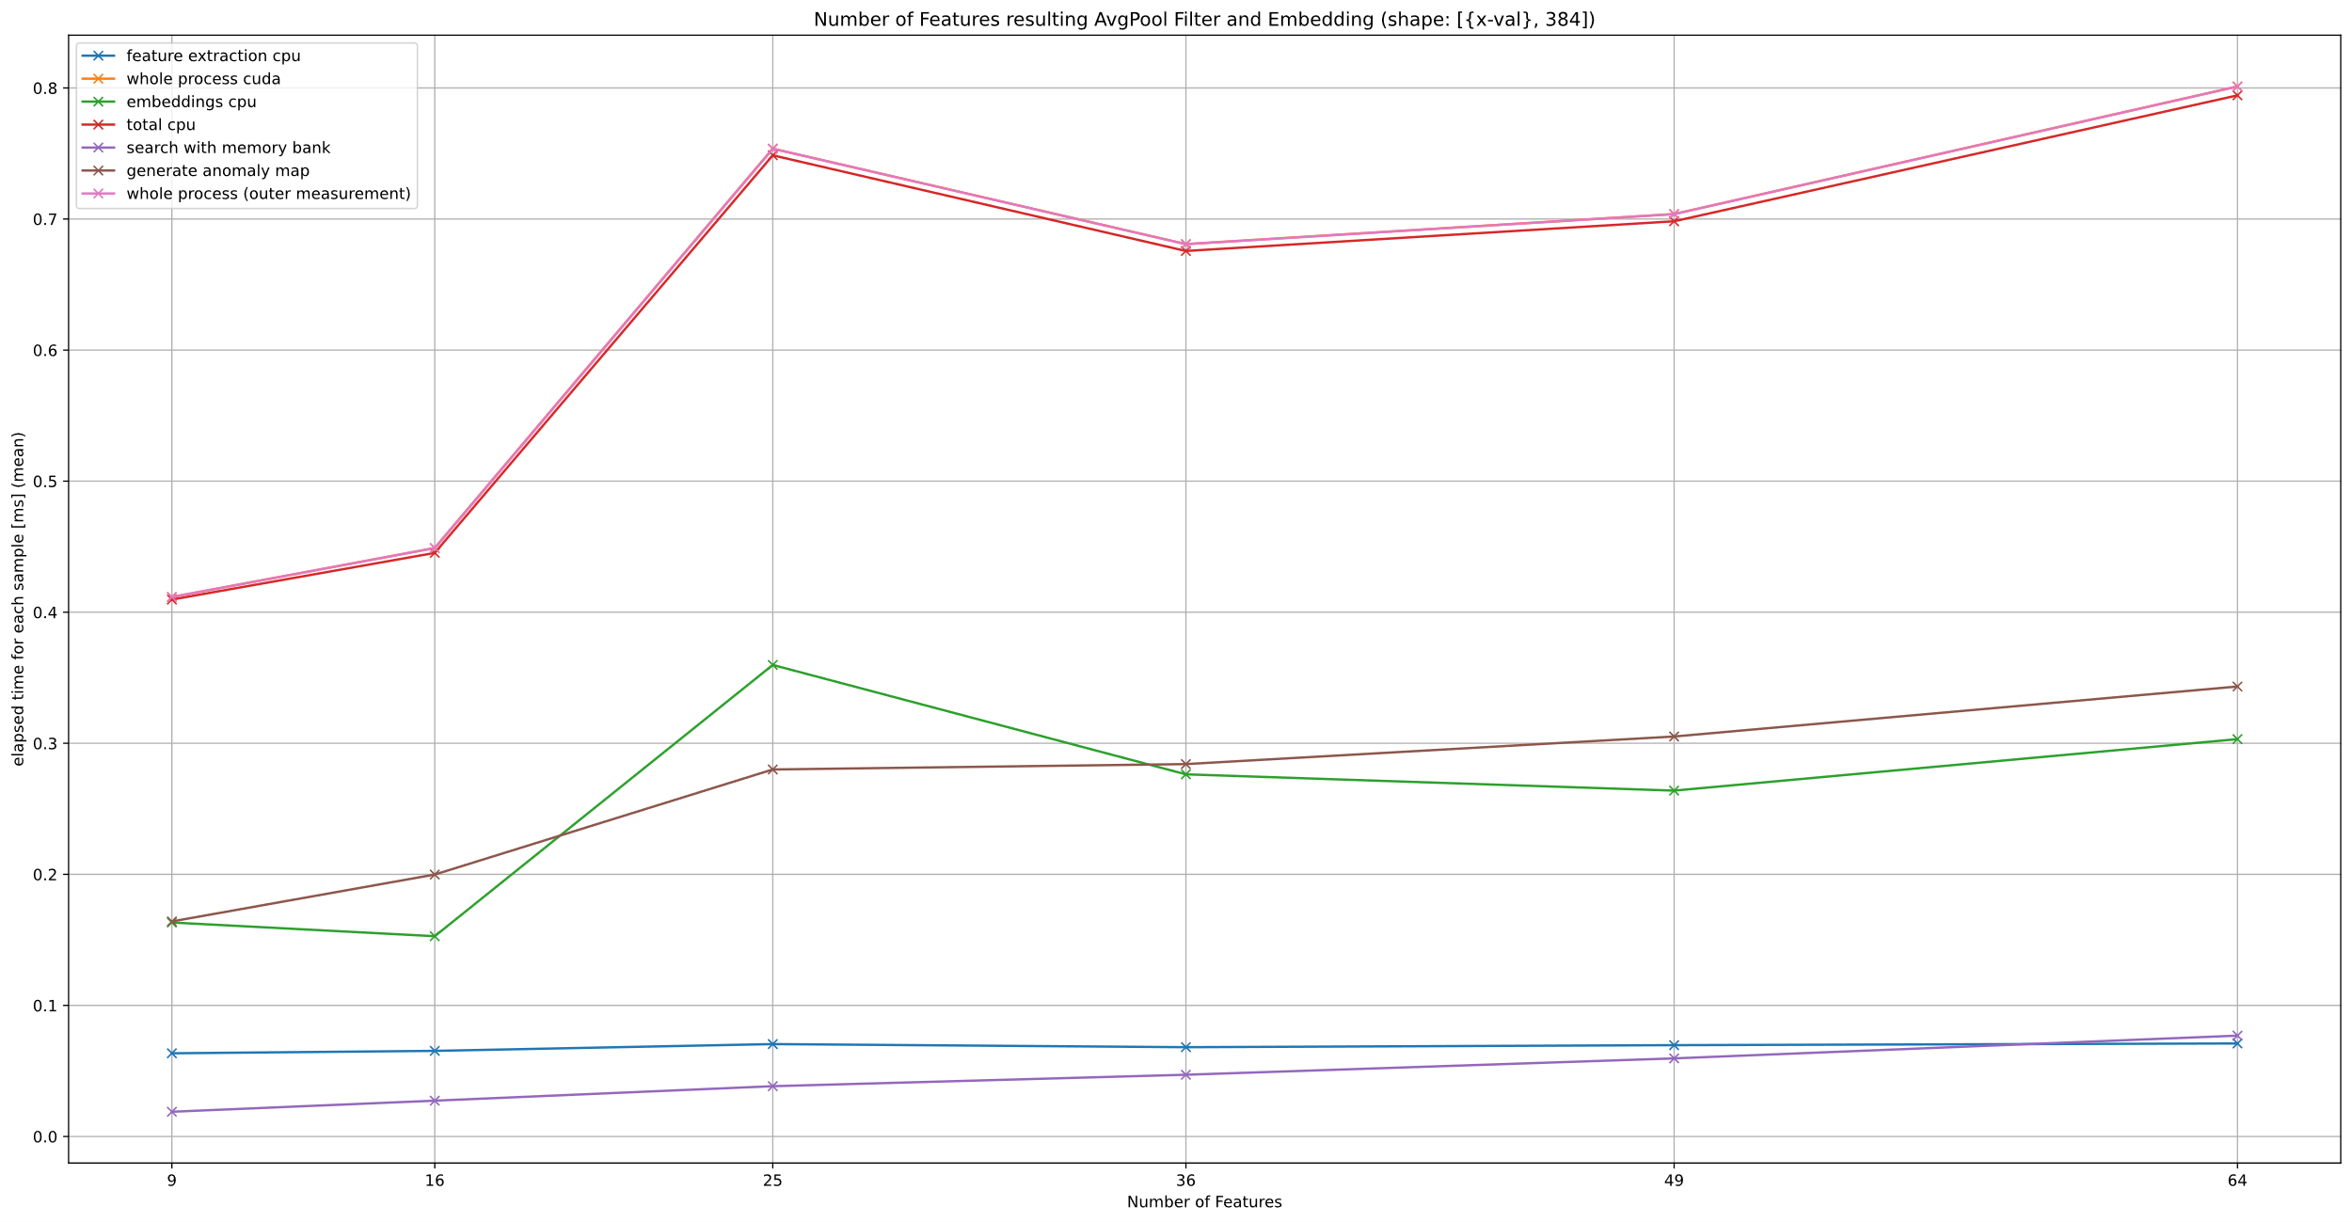
Notes:
What has been done?
new args added for controlling parameters of avgpooling: kernel_size, stride, padding
PoolingLayer is now class attribute which ensures that everywhere same pooling layer is used
New info is added to csv: parameters of PoolingLayer & number of feautures resulting after AvgPool Filter and Embedding
Assumption: Process time / inference time depends only on the number of features resulting from Pooling Layer Proof: following two Slides

Slide 3
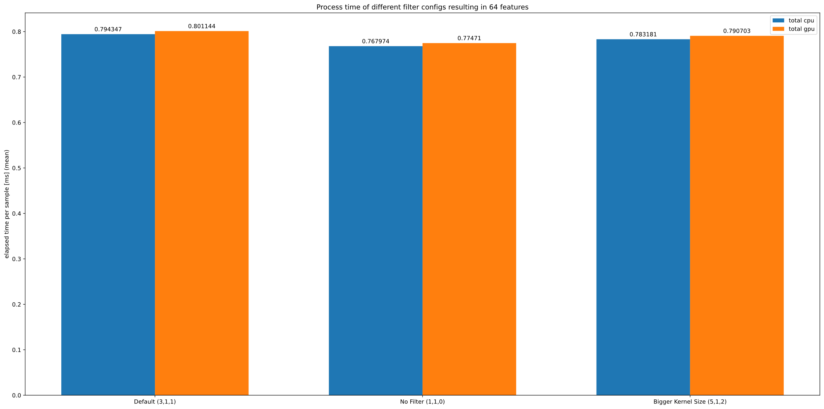
Notes:
Three different types of filters resulting in 64 Samples:
Default
No filter: Kernel_size: 1, stride: 1, padding: 0
Kernel size: 5; stride: 1; padding: 2
Batch size = 56 because this results in 4 batches with equal size

Slide 4
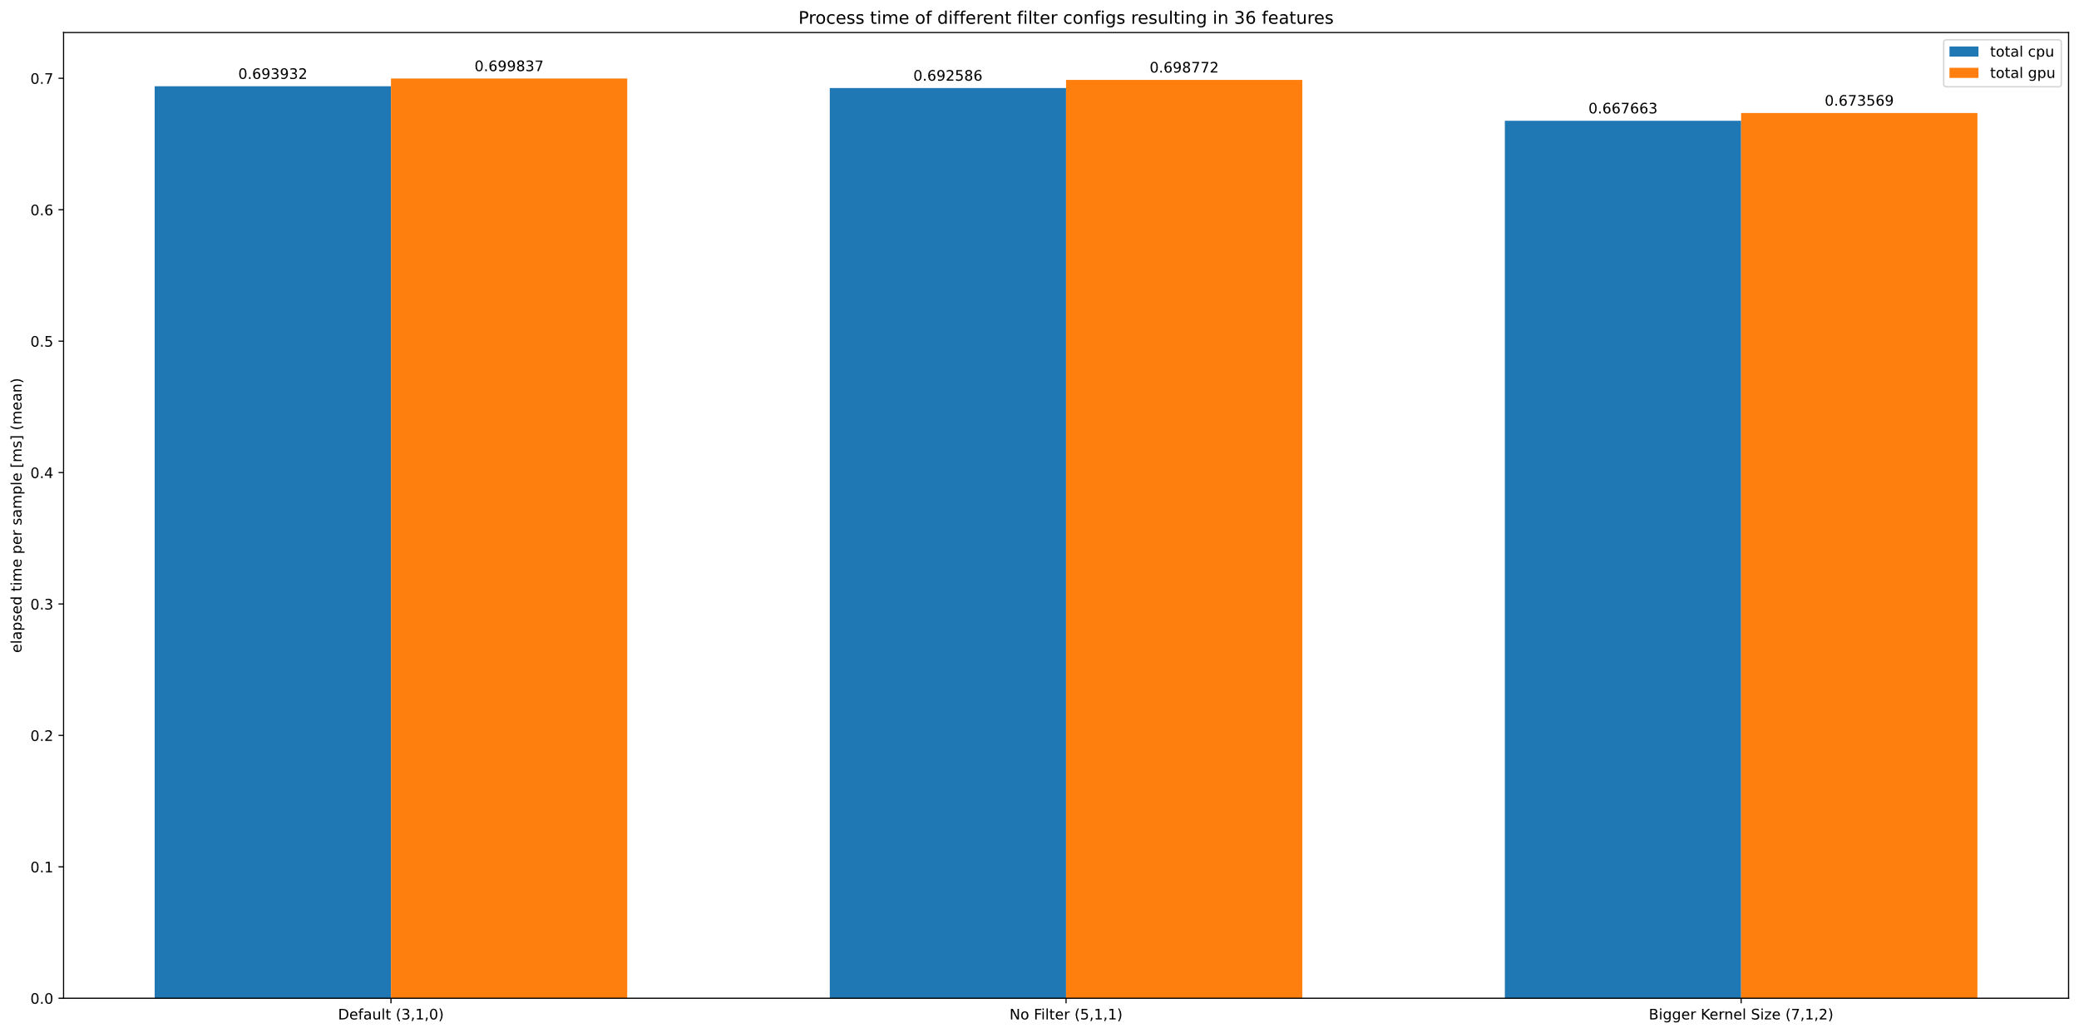
Notes:
Three different types of filters resulting in 36 Samples:
Default without pading
Kernel_size: 5, stride: 1; padding: 1
Kernel size: 7; stride: 1; padding: 2

Slide 5
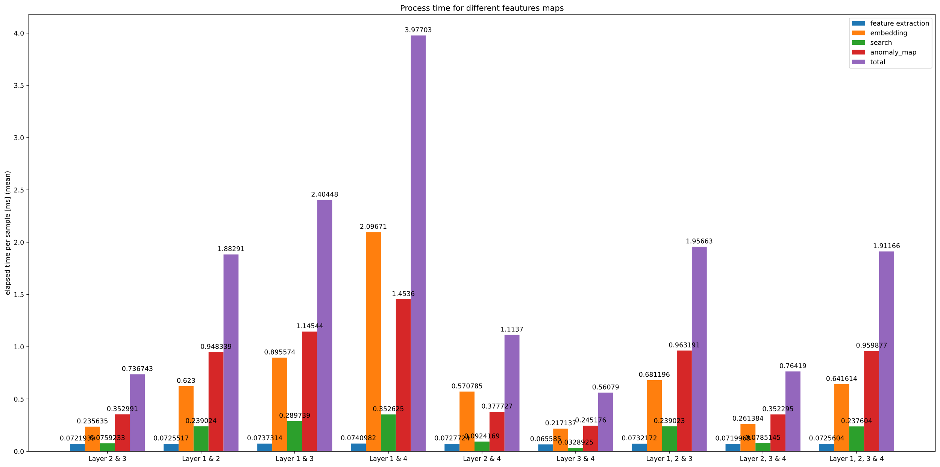
Notes:
py train_latences_dev.py --batch_size 56 --feature_maps_selected 1 2 3 4 --file_name_latences "1234.csv"
py train_latences_dev.py --batch_size 56 --feature_maps_selected 1 2 3 --file_name_latences "123.csv"
py train_latences_dev.py --batch_size 56 --feature_maps_selected 2 3 4 --file_name_latences "234.csv"
py train_latences_dev.py --batch_size 56 --feature_maps_selected 2 3 --file_name_latences "23.csv"
py train_latences_dev.py --batch_size 56 --feature_maps_selected 1 2 --file_name_latences "12.csv"
py train_latences_dev.py --batch_size 56 --feature_maps_selected 1 3 --file_name_latences "13.csv"
py train_latences_dev.py --batch_size 56 --feature_maps_selected 1 4 --file_name_latences "14.csv"
py train_latences_dev.py --batch_size 56 --feature_maps_selected 2 4 --file_name_latences "24.csv"
py train_latences_dev.py --batch_size 56 --feature_maps_selected 3 4 --file_name_latences "34.csv„ Was fällt auf? - feature extraction ist immer gleich! → Komplettes Netz wird durchlaufen → Verbesserung durch explizites Ausblenden der nicht benutzten Layers? (nur wegen großer batch_size so geringer Anteil
- Ansonsten große Streuung! → Validierung notwendig!
Große Differenz zwischen der Auflösung der feautre maps → großer „interpolationsaufwand“ (?) → große Rechenzeit (Embedding + anomaly map)
Search nur von feature_size abhängig

Slide 6
