Slide 1
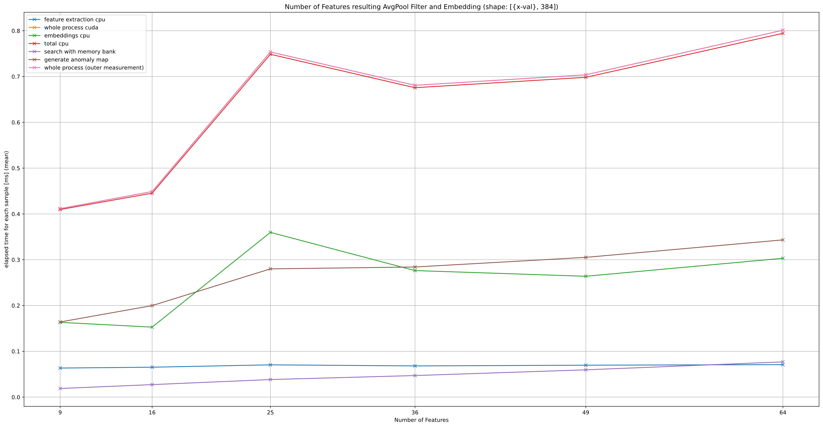
Notes:
What has been done?
new args added for controlling parameters of avgpooling: kernel_size, stride, padding
PoolingLayer is now class attribute which ensures that everywhere same pooling layer is used
New info is added to csv: parameters of PoolingLayer & number of feautures resulting after AvgPool Filter and Embedding
Assumption: Process time / inference time depends only on the number of features resulting from Pooling Layer Proof: following two Slides

Slide 2
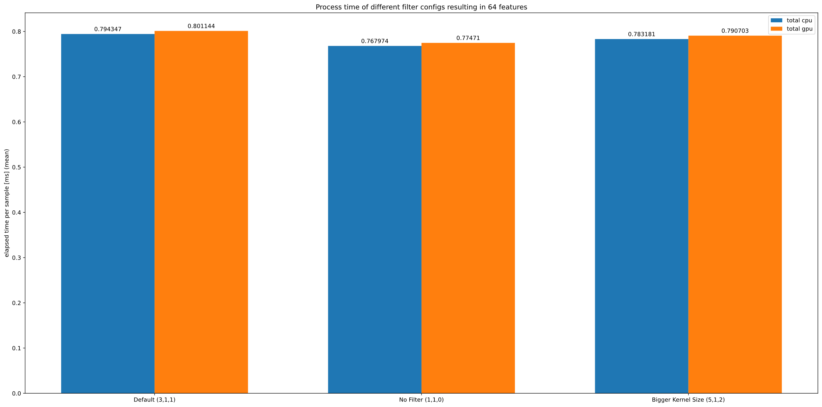
Notes:
Three different types of filters resulting in 64 Samples:
Default
No filter: Kernel_size: 1, stride: 1, padding: 0
Kernel size: 5; stride: 1; padding: 2
Batch size = 56 because this results in 4 batches with equal size

Slide 3
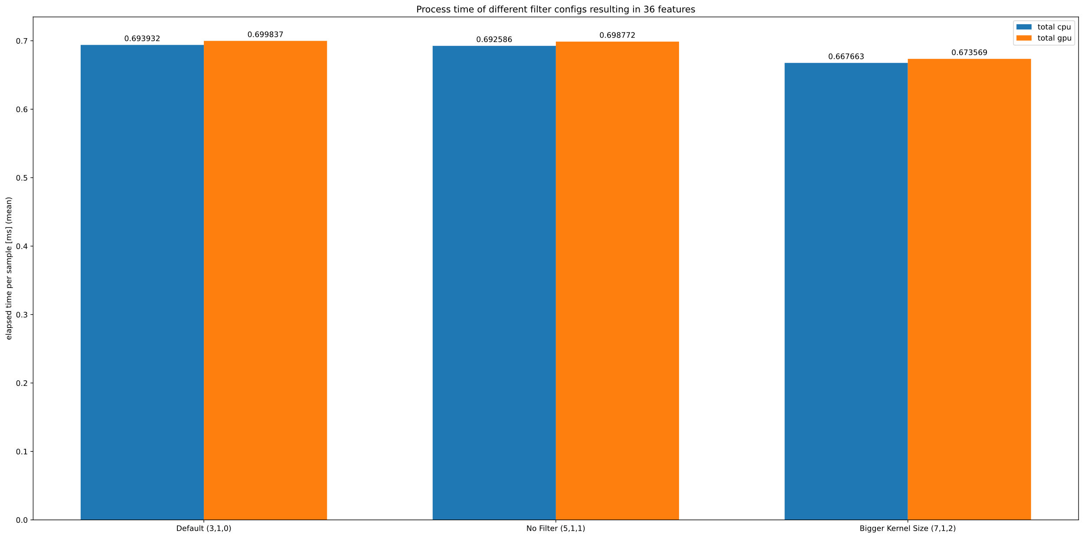
Notes:
Three different types of filters resulting in 36 Samples:
Default without pading
Kernel_size: 5, stride: 1; padding: 1
Kernel size: 7; stride: 1; padding: 2

